Slide 1
Ecological Mental Functioning Ontology (EMFO) Graph
2024-06-14
Revised

Slide 2
is_a
Upper Levels/Categories
part_of
White Bold
Social Environments
Physical Environments
is_a & part_of
Attribute and
Property Classes
is_a &
part_of
has
provides
White Bold
Environment
has
Environmental Factors
influence
Lower Levels/Classes
External Factors
integrates
Black
Black Italics
part_of
Distal Contexts
uses
Categories, Concepts Legend
Internal Feedback
Somewhat dependent on
part_of
is_a
Is_a part_of
Feedback
provides
Input
Context
has
Contextual Factors
is_a &
part_of
relationship Legend
External Feedback
part_of
Proximal Contexts
part_of
Ecological Mental Functioning Ontology
part_of
uses
provides
Learning & Applying Knowledge
part_of
Health Condition Factors
part_of
Psychological
Communication Activities
Physical Functioning
Output
uses
Throughput
is_a & part_of
is_a
is_a & part_of
Personal Background Factors
Mobility Activities
has
Person Factors
Biographical
part_of
is_a
is_a
Person
is_a & part_of
Self_Care Activities
part_of
Demographic
part_of
processing
influence
Impairments
influence
Body Structures
General Tasks and Demands
Domestic Life Activities
is_a
is_a
Mental Activity Limitations
influence
Is_a & part_of
Interpersonal Interactions and Relationships
Observable
Behavior
Mental Functions
is_a & part_of
Body Functions
Brain
part_of
is_a
Mental Functioning
uses
Major Life Areas Activities
is_a
has
modifier
is_a & part_of
uses
is_a non
anatomical phenomenon within
integrates
uses
Mind
Communication Functions
Feedback Appraisal
Community, Social and Civic Life Activities
Activities
Level of Performance
is_a & part_of
is_a & part_of
Experiences
influence
Cognitive Functions
Participation

Slide 3
Feedback
provides
Input
part_of
part_of
Ecological Mental Functioning Ontology
uses
provides
part_of
part_of
Output
uses
Throughput

Slide 4
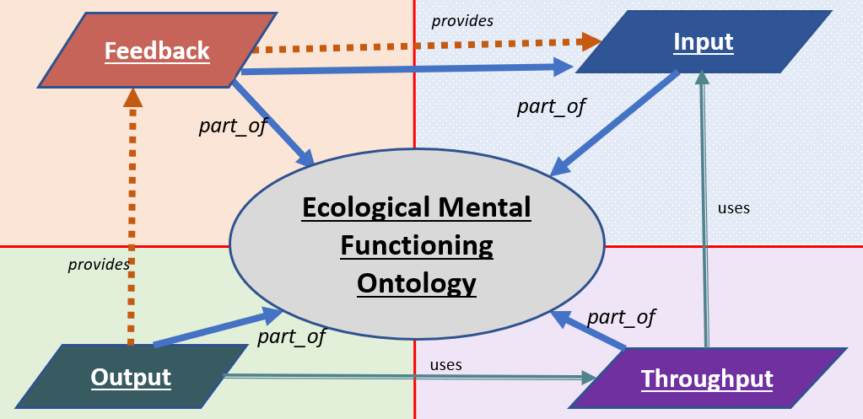

Slide 5
Context
Environment
External
Factors
Environmental Factors
Social Environments
Physical Environments

Slide 6
is_a
Upper Levels/Categories
part_of
White Bold
Social Environments
Physical Environments
is_a & part_of
Attribute and
Property Classes
is_a &
part_of
has
provides
White Bold
Environment
has
Environmental Factors
influence
Lower Levels/Classes
External Factors
integrates
Black
Black Italics
part_of
Distal Contexts
uses
Categories, Concepts Legend
Internal Feedback
Somewhat dependent on
part_of
is_a
Is_a part_of
Feedback
provides
Input
Context
has
Contextual Factors
is_a &
part_of
relationship Legend
External Feedback
part_of
Proximal Contexts
part_of
Ecological Mental Functioning Ontology
part_of
uses
provides
Learning & Applying Knowledge
part_of
Health Condition Factors
part_of
Psychological
Communication Activities
Physical Functioning
Output
uses
Throughput
is_a & part_of
is_a
is_a & part_of
Personal Background Factors
Mobility Activities
has
Person Factors
Biographical
part_of
is_a
Person
is_a & part_of
Self_Care Activities
part_of
Demographic
part_of
influence
Impairments
influence
Body Structures
General Tasks and Demands
Domestic Life Activities
is_a
Mental Activity Limitations
influence
Is_a & part_of
Interpersonal Interactions and Relationships
Observable
Behavior
Mental Functions
is_a & part_of
Body Functions
Brain
part_of
is_a
Mental Functioning
uses
Major Life Areas Activities
is_a
is_a & part_of
uses
is_a non
anatomical phenomenon within
integrates
Evaluates
describes
uses
Mind
assesses
Communication Functions
Feedback Appraisal
Community, Social and Civic Life Activities
Activities
Level of Performance
is_a & part_of
is_a & part_of
Experiences
influence
Cognitive Functions
Participation

Slide 7
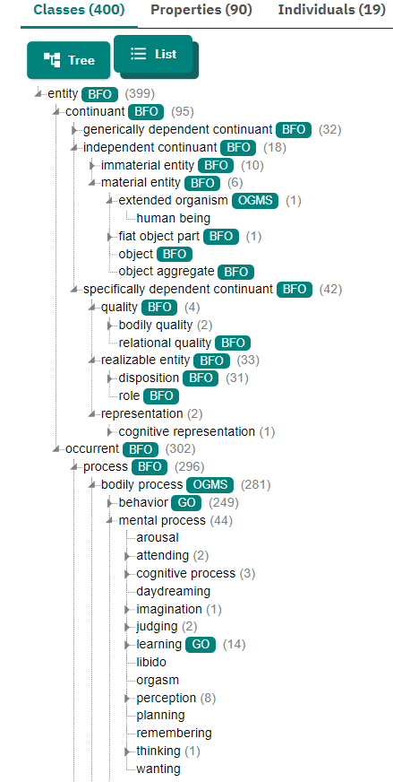
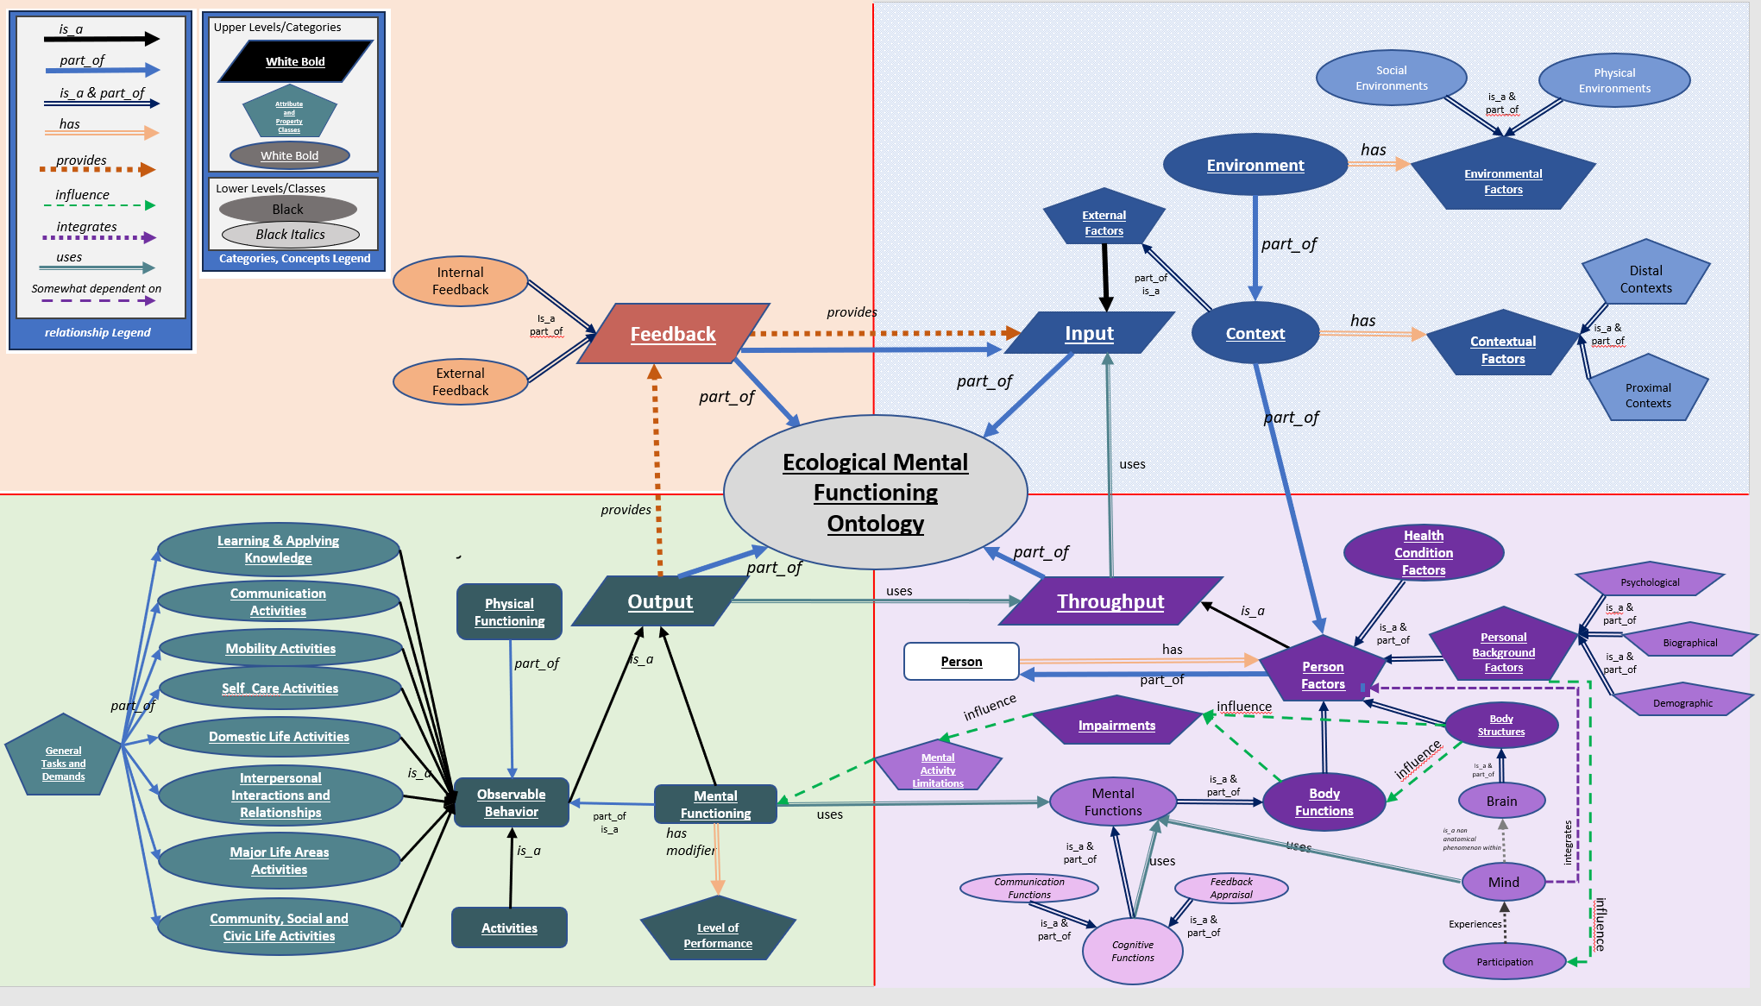
MF Ontology Mappings
Move

