Slide 3
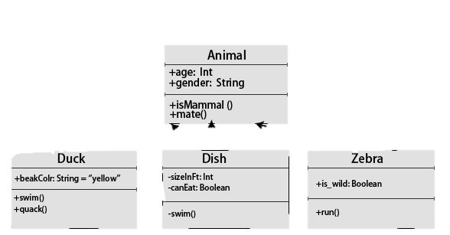
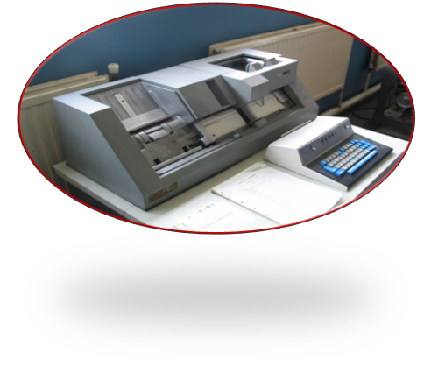

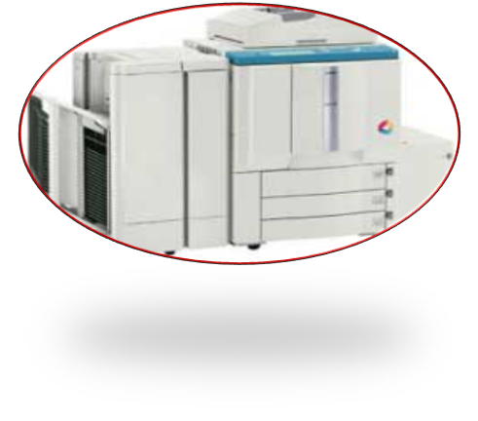
A Workbench
Type Descriptors
Reader
Annotator
Annotator
Annotator
Framework Application
Writers

Slide 4



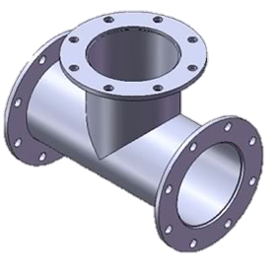
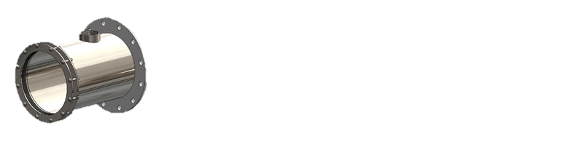

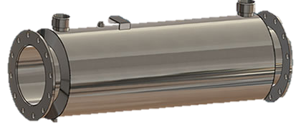
NER Mechanics
Mental Function Annotators
Dictionary Lookup
Annotators, connected together is an NLP Pipeline
Basic Pipeline Annotators for Mental Function Ontology
Medical Text
Activities And Participation
conTEXT
Person Factors
External Factors
POS
Term
Question Identification
Regex Shapes Identifier
Sentence
Slot: Value
Sectionizer
Tokenizer
Line Annotator
Document Decomposition Annotators

