Slide 1
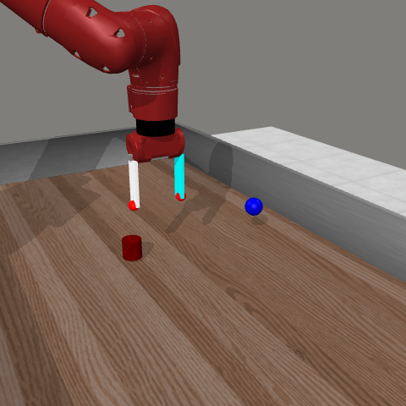
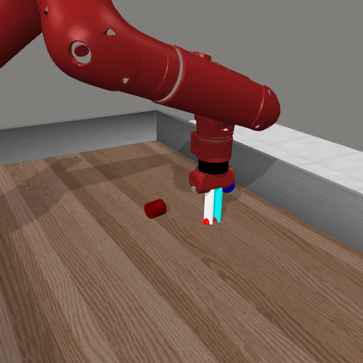
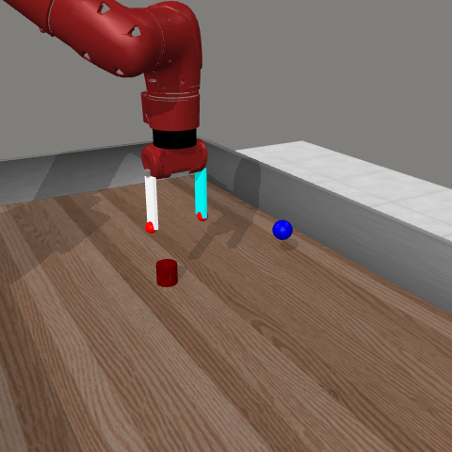
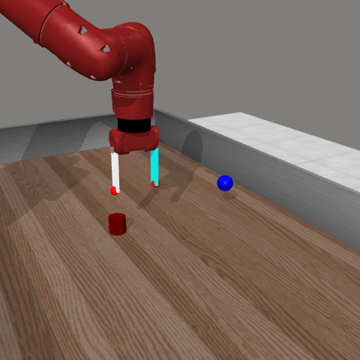
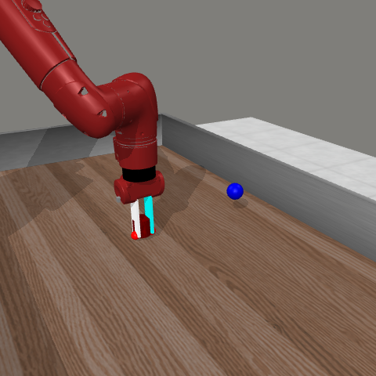
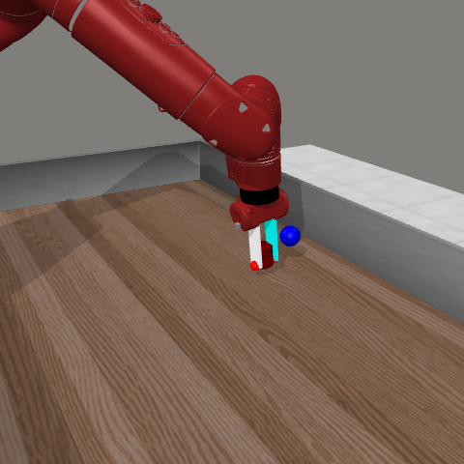
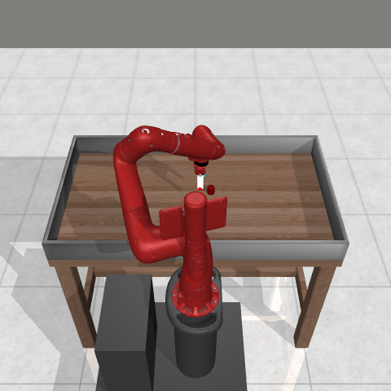
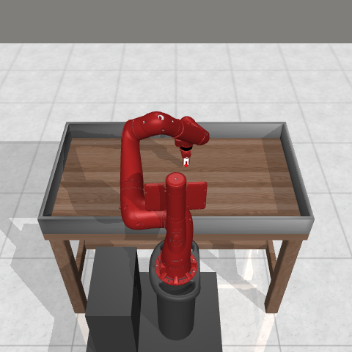
(a)
Problem
(b)
REIM framework
(c)
Closed-loop result
low risk
ACT
nominal chunk
ACT action
risk gate
pₜ ≥ 0.20?
high risk
LSTM
risk pₜ
recovery
policy
risk
re-grasp
success
object shifted
ACT timeout
robot state sₜ
Task success (%)
+17.0 pp
Predicted action chunk
!
closed-loop next state sₜ₊₁
aₜ
disturbance
Trigger-aligned recovery training
42,386 train · 8,212 disjoint val. pairs
The state leaves the demonstration distribution
Smooth-L1
supervision
recovery
actor
Stale action chunk
No recovery available
trigger state
expert continuation
same states visited by the gate
1,000 paired PickPlace episodes
gain 95% CI +14.7 to +19.3 pp
Notes:
Figure 1 overview source. All robot frames are local Meta-World/MuJoCo simulation outputs from results/figures/recovery_operation_sequence_frames. Primary result: ACT 73.4% and REIM 90.4% task success over 1,000 paired PickPlace episodes; paired gain +17.0 percentage points with 95% CI [+14.7,+19.3]. Metrics come from paper_assets/reim_macros.tex and paper_assets/Table1_final_baseline.tex. Recovery training counts are 42,386 train pairs and 8,212 disjoint validation pairs, from the audited project documentation. The figure shows simulation only and makes no real-robot claim.

