Slide 1



Tamara Dahlgren, Tom Epperly,
Scott Kohn, & Gary Kumfert
Center for Applied Scientific Computing
Tutorial
Notes:
1

Slide 2
Audience Calibration
What is a component?
Who writes code?
Who uses code?
What languages used?
What platforms used?
# 3rd party libraries your code uses?
# apps uses your libraries?

Slide 3
Outline
Problem Motivation
Babel Solution Strategy
SIDL
Using Babel
Outstanding Problems
Future R&D

Slide 4
Problem Motivation
Code Reuse is Hard.
Scientific Code Reuse is Harder!
Barriers to Reuse...
  Language Interoperability
  Semantics
  Software Portability
  Lack of Standards
  More...

Slide 5
What I mean by
“Language Interoperability”
Scripting Driver
(Python)
Simulation Framework
(C)
Visualization System
(Java)
Numerical Routines
(f77)
Solver Library
(C++)
Callback Handlers
(Python)

Slide 6
Current Language Interoperability
f77
Native
cfortran.h
SWIG
JNI
Siloon
Chasm
Platform
Dependent
C
f90
C++
Python
Java

Slide 7
Babel Enabled
Language Interoperability
f77
C
f90
C++
Python
Java

Slide 8
Babel Enabled
Language Interoperability
f77
What’s in version 0.6?
C
f90
C++
Python
Java

Slide 9
Outline
Problem Motivation
Babel Solution Strategy
SIDL
Using Babel
Outstanding Problems
Future R&D

Slide 10
Developer Writes Interface
SIDL interface
description
SIDL: Scientific Interface Definition Language
Similar to CORBA/COM IDLs...
  Language/Platform Independent
...but tuned for scientific apps
  complex numbers
  dynamic, multidimensional arrays

Slide 11
version MySolverLib 0.1.0;
import ESI;
package MySolverLib {
interface MatrixGenerator { ... }
class OptionDatabase {
void getOption( in string name,
out string val );
}
class Vector implements-all ESI.Vector {
void setOptions( in OptionDatabase db );
}
class Bizarre implements MatrixGenerator {
...
void setData( in array<dcomplex,2> a );
}
}

Slide 12
Babel Generates Glue Code
XML repository
interface
description
machine
configuration
database
XML
C
C++
SIDL interface
description
parser
analyzer
backend
F77
Python
Java
F90
Matlab?

Slide 13
Babel Provides
Uniform Object Model
f77
Universal Base Classes
Virtual Method Dispatch
Exception Handling
Reference Counting
C
f90
C++
Python
...It all happens here!
Java

Slide 14
Babel Provides a Firewall
Between Use and Implementation
Application
SIDL interface
description
Stubs
IORs
Skels
Impls

Slide 15
Outline
Problem Motivation
Babel Solution Strategy
SIDL
Using Babel
Outstanding Problems
Future R&D

Slide 16
SIDL as a text-based design tool
Express only the public API
Prevents discussion drift into implementation details
Amenable to email debates
Easier to learn than UML

Slide 17
The SIDL Grammar
Packages & Versions
Interfaces & Classes
Inheritance Model
Methods
Polymorphism Modifiers
Intrinsic Data Types
Parameter Modes
Gotchas

Slide 18
Packages
Use SIDL packages to prevent symbol conflicts
  packages in Java
  namespaces in C++
  prefixes in C / Fortran
  (e.g. mpi_send() )
must have version number
lowercase symbols recommended
Can be nested
version foo 1.0; package foo {
// ...
};
package gov {
package llnl {
package babel {
// ...
};
};
};

Slide 19
Interfaces and Classes
ObjectiveC and Java Inheritance Model
Interfaces
  pure abstract base classes in C++
  define calling sequence only
  provide no implementation
  cannot be instantiated
  can inherit (“extend”) other interfaces
Classes
  inherit (“extend”) from at most one class
  (including its implementation)
  may inherit (“implement”) multiple interfaces

Slide 20
Interfaces and Classes (Example)
version their 1.0;
package their {
interface Foo {/* .. */};
interface Bar {/* .. */};
interface Baz {/* .. */};
};
version my 1.12;
import their;
package my {
interface Foo extends their.Foo { };
class CFoo implements Foo { };
class Bar extends CFoo implements their.Bar { };
class Baz extends CFoo implements their.Bar,
their.Baz { };
};

Slide 21
Inheritance Model
Interfaces form contracts between implementor and user.
Default Inheritance:
  reference counting
  dynamic casting
  introspection
  reflection
SIDL.BaseInterface
implements
extends
SIDL.BaseClass
(interfaces)
extends
(classes)

Slide 22
Abstract Class–
Partially Implemented Class
interface Foo {
int doThis( in int i );
int doThat( in int i );
}
abstract class Bar implements Foo {
int doThis( in int i );
};
class Grille implements-all Foo {
// int doThis( in int i );
// int doThat( in int i );
};
interface Foo {
int doThis( in int i );
int doThat( in int i );
}
class Bar implements Foo {
int doThis( in int i );
};
class Grille implements Foo {
int doThis( in int i );
int doThat( in int i );
};
interface Foo {
int doThis( in int i );
int doThat( in int i );
}
abstract class Bar implements Foo {
int doThis( in int i );
};
class Grille implements Foo {
int doThis( in int i );
int doThat( in int i );
};

Slide 23
Methods (a.k.a. “member functions”)
Belong to both Interfaces and Classes
SIDL has no sense of method “access” specifiers
  (e.g. private, protected, public)
  All methods are public
  Makes sense for an “Interface Definition Language”
In classes only, methods can also be
  static -- independent of an instance
  final -- not overridden by derived classes
No Method Overloading. (yet?)

Slide 24
Method Modifiers
static
  avoid OOP altogether:
  make one class full of static methods.
final
  prevent function from being overridden
  In C++
    methods are final by default
    must be declared “virtual” to be overridden
class Math {
static double sin( in double x );
static double cos( in double x );
};

Slide 25
Intrinsic Data Types
Standard Types
  bool
  char
  int
  long
  float
  double
  fcomplex
  dcomplex
Advanced Types
  string
  enum
  object (interface or class)
  array< Type, Dimension >
  opaque
NOTES:
  Mapped to different types in different languages
  No General Template Mechanism
  (maybe later?!?)

Slide 26
Parameter Modes
Unique to IDLs
Each parameter in a method call has a mode declared
  in
  out
  inout
Intent:
  Communication optimization for distributed components
  Copy minimization when copy is unavoidable
Benefit:
  Easy to understand intent when reading

Slide 27
Parameter Modes II
“in”
  pass by value semantics (not const!)
“out”
  pass by reference semantics
  no initialization required
  information returned
“inout”
  pass by reference semantics
  initialization required
  new information returned
  instance may be destroyed and replaced

Slide 28
Parameter Modes III
package util { // SIDL FILE
class String {
static void reverse( inout string );
};
};
DANGER:
“inout” parameters may be destroyed and replaced under the covers.
Do you want to risk a “free(hi);” in the stubs???
#include <stdio.h>
#include “util_String.h”
int main () {
char * hi = “Hello.”;
util_String_reverse( &hi ) ;
printf(“%s\n”, hi );
}

Slide 29
Parameter Modes IV
package util { // SIDL FILE
class String {
static void appendReverse(inout string);
};
};
#include <stdio.h>
#include “util_String.h”
int main () {
char * hi = “Hello.”;
util_String_appendReverse( &hi ) ;
printf(“%s\n”, hi );
}

Slide 30
Parameter Modes V
package util { // SIDL FILE
class String {
static void appendReverse(inout string);
};
};
#include <stdio.h>
#include <string.h>
#include “util_String.h”
int main () {
char * hi = strdup( “Hello.” );
util_String_appendReverse( &hi ) ;
printf(“%s\n”, hi );
free( hi );
}

Slide 31
Babel Preserves DocComments
// This is a comment
/* This is a Comment Too */
/** This is a DocComment for the package */
package Hello {
/**
* This class has one method
*/
class World {
/** result = “hello” + name */
string getMsg( in string name );
};
};

Slide 32
SIDL Gotchas
Case Sensitive
  SIDL is
  F77 is not
Reserved Words:
  union of C, C++, Fortran
  C++ has 90+ reserved words!
Forbidden Method Names
  same as class name (reserved in C++)
Built-in method names start with “_” to avoid collisions with user defined names.

Slide 33
Outline
Problem Motivation
Babel Solution Strategy
SIDL
Using Babel
Outstanding Problems
Future R&D

Slide 34
Getting The Software
Grab tarball
  http://www.llnl.gov/CASC/components/software.html
  Current release: babel-0.6.3.tar.gz
Typical build/install (using VPATH)
  gtar zxvf babel-0.6.3.tar.gz
  cd babel-0.6.3-build/
  ../babel-0.6.3/configure --prefix=${HOME}/babel
  gmake all check install
Platforms Tested Nightly:
  Linux ( GNU, KCC)
  Solaris ( GNU )

Slide 35
The Babel Compiler – commandline options
Choose exactly one of the following:
--help Display more info
--version Babel Version
--parse-check Parse SIDL, no output
--xml Generate XML
--client=[lang] User of Babel Object
--server=[lang] Developer of Babel Object
Other Options
--output-directory=[dir] Default = .
--repository-path=[path] Semicolon separated URLs
--generate-subdirs

Slide 36
Babel from a developer’s POV
Application
SIDL interface
description
Stubs
IORs
Skels
Impls

Slide 37
hello.sidl
/** This is a DocComment for the package */
version hello 1.0;
package hello {
class World {
void setName( in string name );
/** result = “hello” + name */
string getMsg( );
};
};

Slide 38
Babel Generates LOTS of Code!!!
hello.sidl | 9
Hand added Implementation | 4
Generated C/C++ code (wc –l *) | 4,107

Slide 39
Adding the Implementation
namespace hello {
class World_impl {
private:
// DO-NOT-DELETE splicer.begin(hello.World._implementation)
// Put additional implementation details here...
// DO-NOT-DELETE splicer.end(hello.World._implementation)
string
hello::World_impl::getMsg ()
throw ()
{
// DO-NOT-DELETE splicer.begin(hello.World.getMsg)
// insert implementation here
// DO-NOT-DELETE splicer.end(hello.World.getMsg)
}

Slide 40
Adding the Implementation
namespace hello {
class World_impl {
private:
// DO-NOT-DELETE splicer.begin(hello.World._implementation)
string d_name;
// DO-NOT-DELETE splicer.end(hello.World._implementation)
string
hello::World_impl::getMsg ()
throw ()
{
// DO-NOT-DELETE splicer.begin(hello.World.getMsg)
string msg(“hello “);
return msg + d_name + “!”;
// DO-NOT-DELETE splicer.end(hello.World.getMsg)
}

Slide 41
Methods Beginning with “_”
method names cannot start with “_” in SIDL
Babel uses leading underscores for internal stuff
  e.g. IOR-level methods “_create()”
  e.g. binding specific methods “PKG::CLASS::_get_ior()”
Note: Things that look like a double underscore
e.g. hello_World__create()
is really normal convention with internal method

Slide 42
Babel from a user’s POV
Application
SIDL interface
description
Stubs
libfoo.so

Slide 43
A driver in C
#include <stdio.h>
#include "hello.h"
int main(int argc, char ** argv ) {
hello_World hw;
char * msg;
hw = hello_World__create();
hello_World_setName( hw, argv[1] );
msg = hello_World_getMsg( hw );
fprintf(stdout, "%s", msg );
free( msg );
hello_World_deleteReference( hw );
}

Slide 44
A driver in Python
import hello.World
if __name__ = ‘__main__’:
h = hello.World.World()
h.setName( ‘Gary’ )
print h.getMsg()

Slide 45
Outline
Problem Motivation
Babel Solution Strategy
SIDL
Using Babel
Outstanding Problems
Future R&D

Slide 46
Common Problems
$CLASSPATH not set
compilers not found ($CC, $CXX, $F77)
Python or NumPy not installed
Server-side Python requires libpython.so
(Not in standard distributions)
LD_LIBRARY_PATH issues with shared libraries
C++ and shared libraries

Slide 47
Achilles’ Heel
Babel Generates Correct Code
It does nothing about correct compilation

Slide 48
How Much Language Interoperability Have We Achieved?
Basic Types
  bool
  char
  int
  long
  float
  double
  fcomplex
  dcomplex
  string
  opaque
Modes
  in
  out
  inout
  return value
Extended Types
  Objects
  enumerations
  arrays of basic types
  arrays of objects
  (arrays are multidimensional, no arrays of arrays)
OO Method Dispatch
  regular
  final
  static
  interfaces
  classes
Exception Handling
For All Combinations of Languages
  C C
  C++ C++
  F77 F77
  Python Python
  Java
5200+ test cases
  per platform
    per compiler set

Slide 49
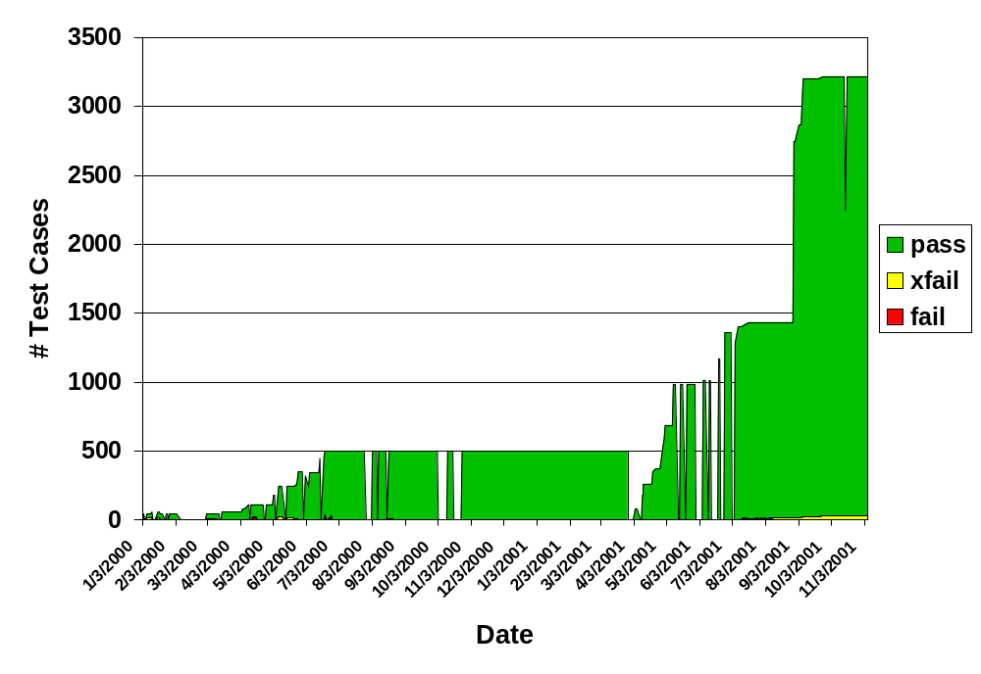
Babel Test History:
sun-sparc-solaris2.7-gcc2.95.x

Slide 50
Babel Development Tools
development platforms
  sun-sparc-solaris2.7
  intelx86-redhat-linux
  cygwin
Compilers
  Python 2.1
  Sun jdk-1.3
  gcc 2.95.x
  sunpro 5.0
  KCC
Build Tools
  make
  autoconf
  automake
  libtool
Testing
  in-house tool
Bug-Tracking
  in-house/bugzilla mods

Slide 51
Outline
Problem Motivation
Babel Solution Strategy
SIDL
Using Babel
Outstanding Problems
Future R&D

Slide 52
Platform Independence
Encourage Locality for Maximum Performance
Connect to separate process space
  to avoid symbol conflicts at link time
Connect to separate machine
  to utilize special hardware
  to use platform specific code
  (Babel doesn’t get Windows apps to run on UNIX!)
  To distribute work

Slide 53
Same Process Space Components
Application
Stubs
IORs
Skels
Impls

Slide 54
Out of Process Components
Application
Stubs
IPC
IORs
IORs
IPC
Skels
Impls

Slide 55
Remote Components
Application
Line Protocol
Stubs
Unmarshaler
IORs
Internet
IORs
Marshaler
Skels
Line Protocol
Impls

Slide 56
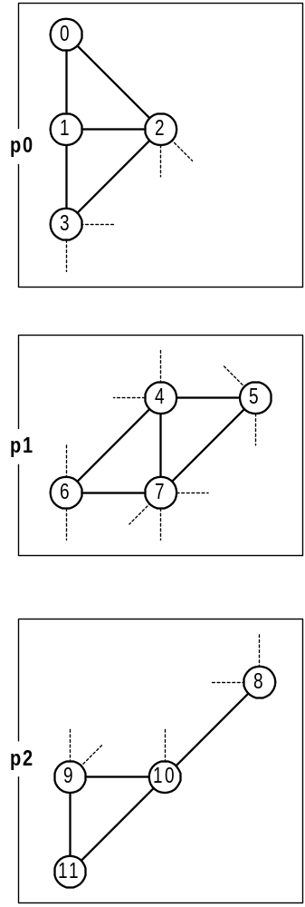
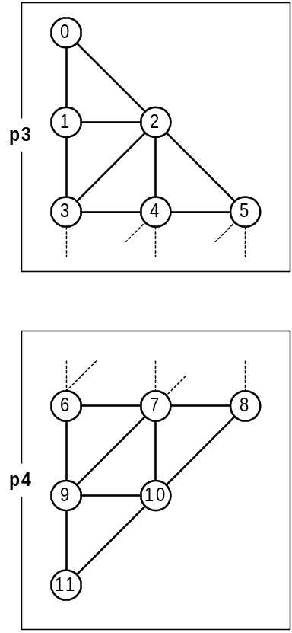
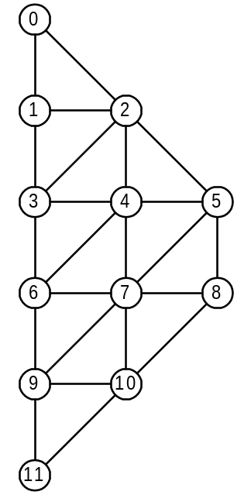
Parallel Components:
MxN Communication

Slide 57
Problem Motivation
Code Reuse is Hard.
Scientific Code Reuse is Harder!
Barriers to Reuse...
  Language Interoperability
  Semantics
  Software Portability
  Lack of Standards
  More...
Tammy Dahlgren’s PhD Thesis

Slide 58
Problem Motivation
Code Reuse is Hard.
Scientific Code Reuse is Harder!
Barriers to Reuse...
  Language Interoperability
  Semantics
  Software Portability
  Lack of Standards
  More...
Whitepaper

Slide 59
How do I find out more???
Website http://www.llnl.gov/CASC/components
User’s Guide
Download Code
Email Reflectors (subscribe via majordomo@lists.llnl.gov)
  babel-users@llnl.gov
  babel-announce@llnl.gov
Email the team
  components@llnl.gov

Slide 60
The End

Slide 61
Business Component Frameworks
CORBA
  Language Independent
  Wide Industry Acceptance
  Primarily Remoting Architecture
COM
  Language Independent
  Most Established
  In Process Optimization
  Network Transparent
Enterprise Java Beans (EJB)
  Platform Independent
  Runs wherever Java does

Slide 62
Business Component Frameworks
Science
CORBA
  Language Independent
  Wide Industry Acceptance
  Primarily Remoting Architecture
  Huge Standard
  No In-Process Optimization
COM
  Language Independent
  Most Established
  In Process Optimization
  Network Transparent
  not Microsoft Transparent
  Relies on sophisticated development tools
Enterprise Java Beans (EJB)
  Platform Independent
  Runs wherever Java does
  Language Specific
  Potentially highest overhead
All The Above
  No Complex Intrinsic Datatype
  No Dynamic Multidimensional Arrays
  No Fortran77/90/95 bindings
  No Parallel Components

Slide 63
Key to Babel’s Interoperability...
Human Compatible
Compiler Compatible
SIDL
IOR
Scientific Interface
Definition Language
Intermediate Object
Representation
XML
eXtensible Markup
Language
Web Compatible

Slide 64
UCRL-VG-142097 REV1
This work was performed under the auspices of the U.S. Department of Energy by the University of California, Lawrence Livermore National Laboratory under contract No. W-7405-Eng-48

