Slide 1

The Common Component Architecture:
Introduction and Concepts
CCTTSS Tutorial Working Group
http://www.cca-forum.org/tutorial/
This work has been sponsored by the Mathematics, Information and Computational Sciences (MICS) Program of the U.S. Dept. of Energy, Office of Science.

Slide 2
Contributors
Ben Allan, SNL
Rob Armstrong, SNL
David Bernholdt, ORNL
Lori Freitag, ANL
Jim Kohl, ORNL (Presenter)
Lois Curfman McInnes, ANL
Boyana Norris, ANL
Craig Rasmussen, LANL
Jaideep Ray, SNL

Slide 3
Challenges in Modern Scientific Software Development
Desire for rapid development cycle
Diversity of languages and tools
  What can be used together?
  Ability to reuse code from inside or outside organization
Parallel computing significantly increases algorithmic complexity
  Where do you find the expertise in all disciplines your code might require?
  Architectural complexity and diversity of modern MPPs
Increasing capability of computers leads to new expectations of simulation
  Higher fidelity, greater sophistication
  Extension to multi-scale and multi-physics simulations
  Coupling of simulations

Slide 4
Component-Based Programming
Based on OO ideas, but at a coarser level
Components encapsulate well-defined units of reusable functionality (in OO sense, often a collection of objects)
They interact through well-defined interfaces
  Separates interface from its implementation: “Good fences make good neighbors”
Components improve modularity and reuse
  Provides for “plug and play” HPC code.
  Facilitates exchange of components between groups
  Facilitates interdisciplinary collaboration in a single app.
  Allows you to focus on your area of interest/expertise
Intended to make it easier to compose software into a working application
Not a magic bullet
  Does not alter algorithms: does not speed up their development, or eliminate bugs. Does not make programming easier

Slide 5
21st Century Application
Physics Modules
Adaptive Solution
Grids
Optimization
Diagnostics
Discretization
Steering
Derivative Computation
Algebraic Solvers
Visualization
Data Reduction
Collaboration
Picture courtesy of
Lois Curfman McInnes, ANL
Parallel I/O

Slide 6
Commodity Component Models
Component models are common in visualization environments
  AVS, Data Explorer
  dataflow-based
Component-based software development has taken the commercial/industrial world by storm.
  CORBA, COM/DCOM, Enterprise JavaBeans
Unfortunately, these systems are not generally suitable for high-performance scientific computing
  Focus exclusively on local & distributed computing
  No concept of parallelism
  High overheads, even for local operation
  Often platform or language-specific

Slide 7
The Common Component Architecture
A component model specifically designed for high-performance computing
Supports both parallel and distributed applications
Designed to be implementable without sacrificing performance
Minimalist approach makes it easier to componentize existing software
Components are peers
  No particular component assumes it is “in charge” of the others.
  Allows the application developer to decide what is important.

Slide 8
CCA Concepts: Ports
usesSolver
linSolve
PhysicsComponent
SolverComponent
Components interact through well-defined interfaces, or ports
  In OO language, a port is a class
  In Fortran languages, a port is a bunch of subroutines
A given component may provide a port – implement the class or subroutines
Another component may use that port – call methods or subroutines in the port.
Links denote a caller/callee relationship, not dataflow!
  e.g., linSolve port might contain: solve(in A, out x, in b)

Slide 9
A More Complex Example
A component may provide and/or use multiple ports
A component may provide some ports and use others
A component may provide or use multiple instances of the same port
linSolve
needAx
usesSolver1
usesSolver2
SolverComponent1
computeAx
configPhys
configModel
DriverComponent
linSolve
needAx
PhysicsComponent
SolverComponent2

Slide 10
Ports, Interoperability, and Reuse
Ports (interfaces) define how components interact
Generality, quality, robustness of ports is up to designer/architect
  “Any old” interface is easy to create, but…
  Developing a robust domain “standard” interface requires thought, effort, and cooperation
General “plug-and-play” interoperability of components requires multiple implementations conforming to the same interface
Designing for interoperability and reuse requires “standard” interfaces
  Typically domain-specific
  “Standard” need not imply a formal process, may mean “widely used”

Slide 11
CCA Concepts: Frameworks
The framework provides the means to “hold” components and compose them into applications
The framework is the application’s “main” or “program”
Frameworks allow exchange ports among components without exposing implementation details
Frameworks may support sequential, distributed, or parallel execution models, or any combination they choose
Frameworks provide a small set of standard services to components
  BuilderServices allow programs to compose CCA apps
Frameworks may make themselves appear as components in order to connect to components in other frameworks

Slide 12
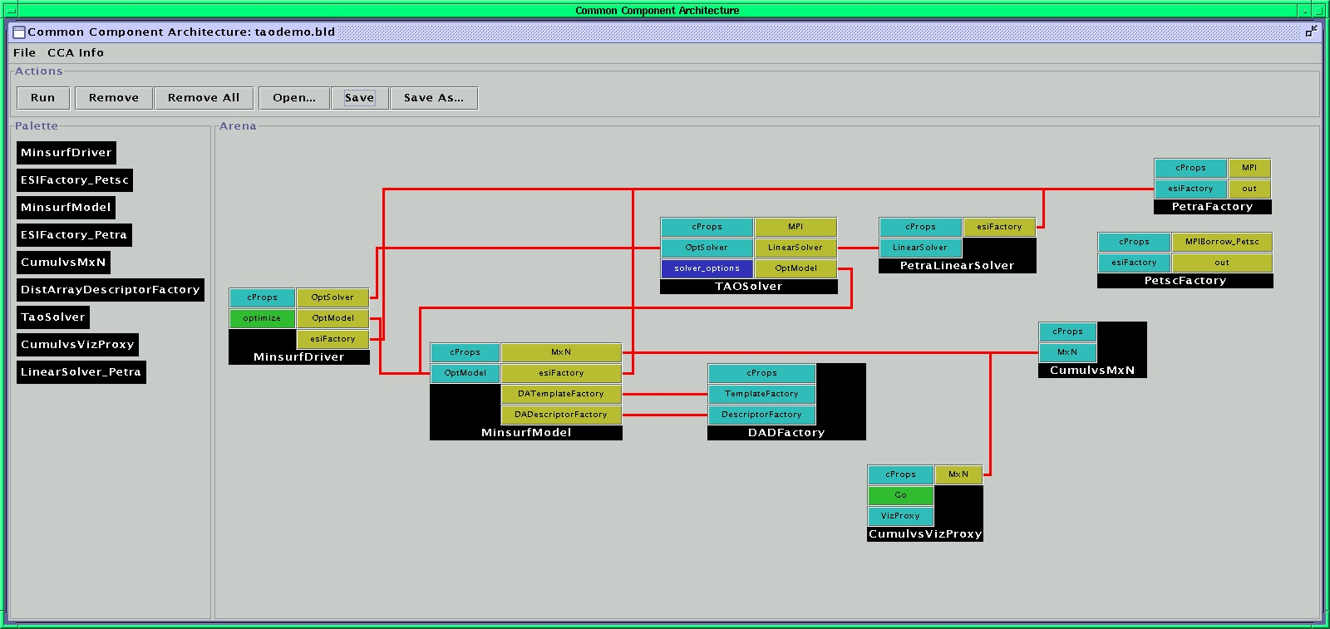
What Does This Look Like?
Launch framework (w/ or w/o GUI)
Instantiate components required for app.
Connect appropriate provided and used ports
Start application (i.e. click Go port)
create TaoSolver TAOSolver
create MinsurfDriver MinsurfDriver
…
connect MinsurfDriver OptModel MinsurfModel OptModel
connect MinsurfDriver OptSolver TAOSolver OptSolver
…

Slide 13
What Makes a CCA Component?
Framework
SolverComponent
All CCA-compliant components must implement a setServices() method
Framework invokes setServices when component is instantiated
Provides component with CCA Services object – the external world (as the framework knows it)
User instantiates SolverComponent
Framework calls SC’s setServices method with a CCA Services object – the component’s window on the external world
void SolverComponent::
setServices(gov::cca::
Services *svc){…}
CCA Services SC

Slide 14
SC Provides a solverPort
Framework
SolverComponent
Within setServices, component declares ports it provides and uses
addProvidesPort places port in CCA Services – makes it visible the framework
Other components cannot yet use solverPort!
setServices completes and control returns to framework to instantiate other components
gov::cca::PortInfo * pInfo;
pInfo = svc->createPortInfo(
“linSolve”,”solverPort”);
err = svc->addProvidesPort(
this, pInfo);
linSolve
solverPort
CCA Services SC

Slide 15
PC Wants to Use a solverPort
Framework
User instantiates PhysicsComponent
Framework calls PC’s setServices
registerUsesPort informs the framework that we want to connect to a component providing a solverPort
setServices completes, control returns to framework
PC cannot see SolverComponent or the solverPort it provides
PhysicsComponent
gov::cca::PortInfo * pInfo;
pInfo = svc->createPortInfo(
“usesSolver”,”solverPort”);
err = svc->registerUsesPort(
pInfo);
usesSolver
solverPort
CCA Services PC

Slide 16
User Instructs Framework to Connect solverPort between User and Provider
Framework
SolverComponent
PhysicsComponent
ccafe> connect PhysicsComponent usesSolver \
SolverComponent linSolve
linSolve
solverPort
usesSolver
solverPort
linSolve
solverPort
CCA Services SC
CCA Services PC

Slide 17
PC Gets the Port from its CCA Services
Framework
SolverComponent
PhysicsComponent
gov::cca::Port * pSolver;
pSolver = svc->getPort(
“usesSolver");
SolverPort * solver;
solver =dynamic_cast
<SolverPort *>(pSolver);
linSolve
solverPort
usesSolver
solverPort
linSolve
solverPort
CCA Services SC
CCA Services PC

Slide 18
PC Can Finally Call solve on SC’s solverPort
Framework
SolverComponent
PhysicsComponent
void SolverComponent::
solve(A, x, b) {…}
solver->solve(A, x, b);
linSolve
solverPort
usesSolver
solverPort
linSolve
solverPort
CCA Services SC
CCA Services PC

Slide 19
Importance of Provides/Uses Pattern for Ports
Component 1
Component 2
Fences between components
  Components must declare both what they provide and what they use
  Components cannot interact until ports are connected
  No mechanism to call anything not part of a port
Ports preserve high performance direct connection semantics…
…While also allowing distributed computing
Provides/Uses
Port
Direct Connection
Component 1
Provides
Port
Network
Connection
Component 2
Uses
Port

Slide 20
CCA Concepts: Direct Connection
Components loaded into separate namespaces in same address space (process) from shared libraries
getPort call returns a pointer to the port’s function table
Invoking a method on a port is equivalent to a C++ virtual function call: lookup function, invoke
Maintains performance (lookup can be cached)

Slide 21
CCA Concepts: SCMD
Single component multiple data (SCMD) model is component analog of widely used SPMD model
Each process loaded with the same set of components wired the same way
Different components in same process “talk to each” other via ports and the framework
Same component in different processes talk to each other through their favorite communications layer (i.e. MPI, PVM, GA)
P0
P1
P2
P3
Components: Blue, Green, Red
Framework: Beige

Slide 22

CCA Concepts:
MxN Parallel Data Redistribution
Share Data Among Coupled Parallel Models
  Disparate Parallel Topologies (M processes vs. N)
  e.g. Ocean & Atmosphere, Solver & Optimizer…
  e.g. Visualization (Mx1, increasingly, MxN)
Parallel Model Coupling
Visualization

Slide 23
MxN: The Problem
M=4
N=9

Slide 24
MxN Research Activities
Distributed data descriptors
  Uniform langauge for expressing distribution
  Draft specification for dense multi-dimensional arrays
MxN port
  Draft specification completed, implemented
  Minimal intrusion to “instrument” component, third-party control possible
  Multiple data fields, exchange in either direction
  One-shot or repeated transfer
Future
  Framework-based solutions
  Higher-level coupling, account for units of data, spatial and termporal interpolation, etc.

Slide 25
CCA Concepts: Language Interoperability
Existing language interoperability approaches are “point-to-point” solutions
Java JNI
Native
SWIG/SILOON
Platform Dependent
Python Library
f77
C
f90
C++
Python
Arrows indicate direction of supported function calls
Java

Slide 26
Language Interoperability w/ Babel
f77
Babel provides a unified approach in which all languages are considered peers
C
f90
Babel
C++
Python
solverPort.sidl
version solverPort 1.0;
package solverPort {
class Solver {
int solve( in array<double,2> A,
out array<double,1> x,
in array<double, 1> b);
}
}
Java
Somewhat similar to the CORBA approach in the business domain

Slide 27
Using Babel
Component Writer
Component User
Implementation Source Code
SIDL
User Source Code
Developer inserts source into file
Babel
Babel
#include…
Implementation File
Other Files
Other Files
Header File
Compiler
Compiler
Linker
Babel Libraries
Linker
SolverComponent
PhysicsComponent

Slide 28
Concept Review
Ports
  Interfaces between components
  Uses/provides model
Framework
  Allows assembly of components into applications
Direct Connection
  Maintain performance of local inter-component calls
Single Component Multiple Data (SCMD)
  Component analog of single program multiple data model
MxN Parallel Data Redistribution
  Model coupling, visualization, etc.
Language Interoperability
  Babel
  Scientific Interface Definition Language (SIDL)

Slide 29
Summary
Components promote modularity & reuse, allow developers to focus on their areas of expertise
CCA is a component model targeted specifically to the needs of high-performance computing
  Supports direct connection of components for local perf.
  Supports distributed computing
  Supports parallel computing by “staying out of the way”
Components exchange ports following a uses-provides design pattern.
Specification intentionally places minimal requirements on components
  1 additional method to become a component
  2 calls to declare a used or provided port
  2 calls required to get a port for use

