Slide 1

CCA Status,
Code Walkthroughs, and Demonstrations
CCTTSS Tutorial Working Group
http://www.cca-forum.org/tutorial/
This work has been sponsored by the Mathematics, Information and Computational Sciences (MICS) Program of the U.S. Dept. of Energy, Office of Science.

Slide 2
Contributors
Ben Allan, SNL
Rob Armstrong, SNL
David Bernholdt, ORNL
Lori Freitag, ANL
Jim Kohl, ORNL
Lois Curfman McInnes, ANL
Boyana Norris, ANL (Presenter)
Craig Rasmussen, LANL
Jaideep Ray, SNL

Slide 3
Prototype CCA Frameworks
XCAT, Indiana University, Dennis Gannon
  Distributed
  Network connection
CCAFFEINE, Sandia National Laboratories, Rob Armstrong
  SPMD/SCMD parallel
  Direct connection
SCIRun/Uintah, University of Utah, Steve Parker
  Parallel, multithreaded
  Direct connection

Slide 4
Current Status of CCA
Specification version 0.5
Working prototype frameworks
Working multi-component parallel and distributed demonstration applications
Draft specifications for
  Basic scientific data objects
  MxN parallel data redistribution
SC01 demonstrations available for download
  four different “direct connect” applications, add’l distributed
  DC demos: 31 distinct components, up to 17 in any single application, 6 used in more than one application
  Components leverage and extend parallel software tools including CUMULVS, GrACE, LSODE, MPICH, PAWS, PETSc, PVM, SUMAA3d, TAO, and Trilinos.

Slide 5
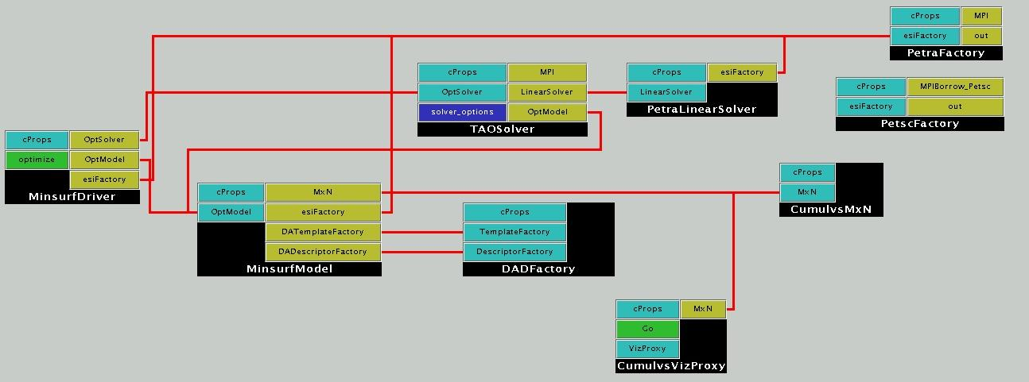
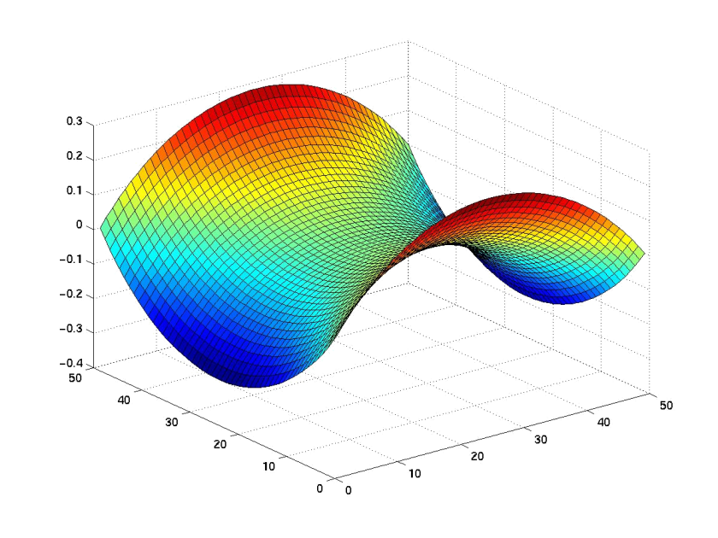
Solution of an unconstrained minimization problem (determining minimal surface area given boundary constraints) using the TAOSolver optimization component
TAOSolver uses linear solver components that incorporate abstract interfaces under development by the Equation Solver Interface (ESI) working group; underlying implementations are provided via the new ESI interfaces to parallel linear solvers within the PETSc and Trilinos libraries. These linear solver components are employed in the other two applications as well.

Slide 6
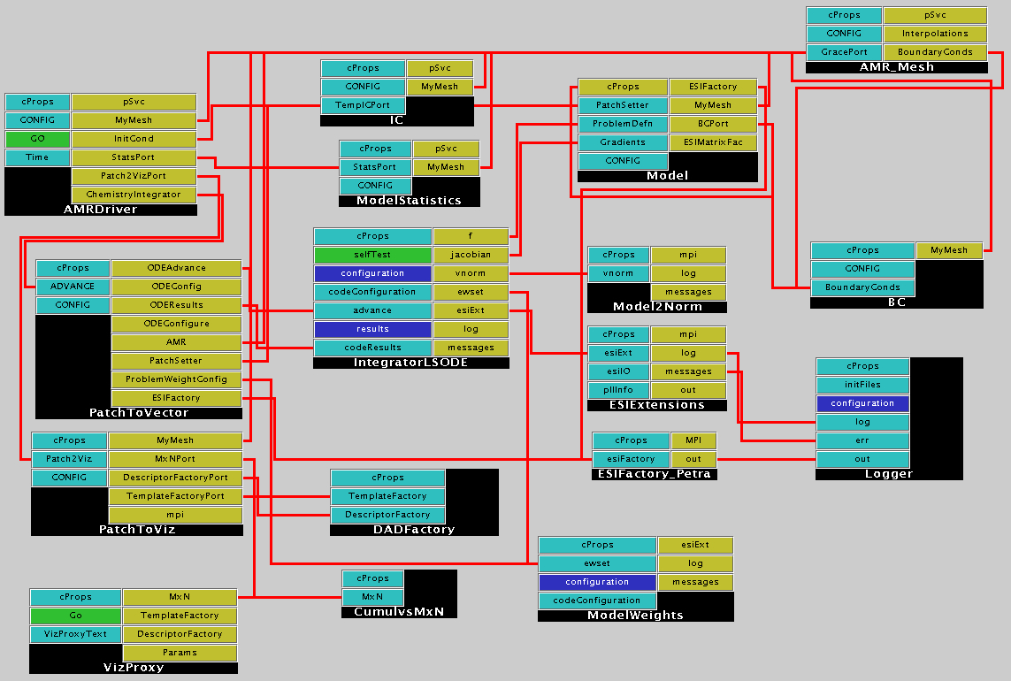
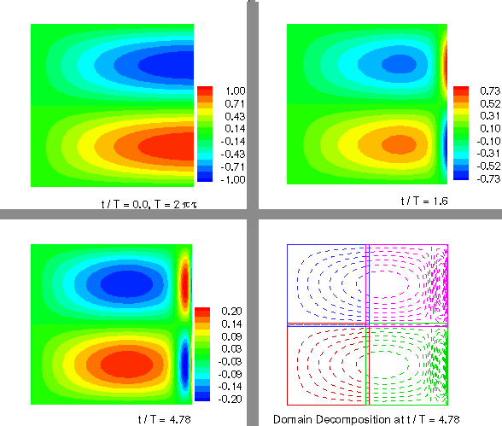
Solution of a two-dimensional heat equation on a square domain using an adaptive structured method.
IntegratorLSODE provides a second-order implicit time integrator, and Model provides a discretization. The remaining components are essentially utilities that construct the global ODE system or adaptors that convert the patch-based data structures of the mesh to the globally distributed array structure used for runtime visualization.

Slide 7
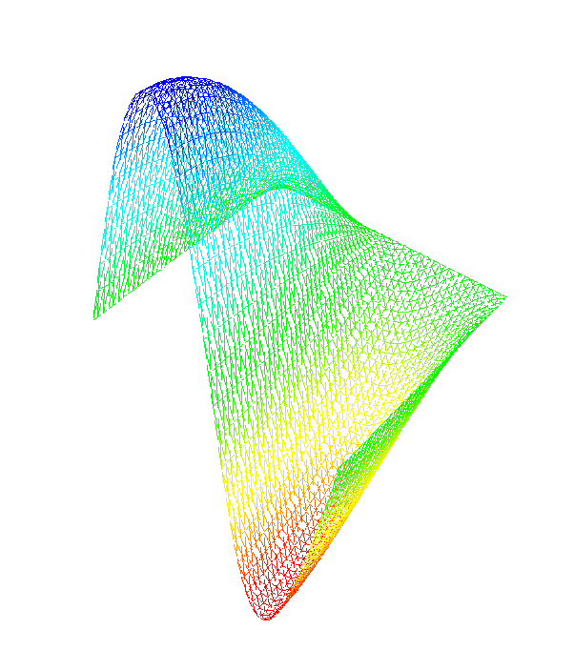
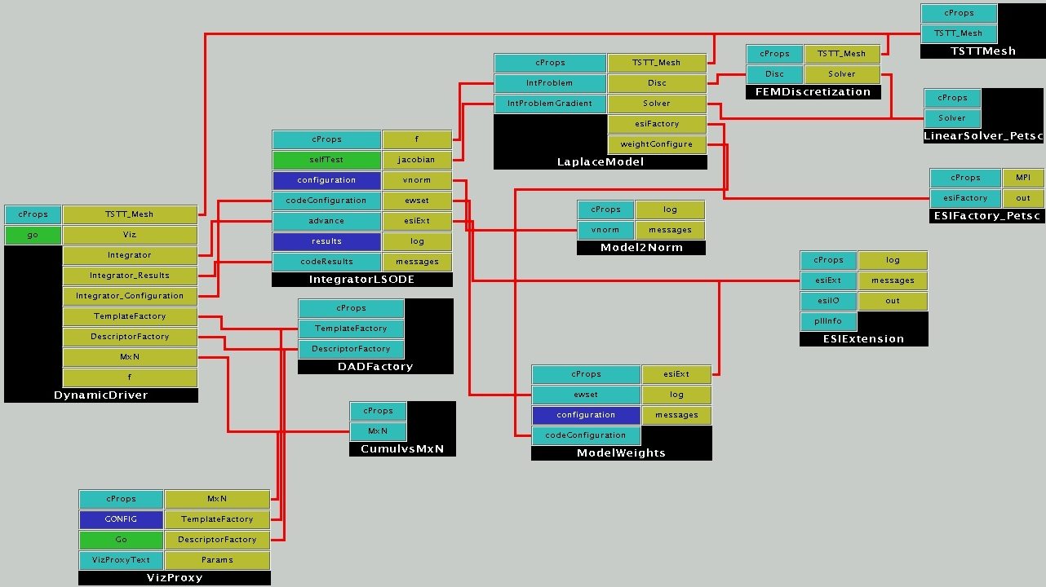
Solution of a time-dependent PDE using a finite element discretization on an unstructured mesh
IntegratorLSODE provides a second-order implicit time integrator, and FEMDiscretization provides a discretization.
This application (and the other two applications as well) use the DADFactory component to describe the parallel data layout so that the CumulsMxN data redistribution component can then collate the data from a multi-processor run to a single processor for runtime visualization.

