Slide 1
Introduction to the Ccaffeine Framework
Ben Allan
Rob Armstrong

Slide 2
Ouline
What is a CCA Framework and what is Ccaffeine?
How can I slip my own component into Ccaffeine?
How do I run Ccaffeine?
Live Demo – does it work?

Slide 3
CCA What CCA compliant framework is expected to do …
Exchange interfaces among components without one component needing to know more about the other than the interface itself.
Component 1
Component 2
1
registerUsesPort("A")
Port
addProvidesPort( ,"A")
CCAServices
Port
Port
3
2
CCAServices
4
Port
= getPort("A")

Slide 4
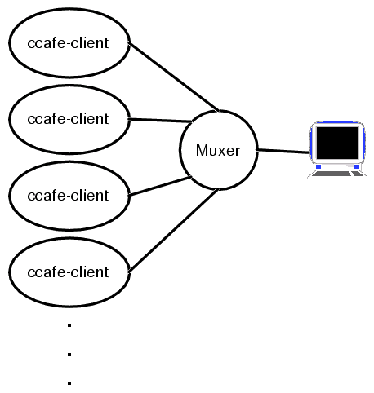
Interactive Parallel Components: what Ccaffeine does
Executable ccafe-client:
  PVM, MPI, or whatever is used for communication between clients.
  Muxer enforces “single process image” of SPMD parallel computing.
HOWTO:
http://www.cca-forum.org/ccafe/
  Build Ccaffeine
  Run Ccaffeine
http://www.cca-forum.org/ccafe/

Slide 5
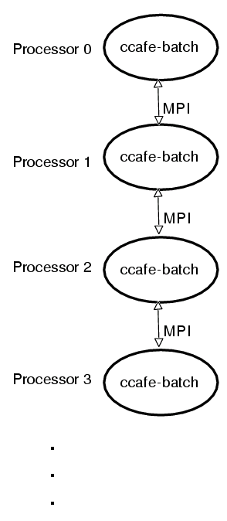
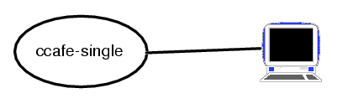
Ccaffeine comes in two other “flavors” and a GUI.
Single process executable:
ccafe-single
  really useful for debugging
Batch executable: ccafe-batch
  when all you want to do is run it.

Slide 6
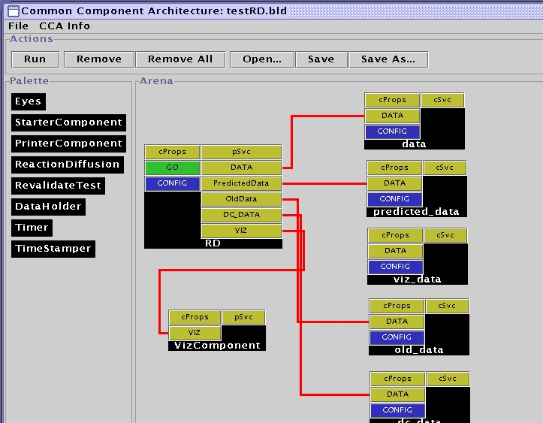
How to run Ccaffeine:
Ccaffeine interactive language: “benSpeak”
  used to configure batch and interactive sessions.
  Allows useful “defaults.”
  Allows the GUI to talk over a socket.

Slide 7
Configuration Commands: interactive or as an “RC” file or as a Batch run
Sample:
#!ccaffeine bootstrap file.
# ------- don't change anything ABOVE this line.-------------
# where to find components:
path set /home/rob/cca/dccafe-classic/cxx/dc/component
# load components into the “pallet”
repository get StarterComponent
repository get TimeStamper
repository get Timer
repository get PrinterComponent
repository get RevalidateTest

Slide 8
Creating a Ccaffeine component*
Beyond the CCA spec, Ccaffeine needs:
  Your component to be built compatibly, consider:
    Special libraries, shared and otherwise
    Compiler compat. (i.e. use the same compiler)
    Loaded dynamically, or statically?
    Defaults: libblas, linpack, g++, dynamic .so components
  To know where your component is
    set path default/path:my/own/path
  To know how to load your component
    needs a “.cca” text file. (auto gen’d in the example)
Whirlwind tour
  start from the tutorial PrinterComponent example.
^{*classic style component} ^{not Babel}

Slide 9
First timers (even nth timers) start with an example and build from there.
grand tour of PrinterComponentEG.
  The CCA “Hello World” example: one component hands a string to another that prints it.
Modify-able into a custom component.
independent of, but uses the Ccaffeine build tree to save work.
./Framework/component/PrinterComponentEG manifest:
genDLWrapperStrict, genDLIndex – scripts for mechanization
PrinterComponentEG.hh – component header
PrinterComponentEG.cxx – component source
Makefile – usual
runOneProcWGU.sed – runs Ccaffeine with your component

Slide 10
Quick guide to creating your own component from the example source
Change the name and implementation of these:
PrinterComponentEG.hh – component header
PrinterComponentEG.cxx – component source
Change the make target:
  COMPONENT_SRC = “MY_NEW_NAME.cxx” in:
Makefile – usual
Everything else should be automatic

Slide 11
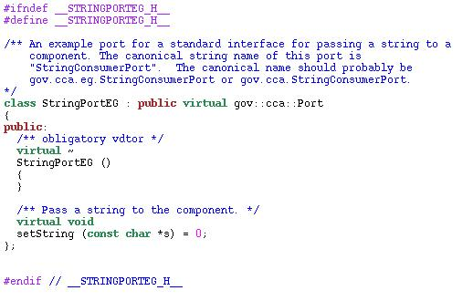
PrinterComponent takes a string and prints it out
It exposes a single interface for use: “StringPortEG” from the file StringPortEG.hh:

Slide 12
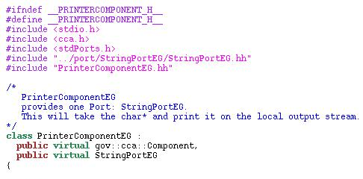
The component must inherit all the stuff of a “normal” CCA component
Must implement gov::cca:Component
  Choose to implement StringPortEG in the component
  Header file: PrinterComponentEG.hh:

Slide 13
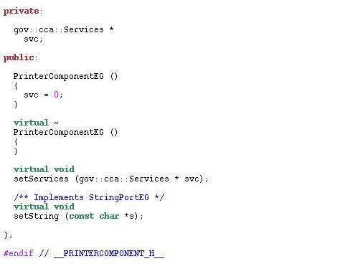
The component must inherit all the stuff of a “normal” CCA component
Implement setServices()
Implement StringPortEG
  implement setString()

Slide 14
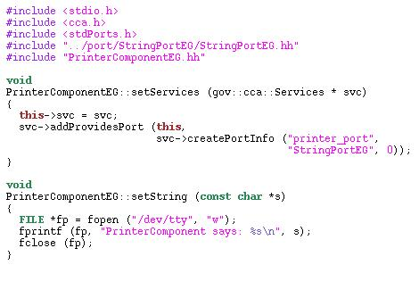
PrinterComponentEG Implementation
File PrinterComponentEG.cxx:

Slide 15
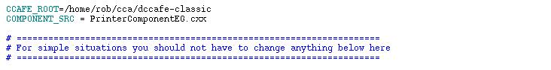
To change this implementation to your own, modify the Makefile
Change the name of the Component from PrinterComponentEG to whatever
  leave the extension .cxx
Makefile (partial) listing:
Type “make” and you’re ready to go.

Slide 16
Time to see if it works...
Use the script runOneProcWGUI
  searches for current component and any that are one dir level above current.
  An identical example is in ./Framework/component/StarterComponent/
  that the script will find.
Creates a CcafeineRC file that initializes the framework with components (Ccaffeine standard and the examples here).

Slide 17
What you are able to do now that you couldn’t before …
Run on parallel cluster or proprietary machine with CCA components that you didn’t write.
  Steve Jobs: “the best software is software I didn’t have to write” –not that he actually ever did.
Develop incrementally & interactively in serial and parallel.
  Detach, go have lunch and reattach.
After everything is working, dump the script and run it in batch mode.

