Slide 1
Introduction to the Ccaffeine Framework

Slide 2
Outline
What is a CCA Framework and what is Ccaffeine?
How can I slip my own component into Ccaffeine?
How do I run Ccaffeine?
Live Demo – does it work?

Slide 3
CCA What CCA compliant framework is expected to do …
Exchange interfaces among components without one component needing to know more about the other than the interface itself.
Component 1
Component 2
1
registerUsesPort("A")
Port
addProvidesPort( ,"A")
CCAServices
Port
Port
3
2
CCAServices
4
Port
= getPort("A")

Slide 4
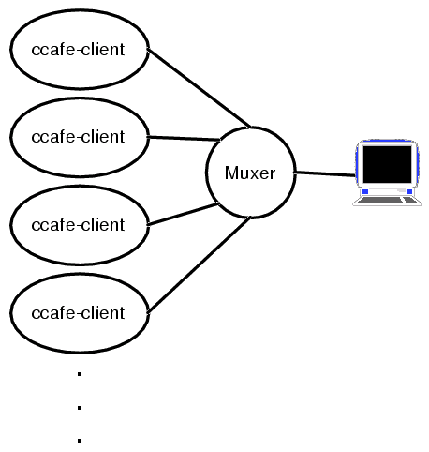
Interactive Parallel Components: what Ccaffeine does
Executable ccafe-client:
  PVM, MPI, or whatever is used for communication between clients.
  Muxer enforces “single process image” of SPMD parallel computing.
HOWTO:
http://www.cca-forum.org/ccafe/
  Build Ccaffeine
  Run Ccaffeine
http://www.cca-forum.org/ccafe/

Slide 5
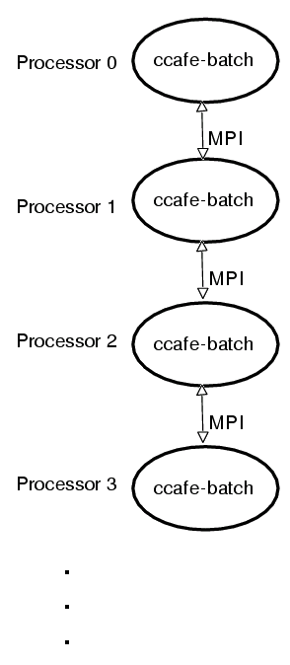
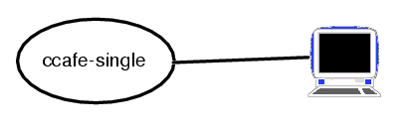
Ccaffeine comes in two other flavors* and a GUI.
Single process executable:
ccafe-single
  really useful for debugging
Batch executable: ccafe-batch
  when all you want to do is run it.
*flavor: same executable, different name and behavior.

Slide 6
How to build Ccaffeine
Have a look at
http://www.cca-forum.org/ccafe
  Obtain the required packages
    Ccaffeine tar ball download
    gcc (2.95.3, 2.96, not 3.x)
    Java (>jdk1.2)
    BLAS, LAPACK (any recent)
    BOOST headers
    Babel (0.7.0 only)
    Ruby (any recent, if you have Linux, probably there now)

Slide 7
How to build Ccaffeine (cont’d)
Untar Ccaffeine-xxx.tgz in build dir
  3 directories appear cca-spec-babel (the spec),
  cca-spec-classic (old C++ spec), dccafe
Run configure
  If confused type “configure –help”
  (cd ./cca-spec-babel; configure --with-babel=/usr/local/babel \
  --with-jdk12=/usr/local/java;make)
  (cd ./cca-spec-classic;configure;make)
  (cd ./dccafe; ./configure --with-cca-babel=`pwd`/../cca-spec-babel \
  --with-cca-classic=`pwd`/../cca-spec-classic \
  --with-mpi=/usr/local/mpich --with-jdk12=/usr/local/java \
  --with-lapack=/home/rob/cca/dccafe/../LAPACK/liblapack.a \
  --with-blas=/home/rob/cca/dccafe/../LAPACK/libblas.a; make)

Slide 8
Ccaffeine build (cont’d)
The Ccaffeine make will take ~5-10 min.
Look in:
http://www.cca-forum.org/ccafe/build-log.html
for a complete listing from Rob’s laptop.
If successful you should get:
=====================================================================
  Testing the Ccaffeine build ...
  didn't crash or hang up early ... looks like it is working.
  done with Ccaffeine tests.
=====================================================================

Slide 9
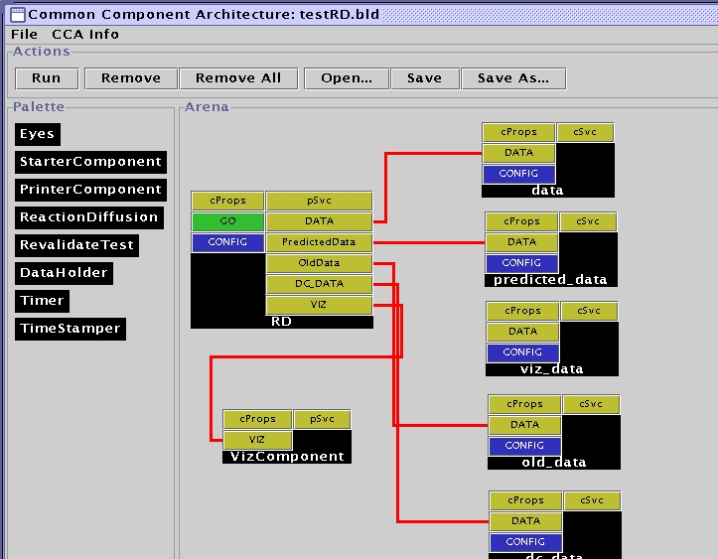
How to run Ccaffeine:
Ccaffeine interactive language
  used to configure batch and interactive sessions.
  Allows useful “defaults.”
  Allows the GUI to talk over a socket.

Slide 10
Ccaffeine scripting language is for those who have grown tired of the GUI
look in:
http://www.cca-forum.org/ccafe/ccafe-man/Ccafe_Manual.html
for all the commands.
The GUI is just a pretty front end that speaks this scripting language to the backend.
You can talk directly to Ccaffeine by typing:
prompt> ccafe-single
MPI_Init called in CmdLineClientMain.cxx
my rank: 0, my pid: 25989
... (output cruft deleted)
cca>help
(complete listing of commands and what they do)

Slide 11
Quick run-through of the Ccaffeine scripting language
scripting language does everything that the GUI does.
Warning: there are two of files that Ccaffeine uses:
  “rc” and script files for building and running apps
  GUI “.bld” files that are state saved by the Ccaffiene GUI.
  These are not the same and will give, sometimes spectacular, undefined behavior.

Slide 12
Magic number and repository function: the top of the script
Must tell the framework where the components are (“path”) and which ones you want loaded into the “pallet”.
#!ccaffeine bootstrap file.
# ------- don't change anything ABOVE this line.-------------
# where to find components:
path set /home/rob/cca/component
# load components into the “pallet”
repository get functions.PiFunction
repository get integrators.MonteCarloIntegrator
repository get integrators.MidPointIntegrator
repository get integrators.ParallelIntegrator
repository get randomgen.RandRandomGenerator
repository get tutorial.driver
At this point no components are instantiated, but are simply known to the system.

Slide 13
Now start instantiating the components that will form your application
Use the “create” function to make an instance of a component and name it.
  first arg is the class name of the component and the second is the instance name you want it to have:
# Instantiate and name components that have been made
# known to the framework
create randomgen.RandRandomGenerator rand
# f(x) = 4.0/(1 + x^2)
create functions.PiFunction function
create tutorial.Driver driver

Slide 14
Connect the components to form a complete application
Connect takes 4 arguments, all of them are instance names of components or ports. In order they are:
  Using component instance name (named in “create”).
  Uses port instance name (name given to it by the component)
  Providing component instance name.
  Provides port instance name.
Script from our example code:
# Connect uses and provides ports
connect integrator FunctionPort function FunctionPort
connect integrator RandomGeneratorPort rand RandomGeneratorPort
connect driver IntegratorPort integrator IntegratorPort

Slide 15
Time to see if it works: the “go” command
The “go” command takes a component instance and a port instance name as an argument
  only the named port on the named component are go()’ed:
# Good to go()
go driver GoPort
At this point Ccaffeine gets completely out of the way.
  So much so that it will not respond until (or if) your application returns from the invocation of the “go()” method.
  There is only one thread of control.

Slide 16
CCA is working on a component delivery specification, until then Ccaffeine has some specific req’ts
“.cca” file describes what the format of the component is: “Babel”, or old-style “Classic.”
Component wrapper class
  introduces to the framework one or more components
  contained in the “.so” file with the component(s).
  will go away for Babel components.

Slide 17
Example “.cca” file: MonteCarloIntegrator in integrators.cca
Ccaffeine-specific file specifying the name of the dynamic library and creation method for each component
!date=Thu Aug 15 14:53:23 CDT 2002
!location=
!componentType=babel
libIntegrator-component-c++.so
create_MonteCarloIntegrator integrators.MonteCarloIntegrator
Component type: “babel” or “classic” (C++)
“.so” Library
C wrapper function name
Component name
Notes:
This is also presented in the Ccaffeine module (the slide can be skipped).

Slide 18
Wrapper C functions
auto-gen the wrapper C code file:
  “genDL” scripts provided by Ccaffeine.
  genDLWrapperStrict to generate the “.cca” file.
  usage: genDLWrapper <component class name>
creates the appropriate symbols to be included in the “.so” file so that Ccaffeine can find and instantiate the component.
In the case of Babel components this step is unnecessary and is soon to be removed.

Slide 19
What you are able to do now that you couldn’t before …
Run on parallel cluster or proprietary machine with CCA components that you didn’t write.
  Steve Jobs: “the best software is software I didn’t have to write” –not that he actually ever did.
Develop incrementally & interactively in serial and parallel.
  Detach, go have lunch and reattach.
Notes:
Don’t need to show this, it depends on what is to be demonstrated.

Slide 20
Showing How it All Works
The Scripts
Next: Complex CCA Applications

