Slide 1
Common Component Architecture Concepts

Slide 2
Goals
Introduce the motivation and essential features of the Common Component Architecture
Provide common vocabulary for remainder of tutorial
What distinguishes CCA from other component environments?

Slide 3
Historical Perspective
Scientific Computing
Has focused on extracting performance, parallelism, etc.
Code complexity has increased due to both performance and scientific issues
Little has been done to address the complexity
Component Models
Have focused on managing complexity
Commodity component models are used primarily in the business and internet software arenas
Performance (at HPC level) not addressed
CCA is intended to bring the benefits of components to scientific computing

Slide 4
What is the CCA? (User View)
A component model specifically designed for high-performance scientific computing
Supports both parallel and distributed applications
Designed to be implementable without sacrificing performance
Minimalist approach makes it easier to componentize existing software

Slide 5
What is the CCA? (2)
Components are peers
Not just a dataflow model
A tool to enhance the productivity of scientific programmers
  Make the hard things easier, make some intractable things tractable
  Support & promote reuse & interoperability
  Not a magic bullet

Slide 6
CCA Concepts: Ports
IntegratorPort
FunctionPort
FunctionPort
MidpointIntegrator
NonlinearFunction
Components interact through well-defined interfaces, or ports
  In OO languages, a port is a class or interface
  In Fortran, a port is a bunch of subroutines or a module
Components may provide ports – implement the class or subroutines of the port ( )
Components may use ports – call methods or subroutines in the port ( )
Links denote a procedural (caller/callee) relationship, not dataflow!
  e.g., FunctionPort could contain: evaluate(in Arg, out Result)
“Provides” Port
“Uses” Port
Notes:
The cartoon is a schematic representation of two components connected to each other. The representation mimics that used in the original GUI for the Ccaffeine framework. Uses ports are shown on the left side of the component, provides ports on the right. They are shown in different colors to help distinguish them.
The MidpointIntegrator component has two ports. It provides an IntegratorPort and uses a FunctionPort. The NonlinearFunction component provides a FunctionPort. The red line connects the user FunctionPort on MidpointIntegrator to the provider FunctionPort on NonlinearFunction.
Another way to think of user/provider is client/server
To repeat: connecting ports does not imply direction of data movement!

Slide 7
CCA Concepts: Components
IntegratorPort
FunctionPort
FunctionPort
MidpointIntegrator
NonlinearFunction
Components are a unit of software composition
Components provide/use one or more ports
  A component with no ports isn’t very interesting
Components include some code which interacts with the CCA framework
  Implement setServices method, constructor, destructor
  Use getPort/releasePort to access ports on other components
The granularity of components is dictated by the application architecture and by performance considerations
Components are peers
  Application architecture determines relationships

Slide 8
CCA Concepts: Frameworks
The framework provides the means to “hold” components and compose them into applications
  The framework is often application’s “main” or “program”
Frameworks allow exchange of ports among components without exposing implementation details
Frameworks provide a small set of standard services to components
  BuilderService allow programs to compose CCA apps
Frameworks may make themselves appear as components in order to connect to components in other frameworks
Currently: specific frameworks support specific computing models (parallel, distributed, etc.).
Future: full flexibility through integration or interoperation

Slide 9
Components and Ports in the Integrator Example
Dashed lines indicate alternate connections
FunctionPort
IntegratorPort
FunctionPort
NonlinearFunction
MidpointIntegrator
FunctionPort
GoPort
IntegratorPort
LinearFunction
Driver
FunctionPort
IntegratorPort
FunctionPort
PiFunction
RandomGeneratorPort
MonteCarloIntegrator
RandomGeneratorPort
Create different applications in "plug-and-play" fashion
RandomGenerator

Slide 10
Writing Components
Components…
  Inherit from gov.cca.Component
    Implement setServices method to register ports this component will provide and use
  Implement the ports they they provide
  Use ports on other components
    getPort/releasePort from framework Services object
Interfaces (ports) extend gov.cca.Port
Much more detail later in the tutorial!

Slide 11
Adapting Existing Code into Components
Suitably structured code (programs, libraries) should be relatively easy to adapt to CCA
Decide level of componentization
  Can evolve with time (start with coarse components, later refine into smaller ones)
Define interfaces and write wrappers between them and existing code
Add framework interaction code for each component
  setServices, constructor, destructor
Modify component internals to use other components as appropriate
  getPort, releasePort and method invocations

Slide 12
Writing Frameworks
There is no reason for most people to write frameworks – just use the existing ones!
Frameworks must provide certain ports…
  ConnectionEventService
    Informs the component of connections
  AbstractFramework
    Allows the component to behave as a framework
  BuilderService
    instantiate components & connect ports
  ComponentRepository
    A default place where components are found
  Coming soon: framework services can be implemented in components and registered as services
Frameworks must be able to load components
  Typically shared object libraries, can be statically linked
Frameworks must provide a way to compose applications from components

Slide 13
Typical Component Lifecycle
We’ll look at actual code in next tutorial module
Composition Phase
  Component is instantiated in framework
  Component interfaces are connected appropriately
Execution Phase
  Code in components uses functions provided by another component
Decomposition Phase
  Connections between component interfaces may be broken
  Component may be destroyed
In an application, individual components may be in different phases at different times
Steps may be under human or software control
Notes:
We’re not really going to talk about disconnecting ports or destroying components here.

Slide 14
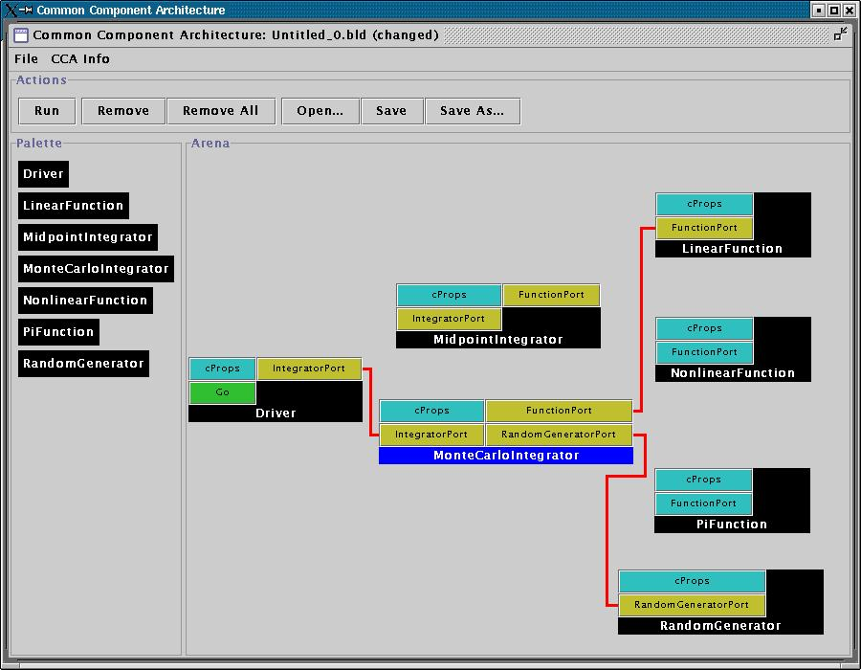
User Viewpoint:
Loading and Instantiating Components
Components are code (usu. library or shared object) + metadata
Using metadata, a Palette of available components is constructed
Components are instantiated by user action (i.e. by dragging from Palette into Arena)
Framework calls component’s constructor, then setServices
Details are framework-specific!
Ccaffeine currently provides both command line and GUI approaches
create Driver Driver
create LinearFunction LinearFunction
create MonteCarloIntegrator MonteCarloIntegrator
Notes:
While this description is specific to Ccaffeine, the concepts are general

Slide 15
User Connects Ports
Can only connect uses & provides
  Not uses/uses or provides/provides
Ports connected by type, not name
  Port names must be unique within component
  Types must match across components
Framework puts info about provider of port into using component’s Services object
connect Driver IntegratorPort MonteCarloIntegrator IntegratorPort
connect MonteCarloIntegrator FunctionPort LinearFunction FunctionPort
…
Notes:
The picture is specific to Ccaffeine, but the concepts are general

Slide 16
Framework Mediates Most
Component Interactions
*
* Method invocation need not be mediated by the framework!
Composition Phase
1
1’
Composition Phase
Execution Phase
Framework interaction code
constructor setServices destructor
Framework interaction code
constructor setServices destructor
2
CCA.Services
provides Result
uses Fun
2’
3
CCA.Services
provides Fun
6
Function code
Fun(x) = 3 * x + 17
Integrator code
getPort(Fun)
y=Fun(x)
releasePort(Fun)
4
5
Integrator
LinearFunction
Notes:
This is a multi-step animation intended to depict how the component and framework interact. The following three slides present the same concepts, but with a lot more words on the slide to explain things. In a normal presentation, I suggest you present this animation and skip over the next three, but then they have the written explanation in their printed handouts.
Here’s the “script” for this slide:
We start building an application in the Composition Phase. Red colored arrows indicate interactions during the composition phase
We instantiate an Integrator components
And the framework immediately calls its setServices method This gives the component a pointer to a CCA Services object, where setServices declares what ports it uses and provides
We instantiate a Linear Function component and the same thing happens there
The user tells the framework to connect the uses and provides ports (dashed line indicates user involvement)
Now the execution phase begins. Interactions here are in black and blue.
The user’s code, within the Integrator component wants to use a port, so it calls getPort and the framework returns a “pointer” to the proviers of the port (or a proxy in the distributed case)
The user code invokes functions on the Fun port. In the direct connection case, this does not need to be mediated by the framework. (Blue color denotes the special nature of this interaction)
When the Integrator code is done using the Fun port, it calls releastPort

Slide 17
Component’s View of Instantiation
Framework calls component’s constructor
Component initializes internal data, etc.
  Knows nothing outside itself
Framework calls component’s setServices
  Passes setServices an object representing everything “outside”
  setServices declares ports component uses and provides
Component still knows nothing outside itself
  But Services object provides the means of communication w/ framework
Framework now knows how to “decorate” component and how it might connect with others
Framework interaction code
constructor setServices destructor
CCA.Services
provides IntegratorPort
uses FunctionPort, RandomGeneratorPort
Integrator code
IntegratorPort
FunctionPort
RandomGeneratorPort
MonteCarloIntegrator
MonteCarloIntegrator
Notes:
The cartoon on the left shows the internals of the component. The cartoon on the right is how the Ccaffeine GUI would render the “decorated” component to the outside world.

Slide 18
Component’s View of Connection
Framework interaction code
CCA.Services
…, uses FunctionPort
(connected to NonlinearFunction FunctionPort), …
Framework puts info about provider into user component’s Services object
  MonteCarloIntegrator’s Services object is aware of connection
  NonlinearFunction is not!
MCI’s integrator code cannot yet call functions on FunctionPort
Integrator code
Framework interaction code
MonteCarloIntegrator
CCA.Services
provides FunctionPort
Function code
NonlinearFunction

Slide 19
Component’s View of Using a Port
User calls getPort to obtain (handle for) port from Services
  Finally user code can “see” provider
Cast port to expected type
  OO programming concept
  Insures type safety
  Helps enforce declared interface
Call methods on port
  e.g.
  sum = sum + function->evaluate(x)
Release port
Framework interaction code
CCA.Services
…, uses FunctionPort
(connected to NonlinearFunction FunctionPort), …
Integrator code
MonteCarloIntegrator
Notes:
This is where the changes to the “library” code turn up. The getPort/cast/releasePort are outright additions. But also, calls to methods on the port will change slightly.

Slide 20
Importance of
Provides/Uses Pattern for Ports
Component 1
Component 2
Fences between components
  Components must declare both what they provide and what they use
  Components cannot interact until ports are connected
  No mechanism to call anything not part of a port
Ports preserve high performance direct connection semantics…
…While also allowing distributed computing
Provides/Uses
Port
Direct Connection
Component 1
Provides
Port
Network
Connection
Component 2
Uses
Port

Slide 21
CCA Concepts: “Direct Connection” Maintains Local Performance
Calls between components equivalent to a C++ virtual function call: lookup function location, invoke it
  Cost equivalent of ~2.8 F77 or C function calls
  ~48 ns vs 17 ns on 500 MHz Pentium III Linux box
Language interoperability can impose additional overheads
  Some arguments require conversion
  Costs vary, but small for typical scientific computing needs
Calls within components have no CCA-imposed overhead
Implications
  Be aware of costs
  Design so inter-component calls do enough work that overhead is negligible
Notes:
Purists often argue with the characterization of a C++ virtual function call as costing the equivalent of n function calls in a language like C or Fortran. The problem is that the virtual function call involves first looking up the function (dereferencing a pointer) and then making the call. The lookup doesn’t happen in C or Fortran, so the argument is that we’re comparing apples and oranges.
On the other hand, a significant number of our audience are Fortran (or perhaps C) programmers with no C++ experience. All they “know” about C++ is that its slow. So above, we give them a measure of what “slow” means in this particular context.
If someone can come up with a succinct way of expressing this that will satisfy the purists as well as the Fortran programmer, please let me know!

Slide 22
How Does Direct Connection Work?
Components loaded into separate namespaces in the same address space (process) from shared libraries
getPort call returns a pointer to the port’s function table
All this happens “automatically” – user just sees high performance
  Description reflects Ccaffeine implementation, but similar or identical mechanisms are in other direct connect fwks
Many CORBA implementations offer a similar approach to improve performance, but using it violates the CORBA standards!

Slide 23
CCA Concepts: Framework Stays “Out of the Way” of Component Parallelism
Single component multiple data (SCMD) model is component analog of widely used SPMD model
P0
P1
P2
P3
Each process loaded with the same set of components wired the same way
Different components in same process “talk to each” other via ports and the framework
Components: Blue, Green, Red
Framework: Gray
Same component in different processes talk to each other through their favorite communications layer (i.e. MPI, PVM, GA)
MCMD/MPMD also supported
Other component models ignore parallelism entirely
Notes:
An animation depicting the important concepts in tightly-coupled parallel computing with CCA.
0) Start with a single process containing a framework with a give set of components (Blue, Green, Red) wired together.
Extend that to a parallel system by giving each process the same set of components wire the same way.
Components on the same process talk to each other via the usual CCA mechanisms (one such case highlighted by dashed box).
Between the same component (Blue, Green, Red) in different processes, the component is free to communicate however it wants – not forced to use CCA mechanisms. This is good because it allows developers to reuse software more easily, and knowledge (about how to use a given communications layer). Different comms layers can coexist in the same application
The CCA spec does not prohibit “diagonal” communication, but it is not encouraged. It would be treated the same as horizontal communication – the framework would stay out of the way.
The MPMD analog of this also “just works”. It is just harder to depict ☺

Slide 24
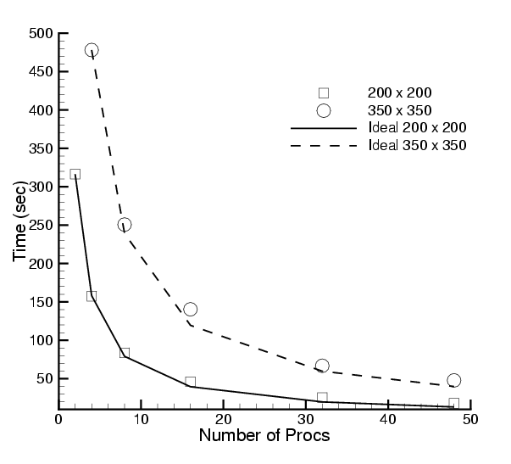
Scalability of Scientific Data Components in CFRFS Combustion Applications
Investigators: S. Lefantzi, J. Ray, and H. Najm (SNL)
Uses GrACEComponent, CvodesComponent, etc.
Shock-hydro code with no refinement
200 x 200 & 350 x 350 meshes
Cplant cluster
  400 MHz EV5 Alphas
  1 Gb/s Myrinet
Negligible component overhead
Worst perf : 73% scaling efficiency for 200x200 mesh on 48 procs
Reference: S. Lefantzi, J. Ray, and H. Najm, Using the Common Component Architecture to Design High Performance Scientific Simulation Codes, Proc of Int. Parallel and Distributed Processing Symposium, Nice, France, 2003, accepted.

Slide 25
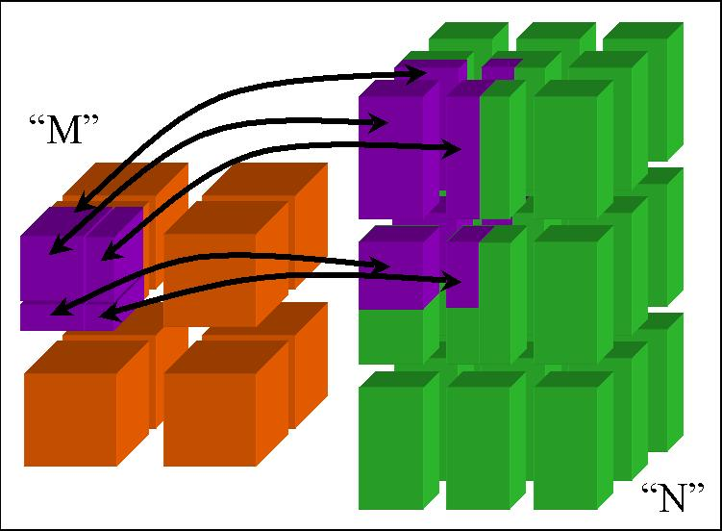
CCA Concepts:
MxN Parallel Data Redistribution
Share Data Among Coupled Parallel Models
  Disparate Parallel Topologies (M processes vs. N)
  e.g. Ocean & Atmosphere, Solver & Optimizer…
  e.g. Visualization (Mx1, increasingly, MxN)
Research area -- tools under development

Slide 26
CCA Concepts:
Language Interoperability
Existing language interoperability approaches are “point-to-point” solutions
Babel provides a unified approach in which all languages are considered peers
Babel used primarily at interfaces
f77
f77
C
f90
C
f90
Babel
C++
Python
C++
Python
Babel tutorial coming up!
Java
Java
Few other component models support all languages and data types important for scientific computing

Slide 27
What the CCA isn’t…
CCA doesn’t specify who owns “main”
  CCA components are peers
  Up to application to define component relationships
    “Driver component” is a common design pattern
CCA doesn’t specify a parallel programming environment
  Choose your favorite
  Mix multiple tools in a single application
CCA doesn’t specify I/O
  But it gives you the infrastructure to create I/O components
  Use of stdio may be problematic in mixed language env.
CCA doesn’t specify interfaces
  But it gives you the infrastructure to define and enforce them
  CCA Forum supports & promotes “standard” interface efforts
CCA doesn’t require (but does support) separation of algorithms/physics from data

Slide 28
What the CCA is…
CCA is a specification for a component environment
  Fundamentally, a design pattern
  Multiple “reference” implementations exist
  Being used by applications
CCA increases productivity
  Supports and promotes software interopability and reuse
  Provides “plug-and-play” paradigm for scientific software
CCA offers the flexibility to architect your application as you think best
  Doesn’t dictate component relationships, programming models, etc.
  Minimal performance overhead
  Minimal cost for incorporation of existing software
CCA provides an environment in which domain-specific application frameworks can be built
  While retaining opportunities for software reuse at multiple levels

Slide 29
Concept Review
Ports
  Interfaces between components
  Uses/provides model
Framework
  Allows assembly of components into applications
Direct Connection
  Maintain performance of local inter-component calls
Parallelism
  Framework stays out of the way of parallel components
MxN Parallel Data Redistribution
  Model coupling, visualization, etc.
Language Interoperability
  Babel, Scientific Interface Definition Language (SIDL)

