Slide 1
CCA Status and Plans
Notes:
CCA Status and Plans
This portion of the Tutorial will describe the ongoing Research Thrust Areas being explored by the CCA Forum and SciDAC CCA Center (CCTTSS).

Slide 2
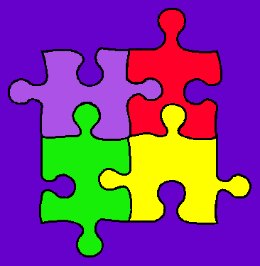
CCTTSS Research Thrust Areas and Main Working Groups
Scientific Components
  Scientific Data Objects
  Lois Curfman McInnes, ANL (curfman@mcs.anl.gov)
“MxN” Parallel Data Redistribution
  Jim Kohl, ORNL (kohlja@ornl.gov)
Frameworks
  Language Interoperability / Babel / SIDL
  Component Deployment / Repository
  Gary Kumfert, LLNL (kumfert@llnl.gov)
User Outreach
  David Bernholdt, ORNL (bernholdtde@ornl.gov)
Notes:
CCTTSS Research Thrusts
There are 4 main thrust areas being researched as part of the CCA effort.
There are a number of special working groups exploring each of these areas.
Scientific Components
The scientific components efforts includes a number of numerical software components, as well as general support components
such as for visualization and computational steering.
As part of this scientific component effort, several special working groups are developing generalized scientific data objects,
for a variety of data meshes, to assist scientists in composing and sharing data between independent components.
MxN
The “MxN” (pronounced “M by N”) research emphasizes the sharing of parallel data among components,
as is often done in climate simulations and other coupled scientific models. This kind of parallel data exchange and
redistribution can be more common in a generalized component environment, and these special parallel interfaces are
some of the primary features that distinguish CCA from other component technologies.
Frameworks
The CCA Framework effort is concerned with providing encapsulating containers, with associated services, for assembling
component-based applications. This work includes challenging issues like language interoperability, as well as the development
of component repositories and deployment strategies.
User Outreach
The 4th Thrust Area involves working closely with scientific application domains, to help them utilize the CCA specifications
and technology, and to coordinate user feedback to help guide and drive the ongoing CCA design.

Slide 3
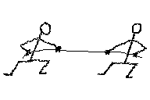
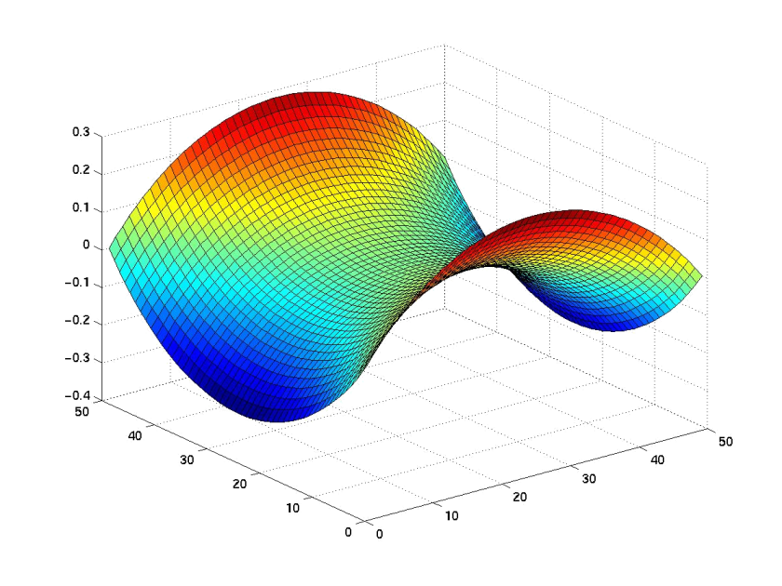

Scientific Components
Abstract Interfaces and Component Implementations
  Mesh management
  Linear, nonlinear, and optimization solvers
  Multi-threading and load redistribution
  Visualization and computational steering
Quality of Service Research
Fault Tolerance
  Components and Frameworks
Notes:
Scientific Components
Scientific Components constitute the machinery and tools that will make component-based scientific computing a reality.
While each scientific domain has its own specialized science, formulas and algorithms, these generalized scientific interfaces
and components allow for the efficient construction of full component applications, by capitalizing on the expertise of other
component developers, in mesh management, linear/nonlinear/optimization solvers, multi-threading and load redistribution,
visualization, computational steering, quality of service, and fault tolerance (of components and their encapsulating frameworks).

Slide 4
Scientific Components
Extended R&D Agenda
Complete development of abstract interfaces and base component prototypes
Advanced component development
  Second-level component extensions
  Application-specific components for chemistry and climate
Implement fault tolerance and recovery mechanisms
Develop quality of service models for numerical components
  Integrate QoS system into repository
Develop interfaces and implementations for multi-level nonlinear solvers and hybrid mesh management schemes
  Collaboration with TOPS and TSTT centers
Notes:
The ongoing research in scientific components strives to complete the development of several key interfaces and
base component prototypes.
Some of the advanced component development will include second-level extensions to existing components,
as well as application-specific components that are catered to special needs in chemistry and climate simulations.
Existing fault tolerance and recovery mechanisms will be incorporated into components and framework services,
for checkpointing and load balancing support.
Quality of Service models will be developed for numerical components, to help scientists make the right component
choices based on their performance needs.
The CCA will also collaborate with the TOPS and TSTT Centers to develop multi-level nonlinear solvers and hybrid
mesh management schemes.

Slide 5
Scientific Data Objects
& Interfaces
Define “Standard” Interfaces for HPC Scientific Data
  Descriptive, Not (Necessarily) Generative…
Basic Scientific Data Object
  David Bernholdt, ORNL
Structured & Unstructured Mesh
  Lori Freitag, ANL
  Collaboration with SciDAC TSTT Center
Block Structured AMR
  Phil Colella, LBNL
  Collaboration with APDEC & TSTT
Notes:
Another research area is being explored to support the various scientific computing components, by providing
a generalized means for describing scientific data.
These new interfaces for HPC data will be more “descriptive” – wrapped over existing data meshing and decomposition
tools and interfaces – than “generative”, as in actually creating new data objects.
Work is in progress to develop basic scientific data interfaces, for local and distributed arrays,
as well as structured, unstructured, and structured block AMR meshes.

Slide 6
Basic Scientific Data Interfaces
Low Level, Raw Data
  Supports high performance access to memory
  Based on IOVec
    (e.g. http://www-sld.slac.stanford.edu/HELP/POSIX/DATA_STRUCTURES/IOVEC)
    Assumes a contiguous memory block
    Supports basic data types such as integer, float, double
    No topology information
Local & Distributed Arrays
  Abstract interfaces for higher-level data description
    1D, 2D, 3D dense arrays
    Various distribution strategies
      HPF-like decomposition types (Block/Cyclic…)
Notes:
At the lowest level, there are “Raw Data” interfaces that describe data in its simplest form,
as long vectors of memory in the basic data types (integer, float, double, etc). This interface
does not include topology information as for a multi-dimensional array, but has the highest
performance for accessing data.
The next abstraction layer describes “Local Arrays”, with add the basic topology and dimensionality
of dense arrays. Distributed collections of these Local Arrays can be described using the
“Distributed Array” interface, which supports most common HPF-like data decomposition
strategies, such as Block/Cyclic…

Slide 7
“MxN” Parallel Data Redistribution:
The Problem…
“N”
“M”
Notes:
Because the CCA departs from traditional component-based architectures, it is essential to provide specialized
interfaces for handling these challenging new parallel semantics.
The “MxN” thrust area focuses on providing a means for specifying how two parallel components, of potentially
different cardinality and decomposition type, can extract, redistribute and share parallel data.
Each specific data element on the “M” side must be mapped to a corresponding element on the “N” side.
Note that this most basic parallel data exchange capability, while still highly complex, does not yet even begin
to address the more complicated issues of spatial and temporal interpolation, or units conversion, as is necessary
for a full-fledged parallel model coupling environment.

Slide 8
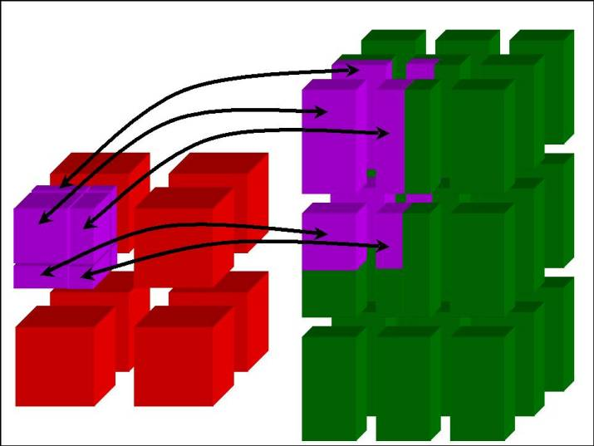
“MxN” Parallel Data Redistribution:
The Problem…
Create complex scientific simulations by coupling together multiple parallel component models
  Share data on “M” processors with data on “N”
    M != N ~ Distinct Resources (Pronounced “M by N”)
  Model coupling, e.g., climate, solver / optimizer
  Collecting data for visualization
    Mx1; increasingly MxN (parallel rendering clusters)
Define “standard” interface
  Fundamental operations for any parallel data coupler
    Full range of synchronization and communication options
Notes:
The most interesting case of “MxN” parallel data redistribution is clearly when “M” is not equal to “N”.
This happens often in scientific model coupling, e.g. in climate simulations, or for visualization where the
case is typically “M by 1”. But this technology could also be useful for more complex component applications
where a solver and optimizer components must share parallel data, whether within the same framework
or spanning multiple frameworks.
The goal of this initial “MxN” effort is to provide a generalized interface that describes all the fundamental
operations supported by any parallel data coupler, including a spectrum of synchronization and communication
options.

Slide 9
Hierarchical MxN Approach
Basic MxN Parallel Data Exchange
  Component implementation
  Initial prototypes based on CUMULVS & PAWS
    Interface generalizes features of both
Higher-Level Coupling Functions
  Time & grid (spatial) interpolation, flux conservation
  Units conversions…
“Automatic” MxN Service via Framework
  Implicit in method invocations, “parallel RMI”
http://www.csm.ornl.gov/cca/mxn/
Notes:
The current MxN interface generalizes the protocols and functions in the CUMULVS (ORNL) and PAWS (LANL)
systems, and also encompasses much of the capabilities in systems like the Model Coupling Toolkit (MCT) for
climate coupling.
(The existing MxN interface is *so* general, that neither CUMULVS, PAWS or MCT fully implement the interface! ☺)
The extended MxN architecture will build on this basic MxN interface, to construct higher-level coupling functions
that handle units conversion, temporal and spatial interpolation, and flux conservation, in the coupling data exchange.
Ultimately, as these capabilities become well understood, such MxN and coupling interfaces might be “automated”
to run as implicit framework services. In a utopian CCA framework, parallel components could share data and
collectively invoke parallel methods on each other without ever knowing their true parallel nature…
But a *significant* research effort in MxN and parallel method invocations, or “Parallel RMI”, is necessary
before any automated system can be constructed.

Slide 10
CCA Frameworks
Component Containers & Run-Time Environments
Research Areas:
  Integration of prototype frameworks
    SCMD/parallel with distributed, bridged for one application
    Unify framework services & interactions…
  Language interoperability tools
    Babel/SIDL, incorporate difficult languages (F90…)
    Production-scale requirement for application areas
  Component deployment
    Component repository, interface lookup & semantics
Notes:
The “Frameworks” thrust area involves the design and development of component containers and
run-time environments for the CCA.
This essential and practical technology carries several complications that are addresses by different
research teams.
The initial prototype CCA frameworks have each been designed to suit a specific parallel
or distributed layout or organization. The existing set of parallel SCMD (“Single Component, Multiple Data”)
and distributed frameworks must be unified into one common framework infrastructure.
Components must be able to see and interact with components in other frameworks, to allow
a full spectrum of hybrid parallel/distributed applications.
2. As component software can be written in a variety of source languages, from Python to C++ to
Java to Fortran, the CCA frameworks must deal with language interoperability to allow components
in one language to reliably and correctly invoke methods on components written in a different
source language. The Babel/SIDL (Scientific Interface Definition Language) team is working on
a generalized solution to this problem, and is currently tackling challenging language bindings such
as Fortran90.
3. Once scientific software components become more proliferate, and even now as more and more
prototype scientific components are being developed inside the CCA, it is increasingly important to
have some straightforward means to locate and download the “Right Component for the Job”…
Another framework team is exploring such component deployment via the use of component
repositories, and other interface semantics and lookup technology.

Slide 11
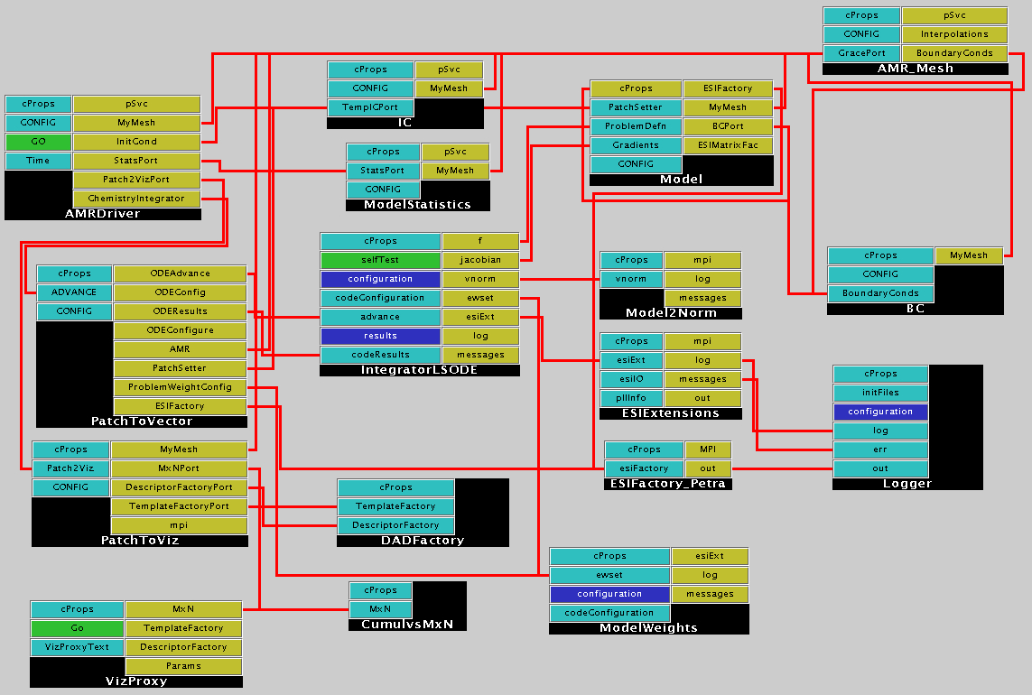
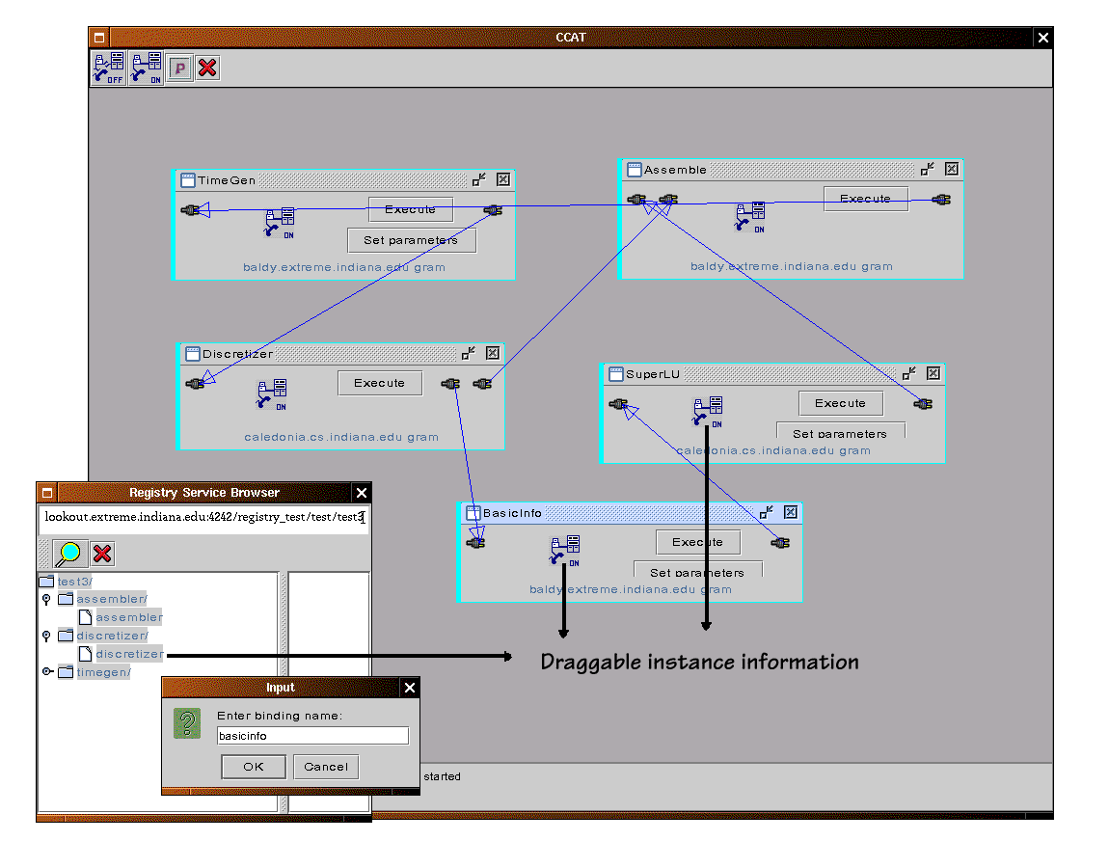
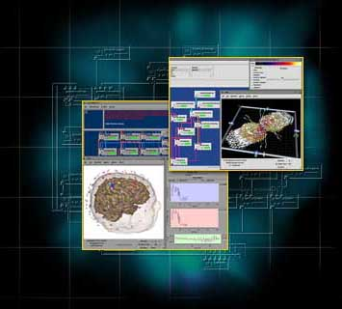
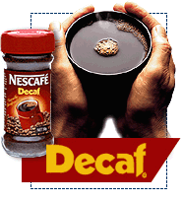

CCA Framework Prototypes
Ccaffeine
  SPMD/SCMD parallel
  Direct connection
CCAT / XCAT
  Distributed
  Network connection
SCIRun
  Parallel, multithreaded
  Direct connection
Decaf
  Original language interoperability via Babel…
Notes:
Here is a quick overview of the existing CCA framework prototypes:
CCAFFEINE ~ Sandia
Supports “SCMD” parallel components, with direct connection among local components that
share a common address space.
CCAT / XCAT ~ Indiana
A “Distributed” framework that connects components via the network, using port “proxies”.
SCIRun ~ Utah
A parallel, multi-threaded component-based development environment that supports direct connection.
Decaf ~ LLNL
The original experimental CCA framework with language interoperability provided by the Babel system and SIDL. Now all of the other frameworks also support such language interoperability.

Slide 12

Outreach and Applications Integration
Tools Not Just “Thrown Over The Fence”…
Several Outreach Efforts:
  General education and awareness
    Tutorials, like this one!
    Papers, conference presentations
  Strong liaison with adopting groups
    Beyond superficial exchanges
    Real production requirements & feedback
  Chemistry and climate work within CCTTSS
    Actual application development work ($$$)
SciDAC Emphasis
  More vital applied advanced computing research!
Notes:
A fundamental difference between DOE’s SciDAC program and previously funded DOE software technology research
is the emphasis on integration of these SciDAC software tools with *real* application codes.
As an explicit part of the CCTTSS, funds are earmarked for “Applications Integration”, to assist domain scientists
with the integration of CCA technology into production scientific simulations. Rather than simply “throwing the
CCA technology over the fence”, to let application scientists struggle with it on their own and figure out how it
should be applied, the CCA is actively working with various scientific teams to help them utilize the CCA
tools and systems.
Several approaches are being explored in CCA Applications Outreach, including general education and awareness,
like this tutorial and via conference papers and presentations. We are forming strong liaison with several adopting
groups, to elicit real production requirements and ongoing feedback. And we are performing actual development
work for chemistry and climate, to integrate CCA technology into existing simulation codes.

Slide 13


Active CCA Forum Working Groups
Adaptive Mesh Refinement
Generalized Data Objects
Tutorial Presentations
Application Domain Groups:
  Climate, Chemistry
MxN Data Redistribution
Embeddable Scripting
Fortran Users
Babel Development & Users
Deployment / XML Schemas
Ccaffeine Open Framework
Component-Based Debugging…
See http://www.cca-forum.org/working_groups.html for more info.
Notes:
There are various working groups in the CCA Forum and CCTTSS that are actively exploring fundamental specifications and technology for components, frameworks, and component-based application development.
Some of these working groups are more focused on high-level integration of existing technologies through the development of community “standards” for component environments.
Other groups focus on more of the low-level “building blocks” (get the figure? ☺) that are necessary to make component-based development more practical for production-scale applications.
See the web site for more information about joining a working group, OR about starting a new working group of interest to the community.

Slide 14
Current CCA / CCTTSS Status
CCA Specification at Version 0.6
Several Operational Prototype Frameworks
Growing Number of Reusable Component Modules
Draft specifications for
  Basic scientific data objects
  MxN parallel data redistribution
Demonstration Software Available for Download
  Several Multi-Component Parallel and Distributed Demonstration Applications
  Variety of components for: optimization, solvers, meshes, data decompositions, visualization, MxN…
  RPM packages for easy Linux install!
http://www.cca-forum.org/software.html
Notes:
For several years, increasingly powerful CCA software prototypes have been under development,
starting with demonstrations at SC2000 and then again last year at SC2001.
The main CCA specification is at version “0.5” to signify that the specification is still under
development, with minor “tweaks” occasionally as more elaborate applications and tools
are created.
As you have seen, there are a variety of working prototype frameworks and scientific
components for fundamental numerical operations, and these components operate
in high-performance parallel environments.
There are draft specifications for basic scientific data objects and the MxN parallel
data redistribution interface, along with simple prototype component implementations.
And this latest collection of software tools and systems has been bundled and is
available for download, including 4 example applications, with 31 distinct components.
To demonstrate component re-use, 6 of these components are used in more than one
example application.

Slide 15

CCA Tutorial Summary
Go Forth and Componentize…
  And ye shall bear good scientific software
Come Together for Domain Standards
  Attain true interoperability & code re-use
Use The Force:
  http://www.cca-forum.org/tutorials/
  tutorial-wg@cca-forum.org
  cca-forum@cca-forum.org
Notes:
SO, if we have convinced you that there is benefit to using the Common Component Architecture
design methodology, and/or to using the specialized interfaces being developed by the various
working groups, then you should “Go Forth and Componentize”, and “Ye Shall Bear the Good
Fruits” of component-based scientific software.
Please note that as an application scientist, you MUST come together to develop “standards”
for your specific science, formulas and algorithms, in order to attain “true” interoperability
and code re-use. The CCA is only a tool, which can be used to further science, or like any
tool, can be misused for ill gains…
But if you ‘Use the Force, Luke”, you can download the CCA software and give it a try!
And if we all work together, “There Will Be Much Rejoicing” ! ☺

