Slide 1
An Overview of Components for Scientific Computing and
Introduction to the Common Component Architecture

Slide 2
Goals of This Module
Introduce basic concepts and vocabulary of component-based software engineering
Highlight the special demands of high-performance scientific computing on component environments
Introduce some terminology and concepts from the Common Component Architecture
Provide a unifying context for the remaining talks
  For those attending the extended CCA tutorial

Slide 3
Motivation: Modern Scientific Software Engineering Challenges
Productivity
  Time to first solution (prototyping)
  Time to solution (“production”)
  Software infrastructure requirements (“other stuff needed”)
Complexity
  Increasingly sophisticated models
  Model coupling – multi-scale, multi-physics, etc.
  “Interdisciplinarity”
Performance
  Increasingly complex algorithms
  Increasingly complex computers
  Increasingly demanding applications

Slide 4
Motivation: For Library Developers
People want to use your software, but need wrappers in languages you don’t support
  Many component models provide language interoperability
Discussions about standardizing interfaces are often sidetracked into implementation issues
  Components separate interfaces from implementation
You want users to stick to your published interface and prevent them from stumbling (prying) into the implementation details
  Most component models actively enforce the separation

Slide 5
Motivation: For Application Developers and Users
You have difficulty managing multiple third-party libraries in your code
You (want to) use more than two languages in your application
Your code is long-lived and different pieces evolve at different rates
You want to be able to swap competing implementations of the same idea and test without modifying any of your code
You want to compose your application with some other(s) that weren’t originally designed to be combined

Slide 6
Some Observations About Software…
“The complexity of software is an essential property, not an accidental one.” [Brooks]
  We can’t get rid of complexity
“Our failure to master the complexity of software results in projects that are late, over budget, and deficient in their stated requirements.” [Booch]
  We must find ways to manage it
Notes:
Help is on the way..
- Building blocks (“A complex system that works…” )
- encapsulation (“Intracomponent linkages…”)
- CCA components high in the hierarchy food chain (“Frequently, complexity …”)

Slide 7
More Observations…
“A complex system that works is invariably found to have evolved from a simple system that worked… A complex system designed from scratch never works and cannot be patched up to make it work.” [Gall]
  Build up from simpler pieces
“The best software is code you don’t have to write” [Jobs]
  Reuse code wherever possible

Slide 8
Component-Based Software Engineering
CBSE methodology is emerging, especially from business and internet areas
Software productivity
  Provides a “plug and play” application development environment
  Many components available “off the shelf”
  Abstract interfaces facilitate reuse and interoperability of software
Software complexity
  Components encapsulate much complexity into “black boxes”
  Plug and play approach simplifies applications
  Model coupling is natural in component-based approach
Software performance (indirect)
  Plug and play approach and rich “off the shelf” component library simplify changes to accommodate different platforms

Slide 9
A Simple Example:
Numerical Integration Components
Interoperable components (provide same interfaces)
FunctionPort
IntegratorPort
FunctionPort
NonlinearFunction
MidpointIntegrator
FunctionPort
GoPort
IntegratorPort
LinearFunction
Driver
FunctionPort
IntegratorPort
FunctionPort
PiFunction
RandomGeneratorPort
MonteCarloIntegrator
RandomGeneratorPort
RandomGenerator
Notes:
A bunch of components that we’ll see throughout the tutorial
The driver’s job is merely to invoke the integrator and print out the result
We have two different integrators (and of course you could have many more)
One uses the simple midpoint integration rule
The other is based on the Monte Carlo approach, so it requires a random number generator in addition to the function to be integrated
On the right are several functions we might want to integrate, as well as a random number generator

Slide 10
Many Applications are Possible…
Dashed lines indicate alternate connections
FunctionPort
IntegratorPort
FunctionPort
NonlinearFunction
MidpointIntegrator
FunctionPort
GoPort
IntegratorPort
LinearFunction
Driver
FunctionPort
IntegratorPort
FunctionPort
PiFunction
RandomGeneratorPort
MonteCarloIntegrator
RandomGeneratorPort
Create different applications in "plug-and-play" fashion
RandomGenerator

Slide 11
The “Sociology” of Components
Components need to be shared to be truly useful
  Sharing can be at several levels
    Source, binaries, remote service
  Various models possible for intellectual property/licensing
    Components with different IP constraints can be mixed in a single application
Peer component models facilitate collaboration of groups on software development
  Group decides overall architecture and interfaces
  Individuals/sub-groups create individual components

Slide 12
Who Writes Components?
“Everyone” involved in creating an application can/should create components
  Domain scientists as well as computer scientists and applied mathematicians
  Most will also use components written by other groups
Allows developers to focus on their interest/specialty
  Get other capabilities via reuse of other’s components
Sharing components within scientific domain allows everyone to be more productive
  Reuse instead of reinvention
As a unit of publication, a well-written and –tested component is like a high-quality library
  Should receive same degree of recognition
  Often a more appropriate unit of publication/recognition than an entire application code

Slide 13
CCA Concepts: Components
IntegratorPort
FunctionPort
FunctionPort
MidpointIntegrator
NonlinearFunction
Components are a unit of software composition
  Composition is based on interfaces (ports)
Components provide/use one or more ports
  A component with no ports isn’t very interesting
  Components interact via ports; implementation is opaque to the outside world
Components include some code which interacts with the CCA framework
The granularity of components is dictated by the application architecture and by performance considerations
Components are peers
  Application architecture determines relationships

Slide 14
What is a Component Architecture?
A set of standards that allows:
  Multiple groups to write units of software (components)…
  And have confidence that their components will work with other components written in the same architecture
These standards define…
  The rights and responsibilities of a component
  How components express their interfaces
  The environment in which are composed to form an application and executed (framework)
  The rights and responsibilities of the framework
Notes:
Followup on Cheesman and Daniels specifying a component architecture.
One really shouldn’t think of components alone, it is the complete environment/architecture

Slide 15
CCA Concepts: Frameworks
The framework provides the means to “hold” components and compose them into applications
  The framework is often application’s “main” or “program”
Frameworks allow exchange of ports among components without exposing implementation details
Frameworks provide a small set of standard services to components
  BuilderService allow programs to compose CCA apps
Frameworks may make themselves appear as components in order to connect to components in other frameworks
Currently: specific frameworks support specific computing models (parallel, distributed, etc.).
Future: full flexibility through integration or interoperation

Slide 16
CCA Concepts: Ports
IntegratorPort
FunctionPort
FunctionPort
MidpointIntegrator
NonlinearFunction
Components interact through well-defined interfaces, or ports
  In OO languages, a port is a class or interface
  In Fortran, a port is a bunch of subroutines or a module
Components may provide ports – implement the class or subroutines of the port ( )
Components may use ports – call methods or subroutines in the port ( )
Links denote a procedural (caller/callee) relationship, not dataflow!
  e.g., FunctionPort could contain: evaluate(in Arg, out Result)
“Provides” Port
“Uses” Port
Notes:
The cartoon is a schematic representation of two components connected to each other. The representation mimics that used in the original GUI for the Ccaffeine framework. Uses ports are shown on the left side of the component, provides ports on the right. They are shown in different colors to help distinguish them.
The MidpointIntegrator component has two ports. It provides an IntegratorPort and uses a FunctionPort. The NonlinearFunction component provides a FunctionPort. The red line connects the user FunctionPort on MidpointIntegrator to the provider FunctionPort on NonlinearFunction.
Another way to think of user/provider is client/server
To repeat: connecting ports does not imply direction of data movement!

Slide 17
Interfaces, Interoperability, and Reuse
Interfaces define how components interact…
Therefore interfaces are key to interoperability and reuse of components
In many cases, “any old interface” will do, but…
General plug and play interoperability requires multiple implementations providing the same interface
Reuse of components occurs when they provide interfaces (functionality) needed in multiple applications

Slide 18
Designing for Reuse, Implications
Designing for interoperability and reuse requires “standard” interfaces
  Typically domain-specific
  “Standard” need not imply a formal process, may mean “widely used”
Generally means collaborating with others
Higher initial development cost (amortized over multiple uses)
Reuse implies longer-lived code
  thoroughly tested
  highly optimized
  improved support for multiple platforms

Slide 19
Relationships:
Components, Objects, and Libraries
Components are typically discussed as objects or collections of objects
  Interfaces generally designed in OO terms, but…
  Component internals need not be OO
  OO languages are not required
Component environments can enforce the use of published interfaces (prevent access to internals)
  Libraries can not
It is possible to load several instances (versions) of a component in a single application
  Impossible with libraries
Components must include some code to interface with the framework/component environment
  Libraries and objects do not

Slide 20
Domain-Specific Frameworks vs Generic Component Architectures
Domain-Specific
Often known as “frameworks”
Provide a significant software infrastructure to support applications in a given domain
  Often attempts to generalize an existing large application
Often hard to adapt to use outside the original domain
  Tend to assume a particular structure/workflow for application
Relatively common
Generic
Provide the infrastructure to hook components together
  Domain-specific infrastructure can be built as components
Usable in many domains
  Few assumptions about application
  More opportunities for reuse
Better supports model coupling across traditional domain boundaries
Relatively rare at present
  Commodity component models often not so useful in HPC scientific context

Slide 21
Special Needs of Scientific HPC
Support for legacy software
  How much change required for component environment?
Performance is important
  What overheads are imposed by the component environment?
Both parallel and distributed computing are important
  What approaches does the component model support?
  What constraints are imposed?
  What are the performance costs?
Support for languages, data types, and platforms
  Fortran?
  Complex numbers? Arrays? (as first-class objects)
  Is it available on my parallel computer?

Slide 22
Commodity Component Models
CORBA, COM, Enterprise JavaBeans
  Arise from business/internet software world
Componentization requirements can be high
Can impose significant performance overheads
No recognition of tightly-coupled parallelism
May be platform specific
May have language constraints
May not support common scientific data types

Slide 23
What is the CCA? (User View)
A component model specifically designed for high-performance scientific computing
Supports both parallel and distributed applications
Designed to be implementable without sacrificing performance
Minimalist approach makes it easier to componentize existing software

Slide 24
What is the CCA? (2)
Components are peers
Not just a dataflow model
A tool to enhance the productivity of scientific programmers
  Make the hard things easier, make some intractable things tractable
  Support & promote reuse & interoperability
  Not a magic bullet

Slide 25
Importance of
Provides/Uses Pattern for Ports
Component 1
Component 2
Fences between components
  Components must declare both what they provide and what they use
  Components cannot interact until ports are connected
  No mechanism to call anything not part of a port
Ports preserve high performance direct connection semantics…
…While also allowing distributed computing
Provides/Uses
Port
Direct Connection
Component 1
Provides
Port
Network
Connection
Component 2
Uses
Port

Slide 26
CCA Concepts: “Direct Connection” Maintains Local Performance
Calls between components equivalent to a C++ virtual function call: lookup function location, invoke it
  Cost equivalent of ~2.8 F77 or C function calls
  ~48 ns vs 17 ns on 500 MHz Pentium III Linux box
Language interoperability can impose additional overheads
  Some arguments require conversion
  Costs vary, but small for typical scientific computing needs
Calls within components have no CCA-imposed overhead
Implications
  Be aware of costs
  Design so inter-component calls do enough work that overhead is negligible
Notes:
Purists often argue with the characterization of a C++ virtual function call as costing the equivalent of n function calls in a language like C or Fortran. The problem is that the virtual function call involves first looking up the function (dereferencing a pointer) and then making the call. The lookup doesn’t happen in C or Fortran, so the argument is that we’re comparing apples and oranges.
On the other hand, a significant number of our audience are Fortran (or perhaps C) programmers with no C++ experience. All they “know” about C++ is that its slow. So above, we give them a measure of what “slow” means in this particular context.
If someone can come up with a succinct way of expressing this that will satisfy the purists as well as the Fortran programmer, please let me know!

Slide 27
CCA Concepts: Framework Stays “Out of the Way” of Component Parallelism
Single component multiple data (SCMD) model is component analog of widely used SPMD model
P0
P1
P2
P3
Each process loaded with the same set of components wired the same way
Different components in same process “talk to each” other via ports and the framework
Components: Blue, Green, Red
Framework: Gray
Same component in different processes talk to each other through their favorite communications layer (i.e. MPI, PVM, GA)
MCMD/MPMD also supported
Other component models ignore parallelism entirely
Notes:
An animation depicting the important concepts in tightly-coupled parallel computing with CCA.
0) Start with a single process containing a framework with a give set of components (Blue, Green, Red) wired together.
Extend that to a parallel system by giving each process the same set of components wire the same way.
Components on the same process talk to each other via the usual CCA mechanisms (one such case highlighted by dashed box).
Between the same component (Blue, Green, Red) in different processes, the component is free to communicate however it wants – not forced to use CCA mechanisms. This is good because it allows developers to reuse software more easily, and knowledge (about how to use a given communications layer). Different comms layers can coexist in the same application
The CCA spec does not prohibit “diagonal” communication, but it is not encouraged. It would be treated the same as horizontal communication – the framework would stay out of the way.
The MPMD analog of this also “just works”. It is just harder to depict ☺

Slide 28
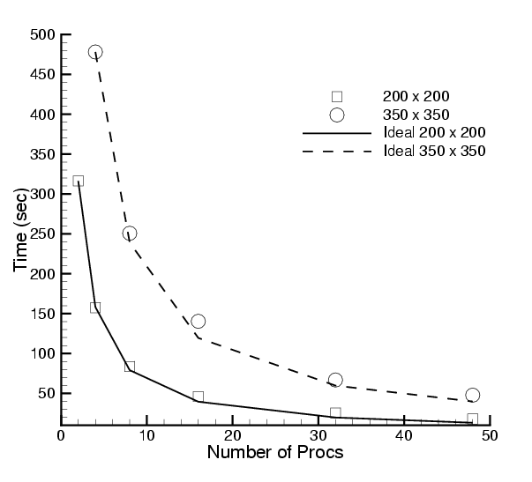
Scalability of Scientific Data Components in CFRFS Combustion Applications
Investigators: S. Lefantzi, J. Ray, and H. Najm (SNL)
Uses GrACEComponent, CvodesComponent, etc.
Shock-hydro code with no refinement
200 x 200 & 350 x 350 meshes
Cplant cluster
  400 MHz EV5 Alphas
  1 Gb/s Myrinet
Negligible component overhead
Worst perf : 73% scaling efficiency for 200x200 mesh on 48 procs
Reference: S. Lefantzi, J. Ray, and H. Najm, Using the Common Component Architecture to Design High Performance Scientific Simulation Codes, Proc of Int. Parallel and Distributed Processing Symposium, Nice, France, 2003, accepted.

Slide 29
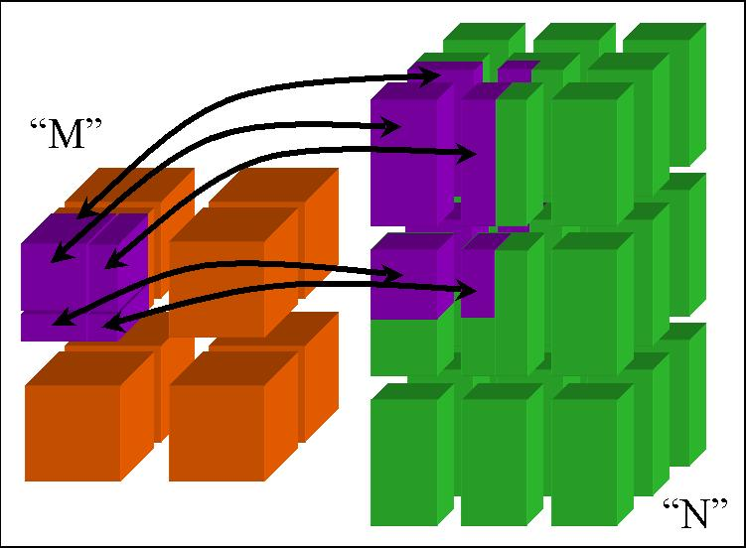
CCA Concepts:
MxN Parallel Data Redistribution
Share Data Among Coupled Parallel Models
  Disparate Parallel Topologies (M processes vs. N)
  e.g. Ocean & Atmosphere, Solver & Optimizer…
  e.g. Visualization (Mx1, increasingly, MxN)
Research area -- tools under development

Slide 30
CCA Concepts:
Language Interoperability
Existing language interoperability approaches are “point-to-point” solutions
Babel provides a unified approach in which all languages are considered peers
Babel used primarily at interfaces
f77
f77
C
f90
C
f90
Babel
C++
Python
C++
Python
Babel tutorial coming up!
Java
Java
Few other component models support all languages and data types important for scientific computing

Slide 31
What the CCA isn’t…
CCA doesn’t specify who owns “main”
  CCA components are peers
  Up to application to define component relationships
    “Driver component” is a common design pattern
CCA doesn’t specify a parallel programming environment
  Choose your favorite
  Mix multiple tools in a single application
CCA doesn’t specify I/O
  But it gives you the infrastructure to create I/O components
  Use of stdio may be problematic in mixed language env.
CCA doesn’t specify interfaces
  But it gives you the infrastructure to define and enforce them
  CCA Forum supports & promotes “standard” interface efforts
CCA doesn’t require (but does support) separation of algorithms/physics from data

Slide 32
What the CCA is…
CCA is a specification for a component environment
  Fundamentally, a design pattern
  Multiple “reference” implementations exist
  Being used by applications
CCA increases productivity
  Supports and promotes software interopability and reuse
  Provides “plug-and-play” paradigm for scientific software
CCA offers the flexibility to architect your application as you think best
  Doesn’t dictate component relationships, programming models, etc.
  Minimal performance overhead
  Minimal cost for incorporation of existing software
CCA provides an environment in which domain-specific application frameworks can be built
  While retaining opportunities for software reuse at multiple levels

Slide 33
Review of CCA Terms & Concepts
Ports
  Interfaces between components
  Uses/provides model
Framework
  Allows assembly of components into applications
Direct Connection
  Maintain performance of local inter-component calls
Parallelism
  Framework stays out of the way of parallel components
MxN Parallel Data Redistribution
  Model coupling, visualization, etc.
Language Interoperability
  Babel, Scientific Interface Definition Language (SIDL)

Slide 34
Summary
Components are a software engineering tool to help address software productivity and complexity
Important concepts: components, interfaces, frameworks, composability, reuse
Scientific component environments come in “domain specific” and “generic” flavors
Scientific HPC imposes special demands on component environments
  Which commodity tools may have trouble with
The Common Component Architecture is specially designed for the needs of HPC

