Slide 1
Welcome to the
Common Component Architecture
Tutorial
ACTS Workshop
8 August, 2003

Slide 2
Who Are We?
(And Where Did We Come From?)
ACTS Toolkit Interoperability Effort (Late 1990’s)
  Part of DOE 2000, Many Tool Integration Projects
    “One-to-One”, Leading to N² Solutions… ☹
Common Component Architecture Forum (1998)
  Goal: To Develop a General Interoperability Solution
  Grass Roots Effort to Explore High-Performance Components for Scientific Software
SciDAC Center for Component Technology for Terascale Simulation Software (CCTTSS, 2001)
  Part of New DOE Scientific Simulation Program
  Technology Development in Several Thrust Areas…

Slide 3
The Common Component Architecture
(CCA) Forum
Define Specifications for High-Performance Scientific Components & Frameworks
Promote and Facilitate Development of Domain-Specific “Standard” Interfaces
Goal: Interoperability between components developed by different expert teams across different institutions
Quarterly Meetings, Open membership…
Mailing List: cca-forum@cca-forum.org
http://www.cca-forum.org/
Notes:
CCA Forum
Who
Goals
Quarterly Meetings

Slide 4
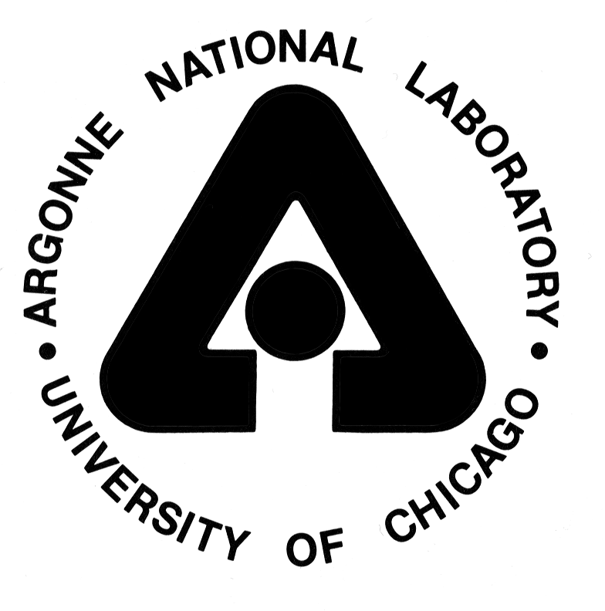







Center for Component Technology for Terascale Simulation Software (CCTTSS)
DOE SciDAC ISIC ($16M over 5 years)
  SciDAC = Scientific Discovery through Advanced Computing
  ISIC = Integrated Software Infrastructure Center
Subset of CCA Forum
Develop CCA technology from current prototype stage to full production environment
Increase understanding of how to use component architectures effectively in HPC environments
Participants: (Funded by the Office of Mathematical, Information and Computational Sciences (MICS) )
Lead PI: Rob Armstrong, SNL <rob@sandia.gov>
http://www.cca-forum.org/ccttss/
Notes:
CCTTSS
What & Who
SciDAC $$$

Slide 5
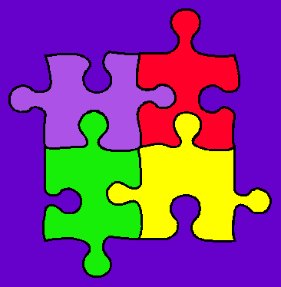
CCTTSS Research Thrust Areas and Main Working Groups
Scientific Components
  Scientific Data Objects
  Lois Curfman McInnes, ANL (curfman@mcs.anl.gov)
“MxN” Parallel Data Redistribution
  Jim Kohl, ORNL (kohlja@ornl.gov)
Frameworks
  Language Interoperability / Babel / SIDL
  Component Deployment / Repository
  Gary Kumfert, LLNL (kumfert@llnl.gov)
User Outreach
  David Bernholdt, ORNL (bernholdtde@ornl.gov)
Notes:
CCTTSS Research Thrusts
Scientific Components (incl Viz, Steer, FT)
Data & MxN
Frameworks
Language Interop / Babel / SIDL
User Outreach

Slide 6
Acknowledgements
CCA Forum Tutorial WG
  Rob Armstrong, David Bernholdt, Wael Elwasif, Lori Freitag, Dan Katz, Jim Kohl, Gary Kumfert, Lois Curfman McInnes, Boyana Norris, Craig Rasmussen, Jaideep Ray, Sameer Shende, Torsten Wilde, Shujia Zhou
  ANL, JPL, LANL, LLNL, NASA/Goddard, ORNL, SNL, U Oregon
And many more contributing to CCA itself…
  ANL - Kate Keahey, Jay Larson, Ray Loy, Lois Curfman McInnes, Boyana Norris, …
  Indiana University - Randall Bramley, Dennis Gannon, …
  JPL – Dan Katz, …
  LANL - Craig Rasmussen, Matt Sotille, …
  LLNL - Tom Epperly, Scott Kohn, Gary Kumfert, …
  NASA/Goddard – Shujia Zhou
  ORNL - David Bernholdt, Wael Elwasif, Jim Kohl, Torsten Wilde, …
  PNNL - Jarek Nieplocha, Theresa Windus, …
  SNL - Rob Armstrong, Ben Allan, Lori Freitag Diachin, Curt Janssen, Jaideep Ray, …
  University of Oregon – Allen Maloney, Sameer Shende, …
  University of Utah - Steve Parker, …
  And others as well …

Slide 7
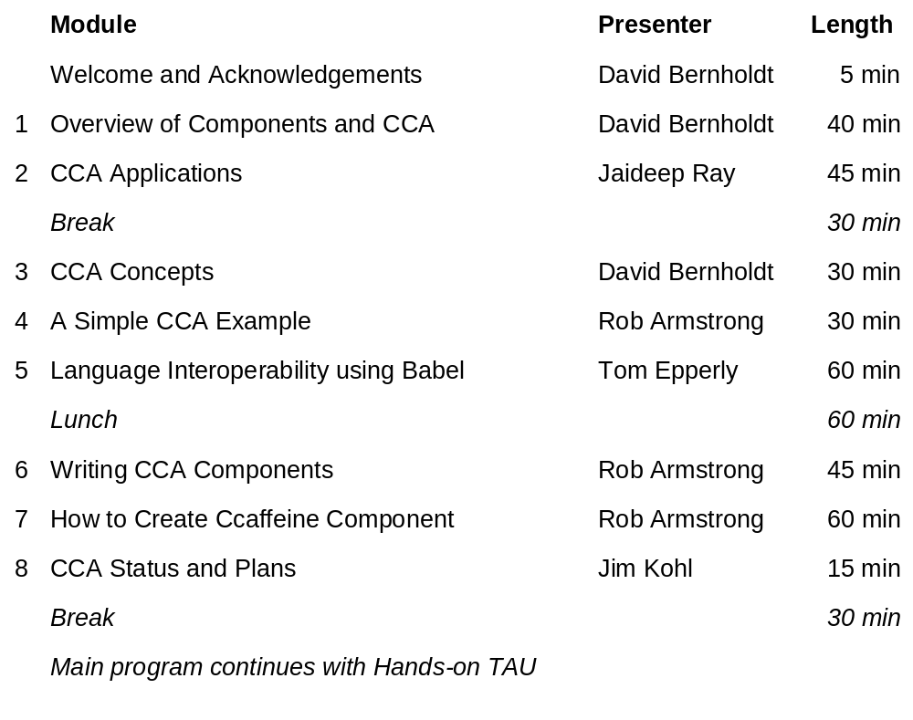
Agenda

