Slide 1
Welcome to the
Common Component Architecture
Tutorial
ACTS Workshop
26 August 2005

Slide 2
Licensing Information
This tutorial is distributed under the Creative Commons Attribution 2.5 License
  http://creativecommons.org/licenses/by/2.5/
In summary, you are free:
  to copy, distribute, display, and perform the work
  to make derivative works
  to make commercial use of the work
Under the following conditions:
  Attribution. You must attribute the work in the manner specified by the author or licensor.
For any reuse or distribution, you must make clear to others the license terms of this work.
Any of these conditions can be waived if you get permission from the copyright holder.
Your fair use and other rights are in no way affected by the above.
Requested reference:
  CCA Forum Tutorial Working Group, Common Component Architecture Tutorial, 2005, http://www.cca-forum.org/tutorials/

Slide 3
Agenda & Table of Contents
Time | Title | Slide No. | Presenter
11:00-11:05am | Welcome | 1 | David Bernholdt, ORNL
11:05am-12:00n | What can Component Technology do for Scientific Computing | 5 | David Bernholdt, ORNL
 | An Introduction to Components & the CCA | 16 | David Bernholdt, ORNL
12:00-12:30pm | CCA Tools | 64 | Jim Kohl, ORNL
12:30-1:30pm | Lunch
1:30-2:10pm | Language Interoperable CCA Components with Babel | 105 | Jim Leek, LLNL
2:10-2:55pm | CCA Applications | 123 | Jaideep Ray, SNL
2:55-3:00pm | Closing | 169 | Jaideep Ray, SNL
3:00-3:30pm | Break (relocate to Wheeler Hall, UCB)
3:30-6:30pm | Hands-On | Hands-On Guide | All

Slide 4
The Common Component Architecture
(CCA) Forum
Combination of standards body and user group for the CCA
Define Specifications for High-Performance Scientific Components & Frameworks
Promote and Facilitate Development of Domain-Specific Common Interfaces
Goal: Interoperability between components developed by different expert teams across different institutions
Quarterly Meetings, Open membership…
Mailing List: cca-forum@cca-forum.org
http://www.cca-forum.org/
Notes:
CCA Forum
Who
Goals
Quarterly Meetings

Slide 5
What Can Component Technology do for Scientific Computing?

Slide 6
Managing Code Complexity
Some Common Situations:
Your code is so large and complex it has become fragile and hard to keep running
You have a simple code, and you want to extend its capabilities – rationally
You want to develop a computational “toolkit”
  Many modules that can be assembled in different ways to perform different scientific calculations
  Gives users w/o programming experience access to a flexible tool for simulation
  Gives users w/o HPC experience access to HPC-ready software
How CCA Can Help:
Components help you think about software in manageable chunks that interact only in well-defined ways
Components provide a “plug-and-play” environment that allows easy, flexible application assembly

Slide 7
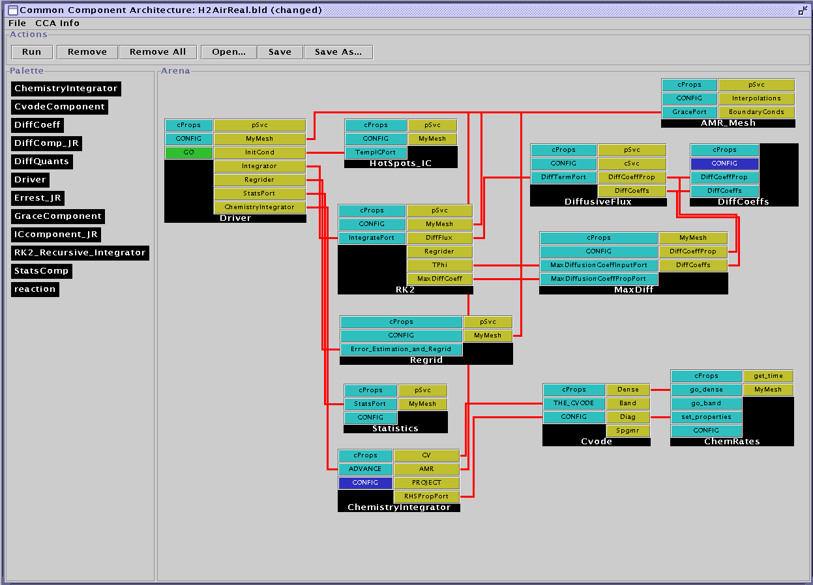
Example: Computational Facility for Reacting Flow Science (CFRFS)
A toolkit to perform simulations of unsteady flames
Solve the Navier-Stokes with detailed chemistry
  Various mechanisms up to ~50 species, 300 reactions
  Structured adaptive mesh refinement
CFRFS today:
  61 components
  7 external libraries
  9 contributors
“Wiring diagram” for a typical CFRFS simulation, utilizing 12 components.
CCA tools used: Ccaffeine, and ccafe-gui
Languages: C, C++, F77

Slide 8
Helping Groups Work with Software
Some Common Situations:
Many (geographically distributed) developers creating a large software system
  Hard to coordinate, different parts of the software don’t work together as required
Groups of developers with different specialties
Forming communities to standardize interfaces or share code
How CCA Can Help:
Components are natural units for
  Expressing software architecture
  Individuals or small groups to develop
  Encapsulating particular expertise
Some component models (including CCA) provide tools to help you think about the interface separately from the implementation

Slide 9
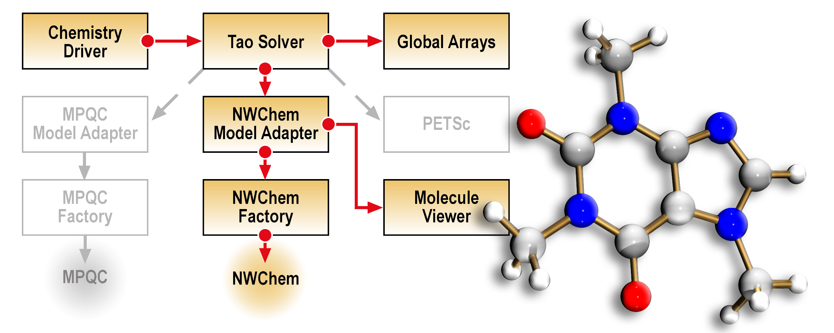
Example: Quantum Chemistry
Integrated state-of-the-art optimization technology into two quantum chemistry packages to explore effectiveness in chemistry applications
Geographically distributed expertise:
  California - chemistry
  Illinois - optimization
  Washington – chemistry, parallel data management
Effective collaboration with minimal face-to-face interaction
Schematic of CCA-based molecular structure determination quantum chemistry application.
Components based on: MPQC, NWChem (quantum chem.), TAO (optimization), Global Arrays, PETSc (parallel linear algebra)
CCA tools used: Babel, Ccaffeine, and ccafe-gui
Languages: C, C++, F77, Python

Slide 10
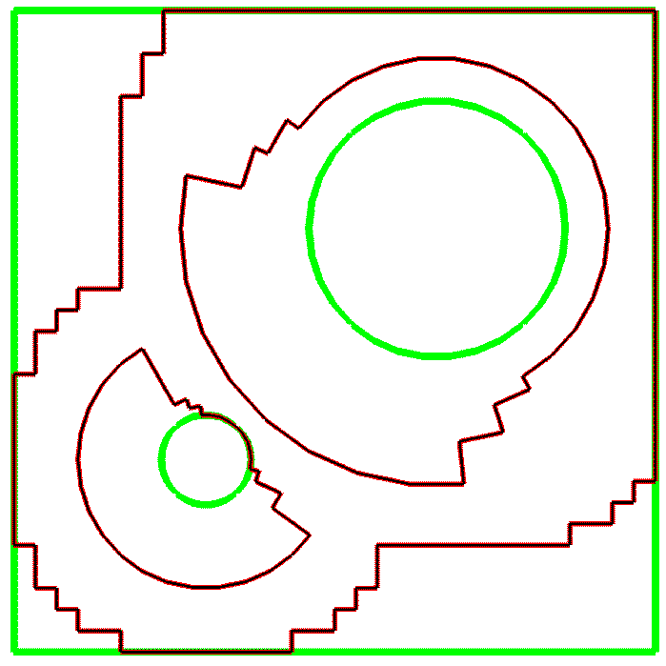
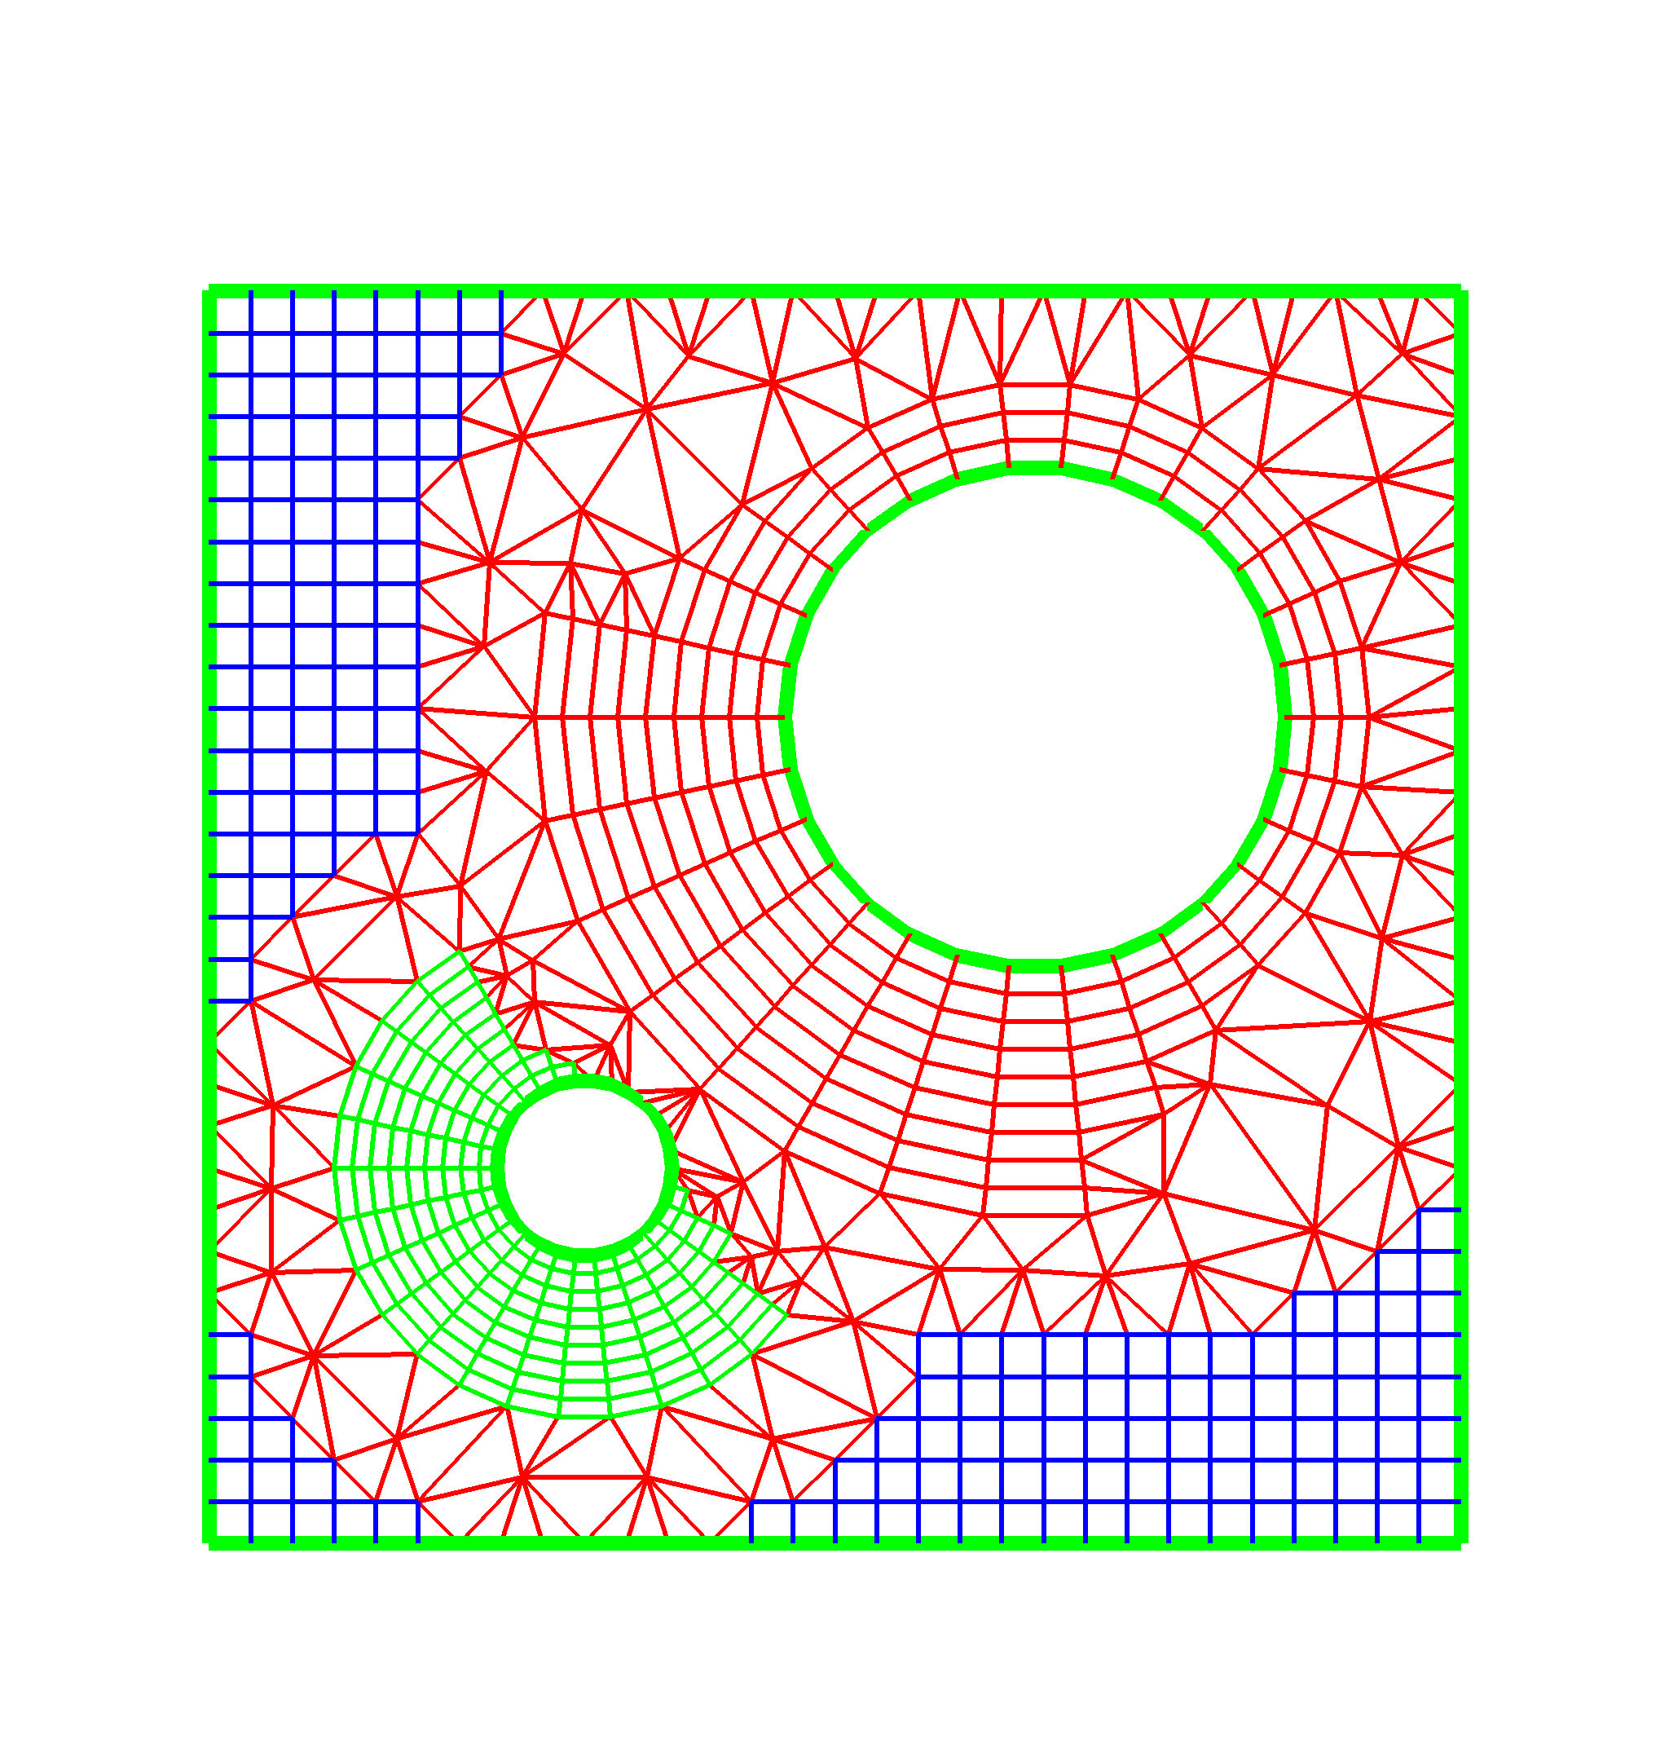
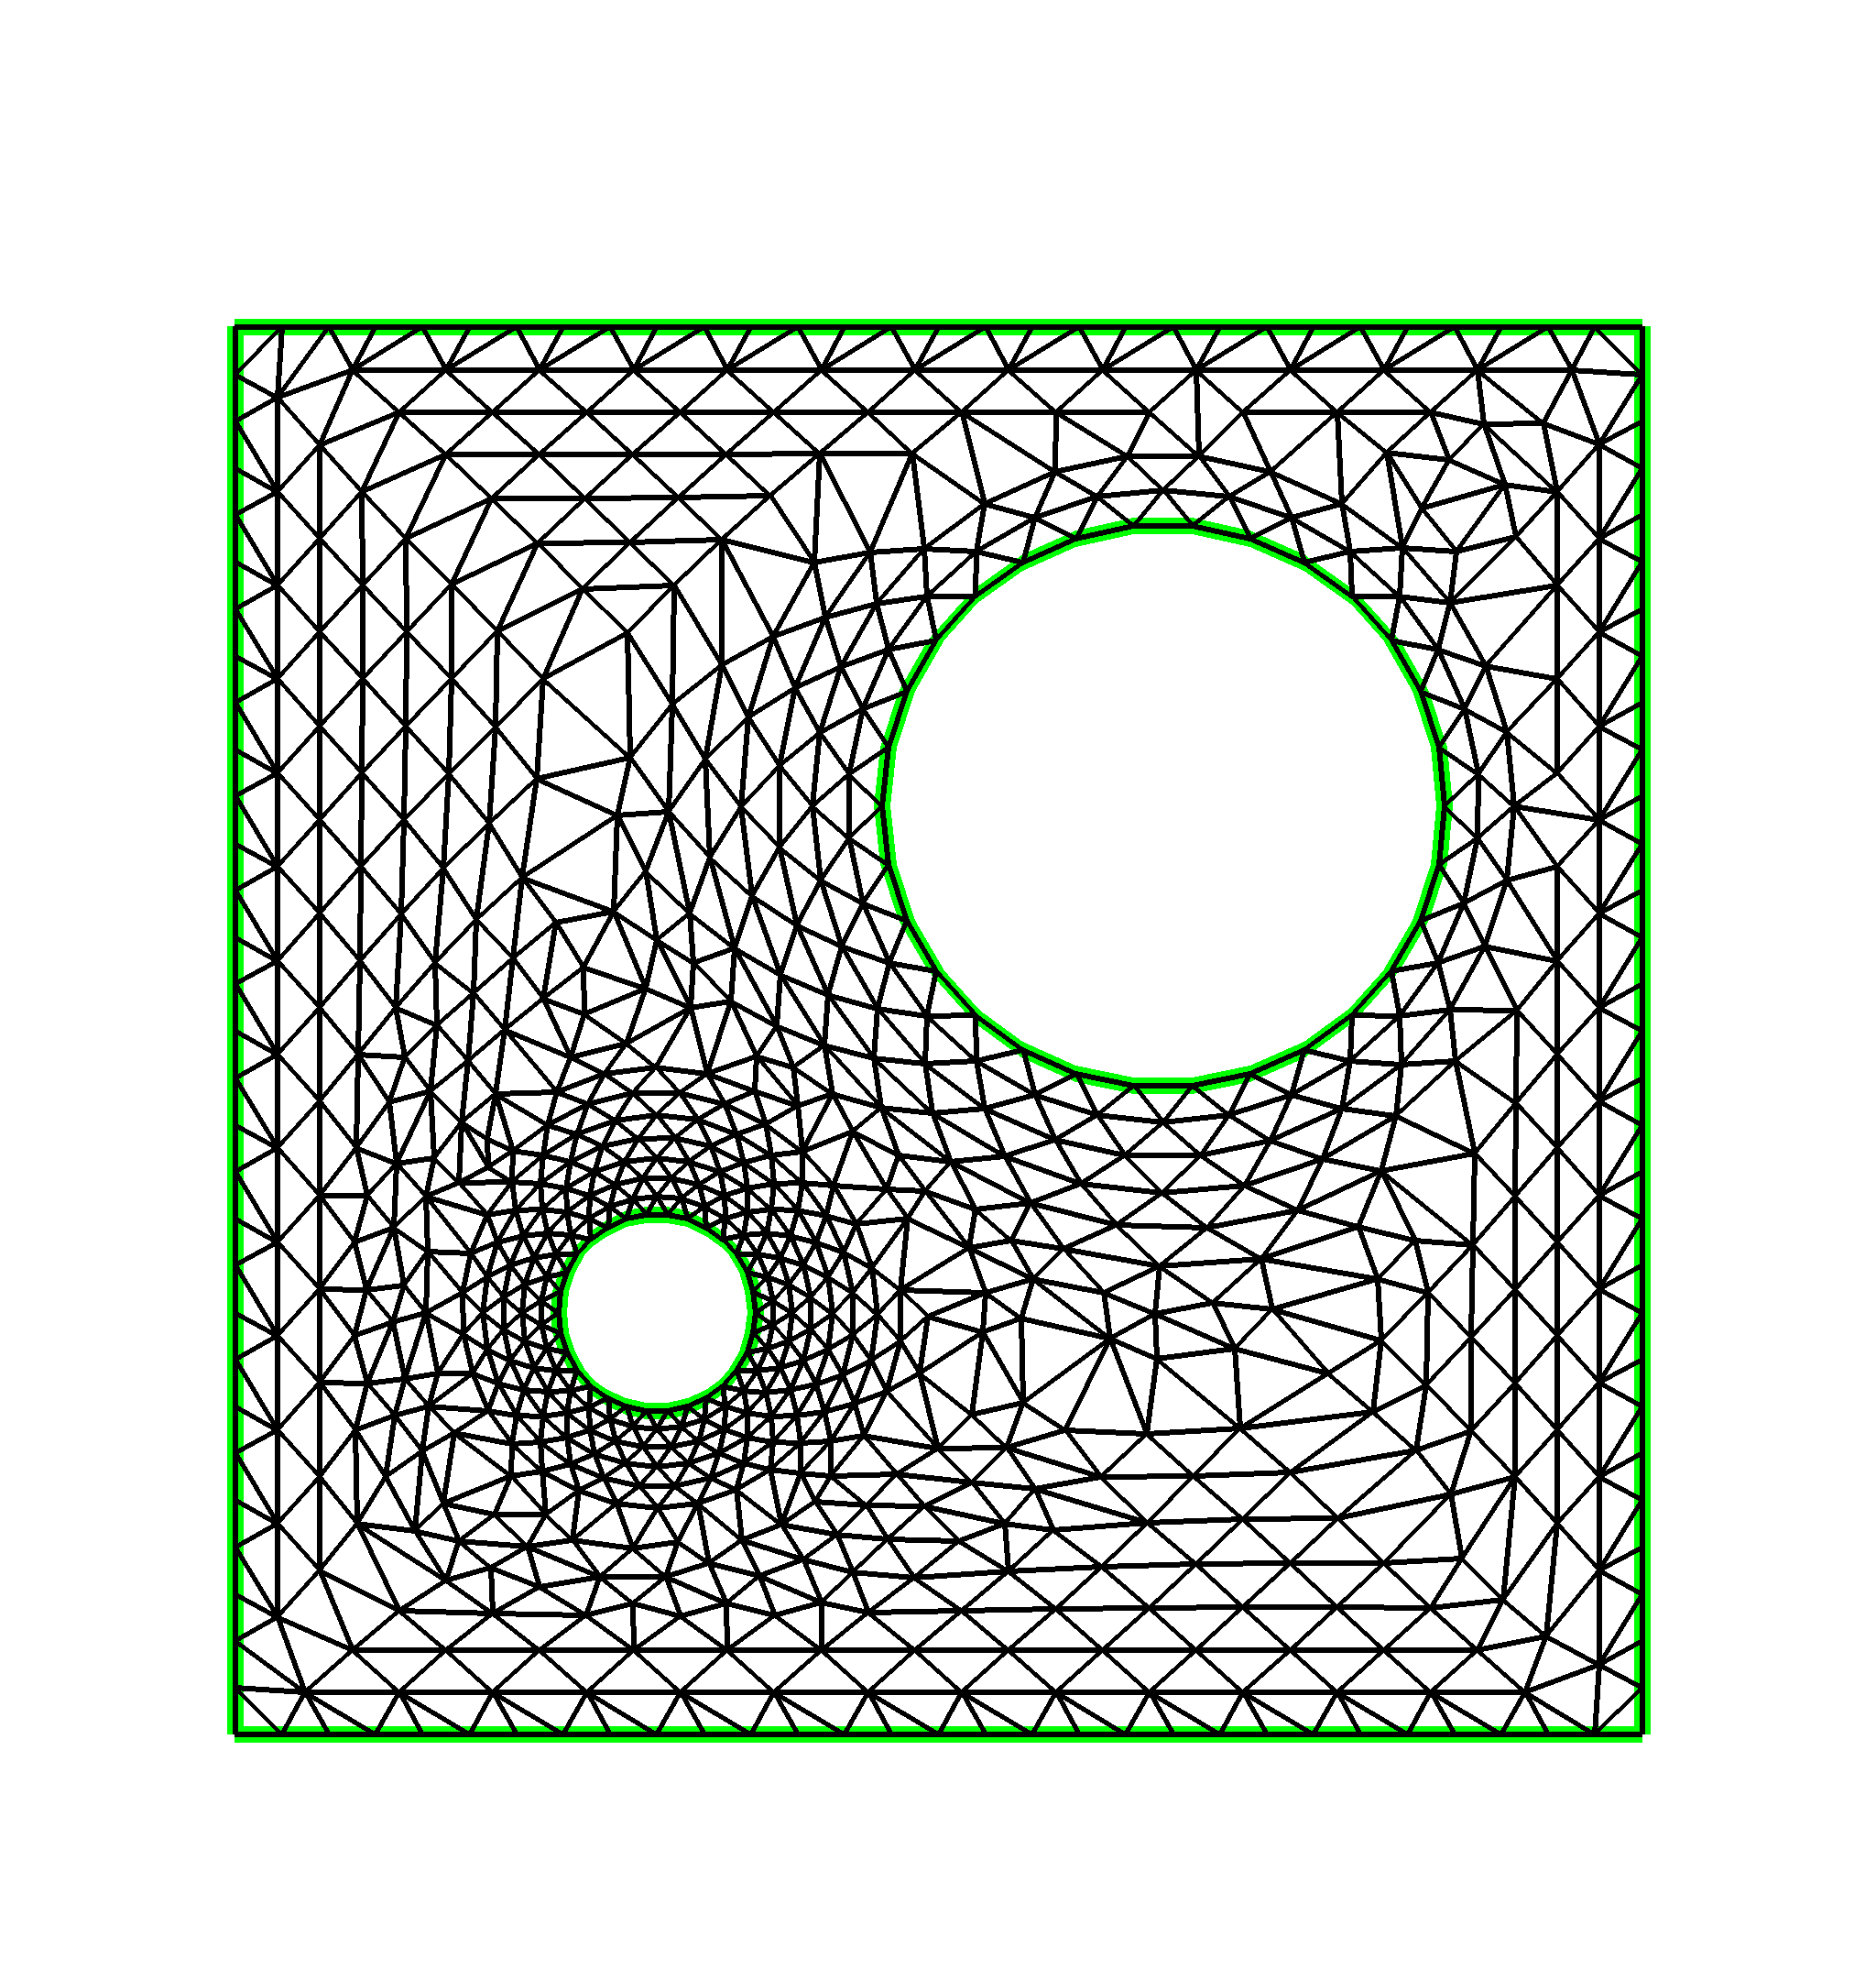
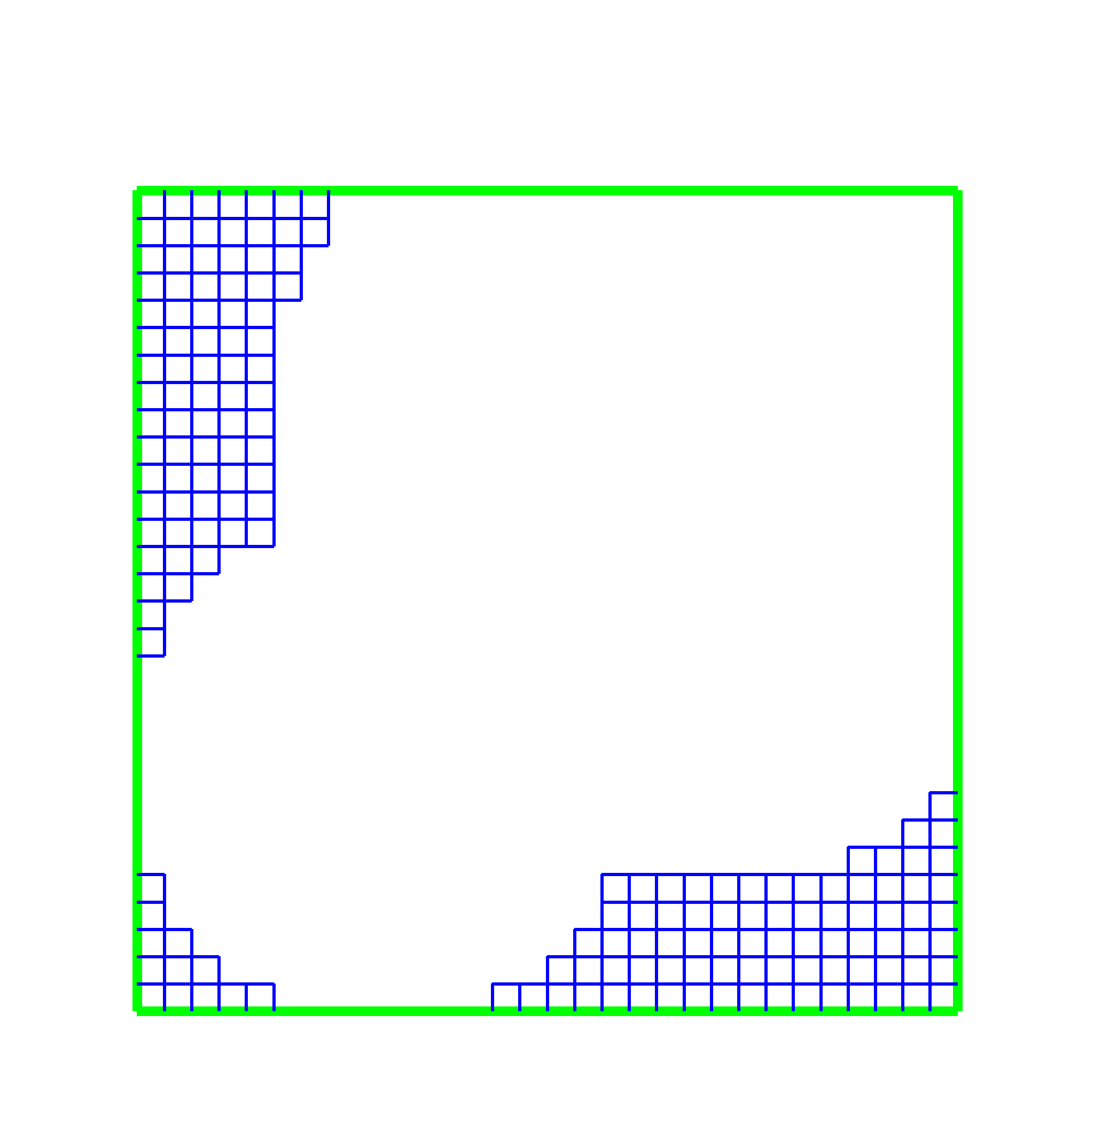
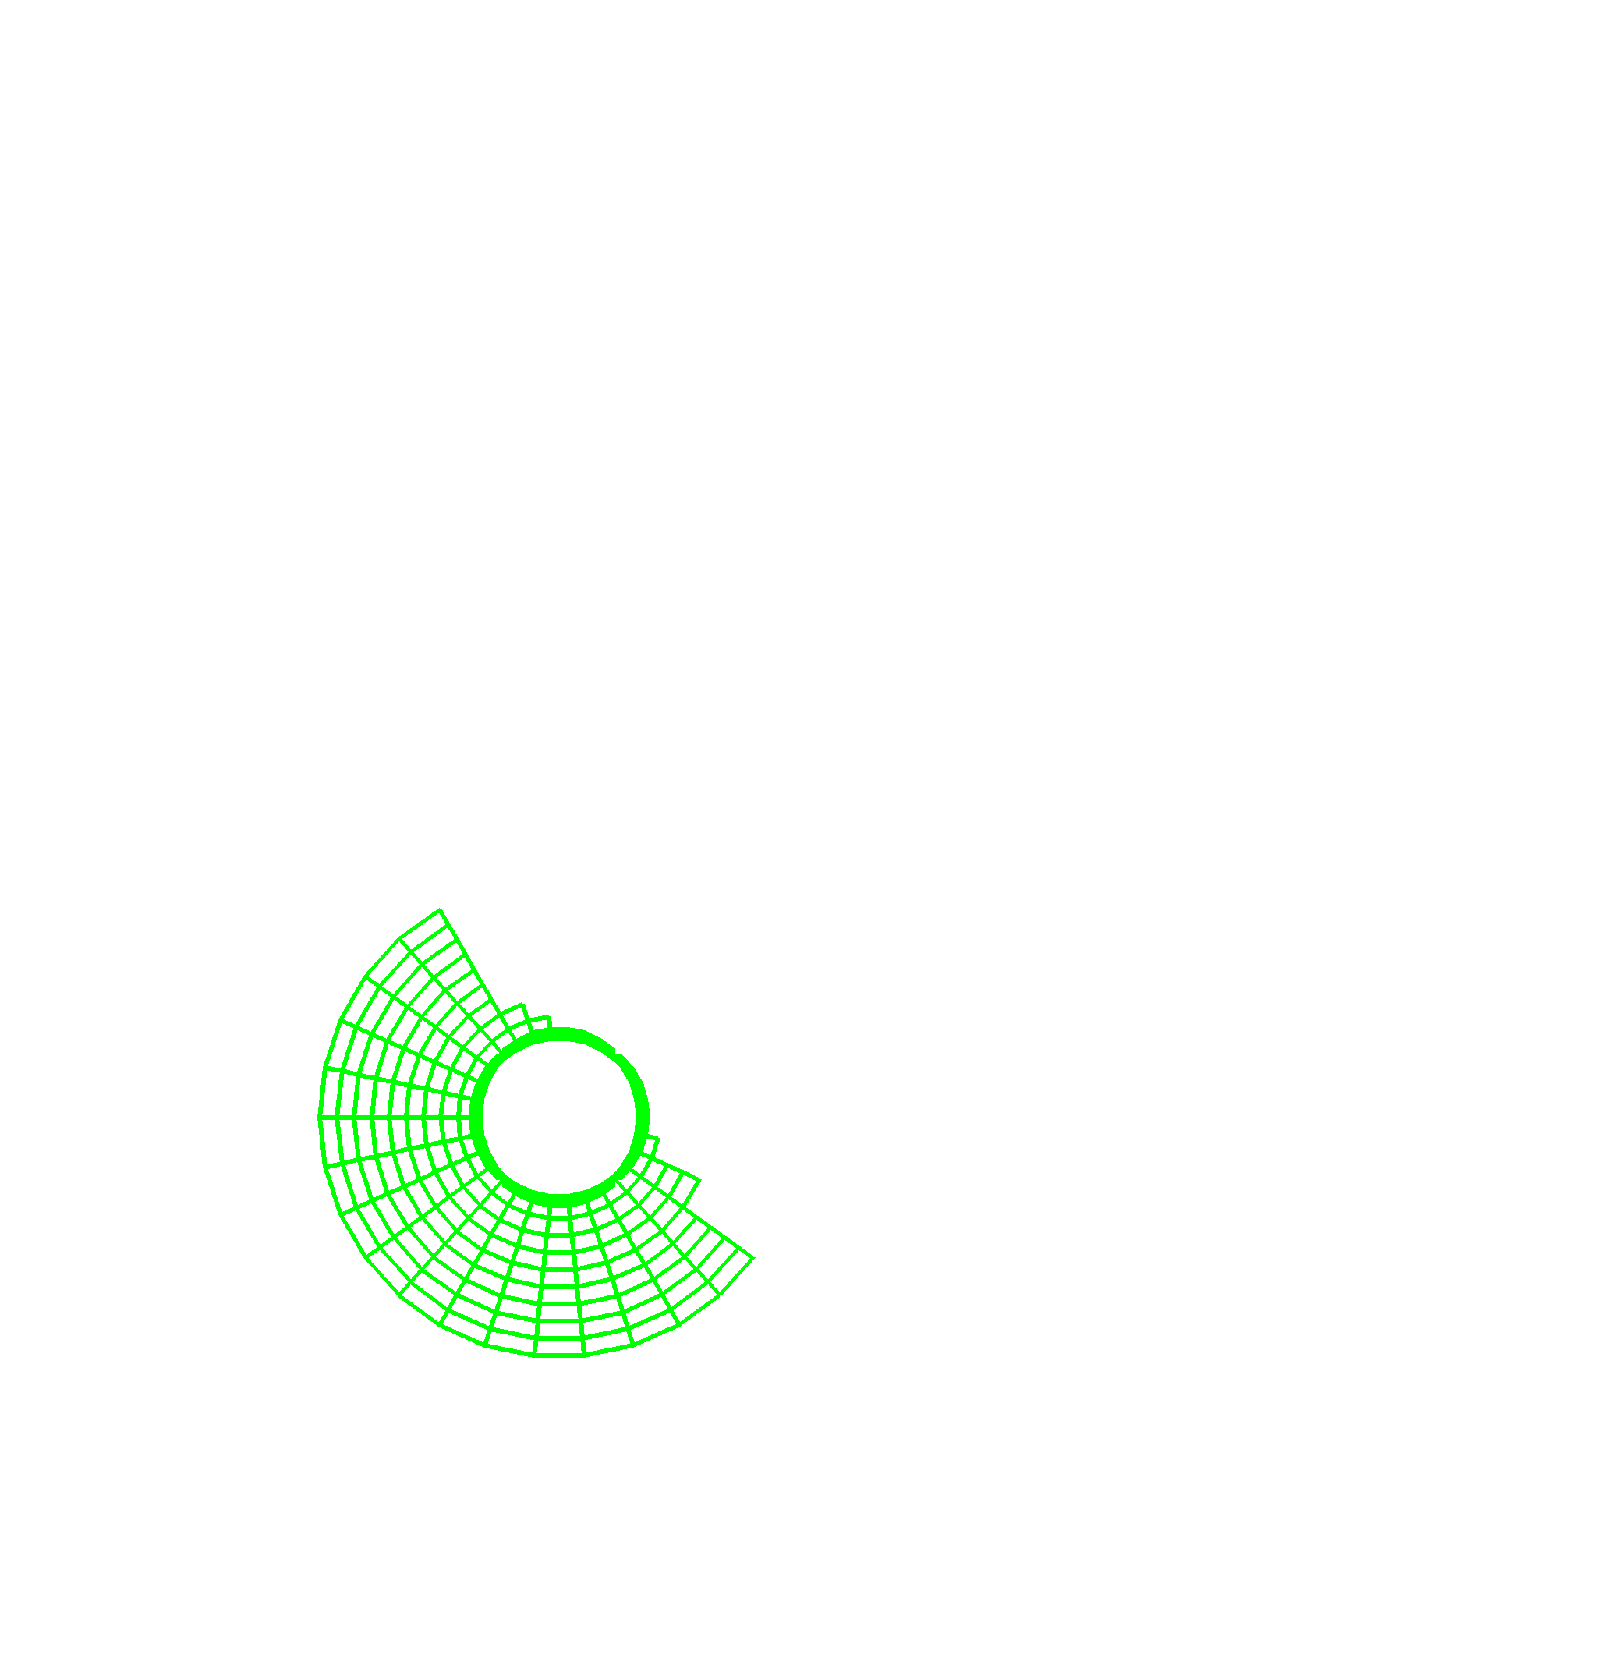
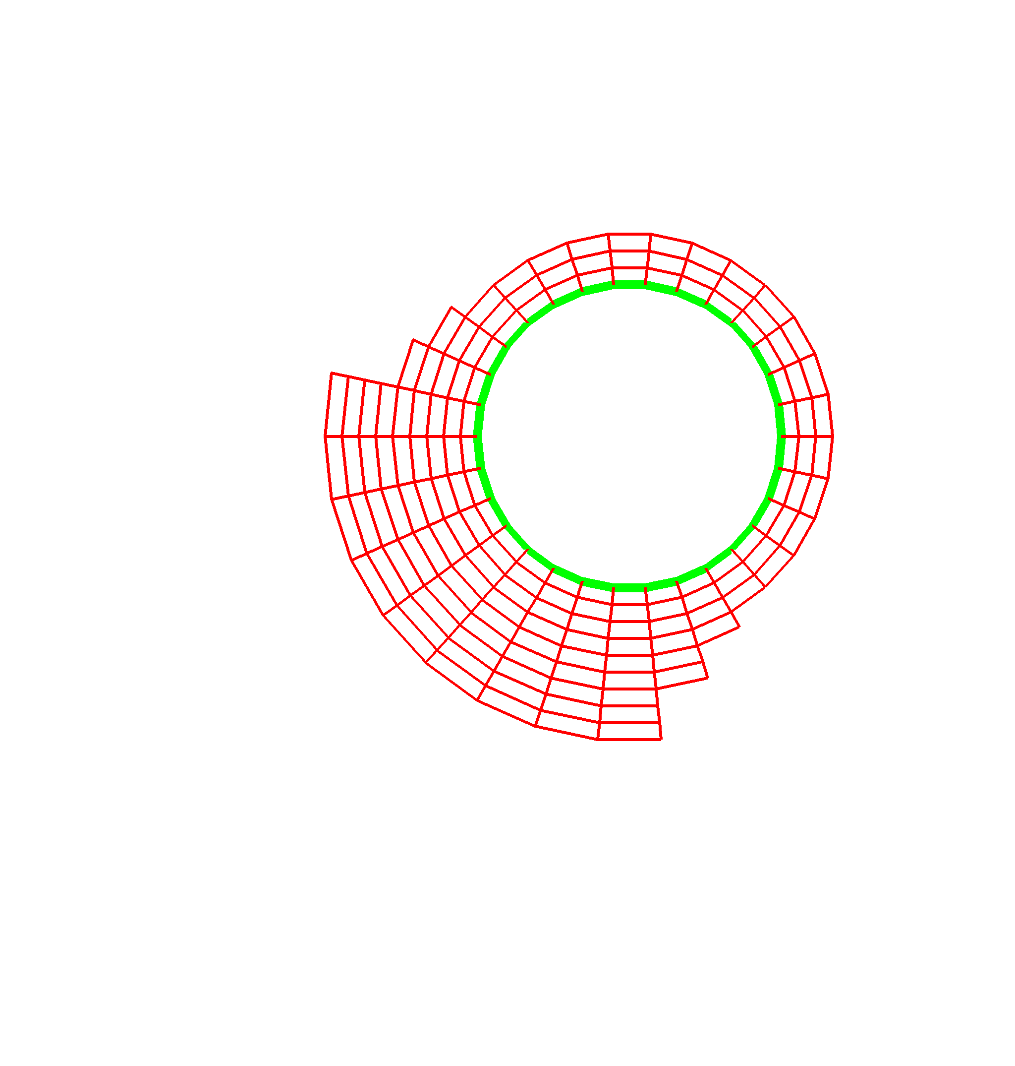
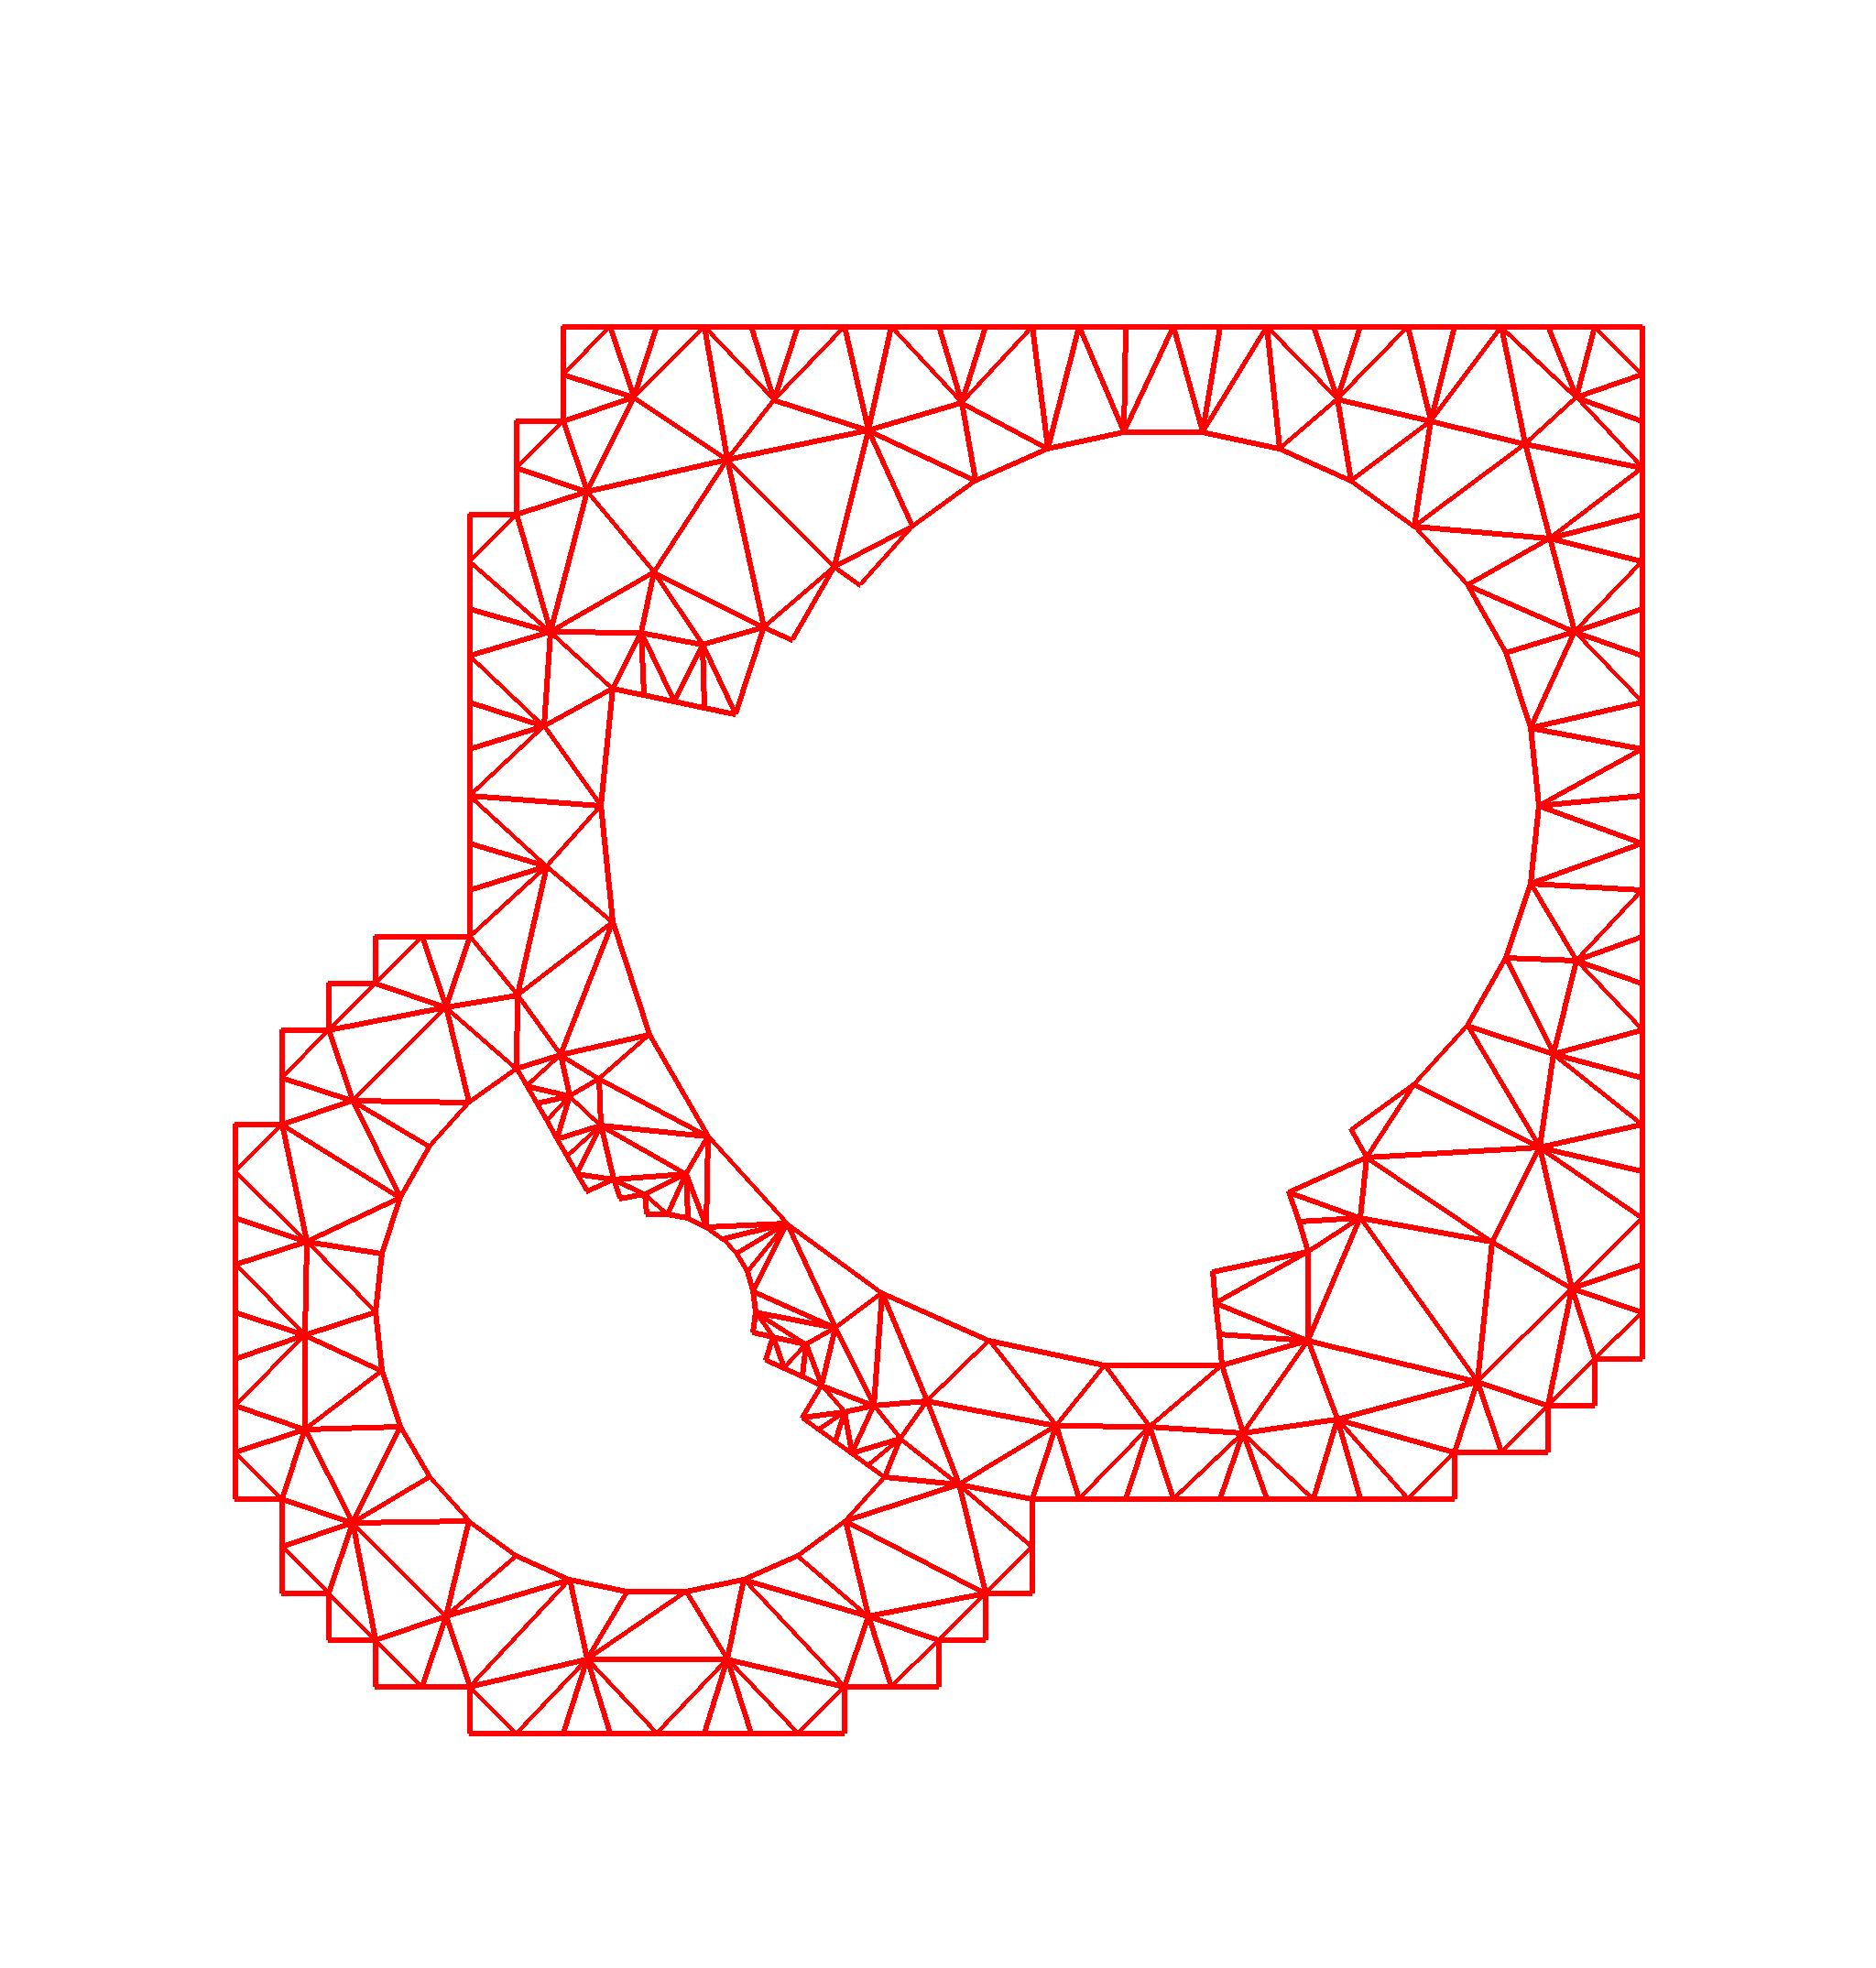
Example: TSTT Unstructured Mesh Tool Interoperability
Geometry
Information
(Level A)
Common interface for unstructured mesh geometry and topology
  7 libraries: FMDB, Frontier, GRUMMP, Mesquite, MOAB, NWGrid, Overture
  6 institutions: ANL, BNL/SUNY-Stony Brook, LLNL, PNNL, RPI, SNL
Reduces need for N² pairwise interfaces to just N
Full
Geometry
Meshes
(Level B)
Mesh
Components
(Level C)
Illustration of geometry domain hierarchy used in TSTT mesh interface.
CCA tools used: Babel (SIDL), Chasm
Library languages: C, C++, F77, F90

Slide 11
Language Interoperability
Some Common Situations:
Need to use existing code or libraries written in multiple languages in the same application?
Want to allow others to access your library from multiple languages?
Technical or sociological reasons for wanting to use multiple languages in your application?
How CCA Can Help:
Some component models (including CCA) allow transparent mixing of languages
Babel (CCA’s language interop. tool) can be used separately from other component concepts

Slide 12

Examples
hypre
High performance preconditioners and linear solvers
Library written in C
Babel-generated object-oriented interfaces provided in C, C++, Fortran
LAPACK07
Update to LAPACK linear algebra library
  To be released 2007
  Library written in F77, F95
Will use Babel-generated interfaces for: C, C++, F77, F95, Java, Python
Possibly also ScaLAPACK (distributed version)
“I implemented a Babel-based interface for the hypre library of linear equation solvers. The Babel interface was straightforward to write and gave us interfaces to several languages for less effort than it would take to interface to a single language.”
-- Jeff Painter, LLNL. 2 June 2003
CCA tools used: Babel, Chasm

Slide 13
Coupling Codes
Some Common Situations:
Your application makes use of numerous third-party libraries
  Some of which interact (version dependencies)
You want to develop a simulation in which your code is coupled with others
  They weren’t designed with this coupling in mind
  They must remain usable separately too
  They are all under continual development, individually
  They’re all parallel and need to exchange data frequently
How CCA Can Help:
Components are isolated from one another
  Interactions via well-defined interfaces
  An application can include multiple versions of a component
Components can be composed flexibly, hierarchically
  Standalone application as one assembly, coupled simulation as another
CCA can be used in SPMD, MPMD, and distributed styles of parallel computing
CCA is developing technology to facilitate data and functional coupling of parallel applications

Slide 14

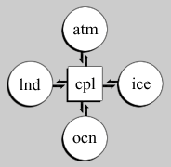
Example: Global Climate Modeling and the Model Coupling Toolkit (MCT)
MCT is the basis for Community Climate System Model (CCSM3.0) coupler (cpl6)
Computes interfacial fluxes and manages redistribution of data among parallel processes
Written in F90, Babel-generated bindings for C++, Python
CCA tools used: Babel, Chasm
Schematic of CCSM showing coupler managing data exchanges between atmosphere, sea ice, ocean, and land models.
(From http://www.ccsm.ucar.edu/models/ccsm3.0/cpl6/)

Slide 15
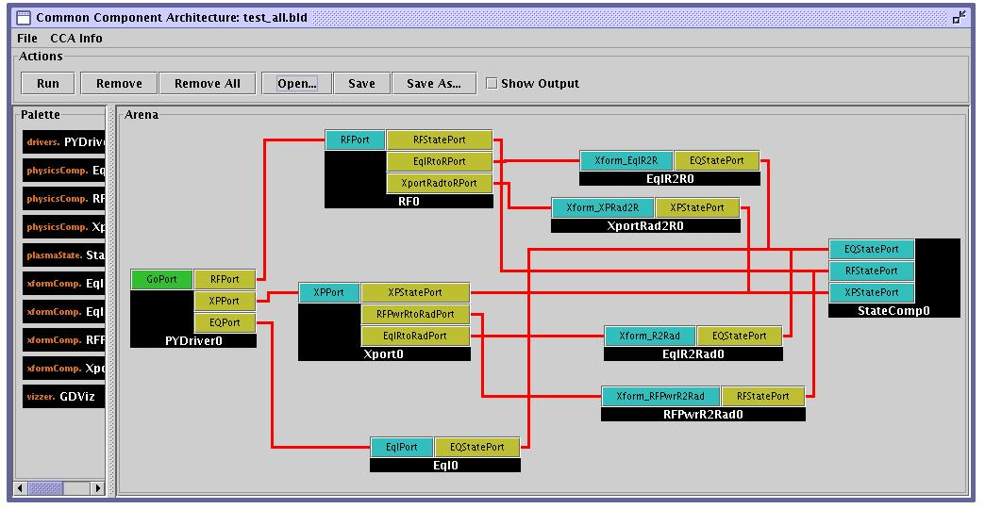
Example: Integrated Fusion Simulation
Proof-of-principle of using CCA for integrated whole-device modeling needed for the ITER fusion reactor
Couples radio frequency (RF) heating of plasma with transport modeling
Coarse-grain encapsulation of pre-existing programs
Follow-on plans for RF, transport, and magneto-hydrodynamics
“Wiring diagram” for integrated fusion simulation.
Components based on: AORSA, Houlberg’s transport library
New components: Driver, State
CCA tools used: Babel, Chasm, Ccaffeine, ccafe-gui
Languages: C++, F90, Python

Slide 16
An Introduction to Components and the
Common Component Architecture

Slide 17
Goals of This Module
Introduce basic concepts and vocabulary of component-based software engineering and the CCA
Highlight the special demands of high-performance scientific computing on component environments
Give you sufficient understanding of the CCA to begin evaluating whether it would be useful to you

Slide 18
What are Components?
No universally accepted definition in computer science research, but key features include…
A unit of software development/deployment/reuse
  i.e. has interesting functionality
  Ideally, functionality someone else might be able to (re)use
  Can be developed independently of other components
Interacts with the outside world only through well-defined interfaces
  Implementation is opaque to the outside world
Can be composed with other components
  “Plug and play” model to build applications
  Composition based on interfaces

Slide 19
What is a Component Architecture?
A set of standards that allows:
  Multiple groups to write units of software (components)…
  And have confidence that their components will work with other components written in the same architecture
These standards define…
  The rights and responsibilities of a component
  How components express their interfaces
  The environment in which components are composed to form an application and executed (framework)
  The rights and responsibilities of the framework
Notes:
Followup on Cheesman and Daniels specifying a component architecture.
One really shouldn’t think of components alone, it is the complete environment/architecture

Slide 20
A Simple Example:
Numerical Integration Components
•
Interoperable components (provide same interfaces)
FunctionPort
IntegratorPort
FunctionPort
NonlinearFunction
MidpointIntegrator
FunctionPort
GoPort
IntegratorPort
LinearFunction
Driver
FunctionPort
IntegratorPort
FunctionPort
PiFunction
RandomGeneratorPort
MonteCarloIntegrator
RandomGeneratorPort
RandomGenerator
Notes:
A bunch of components that we’ll see throughout the tutorial
The driver’s job is merely to invoke the integrator and print out the result
We have two different integrators (and of course you could have many more)
One uses the simple midpoint integration rule
The other is based on the Monte Carlo approach, so it requires a random number generator in addition to the function to be integrated
On the right are several functions we might want to integrate, as well as a random number generator

Slide 21
An Application
Built from the Provided Components
FunctionPort
IntegratorPort
FunctionPort
NonlinearFunction
MidpointIntegrator
FunctionPort
GoPort
IntegratorPort
LinearFunction
Driver
FunctionPort
IntegratorPort
FunctionPort
PiFunction
Hides compexity: Driver doesn’t care that MonteCarloIntegrator needs a random number generator
RandomGeneratorPort
MonteCarloIntegrator
RandomGeneratorPort
RandomGenerator
Notes:
To build a particular application from the components, we connect ports. In this case, we will integrate a function that should give us pi using the Monte Carlo approach.
Creating a valid application depends on connecting up ports according to their semantics, not on simply connecting every possible port. Components may, for example, offer alternative interfaces to accomplish the same task. Or some interfaces might be used only for debugging, performance monitoring, or other purposes.

Slide 22
Another Application…
FunctionPort
IntegratorPort
FunctionPort
NonlinearFunction
MidpointIntegrator
FunctionPort
GoPort
IntegratorPort
LinearFunction
Driver
FunctionPort
IntegratorPort
FunctionPort
PiFunction
RandomGeneratorPort
MonteCarloIntegrator
RandomGeneratorPort
RandomGenerator
Notes:
All we’ve done here is change to integrating a different function

Slide 23
Application 3…
FunctionPort
IntegratorPort
FunctionPort
NonlinearFunction
MidpointIntegrator
FunctionPort
GoPort
IntegratorPort
LinearFunction
Driver
FunctionPort
IntegratorPort
FunctionPort
PiFunction
RandomGeneratorPort
MonteCarloIntegrator
RandomGeneratorPort
RandomGenerator
Notes:
Here we’ve changed integrators and functions

Slide 24
And Many More…
Dashed lines indicate alternate connections
FunctionPort
IntegratorPort
FunctionPort
NonlinearFunction
MidpointIntegrator
FunctionPort
GoPort
IntegratorPort
LinearFunction
Driver
FunctionPort
IntegratorPort
FunctionPort
PiFunction
RandomGeneratorPort
MonteCarloIntegrator
RandomGeneratorPort
Create different applications in "plug-and-play" fashion
RandomGenerator

Slide 25
Be Aware: “Framework” Describes Many Things
Currently in scientific computing, this term often means different things to different people
Basic software composition environment
  Examples: CCA, CORBA Component Model, …
An environment facilitating development of applications in a particular scientific domain (i.e. fusion, computational chemistry, …)
  Example: Earth System Modeling Framework, http://www.esmf.ucar.edu
  Example: Computational Facility for Reacting Flow Science, http://cfrfs.ca.sandia.gov
An environment for managing complex workflows needed to carry out calculations
  Example: Kepler: http://kepler-project.org
Integrated data analysis and visualization environments (IDAVEs)
Lines are often fuzzy
  Example: Cactus, http://www.cactuscode.org
Others types of frameworks could be built based on a basic software composition environment

Slide 26
Relationships:
Components, Objects, and Libraries
Components are typically discussed as objects or collections of objects
  Interfaces generally designed in OO terms, but…
  Component internals need not be OO
  OO languages are not required
Component environments can enforce the use of published interfaces (prevent access to internals)
  Libraries can not
It is possible to load several instances (versions) of a component in a single application
  Impossible with libraries
Components must include some code to interface with the framework/component environment
  Libraries and objects do not

Slide 27
What is the CCA?
Component-based software engineering has been developed in other areas of computing
  Especially business and internet
  Examples: CORBA Component Model, COM, Enterprise JavaBeans
Many of the needs are similar to those in HPC scientific computing
But scientific computing imposes special requirements not common elsewhere
CCA is a component environment specially designed to meet the needs of HPC scientific computing

Slide 28
Special Needs of Scientific HPC
Support for legacy software
  How much change required for component environment?
Performance is important
  What overheads are imposed by the component environment?
Both parallel and distributed computing are important
  What approaches does the component model support?
  What constraints are imposed?
  What are the performance costs?
Support for languages, data types, and platforms
  Fortran?
  Complex numbers? Arrays? (as first-class objects)
  Is it available on my parallel computer?

Slide 29
CCA as Actual Code
We have developed an environment which implements the CCA design pattern
The CCA specification defines standard interfaces to be used by components and frameworks, and the protocol by which components and frameworks interact
A suite of tools that allow you to write and use components
  Language interoperability tools: Chasm, Babel
  Frameworks: Ccaffeine, SCIRun2, XCAT-C++
You do not have to use our tools
  You can create your own
  You can adapt ours for special needs

Slide 30
A Word About the CCA Specification
The CCA spec is currently defined using the Scientific Interface Definition Language (SIDL)
  SIDL is also used by the Babel language interoperability tool
The CCA spec could be translated into other languages if desired
  It was defined in C++ before SIDL was mature
We use the term “CCA compliant” to designate things that conform to any reasonable translation of the CCA spec
  The CCA Forum is considering refining the terminology to express different categories or levels of interoperability

Slide 31

CCA Concepts:
Language Interoperability
Most language interoperability approaches are “point-to-point” solutions
Babel provides a common solution for all supported languages
Scientific Definition Interface Language (SIDL) used to express interfaces
f77
C
f90
f77
C++
Python
C
f90/95
Java
C++
Python
Few other component models support all languages and data types important for scientific computing
More on Babel later!
Java

Slide 32
CCA Concepts: Components
IntegratorPort
FunctionPort
FunctionPort
MidpointIntegrator
NonlinearFunction
A component encapsulates some computational functionality
Components provide/use one or more interfaces
  A component with no interfaces is formally okay, but isn’t very interesting or useful
In SIDL, a component is a class that implements (inherits from) gov.cca.Component
  This means it must implement the setServices method to tell framework what ports this component will provide and use
  gov.cca.Component is defined in the CCA specification

Slide 33
CCA Concepts: Ports
IntegratorPort
FunctionPort
FunctionPort
MidpointIntegrator
NonlinearFunction
Components interact through well-defined interfaces, or ports
  A port expresses some computational functionality
  In Fortran, a port is a bunch of subroutines or a module
  In OO languages, a port is a abstract class or interface
Ports and connections between them are a procedural (caller/callee) relationship, not dataflow!
  e.g., FunctionPort could contain: evaluate(in Arg, out Result)
A single component can implement multiple ports
  Different “views” of the same functionality
  Related pieces of functionality
Multiple components can implement the same port
  Different implementations of the same functionality
  Basis for interoperability of component software
Notes:
The cartoon is a schematic representation of two components connected to each other. The representation mimics that used in the original GUI for the Ccaffeine framework. Uses ports are shown on the left side of the component, provides ports on the right. They are shown in different colors to help distinguish them.
The MidpointIntegrator component has two ports. It provides an IntegratorPort and uses a FunctionPort. The NonlinearFunction component provides a FunctionPort. The red line connects the user FunctionPort on MidpointIntegrator to the provider FunctionPort on NonlinearFunction.
Another way to think of user/provider is client/server
To repeat: connecting ports does not imply direction of data movement!

Slide 34
CCA Concepts: Provides Ports
IntegratorPort
FunctionPort
FunctionPort
MidpointIntegrator
NonlinearFunction
Components may provide ports – implement the class or subroutines of the port ( )
In SIDL, ports are interfaces that extend (inherit from) gov.cca.Port
  gov.cca.Port is defined in the CCA spec and has no methods – simply allows manipulation as a port, enables plug-and-play
In SIDL, a component that provides a port must implement (inherit from) the port’s interface
  These are usually defined by software developers, not in the CCA specification.
  gov.cca.ports.GoPort and gov.cca.ComponentRelease are two special cases – they are defined by the CCA specification, and thus have special meaning
“Provides” Port
Notes:
The cartoon is a schematic representation of two components connected to each other. The representation mimics that used in the original GUI for the Ccaffeine framework. Uses ports are shown on the left side of the component, provides ports on the right. They are shown in different colors to help distinguish them.
The MidpointIntegrator component has two ports. It provides an IntegratorPort and uses a FunctionPort. The NonlinearFunction component provides a FunctionPort. The red line connects the user FunctionPort on MidpointIntegrator to the provider FunctionPort on NonlinearFunction.
Another way to think of user/provider is client/server
To repeat: connecting ports does not imply direction of data movement!

Slide 35
Components and Ports in UML
•
•
•
❸ … which in turn, must extend the CCA spec’s port interface
<<interface>>
gov.cca.Component
<<interface>>
gov.cca.Port
setServices(services: gov.cca.Services)
❶ …must implement the CCA spec’s com-ponent interface to be a component…
<<interface>>
integrator.IntegratorPort
integrate(lowBound: double,
upBound: double, count: int): double
❷ … and must implement the port(s) it wants to provide…
Midpoint
⓿ Our class for the Midpoint Integrator component…
= Inheritance
SIDL keywords

Slide 36
CCA Concepts: Uses Ports
IntegratorPort
FunctionPort
FunctionPort
MidpointIntegrator
NonlinearFunction
Components may use ports – call methods or subroutines in the port ( )
Calling methods on a port you use requires that you first obtain a “handle” for the port
  Done by invoking getPort() on the user’s gov.cca.Services object
  Free up handle by invoking releasePort() when done with port
Best practice is to bracket actual port usage as closely as possible without using getPort()/releasePort() too frequently
  Can be expensive operations, especially in distributed computing contexts
  Performance is in tension with dynamism
    can’t “re-wire” components while one of their ports is “in use”
“Uses” Port
Notes:
The cartoon is a schematic representation of two components connected to each other. The representation mimics that used in the original GUI for the Ccaffeine framework. Uses ports are shown on the left side of the component, provides ports on the right. They are shown in different colors to help distinguish them.
The MidpointIntegrator component has two ports. It provides an IntegratorPort and uses a FunctionPort. The NonlinearFunction component provides a FunctionPort. The red line connects the user FunctionPort on MidpointIntegrator to the provider FunctionPort on NonlinearFunction.
Another way to think of user/provider is client/server
To repeat: connecting ports does not imply direction of data movement!

Slide 37
Components Must Keep Frameworks Informed
IntegratorPort
FunctionPort
FunctionPort
MidpointIntegrator
NonlinearFunction
Components must tell the framework about the ports they are providing and using
  Framework will not allow connections to ports it isn’t aware of
Register them using methods on the component’s gov.cca.Services object
  addProvidesPort() and removeProvidesPort()
  registerUsesPort() and unregisterUsesPort()
  All are defined in the CCA specification
Ports are usually registered in the component’s setServices() method
  Can also be added/removed dynamically during execution
Notes:
The cartoon is a schematic representation of two components connected to each other. The representation mimics that used in the original GUI for the Ccaffeine framework. Uses ports are shown on the left side of the component, provides ports on the right. They are shown in different colors to help distinguish them.
The MidpointIntegrator component has two ports. It provides an IntegratorPort and uses a FunctionPort. The NonlinearFunction component provides a FunctionPort. The red line connects the user FunctionPort on MidpointIntegrator to the provider FunctionPort on NonlinearFunction.
Another way to think of user/provider is client/server
To repeat: connecting ports does not imply direction of data movement!

Slide 38
Interfaces, Interoperability, and Reuse
“Common” or “community” interfaces facilitate reuse and interoperability
  Typically domain specific
  Formality of “standards” process varies
  Significant initial investment for long-term payback
Biggerstaff’s Rule of Threes
  Must look at at least three systems to understand what is common (reusable)
  Reusable software requires three times the effort of usable software
  Payback only after third release
Interfaces define how components interact…
Therefore interfaces are key to interoperability and reuse of components
In many cases, “any old interface” will do, but…
Achieving reuse across multiple applications requires agreement on the same interface for all of them
More about community interface development efforts in “Applications” module

Slide 39
CCA Concepts: Frameworks
The framework provides the means to “hold” components and compose them into applications
Frameworks allow connection of ports without exposing component implementation details
Frameworks provide a small set of standard services to components
Currently: specific frameworks are specialized for specific computing models (parallel, distributed, etc.)
Future: better integration and interoperability of frameworks

Slide 40
See the Hands-On for Examples
See the Hands-On portion of the tutorial for examples of…
CCA components
Provides and uses ports
Using a CCA framework to assemble and run applications
and more…
If there is no hands-on session in this tutorial, you can download the Hands-On Guide and code from our website to study at home

Slide 41
Adapting Existing Code into Components
Example in the hands-on!
Suitably structured code (programs, libraries) should be relatively easy to adapt to the CCA. Here’s how:
Decide level of componentization
  Can evolve with time (start with coarse components, later refine into smaller ones)
Define interfaces and write wrappers between them and existing code
Add framework interaction code for each component
  setServices()
Modify component internals to use other components as appropriate
  getPort(), releasePort() and method invocations

Slide 42
CCA Supports Local, Parallel and Distributed Computing
Integrator
Linear Fun
“Direct connection” preserves high performance of local (“in-process”) and parallel components
  Framework makes connection
  But is not involved in invocation
Distributed computing has same uses/provides pattern, but framework intervenes between user and provider
  Framework provides a proxy provides port local to the uses port
  Framework conveys invocation from proxy to actual provides port
Provides/Uses
Port
Direct Connection
Integrator
Provides
Port
Network
Connection
Linear Fun
Proxy Provides/
UsesPort

Slide 43
CCA Concepts: “Direct Connection” Maintains Local Performance
Calls between components equivalent to a C++ virtual function call: lookup function location, invoke it
  Overhead is on the invocation only, not the total execution time
  Cost equivalent of ~2.8 F77 or C function calls
  ~48 ns vs 17 ns on 500 MHz Pentium III Linux box
Language interoperability can impose additional overheads
  Some arguments require conversion
  Costs vary, but small for typical scientific computing needs
Calls within components have no CCA-imposed overhead
More about performance in the “Applications” module
Notes:
Purists often argue with the characterization of a C++ virtual function call as costing the equivalent of n function calls in a language like C or Fortran. The problem is that the virtual function call involves first looking up the function (dereferencing a pointer) and then making the call. The lookup doesn’t happen in C or Fortran, so the argument is that we’re comparing apples and oranges.
On the other hand, a significant number of our audience are Fortran (or perhaps C) programmers with no C++ experience. All they “know” about C++ is that its slow. So above, we give them a measure of what “slow” means in this particular context.
If someone can come up with a succinct way of expressing this that will satisfy the purists as well as the Fortran programmer, please let me know!

Slide 44
Maintaining HPC Performance
The performance of your application is as important to us as it is to you
The CCA is designed to provide maximum performance
  But the best we can do is to make your code perform no worse
  Are the additional benefits worth the small CCA overhead?
Facts:
  Measured overheads per function call are low
  Most overheads easily amortized by doing enough work per call
  Converting from shared data structures to using abstract interfaces (CCA or not) can impose a larger overhead than adding CCA on top of an existing interface
  Awareness of costs of abstraction and language interoperability facilitates design for high performance

Slide 45
CCA Concepts: Framework Stays “Out of the Way” of Component Parallelism
•
•
•
•
Single component multiple data (SCMD) model is component analog of widely used SPMD model
P0
P1
P2
P3
Each process loaded with the same set of components wired the same way
Different components in same process “talk to each” other via ports and the framework
Components: Blue, Green, Red
Framework: Gray
Same component in different processes talk to each other through their favorite communications layer (i.e. MPI, PVM, GA)
MCMD/MPMD also supported
Other component models ignore parallelism entirely
Notes:
An animation depicting the important concepts in tightly-coupled parallel computing with CCA.
0) Start with a single process containing a framework with a give set of components (Blue, Green, Red) wired together.
Extend that to a parallel system by giving each process the same set of components wire the same way.
Components on the same process talk to each other via the usual CCA mechanisms (one such case highlighted by dashed box).
Between the same component (Blue, Green, Red) in different processes, the component is free to communicate however it wants – not forced to use CCA mechanisms. This is good because it allows developers to reuse software more easily, and knowledge (about how to use a given communications layer). Different comms layers can coexist in the same application
The CCA spec does not prohibit “diagonal” communication, but it is not encouraged. It would be treated the same as horizontal communication – the framework would stay out of the way.
The MPMD analog of this also “just works”. It is just harder to depict ☺

Slide 46
“Multiple-Component Multiple-Data” Applications in CCA
Simulation composed of multiple SCMD sub-tasks
Usage Scenarios:
  Model coupling (e.g. Atmosphere/Ocean)
  General multi-physics applications
  Software licensing issues
Approaches
  Run single parallel framework
    Driver component that partitions processes and builds rest of application as appropriate (through BuilderService)
  Run multiple parallel frameworks
    Link through specialized communications components
    Link as components (through AbstractFramework service)
Driver
Atmosphere
Ocean
Land
Coupler
Processors

Slide 47
MCMD Within A Single Framework
•
•
•
•
Working examples available using Ccaffeine framework, with driver coded in Python
P0
P1
P2
P3
Framework
Application driver & MCMD support component
Components on all processes
Components only on process group A
Components only on process group B
Group A
Group B

Slide 48
Advanced CCA Concepts
Brief introductions only, but more info is available – just ask us!
The Proxy Component pattern (Hands-On Ch. 6, papers)
Component lifecycle (tutorial notes, Hands-On)
Components can be dynamic (papers)
AbstractFramework (papers)
  Frameworks may present themselves as components to other frameworks
  A “traditional” application can treat a CCA framework as a library
Coupling codes: parallel data redistribution and parallel remote method invocation (papers)
Frameworks can provide a specialized programming environment (tutorial notes, papers)

Slide 49
The Proxy Component Pattern
Component interfaces offer an obvious place to collect information about method invocations for performance, debugging, or other purposes
  No intrusion on component internals
A “proxy” component can be inserted between the user and provider of a port without either being aware of it
Proxies can often be generated automatically from SIDL definition of the port
Sample uses for proxy components:
Performance: instrumentation of method calls
Debugging: execution tracing, watching data values
Testing: Capture/replay
Performance Monitoring with TAU
Before:
Component1
Component2
After:
Component1
Proxy for Component2
Component2
MasterMind
(database)
TAU
(measure-
ment)

Slide 50
Component Lifecycle
Additional material in notes
Composition Phase (assembling application)
  Component is instantiated in framework
  Component interfaces are connected appropriately
Execution Phase (running application)
  Code in components uses functions provided by another component
Decomposition Phase (termination of application)
  Connections between component interfaces may be broken
  Component may be destroyed
In an application, individual components may be in different phases at different times
Steps may be under human or software control
Notes:
We’re not really going to talk about disconnecting ports or destroying components here.

Slide 51
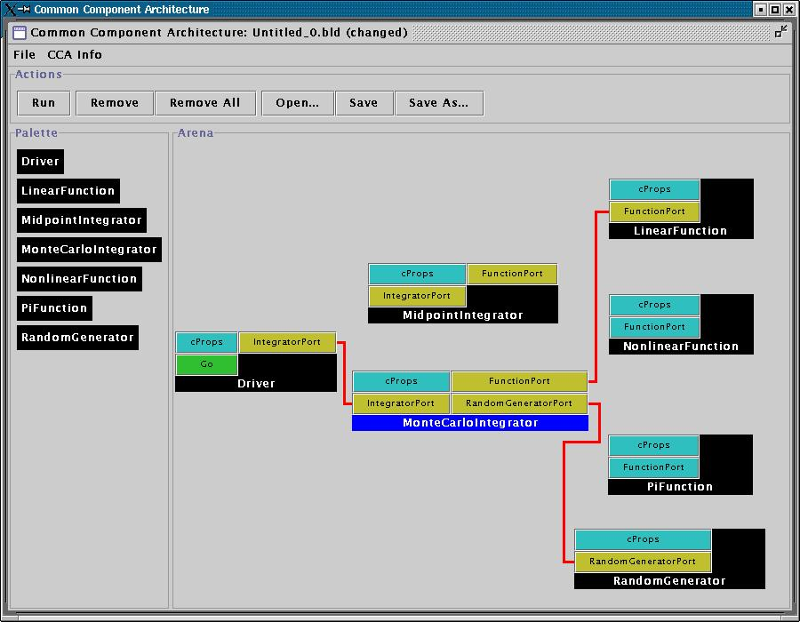
User Viewpoint:
Loading and Instantiating Components
Supplementary material for handouts
Components are code + metadata
Using metadata, a Palette of available components is constructed
Components are instantiated by user action (i.e. by dragging from Palette into Arena)
Framework calls component’s constructor, then setServices
Details are framework-specific!
Ccaffeine currently provides both command line and GUI approaches
create Driver Driver
create LinearFunction LinearFunction
create MonteCarloIntegrator MonteCarloIntegrator
Notes:
While this description is specific to Ccaffeine, the concepts are general

Slide 52
User Connects Ports
Supplementary material for handouts
Can only connect uses & provides
  Not uses/uses or provides/provides
Ports connected by type, not name
  Port names must be unique within component
  Types must match across components
Framework puts info about provider of port into using component’s Services object
connect Driver IntegratorPort MonteCarloIntegrator IntegratorPort
connect MonteCarloIntegrator FunctionPort LinearFunction FunctionPort
…
Notes:
The picture is specific to Ccaffeine, but the concepts are general

Slide 53
Component’s View of Instantiation
Supplementary material for handouts
Framework calls component’s constructor
Component initializes internal data, etc.
  Knows nothing outside itself
Framework calls component’s setServices
  Passes setServices an object representing everything “outside”
  setServices declares ports component uses and provides
Component still knows nothing outside itself
  But Services object provides the means of communication w/ framework
Framework now knows how to “decorate” component and how it might connect with others
Framework interaction code
constructor setServices destructor
CCA.Services
provides IntegratorPort
uses FunctionPort, RandomGeneratorPort
Integrator code
IntegratorPort
FunctionPort
RandomGeneratorPort
MonteCarloIntegrator
MonteCarloIntegrator
Notes:
The cartoon on the left shows the internals of the component. The cartoon on the right is how the Ccaffeine GUI would render the “decorated” component to the outside world.

Slide 54
Component’s View of Connection
Supplementary material for handouts
Framework interaction code
CCA.Services
…, uses FunctionPort
(connected to NonlinearFunction FunctionPort), …
Framework puts info about provider into user component’s Services object
  MonteCarloIntegrator’s Services object is aware of connection
  NonlinearFunction is not!
MCI’s integrator code cannot yet call functions on FunctionPort
Integrator code
Framework interaction code
MonteCarloIntegrator
CCA.Services
provides FunctionPort
Function code
NonlinearFunction

Slide 55
Component’s View of Using a Port
Supplementary material for handouts
User calls getPort to obtain (handle for) port from Services
  Finally user code can “see” provider
Cast port to expected type
  OO programming concept
  Insures type safety
  Helps enforce declared interface
Call methods on port
  e.g.
  sum = sum + function->evaluate(x)
Call releasePort
Framework interaction code
CCA.Services
…, uses FunctionPort
(connected to NonlinearFunction FunctionPort), …
Integrator code
MonteCarloIntegrator
Notes:
This is where the changes to the “library” code turn up. The getPort/cast/releasePort are outright additions. But also, calls to methods on the port will change slightly.

Slide 56
Components can be Dynamic
BuilderService allows programmatic composition of components
  Components can be instantiated, destroyed, connected, and disconnected under program control
  Framework service defined in CCA spec
Sample uses of BuilderService:
Python “driver” script which can assemble and control an application
  i.e. MCMD climate model
Adaptation to changing conditions
  Swap components in and out to give better performance, numerical accuracy, convergence rates, etc.
Encapsulation of reusable complex component assemblies
  Create a “container component” which exposes selected ports from the enclosed components

Slide 57
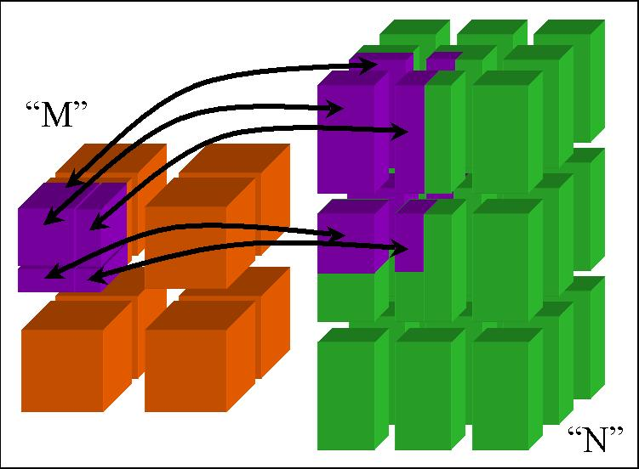
Coupling Codes
Driver
Components provide a natural way to think about coupling codes together
  i.e. multi-scale, multi-physics simulations
Coupled codes may naturally run on different numbers of processors, even different machines
Coupling may involve exchanging data
  Parallel data redistribution (aka “MxN” problem)
Coupling may involve parallel procedure calls
  Parallel remote method invocation (PRMI)
Research areas in which CCA is developing tools
Atmosphere
Ocean
Land
Coupler
Processors
PRMI

Slide 58
Frameworks can Provide Specialized Parallel Programming Environments
Supplementary material for handouts
Because all components run within a framework, a CCA framework can also be used to provide a specialized programming environment
  CCA does not dictate a particular approach to parallelism
  Environment could be implemented as extensions to a CCA-compliant framework and/or special components
Example:
Uintah Computational Framework, based on SCIRun2 (Utah) provides a multi-threaded parallel execution environment based on task graphs
  Graphs express interdependencies of each task’s inputs and outputs
  Specialized to a class of problems using structured adaptive mesh refinement

Slide 59
Is CCA for You?
Much of what CCA does can be done without such tools if you have sufficient discipline
  The larger a group, the harder it becomes to impose the necessary discipline
Projects may use different aspects of the CCA
  CCA is not monolithic – use what you need
  Few projects use all features of the CCA… initially
Evaluate what your project needs against CCA’s capabilities
  Other groups’ criteria probably differ from yours
  CCA continues to evolve, so earlier evaluations may be out of date
Evaluate CCA against other ways of obtaining the desired capabilities
Suggested starting point:
  CCA tutorial “hands-on” exercises

Slide 60
Take an Evolutionary Approach
The CCA is designed to allow selective use and incremental adoption
“Babelize” interfaces incrementally
  Start with essential interfaces
  Remember, only externally exposed interfaces need to be Babelized
Componentize at successively finer granularities
  Start with whole application as one component
    Basic feel for components without “ripping apart” your app.
  Subdivide into finer-grain components as appropriate
    Code reuse opportunities
    Plans for code evolution

Slide 61
View it as an Investment
CCA is a long-term investment in your software
  Like most software engineering approaches
There is a cost to adopt
The payback is longer term
Remember Biggerstaff’s Rule of Threes
  Look at three systems, requires three times the effort, payback after third release

Slide 62
CCA is Still Under Development
We’ve got…
  A stable component model
  Working tools
  Active users
But…
  We know its not perfect
  We’re not “done” by any stretch
Talk to us…
  If you’re evaluating CCA and and need help or have questions
  If you don’t think CCA meets your needs
  If you’ve got suggestions for things we might do better

Slide 63
What Can CCA Do Today?
Ccaffeine framework for HPC/parallel
  XCAT and other options for distributed computing
Language interoperability
  Fortran 77/90/95, C, C++, Java, Python
  Support for Fortran/C user-defined data structures under development
Primarily support Linux platforms so far
  IBM AIX, Sun Solaris, Mac OS X likely to work, but few users so far
  Working on Cray X1, XT3
  Porting is demand-driven

Slide 64
CCA Tools – Language Interoperability and Frameworks

Slide 65
Goal of This Module
CCA/Frameworks
Component A
Component B
CCA IDE
Babel
Chasm
Describe tools for multi-lingual, scientific component ‘plug-and-play’
IDE = Interactive Development Environment

Slide 66
Tools Module Overview
CCA/Frameworks
Component A
Component B
CCA IDE
Babel
Chasm
Language interoperability tools
Frameworks
CCA Interactive Development Environment

Slide 67
Babel Facilitates Scientific
Programming Language Interoperability
Versioned
Babel
Programming language-neutral interface descriptions
Native support for basic scientific data types
  Complex numbers
  Multi-dimensional, multi-strided arrays
Automatic object-oriented wrapper generation
f77
f77
C
f90
C
f90
Babel
vs.
C++
Python
C++
Python
Java
Java
Supported on Linux, AIX, and Solaris 2.7, works on OSX;
C (ANSI C), C++ (GCC), F77 (g77, Sun f77), F90 (Intel, Lahey, GNU, Absoft), Java (1.4)

Slide 68
Babel Generates Object-Oriented Language Interoperability Middleware
Babel
Stubs
comp.sidl
Babel
Compiler
IORs
libcomp.so
Skeletons
Implementations
Babel
Runtime
user creates
Write your SIDL file to define public methods
Generate server side in your native language using Babel
Edit Implementations as appropriate
Compile and link into library/DLL
IOR = Intermediate Object Representation
SIDL = Scientific Interface Definition Language
Notes:
Babel automatically generates language interoperability code.
Step 1: Write your SIDL file to define your public methods. These are the routines that can be invoked from applications or other components.
Step 2: Generate the server side code in your native implementation language using Babel.
Step 3: Edit the implementation hooks as appropriate.
Step 4: Compile and link into a library.

Slide 69
Clients in any supported language can access components in any other language
Babel
C Stubs
C++ Stubs
F77
Stubs
F90
Stubs
Java
Stubs
Python
Stubs
IORs
Skeletons
Implementations
Component
(any supported language)
Babel presentation coming up!
IOR = Intermediate Object Representation
Notes:
Clients in any supported language can access components in any other supported language.

Slide 70
Recent and Upcoming Features
Babel
Supplementary material for notes
Remote Method Invocation (BabelRMI)
Design-by-Contract
Pre- and post-method invocation hooks
Alpha
Alpha
Alpha

Slide 71
Chasm Provides Language Interoperability for Fortran, C, and C++
Versioned
Chasm
Extracts interfaces from C/C++ and Fortran90 codes
Uses library of XSLT stylesheets for language transformations ➔ easily extended
  Generates XML and SIDL representations
  Generates Fortran90 Babel implementation glue
Provides Fortran array descriptor library used by Babel
Supported on Linux, AIX, and Solaris 2.7, works on OSX;
C (ANSI C), C++ (GCC), F90 (Intel, Lahey, GNU, Absoft)

Slide 72
The Entire Chasm Process Involves Three Basic Steps
Chasm
.f90
gfortran
.ptd
.sidl
gfortran2xml
.impl.xml
_Impl.F90
user creates
xalan
comp.impl.xml
_Mod.F90
Start with a Fortran (or C/C++) source file
Create an XML description of the component (or port)
Generate the SIDL specification and glue code files
XML = Extensible Markup Language
PTD = Parse Tree Dump

Slide 73
Chasm-Assisted Glue Code Generation
Chasm
Supplementary material for notes
Create functions_LinearFunction.impl.xml
Create xml description of source procedures
  gfortran -fdump-parse-tree LinearFunction.f90 > LinearFunction.ptd
  gfortran2xml < LinearFunction.ptd > LinearFunction.xml
Create .sidl, _Impl.F90, and _Mod.F90
  xalan –o functions_LinearFunction.sidl functions_LinearFunction.impl.xml
  cca-f90-comp.sidl.xsl
  xalan –o functions_LinearFunction_Impl.F90 functions_LinearFunction.impl.xml
  cca-f90.impl.xsl
  xalan –o functions_LinearFunction_Mod.F90 functions_LinearFunction.impl.xml
  cca-f90.mod.xsl
Run Babel…

Slide 74
User-Created XML
Component Description File
Chasm
Supplementary material for notes
<componentImplementation name="LinearFunction” package="functions”>
<language name=“F90”>
<property name="impl-scope" value="LinearFunction"/>
<property name="impl-xml” value=”/home/cca/LinearFunction.xml"/>
<ports>
<provides name="FunctionPort" package="function">
<MethodsBlock>
<Method name="evaluate" impl="evaluate_lf"/>
</MethodsBlock>
</provides>
</ports>
</language>
</componentImplementation>

Slide 75
Recent and Upcoming Features
Chasm
Supplementary material for notes
Generate Fortran 2003 MPI Bindings
Update XML processor and generator to new PDToolkit releases
1Q 2006
1Q 2006

Slide 76
Tools Module Overview
CCA/Frameworks
Component A
Component B
CCA IDE
Babel
Chasm
Language interoperability tools
Frameworks
CCA Interactive Development Environment

Slide 77
Frameworks are Specialized to Different Computing Environments
Integrator
Linear Fun
“Direct connection” preserves high performance of local (“in-process”) and parallel components
  Framework makes connection
  Framework not involved in invocation
Distributed computing has same uses/provides pattern, but the framework intervenes between user and provider
  Framework provides a proxy port local to the user’s uses port
  Framework conveys invocation from proxy to actual provides port
Provides/Uses
Port
Direct Connection
Integrator
Provides
Port
Network
Connection
Linear Fun
Proxy Provides/
Uses Port

Slide 78
Graphical User Interfaces (GUIs) Deliver Plug-and-Play Experience
Plug & play for:
  Application software assembly
  Visualization pipelines
  Workflow management
Assembling “wiring” diagrams is almost universal.
  Software assembly: Ccaffeine, XCAT, SciRUN
  Workflow: XCAT, SciRUN
  Visualization: SciRUN
None of these (yet) plug into your favorite Integrated Development Environment
(e.g., Eclipse, MS Dev. Studio, Java Studio, …).

Slide 79
Ccaffeine is a Direct-Connect,
Parallel-Friendly Framework
Ccaffeine Framework
Versioned
Supports SIDL/Babel components
  Conforms to latest CCA specification (0.7)
  Also supports legacy CCA specification (0.5)
    Any C++ allowed with C and Fortran by C++ wrappers
Provides command-line and GUI for composition
  Scripting supports batch mode for SPMD
  MPMD/SPMD custom drivers in any Babel language
Supported on Linux, AIX, OSX and is portable to modern UNIXes.

Slide 80
Ccaffeine Involves a Minimum of Three Steps
Ccaffeine Framework
As easy as 1-2-3:
  Write your component.
  Describe it with an XML file.
  Add a line to your Ccaffeine input file to load the component at runtime.
Proceed to plug & play...
There are many details and automated tools that help manage components.

Slide 81
Ccaffeine GUI
Ccaffeine Framework (ccafe-gui)
Versioned
Optional
Process
  User input is broadcast SPMD-wise from Java.
  Changes occur in GUI after the C++ framework replies.
  If your components are computing, GUI changes are blocked.
Components interact through port connections
  provide ports implement class or subroutines
  use ports call methods or subroutines in the port.
  Links denote caller/callee relationship not data flow
“Provides” Port
“Uses” Port
IntegratorPort
FunctionPort
FunctionPort
MidpointIntegrator
NonlinearFunction
Java is required.
Notes:
The cartoon is a schematic representation of two components connected to each other. The representation mimics that used in the original GUI for the Ccaffeine framework. Uses ports are shown on the left side of the component, provides ports on the right. They are shown in different colors to help distinguish them.
The MidpointIntegrator component has two ports. It provides an IntegratorPort and uses a FunctionPort. The NonlinearFunction component provides a FunctionPort. The red line connects the user FunctionPort on MidpointIntegrator to the provider FunctionPort on NonlinearFunction.
Another way to think of user/provider is client/server
To repeat: connecting ports does not imply direction of data movement!

Slide 82
User Connects Ports
Ccaffeine Framework (ccafe-gui)
Supplementary material for notes
Can only connect uses & provides
  Not uses/uses
  Not provides/provides
Ports connected by type not name
  Port names must be unique within component
  Types must match across components
Framework puts info about provider of port into using component’s Services object
connect Driver IntegratorPort MonteCarloIntegrator IntegratorPort
connect MonteCarloIntegrator FunctionPort LinearFunction FunctionPort
…
Notes:
The picture is specific to Ccaffeine, but the concepts are general

Slide 83
Building an Application (1 of 2)
Ccaffeine Framework (ccafe-gui)
Components are code + XML metadata
Using metadata, a Palette of available components is constructed.
Components are instantiated by user action (i.e. by dragging from Palette into Arena).
Framework calls
component’s constructor,
then setServices
create Driver Driver
create LinearFunction LinearFunction
create MonteCarloIntegrator MonteCarloIntegrator
Notes:
While this description is specific to Ccaffeine, the concepts are general

Slide 84
Building an Application (2 of 2)
Ccaffeine Framework (ccafe-gui)
1. Click Configure port to start parameter input dialogue.
2. For each connection:
click a uses port
then click a provides port to establish a connection.
3. Click Go port to start the application.
Right-clicking a connection line breaks the connection -- enabling component substitution.
Notes:
The cartoon is a schematic representation of two components connected to each other. The representation mimics that used in the original GUI for the Ccaffeine framework. Uses ports are shown on the left side of the component, provides ports on the right. They are shown in different colors to help distinguish them.
The MidpointIntegrator component has two ports. It provides an IntegratorPort and uses a FunctionPort. The NonlinearFunction component provides a FunctionPort. The red line connects the user FunctionPort on MidpointIntegrator to the provider FunctionPort on NonlinearFunction.
Another way to think of user/provider is client/server
To repeat: connecting ports does not imply direction of data movement!

Slide 85
Application Configurations can be Re-used
Ccaffeine Framework (ccafe-gui)
Supplementary material for notes
1. Click Save or Save As… to save actions.
2. Click Open to replay actions.
Script optimization
% simplify-bld saved_file.bld > faster_file.bld
Batch conversion
% bld2rc faster_file.bld > faster_file.batch
C++ stand-alone execution
% bld2babel-cpp faster_file.bld faster_file_babel outdir
or % bld2neo faster_file.bld faster_file.batch outdir
Notes:
The cartoon is a schematic representation of two components connected to each other. The representation mimics that used in the original GUI for the Ccaffeine framework. Uses ports are shown on the left side of the component, provides ports on the right. They are shown in different colors to help distinguish them.
The MidpointIntegrator component has two ports. It provides an IntegratorPort and uses a FunctionPort. The NonlinearFunction component provides a FunctionPort. The red line connects the user FunctionPort on MidpointIntegrator to the provider FunctionPort on NonlinearFunction.
Another way to think of user/provider is client/server
To repeat: connecting ports does not imply direction of data movement!

Slide 86
Recent and Upcoming Features
Ccaffeine Framework
Supplementary material for notes
Interoperate with other CCA frameworks
  Via Babel RMI
2H 2006

Slide 87

XCAT is a Web-based
Distributed Component Framework
Alpha
XCAT-C++ Framework
Remote references
  Port types described in C++ header files or in WSDL documents
User Interface
  C++ and Python interface to CCA BuilderService
  Uses SWIG for Python-C++ translations
Component creation
  Remote creation via SSH
Component communication
  Proteus multi-protocol library
  Communication libraries can be loaded at run-time
Tested on Linux.
WSDL = Web Service Definition Language

Slide 88
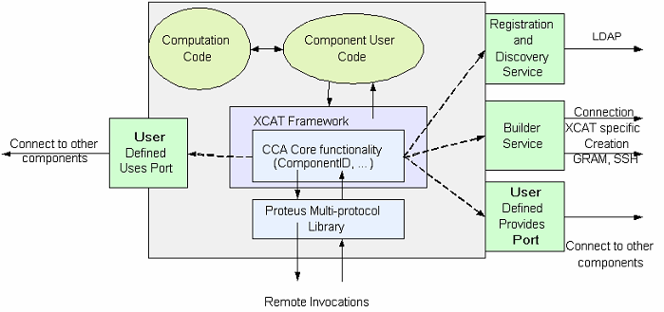
XCAT is Designed for High-Performance Scientific Applications
XCAT-C++ Framework

Slide 89
Recent and Upcoming Features
XCAT-C++ Framework
Supplementary material for notes
Support GRAM for component creation
  Allow use of grid resources
Automated component registration and discovery
Support new protocols such as UDT (in Proteus)
Support Babel’s Remote Method Invocation
  Allows access to Babel objects through remote Babel stubs
  Provides direct support for SIDL in distributed applications
  Leverages Proteus
1H 2006
2H 2006
1H 2006
2H 2006
GRAM = Grid Resource Allocation Management
UDT = UDP-based Data Transfer protocol

Slide 90
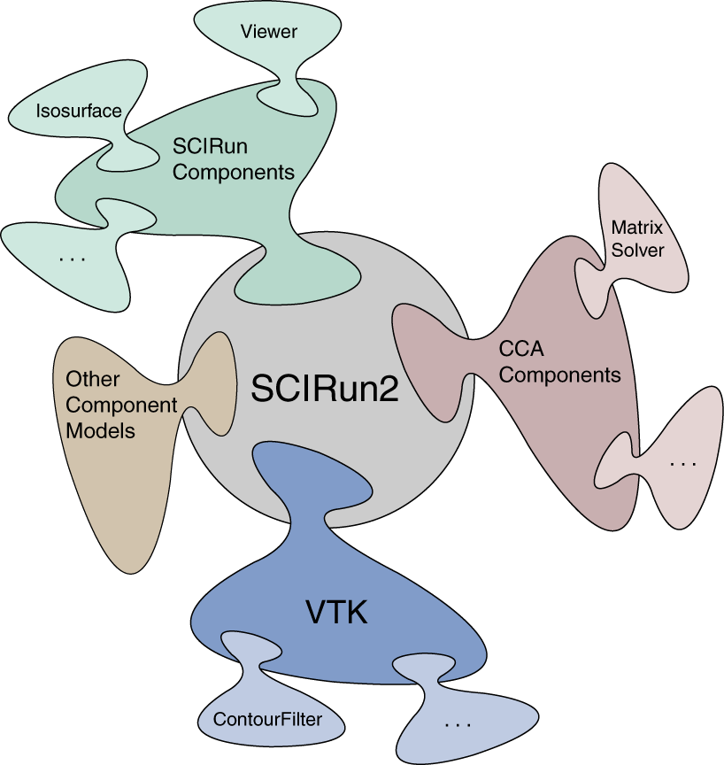
SCIRun2 is a Cross-Component Model, Distributed Component Framework
Alpha
SCIRun2 Framework
Semi-automatically bridges component models
  Templated components connected at
  run-time generate bridges
Parallel Interface Definition Language
(PIDL) – a SIDL variant
User interface – GUI and textual
  Dynamic composition
Component and framework creation
  Remote via SSH
Component communication
  C++ RMI with co-location optimization
  MPI/ Parallel Remote Method Invocation (PRMI)
Supported on Linux.
Notes:
*** Alpha release expected by the end of 2005; Unix variants and Mac OSX support are future work ***
*** Note: Currently the PIIDL/SIDL compiler is not based on Babel ***
The user interface supports:
create, destroy, connect, disconnect, and execute on components
Components and component models can be added at run-time
Slave frameworks can be created and started
Existing frameworks can be connected
Parallel Components:
MPI-Parallel components are supported in SCIRun2, wherein each MPI process may contain multiple threads. These components interact via Parallel Remote Method Invocation (PRMI).

Slide 91
Master Framework Coordinates Slave Frameworks in Each Remote Address Space
SCIRun2 Framework
SCIRun2 Framework (Master Framework)
Component Loader (Slave Framework)
Component Loader (Slave Framework)
Component
Component
Connection
Table
(Referencing remote
Components)
Provides Ports
Provides Ports
Component Code
(User)
PRMI
Component Code
(User)
Component Code
(PIDL-Generated)
Component Code
(PIDL-Generated)
Component ID
Table
(Referencing remote
provides ports)
Uses Ports
Uses Ports
Service Object
Service Object
Builder Service

Slide 92
Basic How-To
SCIRun2 Framework
Add component source files and makefile to SCIRun2 sources
  May need to define ports in SIDL
Add component information to the component model xml file
Build component using SCIRun2 make scripts
  Alternatively, build component using Babel
Start the framework and graphical (default) or text builder
Graphically connect component to other CCA-based or non CCA-based components
  May need to create bridge components to go between models
Press the “Go” button on the driver component
Notes:
No release yet, obtainable through SCI subversion repository -> contact us
Tutorial w/ release

Slide 93
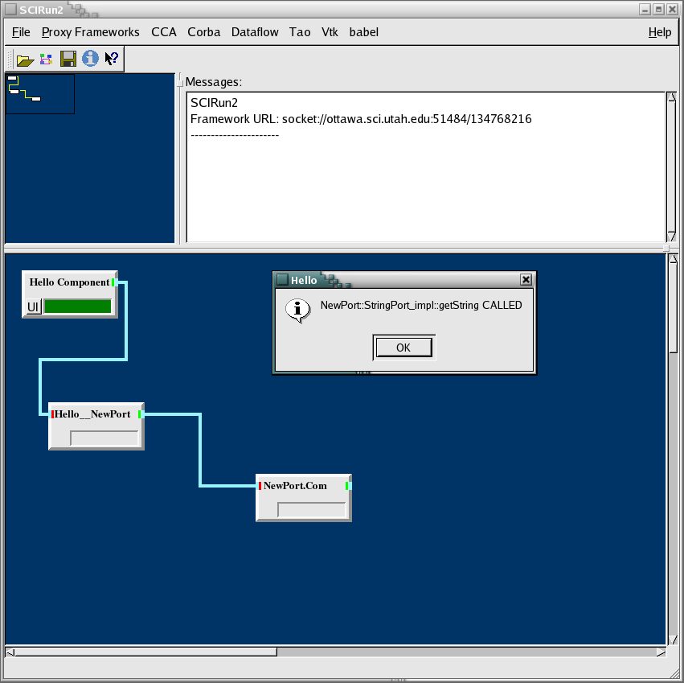
Simple SCIRun2 CCA (PIDL) and Babel Bridge
SCIRun2 Framework
Supplementary material for notes

Slide 94
Recent and Upcoming Features
SCIRun2 Framework
Supplementary material for notes
Merge PIDL with SIDL/Babel
Support additional component models
  Kepler workflows
Support Babel’s Remote Method Invocation PRMI
Automate bridging
1H 2005
1H 2006
2H 2006
On-going

Slide 95
Experimental Frameworks
Supplementary material for notes
Framework | Purpose | Summary
Distributed CCA Framework (DCA) | MxN research | Goal: explore MxN Parallel-Remote Method Invocation (PRMI) using MPI Parallel data transfer and redistribution integrated into port invocation mechanism
LegionCCA | Grid-based research | Goal: allow component-based CCA applications to run in Grid-scale environments using Legion Supports creation, scheduling, persistence, migration, and fault notification; relies on Legion’s built-in RPC mechanism (~Unix sockets)
XCAT-Java | Globus-based Grid research | Goal: explore web interface for launching distributed applications This (alpha) version compatible with latest CCA specification and provides built-in seamless compatibility with OGSI.
Versioned
OGSI = Open Grid Services Infrastructure

Slide 96
Tools Module Overview
CCA/Frameworks
Component A
Component B
CCA IDE
Babel
Chasm
Language interoperability tools
Frameworks
CCA Interactive Development Environment

Slide 97
Component Development Environment Provided via Eclipse Plug-ins
Alpha
CCA IDE
Provides a high-level graphical environment
  Creating new SIDL-based components
  Componentizing legacy codes
    C, C++, Java and Fortran
Automatic code generation
Supported on Linux, Windows, MacOS.

Slide 98
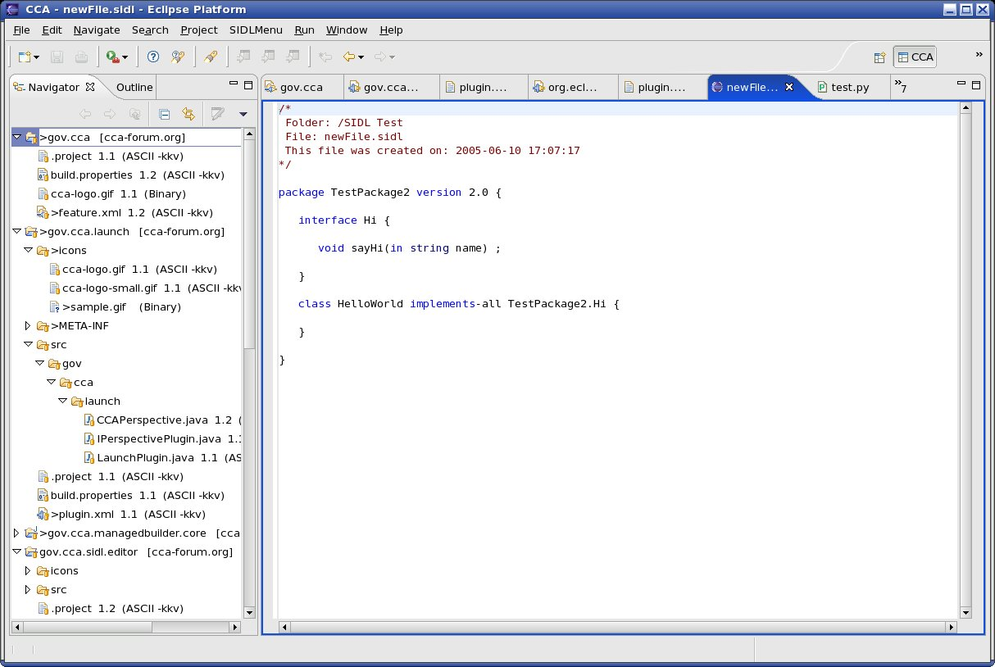
Component Development Environment Starts at the Eclipse Platform Level
CCA IDE
Plug-ins for:
SIDL Editor
Wizards
Preliminary automated build support
Imperative that you start by creating a new project!

Slide 99
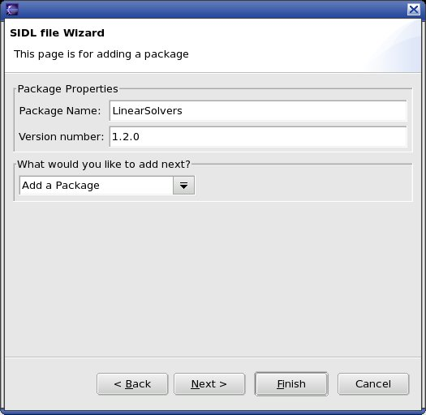
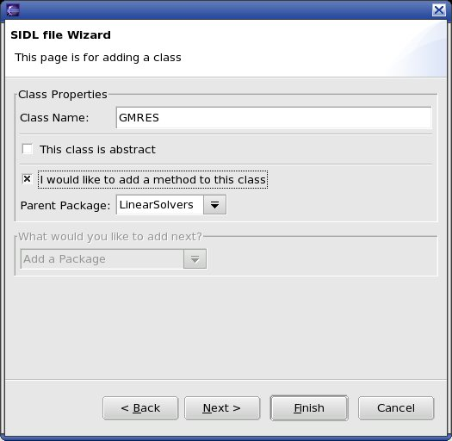
Wizards are Available for Adding Packages and Classes or Generating SIDL from Legacy Codes
CCA IDE
Intuitive interfaces to port and component definition
Helper wizards for setting port, component and (in the future) application properties

Slide 100
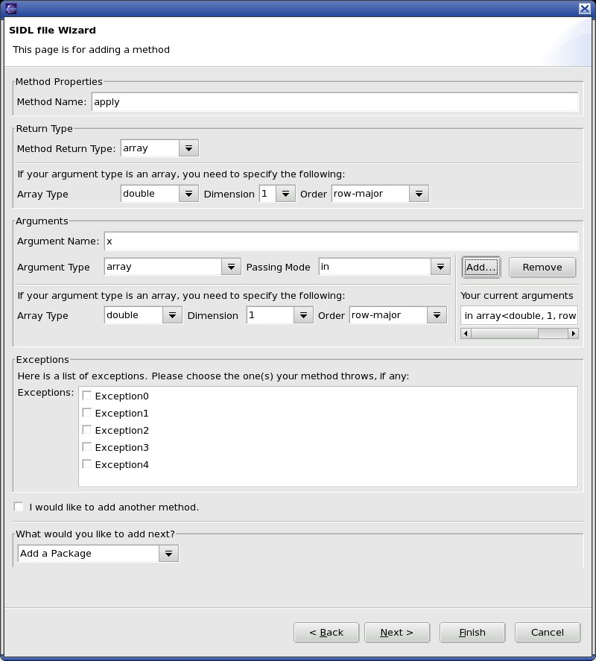
A Wizard is also Available for Adding Methods
CCA IDE
Supplementary material for notes

Slide 101
Recent and Upcoming Features
CCA IDE
Supplementary material for notes
Provide automated build support
Launch application via GUI
1H 2005
1H 2006

Slide 102
CCA Tools Contacts (1 of 2)
Supplementary material for notes
Tool | Purpose | More information
Babel | Scientific language interoperability tool kit | URL: www.llnl.gov/CASC/components Email: components@llnl.gov or babel-users@lists.llnl.gov
Ccaffeine | Direct-connect, parallel-friendly framework | URL: www.cca-forum.org/software/ Email: Ben Allan, ccafe-help@z.ca.sandia.gov Wiki: https://www.cca-forum.org/wiki
Chasm | Fortran90 interoperability wrapper | URL: chasm-interop.sourceforge.net Examples: chasm/example/cca-tutorial
DCA | MxN research framework | URL: www.cs.indiana.edu/~febertra/mxn Email: Felipe Bertrand, febertra@cs.indiana.edu
CCA IDE | CCA development environment | Email: usability@cca-forum.org

Slide 103
CCA Tools Contacts (2 of 2)
Supplementary material for notes
Tool | Purpose | More information
LegionCCA | Grid-based research framework | URL: grid.cs.binghamton.edu/projects/legioncca.html Email: Michael J. Lewis, mlewis@binghamton.edu
SCIRun2 | Cross-component model framework | URL: www.sci.utah.edu/ Email: Steve Parker, sparker@cs.utah.edu
XCAT-C++ | Globus-based GRID framework | URL: grid.cs.binghamton.edu/projects/xcat/ Email: Madhu Govindaraju, mgovinda@cs.binghamton.edu
XCAT-Java | Grid research framework | URL: www.extreme.indiana.edu/xcat/ Email: Dennis Gannon, gannon@cs.indiana.edu

Slide 104
Module Summary
CCA/Frameworks
Component A
Component B
CCA IDE
Babel
Chasm
Described tools for multi-lingual, scientific component ‘plug-and-play’
  Language interoperability through Babel and Chasm
  CCA Frameworks provide mechanisms for composition
  CCA Interactive Development Environment via Eclipse plug-in

Slide 105
Language Interoperable
CCA Components via
Notes:
Good <morning | afternoon>.
In this final module, I will talk about Language Interoperable CCA Components via Babel.

Slide 106
Goal of This Module
Legacy codes → Babelized CCA Components
Introduction
Example
  “Hello World”
Babelized CCA components
Notes:
The goal of this module is to introduce the process of Babelizing CCA components.
We will start with an introduction to the target environment and Babel.
Then I will introduce the Babel toolkit through a simple “Hello World” example.
Finally, we will cover the process of creating a Babelized CCA component.

Slide 107
Language Interoperability Facilitates Building Multiple Language Applications
Scripting Driver
(Python)
Simulation Framework
(C)
Visualization System
(Java)
Numerical Routines
(f77)
Solver Library
(C++)
Callback Handlers
(Python)
Notes:
Outline 1. Intro: what is Babel?
*** Option 1 *** (No animation)
Language interoperability facilitates building multiple language applications.
Basically we’re talking about building applications from components written in a variety of programming languages typically used in scientific computing.
Furthermore, we’re targeting an environment where those components could be switched for equivalent ones at run-time – that is, “plug-and-play” environments.
*** Option 2 *** (Note: Need to restore animation per notes below!)
The first thing I need to do is distinguish between what I mean by “Language Interoperability” and what most people assume by the term.
Most scientific codes these days are at least bi- or tri-lingual. Some aggressive codes may involve five or more languages. But the interfaces between languages is often extremely rigid.
For instance, in this setup could you see something isn’t converging, pause your program...
Animation #1: (Callback Handlers box appears; Line between Solver Library and Callback Handlers appears)
and extend one of your C++ classes in Python, overriding one virtual method called “hasConverged()” to do some extra checking, and then resume the computation.
Animation #2: (Line between Numerical Routines and Callback Handler appears)
Could you do something similar by overriding a numerical routine in F77? No? Why Not?

Slide 108
Babel Toolkit Consists of Two Parts:
Code Generator + Runtime Library
HTML
XML
Babel
Runtime
C
C++
SIDL interface
description
Babel
Compiler
F77
Application
F90
Java
Python
SIDL = Scientific Interface Definition Language
Notes:
Outline: 3.1.3 Babel Code Generation
*** Option 1 ***
The Babel toolkit actually consists of 2 parts: a compiler (or code generator) and a runtime library.
The Babel compiler takes interface descriptions written in the Scientific Interface Definition Language, or SIDL, and generates either textual equivalents – such as HTML and XML – or language interoperability source code and implementation hooks for languages such as C, C++, Fortran, etc.
The Babel Runtime provides a basic set of functionality in support of the object model and features such as dynamic object library management.
*** Option 2 ***
Babel is not an automatic wrapping technology.
Babel requires the interfaces to the software to be specified in our
Scientific Interface Definition Language (SIDL).
Note: Orange line represents link path.

Slide 109
The Basic Middleware Generation Process is Fairly Straightforward
Stubs
mycode.sidl
Babel
Compiler
IORs
libmycode.so
Skeletons
Implementations
Write your SIDL file to define public methods
Generate middleware in your native language using Babel
Fill in the implementation details as appropriate
Compile and link into library/DLL
IOR = Intermediate Object Representation
Notes:
The basic middleware generation process is fairly straightforward. The process essentially starts with a SIDL file describing the API.
That is,
Step 1: Write your SIDL file to define your public methods. These are the routines that can be invoked from applications or libraries.
Step 2: Generate the middleware code in your native implementation language using Babel.
Step 3: Fill in the implementation details as appropriate
Step 4: Compile and link into a library.

Slide 110
Babel Module’s Outline
Introduction
Example
  “Hello World”
Babelized CCA components
Notes:
That’s the introduction to Babel.
What I’d like to do is go right into Babel and the CCA. Since both CCA
and Babel are probably new to this audience, I’m going to discuss Babel in isolation first.
Then add CCA into the mix.

Slide 111
greetings.sidl: A Sample SIDL File for our “Hello World” Example
package greetings version 1.0 {
interface Hello {
void setName( in string name );
string sayIt ( );
}
class English implements-all Hello { }
}
Notes:
Here we have a greetings SIDL file example. It specifies the greetings Application Programming Interface (API). The API consists of a Hello interface that supports a setName() and a sayIt() method. The specification include an English class that implements the Hello functionality.
Packages are used to provide a name space hierarchy to avoid conflicts. They can be versioned – which is required if interfaces or classes are enclosed – or unversioned. Versioning is used to support API evolution.
Interfaces and classes are used to encapsulate functionality in an object-oriented manner.
The signatures of methods are used to define functionality in terms of defining the API.
SIDL is based on a Java-like object model so supports inheritance of interface and class functionality. (The rules and associated keywords – such as extends and implements – are given in the handouts.)

Slide 112
At a Minimum, the Library Developer Generates Single-Language Middleware
•
C++ Stubs
greetings.sidl
Babel
Compiler
IORs
libgreetings.so
C++ Skeletons
C++ Implementations
legacy_library.so
Execute `babel --server=C++ greetings.sidl`
Fill in the implementation details
Compile and link into a library/DLL
to dispatch to legacy code
Notes:
Given our greetings specification, the library developer can produce the language interoperability middleware “glue” and implementation hooks through Babel.
Step 1: Execute Babel to generate the server side glue code.
The glue code is in the form of Stubs, Intermediate Object Representations (or IORs), Skeletons, and Implementation hooks. Stubs provide the actual API to be invoked by the Library User. They also translate arguments between native and SIDL types. IORs serve as an Object-Oriented wrapper for the implementation by supporting the Babel Runtime’s object model. Like Stubs, Skeletons translate arguments between SIDL and native types. Finally, Implementations – as we shall see shortly – provide hooks for the actual behavior. So in...
Step 2: Fill in the implementation details within those hooks.
Step 3: Compile and link the codes into a library.
<Animation>
In the case of wrapping a legacy library, the implementation details are to dispatch to your legacy code. You do NOT need to modify the legacy library itself!

Slide 113
Implementation Details Must be Filled in Between Splicer Blocks
namespace greetings {
class English_impl {
private:
// DO-NOT-DELETE splicer.begin(greetings.English._impl)
string d_name;
// DO-NOT-DELETE splicer.end(greetings.English._impl)
string
greetings::English_impl::sayIt()
throw ()
{
// DO-NOT-DELETE splicer.begin(greetings.English.sayIt)
string msg(“Hello “);
return msg + d_name + “!”;
// DO-NOT-DELETE splicer.end(greetings.English.sayIt)
}
Notes:
Outline: 3.5 Server Side: Adding the Implementation
In this simple example, filling in the implementation hooks is a matter of declaring private data in the header file (to support the name attribute) and adding the implementation statements for the two methods; namely, setName() and sayIt().
This must be done within the splicer blocks as illustrated here. Otherwise, the statements would be lost the next time the Babel compiler is run.

Slide 114
To Allow the Library User To Use Another Language, the Library Developer Must Generate Stubs
Babel
Runtime
greetings.sidl
Babel
Compiler
F90 Stubs
IOR Headers
Application
libgreetings.so
Could be done
by the User!
Execute `babel --client=F90 greetings.sidl`
Invoke stub versions of the methods
Compile and link with generated code, library, & Runtime
Place DLL in suitable location
Notes:
Outline: 3.4 Client Side: Code Generation and Linking
In this scenario, in order for the library to be used for a different language, such as F90 here, the Library User needs the language-specific stubs and IOR headers. So,
Step 1: Execute Babel to generate them.
Step 2: Ensure the application invokes the stub version of the methods.
Step 3: Compile and link the application with the generated code, greetings library, and Babel Runtime.
Step 4: Place the library in a suitable location – such as defined by LD_LIBRARY_PATH and SIDL_DLL_PATH.
Note: Orange lines represent link paths.

Slide 115
So an F90 Version of the “Hello World” Application is Pretty Basic
•
•
program helloclient
use greetings_English
implicit none
type(greetings_English_t) :: obj
character (len=80) :: msg
character (len=20) :: name
name=’World’
call new( obj )
call setName( obj, name )
call sayIt( obj, msg )
print *, msg
call deleteRef( obj )
end program helloclient
These subroutines were
specified in the SIDL.
Other basic subroutines
are “built in” to SIDL
classes (and interfaces).
Notes:
So, in our simple greetings example, an F90 version of the “Hello World” application is pretty basic.
The object is created using the new() method. setName() is invoked to pass in the name “World” and sayIt() is used to build the string “Hello World”.
Finally, to be good programmers and clean up after ourselves, we delete the reference using deleteRef() so it can be garbage collected.
(Animation #1) This example also serves to illustrate the use of routines that are specified in the SIDL – setName() and sayIt() – (Animation #2) as well as built-in routines.
Note that in the F90 world, thanks to the use of the greetings_English module, the method name in the stub corresponds to that in the SIDL file. This is not always the case for other languages supported by Babel (such as C and F77) due to the need to avoid name space collisions.

Slide 116
Using Babel, Step-by-Step
•
•
•
•
•
•
SIDL
C Stub
C Skel
C Impl
C++ Library
C++ Stub
C++ Skel
C++ Impl
Intermediate Object Representation (C)
F77 Stub
F77 Skel
F77 Impl
F90 Stub
F90 Skel
F90 Impl
Java Stub
Java Skel
Java Impl
Py Stub
Py Skel
Py Impl
Notes:
A theoretical representation of Babel’s capabilities
Say we want to create a babel interface for a C++ library
Define a sidl interface file
Babel uses the sidl file to generate the IOR, Skel, and Impl files
The developer fills in the Impl file
Then he can generate the stubs for the client language
He can generate stubs for as many languages as he wants.

Slide 117
Babel Module’s Outline
Introduction
Example
  “Hello World”
Babelized CCA components
Notes:
Now that we have covered the basics of using Babel for building a “Hello World” application from scratch and described the process for wrapping legacy codes, we can turn to the process of Babelizing CCA components.

Slide 118
How to write a
Babelized CCA Component (1/3)
Define “Ports” in SIDL
  CCA Port =
    a SIDL Interface
    extends gov.cca.Port
package functions version 1.0 {
interface Function extends gov.cca.Port {
double evaluate( in double x );
}
}
Notes:
Outline: 4.1.3 Components Implemented Using Babel (**KEY**)
More specifically, Step 1 involves defining a CCA Port. This is accomplished by defining an interface that inherits from gov.cca.Port.
In this functional example, the specification consists of a functions package that defines a Function port. The interface simply defines an evaluate() method.

Slide 119
How to write a
Babelized CCA Component (2/3)
Define “Components” that implement those Ports
  CCA Component =
    SIDL Class
    implements gov.cca.Component (and any provided ports)
class LinearFunction implements functions.Function,
gov.cca.Component {
double evaluate( in double x );
void setServices( in cca.Services svcs );
}
class LinearFunction implements-all
functions.Function, gov.cca.Component { }
Notes:
Outline: 4.1.3 Components Implemented Using Babel (**KEY**)
Now Step 2 involves defining a component class that encapsulates the port functionality.
In this case, by inheriting from both functions.Function and gov.cca.Component, we have a component that does double-duty as a port.
Note that both of these specifications happen to be equivalent in this case.

Slide 120
Tip: Use Babel’s XML output like precompiled headers in C++
Supplementary material for notes
cca.sidl
Babel
Compiler
Type
Repository
XML
Precompile SIDL into XML using ‘--text=xml’
Store XML in a directory
Use Babel’s –R option to specify
search directories
Stubs
functions.sidl
Babel
Compiler
IORs
Skeletons
Implementations

Slide 121
How to write a
Babelized CCA Component (3/3)
Repo
(XML)
C Stubs
functions.sidl
Babel
Compiler
IORs
C Skeletons
libfunctions.so
C Implementations
Use Babel to generate the interoperability glue
  Execute `babel --server=C –RRepo functions.sidl`
Fill in Implementations as needed
Notes:
Outline: 4.1.3 Components Implemented Using Babel (**KEY**)
As before, Step 3 executes Babel to generate the interoperability glue.
Finally, Step 4 involves filling in the implementation hooks as needed. That is, implement the behavior within the splicer blocks we saw before if you’re starting from scratch or fill in the glue to translate and dispatch to your legacy code(s).

Slide 122
Contact Information
Project: http://www.llnl.gov/CASC/components
  Babel: language interoperability tool
  Alexandria: component repository
  Quorum: web-based parliamentary system
  Gauntlet: testing framework
Project Team Email: components@llnl.gov
Mailing Lists: majordomo@lists.llnl.gov
  subscribe babel-users [email address]
  subscribe babel-announce [email address]
Bug Tracking: https://www.cca-forum.org/bugs/babel/
or email to babel-bugs@cca-forum.org
Notes:
If you want to learn more about Babel, feel free to use the most suitable mechanisms listed here.
You can send email directly to the project team through components@llnl.gov.
The mailing lists provide an alternative mechanism for finding out more about Babel. For example, babel-users is a distribution list that is generally for unmoderated discussions and, since it includes collaborators not on the project, can sometimes be a faster source of answers.
The other list, babel-announce, is used for announcements such as news regarding new releases of the Babel toolkit.
Finally, we are now using Roundup for our bug tracking system which captures bug reports from the web site as well as from email submissions to babel-bugs@cca-forum.org.

Slide 123
CCA Applications

Slide 124
Modern Scientific Software Development
Complex codes, often coupling multiple types of physics, time or length scales, involving a broad range of computational and numerical techniques
Different parts of the code require significantly different expertise to write (well)
Generally written
by teams rather
than individuals
Time Evolution
Physics Modules
Mesh
Adaptive Solution
Optimization
Diagnostics
Discretization
Steering
Derivative Computation
Algebraic Solvers
Visualization
Data Reduction
Collaboration
Data Redistribution
Notes:
Physics simulations are becoming increasingly complex and involve a large number of different sophisticated tools ranging from structured and unstructured (potentially adaptive) grids, high order discretization techniques, algebraic solvers and optimization methods, as well as advanced visualization capabilities and computational steering tools. There has been a great deal of work in each of these areas to develop state of the art techniques but it is often difficult for application scientists to take advantage of the latest and greatest
- the software is too hard to use
- it’s difficult to compose applications from tools developed by different groups
Thus, the potential for high fidelity calculations on high performance computers using such techniques will become a reality only if the application scientist can take advantage of the of tools being developed by domain experts.

Slide 125
Overview
Examples (scientific) of increasing complexity
  Laplace equation
  Time-dependent heat equation
  Nonlinear reaction-diffusion system
  Quantum chemistry
  Climate simulation
Tools
  MxN parallel data redistribution
  Performance measurement, modeling and scalability studies
Community efforts & interface development
  TSTT Mesh Interface effort
  CCTTSS’s Data Object Interface effort
Notes:
To highlight how components can be useful in this scenario I will show a series of examples of increasing complexity that highlight component reuse and composability. I will start with a simple steady state PDE and move to a time-dependent PDE and from there to block structured adaptive time dependent PDEs. We will also show the use of several of the same components used in the PDE simulations in optimization-based applications.
I will give single processor performance results and scalability results for distributed memory applications. These results show that if you choose the level of granularity for your components appropriately there is very little performance impact.
Finally, based on our experiences to date, I will discuss strategies for developing your own component-based high performance simulation code. In addition, I will give a case study that highlights some of the issues associated with developing interchangeable and interoperable components in a domain-specific setting through the development of common interfaces.

Slide 126
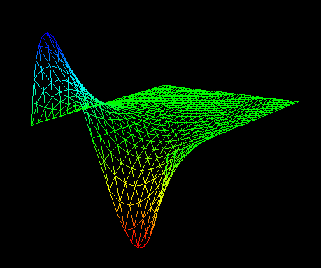
Laplace Equation
∇²ϕ (x,y) = 0 ∈ [0,1] x [0,1]
ϕ(0,y)=0 ϕ(1,y)=sin (2πy)
δϕ/δy(x,0) = δϕ/δy(x,1) = 0
Physics Modules
Mesh
Discretization
Visualization
Algebraic Solvers
Notes:
We start with a simple steady state PDE that solves Poisson’s equation on the unit square with a sine dirichlet boundary condition on the boundary x=1 and Neumann conditions on the upper and lower boundaries. The solution is shown in the lower figure.
This example uses a few of the application components highlighted on the first slide– namely a physics model to capture the PDE of interest, a grid or mesh module, a discretization module, an algebraic solvers module and visualization capabilities. Although this is a very simple example it captures many of the basic components used in real high-performance computing simulations and is an excellent starting point for the development of more sophisticated applications that will reuse pieces of this application (for example the algebraic solvers).

Slide 127
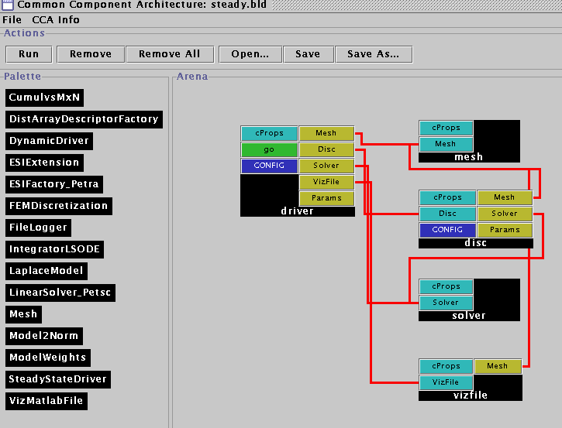
Laplace Equation with Components
The Driver Component
  Responsible for the overall application flow
  Initializes the mesh, discretization, solver and visualization components
  Sets the physics parameters and boundary condition information
Notes:
In the component version of this application we have five components: a driver, mesh, discretization, solver, and visualization component. And we’ll quickly go through the responsibilities of each in this simple application.
The driver is responsible for the overall flow of the application and initializes each of the other components. It is also responsible for setting the various physics parameters and boundary conditions. We note that the driver is the only place where this is done so a new physics application would require a small change to the driver.
We could also have written this application to have a generic driver and a 6th very small component whose only job it would be is to set the physics/mathematical model (which operators are used, what are their coefficients) parameters and boundary conditions on the discretization component.

Slide 128
Laplace Equation with Components
The Driver Component
  Responsible for the overall application flow
  Initializes the mesh, discretization, solver and visualization components
  Sets the physics parameters and boundary condition information
The Mesh Component
  Provides geometry, topology, and boundary information
  Provides the ability to attach user defined data as tags to mesh entities
  Is used by the driver, discretization and visualization components
Notes:
As mentioned earlier, the mesh component provides the geometry, topology and boundary information for the application. This particular component is based on the triangle package developed by Jonathon Shewchuck. It is initialized by reading a file specified by the driver that contains the mesh information. It uses the attribute information provided by the Triangle format to determine which vertices are on boundaries and it stores this information in a pre-defined tag called “boundary” which can be later accessed by the discretization component.
It also provides the ability to attach arbitrarily-sized user defined data to the mesh and to each of the mesh entities. We use this capability to attach a scalar field representing phi to the mesh vertices.
The mesh component is used by the driver, discretization and visualization components. The mesh component does not use the functionality of any other components.

Slide 129
Laplace Equation with Components
The Driver Component
  Responsible for the overall application flow
  Initializes the mesh, discretization, solver and visualization components
  Sets the physics parameters and boundary condition information
The Mesh Component
  Provides geometry and topology information
  Provides the ability to attach user defined data to mesh entities
  Is used by the driver, discretization and visualization components
The Discretization Component
  Provides a finite element discretization of basic operators (gradient, Laplacian, scalar terms)
  Driver determines which terms are included and their coefficients
  Boundary conditions, assembly etc
Notes:
The discretization component is the glue that holds this example together. It provides a finite element discretization of basic operators such as laplacian, gradient, and scalar terms as well as the manipulations needed to implement dirichlet and Neumann boundary conditions in the stiffness matrix. To solve a particular physics problem, it accepts input from the driver pertaining to which operators are used in the example and what their coefficients are.
It also is responsible for gathering and scattering scalar data from the mesh into a vector. It does this by creating and storing a map between the unique global integer id’s of the vertices of the mesh and the corresponding position of the scalar data in the vector (0 to N-1).
This map is also used to assemble the computed element matrices for each mesh region (element) into a global stiffness matrix by using the Set command on the opaque matrix object provided by the solver.

Slide 130
Laplace Equation with Components
The Driver Component
  Responsible for the overall application flow
  Initializes the mesh, discretization, solver and visualization components
  Sets the physics parameters and boundary condition information
The Mesh Component
  Provides geometry and topology information
  Provides the ability to attach user defined data to mesh entities
  Is used by the driver, discretization and visualization components
The Discretization Component
  Provides a finite element discretization of basic operators (gradient, laplacian, scalar terms)
  Provides mechanisms for general Dirichlet and Neumann boundary condition manipulations
The Solver Component
  Provides access to vector and matrix operations (e.g., create, destroy, get, set)
  Provides a “solve” functionality for a linear operator
Notes:
The solver component is based on the PETSc library and provided access to vector and matrix operations. For example, the user of this component can create, destroy, duplicate, copy vectors and matrices as well as set the values of their entries. It also provides a simple solve functionality that uses GMRES for the linear system solution.
Note that only a small subset of the functionality provided by PETSc is available as a CCA component in this example (just enough to make the example work). More work is underway to extend the functionality by PETSc in component form.

Slide 131
Laplace Equation with Components
The Driver Component
  Responsible for the overall application flow
  Initializes the mesh, discretization, solver and visualization components
  Sets the physics parameters and boundary condition information
The Mesh Component
  Provides geometry and topology information
  Provides the ability to attach user defined data to mesh entities
  Is used by the driver, discretization and visualization components
The Discretization Component
  Provides a finite element discretization of basic operators (gradient, laplacian, scalar terms)
  Provides mechanisms for general Dirichlet and Neumann boundary condition manipulations
  Computes element matrices and assembles them into the global stiffness matrix via set methods on the solver
  Gathers and scatters vectors to the mesh (in this case ϕ)
The Solver Component
  Provides access to vector and matrix operations (e.g., create, destroy, get, set)
  Provides a “solve” functionality for a linear operator
The Visualization Component
  Uses the mesh component to print a vtk file of ϕ on the unstructured triangular mesh
  Assumes user data is attached to mesh vertex entities
Notes:
The final component is a visualization component that accesses the mesh geometry and topology information, along with the scalar field phi, to write this information in vtk format to a file specified by the user. More sophisticated, interactive visualization capabilities are highlighted in the next example.

Slide 132
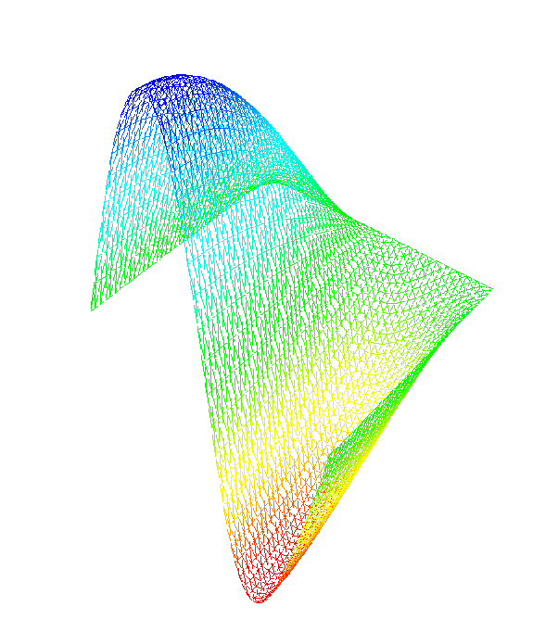
Time-Dependent Heat Equation
δϕ/δt = ∇²ϕ (x,y,t) ∈ [0,1] x [0,1]
ϕ(0,y,t)=0 ϕ(1,y,t)=.5sin(2πy)cos(t/2)
δϕ/δy(x,0) = δϕ/δy(x,1) = 0
ϕ(x,y,0)=sin(.5πx) sin (2πy)
Time Evolution
Physics Modules
Mesh
Discretization
Visualization
Algebraic Solvers
Distributed Arrays
Data Redistribution
Notes:
The next step we take in the evolution of our complex application example is to add time dependence. We are now solving the heat equation with a sinusoidal, time evolving boundary condition on the left boundary, and the same 0 dirichlet condition on the right boundary and Neumann boundary conditions on the top and bottom. The initial condition is chosen to be sinusoidal in the entire domain and consistent with the left boundary condition at time t=0.
We are also going to add an interactive visualization component that displays the results of the computation at each time step. This example also highlights the use of a data redistribution component that can take the data from M processors of a parallel computer to N processors of a parallel computer. In this case both M and N are equal to 1 – it is used here to accommodate the new visualization component that we are using (based on a AVS viewer developed originally to work with the CUMULVS library at ORNL). In particular, this visualization component assumes that data is coming in from a parallel computer via the MxN redistribution component.

Slide 133
Some things change…
Requires a time integration component
  Based on the LSODE library
Uses a new visualization component
  Based on AVS
The visualization component requires a Distributed Array Descriptor component
  Similar to HPF arrays
The driver component changes to accommodate the new physics
Notes:
This more sophisticated example requires some changes to what we were doing previously.. Mostly in the form of additions to the components used
First and most importantly, this application requires the use of an integration component. The one we are using is based on the LSODE library developed at LLNL. The actual component was created by Ben Allan at SNL and is a good example of the use of creating a component by wrapping the functionality of a Fortran-based library with C++ wrappers.
We are also using a new visualization component. This component is based on AVS and expects information to be sent to it via an MxN data redistribution component (It is designed to visualize the results of a parallel simulation code). In this case M=N=1.
The use of the data redistribution component in turn required the use of a Distributed Array component. This component is similar to HPF arrays and was developed by David Bernholdt at ORNL.
We also note that we’re no longer using the linear solvers provided as part of the PETSc-based solver component. We are however still using the vectors as input to the time integration component.

Slide 134
… and some things stay the same
The mesh component doesn’t change
The discretization component doesn’t change
The solver component doesn’t change
  What we use from the solver component changes
  Only vectors are needed
Notes:
We are able to reuse three out of five of our previous components without changing them. In particular, the mesh, discretization, and solver components can be reused, without even recompiling them!
We may change what we use from a given component, for example, the solver component is no longer required to provide the solution to a linear system, but we still use the vector implementations provided.
We could have chosen to reuse the visualization component as well to print out a series of files, but interactive visualization with the time dependent physics is more interesting.

Slide 135
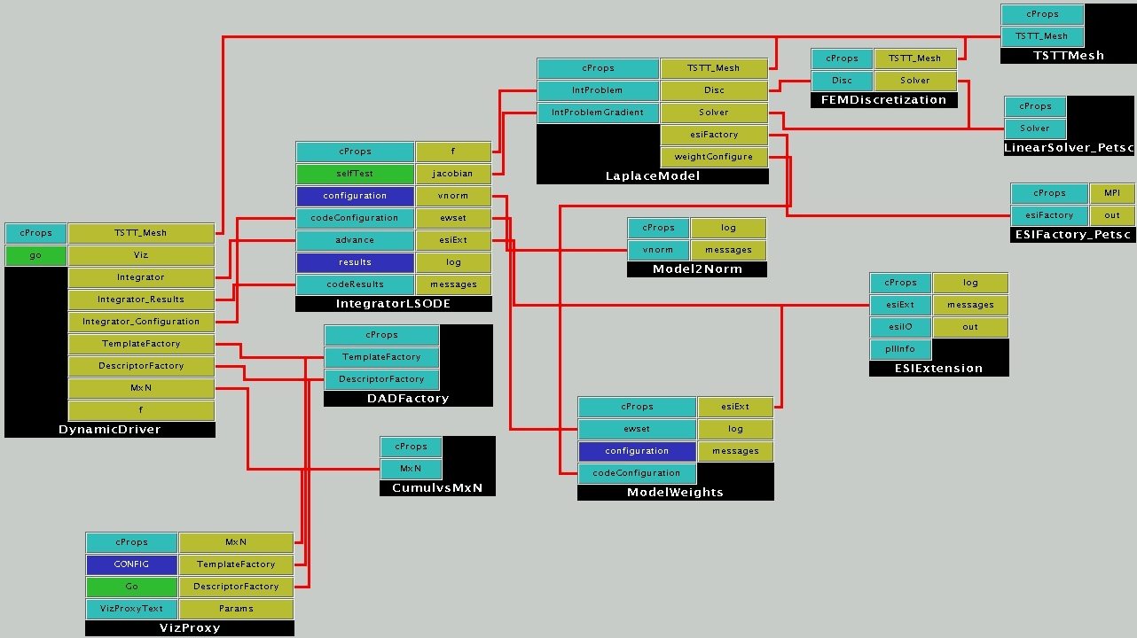
Heat Equation Wiring Diagram
Reused
Integration
Visualization
Driver/Physics
Notes:
As you can see, this is a significantly more complicated application. The driver is again in control of the overall flow of the application and accesses the mesh, visualization, integration, and data redistribution components.
(Press space bar highlight yellow circle) Even though this is a significantly more complicated application we can reuse many of our earlier components including discretization, mesh, and solver components. For the solver component, we have our choice of either a PETSc-based or Trillinos implementation of the Equation Solver Interface(ESI) for the ESI vectors needed in the integration component.
(Press space bar to highlight light blue circles) The integration component is separated into three pieces – the main integration component which contains the LSODE algorithms and application specific portions (the Model2Norm component and the model weights component) that can be used to customize the component for a given application without changing the main component.
(Press space bar to highlight dark blue circles) In this case, the physics has been separated from the driver and is represented in the LaplaceModel component which connects to the discretization, mesh, and solver components.
(press space bar to highlight green circles) The DADFactory and Cumulvs components provide the distributed array and data redistribution functionalities respectively for use in the visualization component.

Slide 136
What did this exercise teach us?
Easy to incorporate the functionalities of components developed at other labs and institutions given a well-defined interface.
  In fact, some components (one uses and one provides) were developed simultaneously across the country from each other after the definition of a header file.
  Amazingly enough, they usually “just worked” when linked together (and debugged individually).
In this case, the complexity of the component-based approach was higher than the original code complexity.
  Partially due to the simplicity of this example
  Partially due to the limitations of the some of the current implementations of components
Notes:
What did we learn? That it really did just work for the most part for this application example. In fact, most of the application was developed at ANL (discretization, mesh, physics) and the supporting components were developed at a number of different DOE labs (LSODE at SNL, Vis and data redistribution components at ORNL). We worked on our various components just before supercomputing of 01 with only a header file specification determined (in particular the visualization of unstructured meshes was not available until just a few days before the show). When we assembled the components into an application it all worked well together (barring individual bugs in the component implementations). Well defined interfaces are key!
However, in this case the complexity of the application code was higher than that of the original code. This is due to two reasons primarily. First, this application was extremely simple and didn’t really exercise the full functionality of most of the components. Second, some of the component implementations are limited at this time. In particular, the fact that the MxN data redistribution component only works with distributed arrays added an extra layer of data translation for the visualization process that was not needed in the original code.

Slide 137
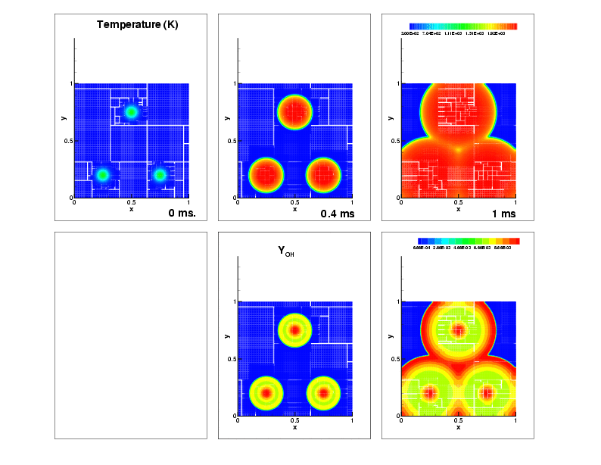
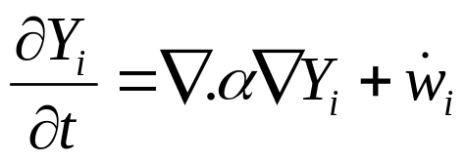
Nonlinear Reaction-Diffusion Equation
Flame Approximation
  H₂-Air mixture; ignition via 3 hot-spots
  9-species, 19 reactions, stiff chemistry
Governing equation
Domain
  1cm X 1cm domain
  100x100 coarse mesh
  finest mesh = 12.5 micron.
Timescales
  O(10ns) to O(10 microseconds)
Notes:
We now highlight two more complex applications that have been developed with component technologies. The first is a reaction diffusion problem that a chemically reacting flame front. The domain consists of a 1 cm x 1 cm area with a H2-Air mixture. The initial condition contains three spots of high temperature. As time progresses, the mixture ignites and we use the adaptive mesh code just described to help model the evolving process.
Apart from H₂, O₂ and N₂, the mechanism contains intermediate species H, O, OH, HO₂, H₂O₂ and H₂, undergoing 19 reversible reactions.
The governing eqn is given. Note that there is both a diffusive term and a chemistry function. The chemistry terms result in stiff ODEs which can be difficult to model.
The timescales that are relevant in this simulation range from10ns – 10 microseconds

Slide 138
Numerical Solution
Adaptive Mesh Refinement: GrACE
Stiff integrator: CVODE
Diffusive integrator: 2nd Order Runge Kutta
Chemical Rates: legacy f77 code
Diffusion Coefficients: legacy f77 code
New code less than 10%
Notes:
The numerical solution of this application uses the same adaptive mesh refinement library as before: GrACE. The integrator has changed to LLNL’s CVODE library to handle the stiff ODE’s associated with the chemical reactions. The calculation of the chemical rates and diffusion coefficients are based on legacy f77 code from SNL Livermore. The new code required for this application (wrappers, statistics, the driver) was quite small, less than 10%.

Slide 139
Reaction-Diffusion Wiring Diagram
Reused
Slow Time Scale Integration
Fast Time Scale Integration
Driver/Physics
Notes:
Here is the wiring diagram for this reaction diffusion example.
(Space bar for yellow circle) The only component explicitly reused from the simple heat equation is the AMR mesh component.
(Space bar for blue circles)Note there is still a driver that controls the flow of the application and an initial condition component that are similar to those used in the previous example.
The major change is in the integration algorithm.
(space bar for purple circles) There are the slow-timescale diffusive physics components which consist of diffusive coefficients, a diffusive flux and a runge-kutta integrator. There are two main ways of advancing this part of the simulation in time based primarily on how you compute the diffusive coefficients. In this example we’re using Lennard-Jones potentials, but if you wanted to replace this with another model (say a curve fitting algorithm) it is easy to do in a component framework. If the interfaces stay the same, you simply point the application to the new component in the repository and rerun. The switch takes just moments.
(space bar for pink circles) There is also a fast-timescale integrator for the chemical physics which includes the CVODE library and a computation of the chemical rates.

Slide 140
Evolution of the Solution
Temperature
No OH at t = 0
OH Profile
Notes:
On the top row we show the evolution of the temperature field. We start with three hotspots which ignite and expand until the ignition fronts meet. The red region is the high temperature hot-products behind the fronts
On the bottom row we show the OH profiles. Typically the profile is high immediately behind the fronts; further behind the fronts them, OH reacts away to form H₂0.
The thick OH structures are big enough for a 100 x 100 mesh – so why mesh refinement ?

Slide 141
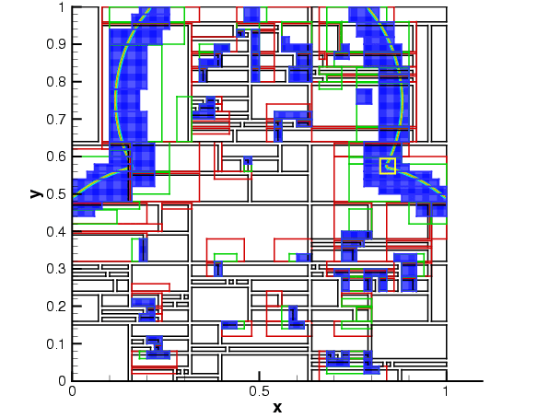
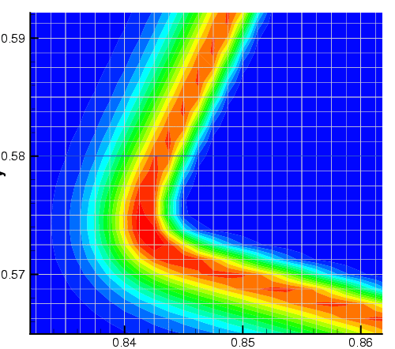
The need for AMR
H₂O₂ chemical subspecies profile
  Only 100 microns thick (about 10 fine level cells)
  Not resolvable on coarsest mesh
Notes:
Shows you the domain and the H₂O₂ profiles. The coarse mesh has been divided into patches (black outlines) and distributed to 30 procs. Sections of the black patches have been refined into green, green into red and red into blue patches where the field has been colored. A zoom into the yellow box shows the structure – the H₂O₂ profiles are around 10 cells wide on the finest mesh ~ 100 microns
The entire structure is contained inside 1 coarse cell – we managed to track and resolve it.

Slide 142
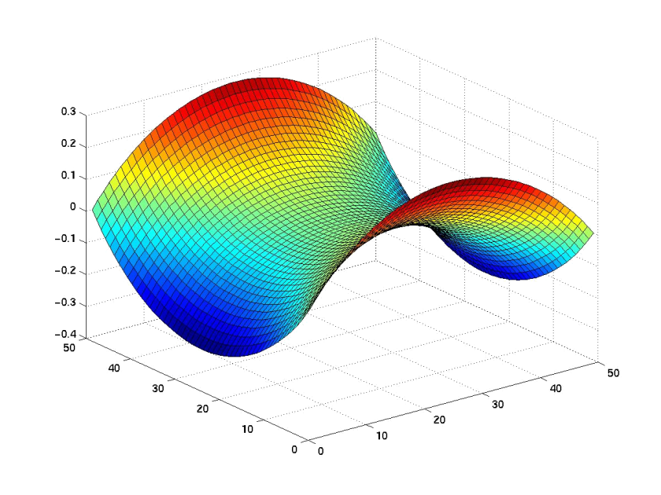
Unconstrained Minimization Problem
Given a rectangular 2-dimensional domain and boundary values along the edges of the domain
Find the surface with minimal area that satisfies the boundary conditions, i.e., compute
min f(x), where f: R → R
Solve using optimization components based on TAO (ANL)
Notes:
Our final application is an unconstrained minimization problem. Given a rectangular 2-D domain and boundary values on the edge of the domain, our goal is to find the surface with the minimum area that satisfies the boundary conditions. That is, we need to compute the minimum of a function f(x) using optimization algorithms. In this case, we’ll use the solvers provided by the Toolkit for Advanced Optimization (TAO) developed at ANL.

Slide 143
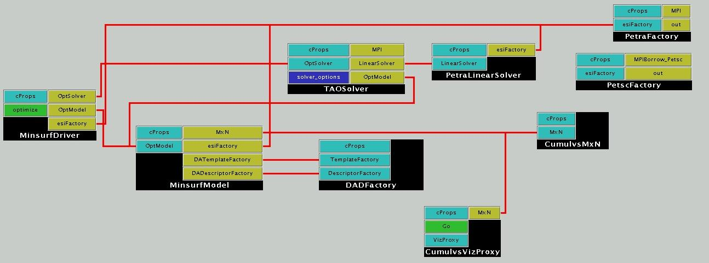
Unconstrained Minimization Using a Structured Mesh
Reused
TAO Solver
Driver/Physics
Notes:
The solution to this optimization problem (although it is very different than the solution of PDEs) still uses many of the same components as before. In particular, solver, distributed arrays, mxn redistribution, and visualization components are all reused (press the space bar to highlight the yellow circles)
The structure is also similar to what we’ve seen earlier. There are two application-specific components– the driver and the min surf model that would need to be altered to run a new application. (press the space bar to highlight the dark blue circles)
The new component in this case is the Tao solver component which is based on the TAO (Toolkit for Advanced Optimization) out of Argonne. (press the space bar to highlight the purple circle)

Slide 144
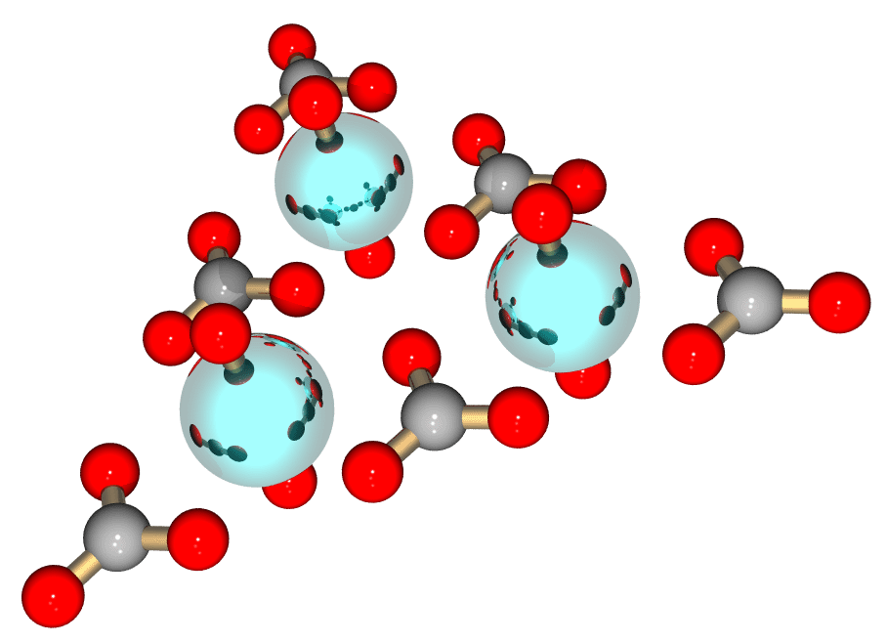
Computational Chemistry:
Molecular Optimization
Investigators: Yuri Alexeev (PNNL), Steve Benson (ANL), Curtis Janssen (SNL), Joe Kenny (SNL), Manoj Krishnan (PNNL), Lois McInnes (ANL), Jarek Nieplocha (PNNL), Jason Sarich (ANL), Theresa Windus (PNNL)
Goals: Demonstrate interoperability among software packages, develop experience with large existing code bases, seed interest in chemistry domain
Problem Domain: Optimization of molecular structures using quantum chemical methods

Slide 145
Molecular Optimization Overview
Decouple geometry optimization from electronic structure
Demonstrate interoperability of electronic structure components
Build towards more challenging optimization problems, e.g., protein/ligand binding studies
Components in gray can be swapped in to create new applications with different capabilities.

Slide 146
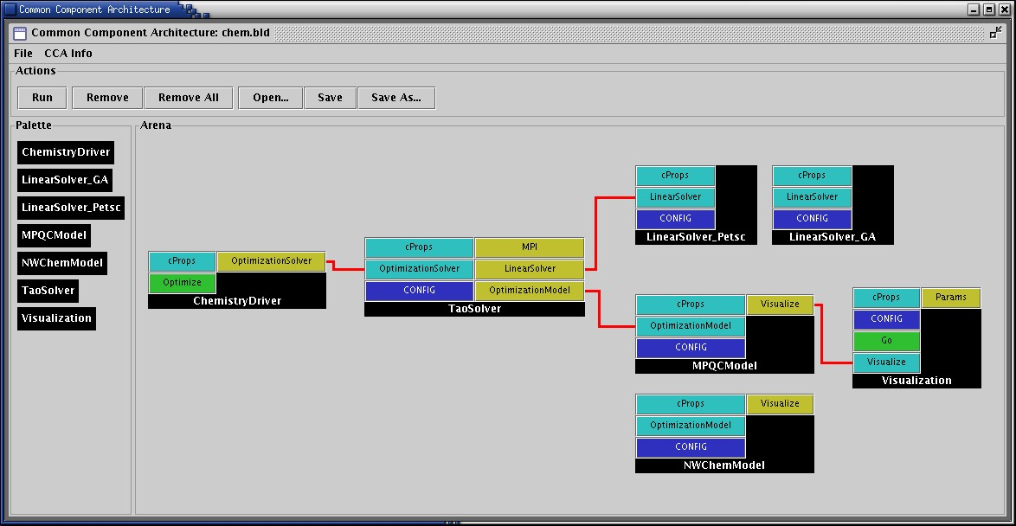
Wiring Diagram for Molecular Optimization
Electronic structures components:
  MPQC (SNL)
  http://aros.ca.sandia.gov/~cljanss/mpqc
  NWChem (PNNL)
  http://www.emsl.pnl.gov/pub/docs/nwchem
Optimization components: TAO (ANL) http://www.mcs.anl.gov/tao
Linear algebra components:
  Global Arrays (PNNL) http://www.emsl.pnl.gov:2080/docs/global/ga.html
  PETSc (ANL)
  http://www.mcs.anl.gov/petsc

Slide 147
Actual Improvements
Molecule | NWChem | NWChem/TAO | MPQC | MPQC/TAO
Glycine | 33 | 19 | 26 | 19
Isoprene | 56 | 45 | 75 | 43
Phosposerine | 79 | 67 | 85 | 62
Aspirin | 43 | 51 | 54 | 48
Cholesterol | 33 | 30 | 27 | 30
Function and gradient evaluations

Slide 148
Componentized Climate Simulations
NASA’s ESMF project has a component-based design for Earth system simulations
  ESMF components can be assembled and run in CCA compliant frameworks such as Ccaffeine.
Zhou et al (NASA Goddard) has integrated a simple coupled Atmosphere-Ocean model into Ccaffeine and is working on the Cane-Zebiak model, well-known for predicting El Nino events.
Different PDEs for ocean and atmosphere, different grids and time-stepped at different rates.
  Synchronization at ocean-atmosphere interface; essentially, interpolations between meshes
  Ocean & atmosphere advanced in sequence
Intuitively : Ocean, Atmosphere and 2 coupler components
  2 couplers : atm-ocean coupler and ocean-atm coupler.
  Also a Driver/orchestrator component.
Notes:
NASA has a component framework called ESMF. It provides a superstructure to orchestrate the sequence of solution (numerical algo) and an infrastructure that supplies math tools (discretizations, interpolations etc) and the “components” (physical and mathematical models) are sandwiched in-between, using the infrastructure and being used by the superstructure. So can these physical and math models be components in the CCA world ?
So Zhou and gang set off to implement a simple ocean-atmosphere coupled model – the Cane-Zebiak model; looks
Like the shallow water equations. Very simple problem decomposition – an Atmosphere component (with multiple initial conditions and atmosphere models in one place), an ocean component (multiple initial conditions and models in one place; the user chooses which one to run) and components that interpolate between the coarse atmosphere mesh and fine ocean mesh. The PDEs that describe the ocean and atmosphere are different and solved differently – they are also
Time-stepped independently. In a given global timestep, the atmosphere and ocean are iterated to a consistent state, before advancing to the next timestep.

Slide 149
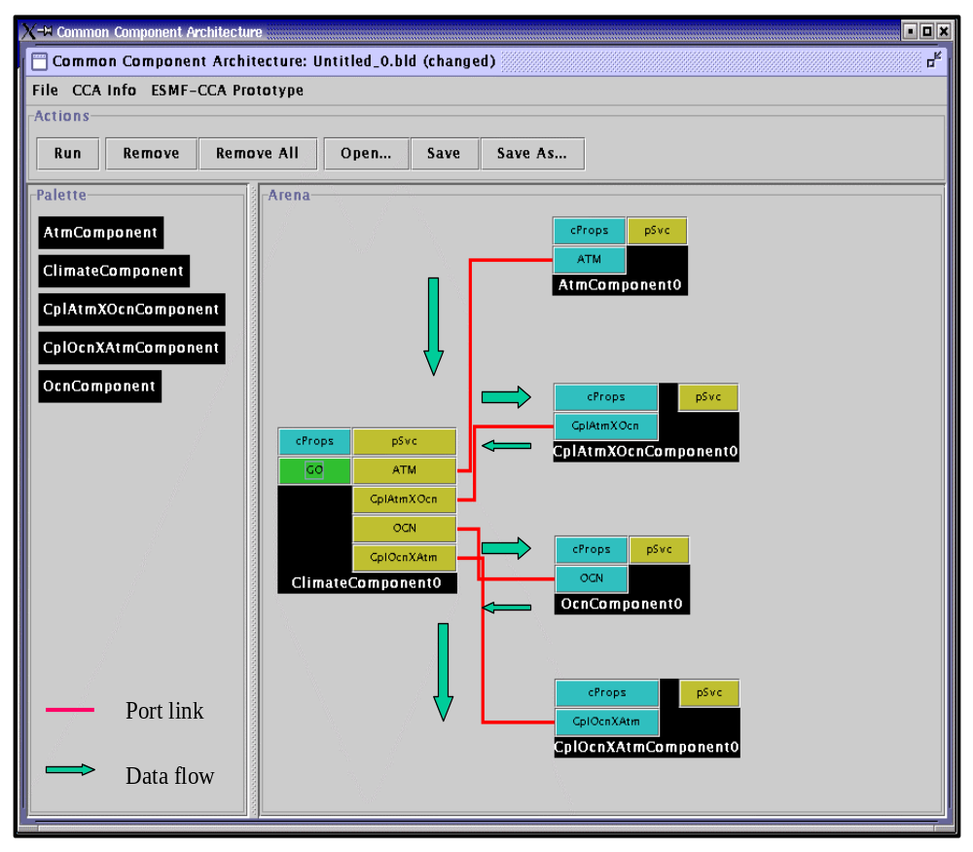
Coupled Atmosphere-Ocean Model Assembly
Climate Component :
  Schedule component coupling
Data flow is via pointer NOT data copy.
  All components in C++; run in Ccaffeine
Multiple ocean models with the same interface
  Can be selected by a user at runtime
Notes:
So here is the CCA wiring diagram. Driver / ClimateComponent on the left. Contains the iterate-till-consistent-algorithm, also counts global timesteps. It calls on the atmosphere, atmosphere-to-ocean coupler, the ocean and then ocean-to-atmosphere coupler in sequence. In each call to ocean or atmosphere, the relevant PDEs are time-stepped at the relevant rate.
The ClimateComponent “flows” the data from component to component, but not by copy.
The ocean component has multiple initial conditions and models built – the user chooses which one to run at runtime.
Zhou and gang are looking at Cumulvs (ORNL) to do runtime viz.

Slide 150
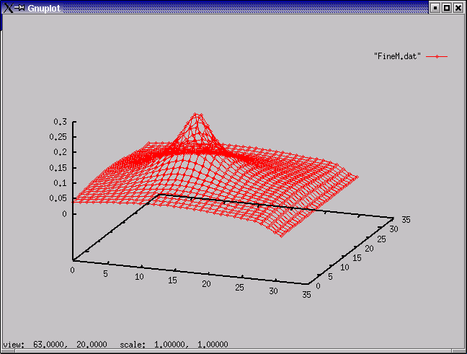
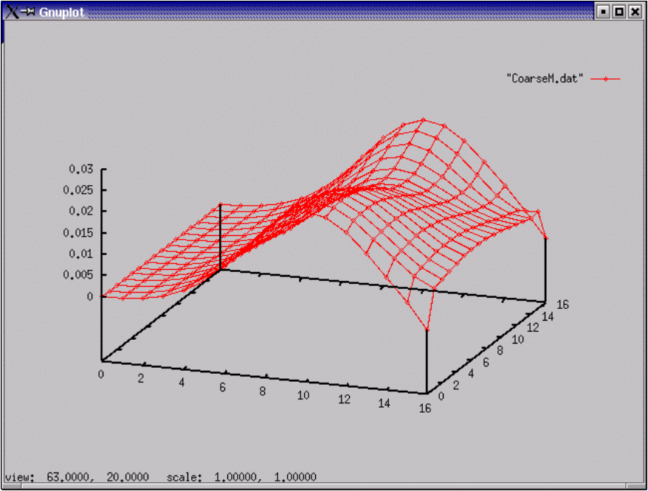
Simulation Results
…changes a field variable (e.g.,wind) in the atmosphere !
A non-uniform ocean field variable (e.g., current)
Notes:
OK, so does it work ?
Left, the velocity field of the atmosphere near the ocean-atmosphere interface. Variation in velocity (there are parts with zero velocity) indicates a wind. This causes shear stress on the water surface, exerting a force and ……….
………on the right, it induces a velocity field in the ocean, also near the ocean-atmosphere interface. Generally, this is referred to as a wave.
The thing works.

Slide 151
Concurrency At Multiple Granularities
Certain simulations need multi-granular concurrency
  Multiple Component Multiple Data, multi-model runs
Usage Scenarios:
  Model coupling (e.g. Atmosphere/Ocean)
  General multi-physics applications
  Software licensing issues
Approaches
  Run single parallel framework
    Driver component that partitions processes and builds rest of application as appropriate (through BuilderService)
  Run multiple parallel frameworks
    Link through specialized communications components
    Link as components (through AbstractFramework service; highly experimental at present)
Driver
Atmosphere
Ocean
Land
Coupler

Slide 152
Overview
Examples (scientific) of increasing complexity
  Laplace equation
  Time-dependent heat equation
  Nonlinear reaction-diffusion system
  Quantum chemistry
  Climate simulation
Tools
  MxN parallel data redistribution
  Performance measurement, modeling and scalability studies
Community efforts & interface development
  TSTT Mesh Interface effort
  CCTTSS’s Data Object Interface effort
Notes:
To highlight how components can be useful in this scenario I will show a series of examples of increasing complexity that highlight component reuse and composability. I will start with a simple steady state PDE and move to a time-dependent PDE and from there to block structured adaptive time dependent PDEs. We will also show the use of several of the same components used in the PDE simulations in optimization-based applications.
I will give single processor performance results and scalability results for distributed memory applications. These results show that if you choose the level of granularity for your components appropriately there is very little performance impact.
Finally, based on our experiences to date, I will discuss strategies for developing your own component-based high performance simulation code. In addition, I will give a case study that highlights some of the issues associated with developing interchangeable and interoperable components in a domain-specific setting through the development of common interfaces.

Slide 153
“MxN” Parallel Data Redistribution:
The Problem…
Create complex scientific simulations by coupling together multiple parallel component models
  Share data on “M” processors with data on “N”
    M != N ~ Distinct Resources (Pronounced “M by N”)
  Model coupling, e.g., climate, solver / optimizer
  Collecting data for visualization
    Mx1; increasingly MxN (parallel rendering clusters)
Define common interface
  Fundamental operations for any parallel data coupler
    Full range of synchronization and communication options
Notes:
The most interesting case of “MxN” parallel data redistribution is clearly when “M” is not equal to “N”.
This happens often in scientific model coupling, e.g. in climate simulations, or for visualization where the
case is typically “M by 1”. But this technology could also be useful for more complex component applications
where a solver and optimizer components must share parallel data, whether within the same framework
or spanning multiple frameworks.
The goal of this initial “MxN” effort is to provide a generalized interface that describes all the fundamental
operations supported by any parallel data coupler, including a spectrum of synchronization and communication
options.

Slide 154
Hierarchical MxN Approach
Basic MxN Parallel Data Exchange
  Component implementation
  Initial prototypes based on CUMULVS & PAWS
    Interface generalizes features of both
Higher-Level Coupling Functions
  Time & grid (spatial) interpolation, flux conservation
  Units conversions…
“Automatic” MxN Service via Framework
  Implicit in method invocations, “parallel RMI”
http://www.csm.ornl.gov/cca/mxn/
Notes:
The current MxN interface generalizes the protocols and functions in the CUMULVS (ORNL) and PAWS (LANL)
systems, and also encompasses much of the capabilities in systems like the Model Coupling Toolkit (MCT) for
climate coupling.
(The existing MxN interface is *so* general, that neither CUMULVS, PAWS or MCT fully implement the interface! ☺)
The extended MxN architecture will build on this basic MxN interface, to construct higher-level coupling functions
that handle units conversion, temporal and spatial interpolation, and flux conservation, in the coupling data exchange.
Ultimately, as these capabilities become well understood, such MxN and coupling interfaces might be “automated”
to run as implicit framework services. In a utopian CCA framework, parallel components could share data and
collectively invoke parallel methods on each other without ever knowing their true parallel nature…
But a *significant* research effort in MxN and parallel method invocations, or “Parallel RMI”, is necessary
before any automated system can be constructed.

Slide 155
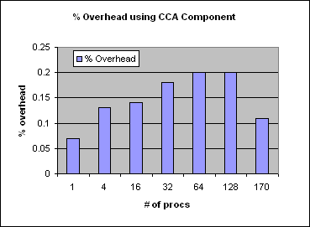
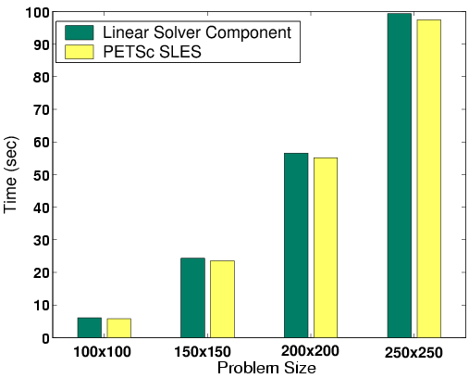
CCA Delivers Performance
Local
No CCA overhead within components
Small overhead between components
Small overhead for language interoperability
Be aware of costs & design with them in mind
  Small costs, easily amortized
Parallel
No CCA overhead on parallel computing
Use your favorite parallel programming model
Supports SPMD and MPMD approaches
Distributed (remote)
No CCA overhead – performance depends on networks, protocols
CCA frameworks support OGSA/Grid Services/Web Services and other approaches
Maximum 0.2% overhead for CCA vs native C++ code for parallel molecular dynamics up to 170 CPUs
Aggregate time for linear solver component in unconstrained minimization problem w/ PETSc

Slide 156
Overhead from Component Invocation
Invoke a component with different arguments
    Array
    Complex
    Double Complex
Compare with f77 method invocation
Environment
  500 MHz Pentium III
  Linux 2.4.18
  GCC 2.95.4-15
Components took 3X longer
Ensure granularity is appropriate!
Paper by Bernholdt, Elwasif, Kohl and Epperly
Function arg type | f77 | Component
Array | 80 ns | 224ns
Complex | 75ns | 209ns
Double complex | 86ns | 241ns
Notes:
To examine the component instantiation costs in more detail we compared the time needed to invoke a function in f77 versus the time needed to invoke a component with an array, a complex and a double complex as arguments.
The components took 3x longer for the function invocation, not function execution so one has to ensure that the granularity is such that the 240 ns overhead is negligible compared to the body of the component.

Slide 157
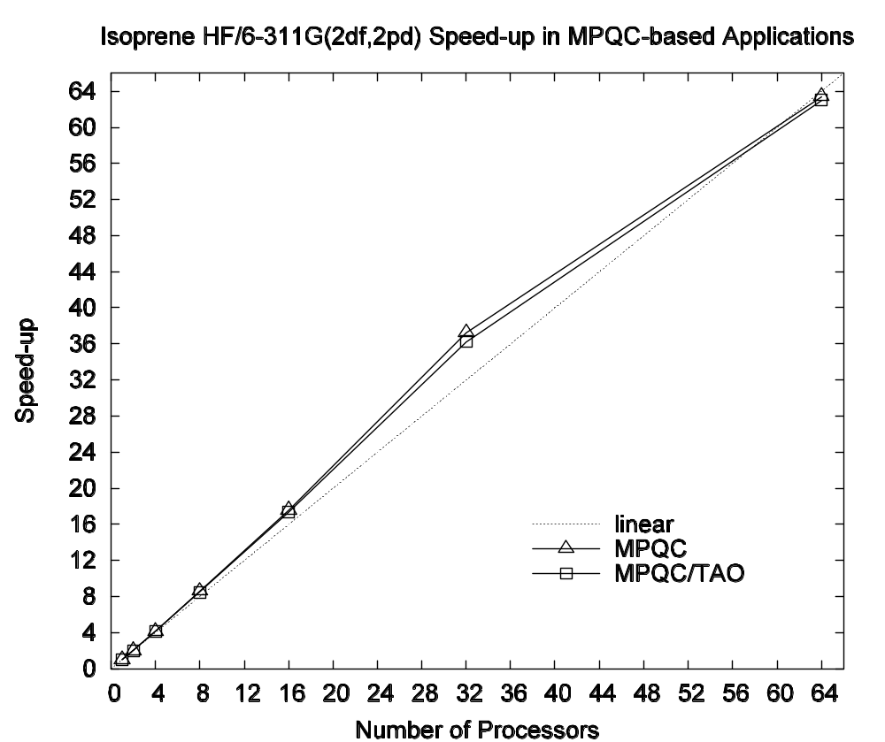
Scalability : Component versus Non-component. I
Quantum chemistry simulation
Sandia’s MPQC code
  Both componentized and non-componentized versions
Componentized version used TAO’s optimization algorithms
Problem :Structure of isoprene HF/6-311G(2df,2pd)
Parallel Scaling of MPQC w/ native and TAO optimizers

Slide 158
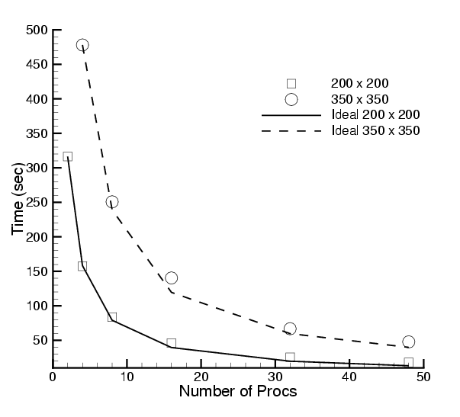
Scalability : Component versus Non-component. II
Hydrodynamics; uses CFRFS set of components
Uses GrACEComponent
Shock-hydro code with no refinement
200 x 200 & 350 x 350 meshes
Cplant cluster
  400 MHz EV5 Alphas
  1 Gb/s Myrinet
Negligible component overhead
Worst perf : 73% scaling efficiency for 200x200 mesh on 48 procs
Reference: S. Lefantzi, J. Ray, and H. Najm, Using the Common Component Architecture to Design High Performance Scientific Simulation Codes, Proc of Int. Parallel and Distributed Processing Symposium, Nice, France, 2003.

Slide 159
Performance Measurement In A Component World
CCA provides a novel means of profiling & modeling component performance
Need to collect incoming inputs and match them up with the corresponding performance, but how ?
  Need to “instrument” the code
    But has to be non-intrusive, since we may not “own” component code
What kind of performance infrastructure can achieve this?
  Previous research suggests proxies
    Proxies serve to intercept and forward method calls

Slide 160

“Integrated” Performance Measurement Capability
Before:
Measurement infrastructure:
Proxy
  Notifies MasterMind of all method invocations of a given component, along with performance dependent inputs
  Generated automatically using PDT
MasterMind
  Collects and stores all measurement data
TAU
  Makes all performance measurements
Component1
Component2
After:
Component1
Proxy for Component2
Component2
MasterMind
TAU

Slide 161
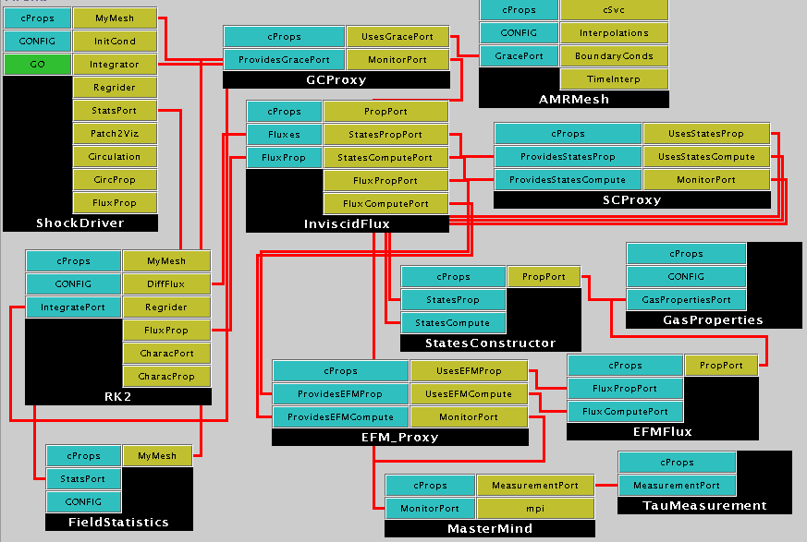
Component Application With Proxies

Slide 162
Overview
Examples (scientific) of increasing complexity
  Laplace equation
  Time-dependent heat equation
  Nonlinear reaction-diffusion system
  Quantum chemistry
  Climate simulation
Tools
  MxN parallel data redistribution
  Performance measurement, modeling and scalability studies
Community efforts & interface development
  TSTT Mesh Interface effort
  CCTTSS’s Data Object Interface effort
Notes:
To highlight how components can be useful in this scenario I will show a series of examples of increasing complexity that highlight component reuse and composability. I will start with a simple steady state PDE and move to a time-dependent PDE and from there to block structured adaptive time dependent PDEs. We will also show the use of several of the same components used in the PDE simulations in optimization-based applications.
I will give single processor performance results and scalability results for distributed memory applications. These results show that if you choose the level of granularity for your components appropriately there is very little performance impact.
Finally, based on our experiences to date, I will discuss strategies for developing your own component-based high performance simulation code. In addition, I will give a case study that highlights some of the issues associated with developing interchangeable and interoperable components in a domain-specific setting through the development of common interfaces.

Slide 163
The Next Level
TSTT
Common Interface Specification
  Provides plug-and-play interchangeability
  Requires domain specific experts
  Typically a difficult, time-consuming task
  A success story: MPI
A case study… the TSTT/CCA mesh interface
  TSTT = Terascale Simulation Tools and
  Technologies (www.tstt-scidac.org)
  A DOE SciDAC ISIC focusing on meshes
  and discretization
  Goal is to enable
    hybrid solution strategies
    high order discretization
    Adaptive techniques
Geometry
Information
(Level A)
Full
Geometry
Meshes
(Level B)
Mesh
Components
(Level C)
Notes:
To be able to truly experience the power of component implementations it would be nice to be able to experiment with scientific software in a plug-and-play manner that allows application scientists to quickly and easily explore a number of different strategies (discretizations, solvers, etc) to determine which is best suited for their particular application.
This is impossible to do unless many tools that provide similar functionality also support the same interfaces. To achieve this in any particular domain, a number of experts must be willing to come to the table to hammer out the interface specification which is a difficult and time consuming task. Of course the pay-offs can be enormous for our community – the MPI standarization effort comes to mind.
In the next few minutes, I’m going to present a case study of an ongoing interface definition effort that’s been undertaken by the TSTT and CCA SciDAC centers (there are more efforts than this, and the next talk will highlight some of these).
The Terascale Simulation Tools and Technologies center (TSTT) is a DOE SciDAC Integrated Software Infrastructure Center (ISIC) whose primary goal is to bring interoperable and interchangeable meshing and discretization strategies to application scientists. In particular, they are trying to increase the use of hybrid solution strategies, high-order discretization and adaptive techniques.
For example, the picture on the lower left corner shows a situation in which a geometric domain is meshed in two different ways – one using mesh components of different types, both structured and unstructured, and the other a completely unstructured mesh. We would like to allow scientists to use either of these meshes without changing their application code by providing a common interface for both.

Slide 164
Proliferations of interfaces – the N² problem
Current Situation
Public interfaces for numerical libraries are unique
Many-to-Many couplings require Many² interfaces
  Often a heroic effort to understand the inner workings of both codes
  Not a scalable solution
Dist. Array
ISIS++
Overture
PETSc
PAOMD
Trilinos
SUMAA3d
Notes:
Currently, there are a large number of tools available that provide mesh management infrastructure (for example, CUBIT (SNL), AOMD (RPI), Overture (LLNL), NWGrid (PNL)). These tools are all very nice and meet particular needs, but they do not interoperate to form composite hybrid meshes, nor are they easily interchanged in an application for experimentation with different strategies because their APIs are all different.
Thus if you wanted to experiment with many different meshing strategies and many different solver strategies you would have to write NxM interfaces which is a time consuming task that most application scientists are not willing to undertake.
Thus, more recent developments in the meshing/discretization/solver community are often underused because it is so difficult to upgrade the application software.

Slide 165
Common Interface Specification
Reduces the Many-to-Many problem to a Many-to-One problem
  Allows interchangeability and experimentation
  Challenges
    Interface agreement
    Functionality limitations
    Maintaining performance
Dist. Array
T
S
T
T
ISIS++
E
S
I
Overture
PETSc
PAOMD
Trilinos
SUMAA3d
Notes:
Instead we would like to reduce the many-to-many problem to a Many-to-one problem in which a common interface is supported by a large number of tool providers so that the application scientist can code to the interface and then use any compliant tool.
The challenges associated with determining such an interface are many. First and foremost the participants must agree to an interface that maintains both performance and flexibility.

Slide 166
TSTT Philosophy
Create a small set of interfaces that existing packages can support
  AOMD, CUBIT, Overture, GrACE, …
  Enable both interchangeability and interoperability
Balance performance and flexibility
Work with a large tool provider and application community to ensure applicability
  Tool providers: TSTT and CCA SciDAC centers
  Application community: SciDAC and other DOE applications
Notes:
Within the TST center we have decided to create a small set of interface that existing packages can support for mesh query, access, and modification. Note – we are not imposing any particular data structure on the mesh management package, rather we are providing mechanisms to ask questions of the package to retrieve information such as vertex coordinate and connectivity information.
To achieve a balance between performance and flexibility we are providing interfaces that are appropriate for both structured and unstructured grids (for example entity-by-entity traversal of the mesh as well as array based access to information).
We are working with a large tool provider and application base to ensure applicability of the interface. As a group we have a large number of connections with the DOE application community and are always looking for more contacts.

Slide 167
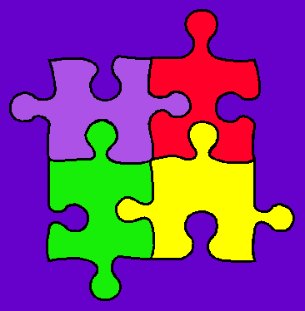
CCTTSS Research Thrust Areas and Main Working Groups
Scientific Components
  Lois Curfman McInnes, ANL (curfman@mcs.anl.gov)
“MxN” Parallel Data Redistribution
  Jim Kohl, ORNL (kohlja@ornl.gov)
Frameworks
  Language Interoperability / Babel / SIDL
  Gary Kumfert, LLNL (kumfert@llnl.gov)
User Outreach
  David Bernholdt, ORNL (bernholdtde@ornl.gov)
Notes:
CCTTSS Research Thrusts
There are 4 main thrust areas being researched as part of the CCA effort.
There are a number of special working groups exploring each of these areas.
Scientific Components
The scientific components efforts includes a number of numerical software components, as well as general support components
such as for visualization and computational steering.
As part of this scientific component effort, several special working groups are developing generalized scientific data objects,
for a variety of data meshes, to assist scientists in composing and sharing data between independent components.
MxN
The “MxN” (pronounced “M by N”) research emphasizes the sharing of parallel data among components,
as is often done in climate simulations and other coupled scientific models. This kind of parallel data exchange and
redistribution can be more common in a generalized component environment, and these special parallel interfaces are
some of the primary features that distinguish CCA from other component technologies.
Frameworks
The CCA Framework effort is concerned with providing encapsulating containers, with associated services, for assembling
component-based applications. This work includes challenging issues like language interoperability, as well as the development
of component repositories and deployment strategies.
User Outreach
The 4th Thrust Area involves working closely with scientific application domains, to help them utilize the CCA specifications
and technology, and to coordinate user feedback to help guide and drive the ongoing CCA design.

Slide 168
Summary
Complex applications that use components are possible
  Combustion
  Chemistry applications
  Optimization problems
  Climate simulations
Component reuse is significant
  Adaptive Meshes
  Linear Solvers (PETSc, Trilinos)
  Distributed Arrays and MxN Redistribution
  Time Integrators
  Visualization
Examples shown here leverage and extend parallel software and interfaces developed at different institutions
  Including CUMULVS, ESI, GrACE, LSODE, MPICH, PAWS, PETSc, PVM, TAO, Trilinos, TSTT.
Performance is not significantly affected by component use
Definition of domain-specific common interfaces is key
Notes:
In summary, I hope that this talk has shown you that the use of components in complex, useful applications such as shock hydrodynamics, reaction diffusion applications, and optimization problems is both feasible and does not have to significantly impact performance.
We have shown a significant reuse of “infrastructure” type components such as meshes, solvers, visualization and integration tools. The examples shown here leveraged significant pieces of parallel software such as CUMULVS, GrACE, PETSc, TAO, Trillinos, etc..
I have also tried to highlight the importance of defining domain specific common interfaces to achieve the full potential of scientific components.

Slide 169
A Few Notes in Closing

Slide 170
Resources: Its All Online
Information about all CCA tutorials, past, present, and future:
http://www.cca-forum.org/tutorials/
Specifically…
  Latest versions of hands-on materials and code:
  http://www.cca-forum.org/tutorials/#sources
    Hands-On designed for self-study as well as use in an organized tutorial
    Should work on most Linux distributions, less tested on other unixen
    Still evolving, so please contact us if you have questions or problems
  Archives of all tutorial presentations:
  http://www.cca-forum.org/tutorials/archives/
Questions…
tutorial-wg@cca-forum.org

Slide 171
Getting Help
We want to help insure you have a good experience with CCA, so let us know if you’re having problems!
Tutorial or “start-up” questions
  tutorial-wg@cca-forum.org
Problems with specific tools
  check documentation for updated contact info
  cca-tools bundle (includes Chasm, Babel, Ccaffeine): Rob Armstrong, rob@sandia.gov
  Chasm: Craig Rasmussen, crasmussen@lanl.gov
  Babel: babel-users@llnl.gov
  Ccaffeine: ccafe-users@cca-forum.org
General questions, or not sure who to ask?
  cca-forum@cca-forum.org

Slide 172
CCA is Interactive
Collectively, CCA developers and users span a broad range of scientific interests.
  There’s a good chance we can put you in touch with others with relevant experience with CCA
CCA Forum Quarterly Meetings
  Meet many CCA developers and users
  http://www.cca-forum.org/meetings/
“Coding Camps”
  Bring together CCA users & developers for a concentrated session of coding
  Held as needed, typically 3-5 days
  May focus on a particular theme, but generally open to all interested participants
  If you’re interested in having one, speak up (to individuals or cca-forum@cca-forum.org)
Visits, Internships, etc.

Slide 173
Acknowledgements:
Tutorial Working Group
People: Benjamin A. Allan, Rob Armstrong, David E. Bernholdt, Randy Bramley, Tamara L. Dahlgren, Lori Freitag Diachin, Wael Elwasif, Tom Epperly, Madhusudhan Govindaraju, Ragib Hasan, Dan Katz, Jim Kohl, Gary Kumfert, Lois Curfman McInnes, Alan Morris, Boyana Norris, Craig Rasmussen, Jaideep Ray, Sameer Shende, Torsten Wilde, Shujia Zhou
Institutions: ANL, Binghamton U, Indiana U, JPL, LANL, LLNL, NASA/Goddard, ORNL, SNL, U Illinois, U Oregon
Computer facilities provided by the Computer Science Department and University Information Technology Services of Indiana University, supported in part by NSF grants CDA-9601632 and EIA-0202048.

Slide 174
Acknowledgements: The CCA
ANL –Steve Benson, Jay Larson, Ray Loy, Lois Curfman McInnes, Boyana Norris, Everest Ong, Jason Sarich…
Binghamton University - Madhu Govindaraju, Michael Lewis, …
Indiana University - Randall Bramley, Dennis Gannon, …
JPL – Dan Katz, …
LANL - Craig Rasmussen, Matt Sotille, …
LLNL – Tammy Dahlgren, Lori Freitag Diachin, Tom Epperly, Scott Kohn, Gary Kumfert, …
NASA/Goddard – Shujia Zhou
ORNL - David Bernholdt, Wael Elwasif, Jim Kohl, Torsten Wilde, …
PNNL - Jarek Nieplocha, Theresa Windus, …
SNL - Rob Armstrong, Ben Allan, Lori Freitag Diachin, Curt Janssen, Jaideep Ray, …
Tech-X Corp. – Johan Carlsson, Svetlana Shasharina, Ovsei Volberg, Nanbor Wang
University of Oregon – Allen Malony, Sameer Shende, …
University of Utah - Steve Parker, …
and many more… without whom we wouldn’t have much to talk about!

Slide 175
Thank You!
Thanks for attending this tutorial
We welcome feedback and questions

