Slide 1
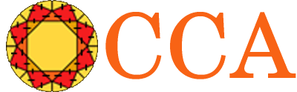

Component Technology for Terascale Simulation Software:
Bringing Components to High Performance Computing
http://www.cca-forum.org/ccttss
Common Component Architecture
Participants:
ANL
Indiana Univ.
LANL
LLNL
ORNL
PNNL
SNL
Univ. of Utah
Partners:
Climate Modeling
Quantum Chemistry
Combustion Modeling
Currently DOE Apps Are:
One-off, stove-pipe, few participants
But Also:
Scalable, and low latency
Large & rich legacy investment
Challenges
Practical parallel HPC component model
Integrate legacy software investment
Connection to Grid components
Multi-language
Goals
Enable plug-and-play parallel simulations
Establish component "marketplace" with applications partners
Extend commodity component technology for HPC
Today:
Single-purpose, monolithic,
tightly-coupled
parallel codes
Component-Based
Scientific Application
High Performance
Component
Framework
Discretization
Engine
Scientific
Components
CCA
Ports
Implicit Solve
“MxN” Parallel Data
Redistribution
Link
Applications
Integration
Rob
Visualization

