Slide 1
Center for Component Technology for Terascale Simulation Software
(aka Common Component Architecture) (aka CCA)
Rob Armstrong & the CCA Working Group
Sandia National Labs
rob@cca-forum.org
cca-forum@cca-forum.org

Slide 2


Component Technology for Terascale Simulation Software:
Bringing Components to High Performance Computing
http://www.cca-forum.org/ccttss
Common Component Architecture
Participants:
ANL
Indiana Univ.
LANL
LLNL
ORNL
PNNL
SNL
Univ. of Utah
Partners:
Climate Modeling
Quantum Chemistry
Combustion Modeling
Currently DOE Apps Are:
One-off, stove-pipe, few participants
But Also:
Scalable, and low latency
Large & rich legacy investment
Challenges
Practical parallel HPC component model
Integrate legacy software investment
Connection to Grid components
Multi-language
Goals
Enable plug-and-play parallel simulations
Establish component "marketplace" with applications partners
Extend commodity component technology for HPC
Today:
Single-purpose, monolithic,
tightly-coupled
parallel codes
Component-Based
Scientific Application
High Performance
Component
Framework
Discretization
Engine
Scientific
Components
CCA
Ports
Implicit Solve
“MxN” Parallel Data
Redistribution
Link
Applications
Integration
Rob
Visualization

Slide 3
Common Component Architecture: what we do for you & to you
Gain
  Users:
    Choice of useful software for high-performance computing (HPC)
    In a near mix-and-match, plug-and-play fashion
    Independently developed code works together in parallel
  Developers:
    Produce code that will find a wider audience
    With consequent fame and maintenance drudgery
    Use other people’s code and take credit for it
Pain
  Can’t continue develop software “unconstrained”
  CCA Constraints:
    Provide the fences that make good neighbors
    Are small when wrapping well-designed legacy code
    Identify and disallow behaviors that produce incompatibility

Slide 4
21st Century Application
Physics Modules
Adaptive Solution
Grids
Optimization
Diagnostics
Discretization
Steering
Derivative Computation
Algebraic Solvers
Visualization
Data Reduction
Collaboration
Parallel I/O

Slide 5
By definition components are independent software modules that are composable...
Component - Encapsulated software object that provides a certain functionality or service and can be used in conjunction with other components to build applications
A component consists of
  an API (abstract interface) and
  one or more component implementations
  common behavior among these components
CCA uses a peer component model - No particular component assumes it is “in charge” of the others. Allows the application developer to decide what is important.

Slide 6
CCA Motivation
Desire to build Science Applications by hooking together drag-N-drop components.
DOE Common Component Architecture provides a mechanism for interoperability of high performance
components developed by many different groups
in different languages or frameworks.
Existing Component Architecture Standards such as CORBA, Java Beans, and COM do not provide support for parallel components.
-6
-4
-1
Latency
between
components
10
10
10
1
sec
MPI
CCA
CORBA/Java

Slide 7
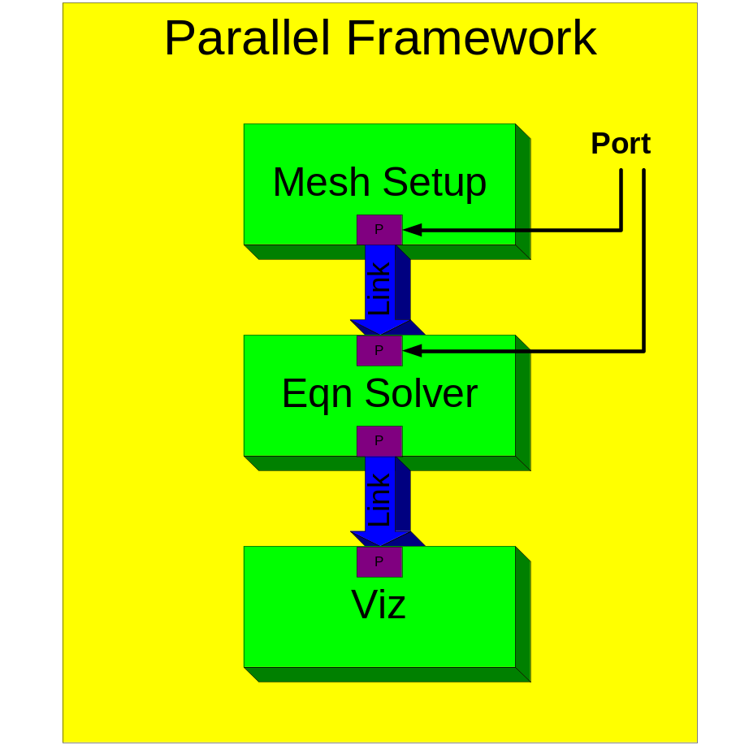
What have we developed?
Metaphor from visual programming (e.g. AVS)
  instead of data-flow ports are linked with interfaces
  provides/uses design pattern
Scripting support for applications
  create Python applications out of components
Scientific IDL spec.
  provides language interoperability only - not part of the component arch. per se.
  introspection.
http://www.cca-forum.org/spec

Slide 8
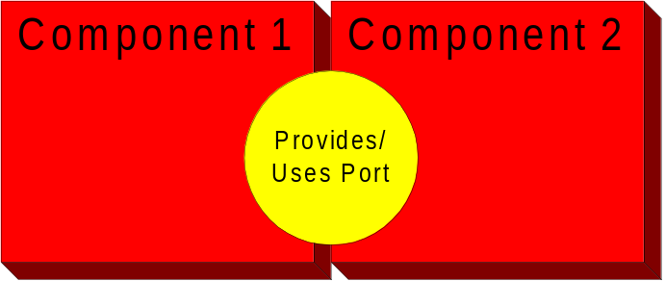
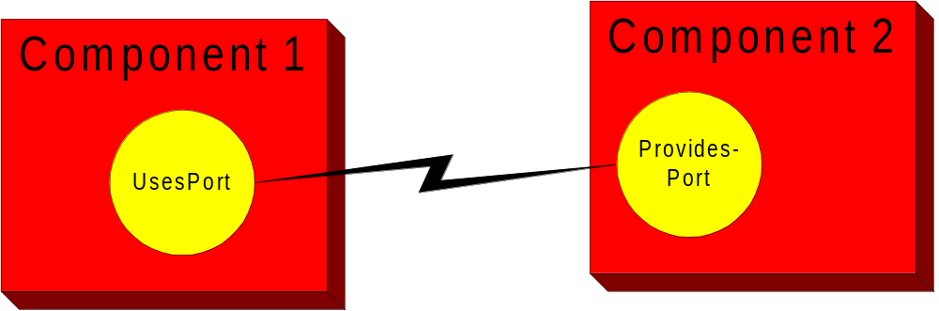
Ports preserve the high-performance of direct connections plus the versatility of distributed object systems
Allow directly connected interfaces: the next component is one function call away.
Adapters will create network-distributed objects out of the same components without altering them.

Slide 9

CCA develops components & supporting code for direct use in apps
Proc1
Proc2
Proc3
etc...
Reference Framework
  One unified framework
  Parallel and grid aware
MxN
  Data re-decomposition components
  Framework plug-ins
Components and Applications
  Various component prototypes
    service capabilities, discretization, mesh management, linear algebra, vizualization, etc.
  Collaboration with other groups to define common interface suites
    E.g., scientific data interfaces (structured and unstructured)
Details: http://cca-forum.org/ccttss/report/Dec01
A
MPI
A
A
A
B
MPI
B
B
B
Physics Modules
Optimization
Grids
Discretization
Derivative Computation

Slide 10
Collaborations with Other SciDAC Groups
CCA does not pretend to be experts in all numerical algorithms, just to provide a standard way to exchange component capabilities.
Medium of exchange: interfaces
  Equation Solver Interface Forum (ESI) has made headway toward defining interfaces for linear algebra
    http://z.ca.sandia.gov/esi
  Need experts in various areas to define sets of domain-specific abstract interfaces
    scientific application domains, applied math, visualization, etc.
      e.g., compressible flow component
      e.g., Newton-Krylov methods
This
means
you!

Slide 11
CCA aids other centers with their component oriented applications
CCA tutorials
  Recent: PNNL (Dec 2001) & prior to CCA Forum meeting in Santa Fe (last week)
  Planned: adjunct to future CCA Forum meetings (quarterly).
  Materials to be placed on web:
  http://www.cca-forum.org/tutorial
Direct interactions with application centers and other ISIC’s (http://www.cca-forum.org/ccttss/report/Dec01/outreach.pdf).
Example code:
  Specification site has toy examples:
    http://www.cca-forum.org/spec
  SC01 code is available
    Several heavy-weight applications.
      Not toys, takes some work to build:
      http://www.cca-forum.org/cca-sc01

Slide 12
Some Current Interactions between CCA and Other SciDAC Groups
Chemistry/Combustion modeling
  A Computational Facility for Reacting Flow Science (PI: H. Najm) - Develop a CCA-based software research “facility” for reacting flow science
  Advanced Software for the Calculation of Thermochemistry, Kinetics, and Dynamics (PI: A. Wagner) – Develop component-based solutions for the coupling of electronic structure and kinetics software
Collaborative Design and Development of the Community Climate System Model for Terascale Computers (PI: R. Malone)
  Develop component-based software design methodologies and integrate the CCA with current componentization efforts within the climate community
Terascale Optimal PDE Simulations ISIC (PI: D. Keyes)
  Create suites of interoperable solvers and define common interfaces for PDE, eigenanalysis, and optimization components
Terascale Simulation Tools and Technologies ISIC (PI: J. Glimm)
  Create interoperable meshing and discretization technologies and define common interfaces for scientific data components
Additional SciDAC interactions in progress (see http://www.cca-forum.org/ccttss), and we are seeking new SciDAC collaborations also

