Slide 1

Component-Based Software for High-Performance Computing: An Introduction to the Common Component Architecture
David E. Bernholdt
Computer Science and Mathematics Division, Oak Ridge National Laboratory
and
Center for Component Technology for Terascale Simulation Software

Slide 2
Acknowledgements
Members of the CCTTSS, especially
  Rob Armstrong, SNL
  Lori Frietag, ANL
  Jim Kohl, ORNL
  Lois Curfman McInnes, ANL
  Boyanna Norris, ANL
  Jaideep Ray, SNL
This work is sponsored by…
  US Dept. of Energy
    Office of Science
      Advanced Scientific Computing Research (ASCR)
        Mathematics, Information and Computer Science (MICS)
      Scientific Discovery through Advanced Computing (SciDAC) program

Slide 3
Challenges in Modern Scientific Software Development
Desire for rapid development cycle
Diversity of languages and tools
  What can be used together?
  Ability to reuse code from inside or outside organization
Parallel computing significantly increases algorithmic complexity
  Where do you find the expertise in all disciplines your code might require?
  Architectural complexity and diversity of modern MPPs
Increasing capability of computers leads to new expectations of simulation
  Higher fidelity, greater sophistication
  Extension to multi-scale and multi-physics simulations
  Coupling of simulations

Slide 4
Managing Software Complexity: Object-Oriented Programming
OO design is a well-established, popular, and widely used methodology
  Often sold as a means for managing software complexity
  Fundamental ideas: Modularity, Abstraction, Encapsulation, Hierarchy
OO programming does not require OO languages, but langauge support can be very helpful
  Support for encapsulation, hierarchy, etc.
Objects can simplify abstraction and encapsulation, facilitating reuse
  But deep object hierarchies make reuse harder
OO languages are still rather immature
  Reliance on OO language features can make language interoperability hard

Slide 5
Component-Based Programming
Based on OO ideas, but at a coarser level
Components encapsulate well-defined units of reusable functionality (in OO sense, often a collection of objects)
They interact through well-defined interfaces
  Separates interface from its implementation: “Good fences make good neighbors”
Components improve modularity and reuse
  Provides for “plug and play” HPC code.
  Facilitates exchange of components between groups
  Facilitates interdisciplinary collaboration in a single app.
  Allows you to focus on your area of interest/expertise
Intended to make it easier to compose software into a working application
Not a magic bullet
  Does not alter algorithms: does not speed up their development, or eliminate bugs. Does not make programming easier

Slide 6
21st Century Application
Physics Modules
Adaptive Solution
Grids
Optimization
Diagnostics
Discretization
Steering
Derivative Computation
Algebraic Solvers
Visualization
Data Reduction
Collaboration
Picture courtesy of
Lois Curfman McInnes, ANL
Parallel I/O

Slide 7
Commodity Component Models
Component models are common in visualization environments
  AVS, Data Explorer
  dataflow-based
Component-based software development has taken the commercial/industrial world by storm.
  CORBA, COM/DCOM, Enterprise JavaBeans
Unfortunately, these systems are not generally suitable for high-performance scientific computing
  Focus exclusively on local & distributed computing
  No concept of parallelism
  High overheads, even for local operation
  Often platform or language-specific

Slide 8
The Common Component Architecture
A component model specifically designed for high-performance computing
Supports both parallel and distributed applications
Designed to be implementable without sacrificing performance
Minimalist approach makes it easier to componentize existing software

Slide 9
CCA Concepts: Ports
usesSolver
linSolve
PhysicsComponent
SolverComponent
Components interact through well-defined interfaces, or ports
  In OO language, a port is a class
  In Fortran languages, a port is a bunch of subroutines
A given component may provide a port – implement the class or subroutines
Another component may use that port – call methods or subroutines in the port.
Links denote a caller/callee relationship, not dataflow!
  e.g., linSolve port might contain: solve(in A, out x, in b)

Slide 10
A More Complex Example
A component may provide and/or use multiple ports
A component may provide some ports and use others
A component may provide or use multiple instances of the same port
linSolve
needAx
usesSolver1
usesSolver2
SolverComponent1
computeAx
configPhys
configModel
DriverComponent
linSolve
needAx
PhysicsComponent
SolverComponent2

Slide 11
CCA Concepts: Frameworks
The framework provides the means to “hold” components and compose them into applications
The framework is the application’s “main” or “program”
Frameworks allow exchange ports among components without exposing implementation details
Frameworks may support sequential, distributed, or parallel execution models, or any combination they choose
Frameworks provide a small set of standard services to components
  BuilderServices allow programs to compose CCA apps
Frameworks may make themselves appear as components in order to connect to components in other frameworks

Slide 12
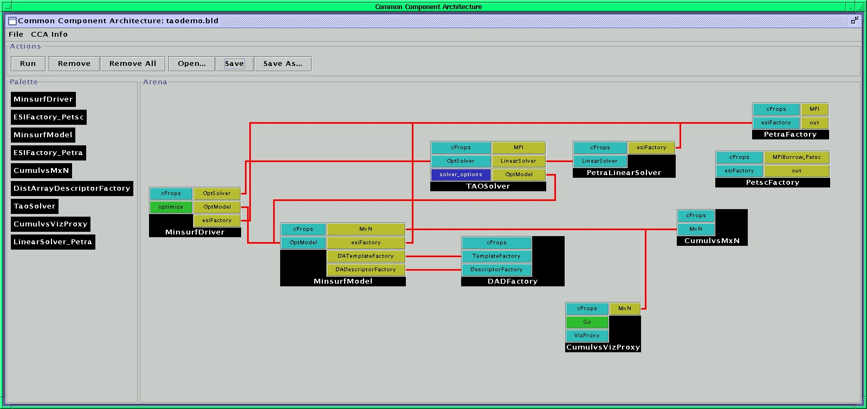
What Does This Look Like?
Launch framework (w/ or w/o GUI)
Instantiate components required for app.
Connect appropriate provided and used ports
Start application (i.e. click Go port)
create TaoSolver TAOSolver
create MinsurfDriver MinsurfDriver
…
connect MinsurfDriver OptModel MinsurfModel OptModel
connect MinsurfDriver OptSolver TAOSolver OptSolver
…

Slide 13
What Makes a CCA Component?
Framework
SolverComponent
All CCA-compliant components must implement a setServices() method
Framework invokes setServices when component is instantiated
Provides component with CCA Services object – the external world (as the framework knows it)
User instantiates SolverComponent
Framework calls SC’s setServices method with a CCA Services object – the component’s window on the external world
void SolverComponent::
setServices(gov::cca::
Services *svc){…}
CCA Services SC

Slide 14
SC Provides a solverPort
Framework
SolverComponent
Within setServices, component declares ports it provides and uses
addProvidesPort places port in CCA Services – makes it visible the framework
Other components cannot yet use solverPort!
setServices completes and control returns to framework to instantiate other components
gov::cca::PortInfo * pInfo;
pInfo = svc->createPortInfo(
“linSolve”,”solverPort”);
err = svc->addProvidesPort(
this, pInfo);
linSolve
solverPort
CCA Services SC

Slide 15
PC Wants to Use a solverPort
Framework
User instantiates PhysicsComponent
Framework calls PC’s setServices
registerUsesPort informs the framework that we want to connect to a component providing a solverPort
setServices completes, control returns to framework
PC cannot see SolverComponent or the solverPort it provides
PhysicsComponent
gov::cca::PortInfo * pInfo;
pInfo = svc->createPortInfo(
“usesSolver”,”solverPort”);
err = svc->registerUsesPort(
pInfo);
usesSolver
solverPort
CCA Services PC

Slide 16
User Instructs Framework to Connect solverPort between User and Provider
Framework
SolverComponent
PhysicsComponent
ccafe> connect PhysicsComponent usesSolver \
SolverComponent linSolve
linSolve
solverPort
usesSolver
solverPort
linSolve
solverPort
CCA Services SC
CCA Services PC

Slide 17
PC Gets the Port from its CCA Services
Framework
SolverComponent
PhysicsComponent
gov::cca::Port * pSolver;
pSolver = svc->getPort(
“usesSolver");
SolverPort * solver;
solver =dynamic_cast
<SolverPort *>(pSolver);
linSolve
solverPort
usesSolver
solverPort
linSolve
solverPort
CCA Services SC
CCA Services PC

Slide 18
PC Can Finally Call solve on SC’s solverPort
Framework
SolverComponent
PhysicsComponent
void SolverComponent::
solve(A, x, b) {…}
solver->solve(A, x, b);
linSolve
solverPort
usesSolver
solverPort
linSolve
solverPort
CCA Services SC
CCA Services PC

Slide 19
Important Features of CCA Component Model
Component 1
Component 2
Fences between components
  Components must declare both what they provide and what they use
  Components cannot interact until ports are connected
  No mechanism to call anything not part of a port
Ports preserve high performance direct connection semantics…
…While also allowing distributed computing
Provides/Uses
Port
Direct Connection
Component 1
Provides
Port
Network
Connection
Component 2
Uses
Port

Slide 20
Prototype CCA Frameworks
CCAT, Indiana University, Dennis Gannon
  Distributed
  Network connection
CCAFFEINE, Sandia National Laboratories, Rob Armstrong
  SPMD/SCMD parallel
  Direct connection
SCIRun/Uintah, University of Utah, Steve Parker
  Parallel, multithreaded
  Direct connection

Slide 21
CCA Concepts: Direct Connection
Components loaded into separate namespaces in same address space (process) from shared libraries
getPort call returns a pointer to the port’s function table
Invoking a method on a port is equivalent to a C++ virtual function call: lookup function, invoke
Maintains performance (lookup can be cached)

Slide 22
CCA Concepts: SCMD
Single component multiple data (SCMD) model is component analog of widely used SPMD model
Each process loaded with the same set of components wired the same way
Different components in same process “talk to each” other via ports and the framework
Same component in different processes talk to each other through their favorite communications layer (i.e. MPI, PVM, GA)
P0
P1
P2
P3
Components: Blue, Green, Red
Framework: Beige

Slide 23
Current Status of CCA
Specification version 0.5
Working prototype frameworks
Working multi-component parallel and distributed demonstration applications
Draft specifications for
  Basic scientific data objects
  MxN parallel data redistribution
SC01 demonstrations
  four different “direct connect” applications, add’l distributed
  DC demos: 31 distinct components, up to 17 in any single application, 6 used in more than one application
  Components leverage and extend parallel software tools including CUMULVS, GrACE, LSODE, MPICH, PAWS, PETSc, PVM, SUMAA3d, TAO, and Trilinos.

Slide 24
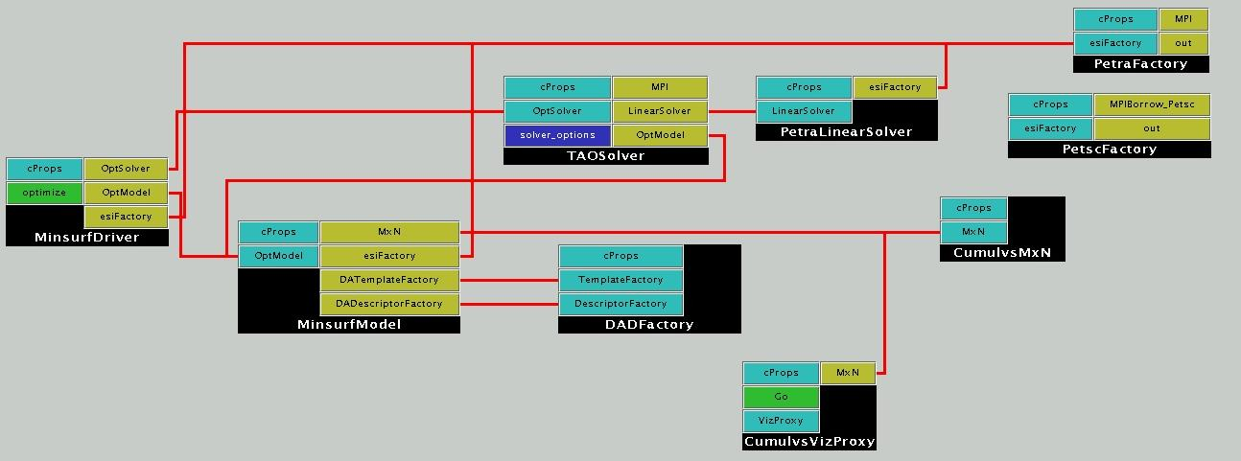
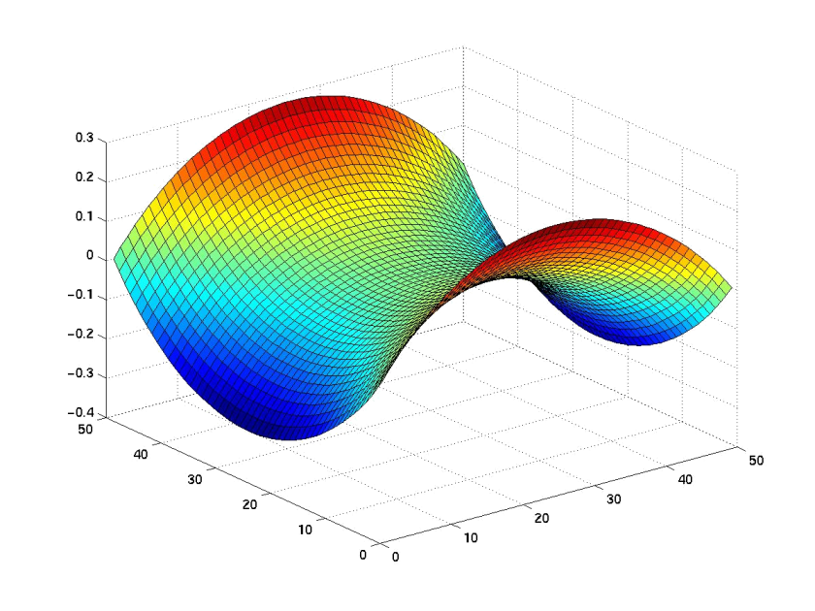
Solution of an unconstrained minimization problem (determining minimal surface area given boundary constraints) using the TAOSolver optimization component
TAOSolver uses linear solver components that incorporate abstract interfaces under development by the Equation Solver Interface (ESI) working group; underlying implementations are provided via the new ESI interfaces to parallel linear solvers within the PETSc and Trilinos libraries. These linear solver components are employed in the other two applications as well.

Slide 25
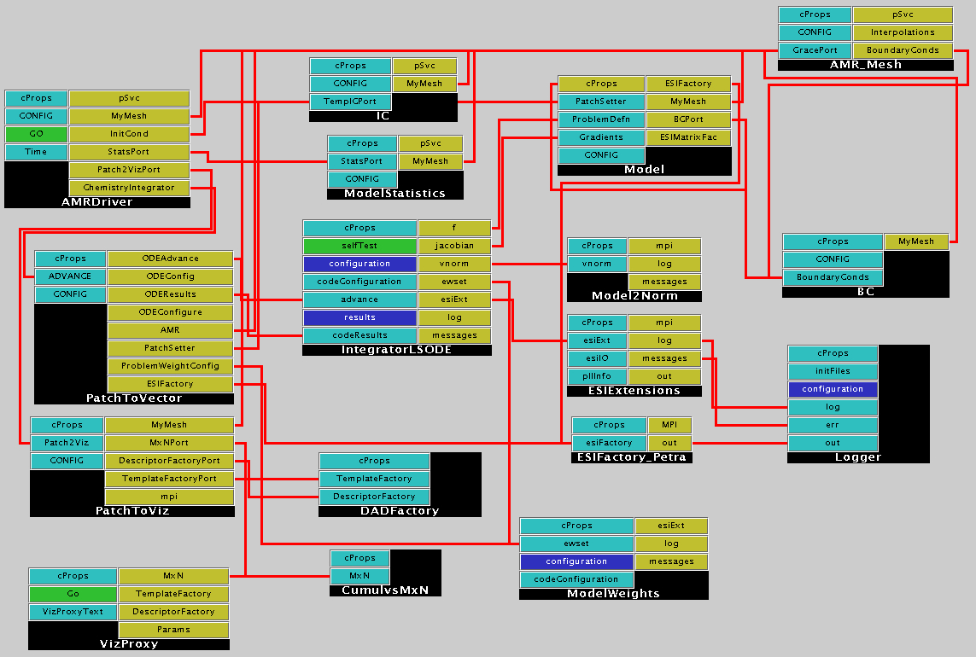
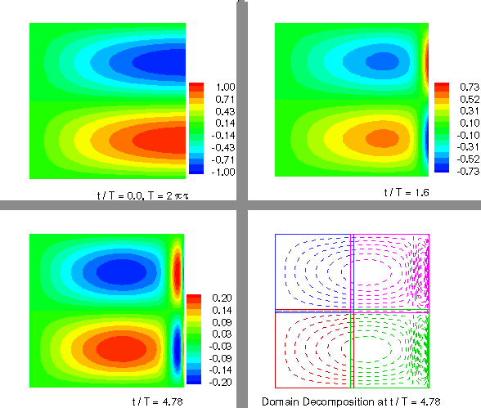
Solution of a two-dimensional heat equation on a square domain using an adaptive structured method.
IntegratorLSODE provides a second-order implicit time integrator, and Model provides a discretization. The remaining components are essentially utilities that construct the global ODE system or adaptors that convert the patch-based data structures of the mesh to the globally distributed array structure used for runtime visualization.

Slide 26
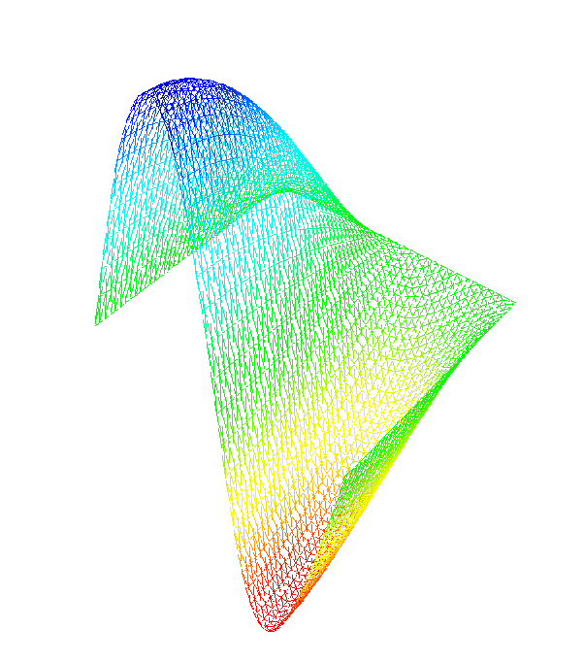
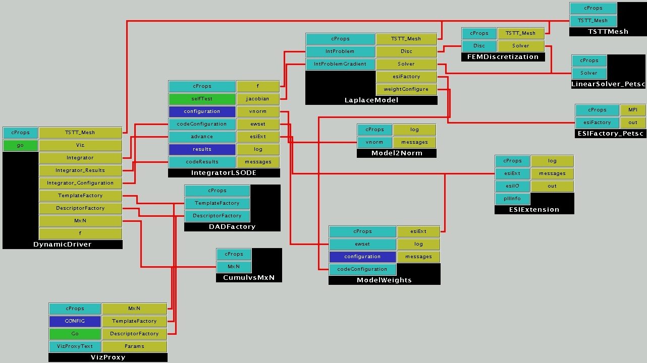
Solution of a time-dependent PDE using a finite element discretization on an unstructured mesh
IntegratorLSODE provides a second-order implicit time integrator, and FEMDiscretization provides a discretization.
This application (and the other two applications as well) use the DADFactory component to describe the parallel data layout so that the CumulsMxN data redistribution component can then collate the data from a multi-processor run to a single processor for runtime visualization.

Slide 27
The CCA Forum
The Common Component Architecture is merely a specification for what is required to be a CCA component and a CCA framework
Specification determined by the CCA Forum
  Open membership
  Face-to-face meetings quarterly
  Voting privileges based on attendance at recent meetings
CCA Forum has been meeting regularly since January 1998
  Next meeting: Bishop’s Lodge, Santa Fe, NM
    9 January 2002 – working groups & tutorial,
    10-11 January 2002 – general Forum meeting

Slide 28
The Center for Component Technology for Terascale Simulation Software (CCTTSS)
A SciDAC Integrated Software Infrastructure Center (ISIC)
Mission: Advance research in high-performance component technology and bring CCA from a conceptual prototype to a full-fledged production-quality environment
Participants:
  Argonne, Livermore, Los Alamos, Oak Ridge, Pacific Northwest, and Sandia National Laboratories;
  Indiana University, and University of Utah

Slide 29
CCTTSS’s R&D Agenda
Frameworks
  Integration of prototype frameworks
  Language interoperability tools
  Component deployment
Scientific Components
  Abstract interfaces and component implementations
  Scientific data; Linear, nonlinear, and optimization solvers; Steering and visualization; Multi-threading and load redistribution; Fault tolerance
  Quality of service research
MxN Parallel Data Redistribution
Applications Integration
  Chemistry and Climate work within CCTTSS
  Close collaboration with other SciDAC infrastructure projects (especially TOPS, TSTT)
  Strong liaison with adopting groups

Slide 30

CCA Concepts:
MxN Parallel Data Redistribution
Share Data Among Coupled Parallel Models
  Disparate Parallel Topologies (M processes vs. N)
  e.g. Ocean & Atmosphere, Solver & Optimizer…
  e.g. Visualization (Mx1, increasingly, MxN)
Parallel Model Coupling
Visualization

Slide 31
MxN: The Problem
M=4
N=9

Slide 32
MxN Research Activities
Distributed data descriptors
  Uniform langauge for expressing distribution
  Draft specification for dense multi-dimensional arrays
MxN port
  Draft specification completed, implemented
  Minimal intrusion to “instrument” component, third-party control possible
  Multiple data fields, exchange in either direction
  One-shot or repeated transfer
Future
  Framework-based solutions
  Higher-level coupling, account for units of data, spatial and termporal interpolation, etc.

Slide 33
CCA Concepts: Language Interoperability
Existing language interoperability approaches are “point-to-point” solutions
Java JNI
Native
SWIG/SILOON
Platform Dependent
Python Library
f77
C
f90
C++
Python
Arrows indicate direction of supported function calls
Java

Slide 34
Language Interoperability w/ Babel
f77
Babel provides a unified approach in which all languages are considered peers
C
f90
Babel
C++
Python
solverPort.sidl
version solverPort 1.0;
package solverPort {
class Solver {
int solve( in array<double,2> A,
out array<double,1> x,
in array<double, 1> b);
}
}
Java
Somewhat similar to the CORBA approach in the business domain

Slide 35
Using Babel
Component Writer
Component User
Implementation Source Code
SIDL
User Source Code
Developer inserts source into file
Babel
Babel
#include…
Implementation File
Other Files
Other Files
Header File
Compiler
Compiler
Linker
Babel Libraries
Linker
SolverComponent
PhysicsComponent

Slide 36
Summary
Components promote modularity & reuse, allow developers to focus on their areas of expertise
CCA is a component model targeted specifically to the needs of high-performance computing – supports direct connection of components (as well as distributed computing)
Components exchange ports following a uses-provides design pattern.
Specification intentionally places minimal requirements on components
  1 additional method to become a component
  2 calls to declare a used or provided port
  2 calls required to get a port for use
Useful prototypes exist, applications being developed
CCTTSS mission to bring CCA from prototype to production-quality system

Slide 37
Information Pointers
http://www.cca-forum.org
http://www.cca-forum.org/ccttss
Mailing list: cca-forum@z.ca.sandia.gov (majordomo)
CCTTSS contacts:
Lead PI | Rob Armstrong | SNL | rob@sandia.gov
Frameworks | Scott Kohn | LLNL | skohn@llnl.gov
Scientific Data Components | Lois McInnes | ANL | mcinnes@anl.gov
MxN Data Redistribution | Jim Kohl | ORNL | kohlja@ornl.gov
Applications Integration | David Bernholdt | ORNL | bernholdtde@ornl.gov
PNNL PI | Jarek Nieplocha | PNNL | j_nieplocha@pnl.gov

Slide 38
The End

Slide 39
Creating a Component Using Babel
babel.make
makefile
SIDL_BaseClass_fStub.c
SIDL_BaseException_fStub.c
SIDL_BaseInterface_fStub.c
SIDL_DLL_fStub.c
SIDL_Loader_fStub.c
solverPort_IOR.h
solverPort_Solver_fSkel.c
solverPort_Solver_fStub.c
solverPort_Solver_Impl.f
solverPort_Solver_IOR.c
solverPort_Solver_IOR.h
babel -sF77 solverPort.sidl -olib
Arguments:
Language of “server” (implementation)
Input SIDL file
Output directory
solverPort_Solver_Impl.f
subroutine solverPort_Solver__ctor_impl(self)
implicit none
integer*8 self
subroutine solverPort_Solver__dtor_impl(self)
implicit none
integer*8 self
subroutine solverPort_Solver_solve_impl(self, A, x, b, retval)
implicit none
integer*8 self, A, x, b
integer*4 retval
Class Constructor
Class Destructor
Solve Implementation

Slide 40
Using a Babel-Created Component
babel -cC solverPort.sidl
babel.make
solverPort.h
solverPort_IOR.h
solverPort_Solver.h
solverPort_Solver_IOR.c
solverPort_Solver_IOR.h
solverPort_Solver_Stub.c
Arguments:
Language of “client” (user)
Input SIDL file
usesSolver.c
#include “solverPort.h”
…
solverPort_Solver_solve(A, x,b);
…
Babel
solverPort_Solver_Impl.f
subroutine solverPort_Solver_solve_impl(self, A, x, b, retval)

Slide 41
Institution | Frameworks Scott Kohn, LLNL | Parallel Components Lois McInnes, ANL | MxN Jim Kohl, ORNL | Applications David Bernholdt, ORNL
ANL Lois Curfman McInnes | Low-level services | Data Components Optimization Nonlinear Solvers |  | Climate
Indiana Dennis Gannon | Distributed Framework | Linear Solvers
LANL Craig Rasmussen |  |  | Component
LLNL Scott Kohn | Language Interoperability Component Repository |  | Framework
ORNL David Bernholdt, Jim Kohl |  | Fault Tolerance Visualization and Steering | Component | Climate Liaison
PNNL Jarek Nieplocha |  | Data Components |  | Chemistry
SNL Rob Armstrong (Lead PI) | SCMD Framework | Data Components |  | Chemistry
Utah Steve Parker | Builder Service Thread Satefy | GUI Component | Framework

