Slide 1
Recommended Viewing:
Since this is a pictorial presentation, I’ve gone through the effort to type up what I normally say in the “notes” section.
To enjoy the animations, I recommend printing out the “notes” then watching via the slide show viewer.
--Gary Kumfert

Slide 2
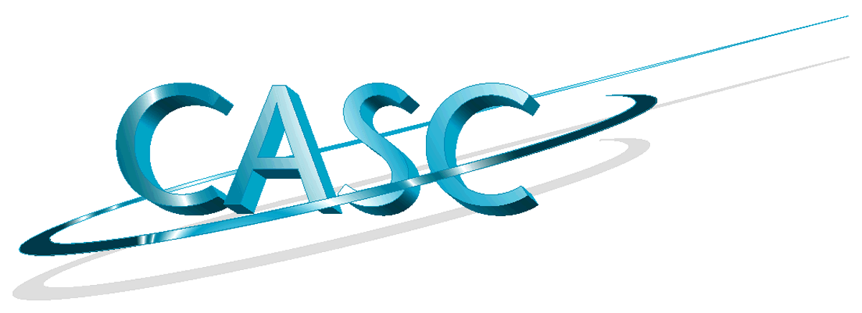

A Pictorial Introduction to Components in Scientific Computing
Gary Kumfert
with
Steve Smith, Scott Kohn,
Tom Epperly, Tammy Dahlgren, & Bill Bosl
Notes:
1
This is a quick and easy introduction (and justification) to components in the domain of scientific computing.
Listed are the current team members to the components effort here at CASC in Lawrence Livermore National Lab.
My team members call this “The Sausage Grinder Talk”

Slide 3
Once upon a time...
Input
Output
Program
Notes:
Once upon a time, computing was simple
There was a program and you put stuff into it and you get stuff out.

Slide 4
As Scientific Computing grew...
Bottle Neck
Notes:
But as scientific computing grew, the data required out of the computations grew.
So then the input grew in turn and the program became the bottle neck.

Slide 5
Tried to ease the bottle neck
Notes:
There were several attempts to ease the congestion.
First was to spend money on custom processors that made the program run really fast. (supercomputers)
Then they started adding more expensive hardware so that one program could do the same thing several times in lock-step (vector supercomputers)

Slide 6
SPMD was born.
1
2
1
3
4
2
1
2
4
3
4
3
Notes:
Finally, someone realized how cheap off-the-shelf processors were, and just bought a lot of cheap processors instead of one expensive one.
This meant that the program could run in multiple places at the same time.
This also meant that the inputs needed to be cut up and distributed among the different processors and the output had to be reconstructed from the resulting fragments.
Thus, SPMD was born, Single Program Multiple Data.

Slide 7
SPMD worked.
But it
isn’t
easy!!!
But it
isn’t
easy!!!
1
2
1
3
4
2
1
2
4
3
4
3
Notes:
But...
As everyone knows there are very few problems like SETI@home where each part can be computed independently.
For our problems of interest, the data for a single output piece (number 2) has dependencies interwoven throughout the data.
So we set up message passing, which basically means that each instance of the program finds data that it needs and data that it knows to transmit and they call each other and exchange information.
This is “state of art” today in Scientific Computing. SPMD on Distributed Memory, message passing systems.

Slide 8
Meanwhile, corporate computing was growing in a different way
Input
Input
email client
spreadsheet
browser
graphics
Output
editor
Unicode
Program
multimedia
database
Notes:
Now, separately from Scientific Computing, Business computing really took off in the last couple decades.
However, it grew in an orthogonal direction.
The input and outputs for programs (say a word processor) didn’t grow by a dozen orders of magnitude, but the application used to construct these documents did!

Slide 9
This created a whole new set of problems...
Interoperability across multiple languages
Interoperability across multiple platforms
Incremental evolution of large legacy systems (esp. w/ multiple 3rd party software)
email client
spreadsheet
browser
graphics
editor
Unicode
multimedia
database
Notes:
This created a whole new set of problems.
These are the three that I want to concentrate on today. You will see them again in this talk.
They are ....

Slide 10
Component Technology addresses these problems
Notes:
So this is how I draw component software.
The key word to remember about components:
Loose coupling
Let me explain what this drawing means

Slide 11
So what’s a component ???
Implementation :
No Direct Access
Interface Access :
Generated by Tools
Matching Connector :
Assigned by Framework
Hidden from User
Notes:
The box is the developer’s software. It remains (essentially) unchanged.
This socket that is attached to it is an interrface. It is usually generated by some tools.
The connector on the right is assigned to the component by the framework, possibly at runtime.

Slide 12
1. Interoperability across multiple languages
Language &
Platform
independent
interfaces
C
F77
Java
C++
Automatically
generated
bindings to
working code
Python
Notes:
I told you that we’d discuss three problems in detail. Here’s the first.
So let me add the languages
And that’s it. There’s no problem. Each box may be another
language, but that’s an internal detail of the component.
The “wires” are language and platform independent, and the generated interfaces to the actual code do all the translation between the wires and the particular implementation language.

Slide 13
2. Interoperability Across Multiple
Platforms
Imagine a company migrates to a new system, OS, etc.
What if the source to this one part is lost???
Notes:
Now a slightly harder problem.
Imagine....
What if...
(I’ve seen this happen to companies)

Slide 14
Transparent Distributed Computing
These wires
are very,
very smart!
internet
internet
Notes:
In components, the yellow block would still have to run on the old platform, but the others can move over and communicate over the internet.
More importantly, this can occur without any changes inside any of the boxes, a.k.a the implementation.
Just as the interfaces hide the implementation language from the wires... they can hide the type of wires from implementation.
These wires can be complicated things and not just simple communication paths.

Slide 15
3. Incremental Evolution With
Multiple 3rd party software
v 1.0
v 2.0
v 3.0
Notes:
Okay, one last problem with incremental evolution and how industry components handles this.
Let’s start by putting some version numbers on these components

Slide 16
Now suppose you find this bug...
v 1.0
v 2.0
v 3.0
Notes:
Now imagine you find a bug on the orange component right there in the middle.
Now your whole system is broken, because you need this fixed.

Slide 17
Good news: an upgrade available
Bad news: there’s a dependency
v 1.0
2.0
v 2.0
v 3.0
2.1
Notes:
The good news is that there is an upgrade available
The bad news is that it depends on a new (and incompatible) version of the teal component at the top.
Now you also have the red component which hasn’t yet upgraded to teal 2.0.
How many have run into these kinds of situations?
What can you do?

Slide 18
Great News:
Solvable with Components
2.0
2.1
v 3.0
Notes:
With components, this will still work.

Slide 19
Great News:
Solvable with Components
2.0
v 1.0
2.1
v 3.0
Notes:
The trick is (at least with COM) that new interfaces still hold references to the older interfaces under the hood.
The component framework can detect the version mismatch and have the component drill down to its older interface underneath.

Slide 20
Why Components for Scientific Computing?
Interoperability across multiple languages
Interoperability across multiple platforms
Incremental evolution of large legacy systems (esp. w/ multiple 3rd party software)
DataFoundry
SAMRAI
JEEP
Sapphire
Scientific Viz
Ardra
Overture
nonlinear solvers
ALPS
hypre
linear solvers
Notes:
So now let’s take a step back and ask...
Components seems effective in industry, but what has that to do with
scientific computing?
Well, if you look the way we’ve been adding more physics, more fidelity, and more features into our codes lately, you’d see
1. its beginning to look like this
2. We’re suffering from the same problems.

Slide 21
The Model for Scientific Component Programming
Science
Industry
?
Notes:
So here’s where are research begins.
We know how computing started
We know how science went to SPMD programming
And we know how industry went to component programming.
What happens when you merge the two???

Slide 22
Parallel Distributed Component-Based Application
Notes:
Here’s my attempt to draw a parallel distributed, component based, scientific application.
I start with a regular component application and make it parallel.
Then I add in my MPI communication network (telephone poles)
But this was too messy so I simplified them into green lines.
Observations:
1. Not all components are MPI enabled (orange)
2. MPI communication is intra component (implementation) detail
and orthogonal to the component interfaces
3. Notation is getting strained since I’ve got four separate clouds for
one physical network.

Slide 23
Research Issues:
#1. The “MxN Problem”
Notes:
With this notation, it become easy to draw out what is hard to describe, our MxN problem. This problem is unique to the case when you have parallel and distributed components.
Imagine if we have components hooked up at the top on two processors, but the yellow component is actually running on three.
How do these communicate to each other?
What if there’s a vector on the yellow components and a vector on the red ones... how do we do a dot product?
What about user defined, distributed data?

Slide 24
Research Issues:
#2: Programming Model
Science
Industry
?
vector.getLocalSize()
on remote objects?
Notes:
Here’s a second problem.
In SPMD programming, we’ve always kept straight in our heads the semantic differences between local operations, and ones requiring communication. For instance, parallel vector usually has getGlobalSize() and getLocalSize() methods. One returns the size of the parallel distributed vector, one just the size of the subset on that processor.
Now, what does it mean when you have a proxy to a remote parallel vector and you ask its local size?

Slide 25
Is This Still SPMD?
Science
Industry
Notes:
Then there is the big question....
If I merge the two. Is it still SPMD?

Slide 26
Is This Still SPMD?
No
  Each “component” may be an entire legacy SPMD code
  Multiple components (possibly distributed) working together on a single problem
    MPMD, MCMD, DPMD???
But
  Will look like SPMD to application developer
  Business components look like serial code.
Notes:
One slide with no pictures

Slide 27
Why Components for Scientific Computing?
Interoperability across multiple languages
Interoperability across multiple platforms
Incremental evolution of large legacy systems (esp. w/ multiple 3rd party software)
DataFoundry
SAMRAI
JEEP
Sapphire
Scientific Viz
Ardra
Overture
nonlinear solvers
ALPS
hypre
linear solvers
Notes:
So why are we looking into components for scientific computing?
To solve our scalability problem....
Not scalability in terms of numbers of processors our software runs on, but scalability in terms of number of projects that can be combined in a single application.
We feel that this technology will greatly alleviate computer science burdens put on code teams. It will help get their code to be deployed and used under more circumstances.
And it is our best bet for helping us cope with these three problems we suffer from

Slide 28
The End

Slide 29
UCRL-VG-143384
25 Apr 2001
Work performed under the auspices of the U. S. Department of Energy by the University of California, Lawrence Livermore National Laboratory under Contract W-7405-Eng-48

