Slide 1

Interfaces: The Key to Code Reuse and Interoperability
CCTTSS Tutorial Working Group
http://www.cca-forum.org/tutorial/
This work has been sponsored by the Mathematics, Information and Computational Sciences (MICS) Program of the U.S. Dept. of Energy, Office of Science.

Slide 2
Contributors
David Bernholdt, ORNL (Presenter)
Jim Kohl, ORNL
Lori Freitag, ANL

Slide 3
Interfaces are Central
In the CCA, components interact only through their interfaces
Both syntax and semantics of interface important
  CCA tools currently only express syntax
  Semantics via interface documentation (i.e. SIDL comments)
Components which provide the same interface are interchangeable
Interfaces need not be “standardized”, but…
Interfaces which are widely used promote reuse and interoperability of components
  Standardization within a given scientific domain
    i.e. CFD, computational chemistry, nuclear physics, …
  Standards for cross-cutting functionality/services
    i.e. solvers, scientific data objects, communications, …

Slide 4
Interfaces as Community Standards
Communities of interest with the relevant background and expertise are the right people to develop and endorse domain-specific and cross-cutting interfaces
The CCA Forum and CCTTSS…
  Develop and endorse standards pertaining to the core CCA specification (i.e. framework services)
  Domain-specific and cross-cutting interfaces are not part of the formal CCA specification
  Promote and assist in the development of domain-specific and cross-cutting interfaces
  CCTTSS R&D Thrust in Scientific Components includes interface development activities
Design of “standard” interfaces requires time and effort; payoff is for community rather than individual

Slide 5
Current Interface Development Activities
CCA Forum Scientific Data Components Working Group
Basic Scientific Data Objects
  Lead: David Bernholdt, ORNL
Structures and Unstructured Meshes
  Lead: Lori Freitag, ANL
  in collaboration with TSTT (SciDAC ISIC)
Structured Adaptive Mesh Refinement
  Lead: Phil Colella, LBNL
  in collaboration with APDEC (SciDAC ISIC)
Other Groups
Equation Solver Interface (ESI)
  Lead: Robert Clay, Terascale
  Predates CCA, moving towards Babel compliance, possibly CCA compatability
MxN Parallel Data Redistribution
  Lead: Jim Kohl, ORNL
  Part of CCTTSS MxN Thrust
Quantum Chemistry
  Leads: Curt Janssen, SNL; Theresa Windus, PNNL
  Part of CCTTSS Applications Integration Thrust

Slide 6
Scientific Data Components Working Group Approach
Agreement on representations for basic scientific data types facilitates design of interoperable components
Focus on uniform descriptions of existing data rather than forcing new data types on code
  Facilitates use with existing codes
Later, develop “native” CCA data types for use in from-scratch component development
Focus on local & distributed arrays, meshes, etc.

Slide 7
Basic Scientific Data Objects
Raw Data Interface (Data Working Group)
  Tentative definition, no implementation
Local Array Interface (Data Working Group)
  Dense rectangular multi-dimensional arrays
  Tentative definition, no implementation
Distributed Array Descriptor Interface
  Dense rectangular multi-dimensional arrays
  Fairly mature definition (Bernholdt + Data Working Group)
    Supports HPF 2.0 capabilities and more
    Compatible w/ CUMULVS, Global Arrays, SCALAPACK, PETSc, ESI, …
  Implemented for SC01 demo applications (Bernholdt)
  Developing interface revisions based on experience, SIDLization (Elwasif)
“Native” CCA Distributed Array Interface
  Planned based on DAD

Slide 8
Distributed Array Descriptor
Object-oriented, programmatic approach based on HPF-2 distributed array model, extended
Array template
  Template for distribution of array across processes
  Virtual distributed array, no data type, no storage
  Any number of actual arrays can be aligned to any part of a template
Array descriptor
  Associates actual array with distribution template
  Specifies local data location, local data strides, type
Interface follows factory design pattern
  Factory ports allow you to create, clone, destroy templ./descr.
  Templates, descriptors are standalone objects with interfaces defined by the spec
  Descriptors passed among components as a way of exchanging distributed arrays
B
C

Slide 9
Templates
Name, rank, global bounds, process topology
Distribution type & parameters
  Axis-wise:
    Collapsed
    Block (incl. cyclic, block-cyclic)
    Generalized block (one per process)
    Implicit (a la HPF)
  Explicit (tile with arbitrary rectangular multi-dimensional regions)

Slide 10
Descriptors
A
B
Name
Template
Process coordinates
Data type
  Arbitrary complex data types based on MPI types approach
Alignment map
  Actual array may cover all of template (A), a subset (B, C), or more arbitrary mappings (D)
Local region info
  Bounds (global coordinates)
  Strides (compat. w/ C and Fortran native arrays)
  Pointer to data
Queries for owner of given region, region owned by given process
C
D

Slide 11
Dist. Array Descriptor Notes
Interface somewhat “verbose” for simple distributed arrays, but…
Generality requires current complexity
Assumes local regions are in contiguous memory blocks
Strides provide flexibility, language independence
Accommodates, but does not explicitly support, ghost regions, etc.
Partial implementation for SC01 demo apps
  Simple types only, identity alignment maps only, minimal query capability, minimal error checking
Currently working towards SIDL-based version
For more info contact David Bernholdt, ORNL

Slide 12
Meshes: Structured and Unstructured
Goal: To provide common interfaces for mesh and geometry query and modification
  Hybrid solution strategies
    Different mesh and element types in different parts of the computational domain
    Different meshes for different physics in the same domain
  Plug and play experimentation
    Mesh type
    Discretization scheme
    Adaptation strategy
Collaboration of CCA and TSTT SciDAC centers
  TSTT brings together mesh and discretization expertise from ANL, BNL, LLNL, ORNL, PNL, SNL, RPI, SUNY Stony Brook, and Terascale

Slide 13
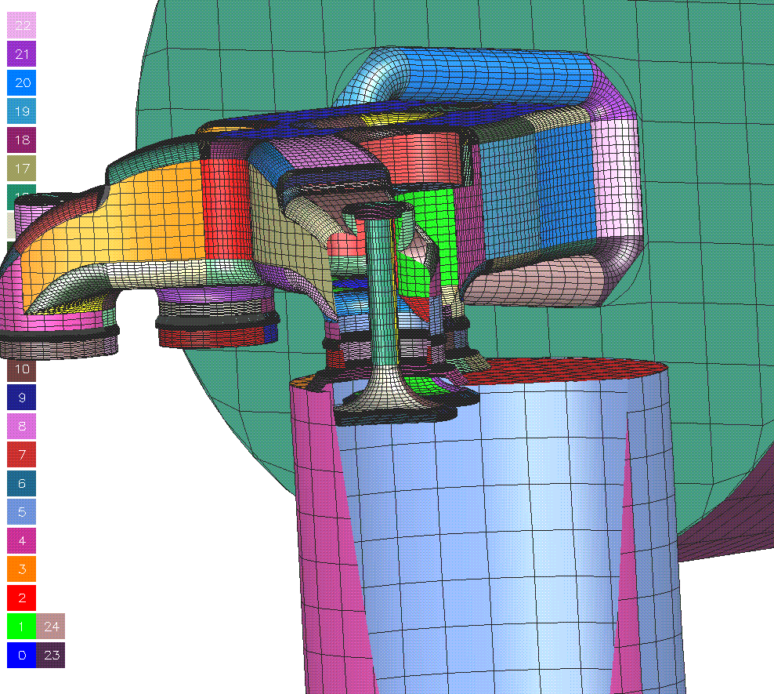
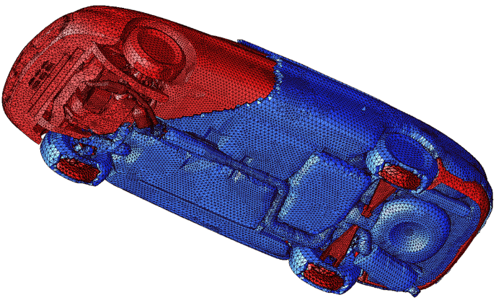
Existing TSTT Tools
A wide variety of tools exist for the generation of …
  … structured meshes
    Overture - high quality predominantly structured meshes on complex CAD geometries (LLNL)
    Variational and Elliptic Grid Generators (ORNL, SNL)
  … unstructured meshes
    MEGA (RPI) - primarily tetrahedral meshes, boundary layer mesh generation, curved elements, AMR
    CUBIT (SNL) - primarily hexahedral
    meshes, automatic decomposition
    tools, common geometry module
    NWGrid (PNNL) - hybrid meshes using
    combined Delaunay, AMR and block
    structured algorithms
These tools all meet particular needs, but they do
not interoperate to form hybrid, composite meshes
Need Geometry and Mesh Hierarchies
Overture Diesel Engine Mesh (LLNL)
MEGA Boundary Layer Mesh (RPI)

Slide 14
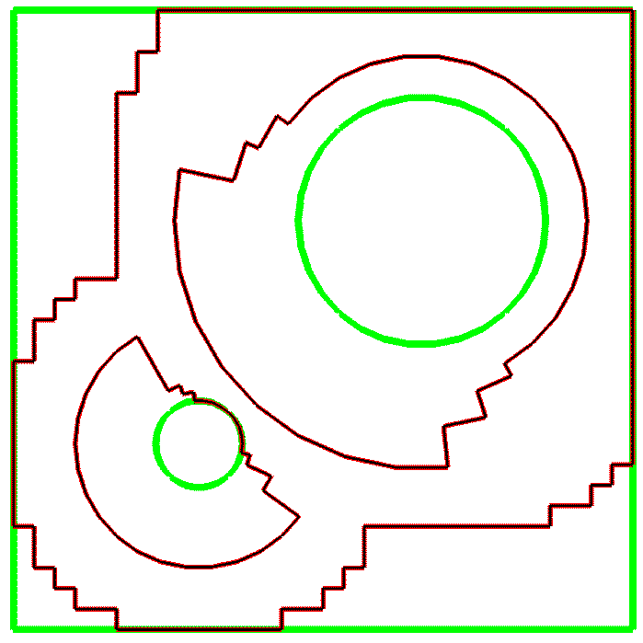
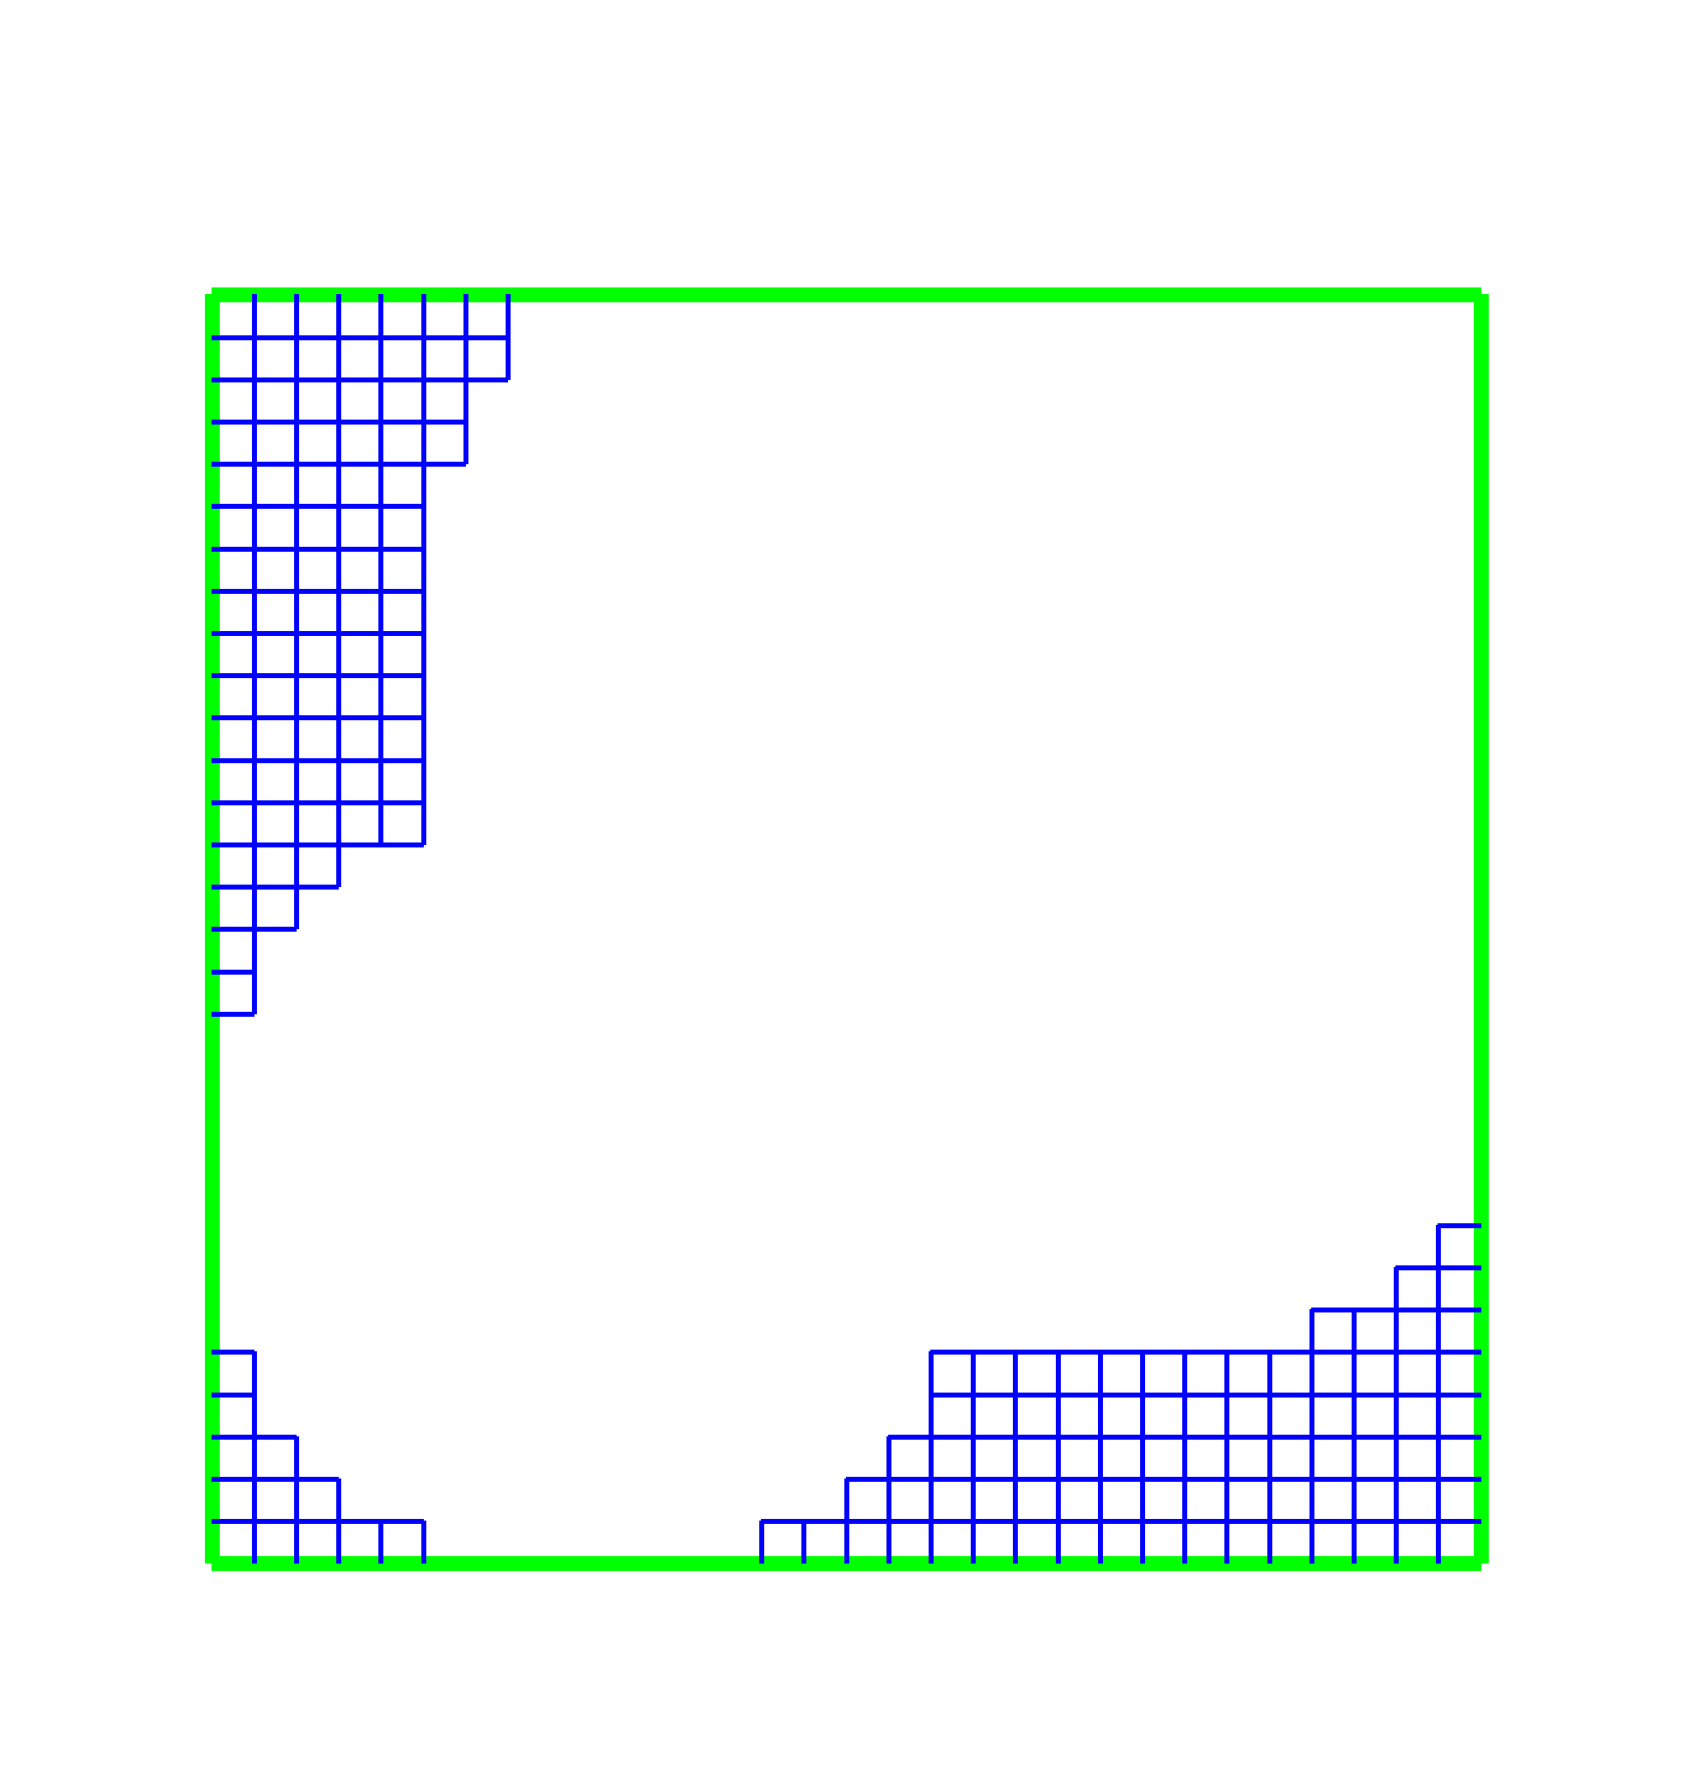
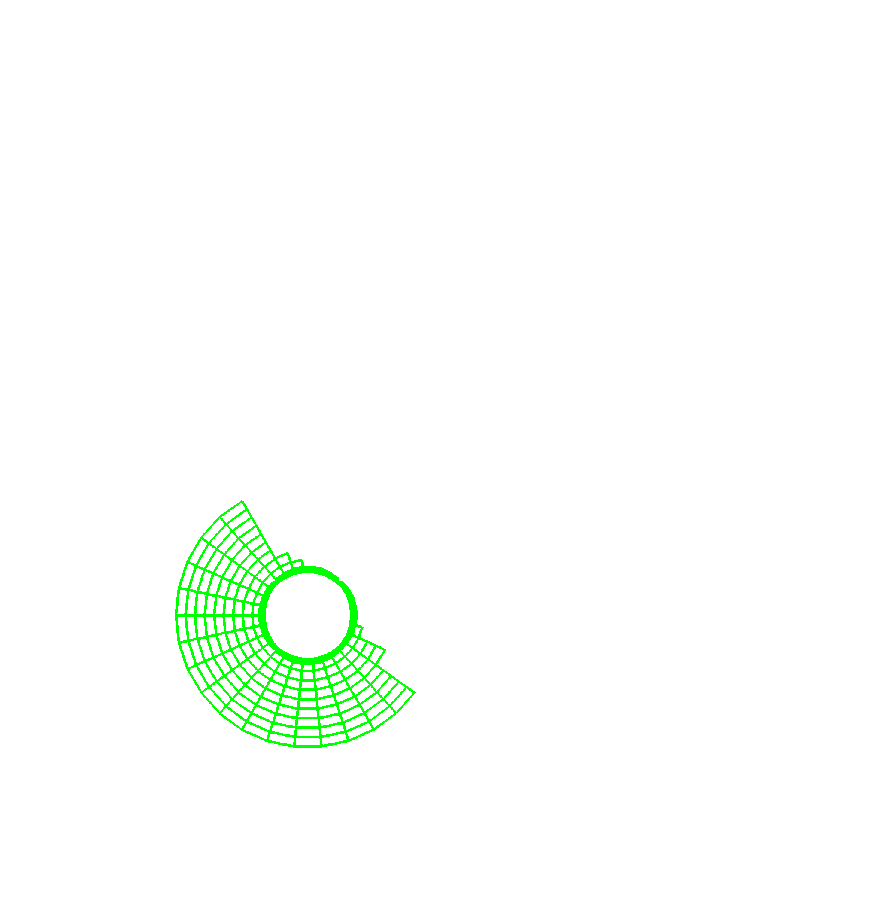
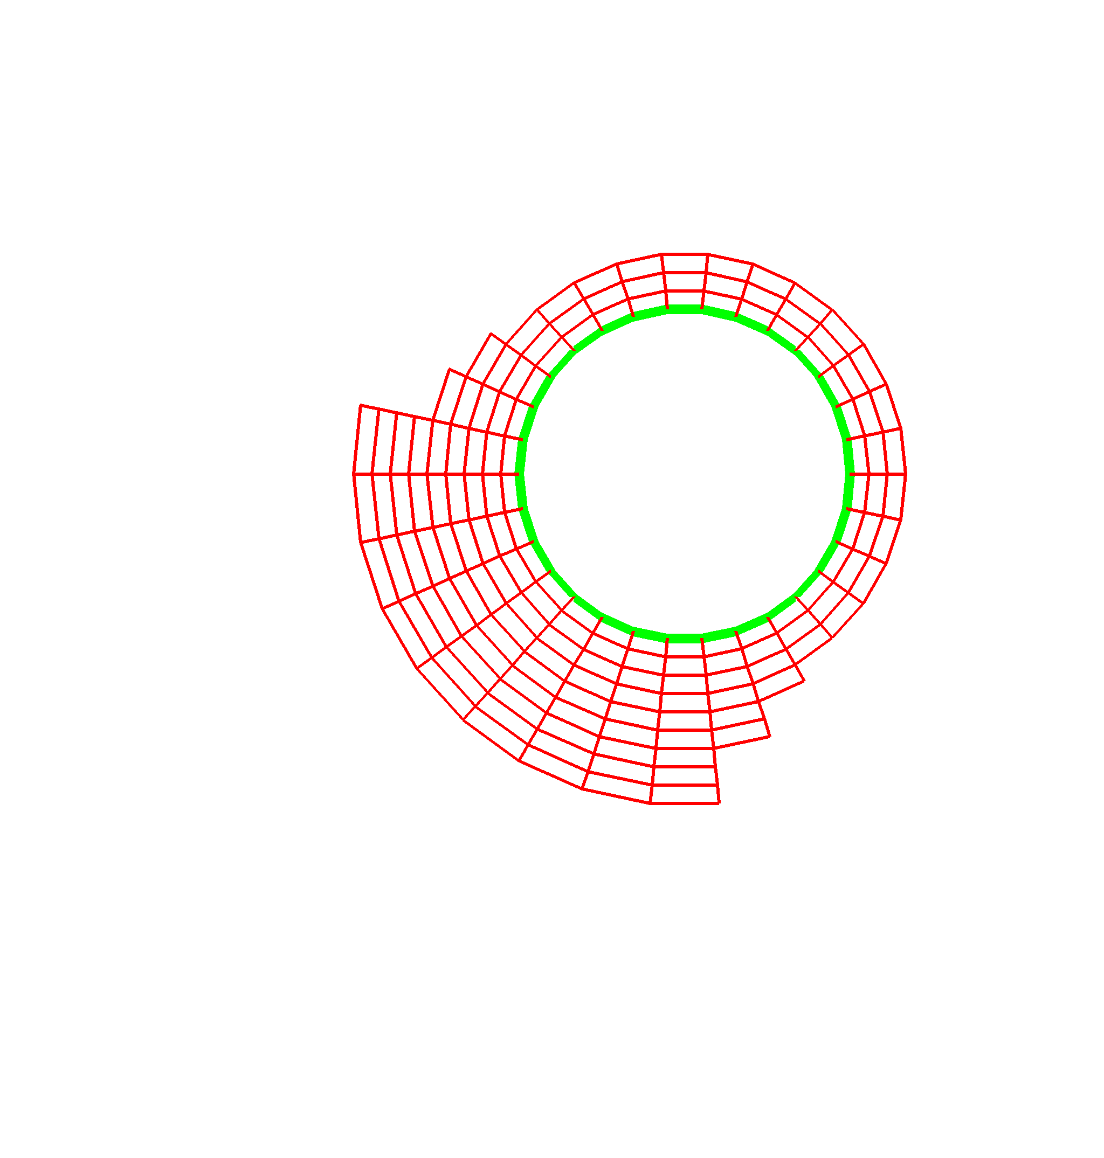
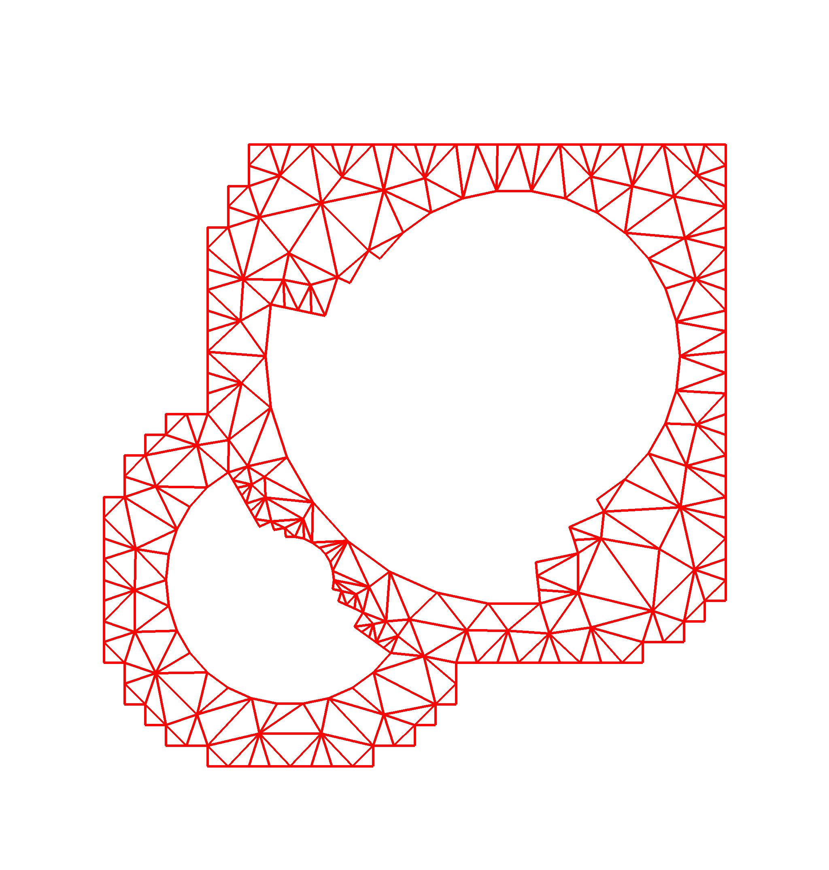
Geometric Hierarchy
Required to
  provide a common frame of reference for all tools
  facilitate multilevel solvers
  facilitate transfer of information in discretizations
Level 0: Original problem specification via high level geometric description
Level 1/2: Decomposition into subdomains and mesh components that refer back to Level 0
Level 3: Partitioning
Level 0
Given Geometry
Specification
Level 1
Domain
Decomposition
Level 2
Mesh
Components
P0
P1
P4
P5
P8
P9
Pc
Pd
Parallel
Decomposition
Level 3
P2
P3
P6
P7
Pa
Pb
Pe
Pf

Slide 15
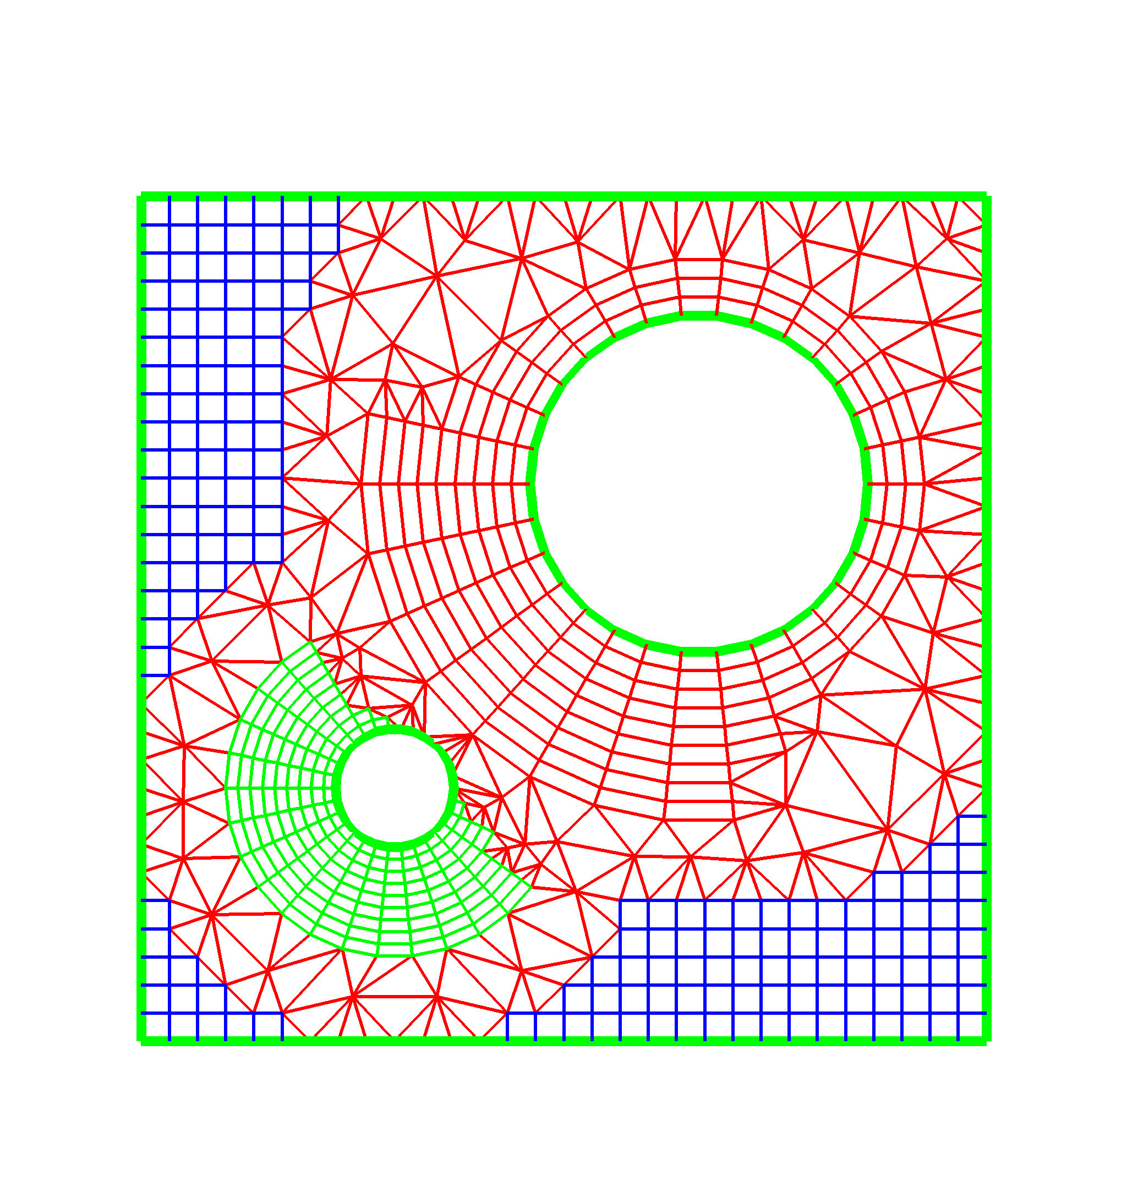
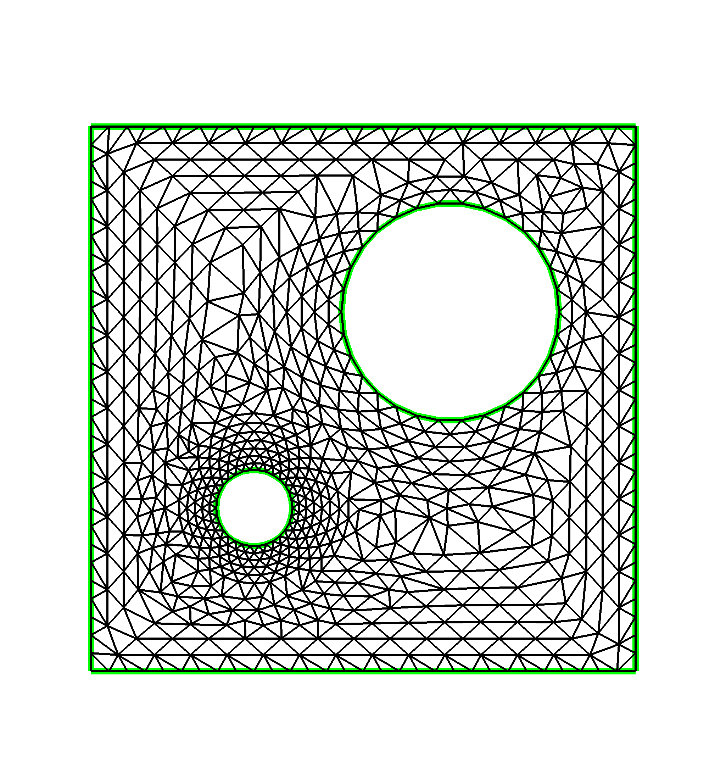
Mesh Data Hierarchy
Level A: Geometric description of the domain
  Accessed via tools such as CGM (SNL) or functional interfaces to solid modeling kernels (RPI)
Level B: Full geometry hybrid meshes
  communication mechanisms that link mesh components (key new research area)
  allows structured and unstructured meshes to be combined in a single computation
Level C: Mesh Components
Geometry
Information
(Level A)
Full
Geometry
Meshes
(Level B)
Mesh
Components
(Level C)

Slide 16
Access to Mesh Data Hierarchy
As a single object (high-level common interfaces)
  Develop functions that provide, e.g.,
    PDE discretization operators
    adaptive mesh refinement
    multilevel data transfer
  Prototype provided by Overture framework
  Enables rapid development of new mesh-based applications
Through the mesh components (low-level common interfaces)
  Provide, e.g.,
    element-by-element access to mesh components
    fortran-callable routines that return interpolation coefficients at a single point (or array of points)
  Facilitates incorporation into existing applications

Slide 17
Common Interface Specification
Initially focusing on low level access to static mesh components (Level C)
  Data: mesh geometry, topology, field data
  Efficiency though
    Access patterns appropriate for each mesh type
    Caching strategies and agglomerated access
  Appropriateness through working with
    Application scientists
    TOPS and CCA SciDAC ISICs
  Application scientists program to the common interface and can than use any conforming tool without changing their code
High level interfaces
  to entire grid hierarchy which allows interoperable meshing by creating a common view of geometry
  mesh adaptation including error estimators and curved elements
All TSTT tools will be interface compliant

Slide 18
Challenges
Basic data representation differs dramatically among existing tools
  Array-based access
  Iterator-based access
The separation of meshes and discretization
  Higher order node representation; via global array access or entity association
Language interoperability
  Most tools in C or C++; most applications in Fortran
  C-style interface, SIDL, language specific options
Flexible memory management system
  User to pass in preallocated arrays
  Have the underlying tool create memory
Tradeoffs of efficiency, flexibility, generality

Slide 19
Current Interface Definition
Defined mesh entities and topologies
  Vertex, Edge, Face and Region
  Polygon, Triangle, Quadrilateral, Polyhedral, Tetrahedron, Hexahedron, Prism, Pyramid, Septahedron
Opaque Objects
  Mesh_Handle, Entity_Handle, Tag_Handle, Mesh_Error
Functions
  Mesh Create, Load, Services, Entity Arrays, Adjacency Arrays, Entity and Adjacency Iterators, Coordinates and Indices, Destroy
  Entity Type, Topology, Dimension, Adjacencies, Vertex Coords
Proposed Functions
  Tag add/get/set/delete
  Mesh Sets, Submeshes, Higher Order Node Access, Parallel Queries

Slide 20
Status and Information
Status
  Most TSTT sites have at least a partial implementation of the interface
  Prototype interface demonstrated as a CCA-compliant component at SC in time-dependent PDE simulation
  Biweekly teleconferences to continue specification definition
  Opportunistic all-hands meetings
  10 IMR, Grid2002
  Internal use and exchange of tools
Information
  www.tstt-scidac.org
  Contact: Lori Freitag Diachin, ANL

Slide 21
MxN Parallel Data Redistribution
Low-level interface to allow exchange of data between different parallel distributions
  Support for unit conversion, grid interpolation, etc. to be built on top
Designed for minimal intrusion on existing code
Allows “third-party” control of transfer between components
Extension of CUMULVS & PAWS packages w/ input from various load balancing/partitioning packages
Approach involves separate MxNDataPort and MxNCtrlPort, and standalone MxNDataHandle object

Slide 22
MxN Port Model -- Setup
Participating components register specific data objects for MxN access
  Currently uses Dist. Array Descriptor to specify data
  Each object can be read-only, write-only, read-write
Controlling component requests comm. schedule linking objects on M and N sides
  Ultimately, user must know which objects they want to connect
Controlling component makes connection between objects on M and N sides
  Specify synchronization, frequency of transfer

Slide 23
MxN Port Model -- Use
Controlling component posts requestTransfer for those connections it is interested in
  Thereafter, that data transferred when ready, according to specified frequency
Participating components call dataReady for data object when it is in a consistent state, suitable for transfer
  Each dataReady increments object’s “iteration” count – used when periodic transfer requested
  Data transferred if required
  dataReady falls through if no transfer required
Blocking and non-blocking versions available

Slide 24
MxN Port Notes
Participating components must be “instrumented” with registerData and dataReady calls
  Minimal overhead if no transfers requested
Controller chooses which data to connect, how to connect it, and what to actually transfer
Controller may or may not be a participant
Two implementations (earlier version of spec) for SC01 demo apps
  CUMULVS-based, ORNL
  PAWS-based, LANL
Contact Jim Kohl, ORNL for more information

Slide 25
What Can You Do?
When designing software, think about interfaces that maximize flexibility and might be useful to others
Look for “standard” interfaces before creating a new one
Find and participate in existing interface development efforts relevant to your work
Where you see an opportunity, start a new community-based interface effort
  CCA Forum and CCTTSS will help
  Contact: Lois McInnes, ANL, Scientific Components Focus Lead
The best software is code you don’t have to write
-- Steve Jobs

