Slide 1
A Simple CCA Component Application

Slide 2
Module Overview
What the example does: the math.
From math to components: the architecture.
The making of components: inheritance and ports.
Framework-component interactions.
Putting it all together: the Ccafeine ways.
The application in action.

Slide 3
Goals
To show how CCA components are used to build an application to numerically integrate a continuous function using two different integration techniques.

Slide 4

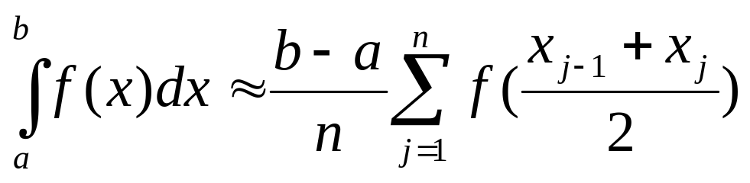
The Math: Integrator (1)
The midpoint numerical integrator
x
a
b

Slide 5
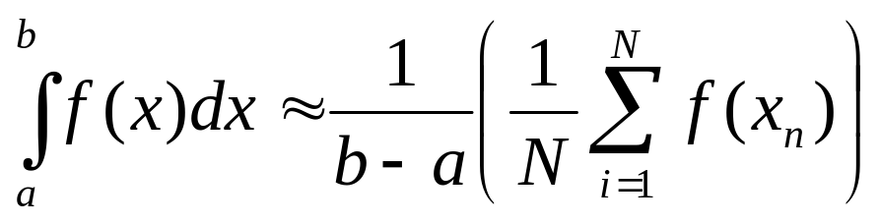
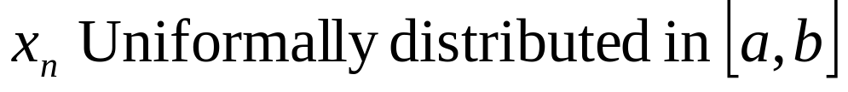
The Math: Integrator (2)
The Monte Carlo integrator
x
a
b

Slide 6
Example Architecture
RandomGeneratorPort
IntegratorPort
FunctionPort
RandomGenerator
RandomGeneratorPort
MonteCarloIntegrator
FunctionPort
Go
IntegratorPort
NonLinearFunction
Driver
FunctionPort
PiFunction
IntegratorPort
FunctionPort
FunctionPort
MidpointIntegrator
LinearFunction

Slide 7
Pluggability: Scenario 1
RandomGeneratorPort
IntegratorPort
FunctionPort
RandomGenerator
RandomGeneratorPort
MonteCarloIntegrator
FunctionPort
Go
IntegratorPort
NonLinearFunction
Driver
FunctionPort
PiFunction
IntegratorPort
FunctionPort
FunctionPort
MidpointIntegrator
LinearFunction

Slide 8
Pluggability: Scenario 1
RandomGeneratorPort
IntegratorPort
FunctionPort
RandomGenerator
RandomGeneratorPort
MonteCarloIntegrator
FunctionPort
Go
IntegratorPort
NonLinearFunction
Driver
FunctionPort
PiFunction
IntegratorPort
FunctionPort
FunctionPort
MidpointIntegrator
LinearFunction

Slide 9
MonteCarloIntegrator in Details
integrators::ccaports::
Integrator
gov::cca::Component
IntegratorPort
FunctionPort
RandomGeneratorPort
MonteCarloIntegrator
Relevant files:
MonteCarloIntegrator_CCA.hIntegrator_CCA.h
Function_CCA.h
RandomGenerator_CCA.h
MonteCarloIntegrator
Inheritance Tree
What makes it a component?
Inheritance from gov:cca::component
Where does IntegratorPort come from?
Inheritance from integrators::ccaports::Integrator

Slide 10
Notes
Inheritance from gov::cca::Component furnishes the only method known to the framework: setServices()
“Provides” ports are interfaces that need to inherit from gov::cca::Port
A component need to have access to definitions of methods in the ports it “Uses” , hence the need to include Function_CCA.h and RandomGenerator_CCA.h

Slide 11
The Framework Role
Framework-to-Component: setServices()
  Called after the component is constructed.
  The component’s chance to identify:
    Ports it provides – addProvidesPort()
    Ports it uses – addUsesPort()
  Component should not acquire the port here – Reason: it may not be there yet !!!!.
  Also used to “shutdown” the component.

Slide 12
Component-to-Framework
Mainly through Services object passed through setServices().
createPortInfo():
  portName, portType, portProperties.
addProvidesPort(), registerUsesPort():
  Component “pointer”, PortInfo
getPort():
  Called by the using component.
  Matching using portType (not name).
releasePort(), removeProvidesPort():
  When all is done.

Slide 13
When are calls made??
Framework
Create MonteCarloIntegrator
create
MonteCarloIntegrator
Create PiFunction
setServices()
PiFunction
addProvidesPort()
create
setServices()
registerUsesPort()
setServices()
setServices()
addProvidesPort()
integrate()
getPort()
evaluate()
integrate()

Slide 14
Notes
Relevant code : MonteCarloIntegrator_CCA.cc
getPort() is called immediately before the port is used.
The framework only knows gov::cca::Port , hence the dynamic_cast<>.
Making a port call: it’s just a regular virtual call.

Slide 15
Putting it all together
Getting the application to do something:
  Assembling the components into an app.
  Launching the Application.
App. assembly:
  Framework need to be told what components to use, and where to find them.
  Framework need to be told which uses port connects to which provides port.
App execution: the GO port:
  Special provides port used to launch the application (after connections are made).

Slide 16
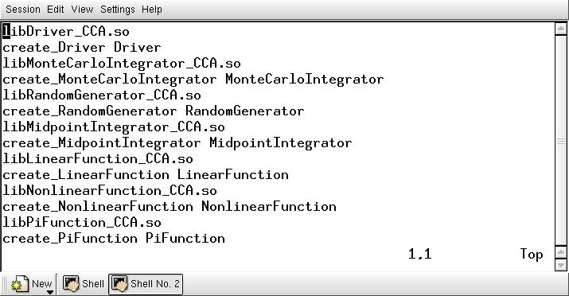
Oh Component , where art thou?.
Which components, and how to create them
Questions?. Ask Rob

Slide 17
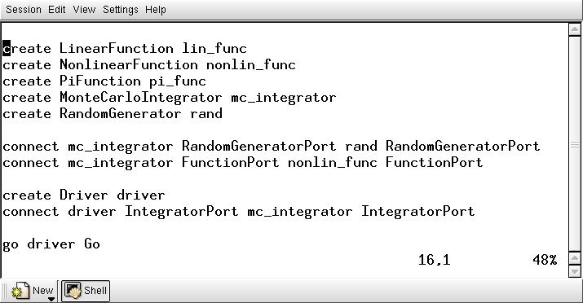
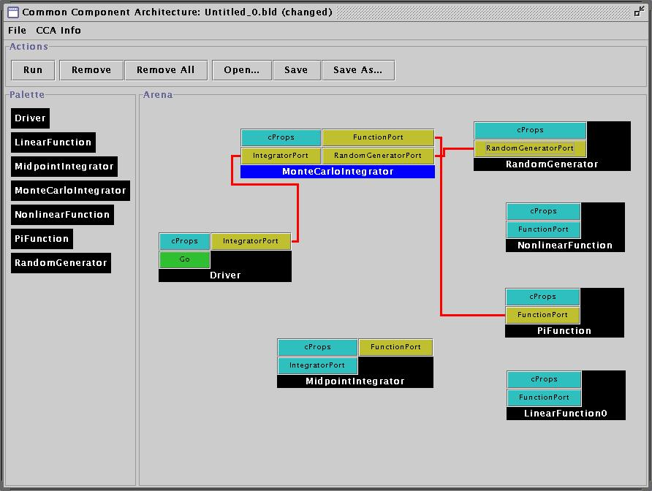
App. Assembly The Ccafeine way
Command line “script”
GUI Interface

Slide 18
And now, our feature presentation.

