Slide 1
Common Component Architecture Concepts

Slide 2
Goals
Introduce essential features of the Common Component Architecture
Provide common vocabulary for remainder of tutorial
What distinguishes CCA from other component environments?

Slide 3
Features of the Common Component Architecture
A component model specifically designed for high-performance computing
  Support HPC languages (Babel)
  Support parallel as well as distributed execution models
  Minimize performance overhead
Minimalist approach makes it easier to componentize existing software
Component interactions are not merely dataflow
Components are peers
  No particular component assumes it is “in charge” of the others.
  Allows the application developer to decide what is important.

Slide 4
CCA Concepts: Ports
IntegratorPort
FunctionPort
FunctionPort
MidpointIntegrator
NonlinearFunction
Components interact through well-defined interfaces, or ports
  In OO languages, a port is a class or interface
  In Fortran, a port is a bunch of subroutines or a module
Components may provide ports – implement the class or subroutines of the port
Components may use ports – call methods or subroutines in the port
Links denote a caller/callee relationship, not dataflow!
  e.g., FunctionPort could contain: evaluate(in Arg, out Result)

Slide 5
Ports in the Integrator Example
Dashed lines indicate alternate connections
FunctionPort
IntegratorPort
FunctionPort
NonlinearFunction
MidpointIntegrator
FunctionPort
GoPort
IntegratorPort
LinearFunction
Driver
FunctionPort
IntegratorPort
FunctionPort
PiFunction
RandomGeneratorPort
MonteCarloIntegrator
RandomGeneratorPort
Create different applications in "plug-and-play" fashion
RandomGenerator

Slide 6
Ports, Interoperability, and Reuse
Ports (interfaces) define how components interact
Generality, quality, robustness of ports is up to designer/architect
  “Any old” interface is easy to create, but…
  Developing a robust domain “standard” interface requires thought, effort, and cooperation
General “plug-and-play” interoperability of components requires multiple implementations conforming to the same interface
Designing for interoperability and reuse requires “standard” interfaces
  Typically domain-specific
  “Standard” need not imply a formal process, may mean “widely used”

Slide 7
CCA Concepts: Frameworks
The framework provides the means to “hold” components and compose them into applications
  The framework is the application’s “main” or “program”
Frameworks allow exchange of ports among components without exposing implementation details
Frameworks provide a small set of standard services to components
  BuilderServices allow programs to compose CCA apps
Frameworks may make themselves appear as components in order to connect to components in other frameworks
Currently: specific frameworks support specific computing models (parallel, distributed, etc.).
Future: full flexibility through integration or interoperation

Slide 8
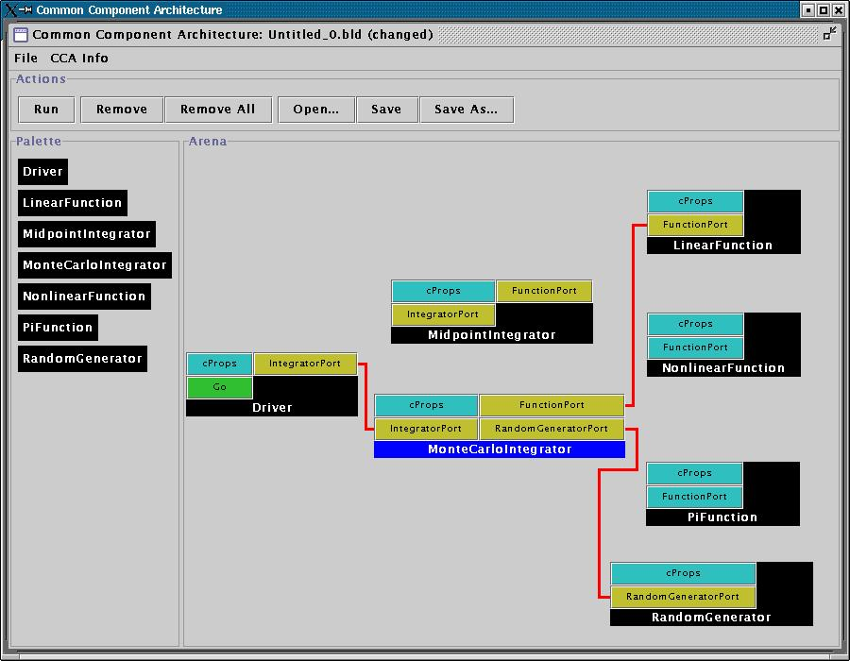
User Interaction w/ Framework
Launch framework (text or GUI interface)
Instantiate components required for app.
Connect appropriate provided and used ports
Start application (i.e. click Go port)
create Driver Driver
create LinearFunction LinearFunction
create MonteCarloIntegrator MonteCarloIntegrator
…
connect Driver IntegratorPort MonteCarloIntegrator IntegratorPort
connect MonteCarloIntegrator FunctionPort LinearFunction FunctionPort
…

Slide 9
Interactions Between
Components and Frameworks
When component is instantiated…
  Framework calls component’s setServices
  setServices registers ports to be used or provided
When user connects a uses port to a provides port…
  CCA Services object in uses component "becomes aware” of provider's implementation
When component wants to use a port…
  Get a pointer to the port with getPort (once)
  Call methods on the port (many times)
Look at actual code in next tutorial module

Slide 10
What Makes a CCA Component?
Framework
MidpointIntegrator
All CCA-compliant components must implement a setServices() method
Framework invokes setServices when component is instantiated
Provides component with CCA Services object – the external world (as the framework knows it)
User instantiates MidpointIntegrator
Framework calls MI’s setServices method with a CCA Services object – the component’s window on the external world
void MidpointIntegrator::
setServices(gov::cca::
Services *fwkSvcs){…}
CCA Services MI

Slide 11
MI Provides an IntegratorPort…
Framework
MidpointIntegrator
Within setServices, component declares ports it provides and uses
addProvidesPort declares that we will implement the port . Places port in CCA Services, making it visible to the framework
Other components cannot yet see MI or use the IntegratorPort it provides!
gov::cca::PortInfo * pInfo;
pInfo = fwkSvcs->createPortInfo(
“IntegratorPort”, “integrators.ccaports.Integrator”);
err = fwkSvcs->addProvidesPort(
this, pInfo);
IntegratorPort
CCA Services MI

Slide 12
…and Uses a FunctionPort
Framework
MidpointIntegrator
registerUsesPort tells framework we want to be connected to a component providing a FunctionPort
setServices completes and control returns to framework to instantiate other components
FunctionPort is not yet connected to anything!
pInfo = fwkSvcs->createPortInfo(
“FunctionPort”, “fns.ccaports.Function”);
err = fwkSvcs->registerUsesPort(
this, pInfo);
FunctionPort
IntegratorPort
CCA Services MI

Slide 13
NF Provides a FunctionPort
Framework
User instantiates NonlinearFunction
Framework calls NF’s setServices
addProvidesPort informs the framework that we implement a FunctionPort
setServices completes, control returns to framework
MI cannot yet see NonlinearFunction or the FunctionPort it provides
NonlinearFunction
gov::cca::PortInfo * pInfo;
pInfo = fwkSvcs->createPortInfo(
“FunctionPort”, “fns.ccaports.Function”);
err = fwkSvcs->addProvidesPort(
this, pInfo);
FunctionPort
CCA Services NF

Slide 14
Interactions Between
Components and Frameworks
When component is instantiated…
  Framework calls component’s setServices
  setServices registers ports to be used or provided
When user connects a uses port to a provides port…
  CCA Services object in uses component "becomes aware” of provider's implementation
When component wants to use a port…
  Get a pointer to the port with getPort (once)
  Call methods on the port (many times)

Slide 15
User Tells Framework to Connect Ports
Framework
MidpointIntegrator
NonlinearFunction
connect MidpointIntegrator FunctionPort \
NonlinearFunction FunctionPort
FunctionPort
FunctionPort
FunctionPort
IntegratorPort
CCA Services MI
CCA Services NF

Slide 16
Interactions Between
Components and Frameworks
When component is instantiated…
  Framework calls component’s setServices
  setServices registers ports to be used or provided
When user connects a uses port to a provides port…
  CCA Services object in uses component "becomes aware” of provider's implementation
When component wants to use a port…
  Get a pointer to the port with getPort (once)
  Call methods on the port (many times)

Slide 17
MI Gets Port from its CCA Services
Framework
MidpointIntegrator
NonlinearFunction
gov::cca::Port * port;
port = fwkSvcs->getPort(
“FunctionPort");
fns::ccaports::Function *
function_m;
function_m =dynamic_cast
<fns::ccaports::Function*>(port);
FunctionPort
FunctionPort
FunctionPort
IntegratorPort
CCA Services MI
CCA Services NF

Slide 18
MI Gets Port from its CCA Services
Framework
MidpointIntegrator
NonlinearFunction
sum = sum
+ function_m->evaluate(x);
double NonlinearFunction::
evaluate(double x) {…}
FunctionPort
FunctionPort
FunctionPort
IntegratorPort
CCA Services MI
CCA Services NF

Slide 19
Importance of Provides/Uses Pattern for Ports
Component 1
Component 2
Fences between components
  Components must declare both what they provide and what they use
  Components cannot interact until ports are connected
  No mechanism to call anything not part of a port
Ports preserve high performance direct connection semantics…
…While also allowing distributed computing
Provides/Uses
Port
Direct Connection
Component 1
Provides
Port
Network
Connection
Component 2
Uses
Port

Slide 20
CCA Concepts: Direct Connection
Components loaded into separate namespaces in the same address space (process) from shared libraries
getPort call returns a pointer to the port’s function table
Calls between components equivalent to a C++ virtual function call: lookup function location, invoke
Cost equivalent of ~2.8 F77 or C function calls
All this happens “automatically” – user just sees high performance
Description reflects Ccaffeine implementation, but similar or identical mechanisms in other direct connect fwks

Slide 21
CCA Concepts:
Parallel Components
Single component multiple data (SCMD) model is component analog of widely used SPMD model
Each process loaded with the same set of components wired the same way
Different components in same process “talk to each” other via ports and the framework
Same component in different processes talk to each other through their favorite communications layer (i.e. MPI, PVM, GA)
Also supports MPMD/MCMD
P0
P1
P2
P3
Components: Red, Green, Blue
Framework: Gray
Framework stays “out of the way” of component parallelism

Slide 22
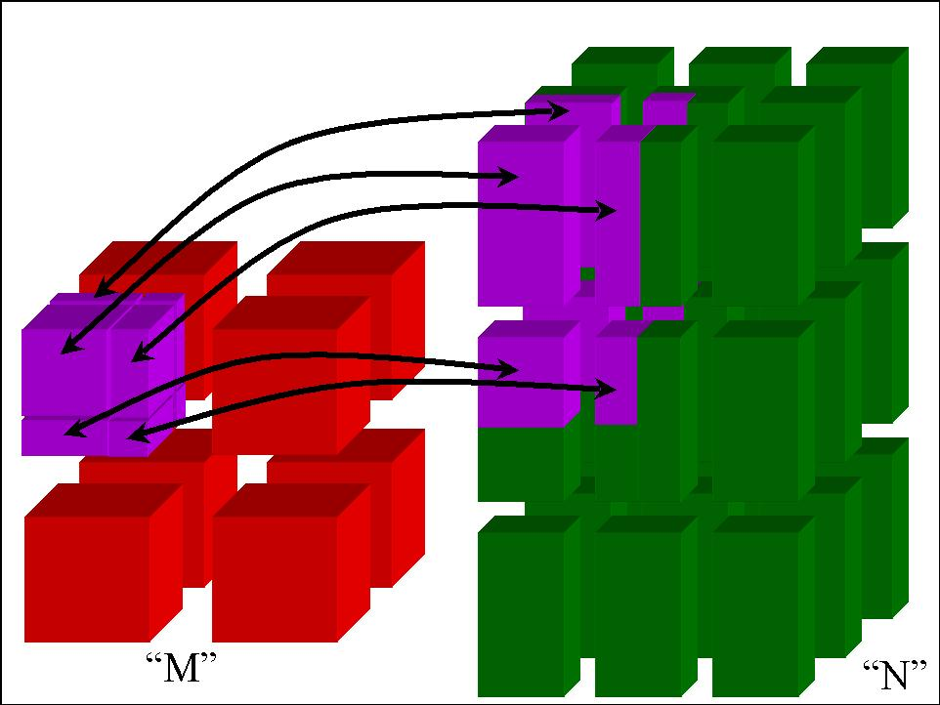
CCA Concepts:
MxN Parallel Data Redistribution
Share Data Among Coupled Parallel Models
  Disparate Parallel Topologies (M processes vs. N)
  e.g. Ocean & Atmosphere, Solver & Optimizer…
  e.g. Visualization (Mx1, increasingly, MxN)
Research area -- tools under development

Slide 23
CCA Concepts: Language Interoperability
Existing language interoperability approaches are “point-to-point” solutions
Babel provides a unified approach in which all languages are considered peers
Babel used primarily at interfaces
f77
f77
C
f90
C
f90
Babel
C++
Python
C++
Python
Babel tutorial coming up!
Java
Java

Slide 24
Concept Review
Ports
  Interfaces between components
  Uses/provides model
Framework
  Allows assembly of components into applications
Direct Connection
  Maintain performance of local inter-component calls
Parallelism
  Framework stays out of the way of parallel components
MxN Parallel Data Redistribution
  Model coupling, visualization, etc.
Language Interoperability
  Babel, Scientific Interface Definition Language (SIDL)

