Slide 1
Welcome to the
Common Component Architecture
Tutorial
Active Members:
Rob Armstrong, David Bernholdt, Wael Elwasif, Lori Freitag, Dan Katz, Jim Kohl, Gary Kumfert, Lois Curfman McInnes, Boyana Norris, Craig Rasmussen, Jaideep Ray

Slide 2
Acknowledgements
Thanks to all members of the CCA Forum
  Originated in 1998; open to everyone interested in HPC components
  See http://www.cca-forum.org
  Active CCA Forum participants include
    ANL - Lori Freitag, Kate Keahey, Jay Larson, Ray Loy, Lois Curfman McInnes, Boyana Norris, …
    Indiana University - Randall Bramley, Dennis Gannon, …
    JPL – Dan Katz, …
    LANL - Craig Rasmusse, Matt Sotille, …
    LLNL - Tom Epperly, Scott Kohn, Gary Kumfert, …
    ORNL - David Bernholdt, Wael Elwasif, Jim Kohl, Torsten Wilde, …
    PNNL - Jarek Nieplocha, Theresa Windus, …
    SNL - Rob Armstrong, Ben Allan, Curt Janssen, Jaideep Ray, …
    University of Utah - Steve Parker, …
    And others as well …
Thanks to the Office of Mathematical, Information, and Computational Sciences (MICS), U.S. Department of Energy
  Support of the Center for Component Technology for Terascale Simulation Software (CCTTSS), which is funded through the SciDAC Initiative
    CCTTSS team is a subset of the CCA Forum; leader is Rob Armstrong (SNL)
    See http://www.cca-forum.org/ccttss

Slide 3
Introduction to Components

Slide 4
Overview
Why do we need components?
What are components?
How do we make components?

Slide 5
Why Components
In “Components, The Movie”
  Interoperability across multiple languages
  Interoperability across multiple platforms
  Incremental evolution of large legacy systems (esp. w/ multiple 3rd party software)
Complexity
Notes:
The movie answers why components with …
- Evolution -> adaptability, potential for growth
We look more closely at another reason, complexity, also briefly touched on in the movie

Slide 6
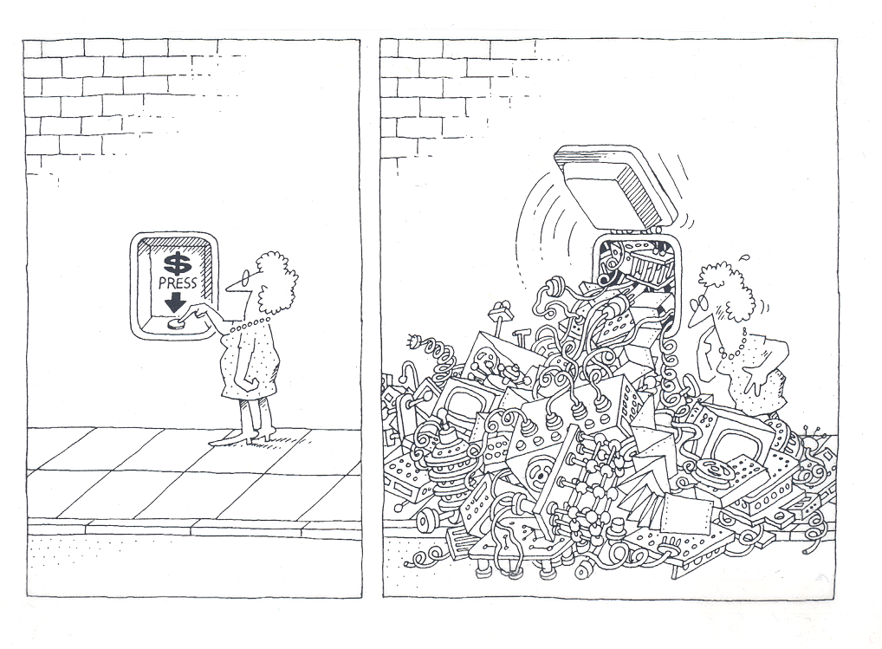
Why Components
The task of the software development team is to engineer the illusion of simplicity [Booch].
Notes:
A physician, a civil engineer, and a computer scientist were arguing about what was the oldest profession in the world. The physician remarked, “Well, in the Bible, it says that God created Eve from a rib taken out of Adam. This clearly required surgery, and so I can rightly claim that mine is the oldest profession in the world.” The civil engineer interrupted, and said, “But even earlier in the book of Genesis, it states that God created the order of the heavens and the earth out of the chaos. This was the first and certainly the most spectacular application of civil engineering. Therefore, fair doctor, you are wrong: mine is the oldest profession in the world.” The computer scientist leaned back in her chair, smiled, and then said confidently, “Ah, but who do you think created the chaos?”

Slide 7
Software Complexity
Software crisis
  “Our failure to master the complexity of software results in projects that are late, over budget, and deficient in their stated requirements” [Booch]
Can’t escape it
  “The complexity of software is an essential property, not an accidental one” [Brooks]
Help is on the way…
  “A complex system that works is invariably found to have evolved from a simple system that worked… A complex system designed from scratch never works and cannot be patched up to make it work.” [Gall]
  “Intracomponent linkages are generally stronger than intercomponent linkages” [Simon]
  “Frequently, complexity takes the form of a hierarchy” [Courtois]
Notes:
Help is on the way..
- Building blocks (“A complex system that works…” )
- encapsulation (“Intracomponent linkages…”)
- CCA components high in the hierarchy food chain (“Frequently, complexity …”)

Slide 8
The Good the Bad and the Ugly
An example of what can lead to a crisis in software:
At least 41 different Fast Fourier Transform (FFT) libraries:
  see, http://www.fftw.org/benchfft/doc/ffts.html
Many (if not all) have different interfaces
  different procedure names and different input and output parameters
SUBROUTINE FOUR1(DATA, NN, ISIGN)
  Replaces DATA by its discrete Fourier transform (if ISIGN is input as 1) or replaces DATA by NN times its inverse discrete Fourier transform (if ISIGN is input as -1). DATA is a complex array of length NN or, equivalently, a real array of length 2*NN. NN MUST be an integer power of 2 (this is not checked for!).

Slide 9

Components Promote Reuse
X
Rob
Hero programmer producing single-purpose, monolithic, tightly-coupled parallel codes
Components promote software reuse
  “The best software is code you don’t have to write” [Steve Jobs]
Reuse, through cost amortization increases software quality
  thoroughly tested code
  highly optimized code
  improved support for multiple platforms
  developer team specialization
Notes:
Components help solve complexity, they also encourage reuse.

Slide 10
What Are Components
Why do we need components?
What are components?
How do we make components?

Slide 11
What Are Components [Szyperski]
A component is a binary unit of independent deployment
  well separated from other components
    fences make good neighbors
  can be deployed independently
A component is a unit of third-party composition
  is composable (even by physicists)
  comes with clear specifications of what it requires and provides
  interacts with its environment through well-defined interfaces
A component has no persistent state
  temporary state set only through well-defined interfaces
  throw away that dependence on global data (common blocks)
Similar to Java packages and Fortran 90 modules (with a little help)
Notes:
Independent of what (other componets)
Independece leads to the ability to compose
Global data -> across components not oK, but ok within

Slide 12
What Does This Mean
Once again
  A component is a binary unit of independent deployment
  A component is a unit of third-party composition
  A component has no persistent state
So what does this mean
  Components are “plug and play”
  Components are reusable
  Component applications are evolvable

Slide 13
What Are Components II
Components live in an environment and interact with the environment through a framework and connections with other components.
Components can discover information about their environment from the framework.
Components must explicitly publish what capabilities they provide.
Components must explicitly publish what connections they require.
Components are a runtime entity.

Slide 14
Components Are Different From Objects
Think of a component stereo system:
  You buy a new, super-cool CD player, bring it home, wire it up, turn on the power, and it works!
A software component system:
  You buy (or download) a new, super-fast FFT component, wire the connections, click on the go button, and it works!
  (remember, a software component is a binary unit)
A software class library:
  You buy it, install it, do a little programming (or a lot), compile it, link it, and then run it, and hopefully it works.
Notes:
A market model to point out the differences
- a market for object classes never really developed
Software component not quite binary yet

Slide 15
Components, Different From Objects II
You can build components out of object classes.
But a component is more than just an object.

Slide 16
Pictorial Example
Consumer
Producer
uses
provides
Notes:
UML diagram of components
Remove arrow

Slide 17
Three Components
Integrator
integrate( )
Function
RandomGenerator
evaluate( )
getRandomValue( )
Notes:
Add connections as multiple.

Slide 18
How Do We Make Components
Why do we need components?
What are components?
How do we make components?

Slide 19
Interface Declaration
Integrator
integrate( )
Integrator.h
Integrator.f90
class Integrator
{
virtual void
integrate( double lowBound,
double upBound,
int count ) = 0;
};
MODULE Integrator
interface integrate
module procedure integrate_Abstract
end interface
END MODULE
Notes:
First thing to do is to decide on functionality and design interfaces

Slide 20
Publish the Interface in SIDL
Publish the interface
  interfaces are published in SIDL (Scientific Interface Definition Language)
  can’t publish in native language because of language interoperability requirement
Integrator example:
interface Integrator extends cca.Port
{
double integrate(in double lowBound,
in double upBound,
in int count);
}

Slide 21
F90 Abstract Integrator Module
MODULE Integrator
!
! use the MonteCarloIntegrator module for the implementation
!
use MonteCarloIntegrator
interface integrate
module procedure integrate_Abstract
end interface
CONTAINS
function integrate_Abstract(x0, x1, count)
real(kind(1.0D0)) :: integrate_Abstract, x0, x1
integer :: count
integrate_Abstract = integrate_MonteCarlo(x0, x1, count)
end function integrate_Abstract
END MODULE Integrator
Notes:
This is the wrapper module that calls pre-existing code and gives a hook for Babel.

Slide 22
F90 Program
program Driver
use Integrator
print *, "Integral = ", integrate(0.0D0, 1.0D0, 1000)
end program

Slide 23
C++ Abstract Integrator Class
/**
* This abstract class declares the Integrator interface.
*/
class Integrator
{
public:
virtual ~Integrator() { }
/**
* Sets the function, which will be evaluated by the integration.
*/
virtual void setFunction(Function* function_to_integrate) = 0;
/**
* Returns the result of the integration from lowBound to upBound.
*
* lowBound - the beginning of the integration interval
* upBound - the end of the integration interval
* count - the number of integration points
*/
virtual double integrate(int count, double x0, double x1) = 0;
};
Notes:
Hightlight in red.

Slide 24
C++ Object-Oriented Program
#include <iostream>
#include "Function.h"
#include "Integrator.h"
#include "RandomGenerator.h"
int main(int argc, char* argv[])
{
LinearFunction* function = new LinearFunction();
UniformRandomGenerator* random = new UniformRandomGenerator();
MonteCarloIntegrator* integrator = new MonteCarloIntegrator();
integrator->setFunctionInstance(function);
integrator->setRandomGeneratorInstance(random);
cout << “Integral = “ << integrator->integrate(100) << endl;
return 0;
}

Slide 25
Component Program
Component Library
Program
TrapezoidalIntegrator
MonteCarloIntegrator
integrate( )
integrate( )
GaussianQuadIntegrator
integrate( )
LinearFunction
UniformRandomGenerator
ReallyWierdFunction
evaluate( )
getRandomValue( )
evaluate( )
LinearNRandomGenerator
evaluate( )

Slide 26
Final Thought
Components are reusable assets. Compared with specific solutions to specific problems, components need to be carefully generalized to enable reuse in a variety of contexts. Solving a general problem rather than a specific one takes more work. In addition, because of the variety of deployment contexts, the creation of proper documentation, test suites, tutorials, online help texts, and so on is more demanding for components than for a specialized solution. [Szyperski, p. 14]

Slide 27
Bibliography
Booch, G. 1994. Object-Oriented Analysis and Design with Applications. Second Editions. Santa Clara, CA: The Benjamin/Cummings Publishing Company, p. 8.
Brooks, F. April 1987. No Silver Bullet: Essence and Accidents of Software Engineering. IEEE Computer vol. 20(4), p. 12.
Courtois, P. June 1985. On Time and Space Decomposition of Complex Structures. Communications of the ACM vol 28(6), p. 596.
Gall, J. 1986. Systemantics: How Systems Really Work and How They Fail. Second Edition. Ann Arbor, MI: The General Systemantics Press, p. 65.
Simon, H. 1982. The Sciences of the Artificial. Cambridge, MA: The MIT Press, p. 217.
Szyperski, C. 1998. Component Software: Beyond Object-Oriented Programming. New York, NY: Addison-Wesley, p. 30

