Slide 1
Common Component Architecture Concepts

Slide 2
The Lifecycle of a Component
User instructs framework to load and instantiate components
User instructs framework to connect uses ports to provides ports
Code in components uses functions provided by another component
Ports may be disconnected
Component may be destroyed
Look at actual code in next tutorial module
Notes:
We’re not really going to talk about disconnecting ports or destroying components here.

Slide 3
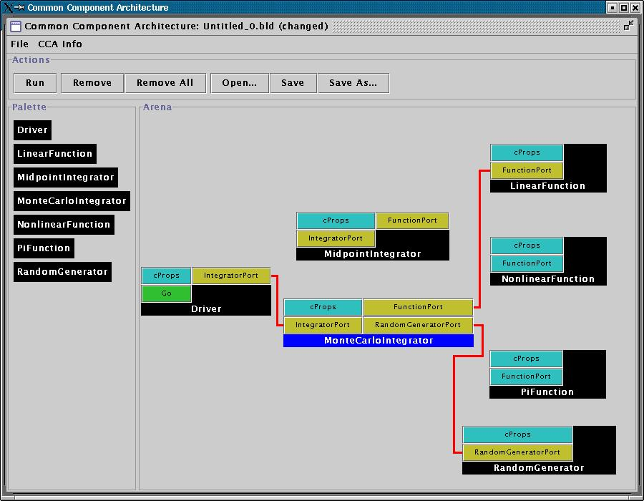
Loading and Instantiating Components
Components are code (usu. library or shared object) + metadata
Using metadata, a Palette of available components is constructed
Components are instantiated by user action (i.e. by dragging from Palette into Arena)
Framework calls component’s constructor, then setServices
Details are framework-specific!
Ccaffeine currently provides both command line and GUI approaches
create Driver Driver
create LinearFunction LinearFunction
create MonteCarloIntegrator MonteCarloIntegrator
Notes:
While this description is specific to Ccaffeine, the concepts are general

Slide 4
Component’s View of Instantiation
Framework calls component’s constructor
Component initializes internal data, etc.
  Knows nothing outside itself
Framework calls component’s setServices
  Passes setServices an object representing everything “outside”
  setServices declares ports component uses and provides
Component still knows nothing outside itself
  But Services object provides the means of communication w/ framework
Framework now knows how to “decorate” component and how it might connect with others
Framework interaction code
constructor setServices destructor
CCA.Services
provides IntegratorPort
uses FunctionPort, RandomGeneratorPort
Integrator code
IntegratorPort
FunctionPort
RandomGeneratorPort
MonteCarloIntegrator
MonteCarloIntegrator
Notes:
The cartoon on the left shows the internals of the component. The cartoon on the right is how the Ccaffeine GUI would render the “decorated” component to the outside world.

Slide 5
User Connects Ports
Can only connect user & provider
  Not uses/uses or provides/provides
Ports connected by type, not name
  Port names must be unique within component
  Types must match across components
Framework puts info about provider into user component’s Services object
connect Driver IntegratorPort MonteCarloIntegrator IntegratorPort
connect MonteCarloIntegrator FunctionPort LinearFunction FunctionPort
…
Notes:
The picture is specific to Ccaffeine, but the concepts are general

Slide 6
Component’s View of Connection
Framework interaction code
CCA.Services
…, uses FunctionPort
(connected to NonlinearFunction FunctionPort), …
Framework puts info about provider into user component’s Services object
  MonteCarloIntegrator’s Services object is aware of connection
  NonlinearFunction is not!
MCI’s integrator code cannot yet call functions on FunctionPort
Integrator code
Framework interaction code
MonteCarloIntegrator
CCA.Services
provides FunctionPort
Function code
NonlinearFunction

Slide 7
Component’s View of Using a Port
User calls getPort to obtain (handle for) port from Services
  Finally user code can “see” provider
Cast port to expected type
  OO programming concept
  Insures type safety
  Helps enforce declared interface
Call methods on port
  e.g.
  sum = sum + function->evaluate(x)
Release port
Framework interaction code
CCA.Services
…, uses FunctionPort
(connected to NonlinearFunction FunctionPort), …
Integrator code
MonteCarloIntegrator
Notes:
This is where the changes to the “library” code turn up. The getPort/cast/releasePort are outright additions. But also, calls to methods on the port will change slightly.

Slide 8
Importance of Provides/Uses Pattern for Ports
Component 1
Component 2
Fences between components
  Components must declare both what they provide and what they use
  Components cannot interact until ports are connected
  No mechanism to call anything not part of a port
Ports preserve high performance direct connection semantics…
…While also allowing distributed computing
Provides/Uses
Port
Direct Connection
Component 1
Provides
Port
Network
Connection
Component 2
Uses
Port

Slide 9
CCA Concepts: Direct Connection
Components loaded into separate namespaces in the same address space (process) from shared libraries
getPort call returns a pointer to the port’s function table
Calls between components equivalent to a C++ virtual function call: lookup function location, invoke
Cost equivalent of ~2.8 F77 or C function calls
All this happens “automatically” – user just sees high performance
Description reflects Ccaffeine implementation, but similar or identical mechanisms in other direct connect fwks
Notes:
In CORBA direct connection optimizations can be done with some ORBs. A paper by Schmidt talks about two “levels” of direct connection optimization – one which preserves all CORBA semantics, but offers little performance improvement, and one which violates CORBA semantics, but gives much better performance and which should be similar to CCA direct connect implementations.

Slide 10
Concept Review
Ports
  Interfaces between components
  Uses/provides model
Framework
  Allows assembly of components into applications
Direct Connection
  Maintain performance of local inter-component calls
Parallelism
  Framework stays out of the way of parallel components
MxN Parallel Data Redistribution
  Model coupling, visualization, etc.
Language Interoperability
  Babel, Scientific Interface Definition Language (SIDL)

Slide 11
Next: A Simple CCA Example

