Slide 1
An Overview of Components and the Common Component Architecture

Slide 2
Outline
Why do we need components?
What are components?
What are CCA components?

Slide 3
Why Components
In “Components, The Movie”
  Interoperability across multiple languages
  Interoperability across multiple platforms
  Incremental evolution of large legacy systems (esp. w/ multiple 3rd party software)
Complexity
Notes:
The movie answers why components with …
- Evolution -> adaptability, potential for growth
We look more closely at another reason, complexity, also briefly touched on in the movie

Slide 4
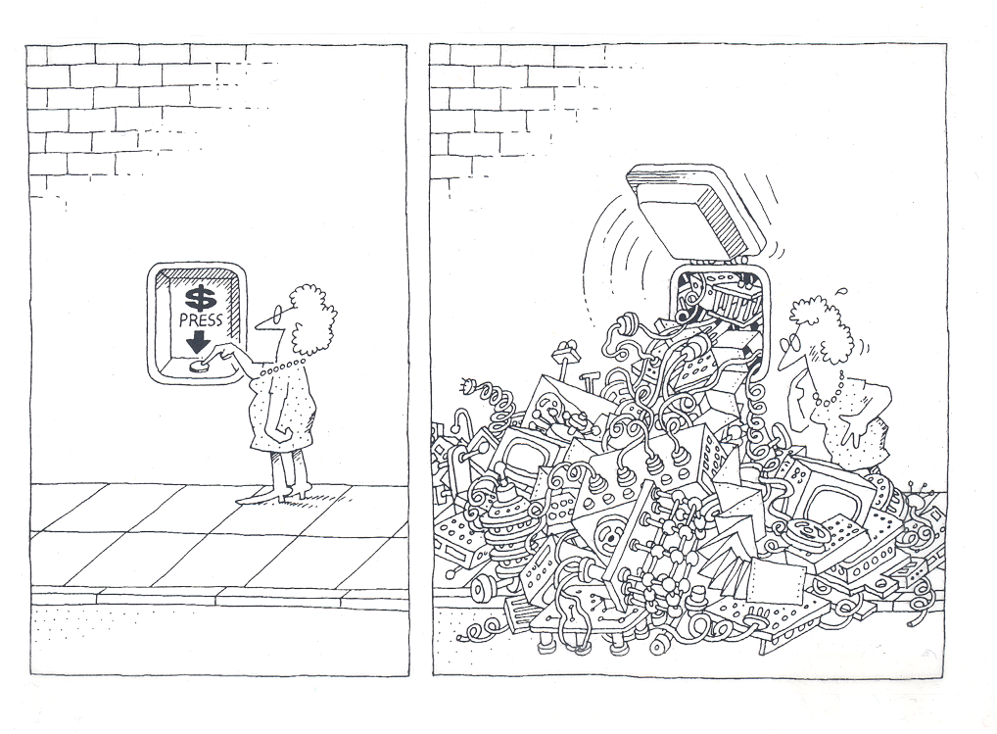
Why Components
The task of the software development team is to engineer the illusion of simplicity [Booch].
Notes:
A physician, a civil engineer, and a computer scientist were arguing about what was the oldest profession in the world. The physician remarked, “Well, in the Bible, it says that God created Eve from a rib taken out of Adam. This clearly required surgery, and so I can rightly claim that mine is the oldest profession in the world.” The civil engineer interrupted, and said, “But even earlier in the book of Genesis, it states that God created the order of the heavens and the earth out of the chaos. This was the first and certainly the most spectacular application of civil engineering. Therefore, fair doctor, you are wrong: mine is the oldest profession in the world.” The computer scientist leaned back in her chair, smiled, and then said confidently, “Ah, but who do you think created the chaos?”

Slide 5
Software Complexity
Software crisis
  “Our failure to master the complexity of software results in projects that are late, over budget, and deficient in their stated requirements” [Booch]
Can’t escape it
  “The complexity of software is an essential property, not an accidental one” [Brooks]
Help is on the way…
  “A complex system that works is invariably found to have evolved from a simple system that worked… A complex system designed from scratch never works and cannot be patched up to make it work.” [Gall]
  “Intracomponent linkages are generally stronger than intercomponent linkages” [Simon]
  “Frequently, complexity takes the form of a hierarchy” [Courtois]
Notes:
Help is on the way..
- Building blocks (“A complex system that works…” )
- encapsulation (“Intracomponent linkages…”)
- CCA components high in the hierarchy food chain (“Frequently, complexity …”)

Slide 6
The Good the Bad and the Ugly
An example of what can lead to a crisis in software:
At least 41 different Fast Fourier Transform (FFT) libraries:
  see, http://www.fftw.org/benchfft/doc/ffts.html
Many (if not all) have different interfaces
  different procedure names and different input and output parameters
SUBROUTINE FOUR1(DATA, NN, ISIGN)
  Replaces DATA by its discrete Fourier transform (if ISIGN is input as 1) or replaces DATA by NN times its inverse discrete Fourier transform (if ISIGN is input as -1). DATA is a complex array of length NN or, equivalently, a real array of length 2*NN. NN MUST be an integer power of 2 (this is not checked for!).

Slide 7

Components Promote Reuse
X
Rob
Hero programmer producing single-purpose, monolithic, tightly-coupled parallel codes
Components promote software reuse
  “The best software is code you don’t have to write” [Steve Jobs]
Reuse, through cost amortization increases software quality
  thoroughly tested code
  highly optimized code
  improved support for multiple platforms
  developer team specialization
Notes:
Components help solve complexity, they also encourage reuse.

Slide 8
What Are Components
Why do we need components?
What are components?
What are CCA components?

Slide 9
What Are Components [Szyperski]
A component is a binary unit of independent deployment
  well separated from other components
    fences make good neighbors
  can be deployed independently
A component is a unit of third-party composition
  is composable (even by physicists)
  comes with clear specifications of what it requires and provides
  interacts with its environment through well-defined interfaces
A component has no persistent state
  temporary state set only through well-defined interfaces
  throw away that dependence on global data (common blocks)
Similar to Java packages and Fortran 90 modules (with a little help)
Notes:
Independent of what (other componets)
Independece leads to the ability to compose
Global data -> across components not oK, but ok within

Slide 10
What Does This Mean
Once again
  A component is a binary unit of independent deployment
  A component is a unit of third-party composition
  A component has no persistent state
So what does this mean
  Components are “plug and play”
  Components are reusable
  Component applications are evolvable

Slide 11
What Are Components II
Components live in an environment and interact with the environment through a framework and connections with other components.
Components can discover information about their environment from the framework.
Components must explicitly publish what capabilities they provide.
Components must explicitly publish what connections they require.
Components are a runtime entity.

Slide 12
Components Are Different From Objects
Think of a component stereo system:
  You buy a new, super-cool CD player, bring it home, wire it up, turn on the power, and it works!
A software component system:
  You buy (or download) a new, super-fast FFT component, wire the connections, click on the go button, and it works!
  (remember, a software component is a binary unit)
A software class library:
  You buy it, install it, do a little programming (or a lot), compile it, link it, and then run it, and hopefully it works.
Notes:
A market model to point out the differences
- a market for object classes never really developed
Software component not quite binary yet

Slide 13
Components, Different From Objects II
You can build components out of object classes.
But a component is more than just an object.

Slide 14
How Do We Make Components
Why do we need components?
What are components?
What are CCA components?

Slide 15
Features of the Common Component Architecture
A component model specifically designed for high-performance computing
  Support HPC languages (Babel)
  Support parallel as well as distributed execution models
  Minimize performance overhead
Minimalist approach makes it easier to componentize existing software
Component interactions are not merely dataflow
Components are peers
  No particular component assumes it is “in charge” of the others.
  Allows the application developer to decide what is important.
Notes:
CORBA, DCOM, and Enterprise JavaBeans are three popular commodity component environments
CORBA, DCOM lack bindings for Fortran and important data types for scientific computing
EJB is Java-specific (but can use native interface to call other languages)
All three focus on distributed computing and have no concept of parallelism
CCA places the least possible requirements on what it means to be a CCA component
Add constructor, destructor (both typically trivial)
Add setServices method
Dataflow-based approaches are popular in visualization toolkits, etc. CCA is more general

Slide 16
CCA Concepts: Ports
IntegratorPort
FunctionPort
FunctionPort
MidpointIntegrator
NonlinearFunction
Components interact through well-defined interfaces, or ports
  In OO languages, a port is a class or interface
  In Fortran, a port is a bunch of subroutines or a module
Components may provide ports – implement the class or subroutines of the port
Components may use ports – call methods or subroutines in the port
Links denote a caller/callee relationship, not dataflow!
  e.g., FunctionPort could contain: evaluate(in Arg, out Result)
Notes:
The cartoon is a schematic representation of two components connected to each other. The representation mimics that used in the original GUI for the Ccaffeine framework. Uses ports are shown on the left side of the component, provides ports on the right. They are shown in different colors to help distinguish them.
The MidpointIntegrator component has two ports. It provides an IntegratorPort and uses a FunctionPort. The NonlinearFunction component provides a FunctionPort. The red line connects the user FunctionPort on MidpointIntegrator to the provider FunctionPort on NonlinearFunction.
Another way to think of user/provider is client/server
To repeat: connecting ports does not imply direction of data movement!

Slide 17
Components and Ports in the Integrator Example
FunctionPort
IntegratorPort
FunctionPort
NonlinearFunction
MidpointIntegrator
FunctionPort
GoPort
IntegratorPort
LinearFunction
Driver
FunctionPort
IntegratorPort
FunctionPort
PiFunction
RandomGeneratorPort
MonteCarloIntegrator
RandomGeneratorPort
RandomGenerator
Notes:
A bunch of components that we’ll see throughout the tutorial
The driver’s job is merely to invoke the integrator and print out the result
We have two different integrators (and of course you could have many more)
One uses the simple midpoint integration rule
The other is based on the Monte Carlo approach, so it requires a random number generator in addition to the function to be integrated
On the right are several functions we might want to integrate, as well as a random number generator

Slide 18
An Application
Built from the Example Components
FunctionPort
IntegratorPort
FunctionPort
NonlinearFunction
MidpointIntegrator
FunctionPort
GoPort
IntegratorPort
LinearFunction
Driver
FunctionPort
IntegratorPort
FunctionPort
PiFunction
RandomGeneratorPort
MonteCarloIntegrator
RandomGeneratorPort
RandomGenerator
Notes:
To build a particular application from the components, we connect ports. In this case, we will integrate a function that should give us pi using the Monte Carlo approach.
Creating a valid application depends on connecting up ports according to their semantics, not on simply connecting every possible port. Components may, for example, offer alternative interfaces to accomplish the same task. Or some interfaces might be used only for debugging, performance monitoring, or other purposes.

Slide 19
Another Application…
FunctionPort
IntegratorPort
FunctionPort
NonlinearFunction
MidpointIntegrator
FunctionPort
GoPort
IntegratorPort
LinearFunction
Driver
FunctionPort
IntegratorPort
FunctionPort
PiFunction
RandomGeneratorPort
MonteCarloIntegrator
RandomGeneratorPort
RandomGenerator
Notes:
All we’ve done here is change to integrating a different function

Slide 20
Application 3…
FunctionPort
IntegratorPort
FunctionPort
NonlinearFunction
MidpointIntegrator
FunctionPort
GoPort
IntegratorPort
LinearFunction
Driver
FunctionPort
IntegratorPort
FunctionPort
PiFunction
RandomGeneratorPort
MonteCarloIntegrator
RandomGeneratorPort
RandomGenerator
Notes:
Here we’ve changed integrators and functions

Slide 21
And Many More…
Dashed lines indicate alternate connections
FunctionPort
IntegratorPort
FunctionPort
NonlinearFunction
MidpointIntegrator
FunctionPort
GoPort
IntegratorPort
LinearFunction
Driver
FunctionPort
IntegratorPort
FunctionPort
PiFunction
RandomGeneratorPort
MonteCarloIntegrator
RandomGeneratorPort
Create different applications in "plug-and-play" fashion
RandomGenerator

Slide 22
Ports, Interoperability, and Reuse
Ports (interfaces) define how components interact
Generality, quality, robustness of ports is up to designer/architect
  “Any old” interface is easy to create, but…
  Developing a robust domain “standard” interface requires thought, effort, and cooperation
General “plug-and-play” interoperability of components requires multiple implementations conforming to the same interface
Designing for interoperability and reuse requires “standard” interfaces
  Typically domain-specific
  “Standard” need not imply a formal process, may mean “widely used”
Notes:
Good interfaces can be a significant investment. The payback is the ability to reuse the code easily in multiple applications.
Some studies suggest that the cost of developing a good interface is paid back in 3-5 re-uses.
Designing good interfaces is often done incrementally. If you don’t have a well-defined interface, start by creating one that works for your application. Then work on generalizing it to encompass other situations and applications.

Slide 23
Components vs Libraries
Component environments rigorously enforce interfaces
Can have several versions of a component loaded into a single application
Component needs add’l code to interact w/ framework
  Constructor and destructor methods
  Tell framework what ports it uses and provides
Invoking methods on other components requires slight modification to “library” code
Framework interaction
code (new)
Integrator library code
(slightly modified)
MonteCarloIntegrator
Notes:
Components are in many ways similar to libraries, but there are some important differences.
In non-OO languages, it is impossible to rigorously enforce interfaces to libraries – someone can “discover” and use functions you only intended for internal use.
Components allow you to have several distinct versions of a “library” loaded into an application at once, so component A, which depends on version 2 of the library can component B, which depends on version 3 can live happily together in the same application
Of course this comes at a cost – you have to add a small amount of code to provide the necessary interactions with the framework, and if your library code uses other components, you have to modify it a little.

Slide 24
CCA Concepts: Frameworks
The framework provides the means to “hold” components and compose them into applications
  The framework is often application’s “main” or “program”
Frameworks allow exchange of ports among components without exposing implementation details
Frameworks provide a small set of standard services to components
  BuilderServices allow programs to compose CCA apps
Frameworks may make themselves appear as components in order to connect to components in other frameworks
Currently: specific frameworks support specific computing models (parallel, distributed, etc.).
Future: full flexibility through integration or interoperation

Slide 25
Importance of Provides/Uses Pattern for Ports
Component 1
Component 2
Fences between components
  Components must declare both what they provide and what they use
  Components cannot interact until ports are connected
  No mechanism to call anything not part of a port
Ports preserve high performance direct connection semantics…
…While also allowing distributed computing
Provides/Uses
Port
Direct Connection
Component 1
Provides
Port
Network
Connection
Component 2
Uses
Port

Slide 26
CCA Concepts:
Parallel Components
Single component multiple data (SCMD) model is component analog of widely used SPMD model
Each process loaded with the same set of components wired the same way
Different components in same process “talk to each” other via ports and the framework
Same component in different processes talk to each other through their favorite communications layer (i.e. MPI, PVM, GA)
Also supports MPMD/MCMD
P0
P1
P2
P3
Components: Red, Green, Blue
Framework: Gray
Framework stays “out of the way” of component parallelism

Slide 27
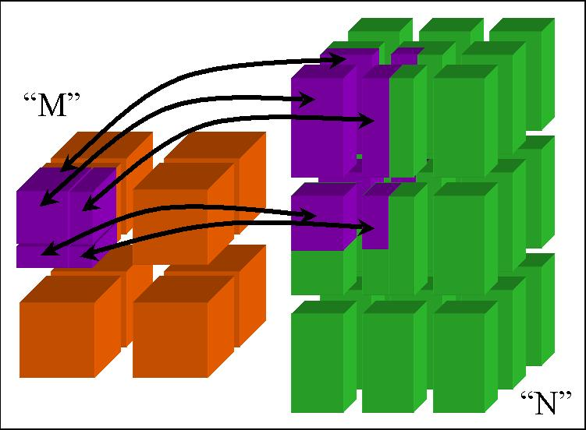
CCA Concepts:
MxN Parallel Data Redistribution
Share Data Among Coupled Parallel Models
  Disparate Parallel Topologies (M processes vs. N)
  e.g. Ocean & Atmosphere, Solver & Optimizer…
  e.g. Visualization (Mx1, increasingly, MxN)
Research area -- tools under development

Slide 28
CCA Concepts: Language Interoperability
Existing language interoperability approaches are “point-to-point” solutions
Babel provides a unified approach in which all languages are considered peers
Babel used primarily at interfaces
f77
f77
C
f90
C
f90
Babel
C++
Python
C++
Python
Babel tutorial coming up!
Java
Java

Slide 29
Concept Review
Ports
  Interfaces between components
  Uses/provides model
Framework
  Allows assembly of components into applications
Direct Connection
  Maintain performance of local inter-component calls
Parallelism
  Framework stays out of the way of parallel components
MxN Parallel Data Redistribution
  Model coupling, visualization, etc.
Language Interoperability
  Babel, Scientific Interface Definition Language (SIDL)

