Slide 1
A Look at More Complex Component-Based Applications

Slide 2
Component model for high performance computing
Components
  C++ objects with a functionality
  Ports : Provides and uses
  Compiled into shared libraries
Framework
  Loads and instantiates components
  Connects uses and provides ports
  Driven by a script or GUI
Notes:
Brief summary of the status of cca apps today
Components are c++ objects (or old libraries with a c++ wrapper) with a physics/numerical functionality.
they have interfaces called Ports that they provides; also use ports provided by other components
compiled into shared objects
Components need to be assembled into cca applications. This assembly is done by the “framework”
So the framework loads and instantiates components (by reading an input file that specifies where the components are and which need to be loaded in.
Connecting the uses and provides ports (also specified by the input file, also called the “script”)
And then gets out of the way. These can be done with a GUI too.

Slide 3
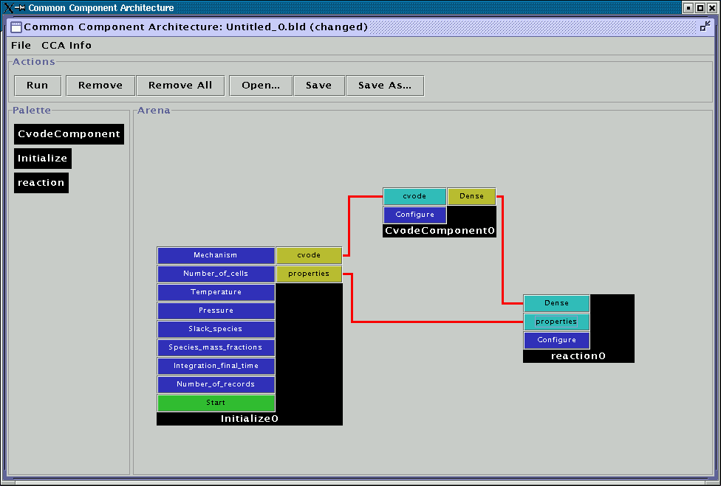
A CCA code
Notes:
So this is what a CCA code looks like :
Have a framework on 1 cpu. Has 3 components inside it.
For each component, on the left hand side, we have the list of Ports it provides. On the right, the ports it uses.
Every uses port needs to be connected to an actual component that supplies the functionality. For example the “cvode” port in Initialize0 is connected to “CvodeComponent0”. Ditto for the other Ports. Calls to methods on a UsesPort, are followed by a virtual pointer lookup to the actual method in the providing component – there is a small overhead, quantified later in the talk. All method calls are on the same CPU – no remote method invocation.
So how does one jimmy-in a parallel computing model into this ? Listen on ….

Slide 4
CCA model for high performance computing
Requirements
  High single cpu performance
  Need parallelism, NOT distributed computing
  SPMD quite sufficient, RMI not needed.
  No parallel computing prescription/model
    No one-size-fits-all
Translates to :
  Light-weight framework
  Onus on the component writer.
Notes:
Fundamentally, what do we need for HPC ?
Good single-cpu performance
Need parallelism; can do without RMI
Need SPMD
Do NOT need a parallel computing model imposed on us
Way too many algorithms out there; can’t afford to lose any performance by adhering to a prescribed par. Computing model.
So basically,
We need a lightweight, non-restrictive framework
Onus on the component writer to determine the best implementation

Slide 5
Component model for high performance computing
Solution :
  Identical frameworks with identical components and connection on P processors.
  Comp. A on proc Q can call methods on Comp. B also on proc Q.
  Comp. A s of all P procs communicate via MPI.
  No RMI – Comp. A on proc Q DOES NOT interact with Comp. B on proc N.
  No parallel comp. Model – the component does what’s right.
  2 such frameworks – Sandia, Utah.
Notes:
Parallel computing model in CCA
Start P frameworks on P processors
All P frameworks read the same input file, so they are identically configured.
At this point flip over to next slide

Slide 6
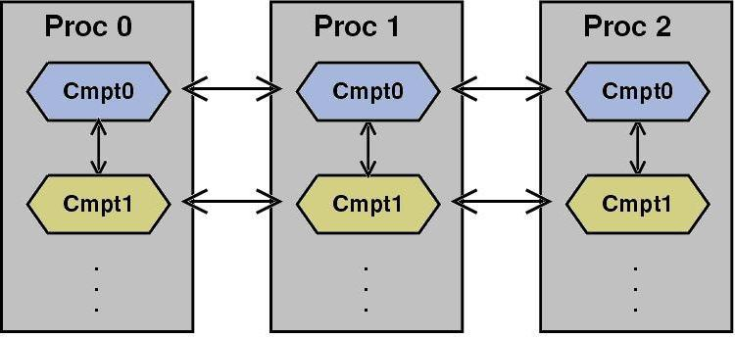
Pictorial example
Notes:
Identical frameworks on Proc 0, 1, 2 ….
Identical components Cmpt0, Cmpt1, .. On all procs, connected and configured identically.
Components on Proc0 can call each other using Ports
Componets Cmpt{0,1…} can exchange data with Cmpt{0,1…} on other procs via MPI
Compt0 on proc N CANNOT invoke methods on Compt1 on proc M

Slide 7
Summary
A lightweight component model for high performance computing.
A restriction on parallel communication
  Comm. Only between a cohort of components.
No RMI – no dist. computing.
Components with a physics / chemistry / numerical algo functionalities.
Standardized interfaces – Ports.
That’s the theory – does it work ?
Notes:
OK, to summarize :
CCA is a lightweight component model for HPC
No parallel computing model thrust on you – just SPMD
No RMI if you use CCAFFEINE
Components embody a physical/numerical functionality
They provide and use standardized interfaces –called Ports
So that’s the theory – does it work ??

Slide 8
Problem categories
Decomposition of simulation codes
  How ? Along physics ? Numerics ?
  Math model provides a hint ?
  What granularity ?
  Interfaces
Libraries
  Interfaces
Nested containers
  I.e. framework enhancements ?
Notes:
What are the problems facing complex applications developers today ?
Say you and you colleagues have monolithic codes, doing much the same physics or numerics and you’d like to break them up into components. Where do you start so that you end up with reusable components ?
Along lines of physics models ? Along numerical algorithms ?
Do the math equations give you a hint at the starting point ?
To what level of granularity does on decompose down to ?
Once you’ve answered the previous questions, start “discussing” interfaces – ways to get data in and out of your components.
This level of analysis has already been done for a lot of field – the outcome is a well-defined black box of functionality called a library.
Library writers usually have to worry about standardizing their calling interfaces – I.e ProvidesPorts.
There might be a preference amongst library writers to break-up (componentize) their libraries for their own reasons. However scientific app writes would hate that level of fine granularity – we don’t want to know about the details of non-linear solvers, for example. What we’d like is to have a fully configured library in a framework that we suck into the framework we are assembling our application in. Hence we get into the business of frameworks within frameworks I.e nested containers.
This, for sure, will need framework enhancements
But first things first

Slide 9
Decomposition of simulation codes
2 different physics simulations
Component reuse
Parallel, scalable, good single CPU performance
A formalism for decomposing a big code into
  Subsystem
  Components.
  Common underlying mathematical structure
Dirty secrets / restrictions / flexibility.
Notes:
So I’m going to show you how I decomposed 2 application codes
very different physics simulations, but roughly same numerics
Will show component reuse – of everything but physics components
Demonstrate good single-CPU performance, scaling
At the end of it, I should be able to give you a formalism for decomposing a big code into subsystems, sub-subsytems and finally into components
Also tell you about the dirty secrets, limits to reuse and what those limits depend on; ditto for flexibility.

Slide 10
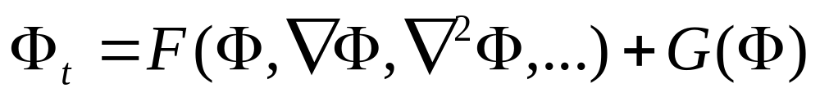
Guidelines regarding apps
Hydrodynamics
P.D.E
Spatial derivatives
  Finite differences, finite volumes
Timescales
Length scales
Notes:
The 2 apps I have in mind are in hydrodynamics
They are both governed by PDEs that have the form above. What F and G are is immaterial – for the 2 codes they ARE different. Phi is a vector
Of physical variables at a point; its evolution is governed by a kind of physics (G) that is determined entirely by the state at a point in space plus another kind of physics (F) that depends upon the state at a point in space and its immediate neighborhood I.e. we have gradients.
There are spatial derivative – one app will have finite differences, the other finite volumes
3 orders of magnitude in timescales and lengthscale differences
As you can see, these are NOT toy problems.

Slide 11
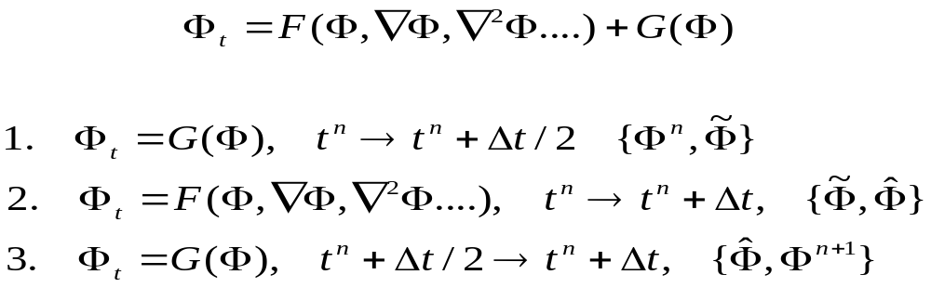
Solution strategy
Timescales
  Explicit integration of slow ones
  Implicit integration of fast ones
Strang-splitting
Notes:
To make things even more complicated
I’ll deal with the slow timescales explicitly
The fast one, implicitly
Will use strang splitting to do so – what this means is that I’ll have 2 integrators working in my code

Slide 12
Solution strategy (cont’d)
Wide spectrum of length scales
  Adaptive mesh refinement
  Structured axis-aligned patches
  GrACE.
Start with a uniform coarse mesh
  Identify regions needing refinement, collate into rectangular patches
  Impose finer mesh in patches
  Recurse; mesh hierarchy.
Notes:
Wide spectrum of length scales, and these structures are dynamic
I need to capture these structures and follow their evolution, keeping them resolved all the time
Will do so withn structured adaptive mesh refinement
In effect, I start with a coarse mesh (Level0)
Determine points needing refinement (because of fine structures), collate them into rectangles, put a finer pacth there
Do so recusively, get a mesh hierarchy

Slide 13
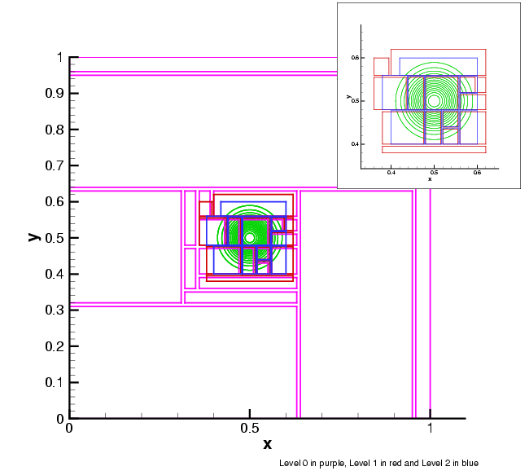
A mesh hierarchy
Notes:
This is what a mesh hierarchy looks like
Domain divided into purple lined boxes; sent off to 10 procs
Some purple boxes, in the area with structure in it are further refined to red boxes
Red boxes refined to blue boxes ; blues are 4x refined than purples

Slide 14
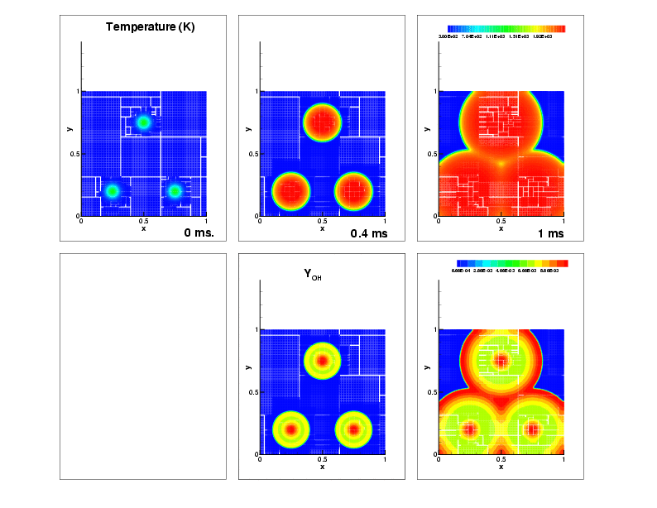
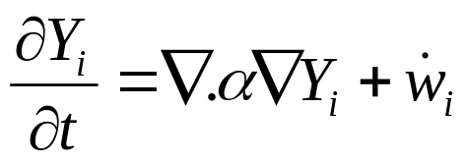
App 1. A reaction-diffusion system.
A coarse approx. to a flame.
H₂-Air mixture; ignition via 3 hot-spots
9-species, 19 reactions, stiff chemistry
1cm X 1cm domain, 100x100 coarse mesh, finest mesh = 12.5 micron.
Timescales : O(10ns) to O(10 microseconds)
Notes:
App # 1 – a reaction-diffusion problem, coarse approx to a flame. Contains a 1cm x 1cm domain with H2-Air with 3 spots of high temperature. The mixture, expectedly, ignites. We’ll try to see how the process starts and establishes itself.
Apart from H2, O2 and N2, the mechnism contains intermediate species H, O, OH, HO2, H2O2 and H2, undergoing 19 reversible reactions.
The governing eqn is given. Note : there is a diffusive term ( the state-at-a-point-and-its-neighborhood function F) and a chemistry function (G) as in the General Model.
Timescales : 10ns – 10 microseconds

Slide 15
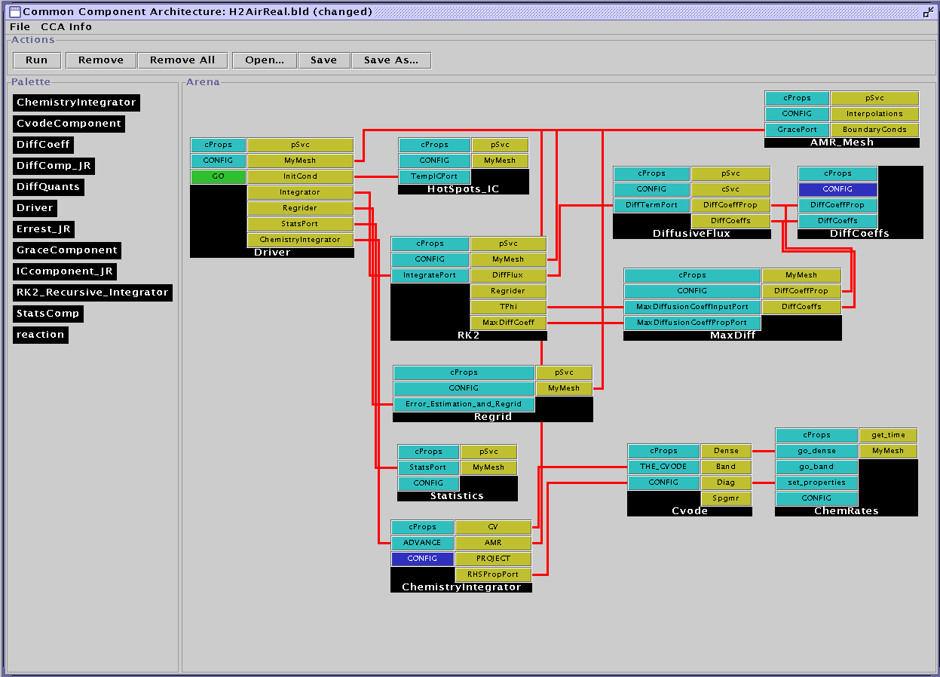
App. 1 - the code
Notes:
The code itself. Note there is a driver, a Iniital Conditions component (HotSpots_IC) and a mesh (AMR_Mesh), also a component for determining “errors” to identify points for refining and coarsening.
There are 2 main subsytems in the assembly – a slow-timescale diffusive physics (hit space here) and a fast timescales chemical physics (hit space here again). These are the 2 main ways of advancing things in time. There is a DiffCoeffs component that calculates diffusion coefficients using Lennard-Jones potentials – if you wanted one with another model (say a curve fit), all you do is replace it with the new one.
Nothing else changes. Since the 2 have the same interfaces, the switch takes five minutes.
And you’re up and running again.

Slide 16
So, how much is new code ?
The mesh – GrACE
Stiff-integrator – CVODE, LLNL
ChemicalRates – old Sandia F77 subroutines
Diff. Coeffs – based on DRFM – old Sandia F77 library
The rest
  We coded – me and the gang.
Notes:
OK, som how much is new code ?
very little indeed.
The mesh (AMR_Mesh) is a C++ wrapper arounf GrACE
ChemRates and DiffCoeffs are wrappers around legacy f77
Cvode is a wrapper around LLNL’s Cvode
The rest we wrote – but that < 10%.

Slide 17
Evolution
Notes:
Evolution of the different fields
Top, the temperature field. Start with 3 hotspots, with ignite and the ignition fronts meet. The red region is the high temeprature hot-products behind the fronts
Below, the OH profiles. Typically right behind the fronts; way behind them, OH reacts away to form H20.
The thick OH structures are big enough for a 100 x 100 mesh – so why mesh refinement ?

Slide 18
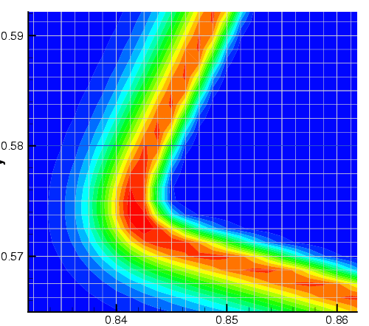
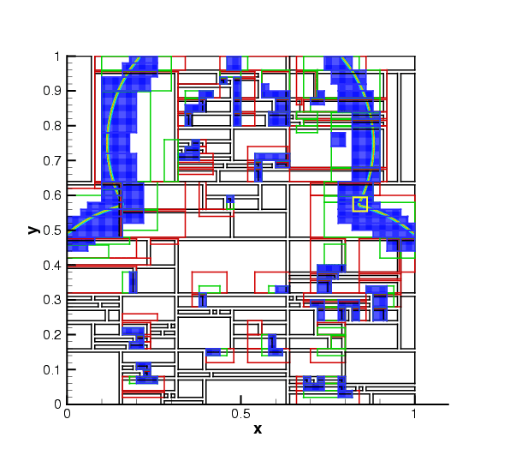
Details
H₂O₂ mass fraction profiles.
Notes:
Shows you the domain and the H2O2 profiles. The coarse mesh has been divided into patches (black outlines) and distributed to 30 procs. Sections of the black patches have been refined into green, green into red and red into blue patches where the field has been colored. A zoom into the yellow box shows the structure – the H2O2 profiles are around 10 cells wide on the finest mesh ~ 100 microns
The entire structure is contained inside 1 coarse cell – we managed to track and resolve it.

Slide 19

App. 2 shock-hydrodynamics
Shock hydrodynamics
Finite volume method (Godunov)
Notes:
So the thing works – for reaction-diffusion at least
Let’s try shock hydrodynamics.
The equations show no correlation with the reaction-diffusion one – except that this physics is determined by state-at-a-point-and-neighborhood type of physics. We’ll use the finite volume method for the physics, but the numerical algo will be the same.
Common sense : all components should be the same, except of course the physics. Really so ?
The experiment itself : a square cross-section shock-tube with 2 gases (of different densities etc) separated by a clean interface. Shock from the left moving right, interacts with the interface, deposits vorticity baroclinically, also reflects and refracts. Lots of structure, all steep.

Slide 20
Interesting features
Shock & interface are sharp discontinuities
Need refinement
Shock deposits vorticity – a governing quantity for turbulence, mixing, …
Insufficient refinement – under predict vorticity, slower mixing/turbulence.
Notes:
Interesting stuff :
The shock and interface are sharp; need to resolve them, by refinement
Shock deposits vorticity; if the interfaces are ill-resolved, this will be under-predicted.
Aim : show that we come to the “correct” vorticity by increasing the refinement; compare vorticity with analytical result.

Slide 21
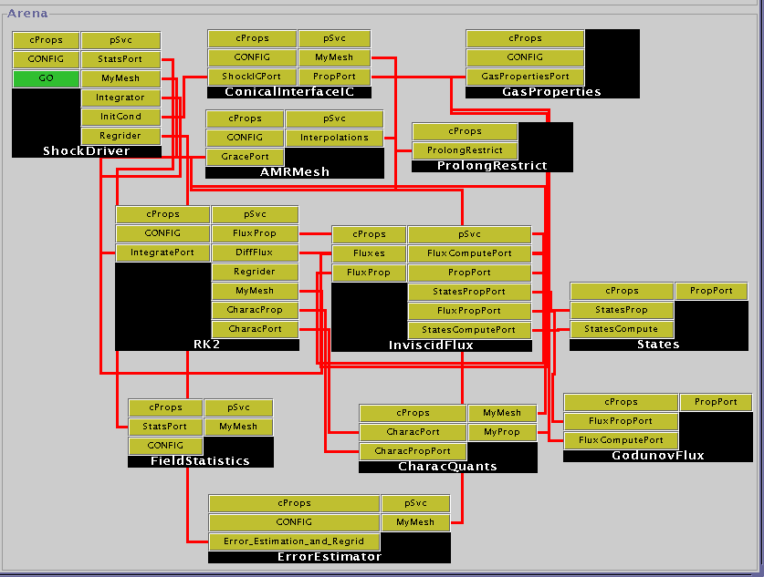
App 2. The code
Notes:
The code itself.
Same as the reaction-diffusion code : a driver, the AMRmesh, a “ConicalInterfaceIC” component for Initial Conditions, components for
Error-finding-and-regriding and max/min field statistics.
<space bar here>
In the middle is the main subsytem – a time integrator (same as before) with a component to construct the RHS (inviscid flux). This guy uses the States component to create the Riemann Invariants at the cell-interfaces and set up the Riemann Problem. GodunovFlux solves it using the Godunov method. Numerous state construction schemes (state or slope limiters) can be implemented simply by replacing States; numerous Riemann solvers (EFM, Roe etc) can be used by replacing Godunov Flux. Nothing else changes. This has actually be run with a EFM solver; GodunovFlux got replaced.

Slide 22
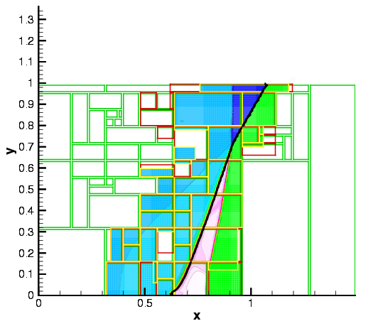
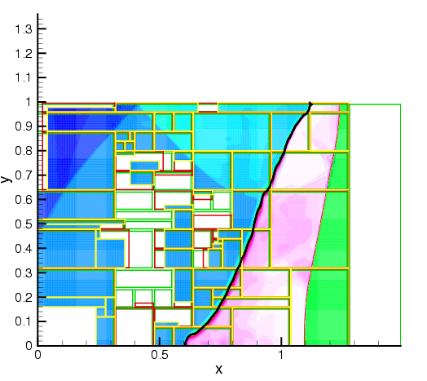
Evolution
Notes:
Evolution as seen in the density field. The black line is the interface. The Green patches are level 0 patches distributed to 25 procs; green –refined-to-red patches and red-refined-to-colored patches which are seen resolving the incident, reflected and transmitted shocks.
Later in time, the incident shock has reflected off the top wall, creating a upstream-moving shock; the transmitted shock moves out of the
Exit and the interface (an inviscid vortex sheet) is rolling up – Kelvin-Helmholtz instabiility.
And yet the interfaces are on Level 2 and hopefully resolved.

Slide 23
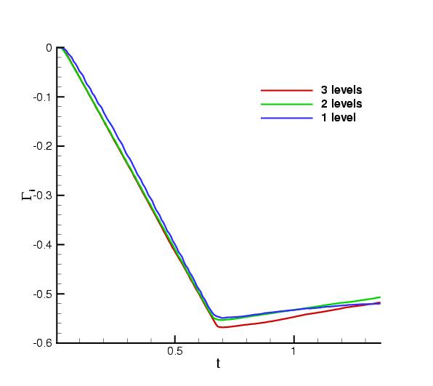
Convergence
Notes:
So how did vorticity behave ?
This plots the vorticity integrated over the interface over time. For no refinement (blue line) the vorticity is underpredicted. For 1 level of refienement, (green) and 2 levels of refinement (red) the numbers are very close – say within 1 %.
Converged !
Analytical answer – max circulation is 0.58.

Slide 24
Are components slow ?
C++ compilers << Fortran compilers
Virtual pointer lookup overhead when accessing a derived class via a pointer to base class
Y’ = F ; [ I - Δt/2 J ] ΔY = H(Y^{n}) + G(Y_{m}) ; used Cvode to solve this system
J & G evaluation requires a call to a component (Chemistry mockup)
Δt changed to make convergence harder – more J & G evaluation
Results compared to plain C and cvode library
Notes:
Are components slow ?
C++ compilers are reputed to be less optimizing than f77.
Also virtual pointer lookup has an overhead. Can we quantify it ?
So we solve a y’ = f problem with a very light-weight f and increase the limits of integration. Do an implicit formulation and set up a Newton problem. Increase the time of integration so as to increase the RHS evaluation – and rack up overheads.
Compare results with a plain C library version where the optimiser can reduce runtimes

Slide 25
Components versus library
Δt | G evaluations | Component time (sec) | Library time (sec)
0.1 | 66 | 1.18 | 1.23
1.0 | 150 | 2.34 | 2.38
100 | 405 | 6.27 | 6.14
1000 | 501 | 7.66 | 7.67
Notes:
Note :
As the limits of integration increase, the number of RHS evaluations increase. The times are roughly the same for component & library.
We used getrusage for timing which is not very accurate. However as the time-interval increased and getrusage’s inaccuracy mattered
Less and less the timings converge to the same number (7.66 vs 7.67 secs).
Essentially no difference.

Slide 26
Really so ?
Difference in calling overhead
Test :
  F77 versus componens
    500 MHz Pentium III
    Linux 2.4.18
    Gcc 2.95.4-15
Function arg type | f77 | Component
Array | 80 ns | 224ns
Complex | 75ns | 209ns
Double complex | 86ns | 241ns
Notes:
Are you telling me that we could do indirection and lose nothing ? Not really
We checked the time needed to invoke a function in f77 versus components with an array, a complex and a double complex as arguments. The components took 3x longer for the function invocation, not function execution.
But at 240 ns, do you really care ?

Slide 27
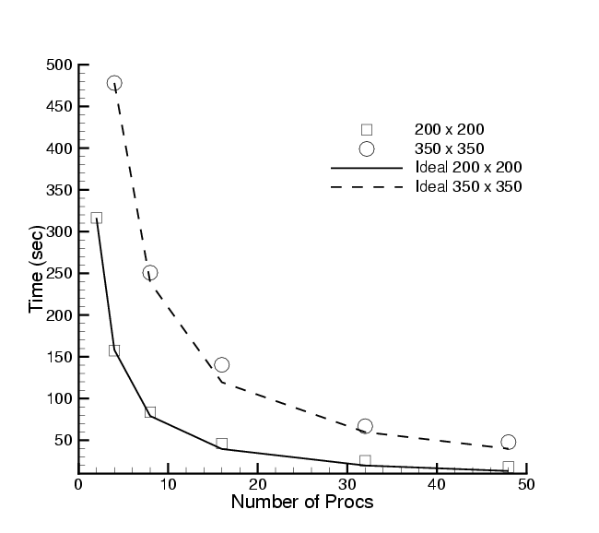
Scalability
Shock-hydro code
No refinement
200 x 200 & 350 x 350 meshes
Cplant cluster
  400 MHz EV5 Alphas
  1 Gb/s Myrinet
Worst perf : 73 % scaling eff. For 200x200 on 48 procs
Notes:
CCA does not prescribe a parallel computing model, so shouldn’t make a difference to scaling.
So we used the shock-hydro code, turned off refinement (because this leads to load-imbalance and then scaling is dependent on load-balancers too) and tested 2 small grids on upto 48 procs. The lines show ideal behavior, the symbols measured ones. The worst efficiency is for a 200x200 grid on 48 procs – 73%, which isn’t that bad.

Slide 28
Summary
Components, code
Very different physics/numerics by replacing physics components
Single cpu performance not harmed by componentization
Scalability – no effect
Flexible, parallel, etc. etc. …
Success story …?
  Not so fast …
Notes:
Components are resuable (proved), flexible etc etc and we wrote 2 codes with them.
Different physics meant different physics components – nothing more
Single cpu performance & scaling not affected
Success story … ?
Wait ….

Slide 29
Pros and cons
Cons :
  A set of components solve a PDE subject to a particular numerical scheme
  Numerics decides the main subsystems of the component assembly
    Variation on the main theme is easy
    Too large a change and you have to recreate a big percentage of components
Pros :
  Physics components appear at the bottom of the hierarchy
  Changing physics models is easy.
  Note : Adding new physics, if requiring a brand-new numerical algorithm is NOT trivial.
So what’s a better design to accommodate this ?
Notes:
This set of components assumed a certain form of the PDE and a certain numerical theme
numerics decide the main subsytems of the decomposition
Variations on the main theme are easy
Too large a change, especially if it means changing the theme of the solution algo might mean some recoding
Pro :
Physics models appear that the end of the call hierarchy
Trying out different models of the same physics is dead easy
But if you wanted to include a completely new physics which needs a specific numerical treatment, might need some head scratching
The basic reason is that I decided to assume a certain for of equation and solution scheme ? Is there a better way ? Need help.

Slide 30
What else is up ?
“libraries” !
  But as components, standard interfaces
    “Linear solver component” (interface!)
      PetSc, Trilinos etc, etc
Meshes :
  Standard interfaces for discretizing domains (unstructured meshes)
  Math operators on such meshes
  Data objects to hold fields on such meshes
Strange things …
  Data de- and re-composition, visualization …
Notes:
What else is up ?
Libraries are being wrapped as components, but with standard interfaces
Meshes, especially unstructured ones have completed figuring out terminology and description of the geometry. Defining fields on meshes is left
Math operators working on unstructured meshes are being debated
Data decomposition and recomposition of data on differently sized parallel virtual machines (for coupled physics models)

Slide 31
Libraries ….
Linear algebra
  PETSc, Trilinos, etc → components
Optimization
  TAO
ODE & DAE Integrators
  LSODE, Cvode
Profiling & optimization (cache artists ?!?)
  TAU
Data redist + Viz
  CUMULVS, using AVS, no less !
Notes:
Status :
Ptesc & trilinos – componentized
Optimization : toolkit for advanced optimization – componentized
Ode and dae integrators : 2 components for cvode and lsode
Profiling : tuning and analysis utilities – done
MxN recomposition for visualization : finished

Slide 32
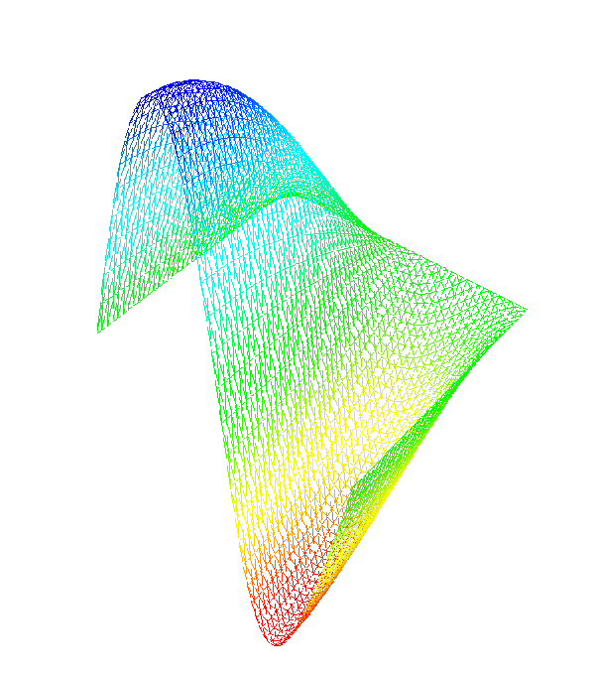
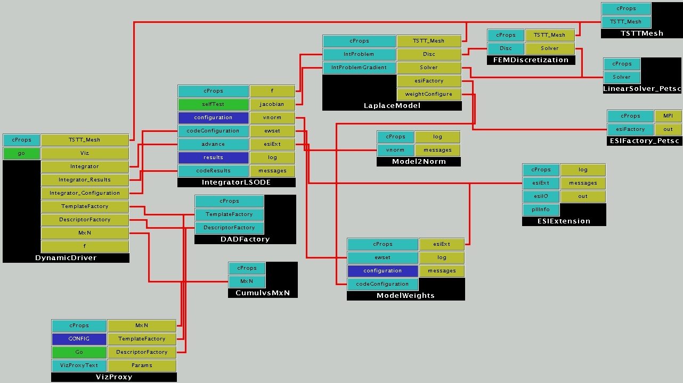
Time-Dependent PDE on an Unstructured Mesh
TSTT unstructured mesh prototype components with finite element discretizations.
Black boxes: components
Blue boxes: provides ports
Gold boxes: uses ports
IntegratorLSODE provides a second-order implicit time integrator, and FEMDiscretization provides a discretization.
This application uses the DADFactory component to describe the parallel data layout so that the CumulsMxN data redistribution component can then collate the data from a multi-processor run to a single processor for runtime visualization.
Notes:
Solving the heat equation on an unstructured mesh. The lynchpin is the integratorLSODE component – the physics is embodied in the Laplace model component. The TSTT mesh supplied a discretized domain and the PetSC solver solves linear systems.

Slide 33
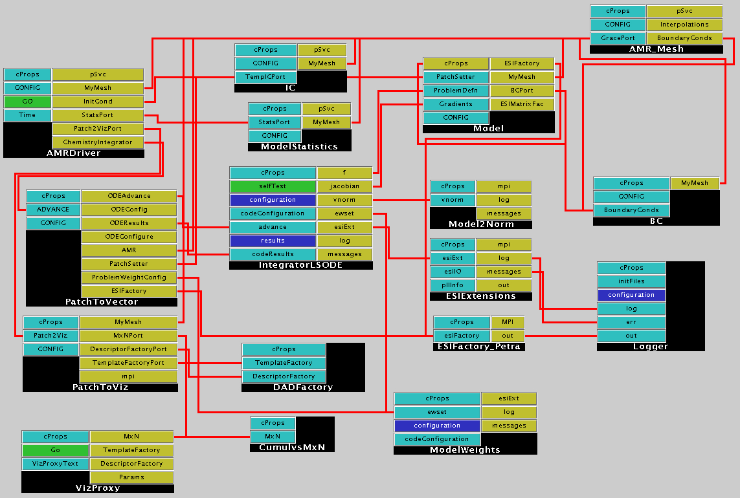
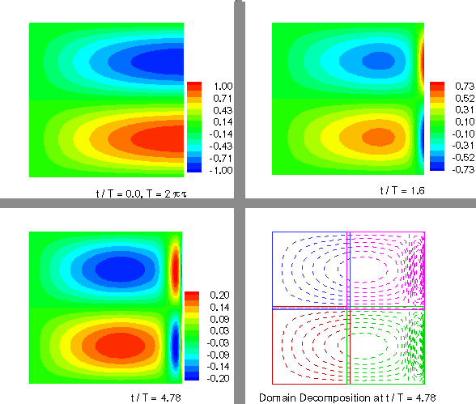
Heat Equation on an Adaptive Structured Mesh
Solution of a two-dimensional heat equation on a square domain using a structured method.
IntegratorLSODE provides a second-order implicit time integrator, and Model provides a discretization. The remaining components are essentially utilities that construct the global ODE system or adaptors that convert the patch-based data structures of the mesh to the globally distributed array structure used for runtime visualization.
Notes:
Ditto but on a structured mesh. Different mesh but identical time integrator with the physics embodied in “Model”

Slide 34
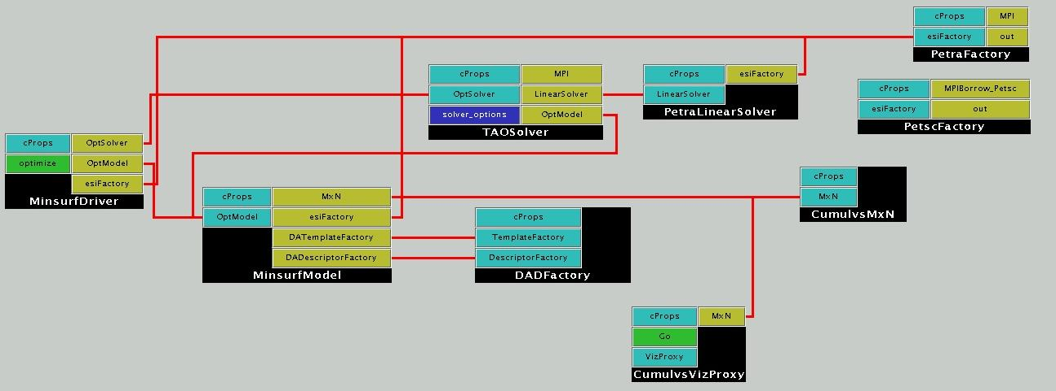
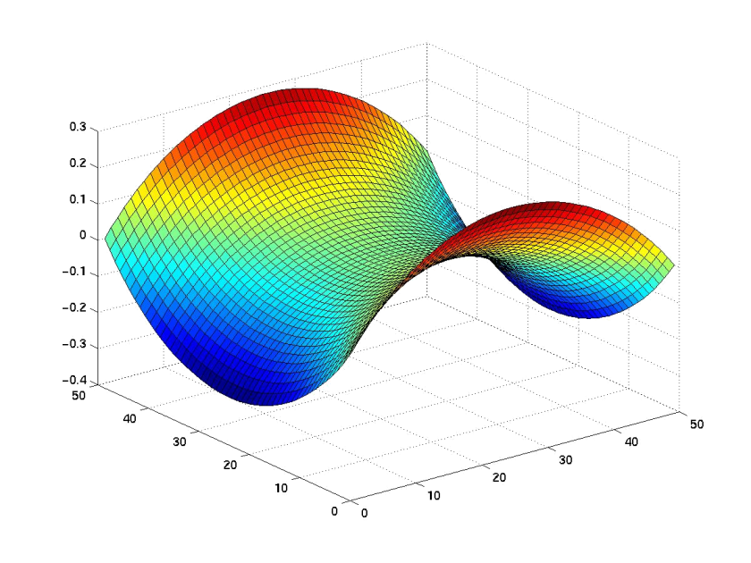
Unconstrained Minimization Using a Structured Mesh
Determine minimal surface area given boundary conditions using the TAOSolver optimization component. I.e., solve min f(x), where f: R → R.
n
TAOSolver uses linear solver components that incorporate abstract interfaces under development by the DOE-wide Equation Solver Interface (ESI) working group. Underlying implementations are provided via the new ESI interfaces to parallel linear solvers within the PETSc (ANL) and Trilinos (SNL) libraries.
Notes:
TAO usage :
Problem : given a unit square with a certain boundary condition, determine a surface that satisfies the BC and minimizes the area. The lynchpin is the TAOSolver that evaluates a “model surface” in MinsurfModel and has the resulting linear system solved by PetSC, suitably turned into a component.

Slide 35
Conclusions
Progress ..
  Libraries <-> components : well ahead
  Decomposing applications
    Slower, but harder job
  Language interoperability
    Framework done
    Adoption by people on
Knotty points
  Interfaces and scientists …
Notes:
Status
Libraries being turned into components rather rapidly
Decomposing apps is harder and slower
Language interoperability
Done – in the framework
Knottiest point :
How do you get a diverse set of scientists to agree to something that they did not invent ?!
Not laughable – most of these things are done on a shoestring budget and once debugged people have little incentive to go messing with them again
Just to adhere to a darn standard.

