Slide 1
A Simple CCA Component Application

Slide 2
Module Overview
What the example does: the math.
From math to components: the architecture.
The making of components: inheritance and ports.
Framework-component interactions.
Putting it all together: the CCafeine ways.
The application in action.

Slide 3
Goals
To show how CCA components are used to build an application to numerically integrate a continuous function using two different integration techniques.

Slide 4


The Math: Integrator (1)
The midpoint numerical integrator
x
a
b

Slide 5


The Math: Integrator (2)
The Monte Carlo integrator
x
a
b

Slide 6
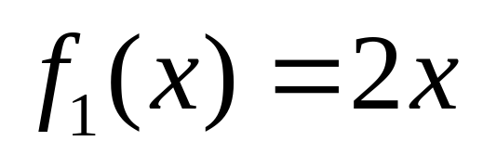


The math: Functions
Linear Function
Nonlinear Function
Pi Function

Slide 7
Available Components
RandomGeneratorPort
IntegratorPort
FunctionPort
RandomGenerator
RandomGeneratorPort
MonteCarloIntegrator
FunctionPort
Go
IntegratorPort
NonLinearFunction
Driver
FunctionPort
PiFunction
IntegratorPort
FunctionPort
FunctionPort
MidpointIntegrator
LinearFunction

Slide 8
Pluggability: Scenario 1
RandomGeneratorPort
IntegratorPort
FunctionPort
RandomGenerator
RandomGeneratorPort
MonteCarloIntegrator
FunctionPort
Go
IntegratorPort
NonLinearFunction
Driver
FunctionPort
PiFunction
IntegratorPort
FunctionPort
FunctionPort
MidpointIntegrator
LinearFunction

Slide 9
Pluggability: Scenario 2
RandomGeneratorPort
IntegratorPort
FunctionPort
RandomGenerator
RandomGeneratorPort
MonteCarloIntegrator
FunctionPort
Go
IntegratorPort
NonLinearFunction
Driver
FunctionPort
PiFunction
IntegratorPort
FunctionPort
FunctionPort
MidpointIntegrator
LinearFunction
Notes:
This is the scenario that we’ll be focusing on for the rest of this tutorial. The MonteCarloIntegrator component exports a single port (Integrator) and uses two ports (functionPOrt and RandomGeneratorPort).

Slide 10
MonteCarloIntegrator in Details
integrators.Integrator
gov.cca.Component
IntegratorPort
FunctionPort
RandomGeneratorPort
MonteCarloIntegrator
Relevant files:
integrator.sidl
function.sidl
random.sidl
MonteCarloIntegrator
Inheritance Tree
What makes it a component?
Inheritance from gov.cca.Component
Where does IntegratorPort come from?
Inheritance from integrators.Integrator
Notes:
The MonteCarloIntegrator component provides the integrators.Integrator port, hence the need to inherit from the integartors.Integrator interface. The fact that the MonteCarloIntegrator uses a FunctionPort and a RandomGeneratorPort is NOT reflected in the architecture of the component (no need to inherit from any special interface), rather this is expressed at run time through calls made to the framework (registerUsesPort())

Slide 11
Saying it in SIDL
version integrators 1.0;
package integrators {
interface Integrator
extends gov.cca.Port
{
double integrate(in double lowBound,
in double upBound, in int count);
}
class MonteCarloIntegrator
implements-all Integrator,
gov.cca.Component
{
}
………
}
Notes:
Interfaces are highlighted in red (the difference between extends and implements all will be discussed in the Babel module)

Slide 12
Notes
Inheritance from gov.cca.Component furnishes the only method known to the framework: setServices()
“Provides” ports are interfaces that need to inherit from gov.cca.Port (Integrator in this case)

Slide 13
The Framework Role
Framework-to-Component: setServices()
  Called after the component is constructed.
  The component’s chance to identify:
    Ports it provides – addProvidesPort()
    Ports it uses – registerUsesPort()
  Component should not acquire the port here – Reason: it may not be there yet !!!!
  Also used to “shutdown” the component.

Slide 14
Component-to-Framework
Mainly through Services object passed through setServices().
addProvidesPort(), registerUsesPort():
  Component “pointer”, PortName, PortType, PortProperties.
getPort():
  Called by the using component.
  Matching using portType (not name).
releasePort(), removeProvidesPort():
  When all is done.
Notes:
releasePort() is paired with getPort() and must be called to do any reconfig of components.

Slide 15
The Life Cycle Revisited
Framework
Create MonteCarloIntegrator
create
MonteCarloIntegrator
Create PiFunction
setServices()
PiFunction
addProvidesPort()
create
registerUsesPort()
setServices()
setServices()
setServices()
Connect MonteCarloIntegrator,
PiFunction
addProvidesPort()
Construction
integrate()
Execution
getPort()
evaluate()
integrate()
evaluate()
Notes:
Red commands on gray background: Composition instructions issued to the framework to “build” an application.
The way these are conveyed to the framework is framework-dependent (GUI, script, command line, main() program in case of framework-as-a-library, ..etc.).
Red commands from Framework: Framework commands issued in response to compositional instructions. The create() command initiates the creation protocol which involves the framework calling setServices() implemented by the newly created component. Inside setServices(), a component typically communicates the ports it provides and the ports that it uses to the framework (through addProvidesPort() and registerUsesPort() respectively.
Blue commands: These are commands issued by the individual components, either to invoke a framework service (e.g. addProvidesPort()) or to invoke action on another component’s provided port (e.g. evaluate()).

Slide 16
Example: setservices() in MonteCarloIntegrator (C++)
………
frameworkServices = services;
if (frameworkServices._not_nil ()) {
gov::cca::TypeMap tm = frameworkServices.createTypeMap ();
gov::cca::Port p = self;
frameworkServices.addProvidesPort (p,
"IntegratorPort",
"integrators.Integrator", tm);
// The Ports I use
frameworkServices.registerUsesPort (
"FunctionPort",
"functions.Function", tm);
frameworkServices.registerUsesPort ( "RandomGeneratorPort",
"randomgen.RandomGenerator", tm);
………
portName
portType
portProperties
Notes:
services object passed into setservices() as input argument from the framework. frameworkServices is an instance (probably private) variable used to cache the handle to the services object for use in future invocations on other methods in the port interface.
portProperties is used to store port specific information that can be queried and used in ways that are outside the framework’s direct control (e.g. it can be used to provide information about the complexity of the algorithm implemented by the port, memory requirements, ..etc.)

Slide 17
Notes
setServices() mainly used to inform the framework which ports the current component provides and/or uses.
No actual connections between ports are established in setServices(), since the “other” port may not yet exist !!!
portName is unique per component.
portType identifies the “interface” that the port implements (used to match user and provider).
portProperties : list of port-specific key-value pairs.

Slide 18
Example: integrate() in MonteCarloIntegrator (C++)
………
functions::Function functionPort;
randomgen::RandomGenerator randomPort;
double sum = 0.0;
randomPort = frameworkServices.getPort ("RandomGeneratorPort");
functionPort = frameworkServices.getPort ("FunctionPort");
for (int i = 0; i < count; i++){
double x = lowBound + (upBound - lowBound) *
randomPort.getRandomNumber();
sum = sum + functionPort.evaluate(x);
}
frameworkServices.releasePort ("FunctionPort");
frameworkServices.releasePort ("RandomGeneratorPort");
return (upBound - lowBound) * sum / count;
………
Notes:
Not shown: test for errors

Slide 19
Putting it all together
Getting the application to do something:
  Assembling the components into an app.
  Launching the Application.
App assembly:
  Framework need to be told what components to use, and where to find them.
  Framework need to be told which uses port connects to which provides port.
App execution: the GO port:
  Special provides port used to launch the application (after connections are established).
  Has one method, go(), that is called by the framework to get the application going.

Slide 20
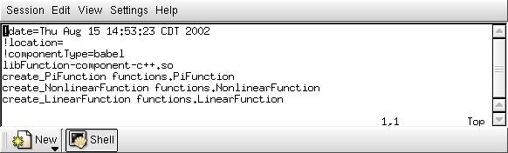
Oh Component , where art thou?.
Which components, and how to create them
More details in the Ccaffeine Module
Notes:
The details of the .cca file will be expounded upon in the Ccaffeine module. These details are framework-specific and not part of the CCA specification itself.

Slide 21
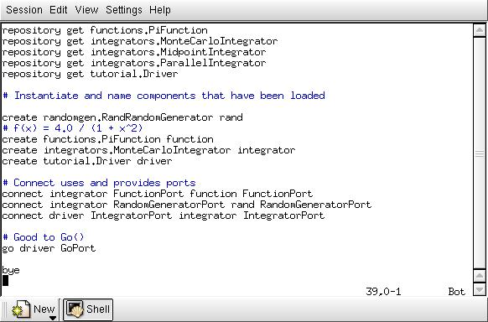
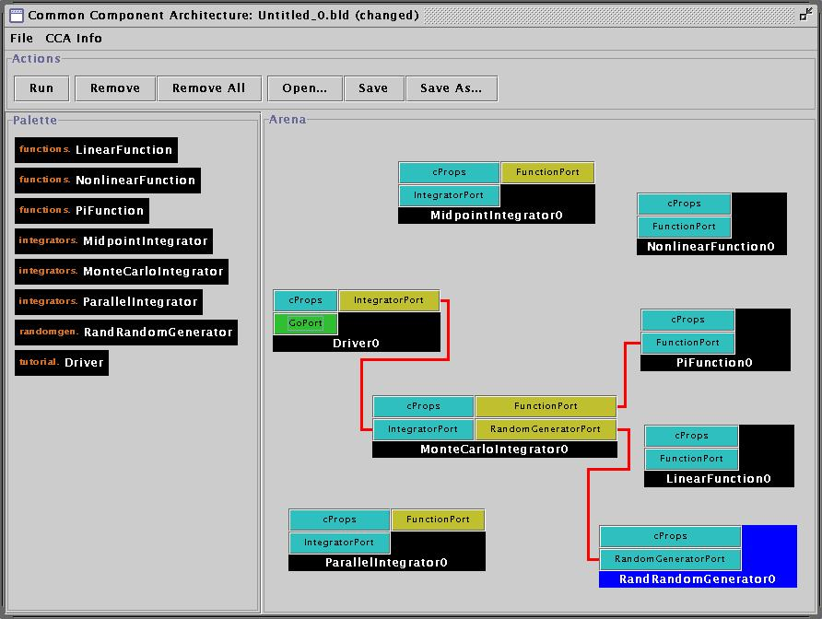
App. Assembly The Ccafeine way
Command line “script”
GUI Interface
Notes:
Switch to the other laptop and do the example1 both gui and script.
./setup_paths
run_gui example1_gui_rc
run_cmdline example1_rc (script)

Slide 22
Next: Babel

