Slide 1
Common Component Architecture Concepts

Slide 2
Goals
Introduce essential features of the Common Component Architecture
Provide common vocabulary for remainder of tutorial
What distinguishes CCA from other component environments?

Slide 3
Features of the Common Component Architecture
A component model specifically designed for high-performance computing
  Support HPC languages (Babel)
  Support parallel as well as distributed execution models
  Minimize performance overhead
Minimalist approach makes it easier to componentize existing software
Component interactions are not merely dataflow
Components are peers
  No particular component assumes it is “in charge” of the others.
  Allows the application developer to decide what is important.
Notes:
CORBA, DCOM, and Enterprise JavaBeans are three popular commodity component environments
CORBA, DCOM lack bindings for Fortran and important data types for scientific computing
EJB is Java-specific (but can use native interface to call other languages)
All three focus on distributed computing and have no concept of parallelism
CCA places the least possible requirements on what it means to be a CCA component
Add constructor, destructor (both typically trivial)
Add setServices method
Dataflow-based approaches are popular in visualization toolkits, etc. CCA is more general

Slide 4
CCA Concepts: Ports
IntegratorPort
FunctionPort
FunctionPort
MidpointIntegrator
NonlinearFunction
Components interact through well-defined interfaces, or ports
  In OO languages, a port is a class or interface
  In Fortran, a port is a bunch of subroutines or a module
Components may provide ports – implement the class or subroutines of the port
Components may use ports – call methods or subroutines in the port
Links denote a caller/callee relationship, not dataflow!
  e.g., FunctionPort could contain: evaluate(in Arg, out Result)
Notes:
The cartoon is a schematic representation of two components connected to each other. The representation mimics that used in the original GUI for the Ccaffeine framework. Uses ports are shown on the left side of the component, provides ports on the right. They are shown in different colors to help distinguish them.
The MidpointIntegrator component has two ports. It provides an IntegratorPort and uses a FunctionPort. The NonlinearFunction component provides a FunctionPort. The red line connects the user FunctionPort on MidpointIntegrator to the provider FunctionPort on NonlinearFunction.
Another way to think of user/provider is client/server
To repeat: connecting ports does not imply direction of data movement!

Slide 5
Components and Ports in the Integrator Example
FunctionPort
IntegratorPort
FunctionPort
NonlinearFunction
MidpointIntegrator
FunctionPort
GoPort
IntegratorPort
LinearFunction
Driver
FunctionPort
IntegratorPort
FunctionPort
PiFunction
RandomGeneratorPort
MonteCarloIntegrator
RandomGeneratorPort
RandomGenerator
Notes:
A bunch of components that we’ll see throughout the tutorial
The driver’s job is merely to invoke the integrator and print out the result
We have two different integrators (and of course you could have many more)
One uses the simple midpoint integration rule
The other is based on the Monte Carlo approach, so it requires a random number generator in addition to the function to be integrated
On the right are several functions we might want to integrate, as well as a random number generator

Slide 6
An Application
Built from the Example Components
FunctionPort
IntegratorPort
FunctionPort
NonlinearFunction
MidpointIntegrator
FunctionPort
GoPort
IntegratorPort
LinearFunction
Driver
FunctionPort
IntegratorPort
FunctionPort
PiFunction
RandomGeneratorPort
MonteCarloIntegrator
RandomGeneratorPort
RandomGenerator
Notes:
To build a particular application from the components, we connect ports. In this case, we will integrate a function that should give us pi using the Monte Carlo approach.
Creating a valid application depends on connecting up ports according to their semantics, not on simply connecting every possible port. Components may, for example, offer alternative interfaces to accomplish the same task. Or some interfaces might be used only for debugging, performance monitoring, or other purposes.

Slide 7
Another Application…
FunctionPort
IntegratorPort
FunctionPort
NonlinearFunction
MidpointIntegrator
FunctionPort
GoPort
IntegratorPort
LinearFunction
Driver
FunctionPort
IntegratorPort
FunctionPort
PiFunction
RandomGeneratorPort
MonteCarloIntegrator
RandomGeneratorPort
RandomGenerator
Notes:
All we’ve done here is change to integrating a different function

Slide 8
Application 3…
FunctionPort
IntegratorPort
FunctionPort
NonlinearFunction
MidpointIntegrator
FunctionPort
GoPort
IntegratorPort
LinearFunction
Driver
FunctionPort
IntegratorPort
FunctionPort
PiFunction
RandomGeneratorPort
MonteCarloIntegrator
RandomGeneratorPort
RandomGenerator
Notes:
Here we’ve changed integrators and functions

Slide 9
And Many More…
Dashed lines indicate alternate connections
FunctionPort
IntegratorPort
FunctionPort
NonlinearFunction
MidpointIntegrator
FunctionPort
GoPort
IntegratorPort
LinearFunction
Driver
FunctionPort
IntegratorPort
FunctionPort
PiFunction
RandomGeneratorPort
MonteCarloIntegrator
RandomGeneratorPort
Create different applications in "plug-and-play" fashion
RandomGenerator

Slide 10
Ports, Interoperability, and Reuse
Ports (interfaces) define how components interact
Generality, quality, robustness of ports is up to designer/architect
  “Any old” interface is easy to create, but…
  Developing a robust domain “standard” interface requires thought, effort, and cooperation
General “plug-and-play” interoperability of components requires multiple implementations conforming to the same interface
Designing for interoperability and reuse requires “standard” interfaces
  Typically domain-specific
  “Standard” need not imply a formal process, may mean “widely used”
Notes:
Good interfaces can be a significant investment. The payback is the ability to reuse the code easily in multiple applications.
Some studies suggest that the cost of developing a good interface is paid back in 3-5 re-uses.
Designing good interfaces is often done incrementally. If you don’t have a well-defined interface, start by creating one that works for your application. Then work on generalizing it to encompass other situations and applications.

Slide 11
Components vs Libraries
Component environments rigorously enforce interfaces
Can have several versions of a component loaded into a single application
Component needs add’l code to interact w/ framework
  Constructor and destructor methods
  Tell framework what ports it uses and provides
Invoking methods on other components requires slight modification to “library” code
Framework interaction
code (new)
Integrator library code
(slightly modified)
MonteCarloIntegrator
Notes:
Components are in many ways similar to libraries, but there are some important differences.
In non-OO languages, it is impossible to rigorously enforce interfaces to libraries – someone can “discover” and use functions you only intended for internal use.
Components allow you to have several distinct versions of a “library” loaded into an application at once, so component A, which depends on version 2 of the library can component B, which depends on version 3 can live happily together in the same application
Of course this comes at a cost – you have to add a small amount of code to provide the necessary interactions with the framework, and if your library code uses other components, you have to modify it a little.

Slide 12
CCA Concepts: Frameworks
The framework provides the means to “hold” components and compose them into applications
  The framework is often application’s “main” or “program”
Frameworks allow exchange of ports among components without exposing implementation details
Frameworks provide a small set of standard services to components
  BuilderServices allow programs to compose CCA apps
Frameworks may make themselves appear as components in order to connect to components in other frameworks
Currently: specific frameworks support specific computing models (parallel, distributed, etc.).
Future: full flexibility through integration or interoperation

Slide 13
The Lifecycle of a Component
User instructs framework to load and instantiate components
User instructs framework to connect uses ports to provides ports
Code in components uses functions provided by another component
Ports may be disconnected
Component may be destroyed
Look at actual code in next tutorial module
Notes:
We’re not really going to talk about disconnecting ports or destroying components here.

Slide 14
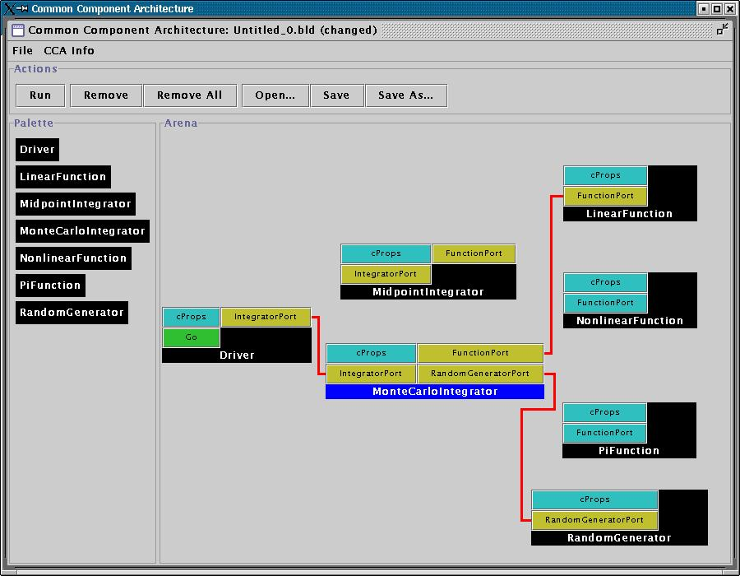
Loading and Instantiating Components
Components are code (usu. library or shared object) + metadata
Using metadata, a Palette of available components is constructed
Components are instantiated by user action (i.e. by dragging from Palette into Arena)
Framework calls component’s constructor, then setServices
Details are framework-specific!
Ccaffeine currently provides both command line and GUI approaches
create Driver Driver
create LinearFunction LinearFunction
create MonteCarloIntegrator MonteCarloIntegrator
Notes:
While this description is specific to Ccaffeine, the concepts are general

Slide 15
Component’s View of Instantiation
Framework calls component’s constructor
Component initializes internal data, etc.
  Knows nothing outside itself
Framework calls component’s setServices
  Passes setServices an object representing everything “outside”
  setServices declares ports component uses and provides
Component still knows nothing outside itself
  But Services object provides the means of communication w/ framework
Framework now knows how to “decorate” component and how it might connect with others
Framework interaction code
constructor setServices destructor
CCA.Services
provides IntegratorPort
uses FunctionPort, RandomGeneratorPort
Integrator code
IntegratorPort
FunctionPort
RandomGeneratorPort
MonteCarloIntegrator
MonteCarloIntegrator
Notes:
The cartoon on the left shows the internals of the component. The cartoon on the right is how the Ccaffeine GUI would render the “decorated” component to the outside world.

Slide 16
User Connects Ports
Can only connect user & provider
  Not uses/uses or provides/provides
Ports connected by type, not name
  Port names must be unique within component
  Types must match across components
Framework puts info about provider into user component’s Services object
connect Driver IntegratorPort MonteCarloIntegrator IntegratorPort
connect MonteCarloIntegrator FunctionPort LinearFunction FunctionPort
…
Notes:
The picture is specific to Ccaffeine, but the concepts are general

Slide 17
Component’s View of Connection
Framework interaction code
CCA.Services
…, uses FunctionPort
(connected to NonlinearFunction FunctionPort), …
Framework puts info about provider into user component’s Services object
  MonteCarloIntegrator’s Services object is aware of connection
  NonlinearFunction is not!
MCI’s integrator code cannot yet call functions on FunctionPort
Integrator code
Framework interaction code
MonteCarloIntegrator
CCA.Services
provides FunctionPort
Function code
NonlinearFunction

Slide 18
Component’s View of Using a Port
User calls getPort to obtain (handle for) port from Services
  Finally user code can “see” provider
Cast port to expected type
  OO programming concept
  Insures type safety
  Helps enforce declared interface
Call methods on port
  e.g.
  sum = sum + function->evaluate(x)
Release port
Framework interaction code
CCA.Services
…, uses FunctionPort
(connected to NonlinearFunction FunctionPort), …
Integrator code
MonteCarloIntegrator
Notes:
This is where the changes to the “library” code turn up. The getPort/cast/releasePort are outright additions. But also, calls to methods on the port will change slightly.

Slide 19
Importance of Provides/Uses Pattern for Ports
Component 1
Component 2
Fences between components
  Components must declare both what they provide and what they use
  Components cannot interact until ports are connected
  No mechanism to call anything not part of a port
Ports preserve high performance direct connection semantics…
…While also allowing distributed computing
Provides/Uses
Port
Direct Connection
Component 1
Provides
Port
Network
Connection
Component 2
Uses
Port

Slide 20
CCA Concepts: Direct Connection
Components loaded into separate namespaces in the same address space (process) from shared libraries
getPort call returns a pointer to the port’s function table
Calls between components equivalent to a C++ virtual function call: lookup function location, invoke
Cost equivalent of ~2.8 F77 or C function calls
All this happens “automatically” – user just sees high performance
Description reflects Ccaffeine implementation, but similar or identical mechanisms in other direct connect fwks
Notes:
In CORBA direct connection optimizations can be done with some ORBs. A paper by Schmidt talks about two “levels” of direct connection optimization – one which preserves all CORBA semantics, but offers little performance improvement, and one which violates CORBA semantics, but gives much better performance and which should be similar to CCA direct connect implementations.

Slide 21
CCA Concepts:
Parallel Components
Single component multiple data (SCMD) model is component analog of widely used SPMD model
Each process loaded with the same set of components wired the same way
Different components in same process “talk to each” other via ports and the framework
Same component in different processes talk to each other through their favorite communications layer (i.e., MPI, PVM, GA)
Also supports MPMD/MCMD
P0
P1
P2
P3
Components: Red, Green, Blue
Framework: Gray
Framework stays “out of the way” of component parallelism

Slide 22
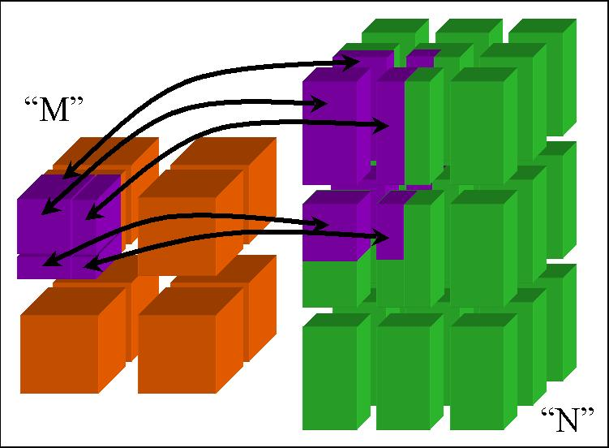
CCA Concepts:
MxN Parallel Data Redistribution
Share Data Among Coupled Parallel Models
  Disparate Parallel Topologies (M processes vs. N)
  e.g. Ocean & Atmosphere, Solver & Optimizer…
  e.g. Visualization (Mx1, increasingly, MxN)
Research area -- tools under development

Slide 23
CCA Concepts: Language Interoperability
Existing language interoperability approaches are “point-to-point” solutions
Babel provides a unified approach in which all languages are considered peers
Babel used primarily at interfaces
f77
f77
C
f90
C
f90
Babel
C++
Python
C++
Python
Babel tutorial coming up!
Java
Java

Slide 24
Concept Review
Ports
  Interfaces between components
  Uses/provides model
Framework
  Allows assembly of components into applications
Direct Connection
  Maintain performance of local inter-component calls
Parallelism
  Framework stays out of the way of parallel components
MxN Parallel Data Redistribution
  Model coupling, visualization, etc.
Language Interoperability
  Babel, Scientific Interface Definition Language (SIDL)

Slide 25
Next: A Simple CCA Example

