Slide 1
Introduction to Components

Slide 2
Overview
Why do we need components?
What are components?
How do we make components?

Slide 3
Why Components
In “Components, The Movie”
  Interoperability across multiple languages
  Interoperability across multiple platforms
  Incremental evolution of large legacy systems (esp. w/ multiple 3rd party software)
Complexity
Notes:
The movie answers why components with …
- Evolution -> adaptability, potential for growth
We look more closely at another reason, complexity, also briefly touched on in the movie

Slide 4
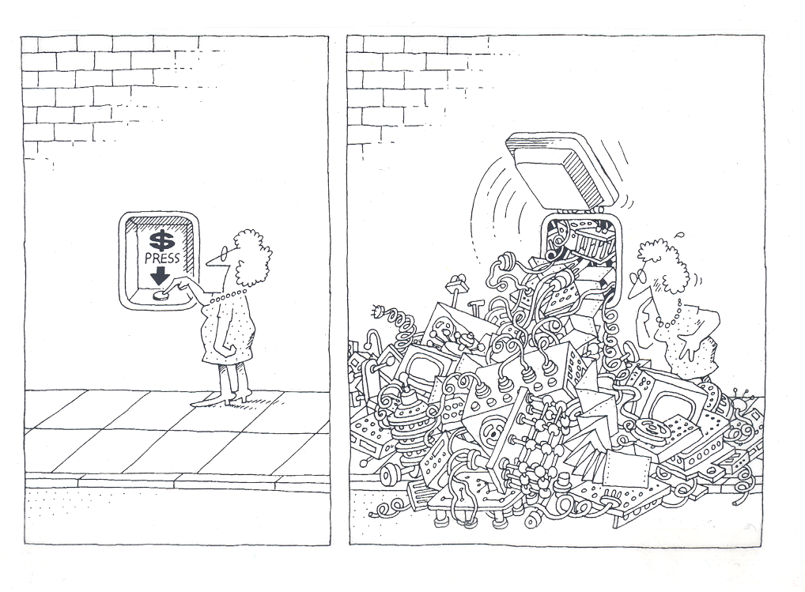
Why Components
The task of the software development team is to engineer the illusion of simplicity [Booch].
Notes:
A physician, a civil engineer, and a computer scientist were arguing about what was the oldest profession in the world. The physician remarked, “Well, in the Bible, it says that God created Eve from a rib taken out of Adam. This clearly required surgery, and so I can rightly claim that mine is the oldest profession in the world.” The civil engineer interrupted, and said, “But even earlier in the book of Genesis, it states that God created the order of the heavens and the earth out of the chaos. This was the first and certainly the most spectacular application of civil engineering. Therefore, fair doctor, you are wrong: mine is the oldest profession in the world.” The computer scientist leaned back in her chair, smiled, and then said confidently, “Ah, but who do you think created the chaos?”

Slide 5
Software Complexity
Software crisis
  “Our failure to master the complexity of software results in projects that are late, over budget, and deficient in their stated requirements.” [Booch]
Can’t escape it
  “The complexity of software is an essential property, not an accidental one.” [Brooks]
Help is on the way…
  “A complex system that works is invariably found to have evolved from a simple system that worked… A complex system designed from scratch never works and cannot be patched up to make it work.” [Gall]
  “Intracomponent linkages are generally stronger than intercomponent linkages.” [Simon]
  “Frequently, complexity takes the form of a hierarchy.” [Courtois]
Notes:
Help is on the way..
- Building blocks (“A complex system that works…” )
- encapsulation (“Intracomponent linkages…”)
- CCA components high in the hierarchy food chain (“Frequently, complexity …”)

Slide 6
The Good the Bad and the Ugly
An example of what can lead to a crisis in software:
At least 41 different Fast Fourier Transform (FFT) libraries:
  see, http://www.fftw.org/benchfft/doc/ffts.html
Many (if not all) have different interfaces
  different procedure names and different input and output parameters
SUBROUTINE FOUR1(DATA, NN, ISIGN)
  Replaces DATA by its discrete Fourier transform (if ISIGN is input as 1) or replaces DATA by NN times its inverse discrete Fourier transform (if ISIGN is input as -1). DATA is a complex array of length NN or, equivalently, a real array of length 2*NN. NN MUST be an integer power of 2 (this is not checked for!).
Notes:
The major problem is with 41 different and poorly specified interfaces which do roughly the same thing.
Work arounds exist but better interfaces needed.
A component architecture would allow a usercomponent to query an FFT provider and select the most appropriate/fastest port.

Slide 7

Components Promote Reuse
X
Hero programmer producing single-purpose, monolithic, tightly-coupled parallel codes
Components promote software reuse
  “The best software is code you don’t have to write” [Steve Jobs]
Reuse, through cost amortization increases software quality
  thoroughly tested code
  highly optimized code
  improved support for multiple platforms
  developer team specialization
Notes:
Components help solve complexity, they also encourage reuse.

Slide 8
What Are Components
Why do we need components?
What are components?
How do we make components?

Slide 9
What Are Components [Szyperski]
A component is a binary unit of independent deployment
  well separated from other components
    fences make good neighbors
  can be deployed independently
A component is a unit of third-party composition
  is composable (even by physicists)
  comes with clear specifications of what it requires and provides
  interacts with its environment through well-defined interfaces
A component has no persistent state
  temporary state set only through well-defined interfaces
  throw away that dependence on global data (common blocks)
Similar to Java packages and Fortran 90 modules (with a little help)
Notes:
Independent of what (other components)
Independence leads to the ability to compose
Global data -> across components NOT ok, but ok within

Slide 10
What Does This Mean
So what does this mean
  Components are “plug and play”
  Components are reusable
  Component applications are evolvable

Slide 11
Component Forms [Cheesman & Daniels]
Component Standard
  must conform to some sort of environment standard (Framework)
Component Specification
  specification of what a component does
Component Interface
  specification of procedure names and procedure parameters
Component Implementation
  written in a computer language (Fortran for example)
Installed Component
  a shared object library (.so file)
Component Object
  services and state joined together
Notes:
Szyperski defines what a component is.
Cheesman and Daniels prefer to state the various forms that a component takes, essentially defining a component architecture

Slide 12
What is a Component Architecture
A set of standards that allows:
  Multiple groups to write units of software (components)
  The groups to be sure that their components will work with other components written in the same architecture
A framework that holds and runs the components
  And provides services to the components to allow them to know about and interact with other components
Notes:
Followup on Cheesman and Daniels specifying a component architecture.
One really shouldn’t think of components alone, it is the complete environment/architecture

Slide 13
What Are Components II
Components live in an environment and interact with the environment through a framework and connections with other components.
Components can discover information about their environment from the framework.
Components must explicitly publish what capabilities they provide.
Components must explicitly publish what connections they require.
Components are a runtime entity.
Notes:
Summarizes what a component is

Slide 14
Components Are Different From Objects
You can build components out of object classes.
  (or out of Fortran procedures)
But a component is more that just an object.
A component only exists in the context of a Component Standard (Framework).
Notes:
Some people have been confused by the difference between an object and a component.
This slide added to clarify the differences

Slide 15
Pictorial Example
Consumer
Producer
uses
provides
Notes:
UML diagram of components showing CCA uses and provides design pattern

Slide 16
Three Components
Integrator
integrate( )
Function
RandomGenerator
evaluate( )
getRandomValue( )
Notes:
Functions/ports added to UML diagram.
A component can be connected to/use multiple components

Slide 17
How Do We Make Components
Why do we need components?
What are components?
How do we make components?

Slide 18
Interface Declaration
Integrator
integrate( )
Integrator.h
Integrator.f90
class Integrator
{
virtual void
integrate( double lowBound,
double upBound,
int count ) = 0;
};
interface
function integrate( lowBound,
upBound,
count )
real(kind(1.0D0)) :: lowBound, upBound
integer :: count
end function
end interface
Notes:
First thing to do is to decide on functionality and design interfaces

Slide 19
Publish the Interface in SIDL
Publish the interface
  interfaces are published in SIDL (Scientific Interface Definition Language)
  can’t publish in native language because of language interoperability requirement
Integrator example:
interface Integrator extends cca.Port
{
double integrate(in double lowBound,
in double upBound,
in int count);
}
Notes:
Still hammering on importance of interfaces.
Declare in SIDL for language interoperability
Only iIntroduce notion of SIDL here, more to follow later in tutorial

Slide 20
F90 Integrator Interface
MODULE Integrator
interface
!
! Returns the result of the integration from lowBound to upBound.
!
! lowBound - the beginning of the integration interval
! upBound - the end of the integration interval
! count - the number of integration points
!
function integrate(port, lowBound, upBound, count)
use CCA
type(CCAPort) :: port
real(kind(1.0D0)) :: integrate, lowBound, upBound
integer :: count
end function integrate
end interface
END MODULE Integrator
Notes:
Interface declaration in Fortran
“Use CCA” and “type(CCAPort) :: port” statements only used by CCA Framework, not by Fortran procedures
Think of an MPI communicator
CCA port totally ignored when Fortran module run outside of CCA environment
So this interface works both inside and outside of CCA

Slide 21
F90 Program
program Driver
use CCA
use MonteCarloIntegrator
type (CCAPort) :: port
print *, "Integral = ", integrate(port, 0.0D0, 1.0D0, 1000)
end program
Notes:
A traditional program outside of CCA environment.
Important to point out the static binding to a particular integrator type (MonteCarloIntegrator)

Slide 22
C++ Abstract Integrator Class
/**
* This abstract class declares the Integrator interface.
*/
class Integrator : public virtual gov::cca::port
{
public:
virtual ~Integrator() { }
/**
* Returns the result of the integration from lowBound to upBound.
*
* lowBound - the beginning of the integration interval
* upBound - the end of the integration interval
* count - the number of integration points
*/
virtual double integrate(double lowBound, double upBound, int count) = 0;
};
Notes:
Integrator interface in C++.
CCA brought in through inheriting from gov::cca::port

Slide 23
C++ Object-Oriented Program
#include <iostream>
#include ”MonteCarloIntegrator.h"
int main(int argc, char* argv[])
{
MonteCarloIntegrator* integrator = new MonteCarloIntegrator();
cout << “Integral = “ << integrator->integrate(0.0, 1.0, 1000) << endl;
return 0;
}
Notes:
Traditional C++ program.
Again note the static/compile time binding to a particular Integrator type (MonteCarloIntegrator)

Slide 24
Component Program
Component Library
Program
TrapezoidalIntegrator
MonteCarloIntegrator
integrate( )
integrate( )
GaussianQuadIntegrator
integrate( )
LinearFunction
UniformRandomGenerator
ReallyWeirdFunction
evaluate( )
getRandomValue( )
evaluate( )
LinearNRandomGenerator
getRandomValue( )
Notes:
One uses component composition to “write”/assemble a component program.
Note that binding to a particular Integrator type (as well as Function and RandomGenerator type) is now done entirely at runtime.

Slide 25
Questions and Answers
Is CCA similar to CORBA or COM/DCOM?
  yes, but is a component architecture oriented towards high-performance computing
Is CCA for parallel or distributed computing?
  both, but currently only one or the other
Can I use CCA today for scientific applications?
  yes, but it is a research project
Where can I get more information?
  http://www.cca-forum.org/
  join the CCA Forum
Notes:
Answers to common questions (FAQ)
CORBA is not a component architecture, oriented towards distributed objects

Slide 26
Final Thought
Components are reusable assets. Compared with specific solutions to specific problems, components need to be carefully generalized to enable reuse in a variety of contexts. Solving a general problem rather than a specific one takes more work. In addition, because of the variety of deployment contexts, the creation of proper documentation, test suites, tutorials, online help texts, and so on is more demanding for components than for a specialized solution. [Szyperski, p. 14]
Notes:
Solving a general problem rather than a particular problem is the point of reusablity.
But it takes more work for the component developer.
Makes life easier on users of components.

Slide 27
Bibliography
Booch, G. 1994. Object-Oriented Analysis and Design with Applications. Second Editions. Santa Clara, CA: The Benjamin/Cummings Publishing Company, p. 8.
Brooks, F. April 1987. No Silver Bullet: Essence and Accidents of Software Engineering. IEEE Computer vol. 20(4), p. 12.
Cheesman, J. and J. Daniels. UML Components: A Simple Process for Specifying Component-Based Software. New York, NY: Addison-Wesley
Courtois, P. June 1985. On Time and Space Decomposition of Complex Structures. Communications of the ACM vol 28(6), p. 596.
Gall, J. 1986. Systemantics: How Systems Really Work and How They Fail. Second Edition. Ann Arbor, MI: The General Systemantics Press, p. 65.
Simon, H. 1982. The Sciences of the Artificial. Cambridge, MA: The MIT Press, p. 217.
Szyperski, C. 1998. Component Software: Beyond Object-Oriented Programming. New York, NY: Addison-Wesley, p. 30

Slide 28
Next: CCA Concepts

