Slide 1
A Look at More Complex Component-Based Applications

Slide 2
Modern Scientific Software Development
Terascale computing will enable high-fidelity calculations based on multiple coupled physical processes and multiple physical scales
  Adaptive algorithms and high-order discretization strategies
  Composite or hybrid solution strategies
  Sophisticated numerical tools
Time Evolution
Physics Modules
Mesh
Adaptive Solution
Optimization
Diagnostics
Discretization
Steering
Derivative Computation
Algebraic Solvers
Visualization
Data Reduction
Collaboration
Data Redistribution
Notes:
Physics simulations are becoming increasingly complex and involve a large number of different sophisticated tools ranging from structured and unstructured (potentially adaptive) grids, high order discretization techniques, algebraic solvers and optimization methods, as well as advanced visualization capabilities and computational steering tools. There has been a great deal of work in each of these areas to develop state of the art techniques but it is often difficult for application scientists to take advantage of the latest and greatest
- the software is too hard to use
- it’s difficult to compose applications from tools developed by different groups
Thus, the potential for high fidelity calculations on high performance computers using such techniques will become a reality only if the application scientist can take advantage of the of tools being developed by domain experts.

Slide 3
Overview
Using components in high performance simulation codes
  Examples of increasing complexity
  Performance
    Single processor
    Scalability
Developing components for high performance simulation codes
  Strategies for thinking about your own application
  Developing interoperable and interchangeable components
Notes:
To highlight how components can be useful in this scenario I will show a series of examples of increasing complexity that highlight component reuse and composability. I will start with a simple steady state PDE and move to a time-dependent PDE and from there to block structured adaptive time dependent PDEs. We will also show the use of several of the same components used in the PDE simulations in optimization-based applications.
I will give single processor performance results and scalability results for distributed memory applications. These results show that if you choose the level of granularity for your components appropriately there is very little performance impact.
Finally, based on our experiences to date, I will discuss strategies for developing your own component-based high performance simulation code. In addition, I will give a case study that highlights some of the issues associated with developing interchangeable and interoperable components in a domain-specific setting through the development of common interfaces.

Slide 4
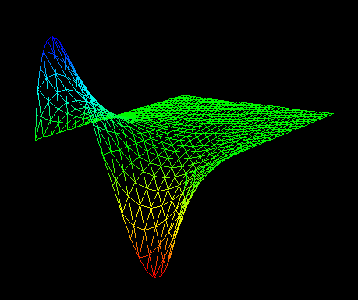
Our Starting Point
∇²ϕ (x,y) = 0 ∈ [0,1] x [0,1]
ϕ(0,y)=0 ϕ(1,y)=sin (2πy)
δϕ/δy(x,0) = δϕ/δy(x,1) = 0
Physics Modules
Mesh
Discretization
Visualization
Algebraic Solvers
Notes:
We start with a simple steady state PDE that solves Poisson’s equation on the unit square with a sine dirichlet boundary condition on the boundary x=1 and Neumann conditions on the upper and lower boundaries. The solution is shown in the lower figure.
This example uses a few of the application components highlighted on the first slide– namely a physics model to capture the PDE of interest, a grid or mesh module, a discretization module, an algebraic solvers module and visualization capabilities. Although this is a very simple example it captures many of the basic components used in real high-performance computing simulations and is an excellent starting point for the development of more sophisticated applications that will reuse pieces of this application (for example the algebraic solvers).

Slide 5
Numerical Solution of Example 1
Physics: Poisson’s equation
Grid: Unstructured triangular mesh
Discretization: Finite element method
Algebraic Solvers: PETSc (Portable Extensible Toolkit for Scientific Computation)
Visualization: VTK tool
Original Language: C
Notes:
The numerical solution of the first example is accomplished using a variety of general-purpose tools that can be used later in more sophisticated applications. In particular, we are using
- a general unstructured mesh component that supports meshes generated with the Triangle package by Jonathon Shewchuck,
- the PETSc library of linear and nonlinear algebraic solvers (it has a wide variety of solvers and preconditioners included in the software and is widely used by application scientists).
- and a visualization tool that is built using VTK which is a freely available class library that can be used for the visualization of scientific data sets of many different types (structured, unstructured, mixed element, 2-3D) etc.
Thus, even though this is a simple example, we’re solving it using many tools that can and are used in much more complicated applications.
The original version of this code was written using C and was a fairly tightly coupled application in which all aspects of the numerical solution had access to the data structures associated with all other aspects of the simulation. For example, each part of the solution process had access to the mesh data structures.

Slide 6
Creating Components: Step 1
Separate the application code into well-defined pieces that encapsulate functionalities
  Decouple code along numerical functionality
    Mesh, discretization, solver, visualization
    Physics is kept separate
  Determine what questions each component can ask of and answer for other components (this determines the ports)
    Mesh provides geometry and topology (needed by discretization and visualization)
    Mesh allows user defined data to be attached to its entities (needed by physics and discretization)
    Mesh does not provide access to its data structures
  If this is not part of the original code design, this is by far the hardest, most time-consuming aspect of componentization
Notes:
How did we create a componentized version of this application?
The first step separating the code into well-defined, functionally separated pieces was by far the hardest . For this application we chose to decompose it along the lines of numerical functionality. In particular, I created mesh, discretization, visualization and solver components and kept the physics separate so that it could be easily changed to something different.
We determined what questions each component could ask of the other and what questions each could component could answer – this provides the functionalities of the ports. This is a fairly straightforward task if you are only considering one application or one underlying toolkit (the API is most likely already determined by the existing code), but the situation is infinitely more complicated if you want to consider
- multiple application scenarios for a given component
- multiple underlying implementations for a given component – particularly if these implementations are large, preexisting libraries such as PETSc and I will give an example of some of the issues that arise in the API determination for unstructured meshes later in the talk.
As an example in this particular case, the Grid provides geometry (grid point locations) and topology (connectivity) information which is needed by the discretization and visualization components. The grid also provides a mechanism for users/other components to attach opaque data to the mesh or mesh entities (such as material properties, degrees of freedom, etc). It does not provide direct access to its data structures however because we do not want the application to be dependent on any given implementation.
In my opinion, if encapsulated functionality is not part of the original code design (as it was not in this case) this step is by far the hardest and most time consuming aspect of componentization. For example, even for this simple application it took 1-2 weeks (not full time) to separate the mesh from the discretization and visualization. The solver was already fairly separate because I was using the PETSc library.

Slide 7
Creating the Components: Step 2
Writing C++ Components
  Create an abstract base class for each port
  Create C++ objects that inherit from the abstract base port class and the CCA component class
  Wrap the existing code as a C++ object
  Implement the setServices method
This process was significantly less time consuming (with an expert present) than the decoupling process
  Lessons learned
    Definitely look at an existing, working example for the targeted framework
    Experts are very handy people to have around ;-)
Notes:
Once the code has been decoupled into separate functionalities the process of creating components is a mechanical one that is not too difficult to learn given good examples or an expert by your side. For example, the first time I created a component – I had an expert directing me in the process and it took about half an hour. The expert left and it took me about 2 hours to recreate the process for the second component… but by the time I did my 5th component it was very smooth and only took half an hour again…
Some of the lessons that I learned are that it is much easier to implement the mechanics of creating a component if an existing working example for the targeted framework is present (especially if you are not an expert in the implementation language). Second, do not hesitate to ask questions if the process is still not clear after this tutorial – your questions will only serve to strengthen our tutorial and point out where more work is needed.

Slide 8
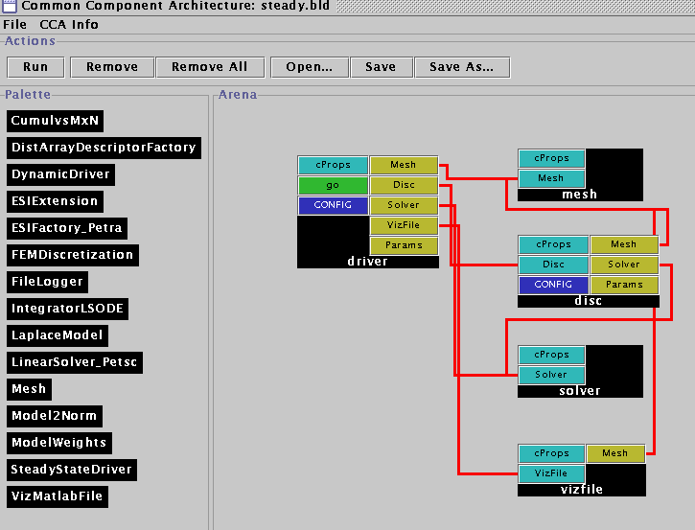
The Componentized Example
The Driver Component
  Responsible for the overall application flow
  Initializes the mesh, discretization, solver and visualization components
  Sets the physics parameters and boundary condition information
Notes:
In the component version of this application we have five components: a driver, mesh, discretization, solver, and visualization component. And we’ll quickly go through the responsibilities of each in this simple application.
The driver is responsible for the overall flow of the application and initializes each of the other components. It is also responsible for setting the various physics parameters and boundary conditions. We note that the driver is the only place where this is done so a new physics application would require a small change to the driver.
We could also have written this application to have a generic driver and a 6th very small component whose only job it would be is to set the physics/mathematical model (which operators are used, what are their coefficients) parameters and boundary conditions on the discretization component.

Slide 9
The Componentized Example
The Driver Component
  Responsible for the overall application flow
  Initializes the mesh, discretization, solver and visualization components
  Sets the physics parameters and boundary condition information
The Mesh Component
  Provides geometry, topology, and boundary information
  Provides the ability to attach user defined data as tags to mesh entities
  Is used by the driver, discretization and visualization components
Notes:
As mentioned earlier, the mesh component provides the geometry, topology and boundary information for the application. This particular component is based on the triangle package developed by Jonathon Shewchuck. It is initialized by reading a file specified by the driver that contains the mesh information. It uses the attribute information provided by the Triangle format to determine which vertices are on boundaries and it stores this information in a pre-defined tag called “boundary” which can be later accessed by the discretization component.
It also provides the ability to attach arbitrarily-sized user defined data to the mesh and to each of the mesh entities. We use this capability to attach a scalar field representing phi to the mesh vertices.
The mesh component is used by the driver, discretization and visualization components. The mesh component does not use the functionality of any other components.

Slide 10
The Componentized Example
The Driver Component
  Responsible for the overall application flow
  Initializes the mesh, discretization, solver and visualization components
  Sets the physics parameters and boundary condition information
The Mesh Component
  Provides geometry and topology information
  Provides the ability to attach user defined data to mesh entities
  Is used by the driver, discretization and visualization components
The Discretization Component
  Provides a finite element discretization of basic operators (gradient, Laplacian, scalar terms)
  Driver determines which terms are included and their coefficients
  Provides mechanisms for general Dirichlet and Neumann boundary condition matrix manipulations
  Computes element matrices and assembles them into the global stiffness matrix via set methods on the solver
  Gathers and scatters vectors to the mesh (in this case ϕ)
Notes:
The discretization component is the glue that holds this example together. It provides a finite element discretization of basic operators such as laplacian, gradient, and scalar terms as well as the manipulations needed to implement dirichlet and Neumann boundary conditions in the stiffness matrix. To solve a particular physics problem, it accepts input from the driver pertaining to which operators are used in the example and what their coefficients are.
It also is responsible for gathering and scattering scalar data from the mesh into a vector. It does this by creating and storing a map between the unique global integer id’s of the vertices of the mesh and the corresponding position of the scalar data in the vector (0 to N-1).
This map is also used to assemble the computed element matrices for each mesh region (element) into a global stiffness matrix by using the Set command on the opaque matrix object provided by the solver.

Slide 11
The Componentized Example
The Driver Component
  Responsible for the overall application flow
  Initializes the mesh, discretization, solver and visualization components
  Sets the physics parameters and boundary condition information
The Mesh Component
  Provides geometry and topology information
  Provides the ability to attach user defined data to mesh entities
  Is used by the driver, discretization and visualization components
The Discretization Component
  Provides a finite element discretization of basic operators (gradient, laplacian, scalar terms)
  Provides mechanisms for general Dirichlet and Neumann boundary condition manipulations
  Computes element matrices and assembles them into the global stiffness matrix via set methods on the solver
  Gathers and scatters vectors to the mesh (in this case ϕ)
The Solver Component
  Provides access to vector and matrix operations (e.g., create, destroy, get, set)
  Provides a “solve” functionality for a linear operator
Notes:
The solver component is based on the PETSc library and provided access to vector and matrix operations. For example, the user of this component can create, destroy, duplicate, copy vectors and matrices as well as set the values of their entries. It also provides a simple solve functionality that uses GMRES for the linear system solution.
Note that only a small subset of the functionality provided by PETSc is available as a CCA component in this example (just enough to make the example work). More work is underway to extend the functionality by PETSc in component form.

Slide 12
The Componentized Example
The Driver Component
  Responsible for the overall application flow
  Initializes the mesh, discretization, solver and visualization components
  Sets the physics parameters and boundary condition information
The Mesh Component
  Provides geometry and topology information
  Provides the ability to attach user defined data to mesh entities
  Is used by the driver, discretization and visualization components
The Discretization Component
  Provides a finite element discretization of basic operators (gradient, laplacian, scalar terms)
  Provides mechanisms for general Dirichlet and Neumann boundary condition manipulations
  Computes element matrices and assembles them into the global stiffness matrix via set methods on the solver
  Gathers and scatters vectors to the mesh (in this case ϕ)
The Solver Component
  Provides access to vector and matrix operations (e.g., create, destroy, get, set)
  Provides a “solve” functionality for a linear operator
The Visualization Component
  Uses the mesh component to print a vtk file of ϕ on the unstructured triangular mesh
  Assumes user data is attached to mesh vertex entities
Notes:
The final component is a visualization component that accesses the mesh geometry and topology information, along with the scalar field phi, to write this information in vtk format to a file specified by the user. More sophisticated, interactive visualization capabilities are highlighted in the next example.

Slide 13
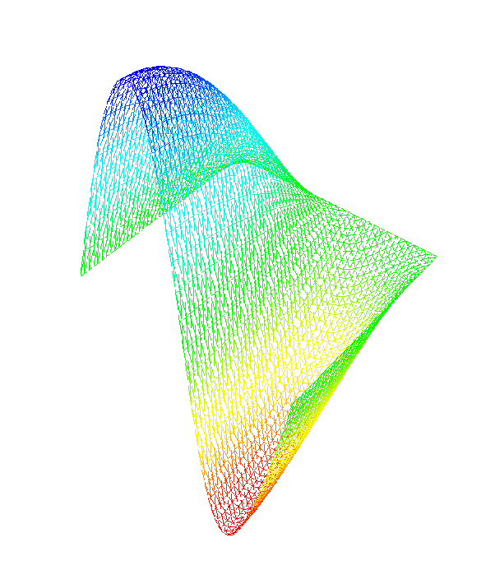
The next step… time dependence
δϕ/δt = ∇²ϕ (x,y,t) ∈ [0,1] x [0,1]
ϕ(0,y,t)=0 ϕ(1,y,t)=.5sin(2πy)cos(t/2)
δϕ/δy(x,0) = δϕ/δy(x,1) = 0
ϕ(x,y,0)=sin(.5πx) sin (2πy)
Time Evolution
Physics Modules
Mesh
Discretization
Visualization
Algebraic Solvers
Distributed Arrays
Data Redistribution
Notes:
The next step we take in the evolution of our complex application example is to add time dependence. We are now solving the heat equation with a sinusoidal, time evolving boundary condition on the left boundary, and the same 0 dirichlet condition on the right boundary and Neumann boundary conditions on the top and bottom. The initial condition is chosen to be sinusoidal in the entire domain and consistent with the left boundary condition at time t=0.
We are also going to add an interactive visualization component that displays the results of the computation at each time step. This example also highlights the use of a data redistribution component that can take the data from M processors of a parallel computer to N processors of a parallel computer. In this case both M and N are equal to 1 – it is used here to accommodate the new visualization component that we are using (based on a AVS viewer developed originally to work with the CUMULVS library at ORNL). In particular, this visualization component assumes that data is coming in from a parallel computer via the MxN redistribution component.

Slide 14
Some things change…
Requires a time integration component
  Based on the LSODE library (LLNL)
  Component implementation developed by Ben Allan (SNL)
Uses a new visualization component
  Based on AVS
  Requires an MxN data redistribution component
  Developed by Jim Kohl (ORNL)
The MxN redistribution component requires a Distributed Array Descriptor component
  Similar to HPF arrays
  Developed by David Bernholdt (ORNL)
The driver component changes to accommodate the new physics
Notes:
This more sophisticated example requires some changes to what we were doing previously.. Mostly in the form of additions to the components used
First and most importantly, this application requires the use of an integration component. The one we are using is based on the LSODE library developed at LLNL. The actual component was created by Ben Allan at SNL and is a good example of the use of creating a component by wrapping the functionality of a Fortran-based library with C++ wrappers.
We are also using a new visualization component. This component is based on AVS and expects information to be sent to it via an MxN data redistribution component (It is designed to visualize the results of a parallel simulation code). In this case M=N=1.
The use of the data redistribution component in turn required the use of a Distributed Array component. This component is similar to HPF arrays and was developed by David Bernholdt at ORNL.
We also note that we’re no longer using the linear solvers provided as part of the PETSc-based solver component. We are however still using the vectors as input to the time integration component.

Slide 15
… and some things stay the same
The mesh component doesn’t change
The discretization component doesn’t change
The solver component doesn’t change
  What we use from the solver component changes
  Only vectors are needed
Notes:
We are able to reuse three out of five of our previous components without changing them. In particular, the mesh, discretization, and solver components can be reused, without even recompiling them!
We may change what we use from a given component, for example, the solver component is no longer required to provide the solution to a linear system, but we still use the vector implementations provided.
We could have chosen to reuse the visualization component as well to print out a series of files, but interactive visualization with the time dependent physics is more interesting.

Slide 16
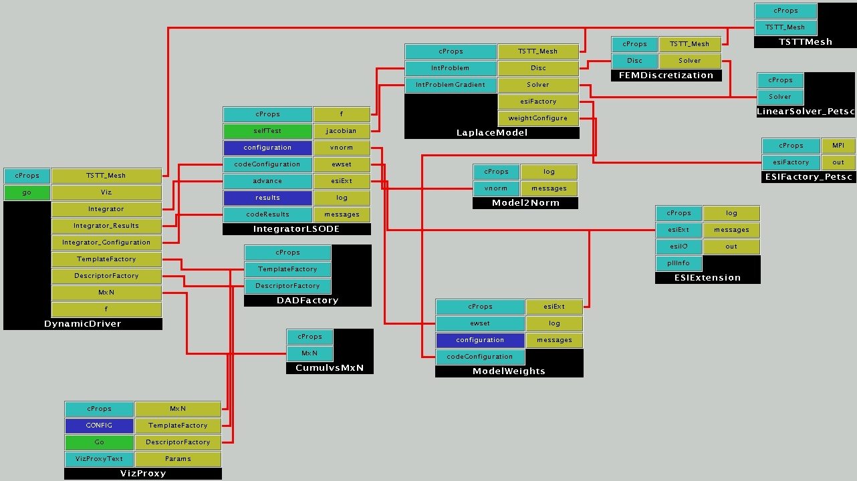
The CCA wiring diagram
Reused
Integration
Visualization
Driver/Physics
Notes:
As you can see, this is a significantly more complicated application. The driver is again in control of the overall flow of the application and accesses the mesh, visualization, integration, and data redistribution components.
(Press space bar highlight yellow circle) Even though this is a significantly more complicated application we can reuse many of our earlier components including discretization, mesh, and solver components. For the solver component, we have our choice of either a PETSc-based or Trillinos implementation of the Equation Solver Interface(ESI) for the ESI vectors needed in the integration component.
(Press space bar to highlight light blue circles) The integration component is separated into three pieces – the main integration component which contains the LSODE algorithms and application specific portions (the Model2Norm component and the model weights component) that can be used to customize the component for a given application without changing the main component.
(Press space bar to highlight dark blue circles) In this case, the physics has been separated from the driver and is represented in the LaplaceModel component which connects to the discretization, mesh, and solver components.
(press space bar to highlight green circles) The DADFactory and Cumulvs components provide the distributed array and data redistribution functionalities respectively for use in the visualization component.

Slide 17
What did this exercise teach us?
It was easy to incorporate the functionalities of components developed at other labs and institutions given a well-defined interface and header file.
  In fact, some components (one uses and one provides) were developed simultaneously across the country from each other after the definition of a header file.
  Amazingly enough, they usually “just worked” when linked together (and debugged individually).
In this case, the complexity of the component-based approach was higher than the original code complexity.
  Partially due to the simplicity of this example
  Partially due to the limitations of the some of the current implementations of components
Notes:
What did we learn? That it really did just work for the most part for this application example. In fact, most of the application was developed at ANL (discretization, mesh, physics) and the supporting components were developed at a number of different DOE labs (LSODE at SNL, Vis and data redistribution components at ORNL). We worked on our various components just before supercomputing of 01 with only a header file specification determined (in particular the visualization of unstructured meshes was not available until just a few days before the show). When we assembled the components into an application it all worked well together (barring individual bugs in the component implementations). Well defined interfaces are key!
However, in this case the complexity of the application code was higher than that of the original code. This is due to two reasons primarily. First, this application was extremely simple and didn’t really exercise the full functionality of most of the components. Second, some of the component implementations are limited at this time. In particular, the fact that the MxN data redistribution component only works with distributed arrays added an extra layer of data translation for the visualization process that was not needed in the original code.

Slide 18
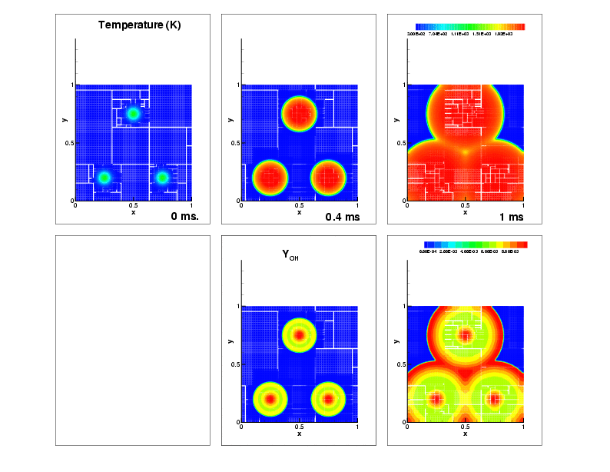
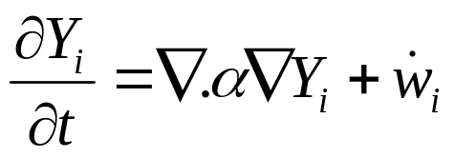
Beyond the heat equation…
Flame Approximation
  H₂-Air mixture; ignition via 3 hot-spots
  9-species, 19 reactions, stiff chemistry
Governing equation
Domain
  1cm X 1cm domain
  100x100 coarse mesh
  finest mesh = 12.5 micron.
Timescales
  O(10ns) to O(10 microseconds)
Notes:
We now highlight two more complex applications that have been developed with component technologies. The first is a reaction diffusion problem that a chemically reacting flame front. The domain consists of a 1 cm x 1 cm area with a H2-Air mixture. The initial condition contains three spots of high temperature. As time progresses, the mixture ignites and we use the adaptive mesh code just described to help model the evolving process.
Apart from H₂, O₂ and N₂, the mechanism contains intermediate species H, O, OH, HO₂, H₂O₂ and H₂, undergoing 19 reversible reactions.
The governing eqn is given. Note that there is both a diffusive term and a chemistry function. The chemistry terms result in stiff ODEs which can be difficult to model.
The timescales that are relevant in this simulation range from10ns – 10 microseconds

Slide 19
Numerical Solution
Adaptive Mesh Refinement: GrACE
Stiff integrator: CVODE (LLNL)
Diffusive integrator: 2nd Order Runge Kutta
Chemical Rates: legacy f77 code (SNL)
Diffusion Coefficients: legacy f77 code (SNL)
New code less than 10%
Notes:
The numerical solution of this application uses the same adaptive mesh refinement library as before: GrACE. The integrator has changed to LLNL’s CVODE library to handle the stiff ODE’s associated with the chemical reactions. The calculation of the chemical rates and diffusion coefficients are based on legacy f77 code from SNL Livermore. The new code required for this application (wrappers, statistics, the driver) was quite small, less than 10%.

Slide 20
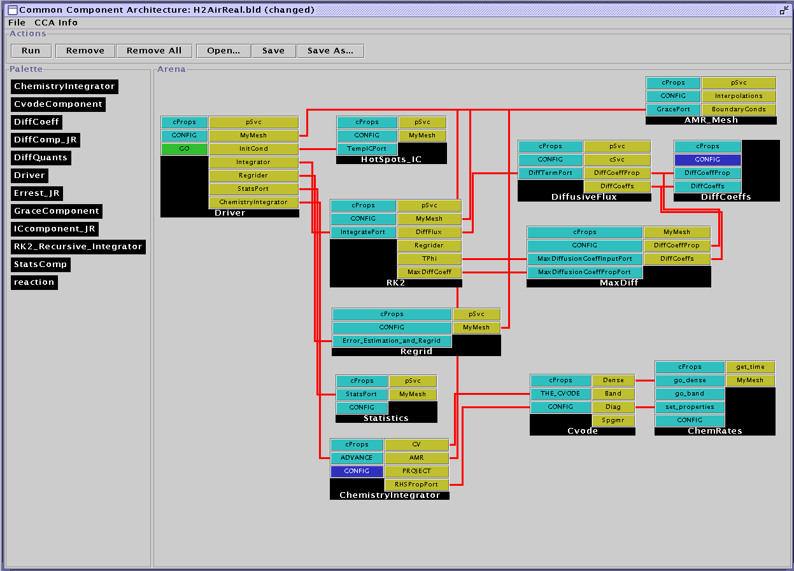
The CCA Wiring Diagram
Reused
Slow Time Scale Integration
Fast Time Scale Integration
Driver/Physics
Notes:
Here is the wiring diagram for this reaction diffusion example.
(Space bar for yellow circle) The only component explicitly reused from the simple heat equation is the AMR mesh component.
(Space bar for blue circles)Note there is still a driver that controls the flow of the application and an initial condition component that are similar to those used in the previous example.
The major change is in the integration algorithm.
(space bar for purple circles) There are the slow-timescale diffusive physics components which consist of diffusive coefficients, a diffusive flux and a runge-kutta integrator. There are two main ways of advancing this part of the simulation in time based primarily on how you compute the diffusive coefficients. In this example we’re using Lennard-Jones potentials, but if you wanted to replace this with another model (say a curve fitting algorithm) it is easy to do in a component framework. If the interfaces stay the same, you simply point the application to the new component in the repository and rerun. The switch takes just moments.
(space bar for pink circles) There is also a fast-timescale integrator for the chemical physics which includes the CVODE library and a computation of the chemical rates.

Slide 21
Evolution of the Solution
Temperature
OH Profile
Notes:
On the top row we show the evolution of the temperature field. We start with three hotspots which ignite and expand until the ignition fronts meet. The red region is the high temperature hot-products behind the fronts
On the bottom row we show the OH profiles. Typically the profile is high immediately behind the fronts; further behind the fronts them, OH reacts away to form H₂0.
The thick OH structures are big enough for a 100 x 100 mesh – so why mesh refinement ?

Slide 22
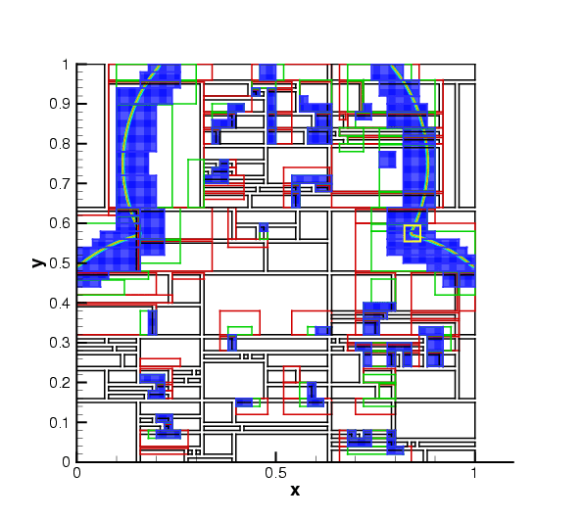
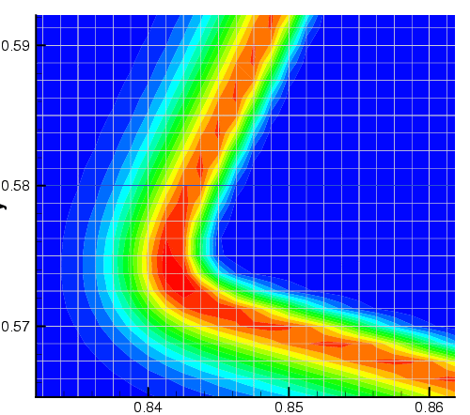
The need for AMR
H₂O₂ chemical subspecies profile
  Only 100 microns thick (about 10 fine level cells)
  Not resolvable on coarsest mesh
Notes:
Shows you the domain and the H₂O₂ profiles. The coarse mesh has been divided into patches (black outlines) and distributed to 30 procs. Sections of the black patches have been refined into green, green into red and red into blue patches where the field has been colored. A zoom into the yellow box shows the structure – the H₂O₂ profiles are around 10 cells wide on the finest mesh ~ 100 microns
The entire structure is contained inside 1 coarse cell – we managed to track and resolve it.

Slide 23
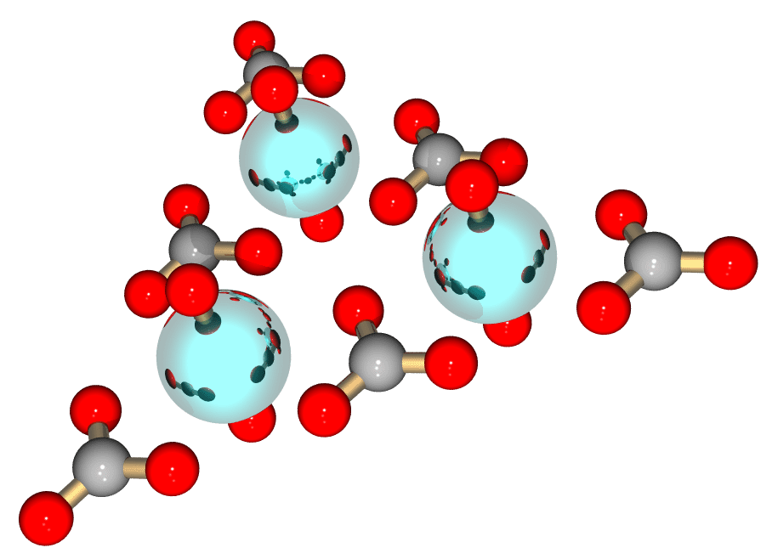
Computational Chemistry:
Molecular Optimization
Investigators: Yuri Alexeev (PNNL), Steve Benson (ANL), Curtis Janssen (SNL), Joe Kenny (SNL), Manoj Krishnan (PNNL), Lois McInnes (ANL), Jarek Nieplocha (PNNL), Jason Sarich (ANL), Theresa Windus (PNNL)
Goals: Demonstrate interoperability among software packages, develop experience with large existing code bases, seed interest in chemistry domain
Problem Domain: Optimization of molecular structures using quantum chemical methods

Slide 24
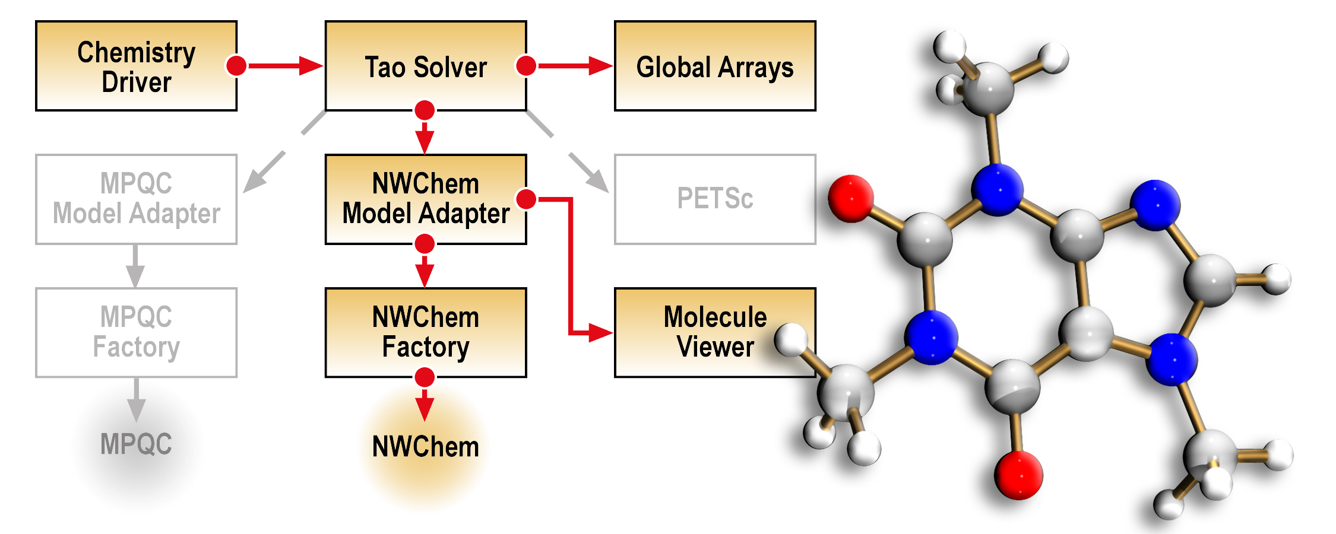
Molecular Optimization Overview
Decouple geometry optimization from electronic structure
Demonstrate interoperability of electronic structure components
Build towards more challenging optimization problems, e.g., protein/ligand binding studies
Components in gray can be swapped in to create new applications with different capabilities.

Slide 25
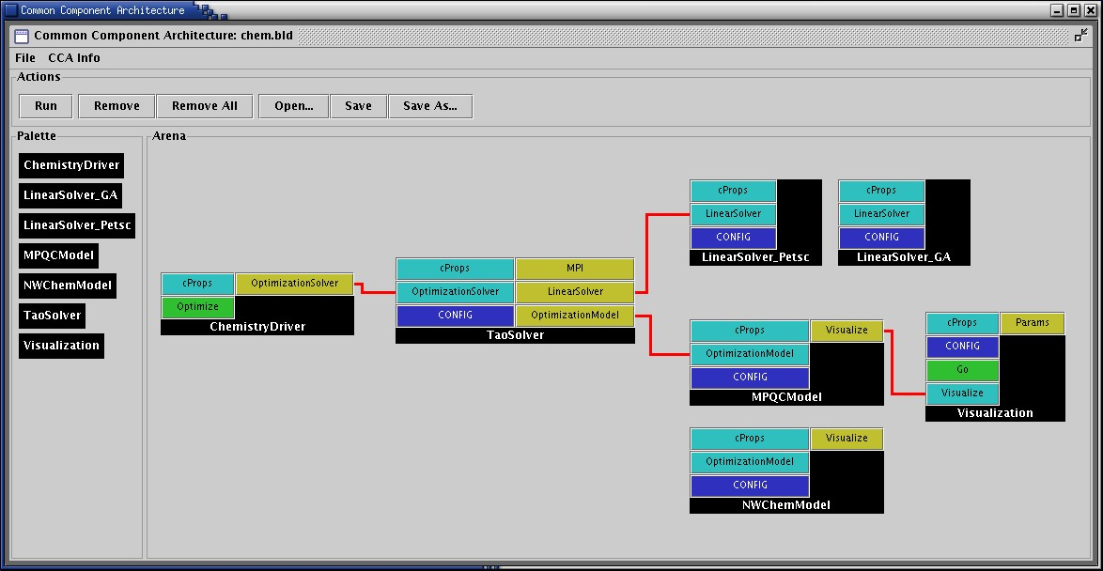
Wiring Diagram for Molecular Optimization
Electronic structures components:
  MPQC (SNL)
  http://aros.ca.sandia.gov/~cljanss/mpqc
  NWChem (PNNL)
  http://www.emsl.pnl.gov/pub/docs/nwchem
Optimization components: TAO (ANL) http://www.mcs.anl.gov/tao
Linear algebra components:
  Global Arrays (PNNL) http://www.emsl.pnl.gov:2080/docs/global/ga.html
  PETSc (ANL)
  http://www.mcs.anl.gov/petsc

Slide 26
Molecular Optimization Summary
CCA Impact
  Demonstrated unprecedented interoperability in a domain not known for it
  Demonstrated value of collaboration through components
  Gained experience with several very different styles of “legacy” code
Future Plans
  Extend to more complex optimization problems
  Extend to deeper levels of interoperability

Slide 27
Componentized Climate Simulations
NASA’s ESMF project has a component-based design for Earth system simulations
  ESMF components can be assembled and run in CCA compliant frameworks such as Ccaffeine.
Zhou et al (NASA Goddard) has integrated a simple coupled Atmosphere-Ocean model into Ccaffeine and is working on the Cane-Zebiak model, well-known for predicting El Nino events.
Different PDEs for ocean and atmosphere, different grids and time-stepped at different rates.
  Synchronization at ocean-atmosphere interface; essentially, interpolations between meshes
  Ocean & atmosphere advanced in sequence
Intuitively : Ocean, Atmosphere and 2 coupler components
  2 couplers : atm-ocean coupler and ocean-atm coupler.
  Also a Driver / orchestrator component.
Notes:
NASA has a component framework called ESMF. It provides a superstructure to orchestrate the sequence of solution (numerical algo) and an infrastructure that supplies math tools (discretizations, interpolations etc) and the “components” (physical and mathematical models) are sandwiched in-between, using the infrastructure and being used by the superstructure. So can these physical and math models be components in the CCA world ?
So Zhou and gang set off to implement a simple ocean-atmosphere coupled model – the Cane-Zebiak model; looks
Like the shallow water equations. Very simple problem decomposition – an Atmosphere component (with multiple initial conditions and atmosphere models in one place), an ocean component (multiple initial conditions and models in one place; the user chooses which one to run) and components that interpolate between the coarse atmosphere mesh and fine ocean mesh. The PDEs that describe the ocean and atmosphere are different and solved differently – they are also
Time-stepped independently. In a given global timestep, the atmosphere and ocean are iterated to a consistent state, before advancing to the next timestep.

Slide 28
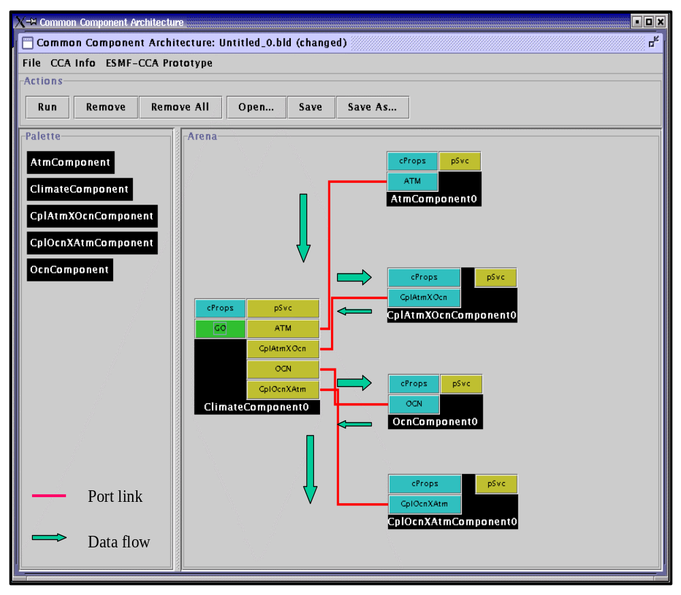
Coupled Atmosphere-Ocean Model Assembly
Climate Component :
  Schedule component coupling
Data flow is via pointer NOT data copy.
  All components in C++; run in CCAFFEINE.
Multiple ocean models with the same interface
  Can be selected by a user at runtime
Notes:
So here is the CCA wiring diagram. Driver / ClimateComponent on the left. Contains the iterate-till-consistent-algorithm, also counts global timesteps. It calls on the atmosphere, atmosphere-to-ocean coupler, the ocean and then ocean-to-atmosphere coupler in sequence. In each call to ocean or atmosphere, the relevant PDEs are time-stepped at the relevant rate.
The ClimateComponent “flows” the data from component to component, but not by copy.
The ocean component has multiple initial conditions and models built – the user chooses which one to run at runtime.
Zhou and gang are looking at Cumulvs (ORNL) to do runtime viz.

Slide 29
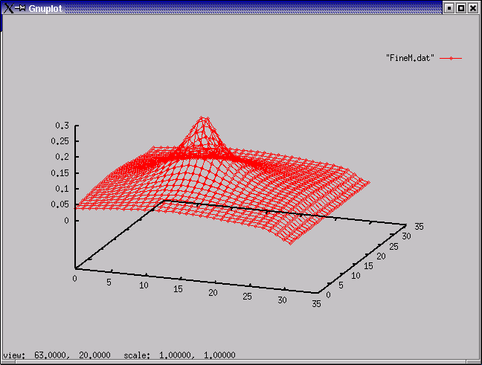
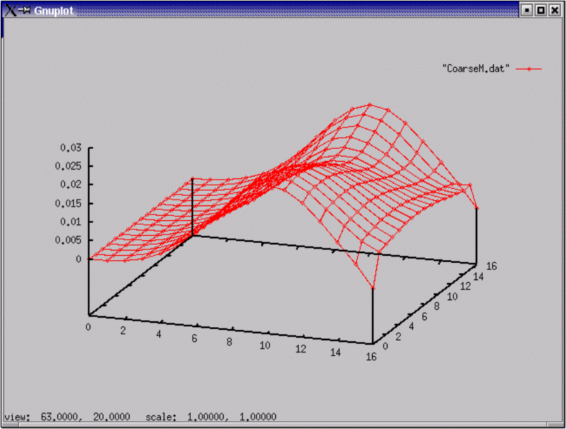
Simulation Results
…changes a field variable (e.g.,wind) in the atmosphere !
A non-uniform ocean field variable (e.g., current)
Notes:
OK, so does it work ?
Left, the velocity field of the atmosphere near the ocean-atmosphere interface. Variation in velocity (there are parts with zero velocity) indicates a wind. This causes shear stress on the water surface, exerting a force and ……….
………on the right, it induces a velocity field in the ocean, also near the ocean-atmosphere interface. Generally, this is referred to as a wave.
The thing works.

Slide 30
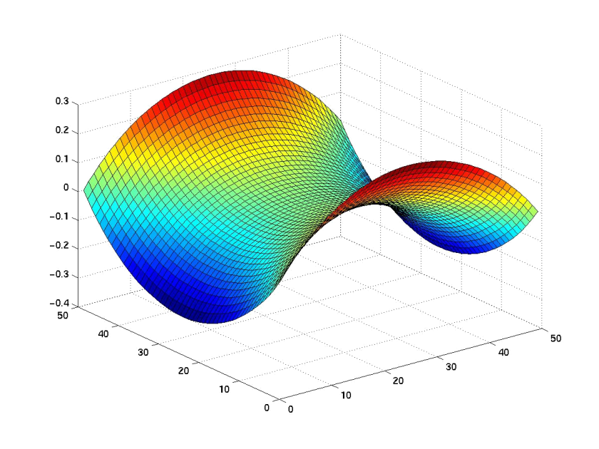
Unconstrained Minimization Problem
Given a rectangular 2-dimensional domain and boundary values along the edges of the domain
Find the surface with minimal area that satisfies the boundary conditions, i.e., compute
min f(x), where f: R → R
Solve using optimization components based on TAO (ANL)
n
Notes:
Our final application is an unconstrained minimization problem. Given a rectangular 2-D domain and boundary values on the edge of the domain, our goal is to find the surface with the minimum area that satisfies the boundary conditions. That is, we need to compute the minimum of a function f(x) using optimization algorithms. In this case, we’ll use the solvers provided by the Toolkit for Advanced Optimization (TAO) developed at ANL.

Slide 31
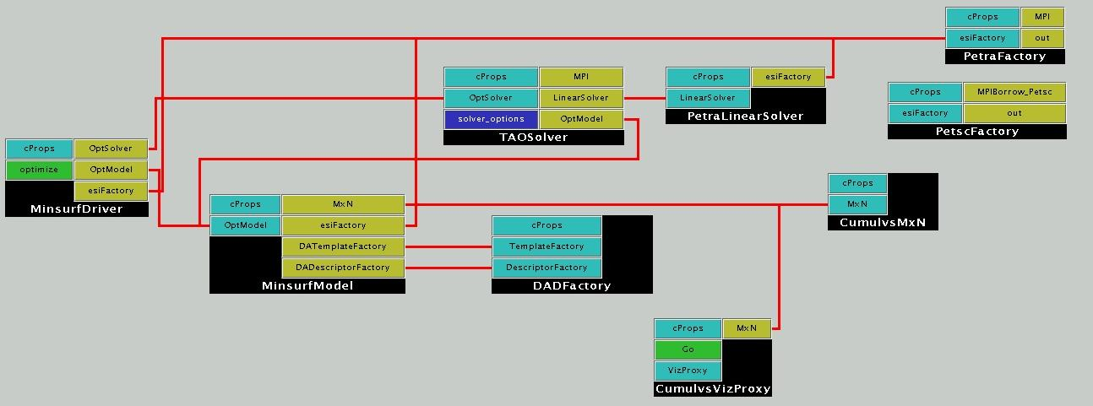
Unconstrained Minimization Using a Structured Mesh
Reused
TAO Solver
Driver/Physics
Notes:
The solution to this optimization problem (although it is very different than the solution of PDEs) still uses many of the same components as before. In particular, solver, distributed arrays, mxn redistribution, and visualization components are all reused (press the space bar to highlight the yellow circles)
The structure is also similar to what we’ve seen earlier. There are two application-specific components– the driver and the min surf model that would need to be altered to run a new application. (press the space bar to highlight the dark blue circles)
The new component in this case is the Tao solver component which is based on the TAO (Toolkit for Advanced Optimization) out of Argonne. (press the space bar to highlight the purple circle)

Slide 32
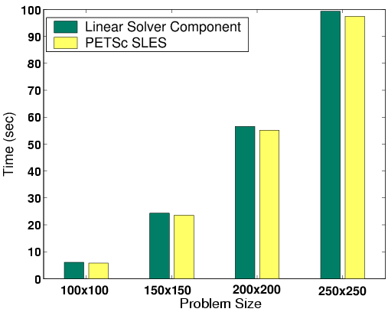
Component Overhead
Negligible overhead for component implementation and abstract interfaces when using appropriate levels of abstraction
Linear solver component currently supports any methods available via the ESI interfaces to PETSc and Trilinos; plan to support additional interfaces the future, e.g., those under development within the TOPS center
Here: Use the conjugate gradient method with no-fill incomplete factorization preconditioning
Aggregate time for linear solver component in unconstrained minimization problem.
Notes:
In the next few slides, I would like to characterize the performance ramifications associated with using components. In this slide, we show the overhead on a single process associated with using a component instantiation of a PETSc SLES linear solver compared with just using the solver directly. The linear solver used in this example is a Preconditioned conjugate gradient solver with a no-fill incomplete factorization as the preconditioner.
As we increase the size of the problem, the component version (shown in green) is slightly higher in cost than the native version (shown in yellow). The difference is small (it ranges from two to five percent) and can be attributed to the introduction of abstractions at several layers of the implementation (including the matrix and vector access) which introduces a number of virtual function calls in the solution process.

Slide 33
Overhead from Component Invocation
Invoke a component with different arguments
    Array
    Complex
    Double Complex
Compare with f77 method invocation
Environment
  500 MHz Pentium III
  Linux 2.4.18
  GCC 2.95.4-15
Components took 3X longer
Ensure granularity is appropriate!
Paper by Bernholdt, Elwasif, Kohl and Epperly
Function arg type | f77 | Component
Array | 80 ns | 224ns
Complex | 75ns | 209ns
Double complex | 86ns | 241ns
Notes:
To examine the component instantiation costs in more detail we compared the time needed to invoke a function in f77 versus the time needed to invoke a component with an array, a complex and a double complex as arguments.
The components took 3x longer for the function invocation, not function execution so one has to ensure that the granularity is such that the 240 ns overhead is negligible compared to the body of the component.

Slide 34
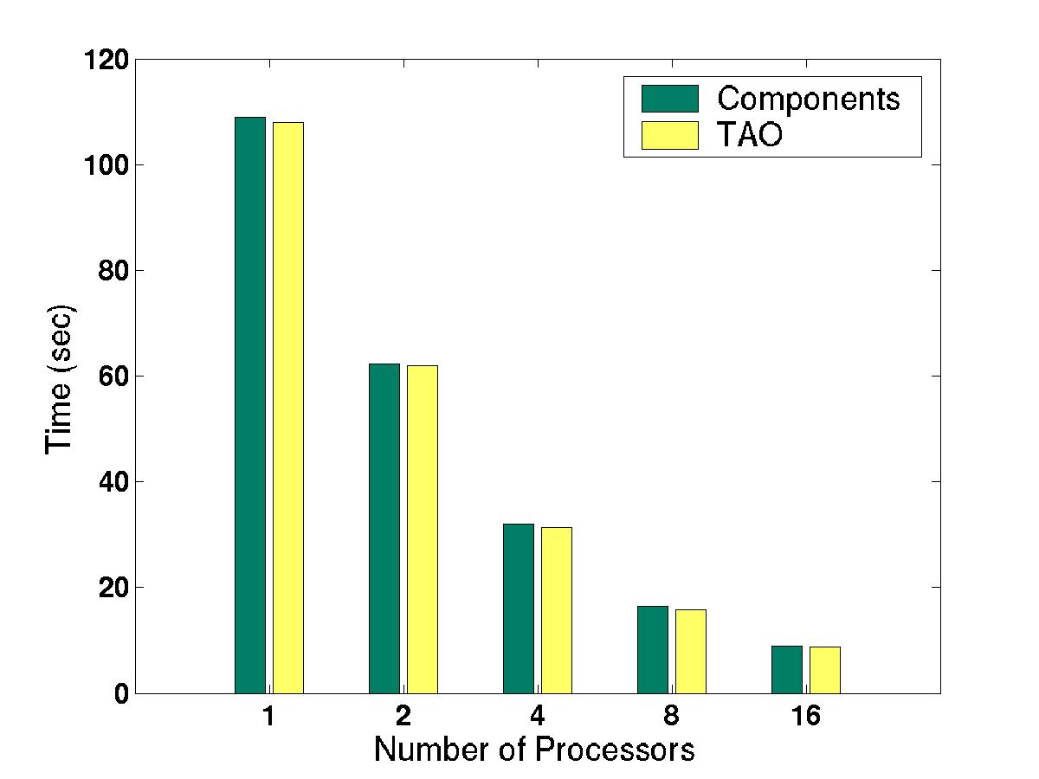
Scalability on a Linux Cluster
Newton method with line search
Solve linear systems with the conjugate gradient method and block Jacobi preconditioning (with no-fill incomplete factorization as each block’s solver, and 1 block per process)
Negligible component overhead; good scalability
Total execution time for the minimum surface minimization problem using a fixed-sized 250x250 mesh.
Notes:
To determine if a component implementation of an algorithm would affect the scalability of an algorithm we compared a native version of newton method with a line search from the TAO library with the equivalent component implementation on 1-16 processors of a Linux cluster (dual 550 MHz Pentium III nodes with 1-Gb of RAME each, connected with Myrinet).
We can see that, again, the overhead of using components is negligible and it does not affect the scalability of the algorithm.

Slide 35
List of Component Re-Use
Various services in Ccaffeine
Integrator
  IntegratorLSODE (2)
  RK2 (2)
Linear solvers
  LinearSolver_Petra (4)
  LinearSolver_PETSc (4)
AMR
  AMRmesh (3)
Data description
  DADFactory (3)
Data redistribution
  CumulvsMxN (3)
Visualization
  CumulvsVizProxy (3)
Component interfaces to numerical libraries
Component interfaces to parallel data management and visualization tools
Notes:
In all of the applications highlighted today I have tried to make the point that component reuse has been a powerful tool in the development of new applications. In particular, for the aspects of the solution that are typically considered “support” type aspects – such as the algebraic solvers, meshes and visualization tools – a significant amount of reuse was obtained. In particular, I’ve listed here several of the components highlighted today and the number of applications (out of 6 total) in which they appeared.
Of course this kind of reuse can be seen today with scientific libraries so what have we really gained by using components? Well, let’s take this to the next level…

Slide 36
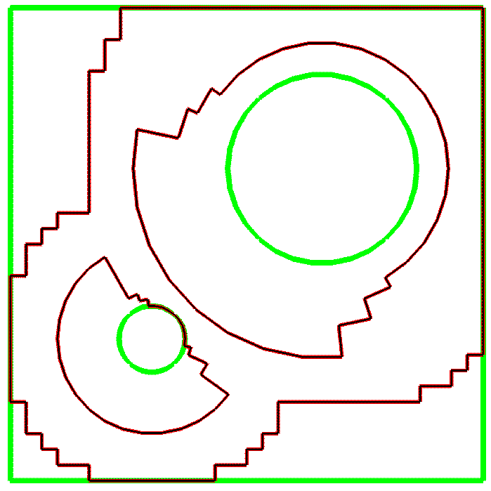
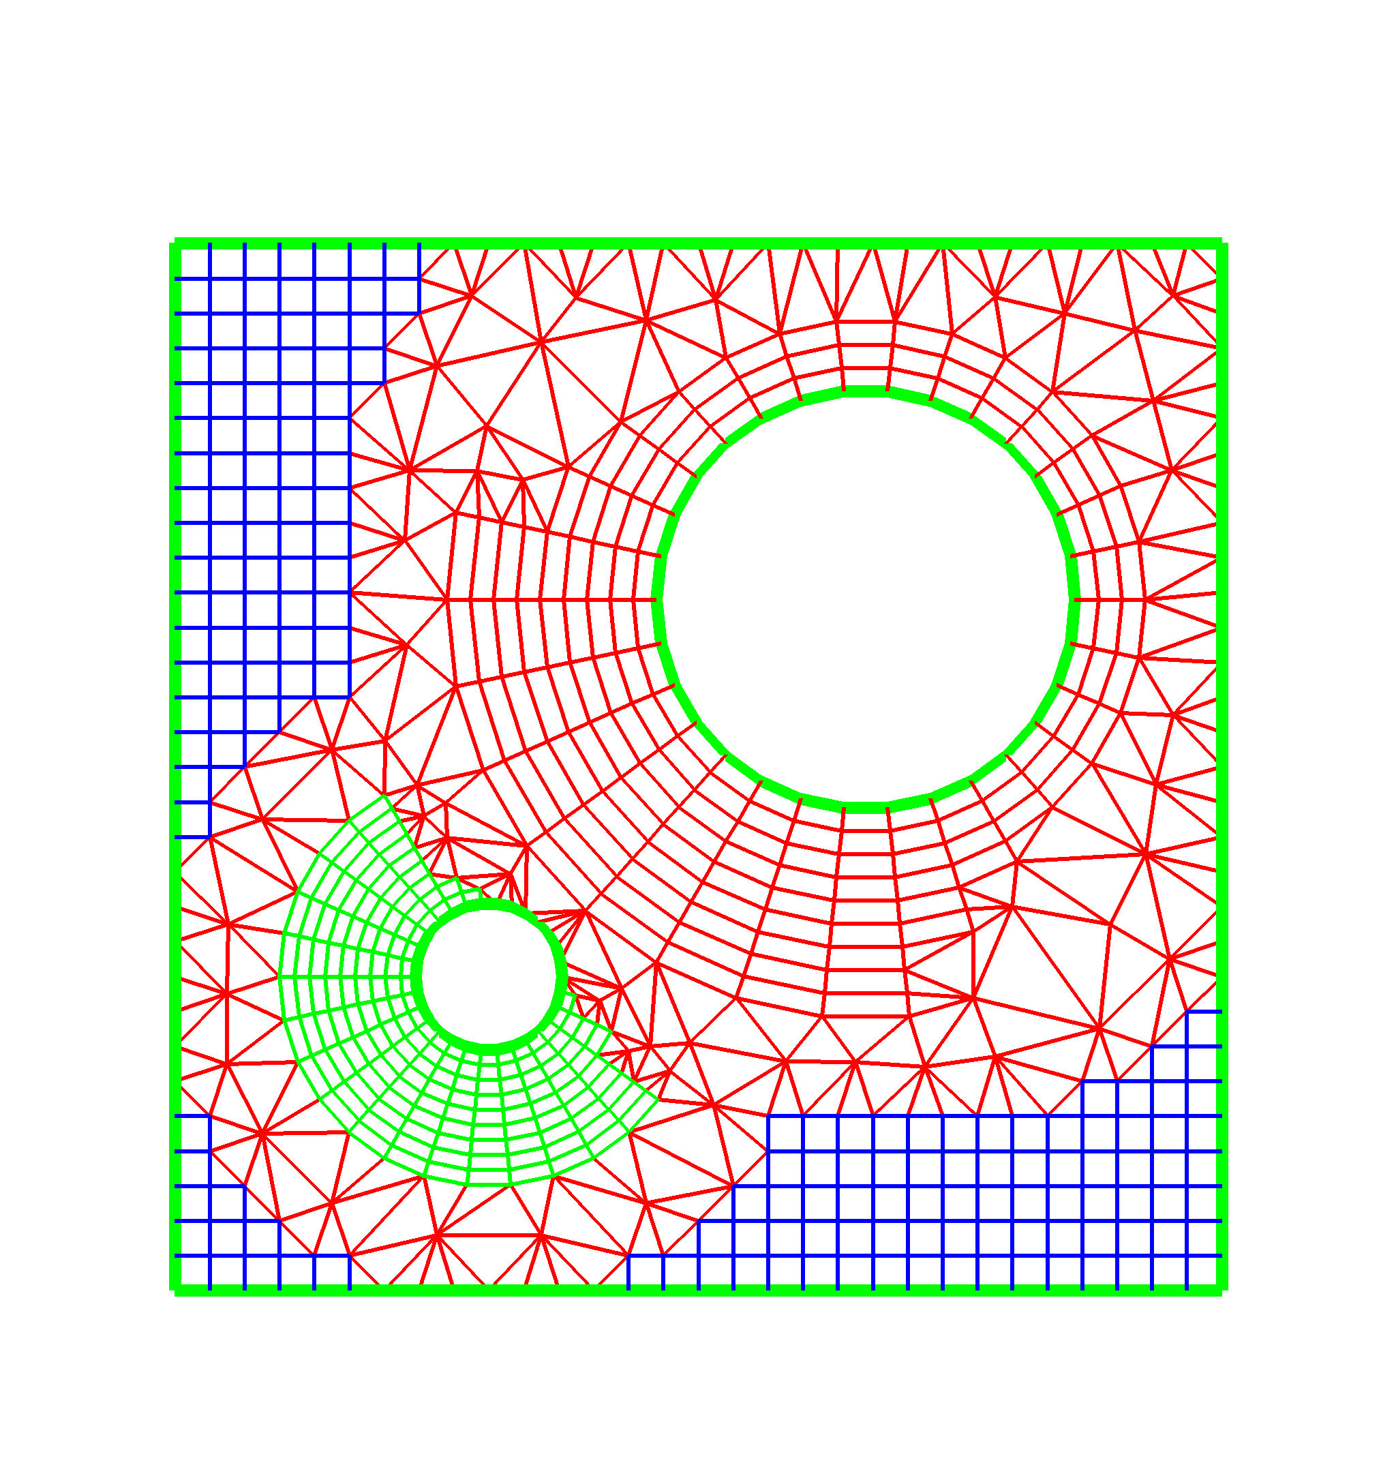
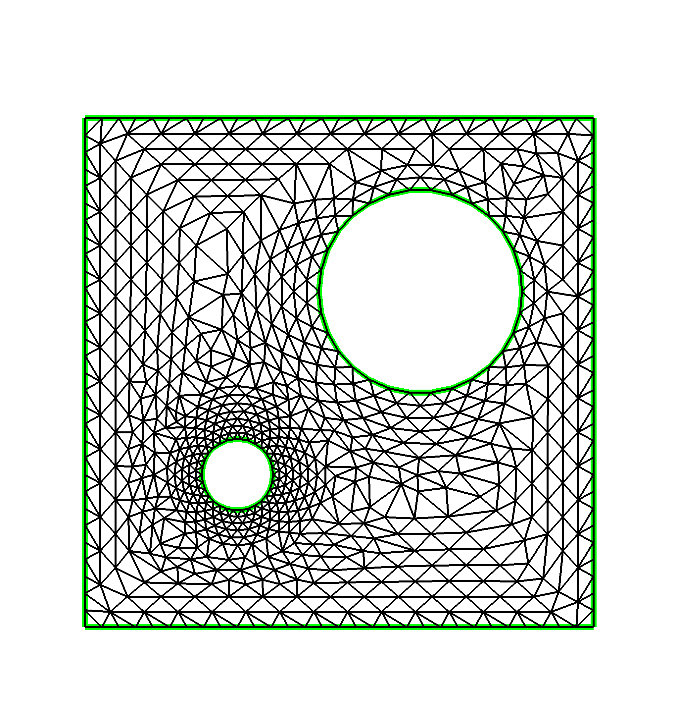
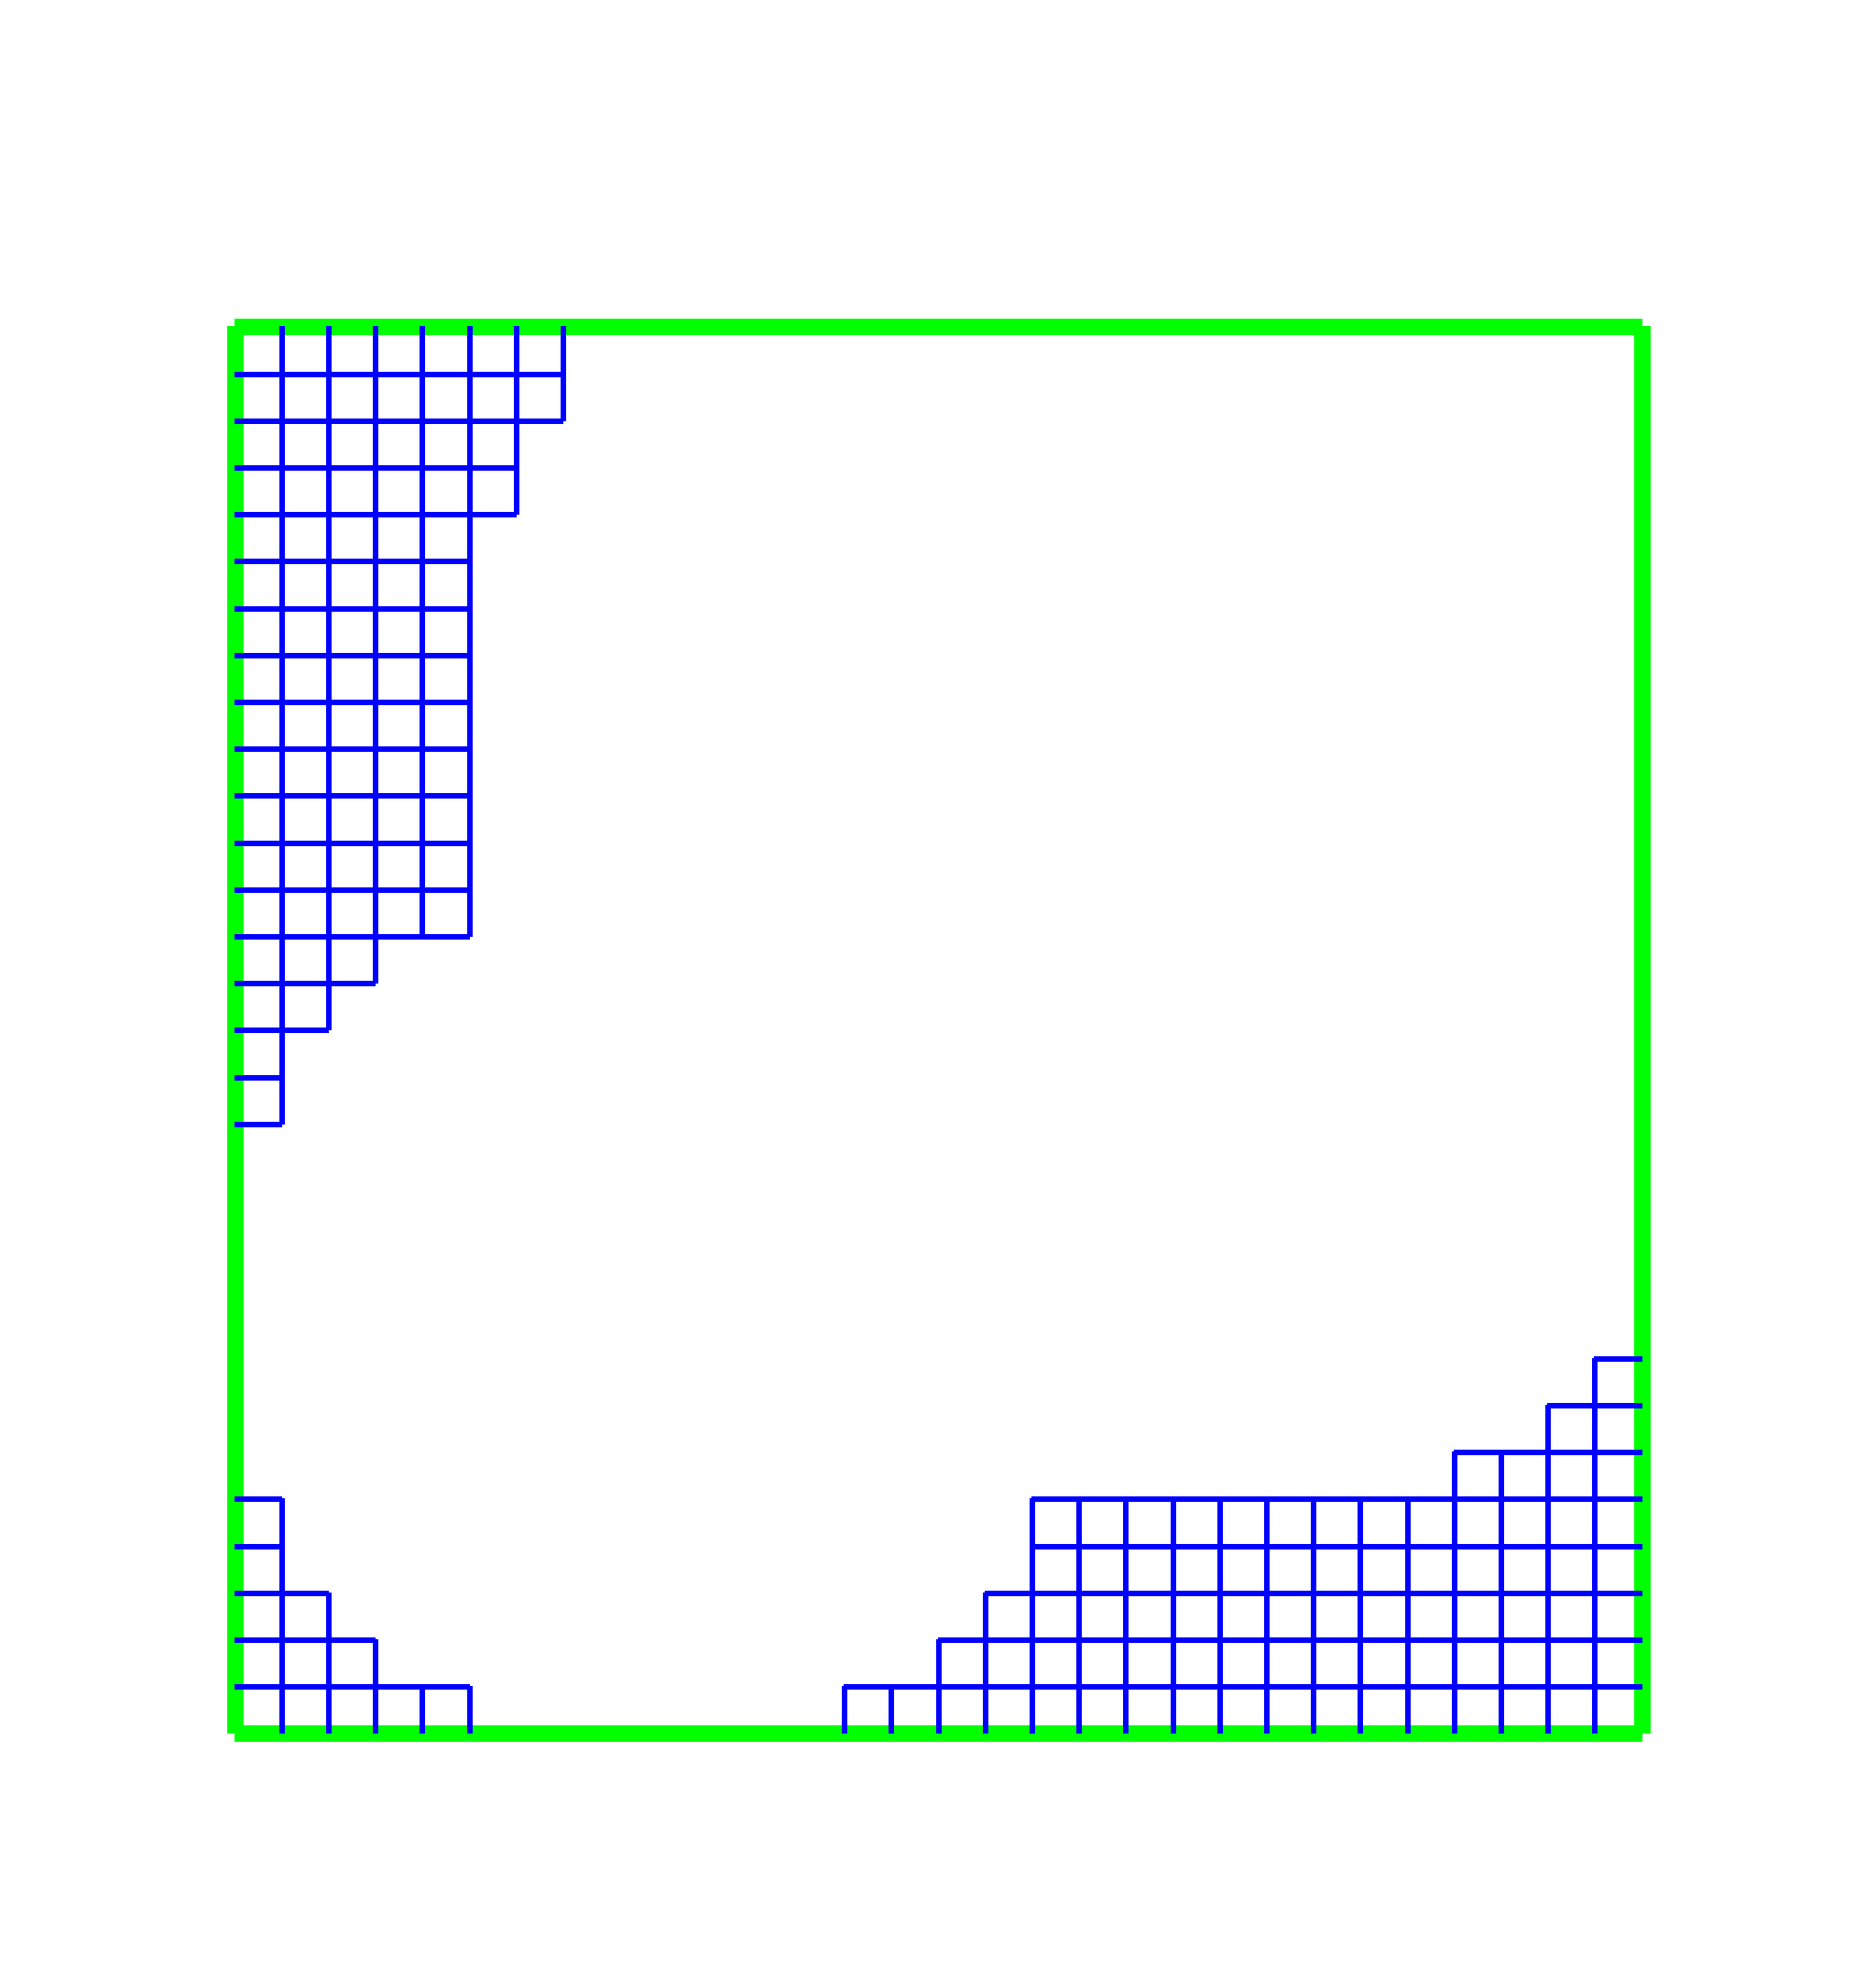
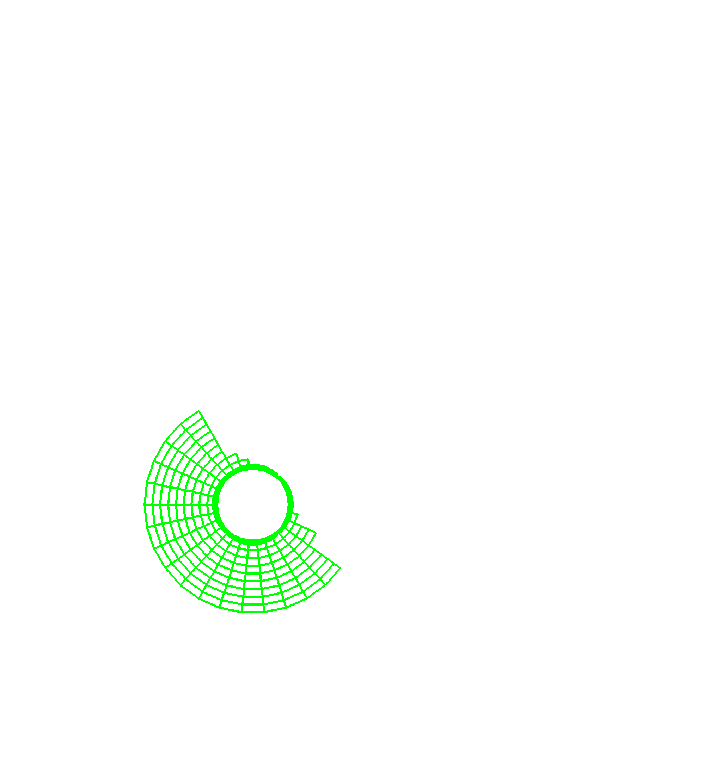
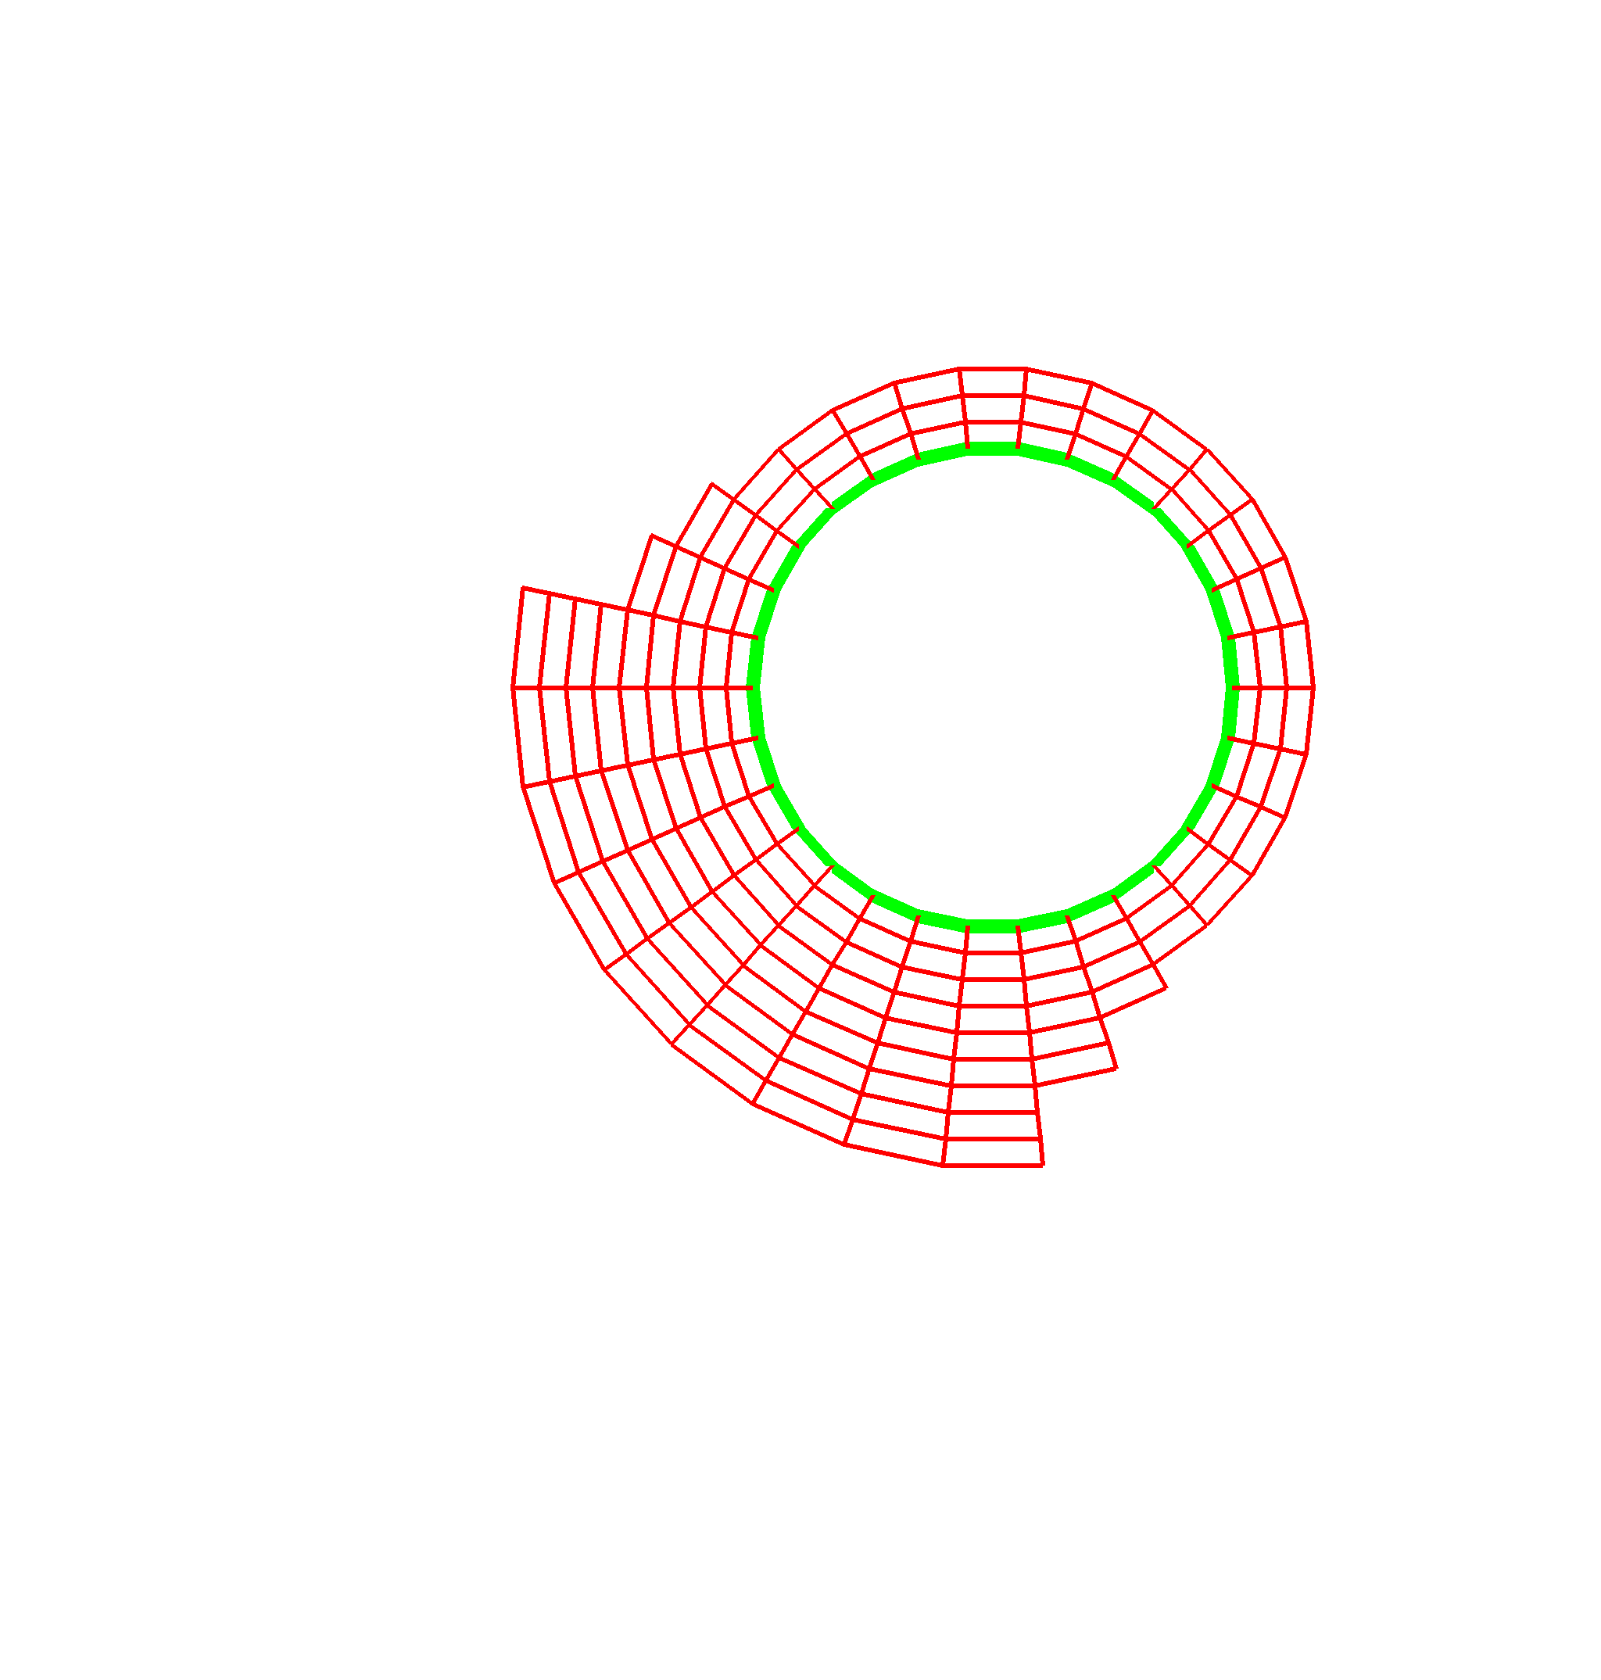
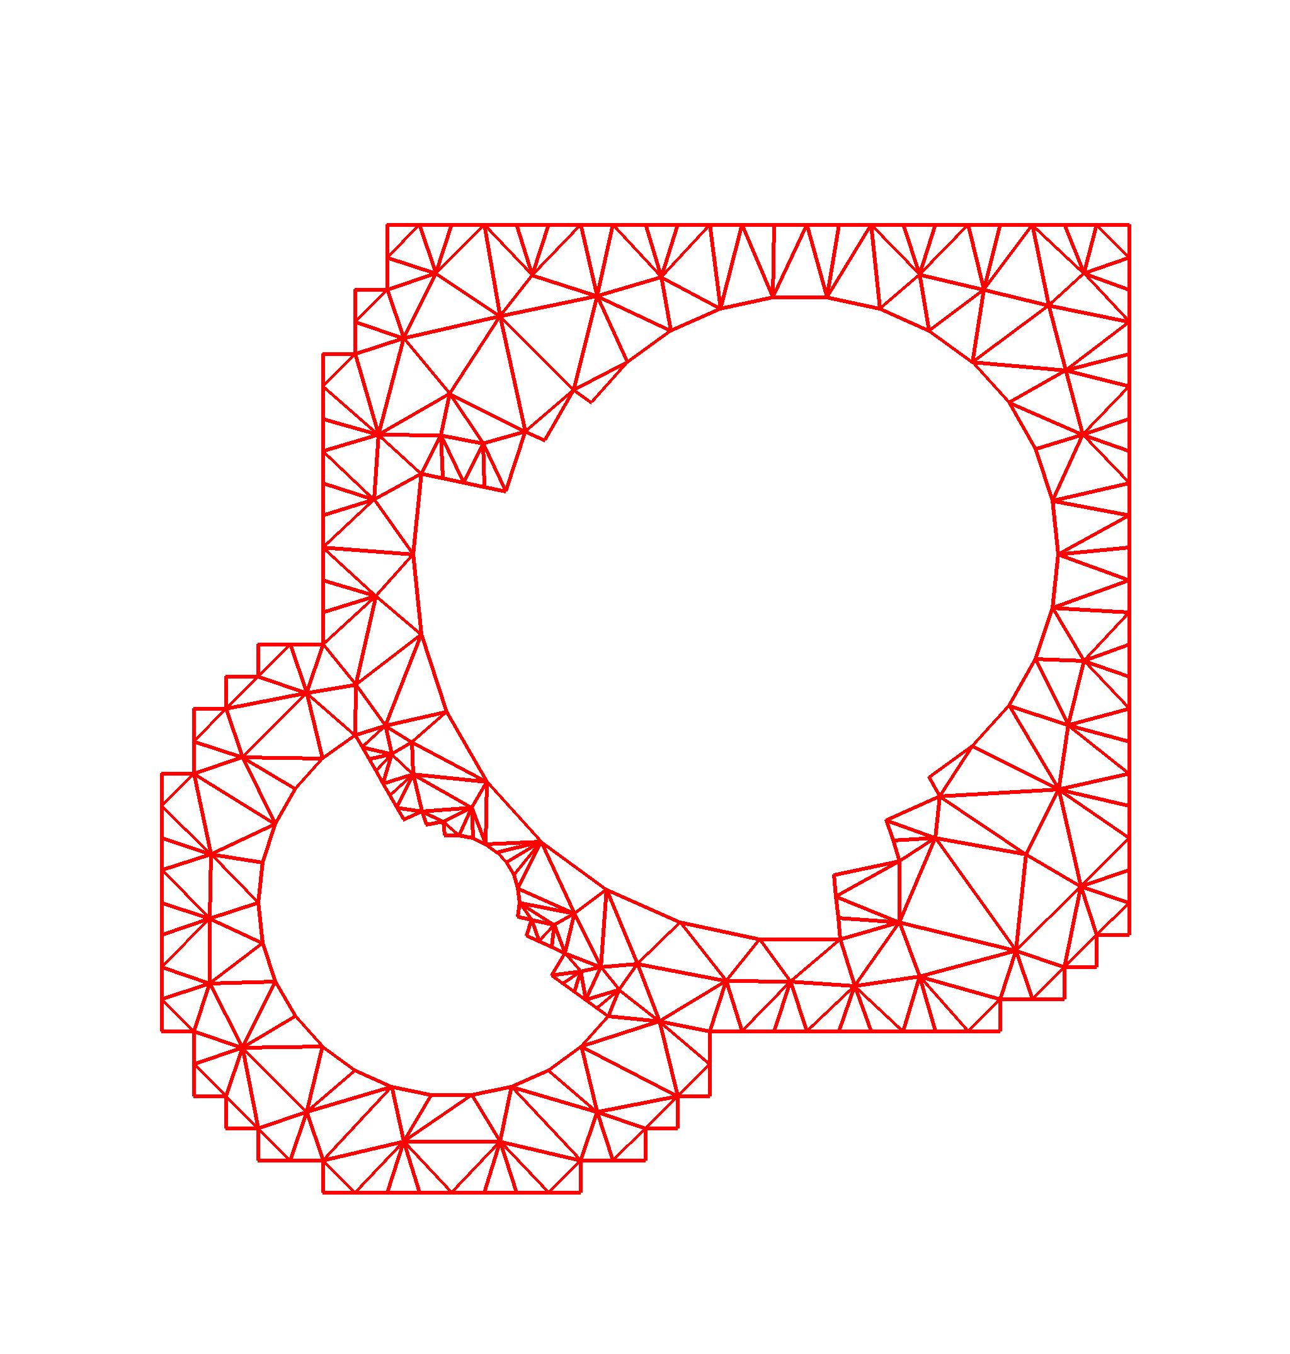
The Next Level
TSTT
Common Interface Specification
  Provides plug-and-play interchangeability
  Requires domain specific experts
  Typically a difficult, time-consuming task
  A success story: MPI
A case study… the TSTT/CCA mesh interface
  TSTT = Terascale Simulation Tools and
  Technologies (www.tstt-scidac.org)
  A DOE SciDAC ISIC focusing on meshes
  and discretization
  Goal is to enable
    hybrid solution strategies
    high order discretization
    Adaptive techniques
Geometry
Information
(Level A)
Full
Geometry
Meshes
(Level B)
Mesh
Components
(Level C)
Notes:
To be able to truly experience the power of component implementations it would be nice to be able to experiment with scientific software in a plug-and-play manner that allows application scientists to quickly and easily explore a number of different strategies (discretizations, solvers, etc) to determine which is best suited for their particular application.
This is impossible to do unless many tools that provide similar functionality also support the same interfaces. To achieve this in any particular domain, a number of experts must be willing to come to the table to hammer out the interface specification which is a difficult and time consuming task. Of course the pay-offs can be enormous for our community – the MPI standarization effort comes to mind.
In the next few minutes, I’m going to present a case study of an ongoing interface definition effort that’s been undertaken by the TSTT and CCA SciDAC centers (there are more efforts than this, and the next talk will highlight some of these).
The Terascale Simulation Tools and Technologies center (TSTT) is a DOE SciDAC Integrated Software Infrastructure Center (ISIC) whose primary goal is to bring interoperable and interchangeable meshing and discretization strategies to application scientists. In particular, they are trying to increase the use of hybrid solution strategies, high-order discretization and adaptive techniques.
For example, the picture on the lower left corner shows a situation in which a geometric domain is meshed in two different ways – one using mesh components of different types, both structured and unstructured, and the other a completely unstructured mesh. We would like to allow scientists to use either of these meshes without changing their application code by providing a common interface for both.

Slide 37
Current Situation
Current Situation
Public interfaces for numerical libraries are unique
Many-to-Many couplings require Many² interfaces
  Often a heroic effort to understand the inner workings of both codes
  Not a scalable solution
Dist. Array
ISIS++
Overture
PETSc
PAOMD
Trilinos
SUMAA3d
Notes:
Currently, there are a large number of tools available that provide mesh management infrastructure (for example, CUBIT (SNL), AOMD (RPI), Overture (LLNL), NWGrid (PNL)). These tools are all very nice and meet particular needs, but they do not interoperate to form composite hybrid meshes, nor are they easily interchanged in an application for experimentation with different strategies because their APIs are all different.
Thus if you wanted to experiment with many different meshing strategies and many different solver strategies you would have to write NxM interfaces which is a time consuming task that most application scientists are not willing to undertake.
Thus, more recent developments in the meshing/discretization/solver community are often underused because it is so difficult to upgrade the application software.

Slide 38
Common Interface Specification
Reduces the Many-to-Many problem to a Many-to-One problem
  Allows interchangeability and experimentation
  Challenges
    Interface agreement
    Functionality limitations
    Maintaining performance
Dist. Array
T
S
T
T
ISIS++
E
S
I
Overture
PETSc
PAOMD
Trilinos
SUMAA3d
Notes:
Instead we would like to reduce the many-to-many problem to a Many-to-one problem in which a common interface is supported by a large number of tool providers so that the application scientist can code to the interface and then use any compliant tool.
The challenges associated with determining such an interface are many. First and foremost the participants must agree to an interface that maintains both performance and flexibility.

Slide 39
TSTT Philosophy
Create a small set of interfaces that existing packages can support
  AOMD, CUBIT, Overture, GrACE, …
  Enable both interchangeability and interoperability
Balance performance and flexibility
Work with a large tool provider and application community to ensure applicability
  Tool providers: TSTT and CCA SciDAC centers
  Application community: SciDAC and other DOE applications
Notes:
Within the TST center we have decided to create a small set of interface that existing packages can support for mesh query, access, and modification. Note – we are not imposing any particular data structure on the mesh management package, rather we are providing mechanisms to ask questions of the package to retrieve information such as vertex coordinate and connectivity information.
To achieve a balance between performance and flexibility we are providing interfaces that are appropriate for both structured and unstructured grids (for example entity-by-entity traversal of the mesh as well as array based access to information).
We are working with a large tool provider and application base to ensure applicability of the interface. As a group we have a large number of connections with the DOE application community and are always looking for more contacts.

Slide 40
Basic Interface
Enumerated types
  Entity Type: VERTEX, EDGE, FACE, REGION
  Entity Topology: POINT, LINE, POLYGON, TRIANGLE, QUADRILATERAL, POLYHEDRON, TETRAHEDRON, HEXAHEDRON, PRISM, PYRAMID, SEPTAHEDRON
Opaque Types
  Mesh, Entity, Workset, Tag
Required interfaces
  Entity queries (geometry, adjacencies), Entity iterators, Array-based query, Workset iterators, Mesh/Entity Tags, Mesh Services
Notes:
To date we have determined the basic query interface for accessing mesh entities. We support the basic four mesh entities (vertex, edge, face and region) and well as a large number of entity topologies, including those most commonly found in application simulation codes.
The opaque types that we use include a Mesh, Entity, Workset (group of entities), and Tags to provide the means of attaching user defined data to the mesh entities.
The required interfaces that all TSTT tools must support include entity queries (coordinate info, first order adjacencies, type, topology, etc), mesh traversal through entities or worksets, an array-based query mechanism (returns all coordinate/connectivity information as large arrays), Tags, and services (to find out basic information about the mesh, e.g., number of vertices, etc).
There are implementations underway at all of the TSTT sites and this interface has been used in a number SC demonstrations, so I encourage you to seek out TSTT participates if you want to learn more.

Slide 41
Issues that have arisen
Nomenclature is harder than we first thought
Cannot achieve the 100 percent solution, so...
  What level of functionality should be supported?
    Minimal interfaces only?
    Interfaces for convenience and performance?
  What about support of existing packages?
    Are there atomic operations that all support?
    What additional functionalities from existing packages should be required?
  What about additional functionalities such as locking?
Language interoperability is a problem
  Most TSTT tools are in C++, most target applications are in Fortran
  How can we avoid the “least common denominator” solution?
  Exploring the SIDL/Babel language interoperability tool
Notes:
A number of issues have arisen that highlight the difficulty of undertaking the task of common interface definition efforts.
First, nomenclature is much harder than we first thought it would be. In particular, as an example, it took several discussions to decide if we should use the word “vertex” or “node” when describing 0D entities in the mesh.
Second, we know that we cannot achieve the 100% solution so we are constantly grappling with a number of issues such as “what level of functionality should we support?” should it be minimal interfaces only? The answer is no as that would imply an unstructured mesh access pattern which would be unacceptably slow (and unnatural) for structured grid users. Should we provide interfaces for convenience and performance? Absolutely yes.
What about the support of existing packages? There are atomic operations that all support, but again this implies entity by entity access which is not appropriate for performance reasons.
Furthermore, the TSTT center is also dealing with language interoperability issues – most of the tools are in C++ and most of the applications are in Fortran. We are trying to avoid the least common denominator solution and also working to maintain as much performance as we can in the low level interfaces. We are using the SIDL/Babel language interoperability tool for the high level function calls and are exploring how to combine it with other strategies to maintain performance for the low level function calls.

Slide 42
Summary
Complex applications that use components are possible
  Combustion
  Chemistry applications
  Optimization problems
  Climate simulations
Component reuse is significant
  Adaptive Meshes
  Linear Solvers (PETSc, Trilinos)
  Distributed Arrays and MxN Redistribution
  Time Integrators
  Visualization
Examples shown here leverage and extend parallel software and interfaces developed at different institutions
  Including CUMULVS, ESI, GrACE, LSODE, MPICH, PAWS, PETSc, PVM, TAO, Trilinos, TSTT.
Performance is not significantly affected by component use
Definition of domain-specific common interfaces is key
Notes:
In summary, I hope that this talk has shown you that the use of components in complex, useful applications such as shock hydrodynamics, reaction diffusion applications, and optimization problems is both feasible and does not have to significantly impact performance.
We have shown a significant reuse of “infrastructure” type components such as meshes, solvers, visualization and integration tools. The examples shown here leveraged significant pieces of parallel software such as CUMULVS, GrACE, PETSc, TAO, Trillinos, etc..
I have also tried to highlight the importance of defining domain specific common interfaces to achieve the full potential of scientific components.

Slide 43
Componentizing your own application
The key step: think about the decomposition strategy
  By physics module?
  Along numerical solver functionality?
  Are there tools that already exist for certain pieces? (solvers, integrators, meshes?)
  Are there common interfaces that already exist for certain pieces?
  Be mindful of the level of granularity
Decouple the application into pieces
  Can be a painful, time-consuming process
Incorporate CCA-compliance
Compose your new component application
Enjoy!
Notes:
If you are thinking about componentizing your own application, the key step is the strategy for decomposing the existing application. Will you decompose by physics module (for example, hydrodynamics, EOS, radiation transport, etc) or by numerical method (integrators, solvers, visualization tools, etc) or both.
You should determine if there are tools/components already available for aspects of your solution process, and, in particular, if they already have a well-defined interface that you might want to conform to to take advantage of their functionality.
In the decomposition strategy, you must be mindful of the granularity of your components. They must be big enough that the overhead of the virtual function calls is negligible compared to the body of the component.
Once you have your decomposition strategy, the next step is implementing it which can be a very time-consuming and painful process. For example, the FLASH center at UofChicago did this for their mesh and it took several months to separate the physics modules and solvers from the mesh data structures.
After that it’s easy.. Just add the code to make the pieces CCA-compliant which is usually a straightforward process (setServices, etc), compose the application, and enjoy.

