Slide 1
Introduction to the Ccaffeine Framework

Slide 2
Outline
What is a CCA Framework and what is Ccaffeine?
How can I slip my own component into Ccaffeine?
How do I run Ccaffeine?
Live Demo – how does it work?

Slide 3
CCA What CCA compliant framework is expected to do …
Exchange interfaces among components without one component needing to know more about the other than the interface itself
Component 1
Component 2
1
registerUsesPort("A")
Port
addProvidesPort( ,"A")
CCAServices
Port
Port
3
2
CCAServices
4
Port
= getPort("A")

Slide 4
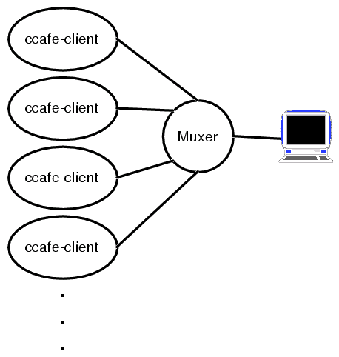
Interactive Parallel Components: what Ccaffeine does
Executable ccafe-client:
  PVM, MPI, or whatever is used for communication between clients
  Muxer enforces “single process image” of SPMD parallel computing
How To:
  Build Ccaffeine
  Run Ccaffeine
http://www.cca-forum.org/ccafe/

Slide 5
How to build Ccaffeine
Have a look at
http://www.cca-forum.org/ccafe
  Obtain the required packages
    gcc (http://gcc.gnu.org)
    Java (>jdk1.2) (http://java.sun.com)
    MPI (http://www.mcs.anl.gov/mpi/mpich)
    BOOST headers (http://www.boost.org)
    Babel (http://www.llnl.gov/casc/components/babel.html)
    Ccaffeine tar ball download (or rpm)
    Optional software
      Fortran 77 and 90 compilers
      Ruby
      Python 2.x
  Install prerequisites

Slide 6
How to build Ccaffeine (cont’d)
Untar Ccaffeine-xxx.tgz in build dir
  3 directories appear cca-spec-babel (the spec),
  cca-spec-classic (old C++ spec), dccafe
Run configure
  If confused type “configure --help”; example options:
  (cd ./cca-spec-babel; configure --with-babel=/usr/local/babel \
  --with-jdk12=/usr/local/java;make; make install)
  (cd ./cca-spec-classic; configure; make; make install)
  (cd ./dccafe; ./configure --with-cca-babel=`pwd`/../cca-spec-babel \
  --with-cca-classic=`pwd`/../cca-spec-classic –with-babel=/usr/local/babel-0.8.4 \
  --with-mpi=/usr/local/mpich --with-jdk12=/usr/local/java \
  --with-lapack=/home/rob/cca/dccafe/../LAPACK/liblapack.a \
  --with-blas=/home/rob/cca/dccafe/../LAPACK/libblas.a; make; make install)
Notes:
skip-able

Slide 7
Ccaffeine build (cont’d)
Example output at “make install” completion:
=====================================================================
Testing the Ccaffeine build ...
proceeding with env vars:
# LD_LIBRARY_PATH=/home/norris/cca/dccafe/cxx/dc/babel/babel-cca/server:/home/software/mpich-1.2.5-ifc/lib/shared:/home/norris/cca/babel-0.8.4/lib:/usr/local/lib/python2.2/config:/usr/local/intel/compiler70/ia32/lib:/usr/local/lib:/usr/local/lib
# SIDL_DLL_PATH=/home/norris/cca/dccafe/lib
didn't crash or hang up early ... looks like it is working.
Looks like CLASSIC dccafe is working.
Looks like BABEL dccafe is working.
done with Ccaffeine tests.
simpleTests: output is in /home/norris/cca/dccafe/simpleTests.out.XXXAL8Cmk.
=====================================================================
Note: depending on environment settings, sometimes the simple tests may fail but you may still have a functional framework.

Slide 8
Running Ccaffeine
Framework needs to be told:
  Where to find components
  Which components to instantiate
  Which uses port gets connected to which provides port
  Which go port sets the application in motion
User-Ccaffeine interaction techniques:
  GUI interface (with some Ccaffeine scripting help)
  Pure Ccaffeine scripting (useful in batch mode)
  Python component driver (with some Ccaffeine scripting help)

Slide 9
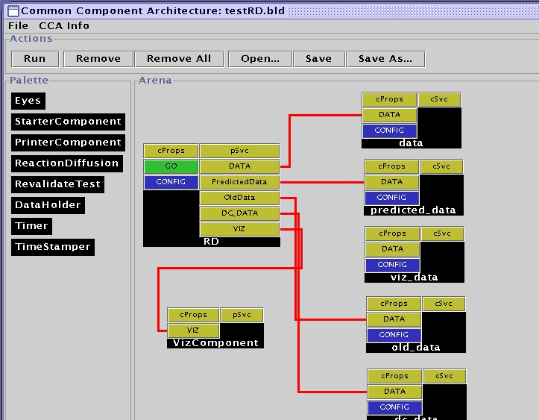
How to run Ccaffeine:
Ccaffeine interactive language
  Used to configure batch and interactive sessions
  Allows useful “defaults”
  Allows the GUI to talk over a socket

Slide 10
The Ccaffeine GUI
Java front end to one (or more) framework instances running in the background
Events propagated to all frameworks through a muxer
Framework(s) still need Ccaffeine script to know about available components
GUI used to instantiate, connect, and configure components (and to launch the whole application as well)
Usage modes:
  Compose and launch application from scratch (graphically).
  Load pre-composed applications (the .bld files)

Slide 11
The GUI
Click and drag to interact with the framework(s)
Component paths and types needed by the framework(s) (the .rc files)
#!ccaffeine bootstrap file.
# ------- don't change anything ABOVE this line.-------------
path set /home/elwasif/CCA/tutorial/src/sidl/random-component-c++
path append /home/elwasif/CCA/tutorial/src/sidl/function-component-c++
path append /home/elwasif/CCA/tutorial/src/sidl/integrator-component-c++
path append /home/elwasif/CCA/tutorial/src/sidl/driver-component-c++
repository get randomgen.RandRandomGenerator
repository get functions.LinearFunction
repository get functions.PiFunction
repository get functions.NonlinearFunction
SIDL_DLL_PATH environment variable also used for locating component shared libraries!

Slide 12
The Command Line Way:
Using Ccaffeine Scripting
Simple scripting “language” to talk to the framework.
For the full list of commands:
  UNIX>ccafe-single
  cca> help
Some commands:
  path set <initial path to components>
  path append <directory containing component code>
  repository get <component class>
  instaniate <component class> <component name>
  connect <use component name> <use port name> \
  <provide component name> <provide port name>
  go <component name> <Go port name>
  bye

Slide 13
Ccaffeine scripting language for batch use
Two modes of execution:
  ccafe-single : uniprocessor, interactive, no MPI
  ccafe-batch or ccafe-client: parallel jobs, GUI
Refer to
http://www.cca-forum.org/ccafe/ccafe-man/Ccafe_Manual.html
for more detailed description of the commands
You can run Ccaffeine interactively by typing:
prompt> ccafe-single
MPI_Init called in CmdLineClientMain.cxx
my rank: 0, my pid: 25989
... (output cruft deleted)
cca>help
(complete listing of commands and what they do)

Slide 14
Quick run-through of the Ccaffeine scripting language
Scripting language does everything that the GUI does
Warning: there are two files that Ccaffeine uses to locate and load component libraries:
  “rc” and script files for building and running apps
  GUI “.bld” files that store state saved by the Ccaffeine GUI
  These are not the same and will give, sometimes spectacular, undefined behavior when used improperly.

Slide 15
Example: example1_rc
SIDL_DLL_PATH environment variable also used for locating component shared libraries!
#!ccaffeine bootstrap file.
# ------- don't change anything ABOVE this line.-------------
path set /home/elwasif/CCA/tutorial/random-component-c++
path append /home/elwasif/CCA/tutorial/function-component-c++
path append /home/elwasif/CCA/tutorial/integrator-component-c++
path append /home/elwasif/CCA/tutorial/driver-component-c++
# load components into the “pallet”
repository get functions.PiFunction
repository get integrators.MonteCarloIntegrator
repository get integrators.MidPointIntegrator
repository get integrators.ParallelIntegrator
repository get randomgen.RandRandomGenerator
repository get tutorial.driver
functions.PiFunction
integrators.MonteCarloIntegrator
integrators.MidPointIntegrator
integrators.ParallelIntegrator
randomgen.RandRandomGenerator
tutorial.driver
Component classes/types
At this point no components are instantiated, but are simply known to the system

Slide 16
Example (cont.): Instantiation
create randomgen.RandRandomGenerator rand
create functions.PiFunction function
create integrators.MonteCarloIntegrator integrator
create tutorial.Driver driver
rand
function
integrator
driver
Component intances names

Slide 17
Example (cont.): Connection
# Connect uses and provides ports
connect integrator FunctionPort function FunctionPort
connect integrator RandomGeneratorPort rand RandomGeneratorPort
connect driver IntegratorPort integrator IntegratorPort
FunctionPort
FunctionPort
RandomGeneratorPort
RandomGeneratorPort
IntegratorPort
IntegratorPort
“Uses” ports names
“Provides” ports names

Slide 18
Example (cont.): Application Launch
# Good to go()
go driver GoPort
GoPort
Provided Go port name
At this point Ccaffeine gets completely out of the way
  So much so that it will not respond until (or if) your application returns from the invocation of the “go()” method
  There is only one thread of control

Slide 19
The third way:
Using CCA BuilderService
Deficiencies of Ccaffeine Scripting
  Non “standard”
  No error checking !!!!
Solution: Use a more “complete” scripting language, e.g. Python
Why Python?? Supported By Babel
Strategy:
  Use a Python “mega driver” to assemble the application
  Talk to the framework through BuilderService interface
  Still need snippets of Ccafeine scripting to set paths, instantiate python driver, and launch it

Slide 20
The BuilderService Port
“Provided” by the Framework, “used” by any component
Major methods:
  createInstance(instanceName, className, properties)
  connect(userID, usePortName, providerID, providPortName)
  See file cca.sidl for complete interface.
Many more methods
Can be “used” from any language, Python just more convenient
See driver-python for details

Slide 21
Component discovery and instantiation
CCA is working on an XML component delivery specification, until then Ccaffeine has some specific requirements
“.cca” file describes what the type of the component is: e.g., “babel” or “classic”(Pre-Babel / C++ only binding).
  Previously there was type “Classic”.
!date=Thu Jul 3 14:53:23 EDT 2003
!location=
!componentType=babel
dummy_libIntegrator-component-c++.so
dummy_create_MonteCarloIntegrator integrators.MonteCarloIntegrator
Component type: “babel” or “classic” (C++)
.so library containing component (pre-Babel)
Component creation function; (pre-Babel)
Component type(class); (pre-Babel)

Slide 22
Showing How it All Works
The Scripts

