Slide 1
Welcome to the
Common Component Architecture
Tutorial
ACTS Collection Workshop
27 August 2004

Slide 2
Agenda & Table of Contents
Time | Title | Slide No. | Presenter
11:30-11:35am | Welcome | 1 | David Bernholdt, ORNL
11:35am-12:30pm | A Pictorial Introduction to Components in Scientific Computing | 6 | David Bernholdt, ORNL
 | An Introduction to Components & the CCA | 26 | David Bernholdt, ORNL
12:30-1:30pm | Lunch
1:30pm-1:50pm | Distributed Computing with the CCA | 67 | David Bernholdt, ORNL
1:50-2:50pm | CCA Applications | 87 | Jaideep Ray, SNL
2:50-3:20pm | Language Interoperable CCA Components with Babel | 136 | Tom Epperly, LLNL
3:20-3:30pm | Questions/Discussion |  | The Team
3:30-4:00pm | Break/Relocate to Tolman Hall
4:00-4:45pm | TAU Hands-On
4:45-6:30pm | CCA Hands-On | Hand-out | Rob Armstrong, SNL & the Team

Slide 3
The Common Component Architecture
(CCA) Forum
Combination of standards body and user group for the CCA
Define Specifications for High-Performance Scientific Components & Frameworks
Promote and Facilitate Development of Domain-Specific “Standard” Interfaces
Goal: Interoperability between components developed by different expert teams across different institutions
Quarterly Meetings, Open membership…
Mailing List: cca-forum@cca-forum.org
http://www.cca-forum.org/
Notes:
CCA Forum
Who
Goals
Quarterly Meetings

Slide 4
Acknowledgements:
Tutorial Working Group
People: Rob Armstrong, David Bernholdt, Randy Bramley, Wael Elwasif, Lori Freitag Diachin, Madhusudhan Govindaraju, Ragib Hasan, Dan Katz, Jim Kohl, Gary Kumfert, Lois Curfman McInnes, Boyana Norris, Craig Rasmussen, Jaideep Ray, Sameer Shende, Torsten Wilde, Shujia Zhou
Institutions: ANL, Binghamton U, Indiana U, JPL, LANL, LLNL, NASA/Goddard, ORNL, SNL, U Illinois, U Oregon
Computer facilities provided by the Computer Science Department and University Information Technology Services of Indiana University, supported in part by NSF grants CDA-9601632 and EIA-0202048.

Slide 5
Acknowledgements: The CCA
ANL –Steve Benson, Jay Larson, Ray Loy, Lois Curfman McInnes, Boyana Norris, Everest Ong, Jason Sarich…
Binghamton University - Madhu Govindaraju, Michael Lewis, …
Indiana University - Randall Bramley, Dennis Gannon, …
JPL – Dan Katz, …
LANL - Craig Rasmussen, Matt Sotille, …
LLNL – Lori Freitag Diachin, Tom Epperly, Scott Kohn, Gary Kumfert, …
NASA/Goddard – Shujia Zhou
ORNL - David Bernholdt, Wael Elwasif, Jim Kohl, Torsten Wilde, …
PNNL - Jarek Nieplocha, Theresa Windus, …
SNL - Rob Armstrong, Ben Allan, Lori Freitag Diachin, Curt Janssen, Jaideep Ray, …
University of Oregon – Allen Malony, Sameer Shende, …
University of Utah - Steve Parker, …
and many more… without whom we wouldn’t have much to talk about!

Slide 6
A Pictorial Introduction to Components in Scientific Computing

Slide 7
Once upon a time...
Input
Output
Program
Notes:
Once upon a time, computing was simple
There was a program and you put stuff into it and you get stuff out.

Slide 8
As Scientific Computing grew...
Bottle Neck
Notes:
But as scientific computing grew, the data required out of the computations grew.
So then the input grew in turn and the program became the bottle neck.

Slide 9
Tried to ease the bottle neck
Notes:
There were several attempts to ease the congestion.
First was to spend money on custom processors that made the program run really fast. (supercomputers)
Then they started adding more expensive hardware so that one program could do the same thing several times in lock-step (vector supercomputers)

Slide 10
SPMD was born.
1
2
1
3
4
2
1
2
4
3
4
3
Notes:
Finally, someone realized how cheap off-the-shelf processors were, and just bought a lot of cheap processors instead of one expensive one.
This meant that the program could run in multiple places at the same time.
This also meant that the inputs needed to be cut up and distributed among the different processors and the output had to be reconstructed from the resulting fragments.
Thus, SPMD was born, Single Program Multiple Data.

Slide 11
SPMD worked.
But it
isn’t
easy!!!
But it
isn’t
easy!!!
1
2
1
3
4
2
1
2
4
3
4
3
Notes:
But...
As everyone knows there are very few problems like SETI@home where each part can be computed independently.
For our problems of interest, the data for a single output piece (number 2) has dependencies interwoven throughout the data.
So we set up message passing, which basically means that each instance of the program finds data that it needs and data that it knows to transmit and they call each other and exchange information.
This is “state of art” today in Scientific Computing. SPMD on Distributed Memory, message passing systems.

Slide 12
Meanwhile, corporate computing was growing in a different way
Input
Input
email client
spreadsheet
browser
graphics
Output
editor
Unicode
Program
multimedia
database
Notes:
Now, separately from Scientific Computing, Business computing really took off in the last couple decades.
However, it grew in an orthogonal direction.
The input and outputs for programs (say a word processor) didn’t grow by a dozen orders of magnitude, but the application used to construct these documents did!

Slide 13
This created a whole new set of problems complexity
Interoperability across multiple languages
Interoperability across multiple platforms
Incremental evolution of large legacy systems (esp. w/ multiple 3rd party software)
email client
spreadsheet
browser
graphics
editor
Unicode
multimedia
database
Notes:
This created a whole new set of problems.
These are the three that I want to concentrate on today. You will see them again in this talk.
They are ....

Slide 14
Component Technology addresses these problems
Notes:
So this is how I draw component software.
The key word to remember about components:
Loose coupling
Let me explain what this drawing means

Slide 15
So what’s a component ???
Implementation :
No Direct Access
Interface Access :
Generated by Tools
Matching Connector :
Assigned by Framework
Hidden from User
Notes:
The box is the developer’s software. It remains (essentially) unchanged.
This socket that is attached to it is an interrface. It is usually generated by some tools.
The connector on the right is assigned to the component by the framework, possibly at runtime.

Slide 16
1. Interoperability across multiple languages
Language &
Platform
independent
interfaces
C
F77
Java
C++
Automatically
generated
bindings to
working code
Python
Notes:
I told you that we’d discuss three problems in detail. Here’s the first.
So let me add the languages
And that’s it. There’s no problem. Each box may be another
language, but that’s an internal detail of the component.
The “wires” are language and platform independent, and the generated interfaces to the actual code do all the translation between the wires and the particular implementation language.

Slide 17
2. Interoperability Across Multiple
Platforms
Imagine a company migrates to a new system, OS, etc.
What if the source to this one part is lost???
Notes:
Now a slightly harder problem.
Imagine....
What if...
(I’ve seen this happen to companies)

Slide 18
Transparent Distributed Computing
These wires
are very,
very smart!
internet
internet
Notes:
In components, the yellow block would still have to run on the old platform, but the others can move over and communicate over the internet.
More importantly, this can occur without any changes inside any of the boxes, a.k.a the implementation.
Just as the interfaces hide the implementation language from the wires... they can hide the type of wires from implementation.
These wires can be complicated things and not just simple communication paths.

Slide 19
3. Incremental Evolution With
Multiple 3rd party software
v 1.0
v 2.0
v 3.0
Notes:
Okay, one last problem with incremental evolution and how industry components handles this.
Let’s start by putting some version numbers on these components

Slide 20
Now suppose you find this bug...
v 1.0
v 2.0
v 3.0
Notes:
Now imagine you find a bug on the orange component right there in the middle.
Now your whole system is broken, because you need this fixed.

Slide 21
Good news: an upgrade available
Bad news: there’s a dependency
v 1.0
2.0
v 2.0
v 3.0
2.1
Notes:
The good news is that there is an upgrade available
The bad news is that it depends on a new (and incompatible) version of the teal component at the top.
Now you also have the red component which hasn’t yet upgraded to teal 2.0.
How many have run into these kinds of situations?
What can you do?

Slide 22
Great News:
Solvable with Components
2.0
2.1
v 3.0
Notes:
With components, this will still work.

Slide 23
Great News:
Solvable with Components
2.0
v 1.0
2.1
v 3.0
Notes:
The trick is (at least with COM) that new interfaces still hold references to the older interfaces under the hood.
The component framework can detect the version mismatch and have the component drill down to its older interface underneath.

Slide 24
Why Components for Scientific Computing Complexity
Interoperability across multiple languages
Interoperability across multiple platforms
Incremental evolution of large legacy systems (esp. w/ multiple 3rd party software)
DataFoundry
SAMRAI
JEEP
Sapphire
Scientific Viz
Ardra
Overture
nonlinear solvers
ALPS
hypre
linear solvers
Notes:
So now let’s take a step back and ask...
Components seems effective in industry, but what has that to do with
scientific computing?
Well, if you look the way we’ve been adding more physics, more fidelity, and more features into our codes lately, you’d see
1. its beginning to look like this
2. We’re suffering from the same problems.

Slide 25
The Model for Scientific Component Programming
Science
Industry
?
CCA
Notes:
So here’s where are research begins.
We know how computing started
We know how science went to SPMD programming
And we know how industry went to component programming.
What happens when you merge the two???

Slide 26
An Introduction to Components and the
Common Component Architecture

Slide 27
Goals of This Module
Introduce basic concepts and vocabulary of component-based software engineering and the CCA
Highlight the special demands of high-performance scientific computing on component environments

Slide 28
Component-Based Software Engineering
CBSE methodology is an emerging approach to software development
  Both in research an in practical application
  Especially popular in business and internet areas
Addresses software complexity issues
Increases software productivity

Slide 29
Motivation: For Library Developers
People want to use your software, but need wrappers in languages you don’t support
  Many component models provide language interoperability
Discussions about standardizing interfaces are often sidetracked into implementation issues
  Components separate interfaces from implementation
You want users to stick to your published interface and prevent them from stumbling (prying) into the implementation details
  Most component models actively enforce the separation

Slide 30
Motivation: For Application Developers and Users
You have difficulty managing multiple third-party libraries in your code
You (want to) use more than two languages in your application
Your code is long-lived and different pieces evolve at different rates
You want to be able to swap competing implementations of the same idea and test without modifying any of your code
You want to compose your application with some other(s) that weren’t originally designed to be combined

Slide 31
What are Components?
No universally accepted definition in computer science research …yet
A unit of software development/deployment/reuse
  i.e. has interesting functionality
  Ideally, functionality someone else might be able to (re)use
  Can be developed independently of other components
Interacts with the outside world only through well-defined interfaces
  Implementation is opaque to the outside world
Can be composed with other components
  “Plug and play” model to build applications
  Composition based on interfaces

Slide 32
What is a Component Architecture?
A set of standards that allows:
  Multiple groups to write units of software (components)…
  And have confidence that their components will work with other components written in the same architecture
These standards define…
  The rights and responsibilities of a component
  How components express their interfaces
  The environment in which are composed to form an application and executed (framework)
  The rights and responsibilities of the framework
Notes:
Followup on Cheesman and Daniels specifying a component architecture.
One really shouldn’t think of components alone, it is the complete environment/architecture

Slide 33
A Simple Example:
Numerical Integration Components
Interoperable components (provide same interfaces)
FunctionPort
IntegratorPort
FunctionPort
NonlinearFunction
MidpointIntegrator
FunctionPort
GoPort
IntegratorPort
LinearFunction
Driver
FunctionPort
IntegratorPort
FunctionPort
PiFunction
RandomGeneratorPort
MonteCarloIntegrator
RandomGeneratorPort
RandomGenerator
Notes:
A bunch of components that we’ll see throughout the tutorial
The driver’s job is merely to invoke the integrator and print out the result
We have two different integrators (and of course you could have many more)
One uses the simple midpoint integration rule
The other is based on the Monte Carlo approach, so it requires a random number generator in addition to the function to be integrated
On the right are several functions we might want to integrate, as well as a random number generator

Slide 34
An Application
Built from the Provided Components
FunctionPort
IntegratorPort
FunctionPort
NonlinearFunction
MidpointIntegrator
FunctionPort
GoPort
IntegratorPort
LinearFunction
Driver
FunctionPort
IntegratorPort
FunctionPort
PiFunction
Hides compexity: Driver doesn’t care that MonteCarloIntegrator needs a random number generator
RandomGeneratorPort
MonteCarloIntegrator
RandomGeneratorPort
RandomGenerator
Notes:
To build a particular application from the components, we connect ports. In this case, we will integrate a function that should give us pi using the Monte Carlo approach.
Creating a valid application depends on connecting up ports according to their semantics, not on simply connecting every possible port. Components may, for example, offer alternative interfaces to accomplish the same task. Or some interfaces might be used only for debugging, performance monitoring, or other purposes.

Slide 35
Another Application…
FunctionPort
IntegratorPort
FunctionPort
NonlinearFunction
MidpointIntegrator
FunctionPort
GoPort
IntegratorPort
LinearFunction
Driver
FunctionPort
IntegratorPort
FunctionPort
PiFunction
RandomGeneratorPort
MonteCarloIntegrator
RandomGeneratorPort
RandomGenerator
Notes:
All we’ve done here is change to integrating a different function

Slide 36
Application 3…
FunctionPort
IntegratorPort
FunctionPort
NonlinearFunction
MidpointIntegrator
FunctionPort
GoPort
IntegratorPort
LinearFunction
Driver
FunctionPort
IntegratorPort
FunctionPort
PiFunction
RandomGeneratorPort
MonteCarloIntegrator
RandomGeneratorPort
RandomGenerator
Notes:
Here we’ve changed integrators and functions

Slide 37
And Many More…
Dashed lines indicate alternate connections
FunctionPort
IntegratorPort
FunctionPort
NonlinearFunction
MidpointIntegrator
FunctionPort
GoPort
IntegratorPort
LinearFunction
Driver
FunctionPort
IntegratorPort
FunctionPort
PiFunction
RandomGeneratorPort
MonteCarloIntegrator
RandomGeneratorPort
Create different applications in "plug-and-play" fashion
RandomGenerator

Slide 38
Relationships:
Components, Objects, and Libraries
Components are typically discussed as objects or collections of objects
  Interfaces generally designed in OO terms, but…
  Component internals need not be OO
  OO languages are not required
Component environments can enforce the use of published interfaces (prevent access to internals)
  Libraries can not
It is possible to load several instances (versions) of a component in a single application
  Impossible with libraries
Components must include some code to interface with the framework/component environment
  Libraries and objects do not

Slide 39
Domain-Specific Frameworks vs Generic Component Architectures
Domain-Specific
Often known as “frameworks”
Provide a significant software infrastructure to support applications in a given domain
  Often attempts to generalize an existing large application
Often hard to adapt to use outside the original domain
  Tend to assume a particular structure/workflow for application
Relatively common
  E.g. Cactus, ESMF, PRISM
  Hypre, Overture, PETSc, POOMA
Generic
Provide the infrastructure to hook components together
  Domain-specific infrastructure can be built as components
Usable in many domains
  Few assumptions about application
  More opportunities for reuse
Better supports model coupling across traditional domain boundaries
Relatively rare at present
  e.g. CCA

Slide 40
Interfaces, Interoperability, and Reuse
Interfaces define how components interact…
Therefore interfaces are key to interoperability and reuse of components
In many cases, “any old interface” will do, but…
Achieving reuse across multiple applications requires agreement on the same interface for all of them
“Standard” or “community” interfaces facilitate reuse and interoperability
  Typically domain specific
  Formality of “standards” process varies
  Significant initial investment for long-term payback
More about community interface development efforts in “Applications” module

Slide 41
Special Needs of Scientific HPC
Support for legacy software
  How much change required for component environment?
Performance is important
  What overheads are imposed by the component environment?
Both parallel and distributed computing are important
  What approaches does the component model support?
  What constraints are imposed?
  What are the performance costs?
Support for languages, data types, and platforms
  Fortran?
  Complex numbers? Arrays? (as first-class objects)
  Is it available on my parallel computer?

Slide 42
Commodity Component Models
CORBA Component Model (CCM), COM, Enterprise JavaBeans
  Arise from business/internet software world
Componentization requirements can be high
Can impose significant performance overheads
No recognition of tightly-coupled parallelism
May be platform specific
May have language constraints
May not support common scientific data types

Slide 43
What is the CCA?
CCA is a specification of a component environment designed for high performance scientific computing
  Specification is decided by the CCA Forum
    CCA Forum membership open to all
  “CCA-compliant” just means conforming to the specification
    Doesn’t require using any of our code!
A tool to enhance the productivity of scientific programmers
  Make the hard things easier, make some intractable things tractable
  Support & promote reuse & interoperability
  Not a magic bullet

Slide 44
CCA Philosophy and Objectives
Local and remote components
  Support local, HPC parallel, and distributed computing
High Performance
  Design should support high-performance mechanisms wherever possible (i.e. minimize copies, extra communications, extra synchronization)
  Support SPMD and MPMD parallelism
  Allow user to chose parallel programming models
Heterogeneity
  Multiple architectures, languages, run-time systems used simultaneously in an application
Integration
  Components should be easy to make and easy to use
Openness and simplicity
  CCA spec should be open & usable with open software

Slide 45
CCA Concepts: Components
IntegratorPort
FunctionPort
FunctionPort
MidpointIntegrator
NonlinearFunction
Components provide/use one or more ports
  A component with no ports isn’t very interesting
Components include some code which interacts with a CCA framework

Slide 46
CCA Concepts: Ports
IntegratorPort
FunctionPort
FunctionPort
MidpointIntegrator
NonlinearFunction
Components interact through well-defined interfaces, or ports
  In OO languages, a port is a class or interface
  In Fortran, a port is a bunch of subroutines or a module
Components may provide ports – implement the class or subroutines of the port ( )
Components may use ports – call methods or subroutines in the port ( )
Links between ports denote a procedural (caller/callee) relationship, not dataflow!
  e.g., FunctionPort could contain: evaluate(in Arg, out Result)
“Provides” Port
“Uses” Port
Notes:
The cartoon is a schematic representation of two components connected to each other. The representation mimics that used in the original GUI for the Ccaffeine framework. Uses ports are shown on the left side of the component, provides ports on the right. They are shown in different colors to help distinguish them.
The MidpointIntegrator component has two ports. It provides an IntegratorPort and uses a FunctionPort. The NonlinearFunction component provides a FunctionPort. The red line connects the user FunctionPort on MidpointIntegrator to the provider FunctionPort on NonlinearFunction.
Another way to think of user/provider is client/server
To repeat: connecting ports does not imply direction of data movement!

Slide 47
CCA Concepts: Frameworks
The framework provides the means to “hold” components and compose them into applications
Frameworks allow connection of ports without exposing component implementation details
Frameworks provide a small set of standard services to components
Currently: specific frameworks support specific computing models (parallel, distributed, etc.)
Future: full flexibility through integration or interoperation

Slide 48
Writing Components
Components…
  Inherit from gov.cca.Component
    Implement setServices method to register ports this component will provide and use
  Implement the ports they provide
  Use ports on other components
    getPort/releasePort from framework Services object
Interfaces (ports) extend gov.cca.Port
Full details in the hands-on!

Slide 49
Adapting Existing Code into Components
Example in the hands-on!
Suitably structured code (programs, libraries) should be relatively easy to adapt to the CCA. Here’s how:
Decide level of componentization
  Can evolve with time (start with coarse components, later refine into smaller ones)
Define interfaces and write wrappers between them and existing code
Add framework interaction code for each component
  setServices
Modify component internals to use other components as appropriate
  getPort, releasePort and method invocations

Slide 50
Writing Frameworks
There is no reason for most people to write frameworks – just use the existing ones!
Frameworks must provide certain ports…
  ConnectionEventService
    Informs the component of connections
  AbstractFramework
    Allows the component to behave as a framework
  BuilderService
    Instantiate components & connect ports
  ComponentRepository
    A default place where components are found
Frameworks must be able to load components
  Typically shared object libraries, can be statically linked
Frameworks must provide a way to compose applications from components

Slide 51
Component Lifecycle
Composition Phase (assembling application)
  Component is instantiated in framework
  Component interfaces are connected appropriately
Execution Phase (running application)
  Code in components uses functions provided by another component
Decomposition Phase (termination of application)
  Connections between component interfaces may be broken
  Component may be destroyed
In an application, individual components may be in different phases at different times
Steps may be under human or software control
Notes:
We’re not really going to talk about disconnecting ports or destroying components here.

Slide 52
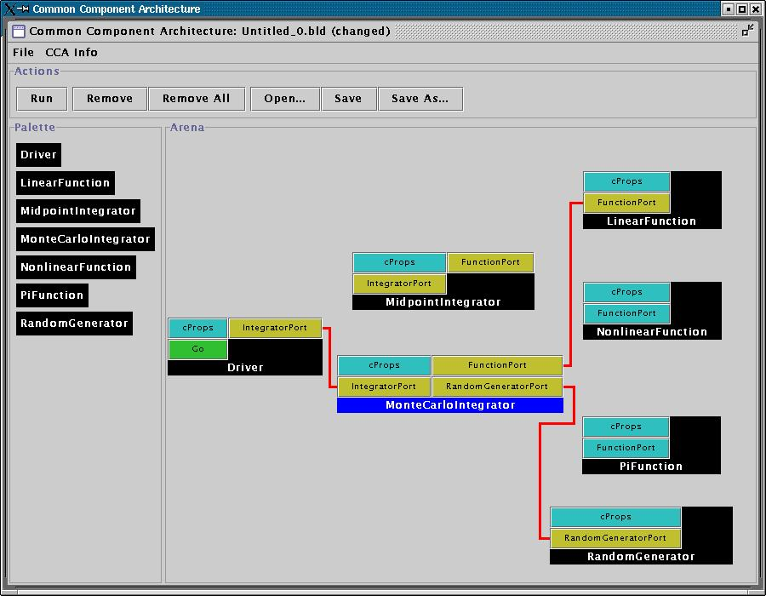
User Viewpoint:
Loading and Instantiating Components
Components are code + metadata
Using metadata, a Palette of available components is constructed
Components are instantiated by user action (i.e. by dragging from Palette into Arena)
Framework calls component’s constructor, then setServices
Details are framework-specific!
Ccaffeine currently provides both command line and GUI approaches
create Driver Driver
create LinearFunction LinearFunction
create MonteCarloIntegrator MonteCarloIntegrator
Notes:
While this description is specific to Ccaffeine, the concepts are general

Slide 53
User Connects Ports
Can only connect uses & provides
  Not uses/uses or provides/provides
Ports connected by type, not name
  Port names must be unique within component
  Types must match across components
Framework puts info about provider of port into using component’s Services object
connect Driver IntegratorPort MonteCarloIntegrator IntegratorPort
connect MonteCarloIntegrator FunctionPort LinearFunction FunctionPort
…
Notes:
The picture is specific to Ccaffeine, but the concepts are general

Slide 54
Component’s View of Instantiation
Framework calls component’s constructor
Component initializes internal data, etc.
  Knows nothing outside itself
Framework calls component’s setServices
  Passes setServices an object representing everything “outside”
  setServices declares ports component uses and provides
Component still knows nothing outside itself
  But Services object provides the means of communication w/ framework
Framework now knows how to “decorate” component and how it might connect with others
Framework interaction code
constructor setServices destructor
CCA.Services
provides IntegratorPort
uses FunctionPort, RandomGeneratorPort
Integrator code
IntegratorPort
FunctionPort
RandomGeneratorPort
MonteCarloIntegrator
MonteCarloIntegrator
Notes:
The cartoon on the left shows the internals of the component. The cartoon on the right is how the Ccaffeine GUI would render the “decorated” component to the outside world.

Slide 55
Component’s View of Connection
Framework interaction code
CCA.Services
…, uses FunctionPort
(connected to NonlinearFunction FunctionPort), …
Framework puts info about provider into user component’s Services object
  MonteCarloIntegrator’s Services object is aware of connection
  NonlinearFunction is not!
MCI’s integrator code cannot yet call functions on FunctionPort
Integrator code
Framework interaction code
MonteCarloIntegrator
CCA.Services
provides FunctionPort
Function code
NonlinearFunction

Slide 56
Component’s View of Using a Port
User calls getPort to obtain (handle for) port from Services
  Finally user code can “see” provider
Cast port to expected type
  OO programming concept
  Insures type safety
  Helps enforce declared interface
Call methods on port
  e.g.
  sum = sum + function->evaluate(x)
Release port
Framework interaction code
CCA.Services
…, uses FunctionPort
(connected to NonlinearFunction FunctionPort), …
Integrator code
MonteCarloIntegrator
Notes:
This is where the changes to the “library” code turn up. The getPort/cast/releasePort are outright additions. But also, calls to methods on the port will change slightly.

Slide 57
CCA Supports Local, Parallel and Distributed Computing
Integrator
Linear Fun
“Direct connection” preserves high performance of local (“in-process”) components
  Framework makes connection
  But is not involved in invocation
Distributed computing has same uses/provides pattern, but framework intervenes between user and provider
  Framework provides a proxy provides port local to the uses port
  Framework conveys invocation from proxy to actual provides port
Provides/Uses
Port
Direct Connection
Integrator
Provides
Port
Network
Connection
Linear Fun
Proxy Provides/
UsesPort

Slide 58
CCA Concepts: “Direct Connection” Maintains Local Performance
Calls between components equivalent to a C++ virtual function call: lookup function location, invoke it
  Cost equivalent of ~2.8 F77 or C function calls
  ~48 ns vs 17 ns on 500 MHz Pentium III Linux box
Language interoperability can impose additional overheads
  Some arguments require conversion
  Costs vary, but small for typical scientific computing needs
Calls within components have no CCA-imposed overhead
Implications
  Be aware of costs
  Design so inter-component calls do enough work that overhead is negligible
More about performance in the “Applications” module
Notes:
Purists often argue with the characterization of a C++ virtual function call as costing the equivalent of n function calls in a language like C or Fortran. The problem is that the virtual function call involves first looking up the function (dereferencing a pointer) and then making the call. The lookup doesn’t happen in C or Fortran, so the argument is that we’re comparing apples and oranges.
On the other hand, a significant number of our audience are Fortran (or perhaps C) programmers with no C++ experience. All they “know” about C++ is that its slow. So above, we give them a measure of what “slow” means in this particular context.
If someone can come up with a succinct way of expressing this that will satisfy the purists as well as the Fortran programmer, please let me know!

Slide 59
CCA Concepts: Framework Stays “Out of the Way” of Component Parallelism
Single component multiple data (SCMD) model is component analog of widely used SPMD model
P0
P1
P2
P3
Each process loaded with the same set of components wired the same way
Different components in same process “talk to each” other via ports and the framework
Components: Blue, Green, Red
Framework: Gray
Same component in different processes talk to each other through their favorite communications layer (i.e. MPI, PVM, GA)
MCMD/MPMD also supported
Other component models ignore parallelism entirely
Notes:
An animation depicting the important concepts in tightly-coupled parallel computing with CCA.
0) Start with a single process containing a framework with a give set of components (Blue, Green, Red) wired together.
Extend that to a parallel system by giving each process the same set of components wire the same way.
Components on the same process talk to each other via the usual CCA mechanisms (one such case highlighted by dashed box).
Between the same component (Blue, Green, Red) in different processes, the component is free to communicate however it wants – not forced to use CCA mechanisms. This is good because it allows developers to reuse software more easily, and knowledge (about how to use a given communications layer). Different comms layers can coexist in the same application
The CCA spec does not prohibit “diagonal” communication, but it is not encouraged. It would be treated the same as horizontal communication – the framework would stay out of the way.
The MPMD analog of this also “just works”. It is just harder to depict ☺

Slide 60
“Multiple-Component Multiple-Data” Applications in CCA
Simulation composed of multiple SCMD sub-tasks
Usage Scenarios:
  Model coupling (e.g. Atmosphere/Ocean)
  General multi-physics applications
  Software licensing issues
Approaches
  Run single parallel framework
    Driver component that partitions processes and builds rest of application as appropriate (through BuilderService)
  Run multiple parallel frameworks
    Link through specialized communications components (e.g. MxN)
    Link as components (through AbstractFramework service; highly experimental at present)
Driver
Atmosphere
Ocean
Land
Coupler (MxN)

Slide 61
MCMD Within A Single Framework
Working examples available using Ccaffeine framework, with driver coded in Python
P0
P1
P2
P3
Framework
Application driver & MCMD support component
Components on all processes
Components only on process group A
Components only on process group B
Group A
Group B

Slide 62
CCA Concepts:
Language Interoperability
Existing language interoperability approaches are “point-to-point” solutions
Babel provides a unified approach in which all languages are considered peers
Babel used primarily at interfaces
f77
f77
C
f90
C
f90
Babel
C++
Python
C++
Python
Babel presentation coming up!
Java
Java
Few other component models support all languages and data types important for scientific computing

Slide 63
Advanced CCA Concepts
Components are peers
  Application architecture determines relationships, not CCA specification
Frameworks provide a BuilderService which allows programmatic composition of components
Frameworks may present themselves as components to other frameworks
A “traditional” application can treat a CCA framework as a library
Meta-component models enable bridging between CCA components and other component(-like) environments
  e.g. SCIRun Dataflow, Visualization Toolkit (VTk), …
No time to go into detail on these, but ask us for more info after the tutorial

Slide 64
What the CCA isn’t…
CCA doesn’t specify who owns “main”
  CCA components are peers
  Up to application to define component relationships
    “Driver component” is a common design pattern
CCA doesn’t specify a parallel programming environment
  Choose your favorite
  Mix multiple tools in a single application
CCA doesn’t specify I/O
  But it gives you the infrastructure to create I/O components
  Use of stdio may be problematic in mixed language env.
CCA doesn’t specify interfaces
  But it gives you the infrastructure to define and enforce them
  CCA Forum supports & promotes “standard” interface efforts
CCA doesn’t require (but does support) separation of algorithms/physics from data
  Generic programming

Slide 65
What the CCA is…
CCA is a specification for a component environment
  Fundamentally, a design pattern
  Multiple “reference” implementations exist
  Being used by applications
CCA is designed for interoperability
  Components within a CCA environment
  CCA environment with other tools, libraries, and frameworks
CCA provides an environment in which domain-specific application frameworks can be built
  While retaining opportunities for software reuse at multiple levels

Slide 66
Concept Review
Ports
  Interfaces between components
  Uses/provides model
Framework
  Allows assembly of components into applications
Direct Connection
  Maintain performance of local inter-component calls
Parallelism
  Framework stays out of the way of parallel components
Language Interoperability
  Babel, Scientific Interface Definition Language (SIDL)

Slide 67
Distributed Computing with the CCA

Slide 68
Component Composition
Components can be linked along shared interfaces (ports) where one component invokes the services of another
  Two types of Ports
    Provides Ports – implements a remote interface
    Uses Ports – uses a remote interface
  A user and a provider of the same type can be linked
  Details of run-time substrate shielded in stubs and skeletons
    Similar in concept to the files generated by Babel
Uses port -
a call site for
a remote function
invocation
Provides Port -
A set of functions which can be invoked remotely

Slide 69
How Distributed Frameworks are Different
Remote Creation
Launch components in remote address spaces
Heterogeneity management
Use resource managers to service requests on each remote resource
Store, move and replicate component binaries
Remote Invocation
Need global pointers and not local pointers
Invoke methods across machine boundaries
Need global namespace for names of components and services
Mechanism for implementing remote method invocation (RMI)
Introspection mechanisms to allow ports and services to be discovered and accessed

Slide 70
CCA Concepts that Influence Design of Distributed Frameworks (1)
Ports
  References to provides ports can move across address spaces
  Uses ports are local to each component
Services Object is present in each component
  Manages all the ports
  Hides details of framework-specific bindings for ports
ComponentID: opaque handle to the component
  Should be serializable and deserializable
  Usually points to the services object

Slide 71
CCA Concepts that Influence Design of Distributed Frameworks (2)
Builder Service: charged with following operations
  Create Components in remote address spaces
    Return a ComponentID of instantiated components
    Hide details of heterogeneous remote environments
  Connect ports of components
    Facilitate connection between uses and provides ports
      Only if they are of the same SIDL type
    Place provides port reference in the uses port table
Introspection
  Allow remote querying of a component
    How many and what type of ports does the component have?

Slide 72
Key Design Choices for Distributed CCA Frameworks (1)
How is the CCA ComponentID represented in a distributed environment?
  Handle that can be passed to remote components
  Serialize and deserialize ComponentID
  Belong to a namespace understood in the entire framework
  Should enable optimized communication for co-located components
How is the PortType represented?
  Provides port should be designed as a remote service
  Uses port should be a local object

Slide 73
Key Design Choices for Distributed CCA Frameworks (2)
Where can the key CCA functions be called from? Are they remote or local?
  getPort() call on the services object
    Should return a remote reference for provides ports
    Note that the same call in the Ccaffeine framework returns a local object
  Details of remote and local calls should be hidden
    Framework should internally distinguish local and remote calls
How can components be connected?
  Need internal mechanism for uses port to obtain remote reference of the provides port
    Information can be stored in a central table, facilitate development of GUIs to show component assembly
    Distributed across components so they are aware of who they are connected to

Slide 74
Key Design Choices for Distributed CCA Frameworks (3)
Should Builder Service be centralized or distributed?
  A component can have its own builder service if
    The builder service is lightweight
    The components has special create/connect requirements
Notes:
Make this a Hidden Slide

Slide 75
Current CCA Distributed Frameworks
SCIRun2
  University of Utah
LegionCCA
  Binghamton University - State University of New York (SUNY)
XCAT (Java and C++)
  Indiana University and Binghamton University
DCA
  Indiana University
  A research framework for MXN
Frameworks address the design questions in different ways
  Each has a different set of capabilities
  Specialized for different kinds of applications

Slide 76
SCIRun2
Remote Method Invocation (RMI)
  Allows distributed components to interact through normal mechanisms
  Components in the same address space incur no additional overhead
  Based on a C++ in-house SIDL compiler
    Currently not based on Babel
Remote creation of distributed components
  A distributed CCA framework uses RMI to coordinate components
  A slave framework resides on each remote address space
  Uses ssh to start the slave framework
  CCA BuilderService communicates with master framework which coordinates slave frameworks

Slide 77
SCIRun2
Support for distributed and parallel components
  Able to launch MPI–parallel components
    Parallel components interact with other parallel components (on different machines) through Parallel Remote Method Invocation (PRMI)
  Each MPI process may contain multiple threads
    Increases concurrency and efficiency in the face of a large parallel invocation load

Slide 78
Architecture of Distributed SCIRun2
SCIRun2 Framework (Master Framework)
Component Loader (Slave Framework)
Component Loader (Slave Framework)
Component
Component
Connection
Table
(Referencing remote
Components)
Provides Ports
Provides Ports
Component Code
(User)
PRMI
Component Code
(User)
Component Code
(PIDL-Generated)
Component Code
(PIDL-Generated)
Component ID
Table
(Referencing remote
provides ports)
Uses Ports
Uses Ports
Service Object
Service Object
Builder Service

Slide 79
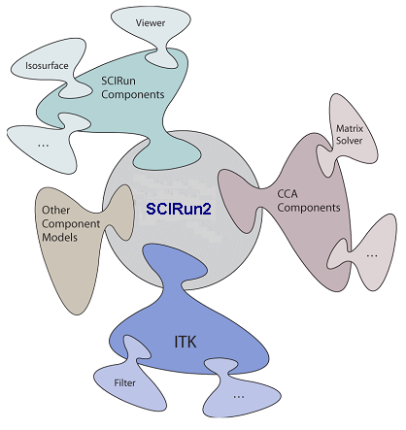
SCIRun2 Meta-Component Model
In the same way that components plug into a CCA framework, component models (such as CCA) plug into SCIRun2
Allows components of several different families to be used together
Currently supports: CCA (Babel), SCIRun Dataflow, Visualization Toolkit (Vtk); others coming…
Bridging between components of different models is semi-automatic; current research is defining a more automatic form of bridging

Slide 80
LegionCCA
Legion is a collection of software services for the Grid
  Provides illusion of a virtual machine for geographically-distributed resources
LegionCCA: models CCA components as Legion objects
Component Communication
  Uses Legion’s built-in RPC mechanisms, based on Unix sockets
ComponentID: based on Legion LOID
  LOID: globally unique object id
Component Connections:
  Information distributed across components
  Tables can be dynamically updated as connections are made and broken

Slide 81
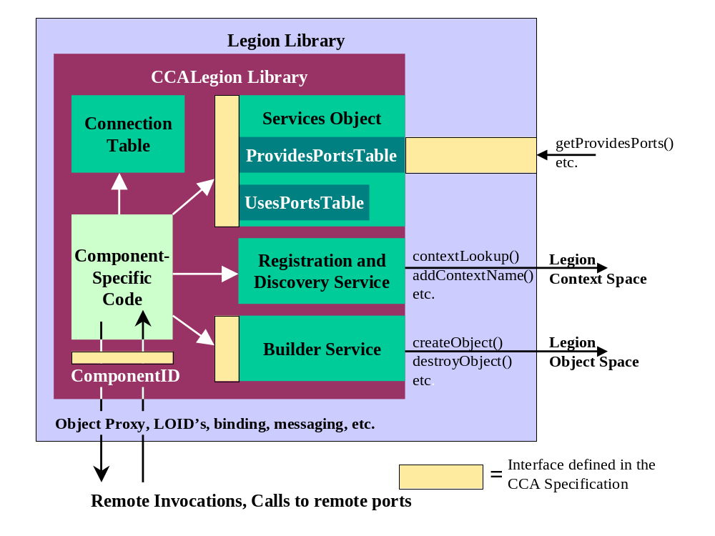
Anatomy of a LegionCCA Component

Slide 82
XCAT-Java
Uses XSOAP for remote invocations
  XSOAP: implementation of the SOAP protocol from Indiana University
  ComponentID: uses the XSOAP remote reference
    An XML document that has a subset of WSDL features
Remote and Local Access to CCA functions
  Services object implements different interfaces for local and remote calls
Component Connections
  Uses an event mechanism to propagate connection information
Builder Service
  Each component has a builder service
  Creation can currently be done via GRAM or ssh
    GRAM: Grid Resource Allocation and Management

Slide 83
XCAT-C++
Remote Method Invocation
  Uses the Proteus multi-protocol library for remote communication
    Proteus supports both messaging and RMI models
    Currently supports two protocols: binary and SOAP
  Stub-Skeleton generation is based on WSDLPull
    A toolkit for parsing WSDL (Web Service Description Language)
  Support for SIDL will be provided via BabelRMI
    BabelRMI: Currently in the research phase
Remote creation of distributed components
  Each component has a BuilderService
  Creation can be based on GRAM or ssh

Slide 84
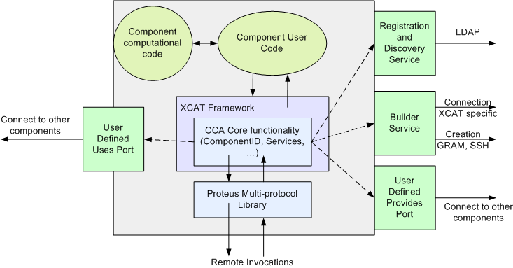
Architecture of an XCAT-C++ Component
Notes:
All ports (registration and discovery, builder service and others) reside within the XCAT framework. However they appear to the users as the interface to the component. The dotted lines are used to indicate this aspect of the components.

Slide 85
Proteus: Multi-Protocol Library
One protocol does not suit all applications
Proteus provides single-protocol abstraction to components
  Allows users to dynamically switch between protocols
    Example: RMI A and RMI B, in the picture
  Facilitates use of specialized implementations of serialization and deserialization
CCA Framework
Proteus API
Protocol 1
Protocol 2
TCP
Myrinet

Slide 86
Babel RMI
Research!
Allows Babel objects to be accessed through remote Babel stubs.
Underlying RMI uses Proteus.
Objects that can be transmitted (serializable) inherent from Serializable.
Actual implementation of serialization functions is by users, since only they know what needs to be serialized.

Slide 87
CCA Applications

Slide 88
Modern Scientific Software Development
Complex codes, often coupling multiple types of physics, time or length scales, involving a broad range of computational and numerical techniques
Different parts of the code require significantly different expertise to write (well)
Generally written
by teams rather
than individuals
Time Evolution
Physics Modules
Mesh
Adaptive Solution
Optimization
Diagnostics
Discretization
Steering
Derivative Computation
Algebraic Solvers
Visualization
Data Reduction
Collaboration
Data Redistribution
Notes:
Physics simulations are becoming increasingly complex and involve a large number of different sophisticated tools ranging from structured and unstructured (potentially adaptive) grids, high order discretization techniques, algebraic solvers and optimization methods, as well as advanced visualization capabilities and computational steering tools. There has been a great deal of work in each of these areas to develop state of the art techniques but it is often difficult for application scientists to take advantage of the latest and greatest
- the software is too hard to use
- it’s difficult to compose applications from tools developed by different groups
Thus, the potential for high fidelity calculations on high performance computers using such techniques will become a reality only if the application scientist can take advantage of the of tools being developed by domain experts.

Slide 89
Overview
Examples (scientific) of increasing complexity
  Laplace equation
  Time-dependent heat equation
  Nonlinear reaction-diffusion system
  Quantum chemistry
  Climate simulation
Tools
  MxN parallel data redistribution
  Performance measurement, modeling and scalability studies
Community efforts & interface development
  TSTT Mesh Interface effort
  CCTTSS’s Data Object Interface effort
Notes:
To highlight how components can be useful in this scenario I will show a series of examples of increasing complexity that highlight component reuse and composability. I will start with a simple steady state PDE and move to a time-dependent PDE and from there to block structured adaptive time dependent PDEs. We will also show the use of several of the same components used in the PDE simulations in optimization-based applications.
I will give single processor performance results and scalability results for distributed memory applications. These results show that if you choose the level of granularity for your components appropriately there is very little performance impact.
Finally, based on our experiences to date, I will discuss strategies for developing your own component-based high performance simulation code. In addition, I will give a case study that highlights some of the issues associated with developing interchangeable and interoperable components in a domain-specific setting through the development of common interfaces.

Slide 90
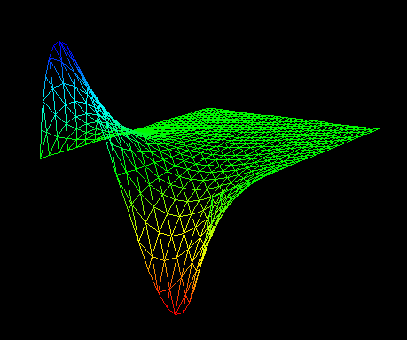
Laplace Equation
∇²ϕ (x,y) = 0 ∈ [0,1] x [0,1]
ϕ(0,y)=0 ϕ(1,y)=sin (2πy)
δϕ/δy(x,0) = δϕ/δy(x,1) = 0
Physics Modules
Mesh
Discretization
Visualization
Algebraic Solvers
Notes:
We start with a simple steady state PDE that solves Poisson’s equation on the unit square with a sine dirichlet boundary condition on the boundary x=1 and Neumann conditions on the upper and lower boundaries. The solution is shown in the lower figure.
This example uses a few of the application components highlighted on the first slide– namely a physics model to capture the PDE of interest, a grid or mesh module, a discretization module, an algebraic solvers module and visualization capabilities. Although this is a very simple example it captures many of the basic components used in real high-performance computing simulations and is an excellent starting point for the development of more sophisticated applications that will reuse pieces of this application (for example the algebraic solvers).

Slide 91
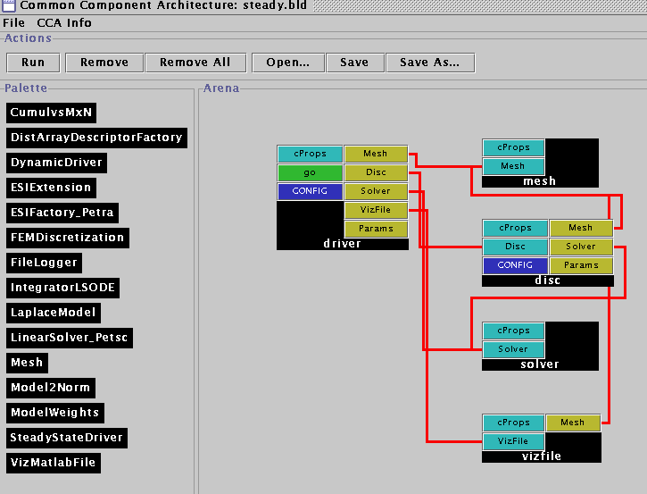
Laplace Equation with Components
The Driver Component
  Responsible for the overall application flow
  Initializes the mesh, discretization, solver and visualization components
  Sets the physics parameters and boundary condition information
Notes:
In the component version of this application we have five components: a driver, mesh, discretization, solver, and visualization component. And we’ll quickly go through the responsibilities of each in this simple application.
The driver is responsible for the overall flow of the application and initializes each of the other components. It is also responsible for setting the various physics parameters and boundary conditions. We note that the driver is the only place where this is done so a new physics application would require a small change to the driver.
We could also have written this application to have a generic driver and a 6th very small component whose only job it would be is to set the physics/mathematical model (which operators are used, what are their coefficients) parameters and boundary conditions on the discretization component.

Slide 92
Laplace Equation with Components
The Driver Component
  Responsible for the overall application flow
  Initializes the mesh, discretization, solver and visualization components
  Sets the physics parameters and boundary condition information
The Mesh Component
  Provides geometry, topology, and boundary information
  Provides the ability to attach user defined data as tags to mesh entities
  Is used by the driver, discretization and visualization components
Notes:
As mentioned earlier, the mesh component provides the geometry, topology and boundary information for the application. This particular component is based on the triangle package developed by Jonathon Shewchuck. It is initialized by reading a file specified by the driver that contains the mesh information. It uses the attribute information provided by the Triangle format to determine which vertices are on boundaries and it stores this information in a pre-defined tag called “boundary” which can be later accessed by the discretization component.
It also provides the ability to attach arbitrarily-sized user defined data to the mesh and to each of the mesh entities. We use this capability to attach a scalar field representing phi to the mesh vertices.
The mesh component is used by the driver, discretization and visualization components. The mesh component does not use the functionality of any other components.

Slide 93
Laplace Equation with Components
The Driver Component
  Responsible for the overall application flow
  Initializes the mesh, discretization, solver and visualization components
  Sets the physics parameters and boundary condition information
The Mesh Component
  Provides geometry and topology information
  Provides the ability to attach user defined data to mesh entities
  Is used by the driver, discretization and visualization components
The Discretization Component
  Provides a finite element discretization of basic operators (gradient, Laplacian, scalar terms)
  Driver determines which terms are included and their coefficients
  BC, Assembly etc
Notes:
The discretization component is the glue that holds this example together. It provides a finite element discretization of basic operators such as laplacian, gradient, and scalar terms as well as the manipulations needed to implement dirichlet and Neumann boundary conditions in the stiffness matrix. To solve a particular physics problem, it accepts input from the driver pertaining to which operators are used in the example and what their coefficients are.
It also is responsible for gathering and scattering scalar data from the mesh into a vector. It does this by creating and storing a map between the unique global integer id’s of the vertices of the mesh and the corresponding position of the scalar data in the vector (0 to N-1).
This map is also used to assemble the computed element matrices for each mesh region (element) into a global stiffness matrix by using the Set command on the opaque matrix object provided by the solver.

Slide 94
Laplace Equation with Components
The Driver Component
  Responsible for the overall application flow
  Initializes the mesh, discretization, solver and visualization components
  Sets the physics parameters and boundary condition information
The Mesh Component
  Provides geometry and topology information
  Provides the ability to attach user defined data to mesh entities
  Is used by the driver, discretization and visualization components
The Discretization Component
  Provides a finite element discretization of basic operators (gradient, laplacian, scalar terms)
  Provides mechanisms for general Dirichlet and Neumann boundary condition manipulations
The Solver Component
  Provides access to vector and matrix operations (e.g., create, destroy, get, set)
  Provides a “solve” functionality for a linear operator
Notes:
The solver component is based on the PETSc library and provided access to vector and matrix operations. For example, the user of this component can create, destroy, duplicate, copy vectors and matrices as well as set the values of their entries. It also provides a simple solve functionality that uses GMRES for the linear system solution.
Note that only a small subset of the functionality provided by PETSc is available as a CCA component in this example (just enough to make the example work). More work is underway to extend the functionality by PETSc in component form.

Slide 95
Laplace Equation with Components
The Driver Component
  Responsible for the overall application flow
  Initializes the mesh, discretization, solver and visualization components
  Sets the physics parameters and boundary condition information
The Mesh Component
  Provides geometry and topology information
  Provides the ability to attach user defined data to mesh entities
  Is used by the driver, discretization and visualization components
The Discretization Component
  Provides a finite element discretization of basic operators (gradient, laplacian, scalar terms)
  Provides mechanisms for general Dirichlet and Neumann boundary condition manipulations
  Computes element matrices and assembles them into the global stiffness matrix via set methods on the solver
  Gathers and scatters vectors to the mesh (in this case ϕ)
The Solver Component
  Provides access to vector and matrix operations (e.g., create, destroy, get, set)
  Provides a “solve” functionality for a linear operator
The Visualization Component
  Uses the mesh component to print a vtk file of ϕ on the unstructured triangular mesh
  Assumes user data is attached to mesh vertex entities
Notes:
The final component is a visualization component that accesses the mesh geometry and topology information, along with the scalar field phi, to write this information in vtk format to a file specified by the user. More sophisticated, interactive visualization capabilities are highlighted in the next example.

Slide 96
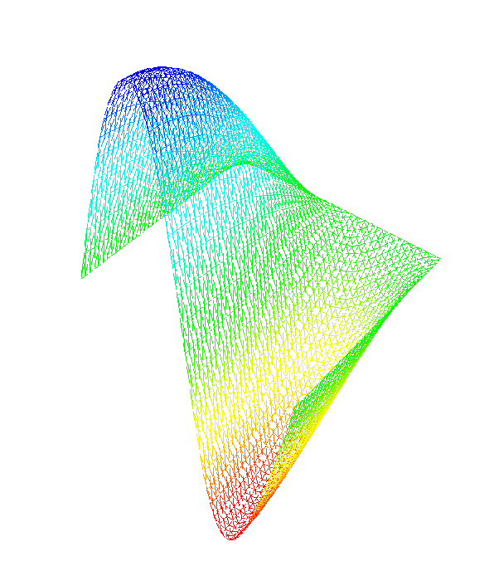
Time-Dependent Heat Equation
δϕ/δt = ∇²ϕ (x,y,t) ∈ [0,1] x [0,1]
ϕ(0,y,t)=0 ϕ(1,y,t)=.5sin(2πy)cos(t/2)
δϕ/δy(x,0) = δϕ/δy(x,1) = 0
ϕ(x,y,0)=sin(.5πx) sin (2πy)
Time Evolution
Physics Modules
Mesh
Discretization
Visualization
Algebraic Solvers
Distributed Arrays
Data Redistribution
Notes:
The next step we take in the evolution of our complex application example is to add time dependence. We are now solving the heat equation with a sinusoidal, time evolving boundary condition on the left boundary, and the same 0 dirichlet condition on the right boundary and Neumann boundary conditions on the top and bottom. The initial condition is chosen to be sinusoidal in the entire domain and consistent with the left boundary condition at time t=0.
We are also going to add an interactive visualization component that displays the results of the computation at each time step. This example also highlights the use of a data redistribution component that can take the data from M processors of a parallel computer to N processors of a parallel computer. In this case both M and N are equal to 1 – it is used here to accommodate the new visualization component that we are using (based on a AVS viewer developed originally to work with the CUMULVS library at ORNL). In particular, this visualization component assumes that data is coming in from a parallel computer via the MxN redistribution component.

Slide 97
Some things change…
Requires a time integration component
  Based on the LSODE library
Uses a new visualization component
  Based on AVS
  Requires an MxN data redistribution component
The MxN redistribution component requires a Distributed Array Descriptor component
  Similar to HPF arrays
The driver component changes to accommodate the new physics
Notes:
This more sophisticated example requires some changes to what we were doing previously.. Mostly in the form of additions to the components used
First and most importantly, this application requires the use of an integration component. The one we are using is based on the LSODE library developed at LLNL. The actual component was created by Ben Allan at SNL and is a good example of the use of creating a component by wrapping the functionality of a Fortran-based library with C++ wrappers.
We are also using a new visualization component. This component is based on AVS and expects information to be sent to it via an MxN data redistribution component (It is designed to visualize the results of a parallel simulation code). In this case M=N=1.
The use of the data redistribution component in turn required the use of a Distributed Array component. This component is similar to HPF arrays and was developed by David Bernholdt at ORNL.
We also note that we’re no longer using the linear solvers provided as part of the PETSc-based solver component. We are however still using the vectors as input to the time integration component.

Slide 98
… and some things stay the same
The mesh component doesn’t change
The discretization component doesn’t change
The solver component doesn’t change
  What we use from the solver component changes
  Only vectors are needed
Notes:
We are able to reuse three out of five of our previous components without changing them. In particular, the mesh, discretization, and solver components can be reused, without even recompiling them!
We may change what we use from a given component, for example, the solver component is no longer required to provide the solution to a linear system, but we still use the vector implementations provided.
We could have chosen to reuse the visualization component as well to print out a series of files, but interactive visualization with the time dependent physics is more interesting.

Slide 99
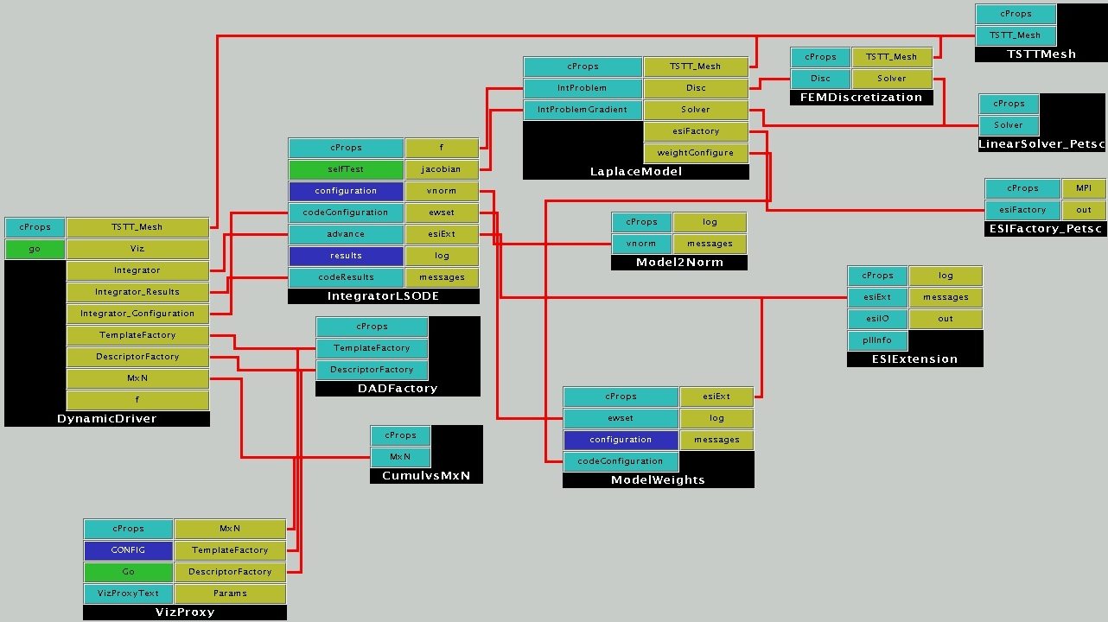
Heat Equation Wiring Diagram
Reused
Integration
Visualization
Driver/Physics
Notes:
As you can see, this is a significantly more complicated application. The driver is again in control of the overall flow of the application and accesses the mesh, visualization, integration, and data redistribution components.
(Press space bar highlight yellow circle) Even though this is a significantly more complicated application we can reuse many of our earlier components including discretization, mesh, and solver components. For the solver component, we have our choice of either a PETSc-based or Trillinos implementation of the Equation Solver Interface(ESI) for the ESI vectors needed in the integration component.
(Press space bar to highlight light blue circles) The integration component is separated into three pieces – the main integration component which contains the LSODE algorithms and application specific portions (the Model2Norm component and the model weights component) that can be used to customize the component for a given application without changing the main component.
(Press space bar to highlight dark blue circles) In this case, the physics has been separated from the driver and is represented in the LaplaceModel component which connects to the discretization, mesh, and solver components.
(press space bar to highlight green circles) The DADFactory and Cumulvs components provide the distributed array and data redistribution functionalities respectively for use in the visualization component.

Slide 100
What did this exercise teach us?
Easy to incorporate the functionalities of components developed at other labs and institutions given a well-defined interface.
  In fact, some components (one uses and one provides) were developed simultaneously across the country from each other after the definition of a header file.
  Amazingly enough, they usually “just worked” when linked together (and debugged individually).
In this case, the complexity of the component-based approach was higher than the original code complexity.
  Partially due to the simplicity of this example
  Partially due to the limitations of the some of the current implementations of components
Notes:
What did we learn? That it really did just work for the most part for this application example. In fact, most of the application was developed at ANL (discretization, mesh, physics) and the supporting components were developed at a number of different DOE labs (LSODE at SNL, Vis and data redistribution components at ORNL). We worked on our various components just before supercomputing of 01 with only a header file specification determined (in particular the visualization of unstructured meshes was not available until just a few days before the show). When we assembled the components into an application it all worked well together (barring individual bugs in the component implementations). Well defined interfaces are key!
However, in this case the complexity of the application code was higher than that of the original code. This is due to two reasons primarily. First, this application was extremely simple and didn’t really exercise the full functionality of most of the components. Second, some of the component implementations are limited at this time. In particular, the fact that the MxN data redistribution component only works with distributed arrays added an extra layer of data translation for the visualization process that was not needed in the original code.

Slide 101
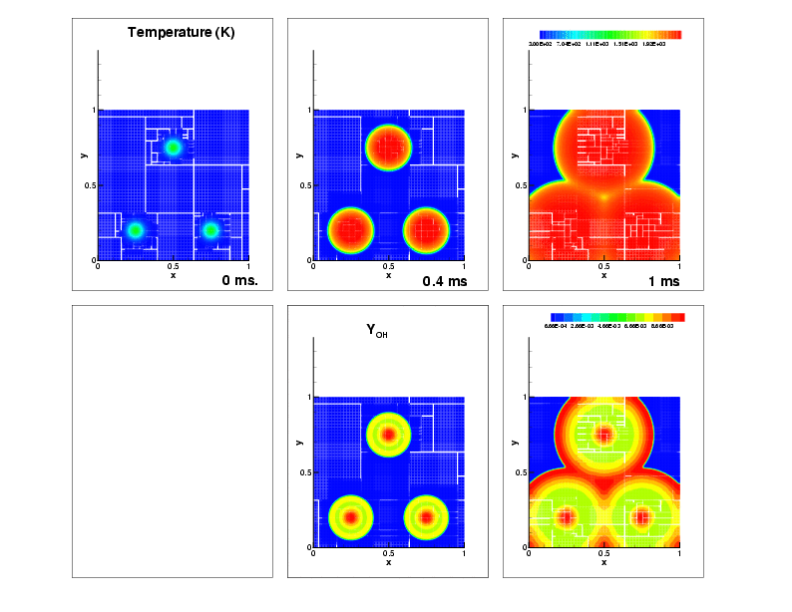
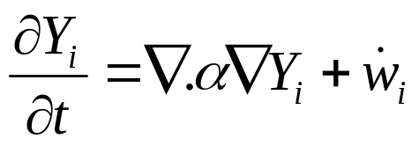
Nonlinear Reaction-Diffusion Equation
Flame Approximation
  H₂-Air mixture; ignition via 3 hot-spots
  9-species, 19 reactions, stiff chemistry
Governing equation
Domain
  1cm X 1cm domain
  100x100 coarse mesh
  finest mesh = 12.5 micron.
Timescales
  O(10ns) to O(10 microseconds)
Notes:
We now highlight two more complex applications that have been developed with component technologies. The first is a reaction diffusion problem that a chemically reacting flame front. The domain consists of a 1 cm x 1 cm area with a H2-Air mixture. The initial condition contains three spots of high temperature. As time progresses, the mixture ignites and we use the adaptive mesh code just described to help model the evolving process.
Apart from H₂, O₂ and N₂, the mechanism contains intermediate species H, O, OH, HO₂, H₂O₂ and H₂, undergoing 19 reversible reactions.
The governing eqn is given. Note that there is both a diffusive term and a chemistry function. The chemistry terms result in stiff ODEs which can be difficult to model.
The timescales that are relevant in this simulation range from10ns – 10 microseconds

Slide 102
Numerical Solution
Adaptive Mesh Refinement: GrACE
Stiff integrator: CVODE
Diffusive integrator: 2nd Order Runge Kutta
Chemical Rates: legacy f77 code
Diffusion Coefficients: legacy f77 code
New code less than 10%
Notes:
The numerical solution of this application uses the same adaptive mesh refinement library as before: GrACE. The integrator has changed to LLNL’s CVODE library to handle the stiff ODE’s associated with the chemical reactions. The calculation of the chemical rates and diffusion coefficients are based on legacy f77 code from SNL Livermore. The new code required for this application (wrappers, statistics, the driver) was quite small, less than 10%.

Slide 103
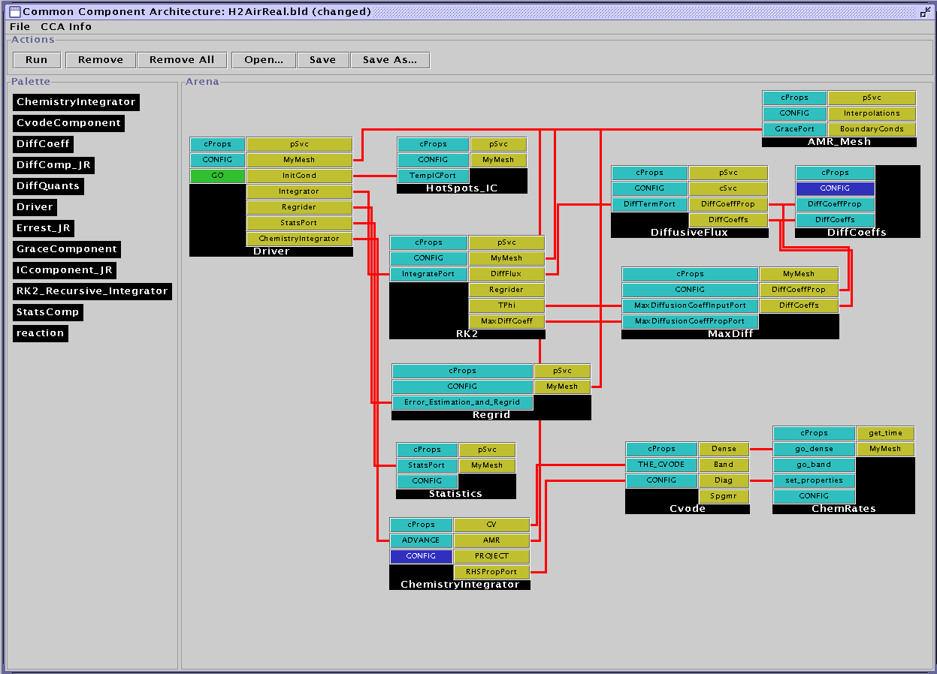
Reaction-Diffusion Wiring Diagram
Reused
Slow Time Scale Integration
Fast Time Scale Integration
Driver/Physics
Notes:
Here is the wiring diagram for this reaction diffusion example.
(Space bar for yellow circle) The only component explicitly reused from the simple heat equation is the AMR mesh component.
(Space bar for blue circles)Note there is still a driver that controls the flow of the application and an initial condition component that are similar to those used in the previous example.
The major change is in the integration algorithm.
(space bar for purple circles) There are the slow-timescale diffusive physics components which consist of diffusive coefficients, a diffusive flux and a runge-kutta integrator. There are two main ways of advancing this part of the simulation in time based primarily on how you compute the diffusive coefficients. In this example we’re using Lennard-Jones potentials, but if you wanted to replace this with another model (say a curve fitting algorithm) it is easy to do in a component framework. If the interfaces stay the same, you simply point the application to the new component in the repository and rerun. The switch takes just moments.
(space bar for pink circles) There is also a fast-timescale integrator for the chemical physics which includes the CVODE library and a computation of the chemical rates.

Slide 104
Evolution of the Solution
Temperature
No OH at t = 0
OH Profile
Notes:
On the top row we show the evolution of the temperature field. We start with three hotspots which ignite and expand until the ignition fronts meet. The red region is the high temperature hot-products behind the fronts
On the bottom row we show the OH profiles. Typically the profile is high immediately behind the fronts; further behind the fronts them, OH reacts away to form H₂0.
The thick OH structures are big enough for a 100 x 100 mesh – so why mesh refinement ?

Slide 105
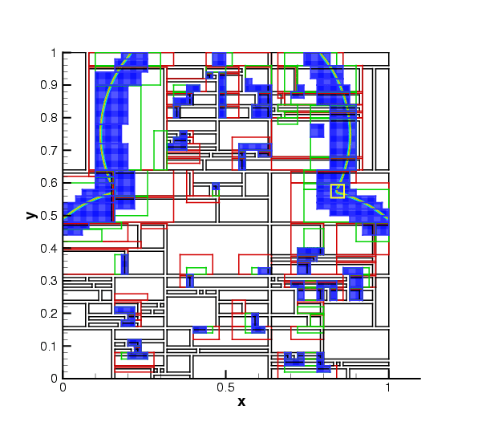
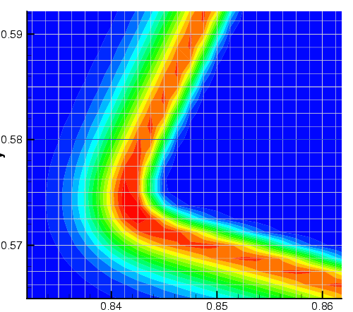
The need for AMR
H₂O₂ chemical subspecies profile
  Only 100 microns thick (about 10 fine level cells)
  Not resolvable on coarsest mesh
Notes:
Shows you the domain and the H₂O₂ profiles. The coarse mesh has been divided into patches (black outlines) and distributed to 30 procs. Sections of the black patches have been refined into green, green into red and red into blue patches where the field has been colored. A zoom into the yellow box shows the structure – the H₂O₂ profiles are around 10 cells wide on the finest mesh ~ 100 microns
The entire structure is contained inside 1 coarse cell – we managed to track and resolve it.

Slide 106
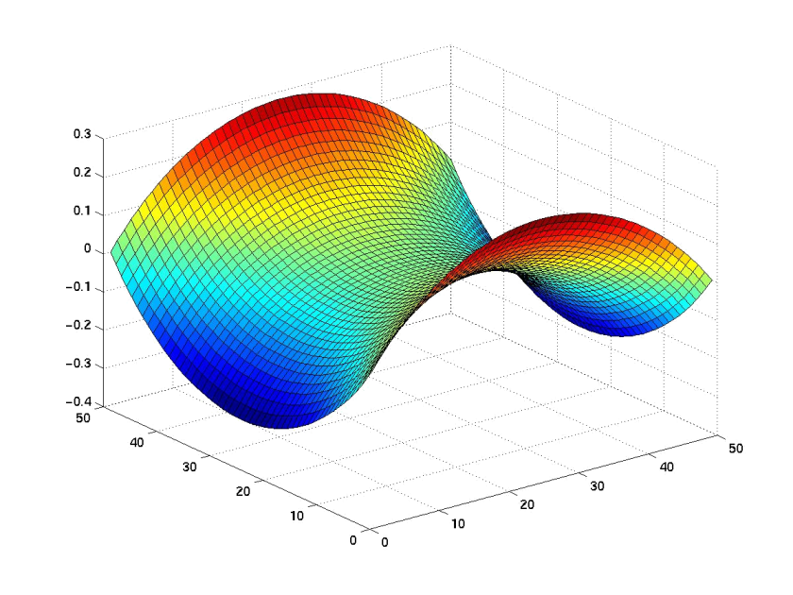
Unconstrained Minimization Problem
Given a rectangular 2-dimensional domain and boundary values along the edges of the domain
Find the surface with minimal area that satisfies the boundary conditions, i.e., compute
min f(x), where f: R → R
Solve using optimization components based on TAO (ANL)
Notes:
Our final application is an unconstrained minimization problem. Given a rectangular 2-D domain and boundary values on the edge of the domain, our goal is to find the surface with the minimum area that satisfies the boundary conditions. That is, we need to compute the minimum of a function f(x) using optimization algorithms. In this case, we’ll use the solvers provided by the Toolkit for Advanced Optimization (TAO) developed at ANL.

Slide 107
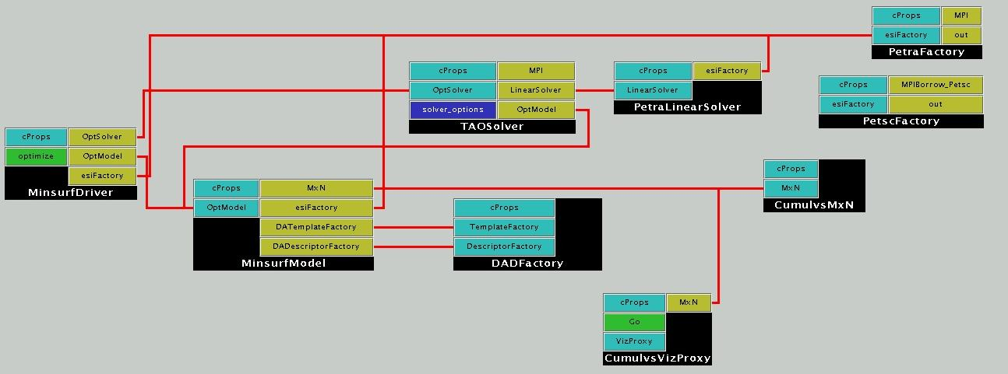
Unconstrained Minimization Using a Structured Mesh
Reused
TAO Solver
Driver/Physics
Notes:
The solution to this optimization problem (although it is very different than the solution of PDEs) still uses many of the same components as before. In particular, solver, distributed arrays, mxn redistribution, and visualization components are all reused (press the space bar to highlight the yellow circles)
The structure is also similar to what we’ve seen earlier. There are two application-specific components– the driver and the min surf model that would need to be altered to run a new application. (press the space bar to highlight the dark blue circles)
The new component in this case is the Tao solver component which is based on the TAO (Toolkit for Advanced Optimization) out of Argonne. (press the space bar to highlight the purple circle)

Slide 108
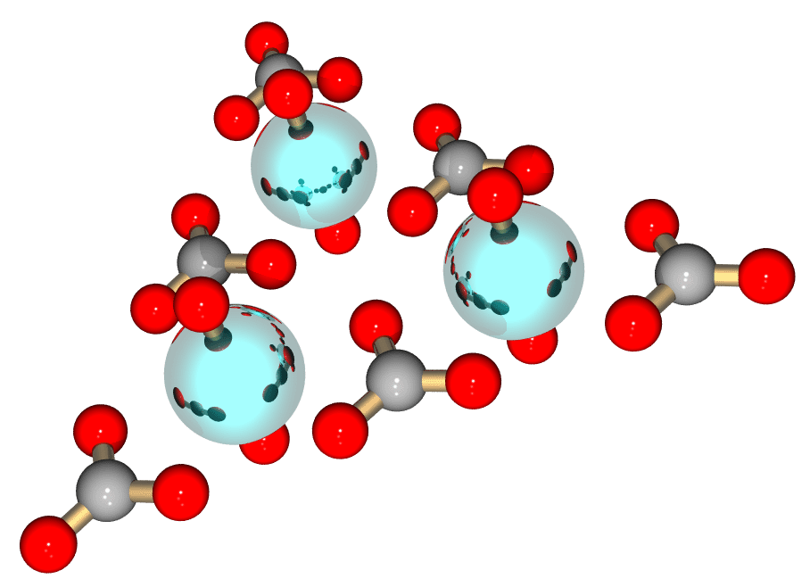
Computational Chemistry:
Molecular Optimization
Investigators: Yuri Alexeev (PNNL), Steve Benson (ANL), Curtis Janssen (SNL), Joe Kenny (SNL), Manoj Krishnan (PNNL), Lois McInnes (ANL), Jarek Nieplocha (PNNL), Jason Sarich (ANL), Theresa Windus (PNNL)
Goals: Demonstrate interoperability among software packages, develop experience with large existing code bases, seed interest in chemistry domain
Problem Domain: Optimization of molecular structures using quantum chemical methods

Slide 109
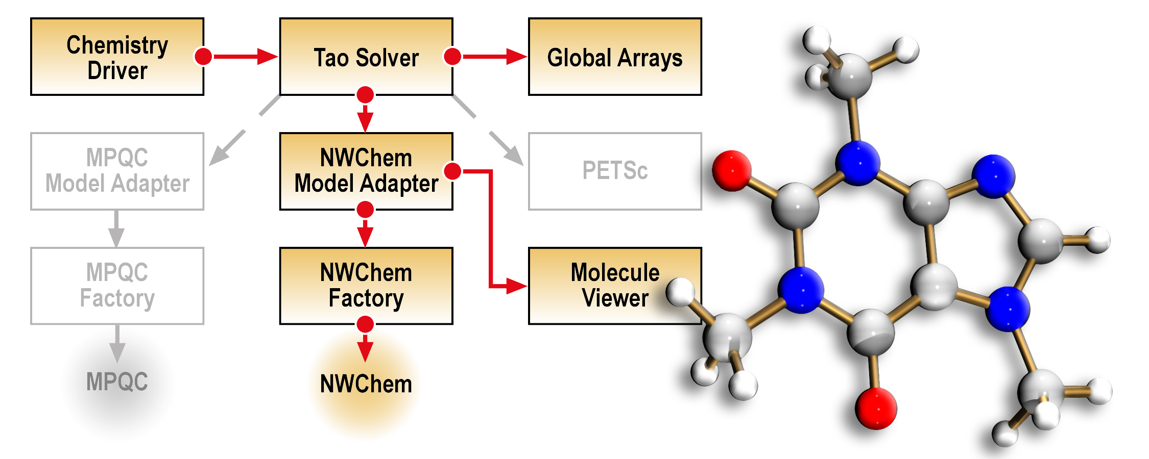
Molecular Optimization Overview
Decouple geometry optimization from electronic structure
Demonstrate interoperability of electronic structure components
Build towards more challenging optimization problems, e.g., protein/ligand binding studies
Components in gray can be swapped in to create new applications with different capabilities.

Slide 110
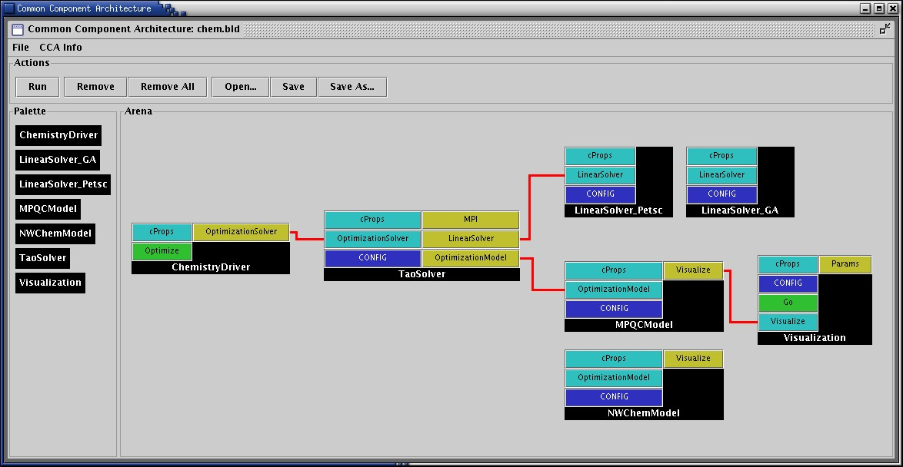
Wiring Diagram for Molecular Optimization
Electronic structures components:
  MPQC (SNL)
  http://aros.ca.sandia.gov/~cljanss/mpqc
  NWChem (PNNL)
  http://www.emsl.pnl.gov/pub/docs/nwchem
Optimization components: TAO (ANL) http://www.mcs.anl.gov/tao
Linear algebra components:
  Global Arrays (PNNL) http://www.emsl.pnl.gov:2080/docs/global/ga.html
  PETSc (ANL)
  http://www.mcs.anl.gov/petsc

Slide 111
Actual Improvements
Molecule | NWChem | NWChem/TAO | MPQC | MPQC/TAO
Glycine | 33 | 19 | 26 | 19
Isoprene | 56 | 45 | 75 | 43
Phosposerine | 79 | 67 | 85 | 62
Aspirin | 43 | 51 | 54 | 48
Cholesterol | 33 | 30 | 27 | 30
Function and gradient evaluations

Slide 112
Componentized Climate Simulations
NASA’s ESMF project has a component-based design for Earth system simulations
  ESMF components can be assembled and run in CCA compliant frameworks such as Ccaffeine.
Zhou et al (NASA Goddard) has integrated a simple coupled Atmosphere-Ocean model into Ccaffeine and is working on the Cane-Zebiak model, well-known for predicting El Nino events.
Different PDEs for ocean and atmosphere, different grids and time-stepped at different rates.
  Synchronization at ocean-atmosphere interface; essentially, interpolations between meshes
  Ocean & atmosphere advanced in sequence
Intuitively : Ocean, Atmosphere and 2 coupler components
  2 couplers : atm-ocean coupler and ocean-atm coupler.
  Also a Driver / orchestrator component.
Notes:
NASA has a component framework called ESMF. It provides a superstructure to orchestrate the sequence of solution (numerical algo) and an infrastructure that supplies math tools (discretizations, interpolations etc) and the “components” (physical and mathematical models) are sandwiched in-between, using the infrastructure and being used by the superstructure. So can these physical and math models be components in the CCA world ?
So Zhou and gang set off to implement a simple ocean-atmosphere coupled model – the Cane-Zebiak model; looks
Like the shallow water equations. Very simple problem decomposition – an Atmosphere component (with multiple initial conditions and atmosphere models in one place), an ocean component (multiple initial conditions and models in one place; the user chooses which one to run) and components that interpolate between the coarse atmosphere mesh and fine ocean mesh. The PDEs that describe the ocean and atmosphere are different and solved differently – they are also
Time-stepped independently. In a given global timestep, the atmosphere and ocean are iterated to a consistent state, before advancing to the next timestep.

Slide 113
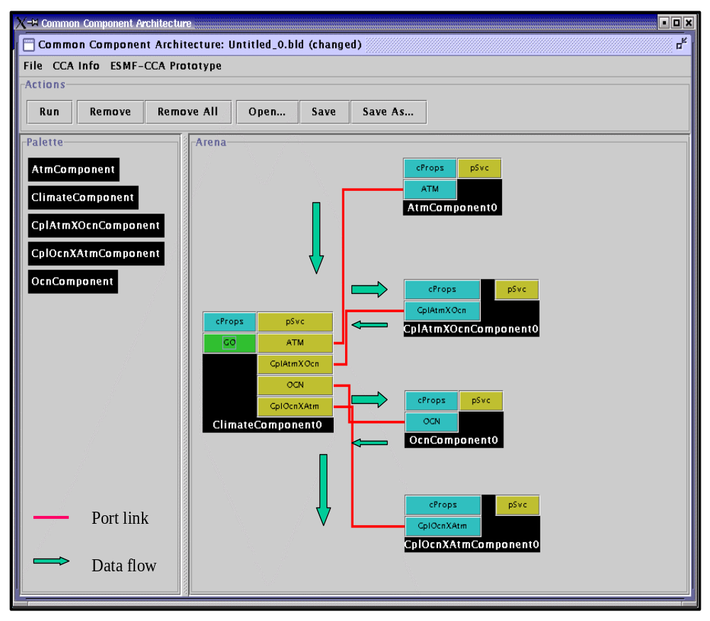
Coupled Atmosphere-Ocean Model Assembly
Climate Component :
  Schedule component coupling
Data flow is via pointer NOT data copy.
  All components in C++; run in CCAFFEINE.
Multiple ocean models with the same interface
  Can be selected by a user at runtime
Notes:
So here is the CCA wiring diagram. Driver / ClimateComponent on the left. Contains the iterate-till-consistent-algorithm, also counts global timesteps. It calls on the atmosphere, atmosphere-to-ocean coupler, the ocean and then ocean-to-atmosphere coupler in sequence. In each call to ocean or atmosphere, the relevant PDEs are time-stepped at the relevant rate.
The ClimateComponent “flows” the data from component to component, but not by copy.
The ocean component has multiple initial conditions and models built – the user chooses which one to run at runtime.
Zhou and gang are looking at Cumulvs (ORNL) to do runtime viz.

Slide 114
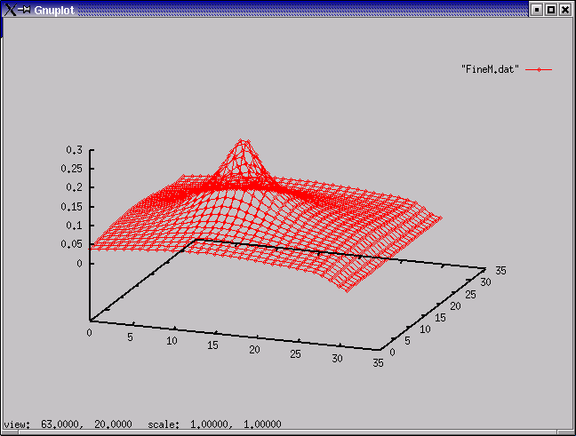
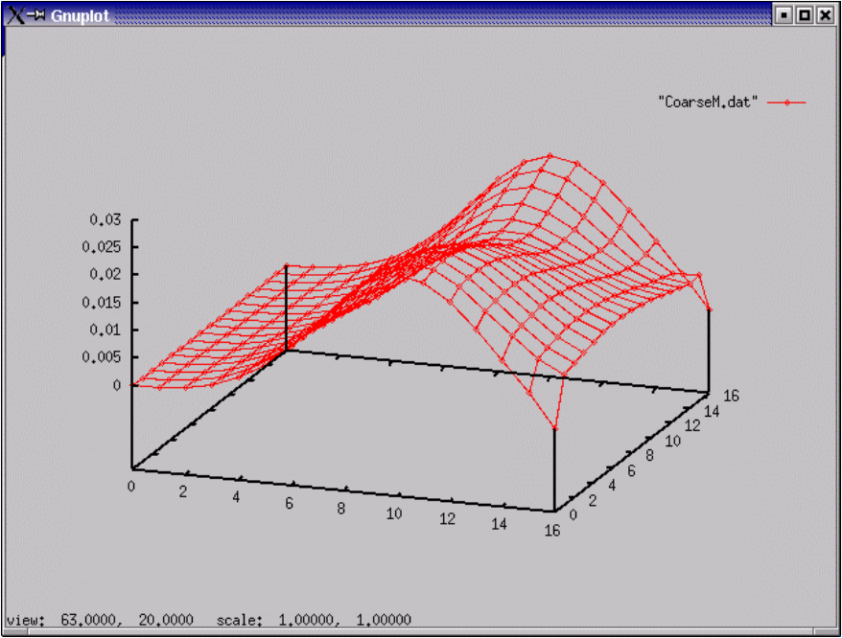
Simulation Results
…changes a field variable (e.g.,wind) in the atmosphere !
A non-uniform ocean field variable (e.g., current)
Notes:
OK, so does it work ?
Left, the velocity field of the atmosphere near the ocean-atmosphere interface. Variation in velocity (there are parts with zero velocity) indicates a wind. This causes shear stress on the water surface, exerting a force and ……….
………on the right, it induces a velocity field in the ocean, also near the ocean-atmosphere interface. Generally, this is referred to as a wave.
The thing works.

Slide 115
Concurrency At Multiple Granularities
Certain simulations need multi-granular concurrency
  Multiple Component Multiple Data, multi-model runs
Usage Scenarios:
  Model coupling (e.g. Atmosphere/Ocean)
  General multi-physics applications
  Software licensing issues
Approaches
  Run single parallel framework
    Driver component that partitions processes and builds rest of application as appropriate (through BuilderService)
  Run multiple parallel frameworks
    Link through specialized communications components (e.g. MxN)
    Link as components (through AbstractFramework service; highly experimental at present)
Driver
Atmosphere
Ocean
Land
Coupler (MxN)

Slide 116
Componentizing your own application
The key step: think about the decomposition strategy
  By physics module?
  Along numerical solver functionality?
  Are there tools that already exist for certain pieces? (solvers, integrators, meshes?)
  Are there common interfaces that already exist for certain pieces?
  Be mindful of the level of granularity
Decouple the application into pieces
  Can be a painful, time-consuming process
Incorporate CCA-compliance
Compose your new component application
Enjoy!
Notes:
If you are thinking about componentizing your own application, the key step is the strategy for decomposing the existing application. Will you decompose by physics module (for example, hydrodynamics, EOS, radiation transport, etc) or by numerical method (integrators, solvers, visualization tools, etc) or both.
You should determine if there are tools/components already available for aspects of your solution process, and, in particular, if they already have a well-defined interface that you might want to conform to to take advantage of their functionality.
In the decomposition strategy, you must be mindful of the granularity of your components. They must be big enough that the overhead of the virtual function calls is negligible compared to the body of the component.
Once you have your decomposition strategy, the next step is implementing it which can be a very time-consuming and painful process. For example, the FLASH center at UofChicago did this for their mesh and it took several months to separate the physics modules and solvers from the mesh data structures.
After that it’s easy.. Just add the code to make the pieces CCA-compliant which is usually a straightforward process (setServices, etc), compose the application, and enjoy.

Slide 117
Overview
Examples (scientific) of increasing complexity
  Laplace equation
  Time-dependent heat equation
  Nonlinear reaction-diffusion system
  Quantum chemistry
  Climate simulation
Tools
  MxN parallel data redistribution
  Performance measurement, modeling and scalability studies
Community efforts & interface development
  TSTT Mesh Interface effort
  CCTTSS’s Data Object Interface effort
Notes:
To highlight how components can be useful in this scenario I will show a series of examples of increasing complexity that highlight component reuse and composability. I will start with a simple steady state PDE and move to a time-dependent PDE and from there to block structured adaptive time dependent PDEs. We will also show the use of several of the same components used in the PDE simulations in optimization-based applications.
I will give single processor performance results and scalability results for distributed memory applications. These results show that if you choose the level of granularity for your components appropriately there is very little performance impact.
Finally, based on our experiences to date, I will discuss strategies for developing your own component-based high performance simulation code. In addition, I will give a case study that highlights some of the issues associated with developing interchangeable and interoperable components in a domain-specific setting through the development of common interfaces.

Slide 118
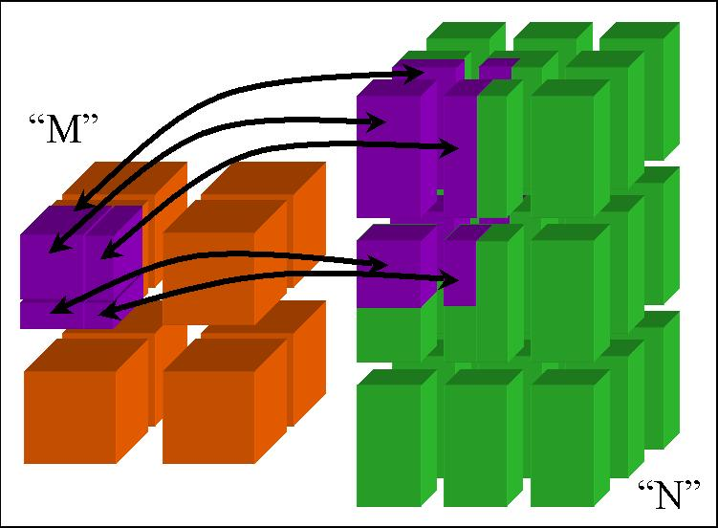
CCA Concepts:
MxN Parallel Data Redistribution
Share Data Among Coupled Parallel Models
  Disparate Parallel Topologies (M processes vs. N)
  e.g. Ocean & Atmosphere, Solver & Optimizer…
  e.g. Visualization (Mx1, increasingly, MxN)
Research area -- tools under development

Slide 119
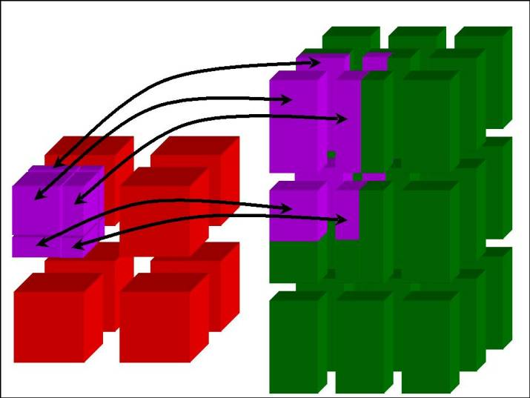
“MxN” Parallel Data Redistribution:
The Problem…
Create complex scientific simulations by coupling together multiple parallel component models
  Share data on “M” processors with data on “N”
    M != N ~ Distinct Resources (Pronounced “M by N”)
  Model coupling, e.g., climate, solver / optimizer
  Collecting data for visualization
    Mx1; increasingly MxN (parallel rendering clusters)
Define “standard” interface
  Fundamental operations for any parallel data coupler
    Full range of synchronization and communication options
Notes:
The most interesting case of “MxN” parallel data redistribution is clearly when “M” is not equal to “N”.
This happens often in scientific model coupling, e.g. in climate simulations, or for visualization where the
case is typically “M by 1”. But this technology could also be useful for more complex component applications
where a solver and optimizer components must share parallel data, whether within the same framework
or spanning multiple frameworks.
The goal of this initial “MxN” effort is to provide a generalized interface that describes all the fundamental
operations supported by any parallel data coupler, including a spectrum of synchronization and communication
options.

Slide 120
Hierarchical MxN Approach
Basic MxN Parallel Data Exchange
  Component implementation
  Initial prototypes based on CUMULVS & PAWS
    Interface generalizes features of both
Higher-Level Coupling Functions
  Time & grid (spatial) interpolation, flux conservation
  Units conversions…
“Automatic” MxN Service via Framework
  Implicit in method invocations, “parallel RMI”
http://www.csm.ornl.gov/cca/mxn/
Notes:
The current MxN interface generalizes the protocols and functions in the CUMULVS (ORNL) and PAWS (LANL)
systems, and also encompasses much of the capabilities in systems like the Model Coupling Toolkit (MCT) for
climate coupling.
(The existing MxN interface is *so* general, that neither CUMULVS, PAWS or MCT fully implement the interface! ☺)
The extended MxN architecture will build on this basic MxN interface, to construct higher-level coupling functions
that handle units conversion, temporal and spatial interpolation, and flux conservation, in the coupling data exchange.
Ultimately, as these capabilities become well understood, such MxN and coupling interfaces might be “automated”
to run as implicit framework services. In a utopian CCA framework, parallel components could share data and
collectively invoke parallel methods on each other without ever knowing their true parallel nature…
But a *significant* research effort in MxN and parallel method invocations, or “Parallel RMI”, is necessary
before any automated system can be constructed.

Slide 121
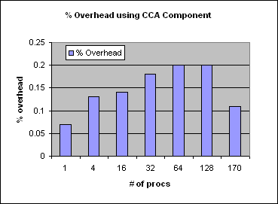
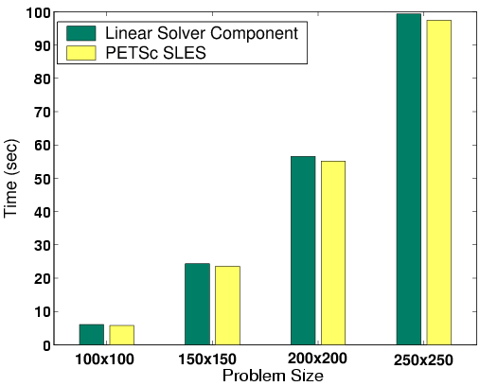
CCA Delivers Performance
Local
No CCA overhead within components
Small overhead between components
Small overhead for language interoperability
Be aware of costs & design with them in mind
  Small costs, easily amortized
Parallel
No CCA overhead on parallel computing
Use your favorite parallel programming model
Supports SPMD and MPMD approaches
Distributed (remote)
No CCA overhead – performance depends on networks, protocols
CCA frameworks support OGSA/Grid Services/Web Services and other approaches
Maximum 0.2% overhead for CCA vs native C++ code for parallel molecular dynamics up to 170 CPUs
Aggregate time for linear solver component in unconstrained minimization problem w/ PETSc

Slide 122
Overhead from Component Invocation
Invoke a component with different arguments
    Array
    Complex
    Double Complex
Compare with f77 method invocation
Environment
  500 MHz Pentium III
  Linux 2.4.18
  GCC 2.95.4-15
Components took 3X longer
Ensure granularity is appropriate!
Paper by Bernholdt, Elwasif, Kohl and Epperly
Function arg type | f77 | Component
Array | 80 ns | 224ns
Complex | 75ns | 209ns
Double complex | 86ns | 241ns
Notes:
To examine the component instantiation costs in more detail we compared the time needed to invoke a function in f77 versus the time needed to invoke a component with an array, a complex and a double complex as arguments.
The components took 3x longer for the function invocation, not function execution so one has to ensure that the granularity is such that the 240 ns overhead is negligible compared to the body of the component.

Slide 123
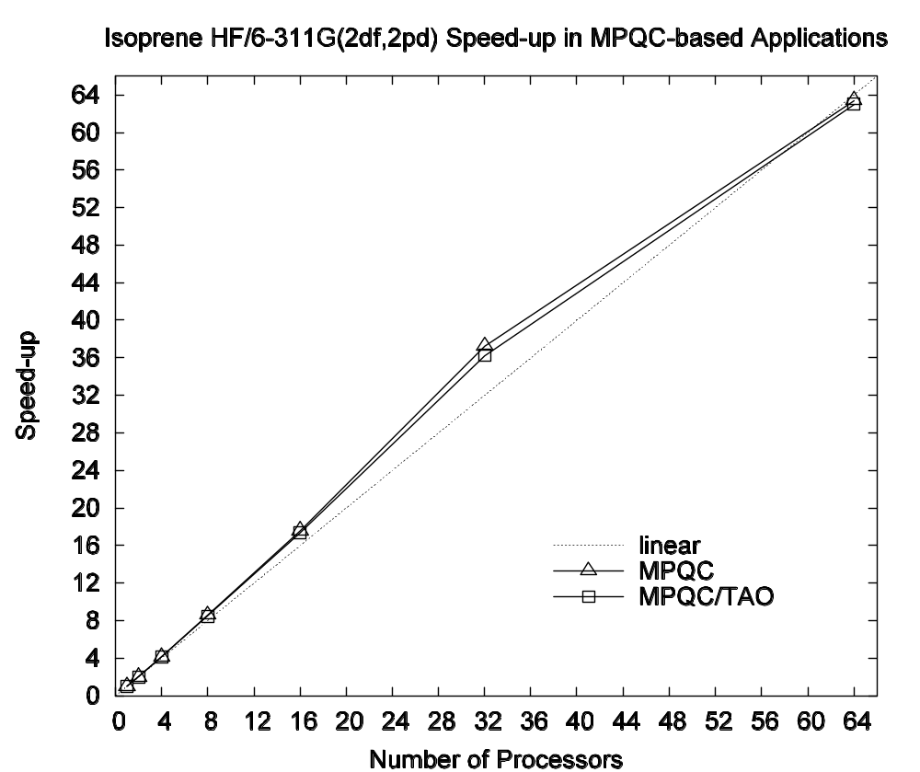
Parallel Scaling of the QC Simulation
Parallel Scaling of MPQC w/ native and TAO optimizers

Slide 124
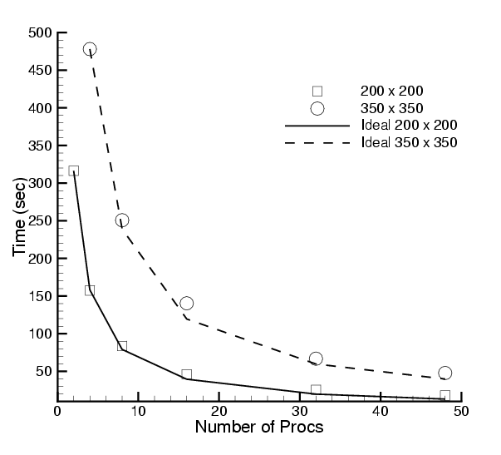
Scalability of Scientific Data Components in CFRFS Combustion Applications
Investigators: S. Lefantzi, J. Ray, and H. Najm (SNL)
Uses GrACEComponent
Shock-hydro code with no refinement
200 x 200 & 350 x 350 meshes
Cplant cluster
  400 MHz EV5 Alphas
  1 Gb/s Myrinet
Negligible component overhead
Worst perf : 73% scaling efficiency for 200x200 mesh on 48 procs
Reference: S. Lefantzi, J. Ray, and H. Najm, Using the Common Component Architecture to Design High Performance Scientific Simulation Codes, Proc of Int. Parallel and Distributed Processing Symposium, Nice, France, 2003.

Slide 125
Performance Measurement In A Component World
CCA provides a novel means of profiling & modeling component performance
Need to collect incoming inputs and match them up with the corresponding performance but how ?
  Need to “instrument” the code
    But has to be non-intrusive, since we may not “own” component code
What kind of performance infrastructure can achieve this?
  Previous research suggests proxies
    Proxies serve to intercept and forward method calls

Slide 126
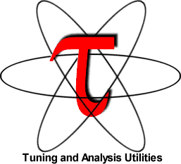
“Integrated” Performance Measurement Capability
Before:
Measurement infrastructure:
Proxy
  Notifies MasterMind of all method invocations of a given component, along with performance dependent inputs
  Generated automatically using PDT
MasterMind
  Collects and stores all measurement data
TAU
  Makes all performance measurements
Component1
Component2
After:
Component1
Proxy for Component2
Component2
MasterMind
TAU

Slide 127
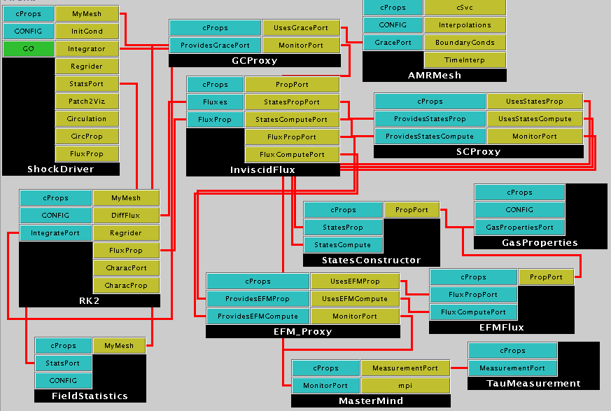
Component Application With Proxies

Slide 128
Overview
Examples (scientific) of increasing complexity
  Laplace equation
  Time-dependent heat equation
  Nonlinear reaction-diffusion system
  Quantum chemistry
  Climate simulation
Tools
  MxN parallel data redistribution
  Performance measurement, modeling and scalability studies
Community efforts & interface development
  TSTT Mesh Interface effort
  CCTTSS’s Data Object Interface effort
Notes:
To highlight how components can be useful in this scenario I will show a series of examples of increasing complexity that highlight component reuse and composability. I will start with a simple steady state PDE and move to a time-dependent PDE and from there to block structured adaptive time dependent PDEs. We will also show the use of several of the same components used in the PDE simulations in optimization-based applications.
I will give single processor performance results and scalability results for distributed memory applications. These results show that if you choose the level of granularity for your components appropriately there is very little performance impact.
Finally, based on our experiences to date, I will discuss strategies for developing your own component-based high performance simulation code. In addition, I will give a case study that highlights some of the issues associated with developing interchangeable and interoperable components in a domain-specific setting through the development of common interfaces.

Slide 129
Scientific Data Objects
& Interfaces
Define “Standard” Interfaces for HPC Scientific Data
  Descriptive, Not (Necessarily) Generative…
Basic Scientific Data Object
  David Bernholdt, ORNL
Structured & Unstructured Mesh
  Lori Freitag, LLNL
  Collaboration with SciDAC TSTT Center
Block Structured AMR
  Phil Colella, LBNL
  Collaboration with APDEC & TSTT
Notes:
Another research area is being explored to support the various scientific computing components, by providing
a generalized means for describing scientific data.
These new interfaces for HPC data will be more “descriptive” – wrapped over existing data meshing and decomposition
tools and interfaces – than “generative”, as in actually creating new data objects.
Work is in progress to develop basic scientific data interfaces, for local and distributed arrays,
as well as structured, unstructured, and structured block AMR meshes.

Slide 130
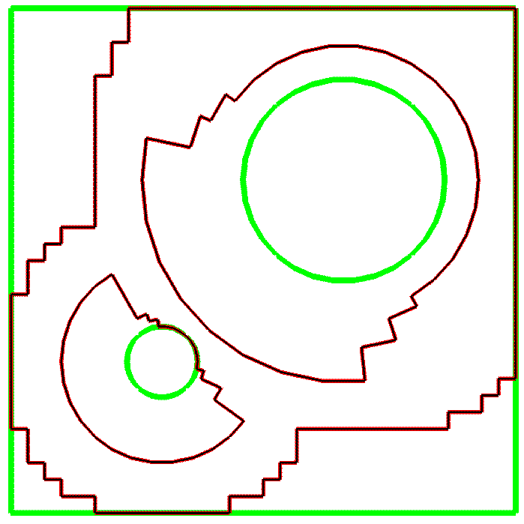
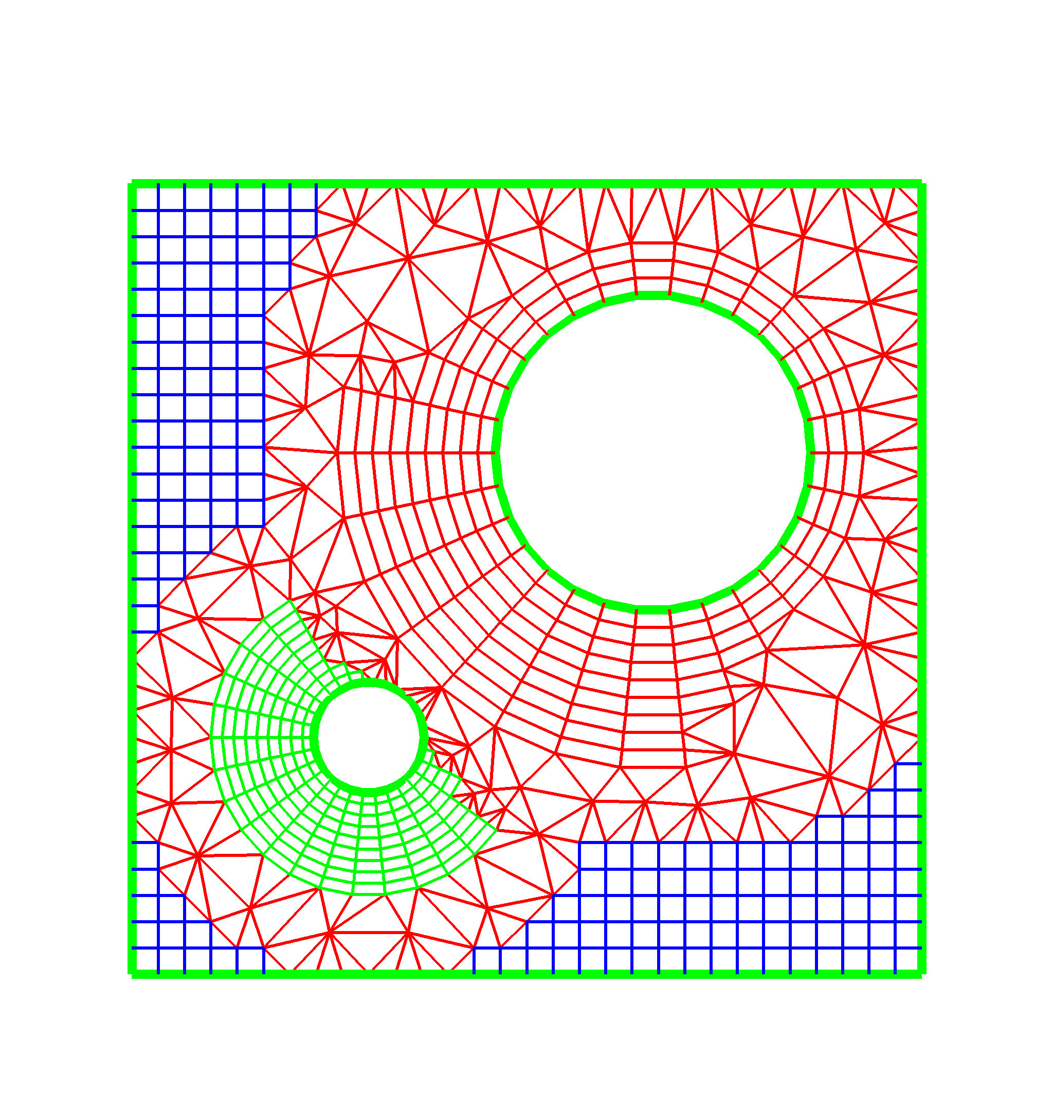
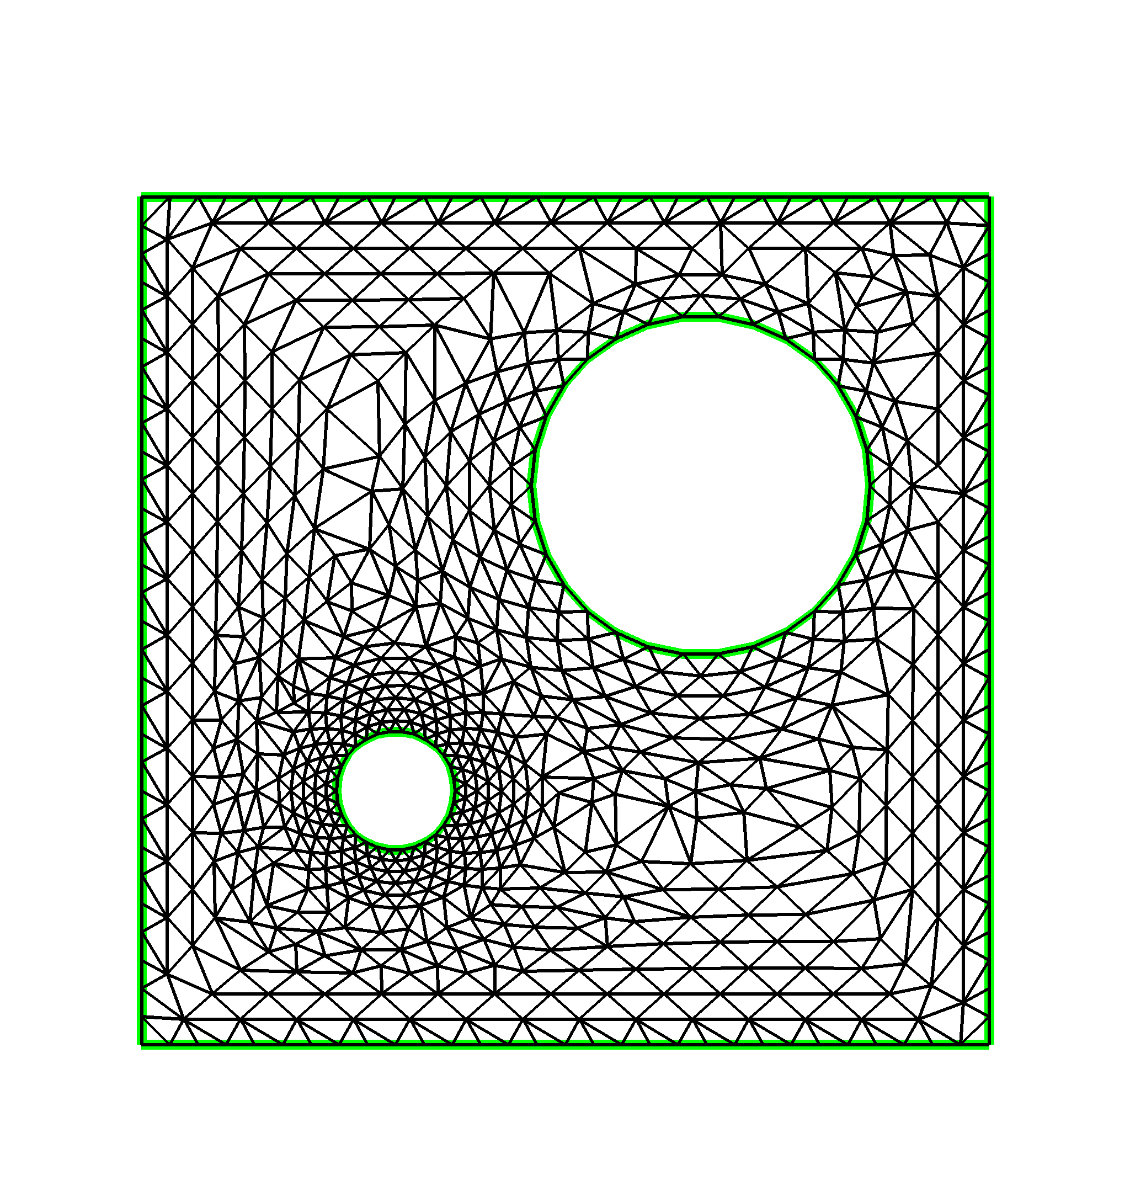
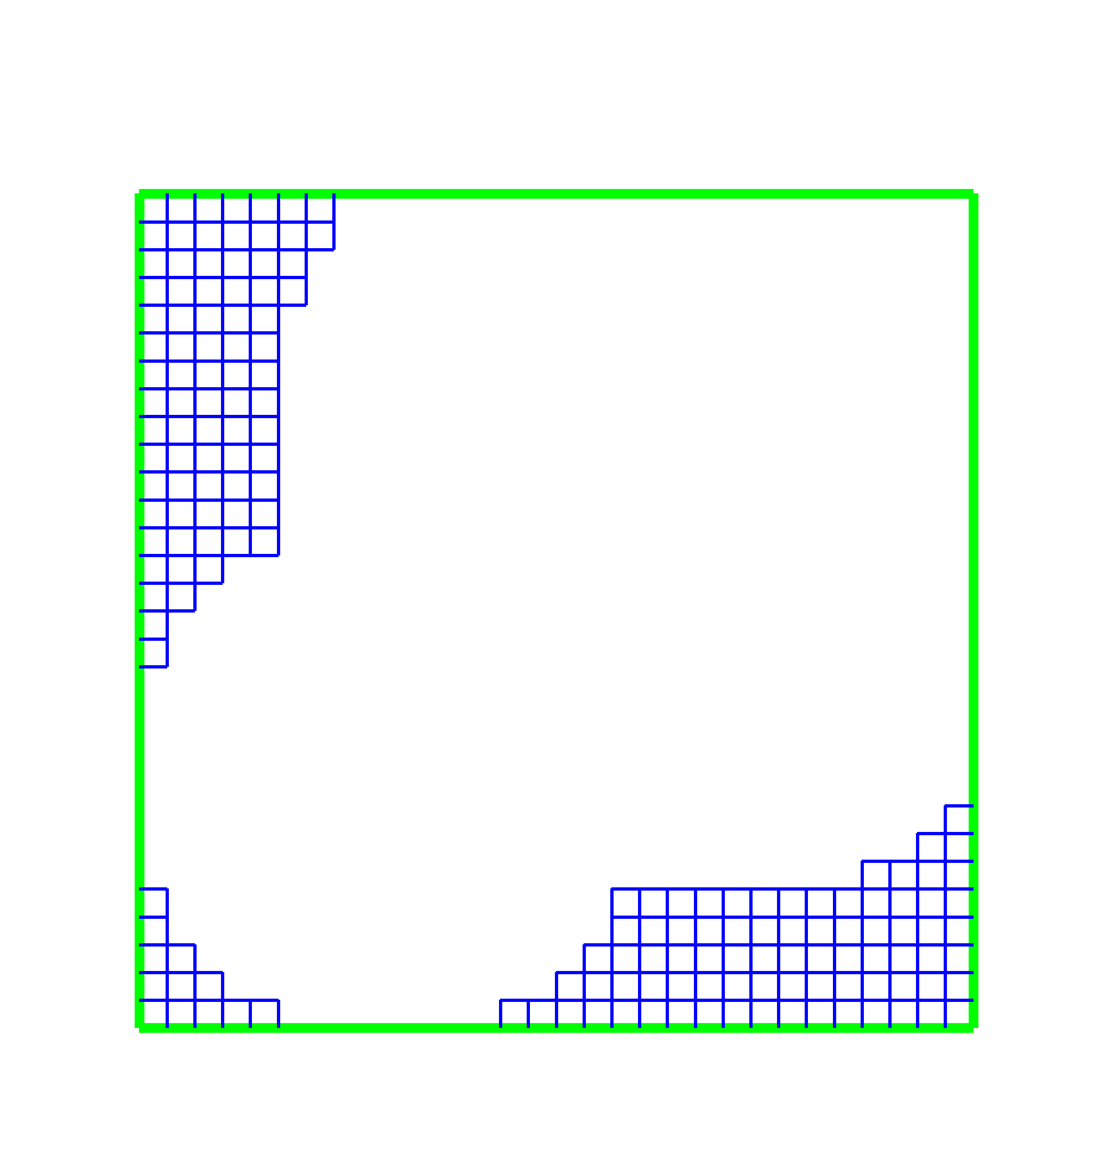
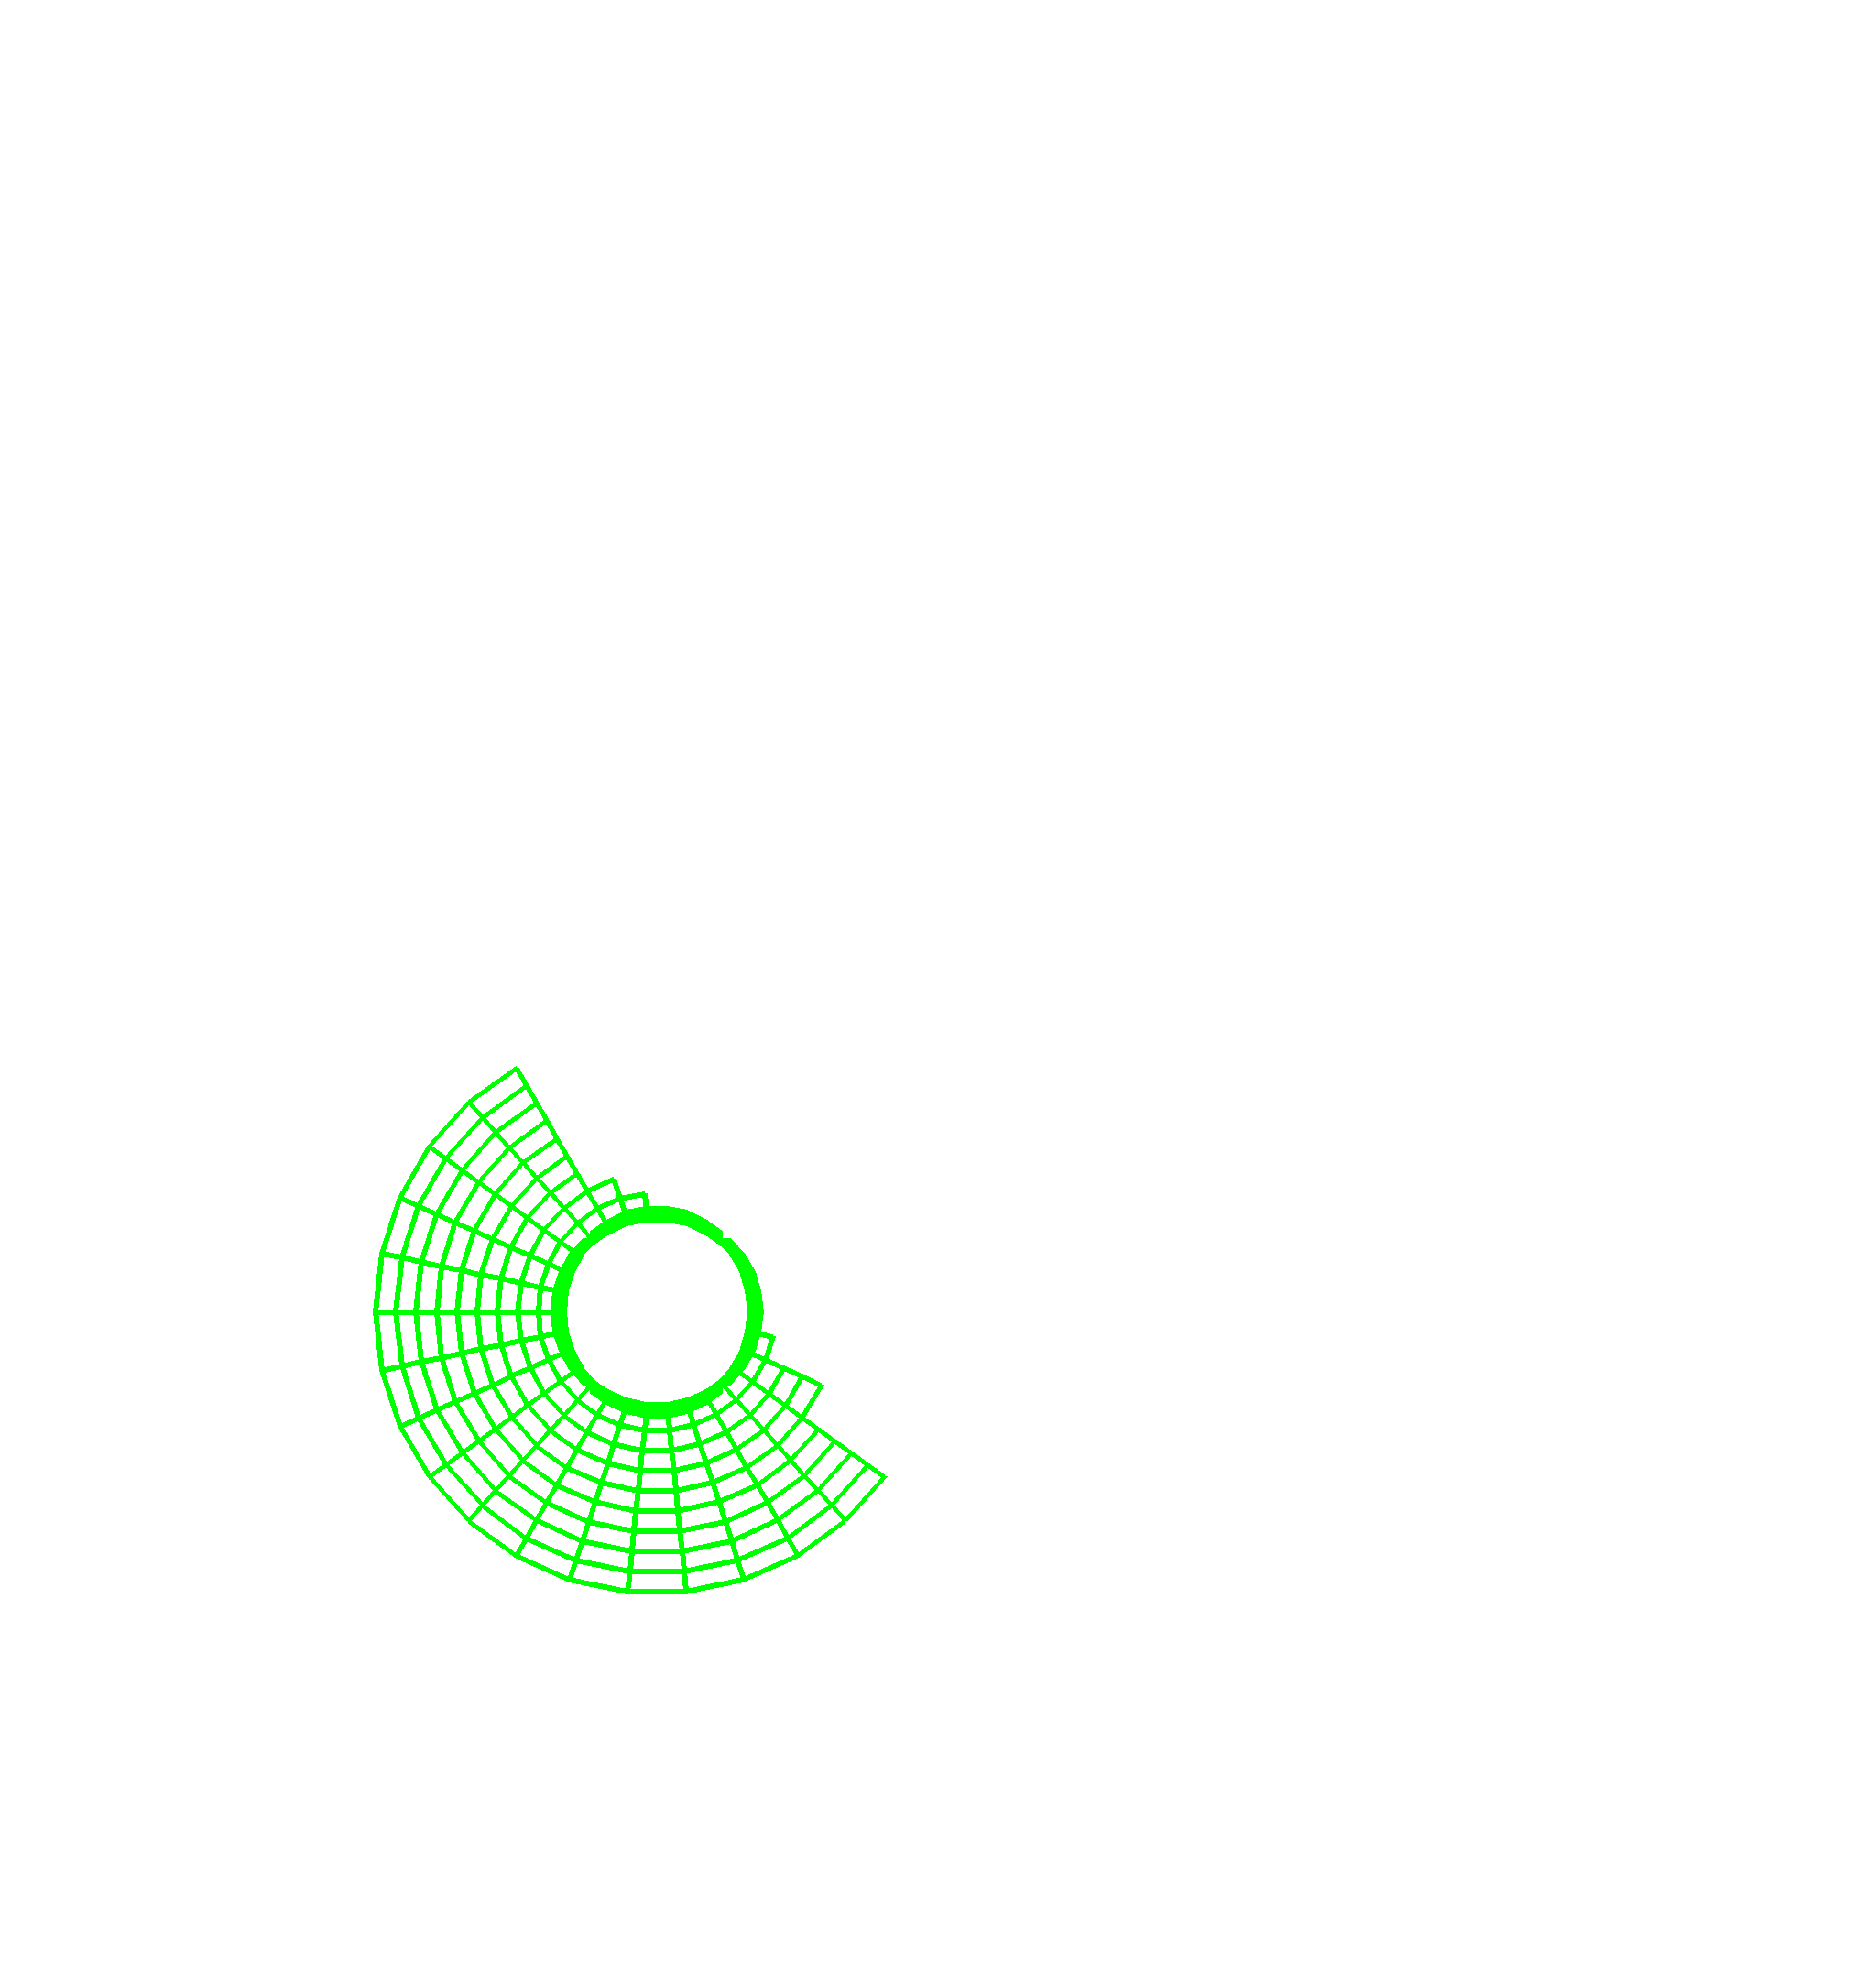
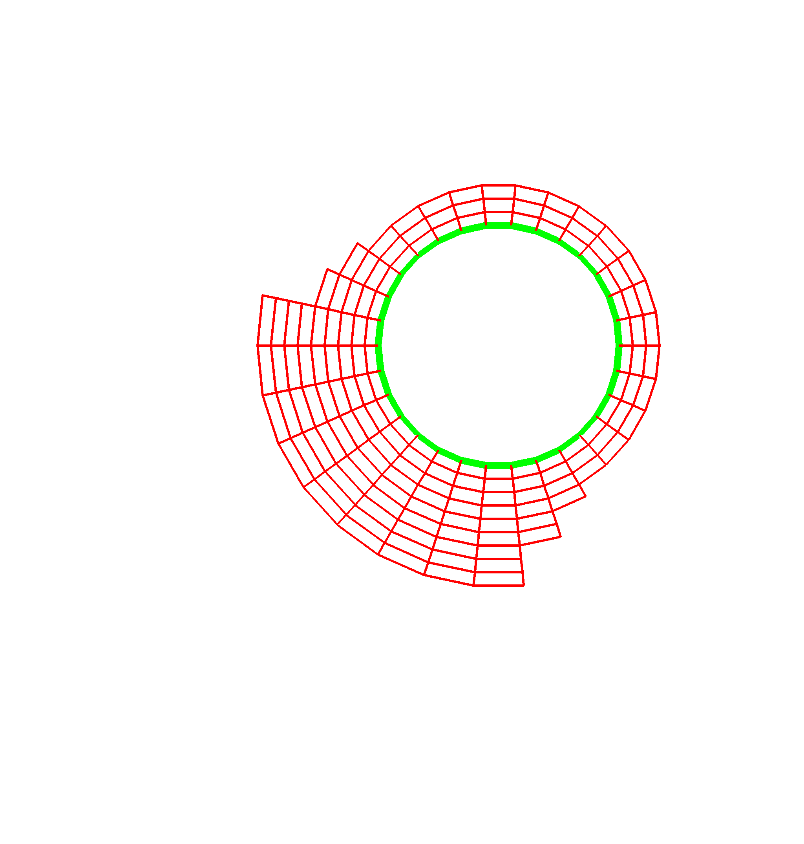
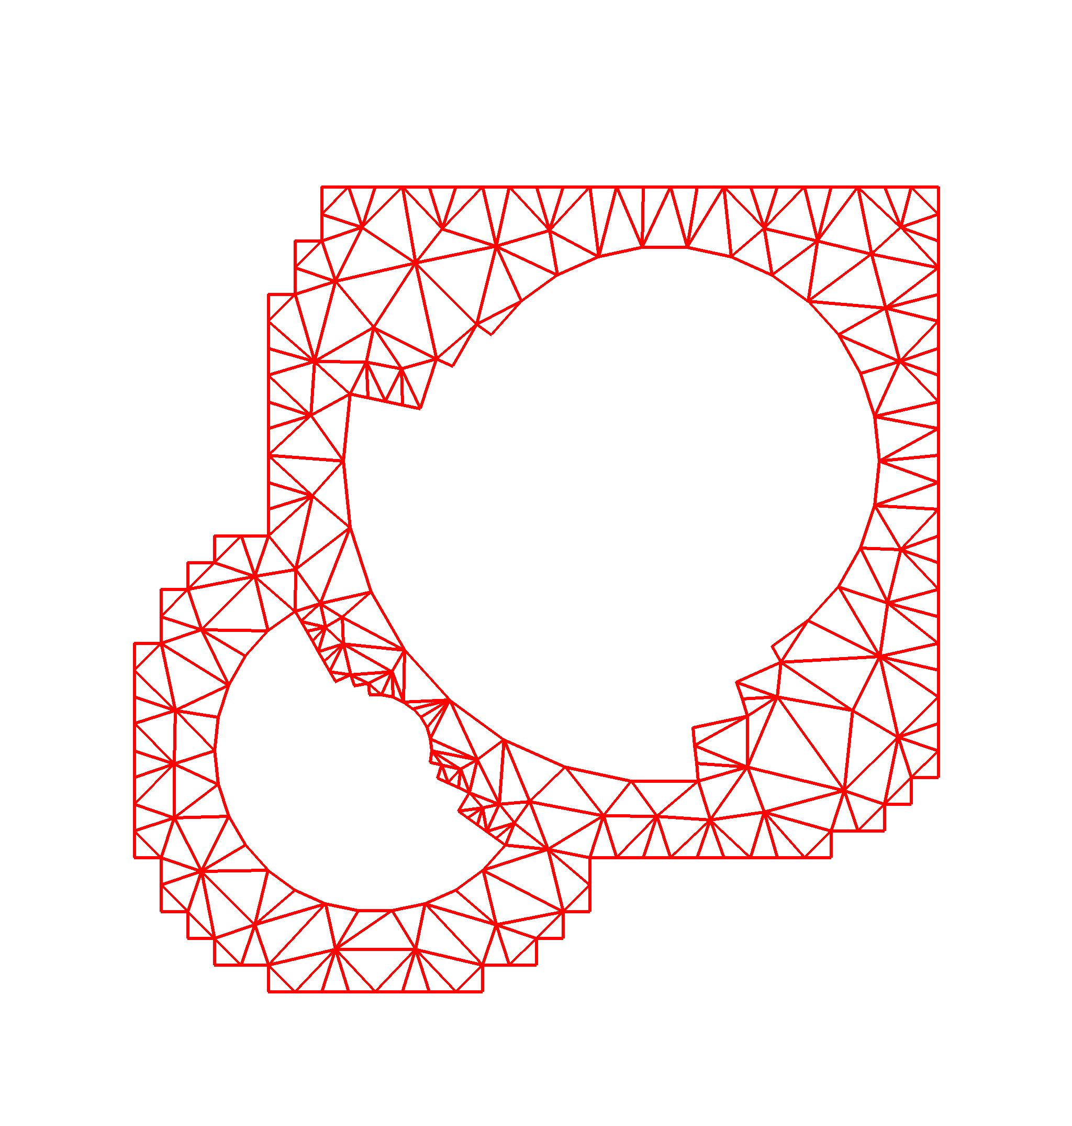
The Next Level
TSTT
Common Interface Specification
  Provides plug-and-play interchangeability
  Requires domain specific experts
  Typically a difficult, time-consuming task
  A success story: MPI
A case study… the TSTT/CCA mesh interface
  TSTT = Terascale Simulation Tools and
  Technologies (www.tstt-scidac.org)
  A DOE SciDAC ISIC focusing on meshes
  and discretization
  Goal is to enable
    hybrid solution strategies
    high order discretization
    Adaptive techniques
Geometry
Information
(Level A)
Full
Geometry
Meshes
(Level B)
Mesh
Components
(Level C)
Notes:
To be able to truly experience the power of component implementations it would be nice to be able to experiment with scientific software in a plug-and-play manner that allows application scientists to quickly and easily explore a number of different strategies (discretizations, solvers, etc) to determine which is best suited for their particular application.
This is impossible to do unless many tools that provide similar functionality also support the same interfaces. To achieve this in any particular domain, a number of experts must be willing to come to the table to hammer out the interface specification which is a difficult and time consuming task. Of course the pay-offs can be enormous for our community – the MPI standarization effort comes to mind.
In the next few minutes, I’m going to present a case study of an ongoing interface definition effort that’s been undertaken by the TSTT and CCA SciDAC centers (there are more efforts than this, and the next talk will highlight some of these).
The Terascale Simulation Tools and Technologies center (TSTT) is a DOE SciDAC Integrated Software Infrastructure Center (ISIC) whose primary goal is to bring interoperable and interchangeable meshing and discretization strategies to application scientists. In particular, they are trying to increase the use of hybrid solution strategies, high-order discretization and adaptive techniques.
For example, the picture on the lower left corner shows a situation in which a geometric domain is meshed in two different ways – one using mesh components of different types, both structured and unstructured, and the other a completely unstructured mesh. We would like to allow scientists to use either of these meshes without changing their application code by providing a common interface for both.

Slide 131
Proliferations of interfaces – the N² problem
Current Situation
Public interfaces for numerical libraries are unique
Many-to-Many couplings require Many² interfaces
  Often a heroic effort to understand the inner workings of both codes
  Not a scalable solution
Dist. Array
ISIS++
Overture
PETSc
PAOMD
Trilinos
SUMAA3d
Notes:
Currently, there are a large number of tools available that provide mesh management infrastructure (for example, CUBIT (SNL), AOMD (RPI), Overture (LLNL), NWGrid (PNL)). These tools are all very nice and meet particular needs, but they do not interoperate to form composite hybrid meshes, nor are they easily interchanged in an application for experimentation with different strategies because their APIs are all different.
Thus if you wanted to experiment with many different meshing strategies and many different solver strategies you would have to write NxM interfaces which is a time consuming task that most application scientists are not willing to undertake.
Thus, more recent developments in the meshing/discretization/solver community are often underused because it is so difficult to upgrade the application software.

Slide 132
Common Interface Specification
Reduces the Many-to-Many problem to a Many-to-One problem
  Allows interchangeability and experimentation
  Challenges
    Interface agreement
    Functionality limitations
    Maintaining performance
Dist. Array
T
S
T
T
ISIS++
E
S
I
Overture
PETSc
PAOMD
Trilinos
SUMAA3d
Notes:
Instead we would like to reduce the many-to-many problem to a Many-to-one problem in which a common interface is supported by a large number of tool providers so that the application scientist can code to the interface and then use any compliant tool.
The challenges associated with determining such an interface are many. First and foremost the participants must agree to an interface that maintains both performance and flexibility.

Slide 133
TSTT Philosophy
Create a small set of interfaces that existing packages can support
  AOMD, CUBIT, Overture, GrACE, …
  Enable both interchangeability and interoperability
Balance performance and flexibility
Work with a large tool provider and application community to ensure applicability
  Tool providers: TSTT and CCA SciDAC centers
  Application community: SciDAC and other DOE applications
Notes:
Within the TST center we have decided to create a small set of interface that existing packages can support for mesh query, access, and modification. Note – we are not imposing any particular data structure on the mesh management package, rather we are providing mechanisms to ask questions of the package to retrieve information such as vertex coordinate and connectivity information.
To achieve a balance between performance and flexibility we are providing interfaces that are appropriate for both structured and unstructured grids (for example entity-by-entity traversal of the mesh as well as array based access to information).
We are working with a large tool provider and application base to ensure applicability of the interface. As a group we have a large number of connections with the DOE application community and are always looking for more contacts.

Slide 134
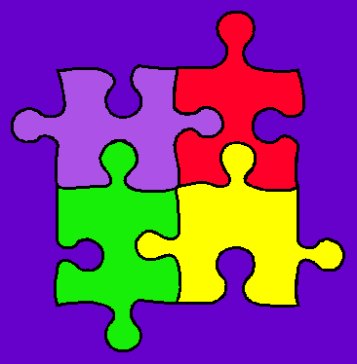
CCTTSS Research Thrust Areas and Main Working Groups
Scientific Components
  Scientific Data Objects
  Lois Curfman McInnes, ANL (curfman@mcs.anl.gov)
“MxN” Parallel Data Redistribution
  Jim Kohl, ORNL (kohlja@ornl.gov)
Frameworks
  Language Interoperability / Babel / SIDL
  Component Deployment / Repository
  Gary Kumfert, LLNL (kumfert@llnl.gov)
User Outreach
  David Bernholdt, ORNL (bernholdtde@ornl.gov)
Notes:
CCTTSS Research Thrusts
There are 4 main thrust areas being researched as part of the CCA effort.
There are a number of special working groups exploring each of these areas.
Scientific Components
The scientific components efforts includes a number of numerical software components, as well as general support components
such as for visualization and computational steering.
As part of this scientific component effort, several special working groups are developing generalized scientific data objects,
for a variety of data meshes, to assist scientists in composing and sharing data between independent components.
MxN
The “MxN” (pronounced “M by N”) research emphasizes the sharing of parallel data among components,
as is often done in climate simulations and other coupled scientific models. This kind of parallel data exchange and
redistribution can be more common in a generalized component environment, and these special parallel interfaces are
some of the primary features that distinguish CCA from other component technologies.
Frameworks
The CCA Framework effort is concerned with providing encapsulating containers, with associated services, for assembling
component-based applications. This work includes challenging issues like language interoperability, as well as the development
of component repositories and deployment strategies.
User Outreach
The 4th Thrust Area involves working closely with scientific application domains, to help them utilize the CCA specifications
and technology, and to coordinate user feedback to help guide and drive the ongoing CCA design.

Slide 135
Summary
Complex applications that use components are possible
  Combustion
  Chemistry applications
  Optimization problems
  Climate simulations
Component reuse is significant
  Adaptive Meshes
  Linear Solvers (PETSc, Trilinos)
  Distributed Arrays and MxN Redistribution
  Time Integrators
  Visualization
Examples shown here leverage and extend parallel software and interfaces developed at different institutions
  Including CUMULVS, ESI, GrACE, LSODE, MPICH, PAWS, PETSc, PVM, TAO, Trilinos, TSTT.
Performance is not significantly affected by component use
Definition of domain-specific common interfaces is key
Notes:
In summary, I hope that this talk has shown you that the use of components in complex, useful applications such as shock hydrodynamics, reaction diffusion applications, and optimization problems is both feasible and does not have to significantly impact performance.
We have shown a significant reuse of “infrastructure” type components such as meshes, solvers, visualization and integration tools. The examples shown here leveraged significant pieces of parallel software such as CUMULVS, GrACE, PETSc, TAO, Trillinos, etc..
I have also tried to highlight the importance of defining domain specific common interfaces to achieve the full potential of scientific components.

Slide 136

Language Interoperable
CCA Components via

Slide 137
Goal of This Module
Legacy codes → Babelized CCA Components
Introduction To:
  Babel
  SIDL
See Babel in use
  “Hello World” example
Babel aspects of writing a CCA component

Slide 138
What I mean by
“Language Interoperability”
Scripting Driver
(Python)
Simulation Framework
(C)
Visualization System
(Java)
Numerical Routines
(f77)
Solver Library
(C++)
Callback Handlers
(Python)
Callback Handlers
(Python)
Notes:
Outline 1. Intro: what is Babel?
The first thing I need to do is distinguish between what I mean by “Language Interoperabiliy”
and what most people assume by the term.
Most scientific codes these days are at least bi- or tri-lingual.
Some agressive codes may involve five or more languages.
But the interfaces between languages is often extremely rigid.
For instance, in this setup could you see something isn’t converging,
pause your program...
Animation #1: and extend one of your C++ classes in Python,
overriding one virtual method called “hasConverged()” to do some extra checking,
and then resume the computation?
Animation #2: Could you do something similar by overriding a numerical routine in F77?
No? Why Not?

Slide 139
One reason why mixing languages is hard
Native
cfortran.h
SWIG
JNI
Siloon
Chasm
Platform
Dependent
f77
C
f90
C++
Python
Java
Notes:
Outline: 3.1.1 Language Interoperability: other technologies
One reason why mixing languages is hard is because many are never designed to be mixed.
Another is that the technologies to overcome this hurdle are all point to point solutions.
At first glance, you might say at least the graph is connected... but the graph is also directed
so while SWIG can automatically wrap C code so its callable in Python, it doesn’t work the
other way around.

Slide 140
Babel makes all supported languages peers
f77
This is not a
Lowest Common
Denominator
Solution!
C
f90
C++
Python
Once a library has been
“Babelized” it is equally
accessible from all
supported languages
Java
Notes:
Outline: 3.1.2 Language Interoperability: Babel
Babel solution to the language interoperability problem is to
reduce the complexity from O(n^2) to O(n).
Babel serves as a central hub from which language bindings
are hung off from.
This is not a “Lowest Common Denominator” solution!
Babel supports an Object-Oriented Programming model
complete with virtual methods and throwing exceptions.
Babel provides extra support to non-OOP languages like
C, F77 to provide a consistent programming model across
all supported languages.

Slide 141
Babel Module’s Outline
Introduction
Babel Basics
  How to use Babel in a “Hello World” Example
  SIDL Grammar
  Wrapping legacy code
Babel aspects of writing a CCA component
Notes:
That’s the introduction to Babel.
What I’d like to do is go right into Babel and the CCA. Since both CCA
and Babel are new to this audience, I’m going to discuss Babel in isolation first.
Then add CCA into the mix.

Slide 142
Babel’s Two Parts:
Code Generator + Runtime Library
XML
Babel
Runtime
C
C++
SIDL interface
description
Babel
Compiler
F77
F90
Application
Java
Python
Matlab?
Notes:
Outline: 3.1.3 Babel Code Generation
Babel is not an automatic wrapping technology.
Babel requires the the interfaces to the software to be specified in our
Scientific Interface Definition Language (SIDL).

Slide 143
greetings.sidl: A Sample SIDL File
package greetings version 1.0 {
interface Hello {
void setName( in string name );
string sayIt ( );
}
class English implements-all Hello { }
}
Notes:
Outline: 3.2 SIDL Grammar
Explain each of the highlighted keywords

Slide 144
Library Developer Does This...
C++ Stubs
SIDL interface
description
Babel
Compiler
IORs
libgreetings.so
C++ Skels
C++ Impls
`babel --server=C++ greetings.sidl`
Add implementation details
Compile & Link into Library/DLL
Notes:
Outline: 3.5 Server Side: Code Generation

Slide 145
Adding the Implementation
namespace greetings {
class English_impl {
private:
// DO-NOT-DELETE splicer.begin(greetings.English._impl)
string d_name;
// DO-NOT-DELETE splicer.end(greetings.English._impl)
string
greetings::English_impl::sayIt()
throw ()
{
// DO-NOT-DELETE splicer.begin(greetings.English.sayIt)
string msg(“Hello “);
return msg + d_name + “!”;
// DO-NOT-DELETE splicer.end(greetings.English.sayIt)
}
Notes:
Outline: 3.5 Server Side: Adding the Implementation

Slide 146
Library User Does This...
Babel
Runtime
SIDL interface
description
Babel
Compiler
F90 Stubs
Application
IOR Headers
libgreetings.so
`babel --client=F90 greetings.sidl`
Compile & Link generated Code & Runtime
Place DLL in suitable location
Notes:
Outline: 3.4 Client Side: Code Generation and Linking

Slide 147
F90/Babel “Hello World” Application
program helloclient
use greetings_English
implicit none
type(greetings_English_t) :: obj
character (len=80) :: msg
character (len=20) :: name
name=’World’
call new( obj )
call setName( obj, name )
call sayIt( obj, msg )
call deleteRef( obj )
print *, msg
end program helloclient
These subroutines
come from directly
from the SIDL
Some other subroutines
are “built in” to every
SIDL class/interface

Slide 148
SIDL Grammar (1/3):
Packages and Versions
You’ll use SIDL in the hands-on
Packages can be nested
Versioned Packages
  defined as packages with explicit version number OR packages enclosed by a versioned package
  Reentrant by default, but can be declared final
  May contain interfaces, classes, or enums
Unversioned Packages
  Can only enclose more packages, not types
  Must be re-entrant. Cannot be declared final
package foo version 0.1 { package bar { ... } }

Slide 149
SIDL Grammar (2/3):
Classes & Interfaces
SIDL has 3 user-defined objects
  Interfaces – APIs only, no implementation
  Abstract Classes – 1 or more methods unimplemented
  Concrete Classes – All methods are implemented
Inheritance (like Java/Objective C)
  Interfaces may extend Interfaces
  Classes extend no more than one Class
  Classes can implement multiple Interfaces
Only concrete classes can be instantiated
Notes:
Outline: 3.2.1 SIDL Grammar: classes and interfaces

Slide 150
SIDL Grammar (3/3):
Methods and Arguments
Methods are public virtual by default
  static methods are not associated with an object instance
  final methods can not be overridden
Arguments have 3 parts
  Mode: can be in, out, or inout (like CORBA, but semantically different than F90)
  Type: one of (bool, char, int, long, float, double, fcomplex, dcomplex, array<Type,Dimension>, enum, interface, class )
  Name
Notes:
Outline: 3.2.1 SIDL Grammar: methods and arguments

Slide 151
Babelizing Legacy Code
Stubs
mycode.sidl
Babel
Compiler
IORs
libmycode.so
Skels
Impls
legacy_library.so
Write your SIDL interface
Generate server side in your native langauge
Edit Implementation (Impls) to dispatch to your code
(Do NOT modify the legacy library itself!)
Compile & Link into Library/DLL
Notes:
Outline: 4.1.2 Frameworks implemented using Babel

Slide 152





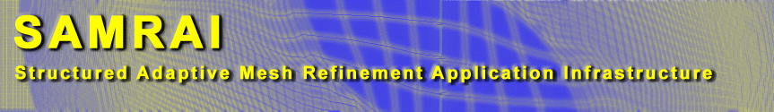

Known Projects Using Babel
(see www.llnl.gov/CASC/components/gallery.html for more)
Supplementary material for notes
I implemented a Babel-based interface for the hypre library of linear equation solvers. The Babel interface was straightforward to write and gave us interfaces to several languages for less effort than it would take to interface to a single language.
--Jeff Painter, LLNL.
research.cs.vt.edu/lacsa

Slide 153
Investing in Babelization can improve the interface to the code.
Supplementary material for notes
“When Babelizing LEOS [an equation of state library at LLNL], I completely ignored the legacy interface and wrote the SIDL the way I thought the interface should be. After running Babel to generate the code, I found all the hooks I needed to connect LEOS without changing any of it. Now I’ve got a clean, new, object-oriented python interface to legacy code. Babel is doing much more than just wrapping here.”
-- Charlie Crabb, LLNL
(conversation)

Slide 154
Babel Module’s Outline
Introduction
Babel Basics
  How to use Babel in a “Hello World” Example
  SIDL Grammar
Babel aspects of writing a CCA component
Notes:
That’s the introduction to Babel.
What I’d like to do is go right into Babel and the CCA. Since both CCA
and Babel are new to this audience, I’m going to discuss Babel in isolation first.
Then add CCA into the mix.

Slide 155
How to Write and Use
Babelized CCA Components
Define “Ports” in SIDL
Define “Components” that implement those Ports, again in SIDL
Use Babel to generate the glue-code
Write the guts of your component(s)
Notes:
Outline: 4.1.3 Components Implemented Using Babel (**KEY**)

Slide 156
How to Write A
Babelized CCA Component (1/3)
Define “Ports” in SIDL
  CCA Port =
    a SIDL Interface
    extends gov.cca.Port
package functions version 1.0 {
interface Function extends gov.cca.Port {
double evaluate( in double x );
}
}
Notes:
Outline: 4.1.3 Components Implemented Using Babel (**KEY**)

Slide 157
How to Write A
Babelized CCA Component (2/3)
Define “Components” that implement those Ports
  CCA Component =
    SIDL Class
    implements gov.cca.Component (& any provided ports)
class LinearFunction implements functions.Function,
gov.cca.Component {
double evaluate( in double x );
void setServices( in cca.Services svcs );
}
class LinearFunction implements-all
functions.Function, gov.cca.Component { }
Notes:
Outline: 4.1.3 Components Implemented Using Babel (**KEY**)

Slide 158
Tip: Use Babel’s XML output like precompiled headers in C++
Supplementary material for notes
cca.sidl
Babel
Compiler
XML
precompile SIDL into XML
--text=xml
store XML in a directory
Use Babel’s –R option to specify search directories
Type
Repository
Stubs
functions.sidl
Babel
Compiler
IORs
Skels
Impls

Slide 159
How to Write A
Babelized CCA Component (3/3)
Repo
(XML)
C Stubs
SIDL interface
description
Babel
Compiler
IORs
libfunction.so
C Skels
C Impls
Use Babel to generate the glue code
  `babel --server=C –Rrepo function.sidl`
Add implementation details
Notes:
Outline: 4.1.3 Components Implemented Using Babel (**KEY**)

Slide 160
Limitations of Babel’s Approach to Language Interoperabilty
Supplementary material for notes
Babel is a code generator
  Do obscure tricks no one would do by hand
  Don’t go beyond published language standards
Customized compilers / linkers / loaders beyond our scope
  E.g. icc and gcc currently don’t mix on Linux
  E.g. No C++-style templates in SIDL. (Would require special linkers/loaders to generate code for template instantiation, like C++ does.)
Babel makes language interoperability feasible, but not trivial
  Build tools severely underpowered for portable multi-language codes

Slide 161
Contact Info
Project: http://www.llnl.gov/CASC/components
  Babel: language interoperability tool
  Alexandria: component repository
  Quorum: web-based parliamentary system
  Gauntlet (coming soon): testing framework
Bug Tracking: http://www-casc.llnl.gov/bugs
Project Team Email: components@llnl.gov
Mailing Lists: majordomo@lists.llnl.gov
  subscribe babel-users [email address]
  subscribe babel-announce [email address]

