Slide 1
Welcome to the
Common Component Architecture
Tutorial
SC2007
12 November 2007

Slide 2
Licensing Information
This tutorial is distributed under the Creative Commons Attribution 2.5 License
  http://creativecommons.org/licenses/by/2.5/
In summary, you are free:
  to copy, distribute, display, and perform the work
  to make derivative works
  to make commercial use of the work
Under the following conditions:
  Attribution. You must attribute the work in the manner specified by the author or licensor.
For any reuse or distribution, you must make clear to others the license terms of this work.
Any of these conditions can be waived if you get permission from the copyright holder.
Your fair use and other rights are in no way affected by the above.
Requested reference:
  CCA Forum Tutorial Working Group, Common Component Architecture Tutorial, 2007, http://www.cca-forum.org/tutorials/

Slide 3
About the Printed Notes
The printed version of these presentations includes additional slides marked “Supplementary material for handouts”
Additional material to address questions sometimes raised, or provide more detail on a topic
We are happy to discuss this material if asked

Slide 4
Agenda & Table of Contents
Time | Title | Slide No. | Presenter
8:30-8:35am | Welcome | 1 | David Bernholdt, ORNL
8:35-9:30am | What Can Component Technology do for Scientific Computing | 6 | David Bernholdt, ORNL
 | An Intro to Components & the CCA | 17 | David Bernholdt, ORNL
9:30-10:00am | CCA Tools | 72 | Rob Armstrong, SNL
10:00-10:30am | Break
10:30-11:10am | Language Interoperable CCA Components with Babel | 109 | Gary Kumfert, LLNL
11:10am-11:55am | Using CCA: Approaches & Experience | 136 | Boyana Norris, ANL
11:55am-12:00n | Closing | 183 | Boyana Norris, ANL
12:00-1:30pm | Lunch
1:30-3:00pm | Hands-On | Hands-On Guide | Rob Armstrong, SNL
3:00-3:30pm | Break
3:30-5:00pm | Hands-On (continued)

Slide 5
Who We Are: The Common Component Architecture (CCA) Forum
Combination of standards body and user group for the CCA
Define specifications for high-performance scientific components & frameworks
Promote and facilitate development of tools for component-based software development, components, and component applications
Open membership, quarterly meetings…
General mailing list: cca-forum@cca-forum.org
Web: http://www.cca-forum.org/
Center for Technology for Advanced Scientific Component Software (TASCS)
  Funded by the US DOE SciDAC program
  Core development team for CCA technologies
Notes:
CCA Forum
Who
Goals
Quarterly Meetings

Slide 6
What Can Component Technology do for Scientific Computing?

Slide 7
Managing Code Complexity
Some Common Situations:
Your code is so large and complex it has become fragile and hard to keep running
You have a simple code, and you want to extend its capabilities – rationally
You want to develop a computational “toolkit”
  Many modules that can be assembled in different ways to perform different scientific calculations
  Gives users w/o programming experience access to a flexible tool for simulation
  Gives users w/o HPC experience access to HPC-ready software
How CCA Can Help:
Components help you think about software in manageable chunks that interact only in well-defined ways
Components provide a “plug-and-play” environment that allows easy, flexible application assembly

Slide 8
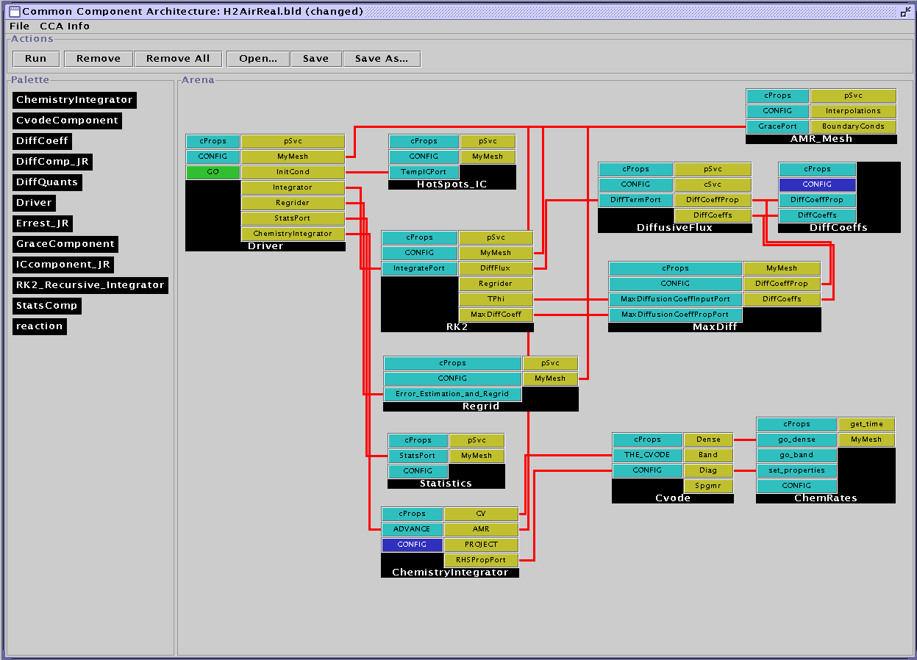
Example: Computational Facility for Reacting Flow Science (CFRFS)
A toolkit to perform simulations of unsteady flames
Solve the Navier-Stokes with detailed chemistry
  Various mechanisms up to ~50 species, 300 reactions
  Structured adaptive mesh refinement
CFRFS today:
  61 components
  7 external libraries
  9 contributors
“Wiring diagram” for a typical CFRFS simulation, utilizing 12 components.
CCA tools used: Ccaffeine, and ccafe-gui
Languages: C, C++, F77

Slide 9
Helping Groups Work with Software
Some Common Situations:
Many (geographically distributed) developers creating a large software system
  Hard to coordinate, different parts of the software don’t work together as required
Groups of developers with different specialties
Forming communities to standardize interfaces or share code
How CCA Can Help:
Components are natural units for
  Expressing software architecture
  Individuals or small groups to develop
  Encapsulating particular expertise
Some component models (including CCA) provide tools to help you think about the interface separately from the implementation

Slide 10
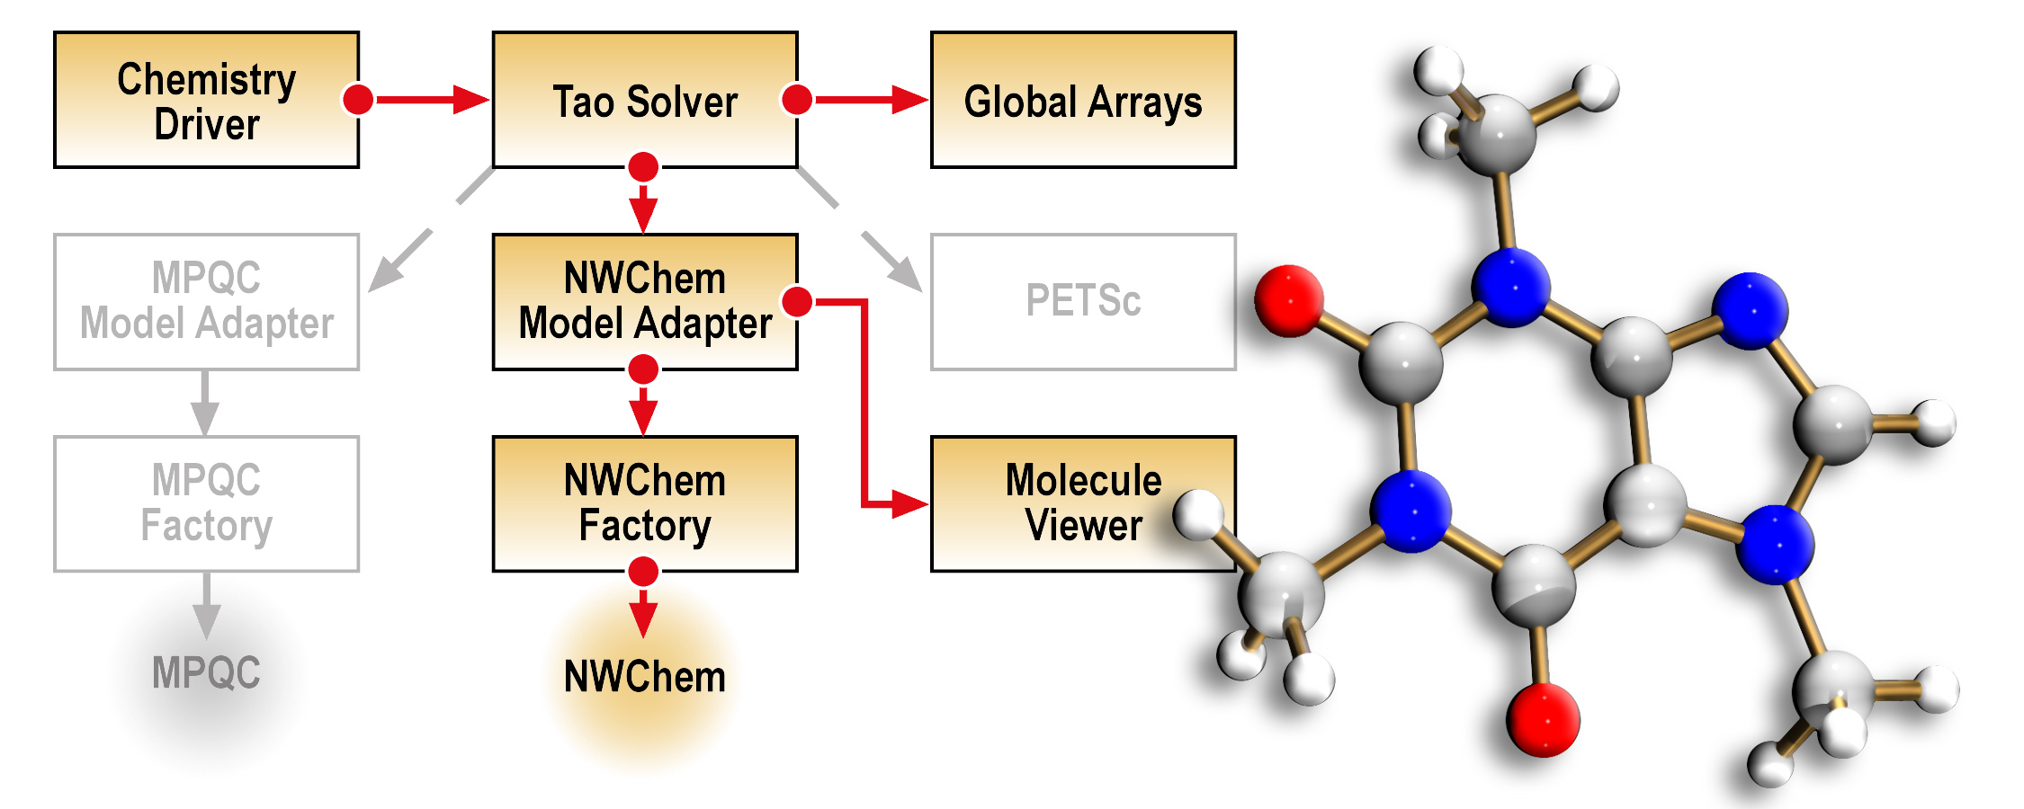
Example: Quantum Chemistry
Integrated state-of-the-art optimization technology into two quantum chemistry packages to explore effectiveness in chemistry applications
Geographically distributed expertise:
  California - chemistry
  Illinois - optimization
  Washington – chemistry, parallel data management
Effective collaboration with minimal face-to-face interaction
Schematic of CCA-based molecular structure determination quantum chemistry application.
Components based on: MPQC, NWChem (quantum chem.), TAO (optimization), Global Arrays, PETSc (parallel linear algebra)
CCA tools used: Babel, Ccaffeine, and ccafe-gui
Languages: C, C++, F77, Python

Slide 11
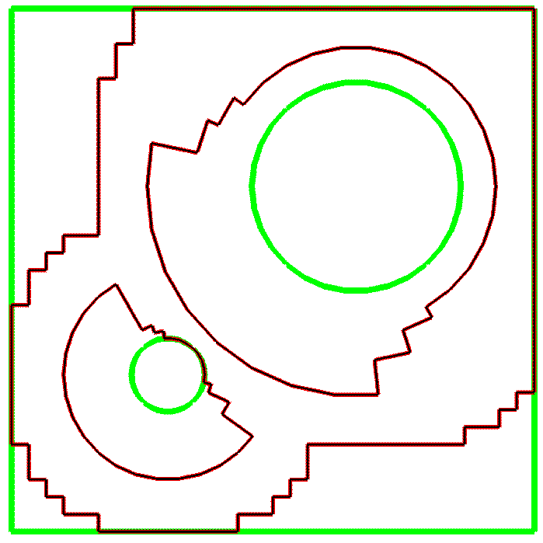
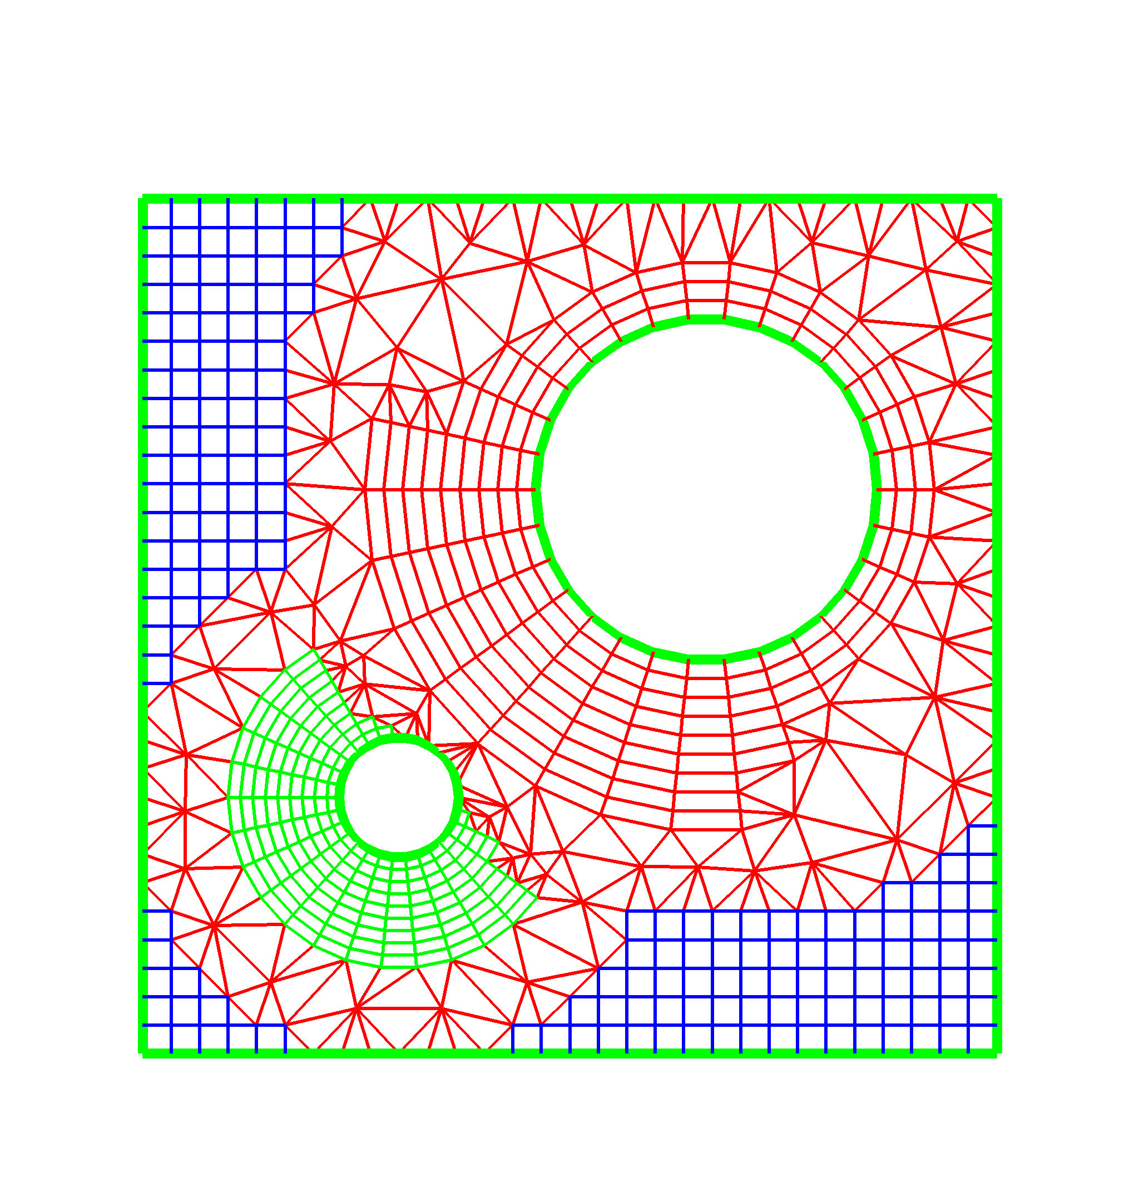
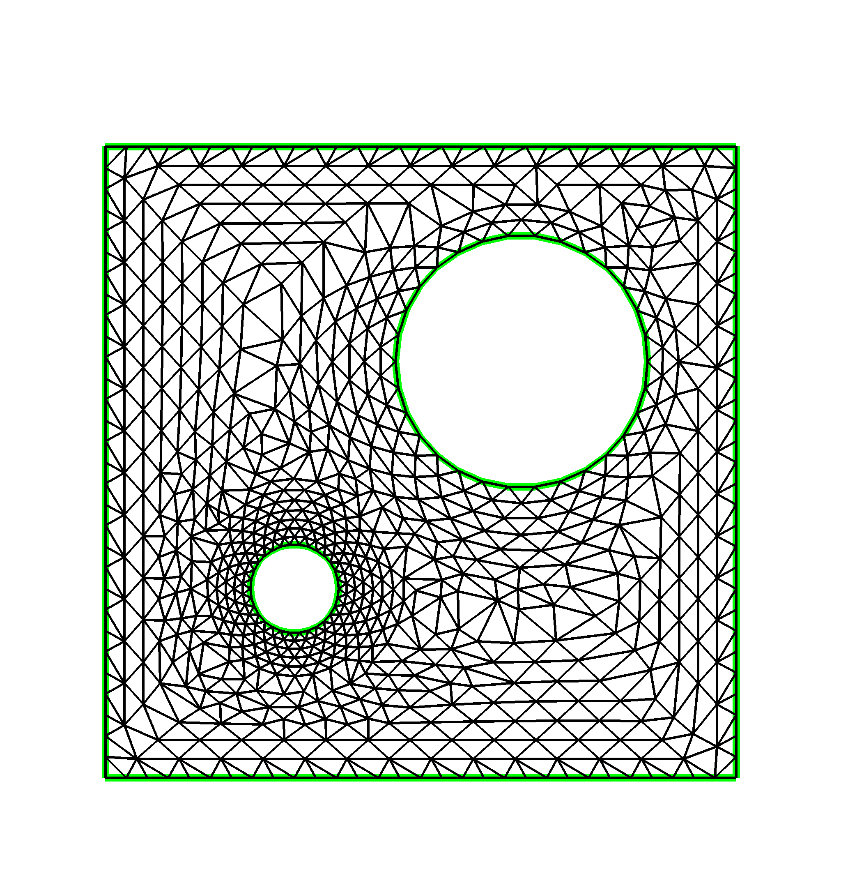
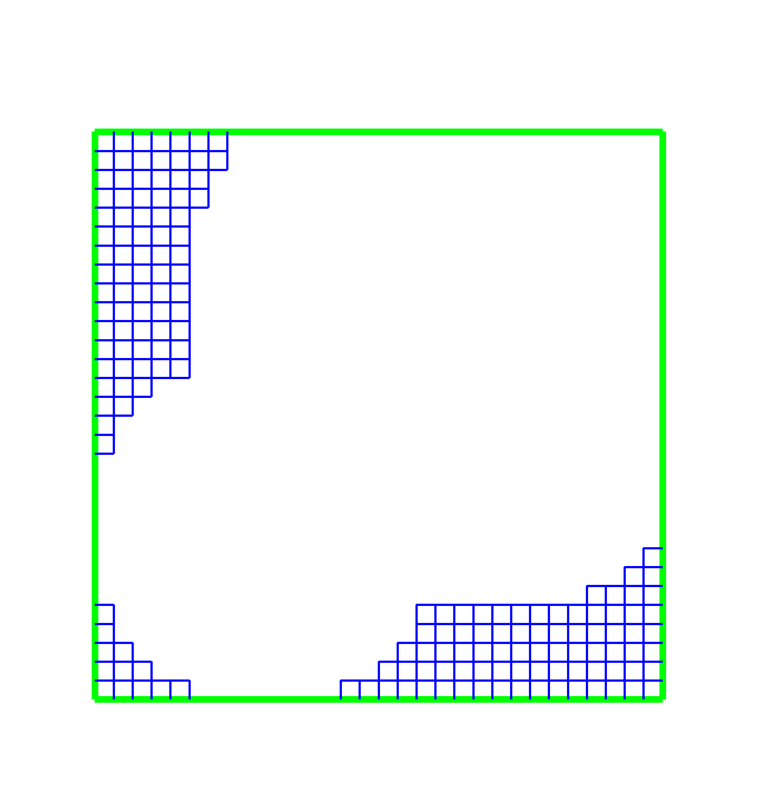
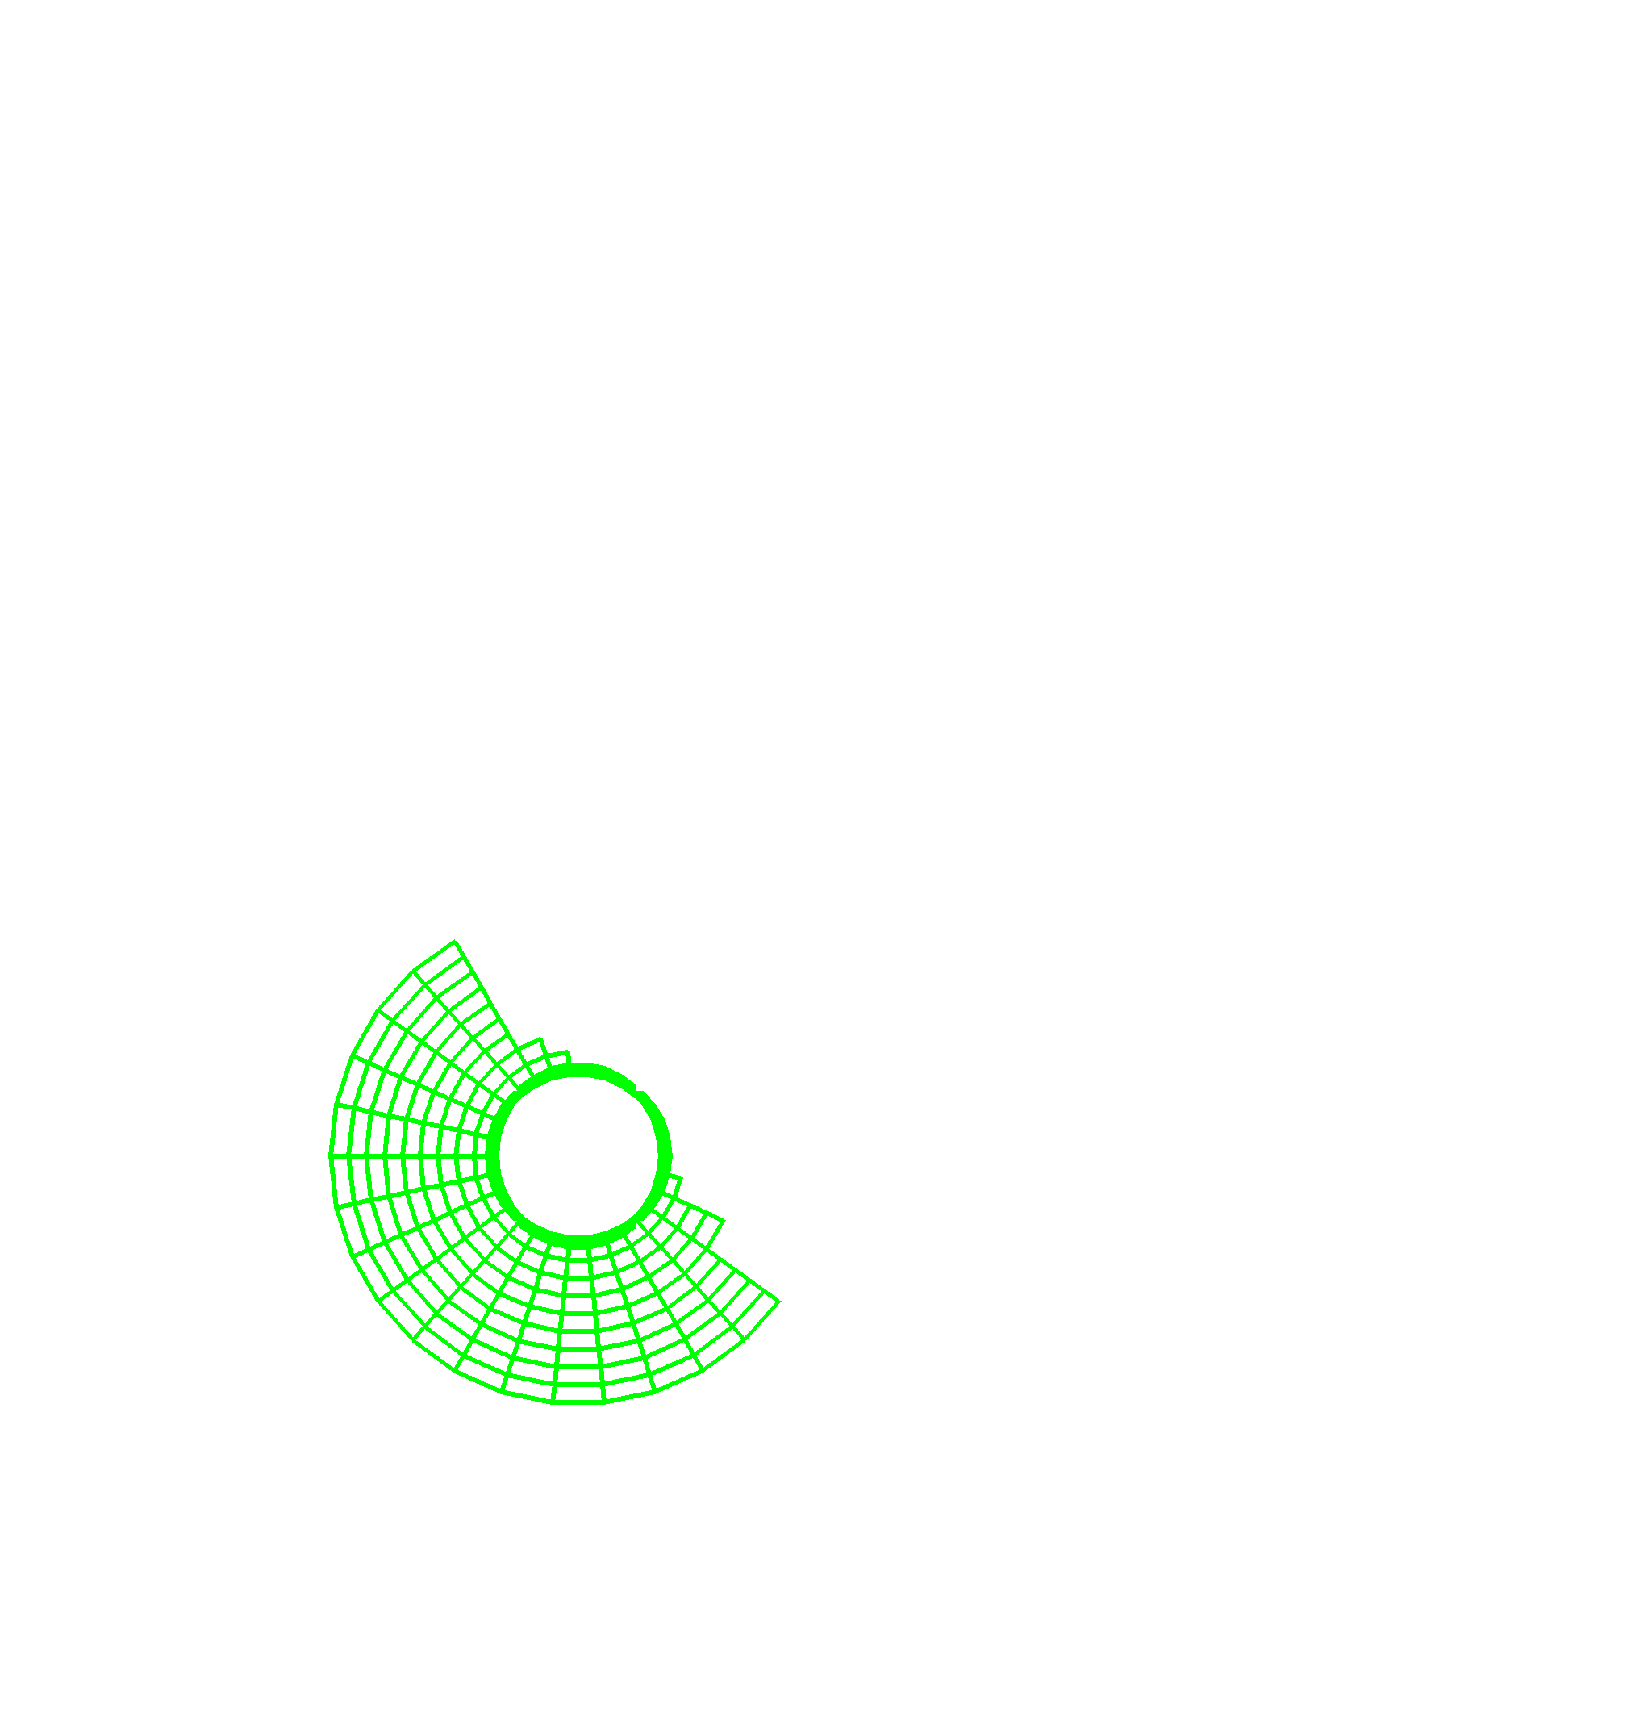
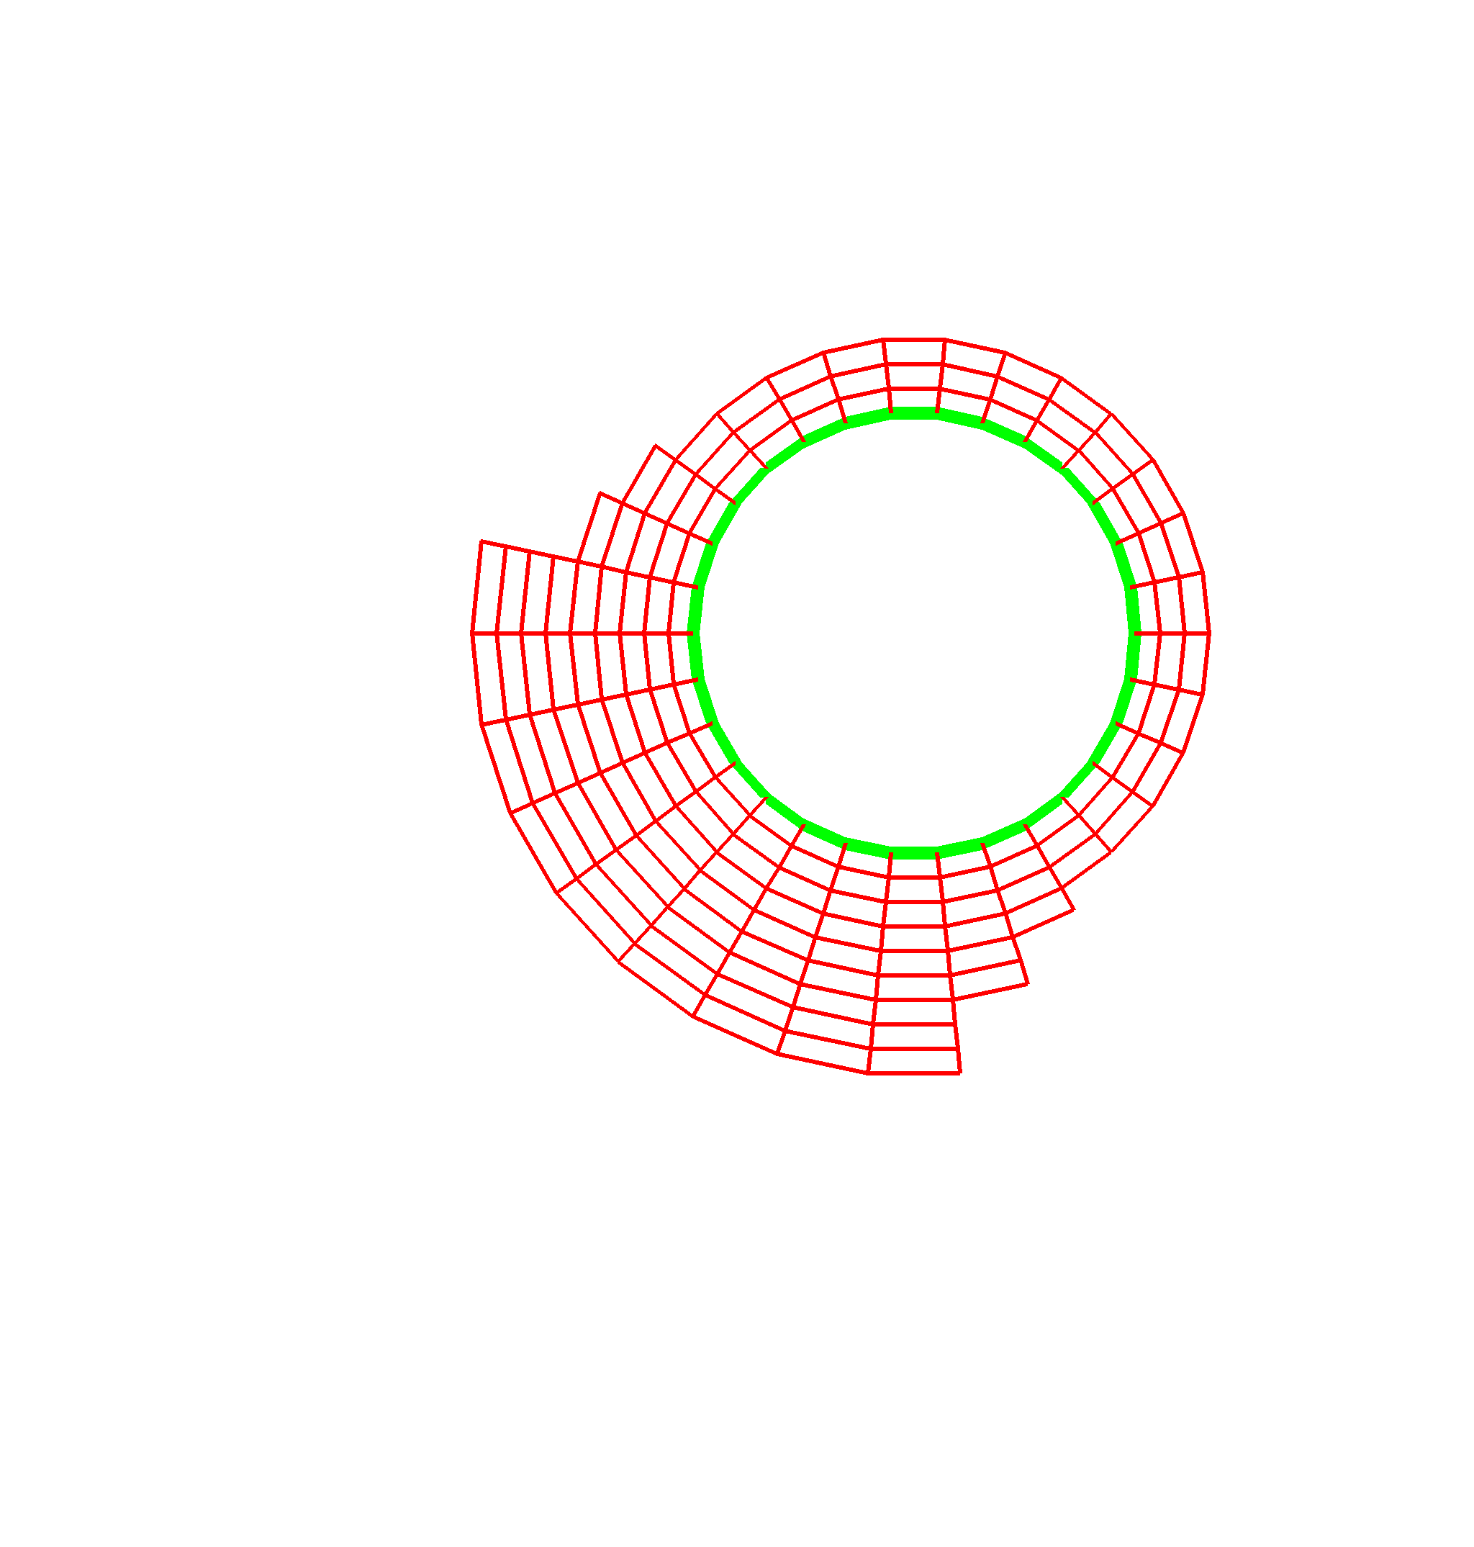
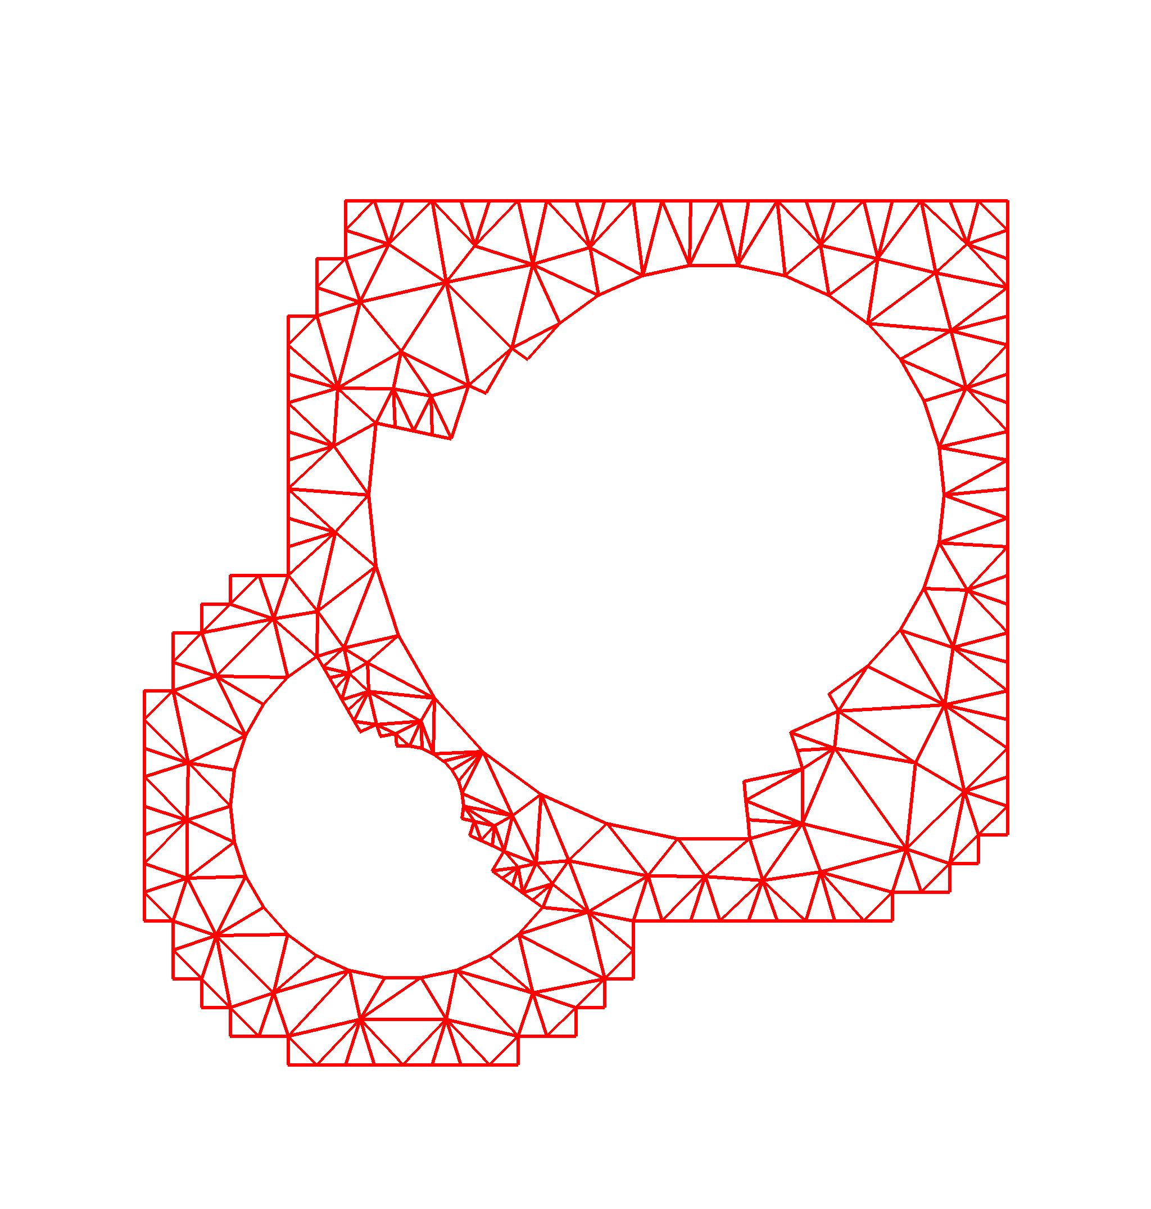
Example: TSTT Unstructured Mesh Tool Interoperability
Geometry
Information
(Level A)
Common interface for unstructured mesh geometry and topology
  7 libraries: FMDB, Frontier, GRUMMP, Mesquite, MOAB, NWGrid, Overture
  6 institutions: ANL, BNL/SUNY-Stony Brook, LLNL, PNNL, RPI, SNL
Reduces need for N² pairwise interfaces to just N
Full
Geometry
Meshes
(Level B)
Mesh
Components
(Level C)
Illustration of geometry domain hierarchy used in TSTT mesh interface.
CCA tools used: Babel (SIDL), Chasm
Library languages: C, C++, F77, F90

Slide 12
Language Interoperability
Some Common Situations:
Need to use existing code or libraries written in multiple languages in the same application?
Want to allow others to access your library from multiple languages?
Technical or sociological reasons for wanting to use multiple languages in your application?
How CCA Can Help:
Some component models (including CCA) allow transparent mixing of languages
Babel (CCA’s language interop. tool) can be used separately from other component concepts

Slide 13
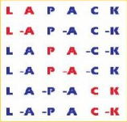

Examples
hypre
High performance preconditioners and linear solvers
Library written in C
Babel-generated object-oriented interfaces provided in C, C++, Fortran
LAPACK07
Update to LAPACK linear algebra library
  To be released 2007
  Library written in F77, F95
Will use Babel-generated interfaces for: C, C++, F77, F95, Java, Python
Possibly also ScaLAPACK (distributed version)
“I implemented a Babel-based interface for the hypre library of linear equation solvers. The Babel interface was straightforward to write and gave us interfaces to several languages for less effort than it would take to interface to a single language.”
-- Jeff Painter, LLNL. 2 June 2003
CCA tools used: Babel, Chasm

Slide 14
Coupling Codes
Some Common Situations:
Your application makes use of numerous third-party libraries
  Some of which interact (version dependencies)
You want to develop a simulation in which your code is coupled with others
  They weren’t designed with this coupling in mind
  They must remain usable separately too
  They are all under continual development, individually
  They’re all parallel and need to exchange data frequently
How CCA Can Help:
Components are isolated from one another
  Interactions via well-defined interfaces
  An application can include multiple versions of a component
Components can be composed flexibly, hierarchically
  Standalone application as one assembly, coupled simulation as another
CCA can be used in SPMD, MPMD, and distributed styles of parallel computing
CCA is developing technology to facilitate data and functional coupling of parallel applications

Slide 15

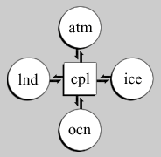
Example: Global Climate Modeling and the Model Coupling Toolkit (MCT)
MCT is the basis for Community Climate System Model (CCSM3.0) coupler (cpl6)
Computes interfacial fluxes and manages redistribution of data among parallel processes
Written in F90, Babel-generated bindings for C++, Python
CCA tools used: Babel, Chasm
Schematic of CCSM showing coupler managing data exchanges between atmosphere, sea ice, ocean, and land models.
(From http://www.ccsm.ucar.edu/models/ccsm3.0/cpl6/)

Slide 16
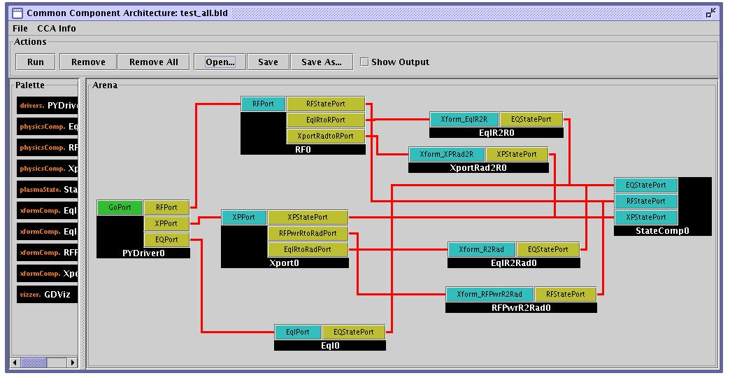
Example: Integrated Fusion Simulation
Proof-of-principle of using CCA for integrated whole-device modeling needed for the ITER fusion reactor
Couples radio frequency (RF) heating of plasma with transport modeling
Coarse-grain encapsulation of pre-existing programs
Follow-on plans for RF, transport, and magneto-hydrodynamics
“Wiring diagram” for integrated fusion simulation.
Components based on: AORSA, Houlberg’s transport library
New components: Driver, State
CCA tools used: Babel, Chasm, Ccaffeine, ccafe-gui
Languages: C++, F90, Python

Slide 17
An Introduction to Components and the
Common Component Architecture

Slide 18
Goals of This Module
Introduce basic concepts and vocabulary of component-based software engineering and the CCA
Highlight the special demands of high-performance scientific computing on component environments
Give you sufficient understanding of the CCA to begin evaluating whether it would be useful to you

Slide 19
What are Components?
No universally accepted definition in computer science research, but key features include…
A unit of software development/deployment/reuse
  i.e. has interesting functionality
  Ideally, functionality someone else might be able to (re)use
  Can be developed independently of other components
Interacts with the outside world only through well-defined interfaces
  Implementation is opaque to the outside world
Can be composed with other components
  “Plug and play” model to build applications
  Composition based on interfaces

Slide 20
What is a Component Architecture?
A set of standards that allows:
  Multiple groups to write units of software (components)…
  And have confidence that their components will work with other components written in the same architecture
These standards define…
  The rights and responsibilities of a component
  How components express their interfaces
  The environment in which components are composed to form an application and executed (framework)
  The rights and responsibilities of the framework
Notes:
Followup on Cheesman and Daniels specifying a component architecture.
One really shouldn’t think of components alone, it is the complete environment/architecture

Slide 21
A Simple Example:
Numerical Integration Components
•
Interoperable components (provide same interfaces)
FunctionPort
IntegratorPort
FunctionPort
NonlinearFunction
MidpointIntegrator
FunctionPort
GoPort
IntegratorPort
LinearFunction
Driver
FunctionPort
IntegratorPort
FunctionPort
PiFunction
RandomGeneratorPort
MonteCarloIntegrator
RandomGeneratorPort
RandomGenerator
Notes:
A bunch of components that we’ll see throughout the tutorial
The driver’s job is merely to invoke the integrator and print out the result
We have two different integrators (and of course you could have many more)
One uses the simple midpoint integration rule
The other is based on the Monte Carlo approach, so it requires a random number generator in addition to the function to be integrated
On the right are several functions we might want to integrate, as well as a random number generator

Slide 22
An Application
Built from the Provided Components
FunctionPort
IntegratorPort
FunctionPort
NonlinearFunction
MidpointIntegrator
FunctionPort
GoPort
IntegratorPort
LinearFunction
Driver
FunctionPort
IntegratorPort
FunctionPort
PiFunction
Hides compexity: Driver doesn’t care that MonteCarloIntegrator needs a random number generator
RandomGeneratorPort
MonteCarloIntegrator
RandomGeneratorPort
RandomGenerator
Notes:
To build a particular application from the components, we connect ports. In this case, we will integrate a function that should give us pi using the Monte Carlo approach.
Creating a valid application depends on connecting up ports according to their semantics, not on simply connecting every possible port. Components may, for example, offer alternative interfaces to accomplish the same task. Or some interfaces might be used only for debugging, performance monitoring, or other purposes.

Slide 23
Another Application…
FunctionPort
IntegratorPort
FunctionPort
NonlinearFunction
MidpointIntegrator
FunctionPort
GoPort
IntegratorPort
LinearFunction
Driver
FunctionPort
IntegratorPort
FunctionPort
PiFunction
RandomGeneratorPort
MonteCarloIntegrator
RandomGeneratorPort
RandomGenerator
Notes:
All we’ve done here is change to integrating a different function

Slide 24
Application 3…
FunctionPort
IntegratorPort
FunctionPort
NonlinearFunction
MidpointIntegrator
FunctionPort
GoPort
IntegratorPort
LinearFunction
Driver
FunctionPort
IntegratorPort
FunctionPort
PiFunction
RandomGeneratorPort
MonteCarloIntegrator
RandomGeneratorPort
RandomGenerator
Notes:
Here we’ve changed integrators and functions

Slide 25
And Many More…
Dashed lines indicate alternate connections
FunctionPort
IntegratorPort
FunctionPort
NonlinearFunction
MidpointIntegrator
FunctionPort
GoPort
IntegratorPort
LinearFunction
Driver
FunctionPort
IntegratorPort
FunctionPort
PiFunction
RandomGeneratorPort
MonteCarloIntegrator
RandomGeneratorPort
Create different applications in "plug-and-play" fashion
RandomGenerator

Slide 26
Comparison of Application Development Approaches
Supplementary material for handouts
Characteristics | Monolithic Simulation Code | Simulation Frameworks | Library-Based | Component-Based
Support for specific workflows and information flows | High | High | Low | Low
Flexibility w.r.t. workflow and information flow | Low | Medium | High | High
User-level extensibility | Low | Medium | High | High
Ease of incorporation of outside code (code reuse) | Low | Low-Medium | Medium | High
Ease of experimentation | Low | Medium | Medium | High
Amount of new code required to create a complete simulation | Low | Medium | High | High (reuse can reduce)
Breadth of current “ecosystem” for “plugins” | Low | Medium | High | Low (but growing)
Ease of coupling simulations | Low | Low | Medium | High
Notes:
This table is meant to provide a rough comparison of different approaches to the development of large-scale simulation codes. Rough means, in part, that the entries in the table are somewhat subjective and depend on the exact circumstances. Here is the essential message…
Monolithic simulation codes are, in many respects, relatively easy to create, but are very limited in flexibility and extensibility. Some have the ability to plug in small amounts of computational functionality (i.e. material characteristics) but many have no flexibility at all.
Simulation frameworks are a major step up from monolithic simulation codes in terms of flexibility. They are characterized by the ability to plug in significant amounts of code at high levels, and by providing a substantial built-in infrastructure of low-level utilities commonly used in the domain. These characteristics can make the development of new simulations very easy – if your new application conforms to the class of problem for which the framework was designed, and if you can reuse the existing low-level utilities. Otherwise, you may be out of luck. The breadth of the ecosystem for plug-in code is typically small, primarily because there is no uniformity among domain-specific simulation frameworks, so plug-in functionality tends to be limited to a single framework.
Library-based software development emphasizes the use of existing libraries wherever possible. These may be domain-specific, general numerical or programming environment tools, or other types of libraries. While this approach provides extreme flexibility, it typically requires more new code to obtain a complete simulation because the libraries tend to provide only the lower-level “utility” functionality. There are of course many, many libraries available, so the ecosystem is large. However there may be problems integrating different libraries into a single simulation code – this can make coupling of simulations harder than it “should” be.
Component-based software development shares many characteristics with the library-based approach – after all, libraries are the most common source of components. However the encapsulation provided by components, and their focus on interfaces, can facilitate some activities in ways that libraries can’t match. In particular, coupling of simulations should be much more tractable in a component environment than any other. The amount of new code required to complete a simulation can be high, as for libraries, assuming that the developer has to write most of the higher-level code. However as the component ecosystem grows it is likely that we’ll see reusable componentized versions of the higher-level functionality that can be reused, and when that starts to happen, the new code needed can drop dramatically. Similarly, the breadth of the ecosystem is currently small simply because not that many things have been made available yet in component form. But this will naturally grow as component ideas catch on. Five years from now, the ecosystem will probably look quite different.

Slide 27
Be Aware: “Framework” Describes Many Things
Currently in scientific computing, this term means different things to different people
Basic software composition environment
  Examples: CCA, CORBA Component Model, …
An environment facilitating development of applications in a particular scientific domain (i.e. fusion, computational chemistry, …)
  Example: Earth System Modeling Framework, http://www.esmf.ucar.edu
  Example: Computational Facility for Reacting Flow Science, http://cfrfs.ca.sandia.gov
An environment for managing complex workflows needed to carry out calculations
  Example: Kepler: http://kepler-project.org
Integrated data analysis and visualization environments (IDAVEs)
Lines are often fuzzy
  Example: Cactus, http://www.cactuscode.org
Others types of frameworks could be built based on a basic software composition environment

Slide 28
Relationships:
Components, Objects, and Libraries
Supplementary material for handouts
Components are typically discussed as objects or collections of objects
  Interfaces generally designed in OO terms, but…
  Component internals need not be OO
  OO languages are not required
Component environments can enforce the use of published interfaces (prevent access to internals)
  Libraries can not
It is possible to load several instances (versions) of a component in a single application
  Impossible with libraries
Components must include some code to interface with the framework/component environment
  Libraries and objects do not

Slide 29
What is the CCA?
Component-based software engineering has been developed in other areas of computing
  Especially business and internet
  Examples: CORBA Component Model, COM, Enterprise JavaBeans
Many of the needs are similar to those in HPC scientific computing
But scientific computing imposes special requirements not common elsewhere
CCA is a component environment specially designed to meet the needs of HPC scientific computing

Slide 30
Special Needs of Scientific HPC
Support for legacy software
  How much change required for component environment?
Performance is important
  What overheads are imposed by the component environment?
Both parallel and distributed computing are important
  What approaches does the component model support?
  What constraints are imposed?
  What are the performance costs?
Support for languages, data types, and platforms
  Fortran?
  Complex numbers? Arrays? (as first-class objects)
  Is it available on my parallel computer?

Slide 31
CCA: Concept and Practice
In the following slides, we explain important concepts of component-based software from the CCA perspective
We also sketch how these concepts are manifested in code (full details in the Hands-On)
The CCA Specification is the mapping between concept and code
  A standard established by the CCA Forum
  Expressed in the Scientific Interface Definition Language (SIDL) for language neutrality (syntax similar to Java)
  SIDL can be translated into bindings for specific programming languages using, e.g., the Babel language interoperability tool

Slide 32
CCA Concepts: Components
IntegratorPort
FunctionPort
FunctionPort
MidpointIntegrator
NonlinearFunction
A component encapsulates some computational functionality
Components provide/use one or more interfaces
  A component with no interfaces is formally okay, but isn’t very interesting or useful
In SIDL, a component is a class that implements (inherits from) gov.cca.Component
  This means it must implement the setServices method to tell framework what ports this component will provide and use
  gov.cca.Component is defined in the CCA specification

Slide 33
CCA Concepts: Ports
IntegratorPort
FunctionPort
FunctionPort
MidpointIntegrator
NonlinearFunction
Components interact through well-defined interfaces, or ports
  A port expresses some computational functionality
  In Fortran, a port is a bunch of subroutines or a module
  In OO languages, a port is an abstract class or interface
Ports and connections between them are a procedural (caller/callee) relationship, not dataflow!
  e.g., FunctionPort could contain a method like evaluate(in Arg, out Result) with data flowing both ways
Notes:
The cartoon is a schematic representation of two components connected to each other. The representation mimics that used in the original GUI for the Ccaffeine framework. Uses ports are shown on the left side of the component, provides ports on the right. They are shown in different colors to help distinguish them.
The MidpointIntegrator component has two ports. It provides an IntegratorPort and uses a FunctionPort. The NonlinearFunction component provides a FunctionPort. The red line connects the user FunctionPort on MidpointIntegrator to the provider FunctionPort on NonlinearFunction.
Another way to think of user/provider is client/server
To repeat: connecting ports does not imply direction of data movement!

Slide 34
CCA Concepts: Provides and Uses Ports
IntegratorPort
FunctionPort
FunctionPort
MidpointIntegrator
NonlinearFunction
Components may provide ports – implement the class or subroutines of the port ( )
  Providing a port implies certain inheritance relationships between the component and the abstract definition of the interface (more details shortly)
  A component can provide multiple ports
    Different “views” of the same functionality, or
    Related pieces of functionality
Components may use ports – call methods or subroutines in the port ( )
  Use of ports is just like calling a method normally except for a little additional work due to the “componentness” (more details shortly)
  No inheritance relationship implied between caller and callee
  A component can use multiple ports
“Provides” Port
“Uses” Port
Notes:
The cartoon is a schematic representation of two components connected to each other. The representation mimics that used in the original GUI for the Ccaffeine framework. Uses ports are shown on the left side of the component, provides ports on the right. They are shown in different colors to help distinguish them.
The MidpointIntegrator component has two ports. It provides an IntegratorPort and uses a FunctionPort. The NonlinearFunction component provides a FunctionPort. The red line connects the user FunctionPort on MidpointIntegrator to the provider FunctionPort on NonlinearFunction.
Another way to think of user/provider is client/server
To repeat: connecting ports does not imply direction of data movement!

Slide 35
Components and Ports (in UML)
•
•
•
•
•
Note that only the provides ports appear in the component’s inheritance hierarchy. Uses ports do not.
A port must extend the CCA spec’s port interface
<<interface>>
gov.cca.Component
<<interface>>
gov.cca.Port
setServices(services: gov.cca.Services)
A component must implement the CCA spec’s component interface
<<interface>>
integrator.IntegratorPort
integrate(lowBound: double,
upBound: double, count: int): double
A component must implement the port(s) it provides
IntegratorPort
FunctionPort
Midpoint
MidpointIntegrator
= Inheritance
Class for Midpoint Integrator component
Key:
SIDL keywords

Slide 36
Components and Ports (in SIDL)
•
•
•
package gov.cca {
interface Component {
void setServices(…);
} }
package gov.cca {
interface Port {
} }
package integrators {
interface IntegratorPort
{
double integrate(…};
} }
extends gov.cca.Port
IntegratorPort
FunctionPort
MidpointIntegrator
package integrators {
class Midpoint
{
} }
implements
gov.cca.Component,
integrator.IntegratorPort
Key:
double integrate(…);
= Inheritance
void setServices(…);
SIDL inheritance
keywords

Slide 37
Using Ports
IntegratorPort
FunctionPort
FunctionPort
MidpointIntegrator
NonlinearFunction
Calling methods on a port you use requires that you first obtain a “handle” for the port
  Done by invoking getPort() on the user’s gov.cca.Services object
  Free up handle by invoking releasePort() when done with port
Best practice is to bracket actual port usage as closely as possible without using getPort(), releasePort() too frequently
  Can be expensive operations, especially in distributed computing contexts
  Performance is in tension with dynamism
    can’t “re-wire” a ports that is “in use”

Slide 38
Where Do Ports Come From?
Most ports are designed and implemented by users of CCA
  May be specific to an application or used more broadly (i.e. community-wide)
The CCA specification defines a small number of ports
  Most are services CCA frameworks must provide for use by components
  Some are intended for users to implement in their components, and have a special meaning recognized by the framework
    E.g. gov.cca.ports.GoPort provides a very simple protocol to start execution of component-based applications

Slide 39
Interfaces are Key to Reuse and Interoperability of Code
Overture
NWGrid
MOAB
hypre
Mesquite
SuperLU
Interoperability -- multiple implementations conforming to the same interface
Reuse – ability to use a component in many applications
The larger the community that agrees to the interface, the greater the opportunity for interoperability and reuse
GRUMMP
PETSc
Frontier
FMDB
Overture
NWGrid
MOAB
hypre
Mesquite
TSTT Unstructured Mesh Interface
TOPS Linear Solver Interface
SuperLU
GRUMMP
PETSc
Frontier
FMDB

Slide 40
Interfaces are an Investment
The larger the community, the greater the time & effort required to obtain agreement
  Equally true in component and non-component environments
    MPI 1.0 (well understood at the start) took 8 months, meeting every six weeks
    MPI 2.0 (not well understood at the start) took 1.5 years, meeting every six weeks
  Convenient communities are often “project” and “scientific domain”
Formality of “standards” process varies
Biggerstaff’s Rule of Threes
  Must look at at least three systems to understand what is common (reusable)
  Reusable software requires three times the effort of usable software
  Payback only after third release

Slide 41
CCA Concepts: Frameworks
The framework provides the means to “hold” components and compose them into applications
Frameworks allow connection of ports without exposing component implementation details
Frameworks provide a small set of standard services to components
  Framework services are CCA ports, just like on components
  Additional (non-standard) services can also be offered
  Components can register ports as services using the ServiceProvider port
Currently: specific frameworks are specialized for specific computing models (parallel, distributed, etc.)
Future: better integration and interoperability of frameworks

Slide 42
Components Must Keep Frameworks Informed
IntegratorPort
FunctionPort
FunctionPort
MidpointIntegrator
NonlinearFunction
Components must tell the framework about the ports they are providing and using
  Framework will not allow connections to ports it isn’t aware of
Register them using methods on the component’s gov.cca.Services object
  addProvidesPort() and removeProvidesPort()
  registerUsesPort() and unregisterUsesPort()
  All are defined in the CCA specification
Ports are usually registered in the component’s setServices() method
  Can also be added/removed dynamically during execution
Notes:
The cartoon is a schematic representation of two components connected to each other. The representation mimics that used in the original GUI for the Ccaffeine framework. Uses ports are shown on the left side of the component, provides ports on the right. They are shown in different colors to help distinguish them.
The MidpointIntegrator component has two ports. It provides an IntegratorPort and uses a FunctionPort. The NonlinearFunction component provides a FunctionPort. The red line connects the user FunctionPort on MidpointIntegrator to the provider FunctionPort on NonlinearFunction.
Another way to think of user/provider is client/server
To repeat: connecting ports does not imply direction of data movement!

Slide 43

CCA Concepts: Language Interoperability
f77
Scientific software is increasingly diverse in use of programming languages
In a component environment, users should not care what language a component is implemented in
“Point-to-point” solutions to language interoperability are not suitable for a component environment
The Babel language interoperability tool provides a common solution for all supported languages
Scientific Interface Definition Language provides language-neutral way of expressing interfaces
C
f90
C++
Python
Java
f77
C
f90/95
C++
Python
More on Babel later!
Java

Slide 44

Coding in a CCA Environment
•
•
•
•
Babel runtime library &
Chasm F90 array library
Language compiler & linker
Compiled Components
(object libraries)
Generated language code
Babel compiler
(SIDL→language)
CCA Framework
Application (component assembly)
Port Definitions (SIDL)
Component source code
Component Definition (SIDL)
Key:
User code
More details in the CCA Tools module
CCA Tools
Generated code
Standard Tools
Object libraries

Slide 45
CCA Supports Parallelism -- by “Staying Out of the Way” of it
•
•
•
•
Single component multiple data (SCMD) model is component analog of widely used SPMD model
P0
P1
P2
P3
Each process loaded with the same set of components wired the same way
Different components in same process “talk to each” other via ports and the framework
Components: Blue, Green, Red
Framework: Gray
Same component in different processes talk to each other through their favorite communications layer (i.e. MPI, PVM, GA)
Any parallel programming environments that can be mixed outside of CCA can be mixed inside
Notes:
An animation depicting the important concepts in tightly-coupled parallel computing with CCA.
0) Start with a single process containing a framework with a give set of components (Blue, Green, Red) wired together.
Extend that to a parallel system by giving each process the same set of components wire the same way.
Components on the same process talk to each other via the usual CCA mechanisms (one such case highlighted by dashed box).
Between the same component (Blue, Green, Red) in different processes, the component is free to communicate however it wants – not forced to use CCA mechanisms. This is good because it allows developers to reuse software more easily, and knowledge (about how to use a given communications layer). Different comms layers can coexist in the same application
The CCA spec does not prohibit “diagonal” communication, but it is not encouraged. It would be treated the same as horizontal communication – the framework would stay out of the way.
The MPMD analog of this also “just works”. It is just harder to depict ☺

Slide 46
“Multiple-Component Multiple-Data” Applications in CCA
Simulation composed of multiple SCMD sub-tasks
Usage Scenarios:
  Model coupling (e.g. Atmosphere/Ocean)
  General multi-physics applications
  Software licensing issues
    i.e. limited number of instances
Approaches
  Run single parallel framework
    Driver component that partitions processes and builds rest of application as appropriate (through BuilderService)
  Run multiple parallel frameworks
    Link through specialized communications components
    Link as components (through AbstractFramework service)
Driver
Atmosphere
Ocean
Land
Coupler
Processors

Slide 47
MCMD Within A Single Framework
•
•
•
•
See example in the Using CCA module (multilevel parallelism in quantum chemistry)
P0
P1
P2
P3
Framework
Application driver & MCMD support component
Components on all processes
Components only on process group A
Components only on process group B
Group A
Group B

Slide 48
CCA Supports High-Performance Local and Distributed Computing
Process
Integrator
Linear Fun
“Direct connection” preserves high performance of local (“in-process”) and parallel components
  Framework makes connection
  But is not involved in invocation
Distributed computing has same uses/provides pattern, but framework intervenes between user and provider
  Framework provides a proxy provides port local to the uses port
  Framework conveys invocation from proxy to actual provides port
Provides/Uses
Port
Direct Connection
Process
Integrator
Provides
Port
Network
Connection
Process
Linear Fun
Proxy Provides/
UsesPort

Slide 49
“Direct Connection” Details
Directly connected components are in the same address space
  Data can be passed by reference instead of copying
  Just like “traditional” programs
  Framework involved in connecting components, but not invocations on ports
Cost of “CCAness” in a direct connect environment is one level of indirection on calls between components
  Equivalent to a C++ virtual function call: lookup function location, invoke it
  Overhead is on the invocation only (i.e. latency), not the total execution time
  Cost equivalent of ~2.8 F77 or C function calls
  ~48 ns vs 17 ns on 500 MHz Pentium III Linux box
Notes:
Purists often argue with the characterization of a C++ virtual function call as costing the equivalent of n function calls in a language like C or Fortran. The problem is that the virtual function call involves first looking up the function (dereferencing a pointer) and then making the call. The lookup doesn’t happen in C or Fortran, so the argument is that we’re comparing apples and oranges.
On the other hand, a significant number of our audience are Fortran (or perhaps C) programmers with no C++ experience. All they “know” about C++ is that its slow. So above, we give them a measure of what “slow” means in this particular context.
If someone can come up with a succinct way of expressing this that will satisfy the purists as well as the Fortran programmer, please let me know!

Slide 50
Performance, the Big Picture
No Overhead
Parallel Computer
Direct-Connect, Parallel
No CCA overhead on…
  calls within component
  parallel communications across components
Small overheads on invocations on ports
  Virtual function call (CCAness)
  Language Interoperability (some data types)
Distributed
No CCA overhead on calls within component
Overheads on invocations on ports
  Language interoperability (some data types)
  Framework
  (Wide area) network
Process 0
Process 1
CCA Framework
CCA Framework
No Overhead
No Overhead
No Overhead
Distributed Environment
Computer A
Computer B
CCA Framework
CCA Framework

Slide 51
Maintaining HPC Performance
The performance of your
application is as important to
us as it is to you
The CCA is designed to provide maximum performance
  But the best we can do is to make your code perform no worse
Facts:
  Measured overheads per function call are low
  Most overheads easily amortized by doing enough work per call
  Other changes made during componentization may also have performance impacts
  Awareness of costs of abstraction and language interoperability facilitates design for high performance
More about performance in notes

Slide 52
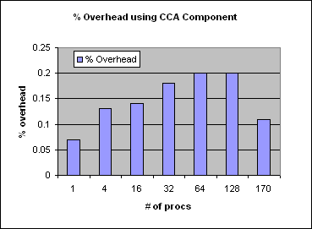
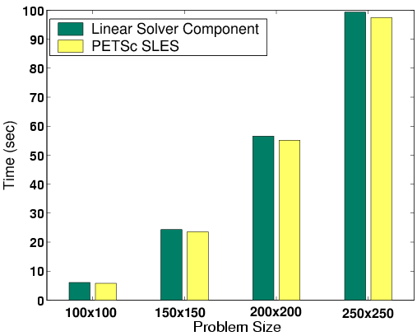
Some Performance Results and References
Supplementary material for handouts
Lois Curfman McInnes,et al. Parallel PDE-Based Simulations Using the Common Component Architecture. In Are Magnus Bruaset, Petter Bjorstad, and Aslak Tveito, editors, Numerical Solution of PDEs on Parallel Computers. Springer-Verlag, 2005. Invited chapter, in press.
S. Benson, et al. Using the GA and TAO Toolkits for Solving Large-Scale Optimization Problems on Parallel Computers. Technical report ANL/MCS-P1084-0903, Argonne National Laboratory, September 2003.
Boyana Norris, et al. Parallel Components for PDEs and Optimization: Some Issues and Experiences. Parallel Computing, 28:1811--1831, 2002.
David E. Bernholdt, et al. A Component Architecture for High-Performance Computing. In Proceedings of the Workshop on Performance Optimization via High-Level Languages and Libraries (POHLL-02), 2002.
Maximum 0.2% overhead for CCA vs native C++ code for parallel molecular dynamics up to 170 CPUs
Aggregate time for linear solver component in unconstrained minimization problem w/ PETSc

Slide 53
Overhead from Component Invocation
Supplementary material for handouts
Invoke a component with different arguments
    Array
    Complex
    Double Complex
Compare with f77 method invocation
Environment
  500 MHz Pentium III
  Linux 2.4.18
  GCC 2.95.4-15
Components took 3X longer
Ensure granularity is appropriate!
Paper by Bernholdt, Elwasif, Kohl and Epperly
Function arg type | f77 | Component
Array | 80 ns | 224ns
Complex | 75ns | 209ns
Double complex | 86ns | 241ns
Notes:
To examine the component instantiation costs in more detail we compared the time needed to invoke a function in f77 versus the time needed to invoke a component with an array, a complex and a double complex as arguments.
The components took 3x longer for the function invocation, not function execution so one has to ensure that the granularity is such that the 240 ns overhead is negligible compared to the body of the component.

Slide 54
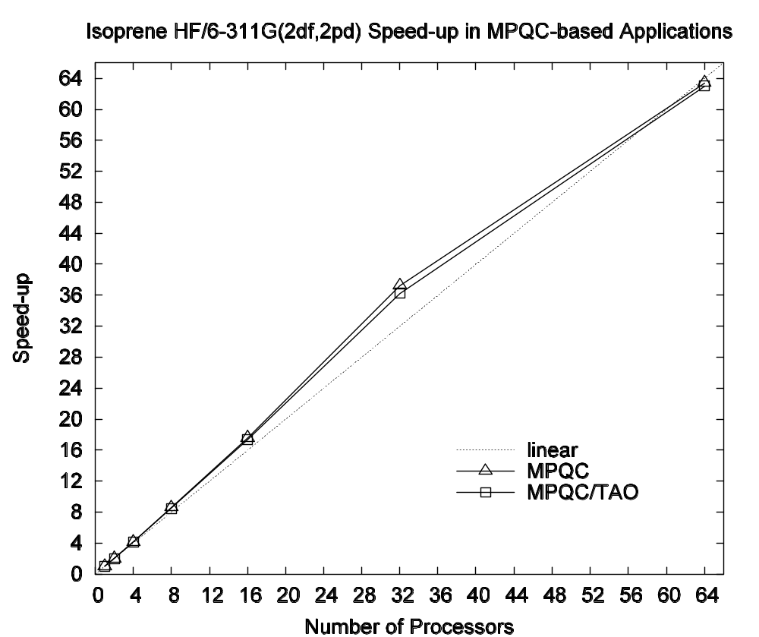
Scalability : Component versus Non-component. I
Supplementary material for handouts
Quantum chemistry simulation
Sandia’s MPQC code
  Both componentized and non-componentized versions
Componentized version used TAO’s optimization algorithms
Problem :Structure of isoprene HF/6-311G(2df,2pd)
Parallel Scaling of MPQC w/ native and TAO optimizers

Slide 55
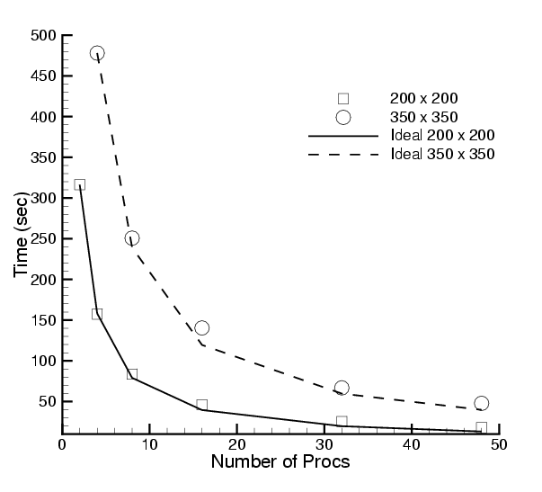
Scalability : Component versus Non-component. II
Supplementary material for handouts
Hydrodynamics; uses CFRFS set of components
Uses GrACEComponent
Shock-hydro code with no refinement
200 x 200 & 350 x 350 meshes
Cplant cluster
  400 MHz EV5 Alphas
  1 Gb/s Myrinet
Negligible component overhead
Worst perf : 73% scaling efficiency for 200x200 mesh on 48 procs
Reference: S. Lefantzi, J. Ray, and H. Najm, Using the Common Component Architecture to Design High Performance Scientific Simulation Codes, Proc of Int. Parallel and Distributed Processing Symposium, Nice, France, 2003.

Slide 56
Advanced CCA Concepts
Brief introductions only, but more info is available – just ask us!
Leveraging the component environment to provide additional capabilities to software developers
The Proxy Component pattern (Hands-On, papers)
Component lifecycle (tutorial notes, Hands-On)
Components can be dynamic (papers)
Improving the quality of component software (papers)
Support for advanced parallel/high-performance computing (papers)

Slide 57
The Proxy Component Pattern
A “proxy” component can be inserted between the user and provider of a port without either being aware of it (non-invasive)
Proxy can observe or act on all invocations of the interface
Similar to aspect-oriented programming
For many purposes, proxies can be generated automatically from SIDL definition of the port
Sample uses for proxy components:
Performance: instrumentation of method calls
Debugging: execution tracing, watching data values
Testing: Capture/replay
Performance Monitoring with TAU
Before:
Component1
Component2
After:
Component1
Proxy for Component2
Component2
MasterMind
(database)
TAU
(measure-
ment)

Slide 58
Component Lifecycle
Additional material in notes
Composition Phase (assembling application)
  Component is instantiated in framework
  Component interfaces are connected appropriately
Execution Phase (running application)
  Code in components uses functions provided by another component
Decomposition Phase (termination of application)
  Connections between component interfaces may be broken
  Component may be destroyed
In an application, individual components may be in different phases at different times
Steps may be under human or software control
Notes:
We’re not really going to talk about disconnecting ports or destroying components here.

Slide 59
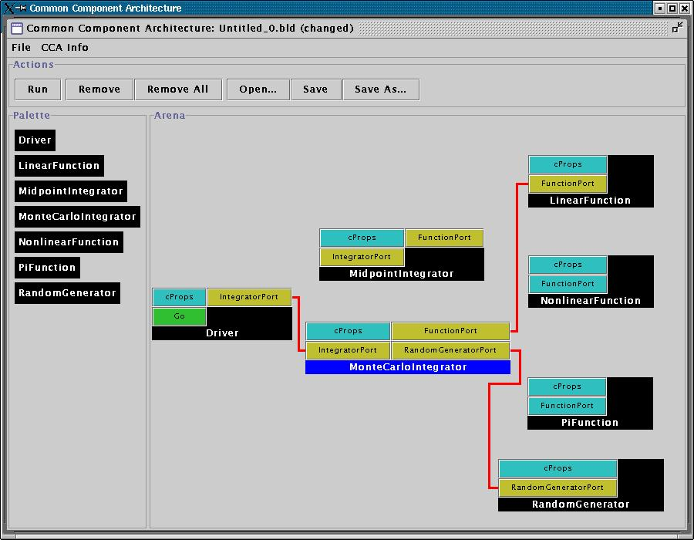
User Viewpoint:
Loading and Instantiating Components
Supplementary material for handouts
Components are code + metadata
Using metadata, a Palette of available components is constructed
Components are instantiated by user action (i.e. by dragging from Palette into Arena)
Framework calls component’s constructor, then setServices
Details are framework-specific!
Ccaffeine currently provides both command line and GUI approaches
create Driver Driver
create LinearFunction LinearFunction
create MonteCarloIntegrator MonteCarloIntegrator
Notes:
While this description is specific to Ccaffeine, the concepts are general

Slide 60
User Connects Ports
Supplementary material for handouts
Can only connect uses & provides
  Not uses/uses or provides/provides
Ports connected by type, not name
  Port names must be unique within component
  Types must match across components
Framework puts info about provider of port into using component’s Services object
connect Driver IntegratorPort MonteCarloIntegrator IntegratorPort
connect MonteCarloIntegrator FunctionPort LinearFunction FunctionPort
…
Notes:
The picture is specific to Ccaffeine, but the concepts are general

Slide 61
Component’s View of Instantiation
Supplementary material for handouts
Framework calls component’s constructor
Component initializes internal data, etc.
  Knows nothing outside itself
Framework calls component’s setServices
  Passes setServices an object representing everything “outside”
  setServices declares ports component uses and provides
Component still knows nothing outside itself
  But Services object provides the means of communication w/ framework
Framework now knows how to “decorate” component and how it might connect with others
Framework interaction code
constructor setServices destructor
CCA.Services
provides IntegratorPort
uses FunctionPort, RandomGeneratorPort
Integrator code
IntegratorPort
FunctionPort
RandomGeneratorPort
MonteCarloIntegrator
MonteCarloIntegrator
Notes:
The cartoon on the left shows the internals of the component. The cartoon on the right is how the Ccaffeine GUI would render the “decorated” component to the outside world.

Slide 62
Component’s View of Connection
Supplementary material for handouts
Framework interaction code
CCA.Services
…, uses FunctionPort
(connected to NonlinearFunction FunctionPort), …
Framework puts info about provider into user component’s Services object
  MonteCarloIntegrator’s Services object is aware of connection
  NonlinearFunction is not!
MCI’s integrator code cannot yet call functions on FunctionPort
Integrator code
Framework interaction code
MonteCarloIntegrator
CCA.Services
provides FunctionPort
Function code
NonlinearFunction

Slide 63
Component’s View of Using a Port
Supplementary material for handouts
User calls getPort to obtain (handle for) port from Services
  Finally user code can “see” provider
Cast port to expected type
  OO programming concept
  Insures type safety
  Helps enforce declared interface
Call methods on port
  e.g.
  sum = sum + function->evaluate(x)
Call releasePort
Framework interaction code
CCA.Services
…, uses FunctionPort
(connected to NonlinearFunction FunctionPort), …
Integrator code
MonteCarloIntegrator
Notes:
This is where the changes to the “library” code turn up. The getPort/cast/releasePort are outright additions. But also, calls to methods on the port will change slightly.

Slide 64
Dynamic Component Assemblies
gov.cca.BuilderService allows programmatic composition of components
  Components can be instantiated/destroyed, and connected/disconnected under program control
Sample uses of BuilderService:
Python “driver” script which can assemble and control an application
  i.e. MCMD climate model
Adaptation to changing conditions
  Swap components in and out to give better performance, numerical accuracy, convergence rates, etc.
  TASCS project “Computational Quality of Service” activity

Slide 65
Enhancing Software Quality
Current component architectures define syntax of interfaces
Extend interface to include semantics (behavior) for more complete definition
  “Design by contract”
  Help ensure
  component
  performs correctly
  Help ensure
  component
  is used correctly
Selective enforcement
to control impact
TASCS project
“Software Quality and
Verification” activity
package vector version 1.0 {
class Utils { …
static double norm(in array<double> u,
in double tol,
in int badLevel)
require /* Preconditions */
not_null : u != null;
u_is_1d : dimen(u) == 1;
non_negative_tolerance : tol >= 0.0;
ensure /* Postconditions */
no_side_effects : is pure;
non_negative_result : result >= 0.0;
nearEqual(result, 0.0, tol)
iff isZero(u, tol);
… }
}

Slide 66
Supporting Emerging HPC Hardware Environments
CCA does not dictate a specific approach to parallelism
Different approaches and tools can be provided via components and custom frameworks
Examples…
Uintah Computational Framework (Utah) provides a multi-threaded parallel execution environment based on task graphs
  Specialized to certain structured adaptive mesh refinement problems
TASCS developing services to manage groups of parallel components/tasks (MCMD)
Also…
TASCS developing support for heterogeneous processor environments
  FPGAs, GP-GPUs, accelerators, and other co-processors
  Accelerator code encapsulated as components, interacting w/ components on primary processors
Integration of fault tolerance capabilities with CCA under development (CIFTS-TASCS collaboration)

Slide 67
Is CCA for You?
Much of what CCA does can be done without such tools if you have sufficient discipline
  The larger a group, the harder it becomes to impose the necessary discipline
Projects may use different aspects of the CCA
  CCA is not monolithic – use what you need
  Few projects use all features of the CCA… initially
Evaluate what your project needs against CCA’s capabilities
  Other groups’ criteria probably differ from yours
  CCA continues to evolve, so earlier evaluations may be out of date
Evaluate CCA against other ways of obtaining the desired capabilities
Suggested starting point:
  CCA tutorial “hands-on” exercises

Slide 68
Take an Evolutionary Approach
The CCA is designed to allow selective use and incremental adoption
“SIDLize” interfaces incrementally
  Start with essential interfaces
  Remember, only externally exposed interfaces need to be Babelized
Componentize at successively finer granularities
  Start with whole application as one component
    Basic feel for components without “ripping apart” your app.
  Subdivide into finer-grain components as appropriate
    Code reuse opportunities
    Plans for code evolution

Slide 69
View it as an Investment
CCA is a long-term investment in your software
  Like most software engineering approaches
There is a cost to adopt
The payback is longer term
Remember Biggerstaff’s Rule of Threes
  Look at three systems, requires three times the effort, payback after third release

Slide 70
CCA is Still Under Development
We’ve got…
  A stable component model
  Working tools
  Active users
But…
  We know its not perfect
  We’re not “done” by any stretch
Talk to us…
  If you’re evaluating CCA and and need help or have questions
  If you don’t think CCA meets your needs
  If you’ve got suggestions for things we might do better

Slide 71
What Can CCA Do Today?
Ccaffeine framework for HPC/parallel
  XCAT and other options for distributed computing
Language interoperability
  Fortran 77/90/95, C, C++, Java, Python
  Support for Fortran/C user-defined data structures under development
CCA Tools working on a variety of platforms
  Linux most widely used
  Mac OS X second
  Some IBM AIX users
  Works on Cray XT series, port to IBM BlueGene in progress
  Porting is driven by user needs, so let us know!

Slide 72
CCA Tools – Language Interoperability and Frameworks

Slide 73
Goal of This Module
CCA/Frameworks
Component A
Component B
CCA IDE
Babel
Chasm
Describe tools for multi-lingual, scientific component ‘plug-and-play’
IDE = Interactive Development Environment

Slide 74
CCA adds value to component development
Babel runtime library &
Chasm F90 array library
Language compiler & linker
Compiled Components
(object libraries)
Generated language code
Babel compiler
(SIDL→language)
CCA Framework
Application (component assembly)
Port Definitions (SIDL)
Component source code
Component Definition (SIDL)
CCA IDE
Key:
User code
CCA Tools
Generated code
Standard Tools
Object libraries
Notes:
The CCA adds value to the component development process. Our Babel and Chasm tools facilitate language interoperability through code generation. Our CCA Frameworks facilitate application composition under a variety of circumstances…
through assembly of components. Finally, recent efforts in developing a CCA Interactive Development Environment
we have tools such as Babel and Chasm for wrapping components that are used to add capabilities to components prior to compilation. We also have frameworks that provide

Slide 75
Tools Module Overview
CCA/Frameworks
Component A
Component B
CCA IDE
Babel
Chasm
Language interoperability tools
Frameworks
CCA Interactive Development Environment

Slide 76
Babel Facilitates Scientific
Programming Language Interoperability
Babel
Programming language-neutral interface descriptions
Native support for basic scientific data types
  Complex numbers
  Multi-dimensional, multi-strided arrays
Automatic object-oriented wrapper generation
f77
f77
C
f90
C
f90
Babel
vs.
C++
Python
C++
Python
Java
Java
Supported on Linux, AIX, works on OSX, catamount;
C (ANSI C), C++ (GCC), F77 (g77, Sun f77), F90 (Intel, Lahey, GNU, Absoft, PGI), Java (1.4)

Slide 77
Babel Generates Object-Oriented Language Interoperability Middleware
Babel
Stubs
comp.sidl
Babel
Compiler
IORs
libcomp.so
Skeletons
Implementations
Babel
Runtime
user creates
Write your SIDL file to define public methods
Generate server side in your native language using Babel
Edit Implementations as appropriate
Compile and link into library/DLL
IOR = Intermediate Object Representation
SIDL = Scientific Interface Definition Language
Notes:
Babel automatically generates language interoperability code.
Step 1: Write your SIDL file to define your public methods. These are the routines that can be invoked from applications or other components.
Step 2: Generate the server side code in your native implementation language using Babel.
Step 3: Edit the implementation hooks as appropriate.
Step 4: Compile and link into a library.

Slide 78
Clients in any supported language can access components in any other language
Babel
C Stubs
C++ Stubs
F77
Stubs
F90
Stubs
Java
Stubs
Python
Stubs
IORs
Skeletons
Implementations
Component
(any supported language)
Babel presentation coming up!
IOR = Intermediate Object Representation
Notes:
Clients in any supported language can access components in any other supported language.

Slide 79
Recent and Upcoming Features
Babel
Remote Method Invocation (Babel RMI)
Kumfert, Leek, & Epperly IPDPS’07
ALPHA – Babel 1.0.* (aka “stable branch”)
BETA – Babel 1.1.*
Final – Future Stable Branch ( Babel 1.2? )
Design-by-Contract
Dahlgren CBSE’07 (to appear)
ALPHA – Internal Babel branch
BETA – Babel 1.1.2 (expected)
Feature requests are accepted and tracked in the open using Roundup
http://www.cca-forum.org/bugs/babel

Slide 80
Tools Module Overview
CCA/Frameworks
Component A
Component B
CCA IDE
Babel
Chasm
Language interoperability tools
Frameworks
CCA Interactive Development Environment

Slide 81
Frameworks are Specialized to Different Computing Environments
Integrator
Linear Fun
“Direct connection” preserves high performance of local (“in-process”) and parallel components
  Framework makes connection
  Framework not involved in invocation
Distributed computing has same uses/provides pattern, but the framework intervenes between user and provider
  Framework provides a proxy port local to the user’s uses port
  Framework conveys invocation from proxy to actual provides port
Provides/Uses
Port
Direct Connection
Integrator
Provides
Port
Network
Connection
Linear Fun
Proxy Provides/
Uses Port

Slide 82
Graphical User Interfaces (GUIs) Deliver Plug-and-Play Experience
Plug & play for:
  Application software assembly
  Visualization pipelines
  Workflow management
Assembling “wiring” diagrams is almost universal.
  Software assembly: Ccaffeine, XCAT, SciRUN
  Workflow: XCAT, SciRUN
  Visualization: SciRUN

Slide 83
Ccaffeine is a Direct-Connect,
Parallel-Friendly Framework
Ccaffeine Framework
Supports SIDL/Babel components
  Conforms to latest CCA specification (0.8)
  Also supports legacy CCA specification (0.5)
    Any C++ allowed with C and Fortran by C++ wrappers
Provides command-line and GUI for composition
  Scripting supports batch mode for SPMD
  MPMD/SPMD custom drivers in any Babel language
Supported on Linux, AIX, OSX and is portable to modern UNIXes.

Slide 84
Ccaffeine Involves a Minimum of Three Steps
Ccaffeine Framework
As easy as 1-2-3:
  Write your component.
  Describe it with an XML file.
  Add a line to your Ccaffeine input file to load the component at runtime.
Proceed to plug & play...
There are many details and automated tools that help manage components.

Slide 85
Ccaffeine GUI
Ccaffeine Framework (ccafe-gui)
Optional
Process
  User input is broadcast SPMD-wise from Java.
  Changes occur in GUI after the C++ framework replies.
  If your components are computing, GUI changes are blocked.
Components interact through port connections
  provide ports implement class or subroutines
  use ports call methods or subroutines in the port.
  Links denote caller/callee relationship not data flow
“Provides” Port
“Uses” Port
IntegratorPort
FunctionPort
FunctionPort
MidpointIntegrator
NonlinearFunction
Notes:
The cartoon is a schematic representation of two components connected to each other. The representation mimics that used in the original GUI for the Ccaffeine framework. Uses ports are shown on the left side of the component, provides ports on the right. They are shown in different colors to help distinguish them.
The MidpointIntegrator component has two ports. It provides an IntegratorPort and uses a FunctionPort. The NonlinearFunction component provides a FunctionPort. The red line connects the user FunctionPort on MidpointIntegrator to the provider FunctionPort on NonlinearFunction.
Another way to think of user/provider is client/server
To repeat: connecting ports does not imply direction of data movement!

Slide 86
User Connects Ports
Ccaffeine Framework (ccafe-gui)
Can only connect uses & provides
  Not uses/uses
  Not provides/provides
Ports connected by type not name
  Port names must be unique within a component
  Types must match across components
Framework puts info about provider of port into using component’s Services object
connect Driver IntegratorPort MonteCarloIntegrator IntegratorPort
connect MonteCarloIntegrator FunctionPort LinearFunction FunctionPort
…
Notes:
The picture is specific to Ccaffeine, but the concepts are general

Slide 87
Building an Application (1 of 2)
Ccaffeine Framework (ccafe-gui)
Components are code + XML metadata
Using metadata, a Palette of available components is constructed.
Components are instantiated by user action (i.e. by dragging from Palette into Arena).
Framework calls
component’s constructor,
then setServices
create Driver Driver
create LinearFunction LinearFunction
create MonteCarloIntegrator MonteCarloIntegrator
Notes:
While this description is specific to Ccaffeine, the concepts are general

Slide 88
Building an Application (2 of 2)
Ccaffeine Framework (ccafe-gui)
1. Click Configure port to start parameter input dialogue.
2. For each connection:
click a uses port
then click a provides port to establish a connection.
3. Click Go port to start the application.
Right-clicking a connection line breaks the connection -- enabling component substitution.
Notes:
The cartoon is a schematic representation of two components connected to each other. The representation mimics that used in the original GUI for the Ccaffeine framework. Uses ports are shown on the left side of the component, provides ports on the right. They are shown in different colors to help distinguish them.
The MidpointIntegrator component has two ports. It provides an IntegratorPort and uses a FunctionPort. The NonlinearFunction component provides a FunctionPort. The red line connects the user FunctionPort on MidpointIntegrator to the provider FunctionPort on NonlinearFunction.
Another way to think of user/provider is client/server
To repeat: connecting ports does not imply direction of data movement!

Slide 89

XCAT is a Web-services based
Distributed Component Framework
XCAT-C++ Framework
Remote references
  Port types described in C++ header files or in WSDL documents
User Interface
  C++ and Python interface to CCA BuilderService
  Uses SWIG for Python-C++ translations
Component creation
  Remote creation via SSH
Component communication
  Proteus multi-protocol library
  Communication libraries can be loaded at run-time
Tested on Linux.
WSDL = Web Service Definition Language

Slide 90
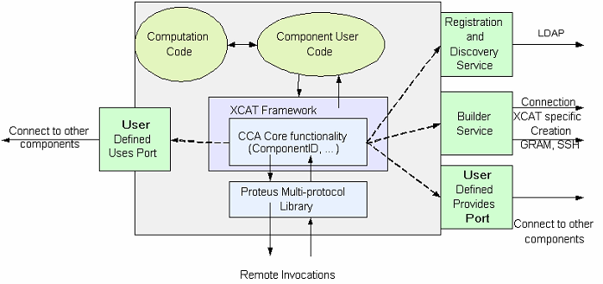
XCAT is Designed for High-Performance Scientific Applications
XCAT-C++ Framework

Slide 91
Basic How-To
XCAT-C++ Framework
Define port interfaces as C++ header files or WSDL docs
Indicate ports used by each component in a config file
Run scripts to generate code for stub-skeletons (for ports)
  Can also generate component-templates for new components
  Use component-templates to convert a scientific library into a CCA component
Build components using XCAT-C++ make scripts
Deploy component executables on the target remote hosts
  Also set up SSH access to remote hosts
Write python scripts (edit examples) to use CCA API to connect components and invoke a Go port
  Alternatively, can use a C++ front-end
Execute the python script (or C++ front-end)
Notes:
No release yet, obtainable through SCI subversion repository -> contact us
Tutorial w/ release

Slide 92
Recent and Upcoming Features
XCAT-C++ Framework
Incorporate Babel’s Remote Method Invocation
  Allows access to Babel objects through remote Babel stubs
  Provides direct support for SIDL in distributed applications
Incorporate Web-services based protocols in BabelRMI
Performance analysis of Babel-RMI based distributed communication
Design Distributed Framework Interoperability Specification

Slide 93
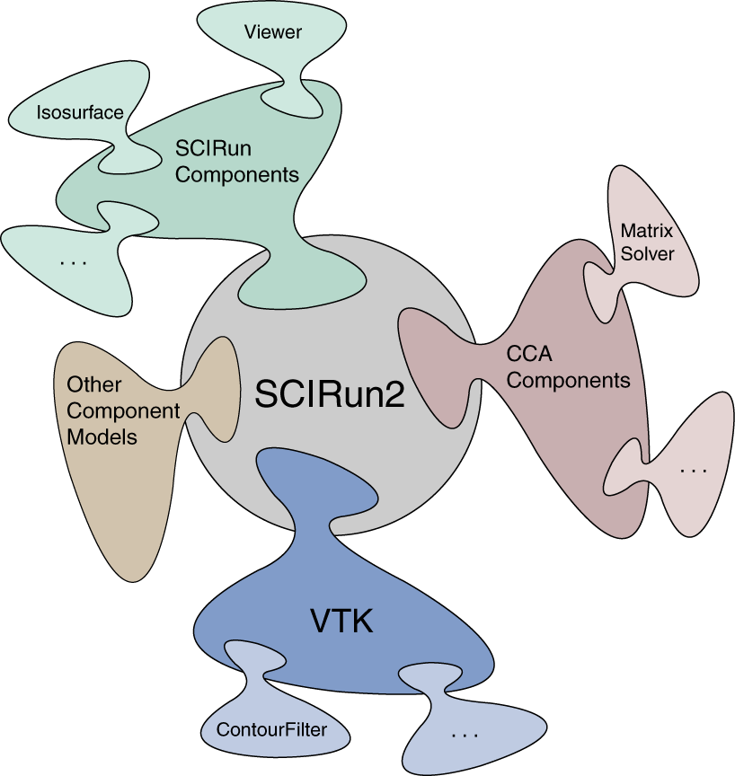
SCIRun2 is a Cross-Component Model, Distributed Component Framework
SCIRun2 Framework
Semi-automatically bridges component models
  Templated components connected at
  run-time generate bridges
Parallel Interface Definition Language
(PIDL) – a SIDL variant
User interface – GUI and textual
  Dynamic composition
Component and framework creation
  Remote via SSH
Component communication
  C++ RMI with co-location optimization
  MPI/ Parallel Remote Method Invocation (PRMI)
Supported on Linux.
Notes:
*** Alpha release expected by the end of 2005; Unix variants and Mac OSX support are future work ***
*** Note: Currently the PIIDL/SIDL compiler is not based on Babel ***
The user interface supports:
create, destroy, connect, disconnect, and execute on components
Components and component models can be added at run-time
Slave frameworks can be created and started
Existing frameworks can be connected
Parallel Components:
MPI-Parallel components are supported in SCIRun2, wherein each MPI process may contain multiple threads. These components interact via Parallel Remote Method Invocation (PRMI).

Slide 94
Master Framework Coordinates Slave Frameworks in Each Remote Address Space
SCIRun2 Framework
SCIRun2 Framework (Master Framework)
Component Loader (Slave Framework)
Component Loader (Slave Framework)
Component
Component
Connection
Table
(Referencing remote
Components)
Provides Ports
Provides Ports
Component Code
(User)
PRMI
Component Code
(User)
Component Code
(PIDL-Generated)
Component Code
(PIDL-Generated)
Component ID
Table
(Referencing remote
provides ports)
Uses Ports
Uses Ports
Service Object
Service Object
Builder Service

Slide 95
Basic How-To
SCIRun2 Framework
Add component source files and makefile to SCIRun2 sources
  May need to define ports in SIDL
Add component information to the component model xml file
Build component using SCIRun2 make scripts
  Alternatively, build component using Babel
Start the framework and graphical (default) or text builder
Graphically connect component to other CCA-based or non CCA-based components
  May need to create bridge components to go between models
Press the “Go” button on the driver component
Notes:
No release yet, obtainable through SCI subversion repository -> contact us
Tutorial w/ release

Slide 96
Experimental Frameworks
Framework | Purpose | Summary
Distributed CCA Framework (DCA) | MxN research | Goal: explore MxN Parallel-Remote Method Invocation (PRMI) using MPI Parallel data transfer and redistribution integrated into port invocation mechanism
LegionCCA | Grid-based research | Goal: allow component-based CCA applications to run in Grid-scale environments using Legion Supports creation, scheduling, persistence, migration, and fault notification; relies on Legion’s built-in RPC mechanism (~Unix sockets)
XCAT-Java | Globus-based Grid research | Goal: explore web interface for launching distributed applications This (alpha) version compatible with latest CCA specification and provides built-in seamless compatibility with OGSI.
OGSI = Open Grid Services Infrastructure

Slide 97
Tools Module Overview
CCA/Frameworks
Component A
Component B
CCA IDE
Babel
Chasm
Language interoperability tools
Frameworks
CCA Development Environment

Slide 98
Component Development Environment
CCA IDE
Supplementary material for notes
Bocca
  Provides a light-weight, portable environment

Slide 99
Eclipse Environment Provided via Eclipse Plug-ins
CCA IDE
Supplementary material for notes
Provides a high-level graphical environment
  Creating new SIDL-based components
  Componentizing legacy codes
    C, C++, Java and Fortran
Automatic code generation
Supported on Linux, Windows, MacOS.

Slide 100
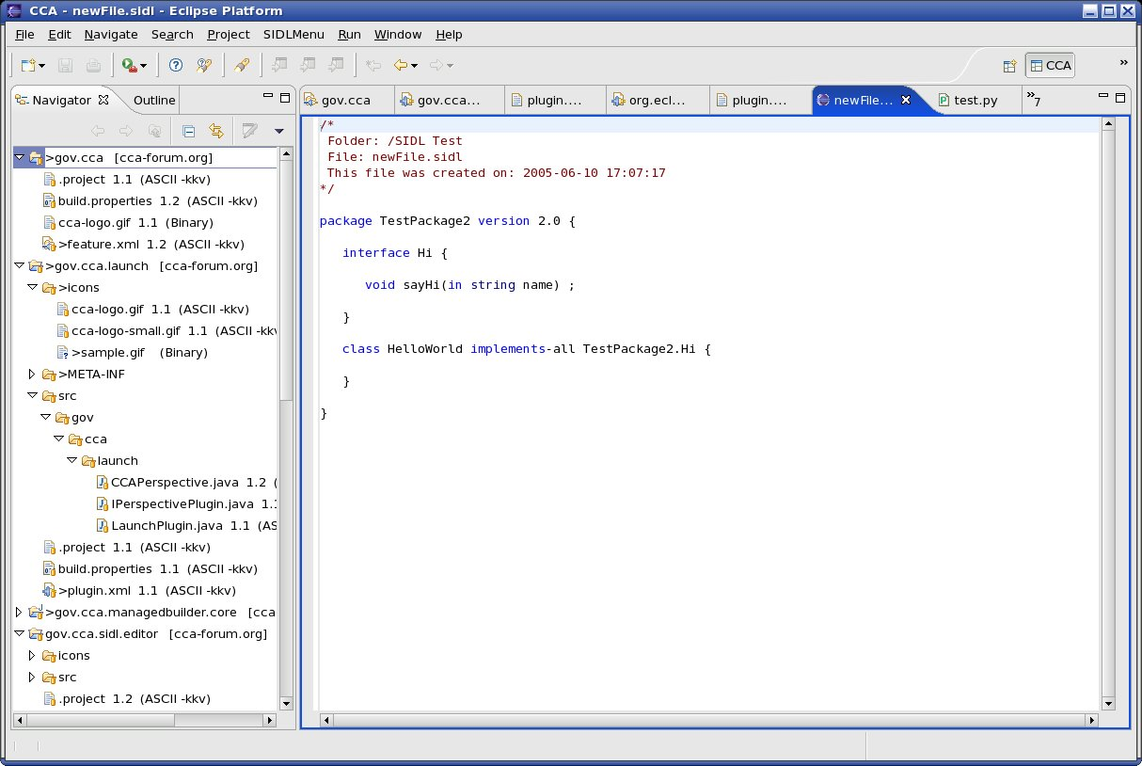
Component Development Environment Starts at the Eclipse Platform Level
CCA IDE
Supplementary material for notes
Plug-ins for:
SIDL Editor
Wizards
Preliminary automated build support
Imperative that you start by creating a new project!

Slide 101
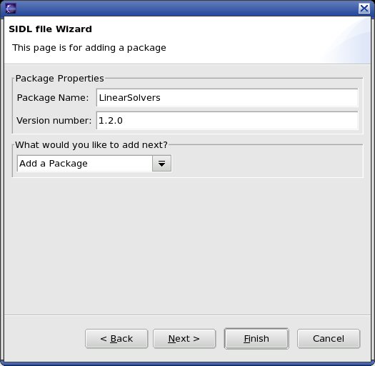
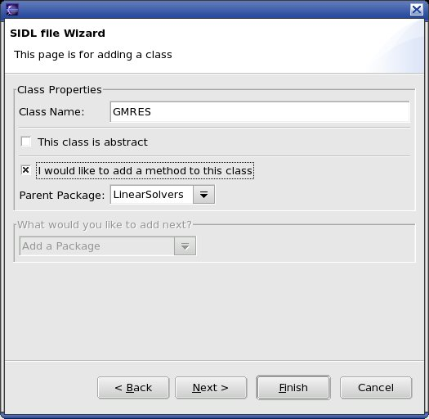
Wizards are Available for Adding Packages and Classes or Generating SIDL from Legacy Codes
CCA IDE
Supplementary material for notes
Intuitive interfaces to port and component definition
Helper wizards for setting port, component and (in the future) application properties

Slide 102
Bocca Development Environment
CCA IDE
Provides a text-based, portable environment
  Create or import SIDL and CCA based codes.
  Automatic build system maintenance.
  Easy to adopt or abandon while preserving code, build.
No GUI required.
Still in the early beta stage of development
  Being tested by managing the tutorial source and a regression test suite.
  Basis for common CCA toolkit installation.
  Manages components in all Babel-supported languages (C, C++, Fortran 77, Fortran 90, Java, Python).

Slide 103
Bocca is an Application Generator
Purely command-line driven
  Generates the glue code that enables components and language interoperability.
  Enables rapid generation of an entire application skeleton and build system in minutes.
  Good for full project life-cycle
    But is also meant to support very rapid prototyping.
Complementary to a normal IDE
  Does not provide an integrated editor for creating code.
  Invoke your own editor with bocca assistance (no need to remember paths to files, build system optionally automatically updated).

Slide 104
Bocca Creates Skeletons for CCA
Including ports and interfaces
  Give the SIDL name and an empty port or interface is created.
Including components and classes
  Give the name and an empty component or class is created.
  Some extra options: the component uses/provides ports, implemented interfaces or extended classes
Including build system
  For all ports/components in the project
  Implemented in any CCA supported language
Create applications with Ccaffeine GUI (today)
Including application composition (coming soon)

Slide 105
Bocca Example
# create an empty but buildable CCA skeleton
bocca create project myproj
cd myproj
./configure
bocca create port myJob
bocca create component myWorker –provides=myJob:job1
# fill in public functionality
bocca edit port myJob
# fill in implementation
bocca edit component –i myWorker
# compile application
make

Slide 106
CCA Tools Contacts (1 of 2)
Tool | Purpose | More information
Babel | Scientific language interoperability tool kit | URL: www.llnl.gov/CASC/components Email: components@llnl.gov or babel-users@lists.llnl.gov
Ccaffeine | Direct-connect, parallel-friendly framework | URL: www.cca-forum.org/software/ Email: Ben Allan, ccafe-help@cca-forum.org Wiki: https://www.cca-forum.org/wiki
Bocca | CCA development environment | Email: bocca-dev@cca-forum.org bocca FAQ: https://www.cca-forum.org/wiki

Slide 107
CCA Tools Contacts (2 of 2)
Tool | Purpose | More information
SCIRun2 | Cross-component model framework | URL: www.sci.utah.edu/ Email: Steve Parker, sparker@cs.utah.edu
XCAT-C++ | Globus-based GRID framework | URL: grid.cs.binghamton.edu/projects/xcat/ Email: Madhu Govindaraju, mgovinda@cs.binghamton.edu

Slide 108
Module Summary
CCA/Frameworks
Component A
Component B
CCA IDE
Babel
Chasm
Described tools for multi-lingual, scientific component ‘plug-and-play’
  Language interoperability through Babel and Chasm
  CCA Frameworks provide mechanisms for composition
  CCA Interactive Development Environments

Slide 109


Slide 110
Goal of This Module
Expose Attendees to How Existing Code is
  Wrapped into Babel objects, and then
  Promoted to CCA components
In the process, will also cover
Babel Basics
Scientific Interface Definition Language (SIDL)
Code sample (“Hello World!”)

Slide 111
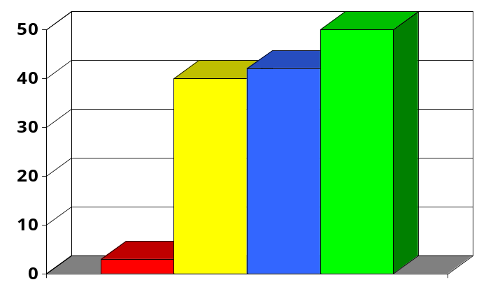

Babel is Middleware for HPC
Performance (in process)
“The world’s most rapid communication among many programming languages in a single application.”
Million calls/sec
Babel
COM
.NET
2006
CORBA
 | CORBA | COM | .NET | Babel
BlueGene, Cray, Linux, AIX, & OS X | No | No | No | Yes
Fortran | No | Limited | Limited | Yes
Multi-Dim Arrays | No | No | No | Yes
Complex Numbers | No | No | No | Yes
Licensing | Vendor Specific | Closed Source | Closed Source | Open Source

Slide 112

Babel Supports a Unified Object-Oriented Type System Spanning Many Languages
XML
C
Babel
Runtime
SIDL
Babel
Compiler
C++
F77
F90
Application
Java
Python
Uses:
Stop hand-writing language wrappers!
Basis for component frameworks
Add polymorphism in single languages
Generate language-neutral API specifications
Turn Python to an interactive debugger

Slide 113
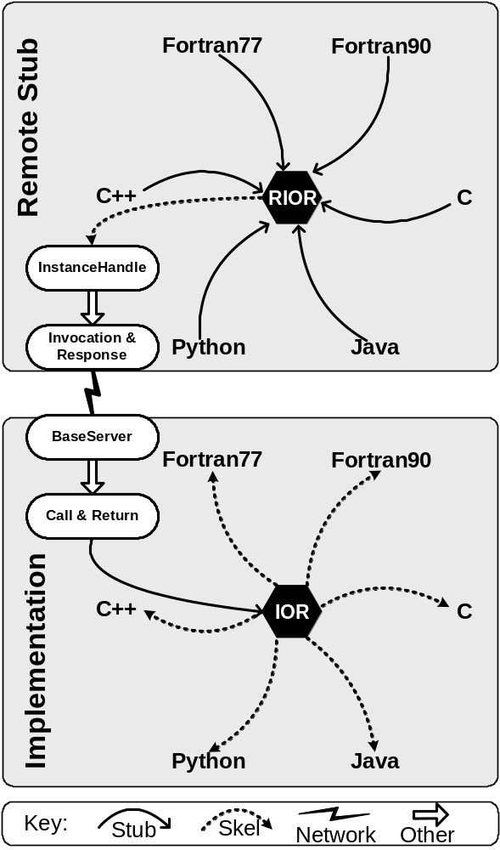
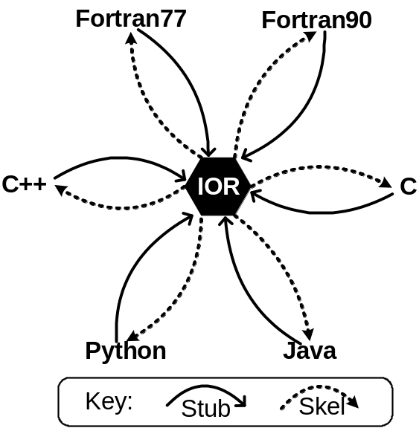
Recently, Babel Added
Distributed Capabilities
(Remote Method Invocation)
Distributed
CCA is still experimenting with RMI, so this talk focuses on in-process case.
In Process
Network Layer defined in SIDL for 3rd party plug-ins

Slide 114
Working Code: “Hello World” in F90
Using a Babel Type
•
•
program helloclient
use greetings_English
use sidl_BaseInterface
implicit none
type(greetings_English_t) :: obj
type(sidl_BaseInterface_t):: exc
character (len=80) :: msg
character (len=20) :: name
name=’World’
call new( obj, exc )
call setName( obj, name, exc )
call sayIt( obj, msg, exc )
call deleteRef( obj, exc )
print *, msg
end program helloclient
①
②
③
④
⑤
⑥
⑦
⑧
⑨

Slide 115
Handout Material: Code Notes
Supplementary material for handouts
Use statement for the greetings.English type
Use statement for the sidl.BaseInterface type
Obj is a F90 derived type we get from the using statement, note the “_t” extension that prevents it from colliding with the using statement.
Exc is used to hold exceptions thrown by methods
In C/C++ examples, this variable would be initialized by a the command-line variable “argv[1]”, but its trickier to do portably in F90 and too long, so I just initialize the name to “World”.
Obj is not yet initialized. The Babel idiom in F90 is to call new() to initialize the Babel type. In other languages its _create(). NOTE: good code would add error checking.
setName() puts data into the obj. It sets its state.
sayIt() returns the entire greeting including the aforementioned name.
deleteRef() is a subroutine that all Babel types inherit from a parent class. All Babel objects are reference counted. When there are no more outstanding references, the object is told to clean up after itself.

Slide 116
Working Code: “Hello World” in F90
Using a Babel Type
•
•
program helloclient
use greetings_English
use sidl_BaseInterface
implicit none
type(greetings_English_t) :: obj
type(sidl_BaseInterface_t):: exc
character (len=80) :: msg
character (len=20) :: name
name=’World’
call new( obj, exc )
call setName( obj, name, exc )
call sayIt( obj, msg, exc )
call deleteRef( obj, exc )
print *, msg
end program helloclient
Looks like a native
F90 derived type
These subroutines were specified in the SIDL.
Other basic subroutines
are “built in” to all Babel types.

Slide 117
Question: What language is “obj” really implemented in?
•
•
program helloclient
use greetings_English
use sidl_BaseInterface
implicit none
type(greetings_English_t) :: obj
type(sidl_BaseInterface_t):: exc
character (len=80) :: msg
character (len=20) :: name
name=’World’
call new( obj, exc )
call setName( obj, name, exc )
call sayIt( obj, msg, exc )
call deleteRef( obj, exc )
print *, msg
end program helloclient
Answer: Can’t Know!
With Babel, it could be C, C++, Python, Java, Fortran77, or Fortran90/95
In fact, it could change on different runs without recompiling this code!

Slide 118
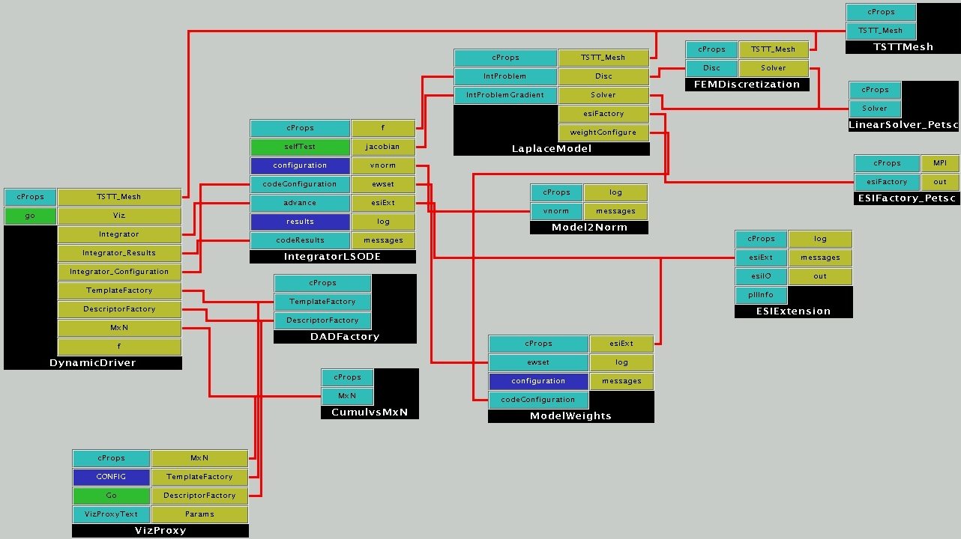
CCA uses Babel for high-performance n-way language interoperabilty
Each one of these red lines, is
potentially a bridge between two languages. No telling which language your component will be connected to when you write it.

Slide 119
The SIDL File that defines the “greetings.English” type
①
②
package greetings version 1.0 {
interface Hello {
void setName( in string name );
string sayIt ( );
}
class English implements-all Hello { }
}
③
④
⑤
⑥

Slide 120
Handout Material: Code Notes
Supplementary material for handouts
Packages contain user-defined types and are used to reduce naming collisions. Packages can be nested.
Packages can be versioned. User defined types must be nested inside a versioned package and gain the same version number as the innermost versioned package
SIDL has a inheritance model similar to Java and Objective C. Classes can inherit multiple interfaces, but at most one implementation (other class).
An interface describes an API, but doesn’t name the implementation.
Note that arguments have mode, type, and name. Mode can be one of “in”, “out”, and “inout”. These SIDL modes have slightly different semantics than Fortran90 “intents”.
This class generates English greetings. One could imagine a strategy for internationalization that uses the Hello interface everywhere, but loads in English, French, or whatever classes based on user’s preference.

Slide 121
Babel Consists of Two Parts:
Code Generator + Runtime Library
XML
HTML
Babel
Runtime
SIDL
Babel
Compiler
C
C++
F77
Application
F90
Code generator reads SIDL, and generates wrapper code…
Java
Python
… very sophisticated wrapper code.

Slide 122
Typical Workflow to Use a Babel type (static linkage)
Babel
Runtime
SIDL
Babel
Compiler
F90 Stubs
Application
IOR Headers
libgreetings.a
`babel --client=F90 greetings.sidl`
Compile generated Code
Link driver, generated code (“Stubs”), Babel Runtime, and library containing Babel type

Slide 123
Typical Workflow to Use a Babel type (dynamic linkage)
Babel
Runtime
SIDL
Babel
Compiler
F90 Stubs
Application
IOR Headers
libgreetings.so
`babel --client=F90 greetings.sidl`
Compile same generated code with different flags
Link driver, and stubs only (both generated code and F90 stubs to Babel Runtime library)
Set SIDL_DLL_PATH environment variable to include relevant *.scl (or *.cca) files.
Actual implementations are linked in at runtime

Slide 124
Static vs. Dynamic Linkage
Static
  Least runtime overhead
  Easiest to get right, debug, etc.
Dynamic
  Allows new types to “plug-in” without relinking driver
  Necessary for Java or Python calling to other languages (unless you relink their virtual machine)
  Induces very nondeterministic behavior if done incorrectly

Slide 125
Workflow for a Developer Wrapping Their Code into Babel Objects
•
C++ Stubs
greetings.sidl
Babel
Compiler
IORs
libgreetings.a
C++ Skeletons
C++ Implementations
legacy_library.a
`babel --server=C++ greetings.sidl`
Fill in the implementation details (see next slide)
Compile and link into a library/DLL

Slide 126
Implementation Details Must be Filled in Between Splicer Blocks
namespace greetings {
class English_impl {
private:
// DO-NOT-DELETE splicer.begin(greetings.English._impl)
string d_name;
// DO-NOT-DELETE splicer.end(greetings.English._impl)
string
greetings::English_impl::sayIt()
throw ()
{
// DO-NOT-DELETE splicer.begin(greetings.English.sayIt)
string msg(“Hello “);
return msg + d_name + “!”;
// DO-NOT-DELETE splicer.end(greetings.English.sayIt)
}

Slide 127
Quick Review of Babel in general before proceeding to CCA specifics
Babel can be used as a standalone tool
Each language binding strikes a balance
  support the SIDL type system (OO, exceptions, etc.)
  provide it in a manner “natural” to experienced programmers in the target language
For more details about Babel and SIDL
  SC|07 tutorial slides for Babel
  http://www.llnl.gov/CASC/components/docs/sc07.html
  Babel User’s Guide (aka. the BUG)
  http://www.llnl.gov/CASC/components/docs/users_guide/

Slide 128
CCA uses SIDL to specify APIs and Type Hierarchy for Frameworks, Services, Components, & Ports
A CCA framework must
  implement gov.cca.AbstractFramework,
  provide a gov.cca.ports.BuilderService,
  etc.
A CCA port must
  be a SIDL interface extending gov.cca.Port
A CCA component must
  be a SIDL class implementing gov.cca.Component
The CCA Specification is a SIDL file.

Slide 129
How to write a
Babelized CCA Component (1/3)
Define “Ports” in SIDL
  CCA Port =
    a SIDL Interface
    extends gov.cca.Port
package functions version 1.0 {
interface Function extends gov.cca.Port {
double evaluate( in double x );
}
}

Slide 130
How to write a
Babelized CCA Component (2/3)
Define “Components” that implement those Ports
  CCA Component =
    SIDL Class
    implements gov.cca.Component (and any provided ports)
class LinearFunction implements functions.Function,
gov.cca.Component {
double evaluate( in double x );
void setServices( in cca.Services svcs );
}
class LinearFunction implements-all
functions.Function, gov.cca.Component { }

Slide 131
Tip: Use Babel’s XML output like precompiled headers in C++
Supplementary material for notes
cca.sidl
Babel
Compiler
Type
Repository
XML
Precompile SIDL into XML using ‘--text=xml’
Store XML in a directory
Use Babel’s –R option to specify
search directories
Stubs
functions.sidl
Babel
Compiler
IORs
Skeletons
Implementations

Slide 132
How to write a
Babelized CCA Component (3/3)
Repo
(XML)
C Stubs
functions.sidl
Babel
Compiler
IORs
C Skeletons
libfunctions.so
C Implementations
Use Babel to generate the interoperability glue
  Execute `babel --server=C –RRepo functions.sidl`
Fill in Implementations as needed
Notes:
Outline: 4.1.3 Components Implemented Using Babel (**KEY**)
As before, Step 3 executes Babel to generate the interoperability glue.
Finally, Step 4 involves filling in the implementation hooks as needed. That is, implement the behavior within the splicer blocks we saw before if you’re starting from scratch or fill in the glue to translate and dispatch to your legacy code(s).

Slide 133
Review: Goal of This Module
Learn how existing code is
  Wrapped into Babel objects, and
  Promoted to CCA components
In the process, will also covered
Babel Basics
Scientific Interface Definition Language (SIDL)
Code sample (“Hello World!”)

Slide 134
Babel Thrives on Research Collaborations & Community
Cray Port
ORNL
Nightly Testing
ANL, ORNL & SNL
Startup
Components Initiative
CCA
SciDAC 1&2
Lab Directed
R&Ds
@ LLNL
Alpha Testers
hypre @LLNL
F90 Arrays
Chasm
LANL
Nonblocking RMI
Cooperative Programming
Improved C++ Bindings
University Utah
FACETS
SciDAC App
J. Cary, PI
Fortran 2003 Bindings
Tech-X
RMI Consulting & Feedback
Univ. Utah, Suny Binghamton,
Indiana Univ. & Tech-X
Feature Requests & Defect Reports
General User Base

Slide 135
Contact Information
Project: http://www.llnl.gov/CASC/components
Project Team Email: components@llnl.gov
Mailing Lists: majordomo@lists.llnl.gov
  subscribe babel-users [email address]
  subscribe babel-announce [email address]
Bug Tracking: https://www.cca-forum.org/bugs/babel/
or email to babel-bugs@cca-forum.org

Slide 136
Using CCA:
Approaches & Experience

Slide 137
Modern Scientific Software Development
Complex codes, often coupling multiple types of physics, time or length scales, involving a broad range of computational and numerical techniques
Different parts of the code require significantly different expertise to write (well)
Generally written by
teams rather than
individuals
Time Evolution
Physics Modules
Mesh
Adaptive Solution
Optimization
Diagnostics
Discretization
Steering
Derivative Computation
Algebraic Solvers
Visualization
Data Reduction
Collaboration
Data Redistribution
Notes:
Physics simulations are becoming increasingly complex and involve a large number of different sophisticated tools ranging from structured and unstructured (potentially adaptive) grids, high order discretization techniques, algebraic solvers and optimization methods, as well as advanced visualization capabilities and computational steering tools. There has been a great deal of work in each of these areas to develop state of the art techniques but it is often difficult for application scientists to take advantage of the latest and greatest
- the software is too hard to use
- it’s difficult to compose applications from tools developed by different groups
Thus, the potential for high fidelity calculations on high performance computers using such techniques will become a reality only if the application scientist can take advantage of the of tools being developed by domain experts.

Slide 138
Using CCA to Help Manage Complexity
Supplementary material for handouts
Application areas participating in the CCA:
  astronomy, astrophysics, biological and medical simulations, chemically reacting flow, climate and weather modelling, combustion, computational chemistry, data management, fusion and plasma physics modelling, linear algebra, materials science, molecular electronics, nanoscience, nuclear power plant simulations, structured adaptive meshes, unstructured meshes, and visualization
Research agencies sponsoring software development using the CCA:
  DOE (SciDAC, Office of Science, NNSA/ASC), NASA, NIH, NSF, DoD, European Union

Slide 139
Outline
Supplementary material for handouts
Developing Components
  Strategies for both developing new codes and wrapping existing codes
Case Studies
  Chemistry project
    Moderate-sized multi-disciplinary, multi-institutional team
    Using Ccaffeine framework, SIDL components
  Combustion toolkit
    Small team, both new and wrapped codes
    Using Ccaffeine framework, C++ components
Notes:
To highlight how components can be useful in this scenario I will show a series of examples of increasing complexity that highlight component reuse and composability. I will start with a simple steady state PDE and move to a time-dependent PDE and from there to block structured adaptive time dependent PDEs. We will also show the use of several of the same components used in the PDE simulations in optimization-based applications.
I will give single processor performance results and scalability results for distributed memory applications. These results show that if you choose the level of granularity for your components appropriately there is very little performance impact.
Finally, based on our experiences to date, I will discuss strategies for developing your own component-based high performance simulation code. In addition, I will give a case study that highlights some of the issues associated with developing interchangeable and interoperable components in a domain-specific setting through the development of common interfaces.

Slide 140
Developing Components
(Both New Codes and Wrappers to Existing Codes)
Supplementary material for handouts
Productivity Benefits
Application Decomposition Strategies
Interface Design Issues
  Social factors
  Technical factors
Implementation Issues and Patterns
Notes:
We are able to reuse three out of five of our previous components without changing them. In particular, the mesh, discretization, and solver components can be reused, without even recompiling them!
We may change what we use from a given component, for example, the solver component is no longer required to provide the solution to a linear system, but we still use the vector implementations provided.
We could have chosen to reuse the visualization component as well to print out a series of files, but interactive visualization with the time dependent physics is more interesting.

Slide 141
CCA Productivity Benefits
Fast algorithmic experiments and benchmarks by substituting components
Once ports are defined, domain-expert component implementers can work separately in their own favorite languages
Work of transient contributors remains as well-defined, lasting components
Wrapped legacy portions need not be reimplemented or reverified
Notes:
We are able to reuse three out of five of our previous components without changing them. In particular, the mesh, discretization, and solver components can be reused, without even recompiling them!
We may change what we use from a given component, for example, the solver component is no longer required to provide the solution to a linear system, but we still use the vector implementations provided.
We could have chosen to reuse the visualization component as well to print out a series of files, but interactive visualization with the time dependent physics is more interesting.

Slide 142
Components in the Small:
Impacts within a Project
Benefits include:
Rapid testing, debugging, and benchmarking
Support for implementation-hiding discipline
Coordination of independent workers
Interface change effects across components are clear and usually automatically found by compilers if overlooked
Object-orientation made simpler for C and Fortran
Notes:
We are able to reuse three out of five of our previous components without changing them. In particular, the mesh, discretization, and solver components can be reused, without even recompiling them!
We may change what we use from a given component, for example, the solver component is no longer required to provide the solution to a linear system, but we still use the vector implementations provided.
We could have chosen to reuse the visualization component as well to print out a series of files, but interactive visualization with the time dependent physics is more interesting.

Slide 143
Components in the Large:
Connecting Multiple Projects
Benefits include:
SIDL can be used to facilitate the interface consensus processes
Different sub-projects do not have to agree on one implementation language
Developers who never meet in person have an excellent chance of code integration working on the first try
Costs include:
Consensus can be expensive to obtain
Writing code for others to use is more difficult than writing it just for yourself
Notes:
We are able to reuse three out of five of our previous components without changing them. In particular, the mesh, discretization, and solver components can be reused, without even recompiling them!
We may change what we use from a given component, for example, the solver component is no longer required to provide the solution to a linear system, but we still use the vector implementations provided.
We could have chosen to reuse the visualization component as well to print out a series of files, but interactive visualization with the time dependent physics is more interesting.

Slide 144
Application Decomposition Strategies
Conceptually decompose the application into
  cutting-edge areas (less stable) and
  areas that can employ existing component-based libraries (more stable)
Decompose each area into components for
  physics
  mathematics
  data management
  as dictated by the application; sketch a typical component layout
Many components will encapsulate algorithmic logic only, with little or no private data
Most HPC applications will have a central data abstraction that provides data memory management and parallel communication
In a multilanguage application, all I/O may need to be isolated into components written in a single common language (file based I/O should not be affected)
Component boundaries (and port interfaces) may be set to isolate proprietary code or difficult contributors

Slide 145
Interface Design: Social Factors
(Defining Ports to Wrap Existing Code)
Supplementary material for handouts
Will the port hide just one implementation, or will there need to be plug compatibility with other implementations? From other teams?
Who defines the interface and maintains it?
  Project dictator? (Fast…)
  The owner of the legacy functionality? (Slow, if not you…)
  A standards committee? (Really slow…)
How many iterations of redefining the ports will the customers tolerate?
Notes:
We are able to reuse three out of five of our previous components without changing them. In particular, the mesh, discretization, and solver components can be reused, without even recompiling them!
We may change what we use from a given component, for example, the solver component is no longer required to provide the solution to a linear system, but we still use the vector implementations provided.
We could have chosen to reuse the visualization component as well to print out a series of files, but interactive visualization with the time dependent physics is more interesting.

Slide 146
Interface Design: Technical Factors
Supplementary material for handouts
Do we make a single large port look like the underlying library or divide functions into groups on separate ports?
Should a function with many optional arguments be split into several alternative functions with simpler usage?
Do we make the ports more general than the existing code?
Do we require the ports to work across languages? Across networks?
  If not, gains in efficiency or coding ease might be had
  If so, memory management and I/O challenges may arise
Notes:
We are able to reuse three out of five of our previous components without changing them. In particular, the mesh, discretization, and solver components can be reused, without even recompiling them!
We may change what we use from a given component, for example, the solver component is no longer required to provide the solution to a linear system, but we still use the vector implementations provided.
We could have chosen to reuse the visualization component as well to print out a series of files, but interactive visualization with the time dependent physics is more interesting.

Slide 147
Implementation Issues in Wrapping
Supplementary material for handouts
Do we split large libraries into several components?
  Splitting is difficult to do if global variables or common blocks are widely used.
Do we expect more than one implementation instance of a port in a single run-time?
  If not, interface contracts may include global side effects
Do we integrate the wrapper code in the existing code’s development and build processes?
  If not, how do we ensure build consistency and on-going wrapper support?
Code bases with large interfaces need automated wrapping tools
  E.g., see Chasm info in the Tools module of the tutorial
Notes:
We are able to reuse three out of five of our previous components without changing them. In particular, the mesh, discretization, and solver components can be reused, without even recompiling them!
We may change what we use from a given component, for example, the solver component is no longer required to provide the solution to a linear system, but we still use the vector implementations provided.
We could have chosen to reuse the visualization component as well to print out a series of files, but interactive visualization with the time dependent physics is more interesting.

Slide 148
Benefits of Wrapping Code Using CCA
Supplementary material for handouts
Setting a language-neutral interface definition (SIDL) can greatly clarify design discussions
Provides a chance to reorganize the interface and hide globals
Allows testing of alternate versions if doing performance studies
Allows easy “experimentation” with new algorithms
Software discipline is enforced, not optional
Implementation decisions (to split libraries, etc) can be easily revised over time if interfaces remain constant (possibly with the addition of new interfaces)
Notes:
We are able to reuse three out of five of our previous components without changing them. In particular, the mesh, discretization, and solver components can be reused, without even recompiling them!
We may change what we use from a given component, for example, the solver component is no longer required to provide the solution to a linear system, but we still use the vector implementations provided.
We could have chosen to reuse the visualization component as well to print out a series of files, but interactive visualization with the time dependent physics is more interesting.

Slide 149
Interface Design for New Code
Supplementary material for handouts
Write SIDL for each connection (port) in the sketched component layout
If two ports must always be used together, consider merging them
Review SIDL drafts for near-duplication of ports
Avoid creating interface contracts that require using hidden global data
Consider exporting tuning and/or configuration parameter inputs as a port
All the design issues from wrapping existing code apply, also
Interfaces will change.
Notes:
We are able to reuse three out of five of our previous components without changing them. In particular, the mesh, discretization, and solver components can be reused, without even recompiling them!
We may change what we use from a given component, for example, the solver component is no longer required to provide the solution to a linear system, but we still use the vector implementations provided.
We could have chosen to reuse the visualization component as well to print out a series of files, but interactive visualization with the time dependent physics is more interesting.

Slide 150
Recommended Implementation Patterns
Supplementary material for handouts
Expect to decompose initial components further as work progresses and requirements expand
Build systems (i.e. make) should be kept as simple as possible
  Keep a subdirectory for port definitions and any implementation-independent glue code derived from the ports
  Keep each component (and any wrapped code) in its own subdirectory
  Keep application-wide flags in a configure script or an include file common to all components and ports
  Consistency is key. Extract build flags from cca-spec-babel-config and if possible compile & link with babel-libtool
Notes:
We are able to reuse three out of five of our previous components without changing them. In particular, the mesh, discretization, and solver components can be reused, without even recompiling them!
We may change what we use from a given component, for example, the solver component is no longer required to provide the solution to a linear system, but we still use the vector implementations provided.
We could have chosen to reuse the visualization component as well to print out a series of files, but interactive visualization with the time dependent physics is more interesting.

Slide 151
Outline
Supplementary material for handouts
Developing Components
  Strategies for both developing new codes and wrapping existing codes
Case Studies
  Chemistry project
    Moderate-sized multi-disciplinary, multi-institutional team
    Using Ccaffeine framework, SIDL components
  Combustion toolkit
    Small team, both new and wrapped codes
    Using Ccaffeine framework, C++ components
Notes:
To highlight how components can be useful in this scenario I will show a series of examples of increasing complexity that highlight component reuse and composability. I will start with a simple steady state PDE and move to a time-dependent PDE and from there to block structured adaptive time dependent PDEs. We will also show the use of several of the same components used in the PDE simulations in optimization-based applications.
I will give single processor performance results and scalability results for distributed memory applications. These results show that if you choose the level of granularity for your components appropriately there is very little performance impact.
Finally, based on our experiences to date, I will discuss strategies for developing your own component-based high performance simulation code. In addition, I will give a case study that highlights some of the issues associated with developing interchangeable and interoperable components in a domain-specific setting through the development of common interfaces.

Slide 152
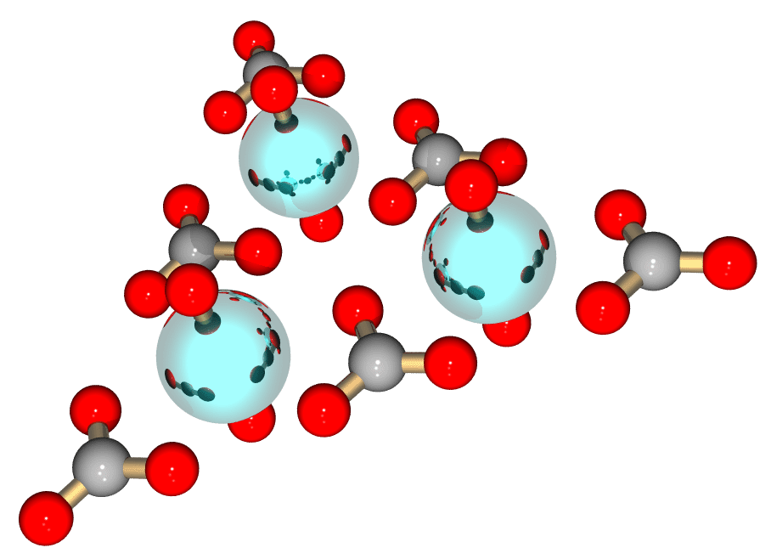
Case Study 1: Chemistry Project
Funded via SciDAC initiative
Initial focus: Full-featured components for structure optimization
  Chemistry models provided by MPQC (SNL) & NWChem (PNNL)
  Numerical optimization provided by TAO (ANL) solvers
  Linear algebra provided by GA (PNNL) and PETSc (ANL)
Recent work:
  Multi-level parallelism
  Low-level chemistry model
  integration (e.g., molecular integrals)

Slide 153
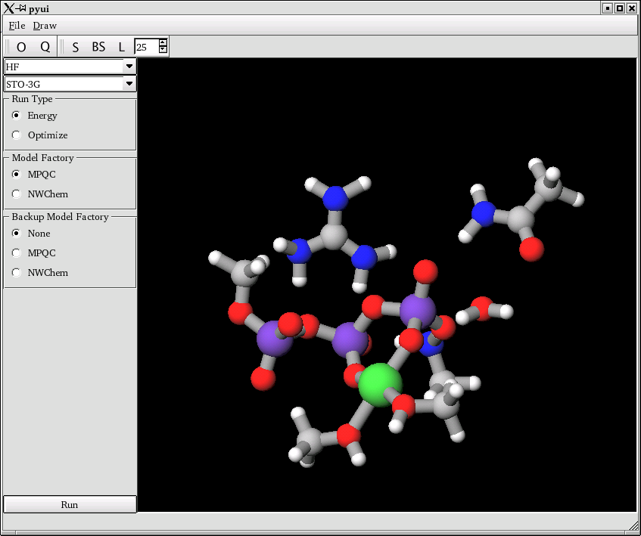



CCA-Chemistry Project Participants
Pacific Northwest National Laboratory
Theresa L. Windus
Yuri Alexeev
Manojkumar Krishnan
Jarek Nieplocha
Carl Fahlstrom
Elizabeth Jurrus
Sandia National Laboratory
Curtis L. Janssen
Joseph P. Kenney
Argonne National Laboratory
Steve Benson
Lois Curfman McInnes
Jason Sarich

Slide 154
CCA Impacts in Computational Chemistry
Through 4 chemistry applications we consider different facets of CCA functionality:
Molecular Geometry Optimization
  Combining diverse expertise of 5 different research groups
Lennard-Jones Molecular Dynamics
  Achieving good scalability and low CCA overhead
Multi-level Parallelism in Computational Chemistry
  Combining SPMD and MPMD parallelism
Molecular Integral Evaluation
  Component interoperability at deeper levels within chemistry libraries

Slide 155
App 1: Molecular Geometry Optimization: Combining Diverse Expertise
CCA quantum chemistry application using components based on:
MPQC, NWChem (chemistry – energy evaluation)
GA, PETSc (parallel data management and linear algebra)
TAO (numerical optimization)

Slide 156
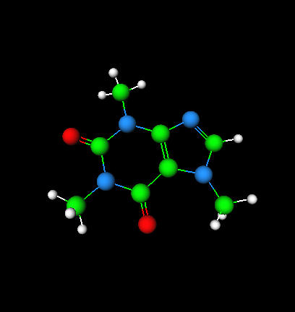
Molecular Geometry Optimization
n
Compute the molecular geometry with minimum energy, i.e. solve min f(u), where f: R R.
Builder
Construct application using framework builder services
build options
GUI
User Input
u_{i+1} (visualization)
f(u) energy
u Cartesian coordinates
u internal coordinates
g gradient (in Cartesians)
g gradient (in internals)
H Hessian (in Cartesians)
H Hessian (in internals)
s update (in internals)
Optimization
u_{i+1} = u_{i} + αs …
f,g,H
Coordinate Model
(perform transformations)
u_{i+1}
u_{i+1}
f,g,H
g,H
s
Model Factory (instantiate model)
Linear
Algebra
PETSc
GA
MPQC
NWChem
Relatively high-
level interfaces

Slide 157
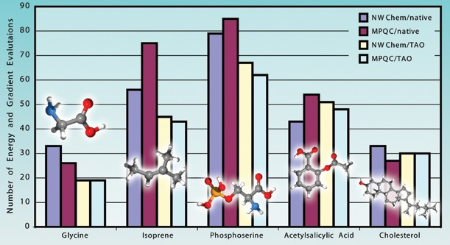
Performance Gains with Better Optimization Algorithms
CCA-based integration of state of the art optimization algorithms from the TAO toolkit provides up to 40% improvement in the time required to optimize molecular structures with MPQC and NWChem.¹
¹Journal of Computational Chemistry 25: 1717-1725, 2004.

Slide 158
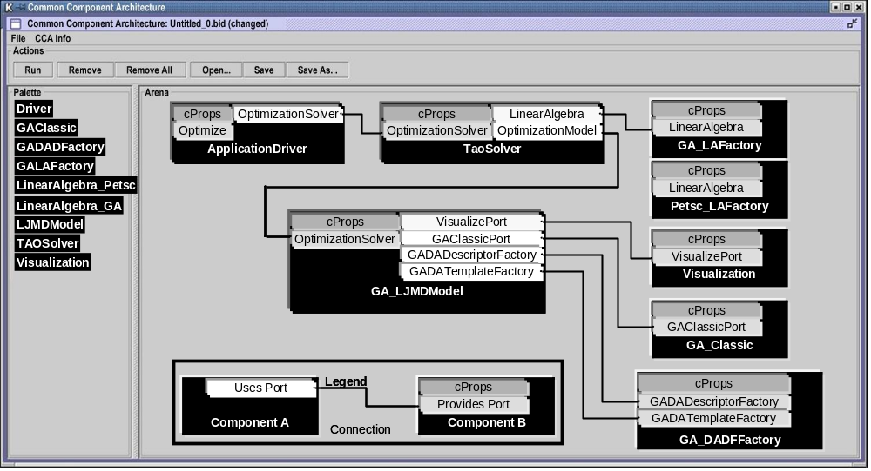
App 2: Molecular Dynamics
CCA component wiring diagram for Lennard-Jones energy optimization, which integrates TAO, GA and Lennard-Jones molecular dynamics components

Slide 159
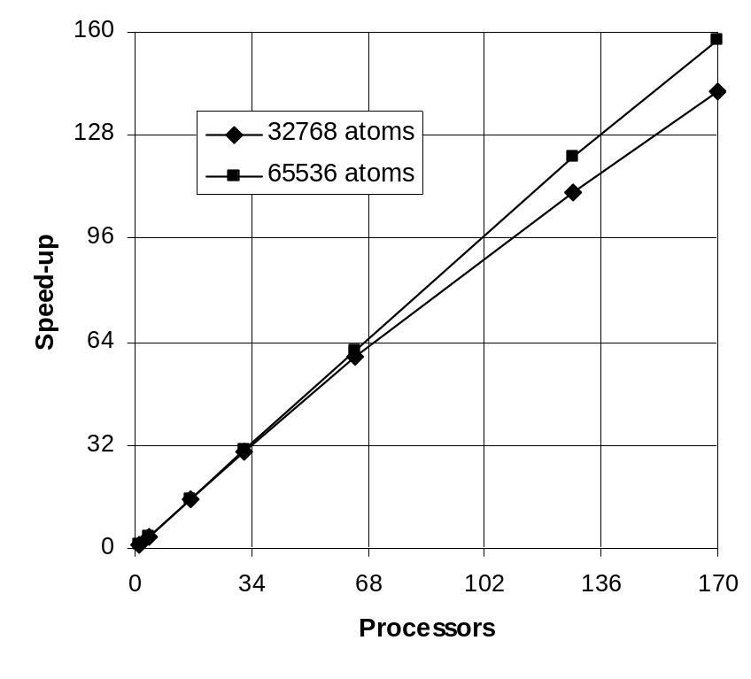
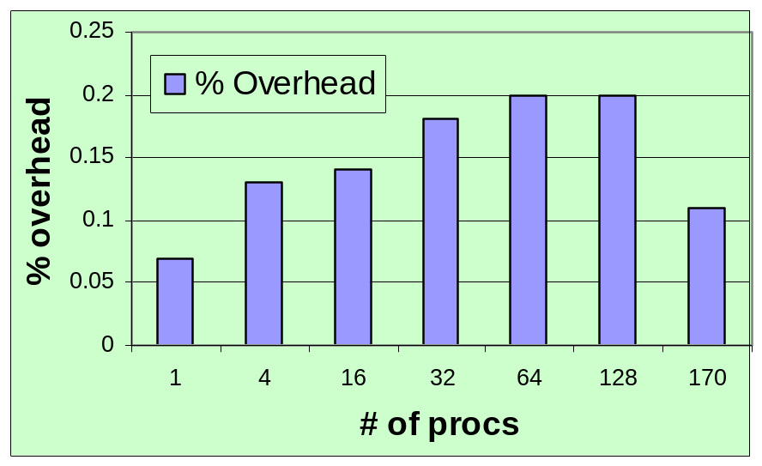
Good CCA Scalability, Negligible Overhead
Overhead of CCA component (using SIDL) vs. “native” C++ implementation of a parallel Lennard-Jones molecular dynamics simulation
Speedup in the Lennard-Jones potential energy optimization for 32,768 and 65,536 particles
% Overhead using CCA Components

Slide 160
App 3: Multilevel Parallelism Using CCA
Massive numbers of CPUs in future systems require leading edge tools to exploit all available parallelism
GA helps exploit multi-level parallelism
Multi-level parallelism using CCA & GA processor groups: Combining SCMD (Single Component Multiple Data) and MCMD (Multiple Component Multiple Data) paradigms
NWChem_QM_0
Energy
The MCMD Driver launches multiple instances of NWChem components on subsets of processors (also assigns a GA communicator for every instance). Each NWChem QM component does multiple energy computations on subgroups.
cProps
Energy
ModelFactory
Param Port
Energy
NWChem_QM_1
Energy
cProps
MCMD Hessian Driver
ModelFactory
Energy
cProps
ModelFactory
Param Port
Go
Energy
NWChem_QM_2
cProps
Energy
ModelFactory
Energy
Param Port
Energy
NWChem_QM_n
Energy
cProps
Energy
ModelFactory
Param Port
Energy

Slide 161
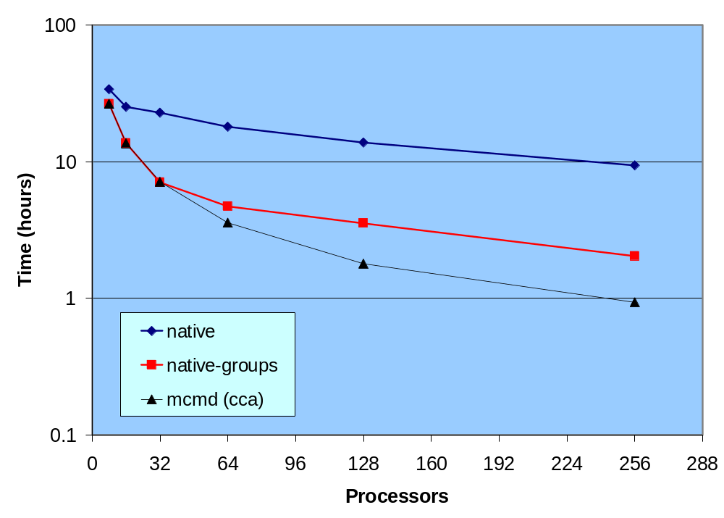
Multilevel Parallelism - MCMD
NWChem Scalability of Numerical Hessian Computation on 11.8 TFlop/s HP Cluster at PNNL
Application efficiency improved 10x on 256 CPUs
M. Krishnan, Y. Alexeev, T. Windus, and J. Nieplocha, Multilevel Parallelism in Computational Chemistry using the Common Component Architecture and Global Arrays, Proceedings of the IEEE/ACM SC2005 Conference.

Slide 162



App 4: Molecular Integrals:
Deeper Levels of Interoperability among Chemistry Packages
As a first step toward low-level integration of chemistry models, capabilities to provide and utilize molecular integral evaluator components are being added to MPQC and NWChem (also working with GAMESS developers)
Specialized integral capabilities are provided to CCA chemistry models
  Relativistic integrals in NWChem
  Non-standard 2-electron integrals for linear-R12 theories in MPQC
U_{i+1}
f,g,H
Integral Evaluator
“Super” Factory
Integral
Evaluator
<ij|kl>
Model
Object
MPQC
Integral Evaluator
Factory
NWChem
Integral Evaluator
Factory
Model
Factory
MPQC
NWChem

Slide 163
CCA Impacts in Computational Chemistry: Review
Supplementary material for handouts
Through 4 chemistry applications we considered different facets of CCA functionality:
Combining diverse expertise of 5 different research groups
Achieving good scalability and low CCA overhead
Implementing multi-level parallelism by combining SPMD and MPMD paradigms
Addressing component interoperability at deeper levels within chemistry libraries

Slide 164
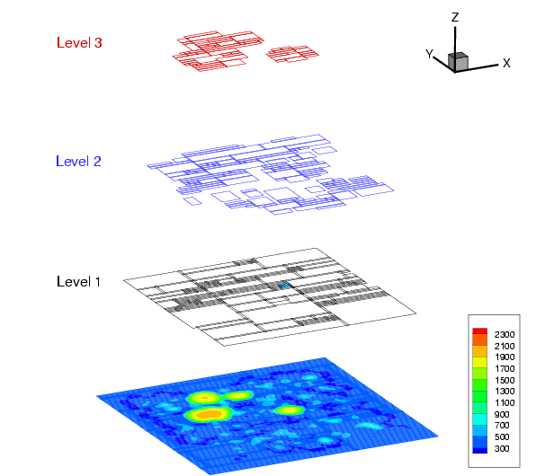
Case Study 2: Combustion Project
Computational Facility for Reacting Flow Science (CFRFS)
  http://cfrfs.ca.sandia.gov
  Funded via SciDAC initiative (PI: H. Najm)
Focus: A toolkit to perform simulations
of lab-sized unsteady flames
  Solve the Navier-Stokes w/detailed chemistry
  Various mechanisms up to ~50 species,
  300 reactions
Consequently:
  Disparity of length scales :
    use structured adaptively refined meshes
  Disparity of time scales (transport versus chemistry) :
    use an operator-split construction and solve chemistry implicitly
    adaptive chemistry: use computational singular perturbation to find and follow low dimensional chemical manifolds
J. Ray, S. Lefantzi, J. Lee, C. Kennedy, W. Ashurst, K. Smith, M. Liu, N. Trebon

Slide 165
Why Use CCA in the CFRFS Toolkit?
Separate clearly the physics models, numerical algorithms, and the “CS” parts of the toolkit
  Strictly functional!
Realize the separation in software
Tame software complexity
Separate contributions by transient contributors
  Form the bulk of the developers
Create “chunks” of well-defined functionality that can be developed by experts (usually numerical analysts and combustion researchers)

Slide 166
Design Principles of the Toolkit / 1
Principal Aim: Reduce software complexity
  We can deal with the rest
Functional decomposition into components
  “Data Object” and Mesh components
  (Large) set of numerical algorithmic components (integrators, linear/nonlinear solvers, etc.)
  (Large) set of physical models components (gas-phase combustion chemistry, thermodynamics, fluid dynamic quantities, e.g. viscous stress tensor)
  Handful of adaptors

Slide 167
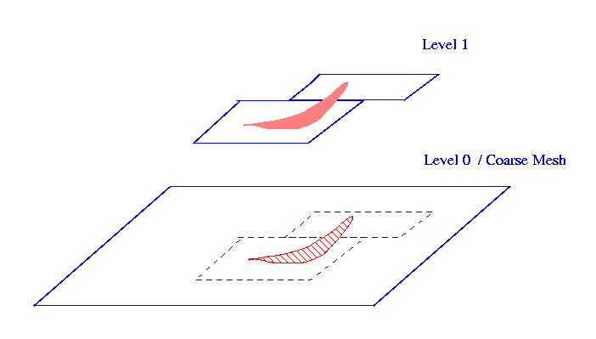
Design Principles of the Toolkit / 2
Decomposition reflected in the port design and implementation
  Most re-implemented port is the one
  that exchanges a rectangular
  sub-domain’s data for processing
  by components
Sparse connectivity between components
  i.e., components communicate with a few others
  Large apps (component assemblies) are composed by assembling smaller, largely independent sub-assemblies
    Sub-assemblies usually deal with a certain physics
  Intuitive way to assemble a multiphysics code

Slide 168
The Code
Transport subassembly
Diffusion coefficients
Chemistry reaction subassembly
Separate component subsystems for transport (black) and for reaction (orange) in a reaction-diffusion code. They two are coupled at a relatively high level.
Notes:
Multiphysics codes can often be constructed from separate subsystems for solving a single type of physical process, with the different processes being coupled at a certain level (of physical resolution). Below this level of resolution, the processes are separate. In software, this concept translates into having subassemblies of components for simulating separate physical processes (diffusion transport, convective transport, reaction, radiation etc) largely separate, with a coupling of component subsystems at a certain level. Such a synthetic approach to constructing/assembling codes mimics the physics, simplifies code structure and keeps us away from a tight mish-mashed connection structure amongst components.

Slide 169
Has the Toolkit Approach Helped
Tame Software Complexity?
Supplementary material for handouts
How has the code evolved?
  How often have new ports been added?
  How many rewrites have been done?
How large are the components?
How many ports do they have?
  How large are the ports?
How many ports exist?
  i.e., Is the design general enough to support many implementations?
What is the connectivity of components in application codes?

Slide 170
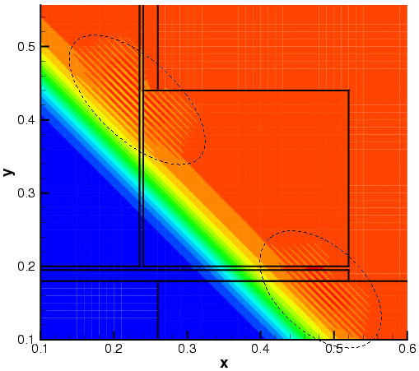
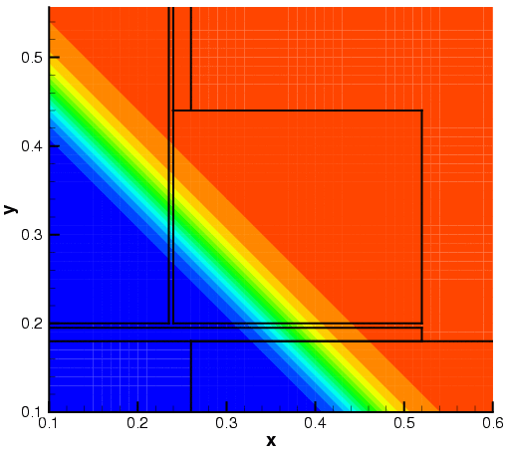
CFRFS Toolkit Status
Started in 2001
61 components today, all peers, independent, mixed and matched for combustion and shock hydrodynamics
7 external libraries
Contributors: 9 in all, including 3 summer students
Only 2 of the 9 contributors are at SNL today
A Fitzhugh-Nagumo equation being solved on a block-structured adaptively refined mesh. The top image illustrates Runge phenomena at coarse-fine interfaces (dashed ovals) when using high-order schemes (6th order interpolations with 4th order discretizations). Filtering them with an 8th order filter removes them (bottom).

Slide 171
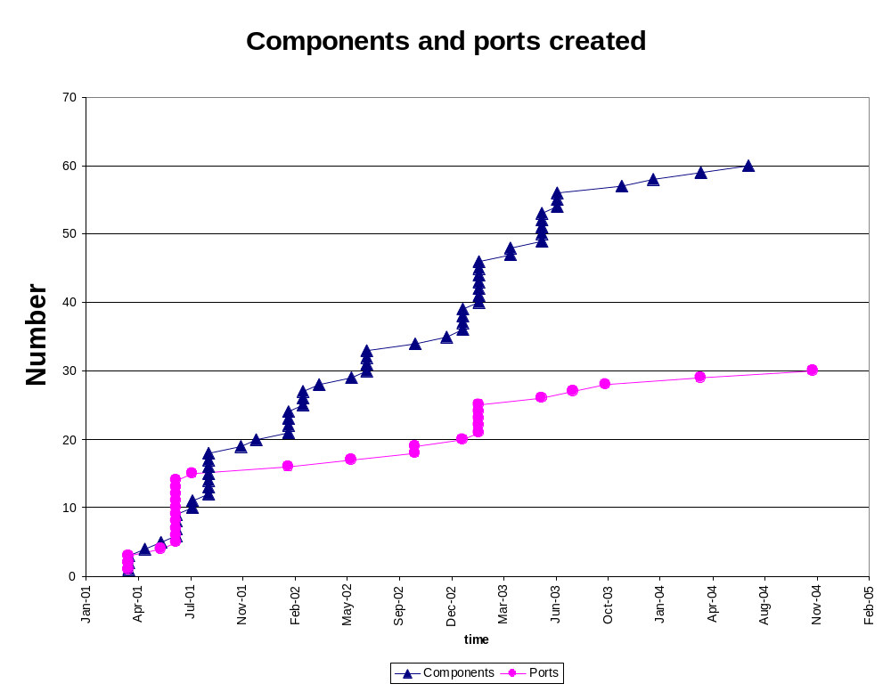
Scalability: Capability Growth without Rewrites
Port designs typically occur in spurts followed by long component development times.
Ports may have multiple implementations; hence the number of ports is typically less than the number of components.
As the toolkit has matured, the number of ports is seen to be asymptoting to a slow growth rate.
Notes:
How does the evolution of a toolkit look? Evidently, interfaces have to be made. Evidently, too, these have to be implemented, debugged and tested. Hence one expects component development to lag port design. However, if ports are designed properly (i.e. one doesn't have to design a new port every time one wants to develop new components), one would expect that the number of components to quickly surpass the number of ports regardless of the time involved in developing components. Also, if the number of ports over time are seen to be asymtoting to a constant, it is a sign that the current collection of ports adequately covers the functionality in the toolkit. Also, if N_ports << N_components, it is a sign that the ports were well designed. If you are designing a toolkit, and these characteristics are not being observed, it would be well worth your time to examine what went wrong.

Slide 172
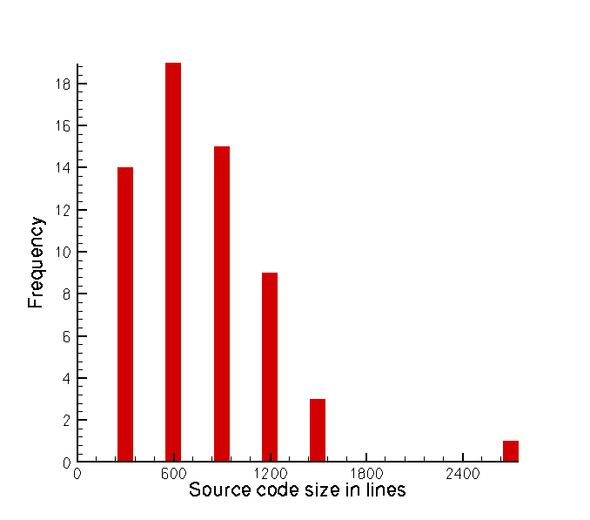
Taming Complexity: Lines of Code
Most components are < 1000 lines, i.e., they are easily maintainable
Components based on GrACE (M. Parashar, Rutgers) and Chombo (P. Colella, LBNL) are the largest in size: parallel mesh libraries with load-balancers

Slide 173
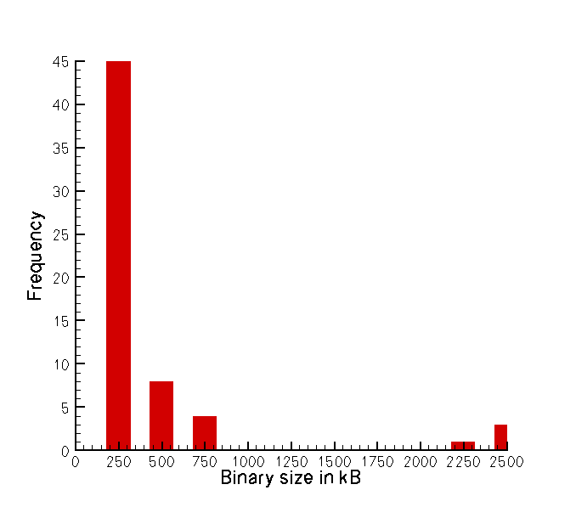
Taming Complexity: Code Size
Most components are < 250 kB
The larger the binary, the more complexity is being hidden in underlying (externally contributed) libraries

Slide 174
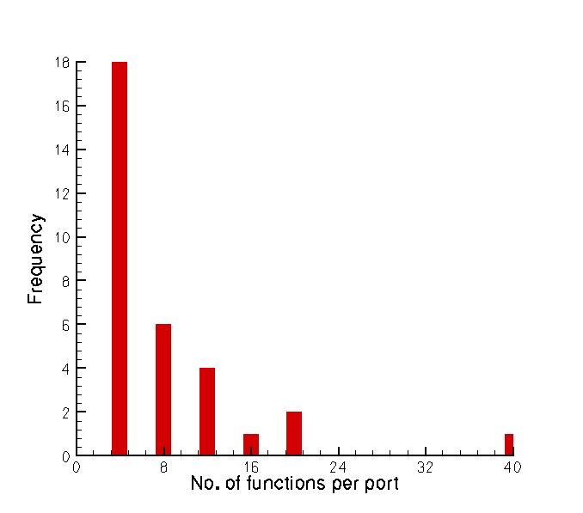
Taming Complexity: Interface Size
A CCA port is a unit of task exchange and generally also a unit of thought
In CFRFS code, this is typically in the range of 5-10 functions
Exception : SAMR mesh data port

Slide 175
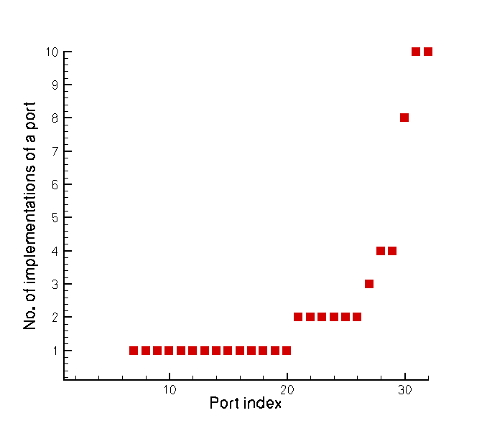
Taming Complexity: Implementations
CFRFS ports may have just one or many imple-mentations, as needed, but ...
Most ports have 1 or 2 implementations
High-utility ports exist, e.g., for exchanging a patch’s worth of data

Slide 176
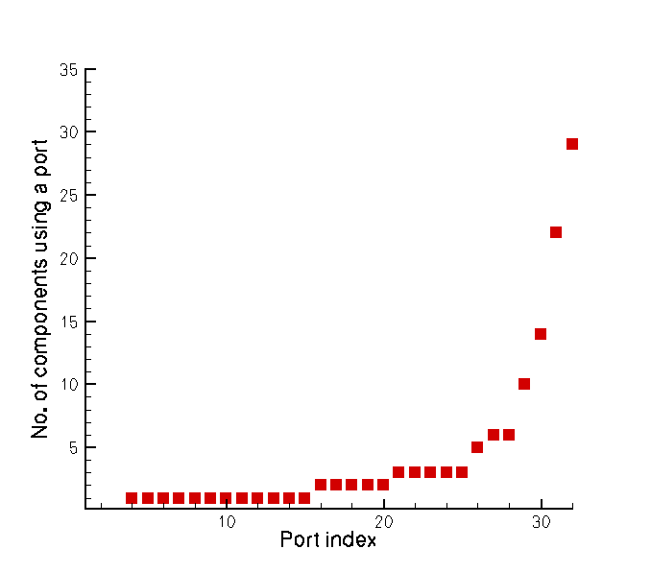
Taming Complexity: Callers
Most CFRFS ports are used by only a few clients, but …
Key ports are used by many components

Slide 177
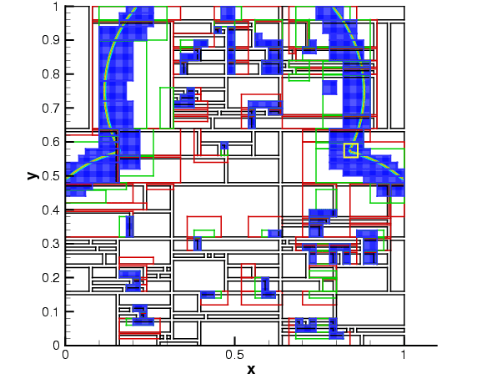
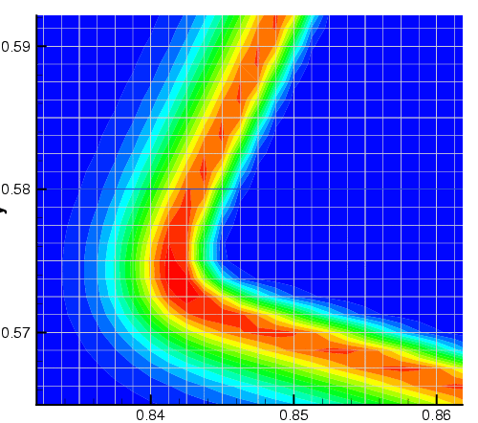
Scientific Productivity
Conventional Measures
  4 journal papers in CFD/Numerics
  4 software-oriented journal papers, 1 book chapter
  ~11 conference papers, including best paper award
  Over 60 presentations
  1 MS and 1 PhD theses
  6 test applications
  See papers at: http://cfrfs.ca.sandia.gov
Unconventional Measures
  Did the toolkit spawn new research in app-focused
  CS (e.g., performance evaluation/enhancement/modeling?)
  Can the design accommodate software which were themselves designed to be frameworks and not components ?
H₂O₂ chemical subspecies profile and associated AMR mesh

Slide 178
Adaptive Codes / Computational Quality of Service
Can codes be optimized during runtime ?
  CCA code is an assembly of components
  Component applications can be non-optimal because
    The mathematical characteristics of the simulation are different from those of the component
    The component is badly implemented
So, can one dynamically “re-arrange” an assembly to improve performance?
Simplistically, 2 approaches:
  Create performance model per component, use best one
  Create expert system that analyzes problem and picks good solution strategy

Slide 179
Requirements for CQoS codes
A software framework within which ordinary components can be “CQoS-ified”
  By “decorating” a given component-network with extra CQoS components
The ‘extra” components form a control system which monitors, tweaks and/or replaces components commensurate with the problem and the computer at hand.
  Requires continuous performance monitoring
    How do you monitor a component non-invasively?
  Requires continuous querying of a performance database to analyze current situation and make predictions
The control infrastructure/framework/software is generic, the control law is domain specific.

Slide 180
Who’s working on CQoS ?
Control law work:
  Computational chemistry: evaluation of integrals
  Partitioning of block-structured adaptive meshes
  Iterative sparse linear algebra: mix-and-match accelerators and preconditioners
Infrastructure work
  Performance measurement: Automatic performance data (statistical) analysis
  Design of a CQoS API (to enable extraction & storage of performance data)
  Quick-and-dirty experimentation in a CQoS world (SciPY based)
  Infrastructural components – databases, regression-ers etc

Slide 181
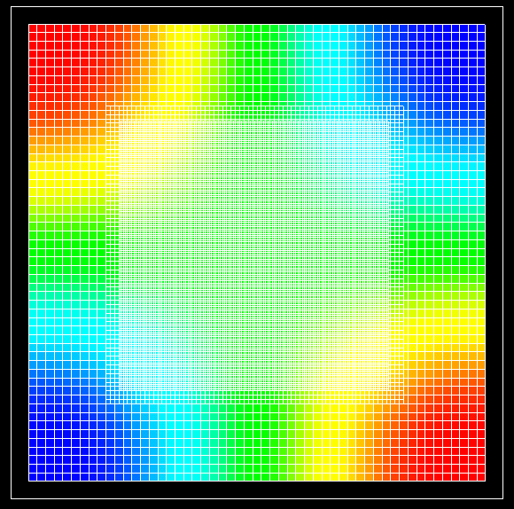
Incorporating Other Frameworks
Chombo (by P. Colella, LBNL) has solvers (AMRGodunov, AMRElliptic, etc.) that:
  Work on block structured adaptive meshes
  Accept Chombo-specific data structures
  But fundamentally require:
    A double pointer, an array, where variables on a patch (box) are stored in blocked format
    Bunch of integer arrays that describe the array
Using Chombo to solve the Poisson equation (needed for CFRFS flame simulations).
Challenge: Can Chombo be used within CCA?
Need a standardized way of getting data into Chombo
  Pointer aliasing, not data copy
Implementation of this “standard” interface

Slide 182
Using CCA: Summary
Review of guidelines for developing high-performance scientific components (both new code and wrappers for existing code)
CCA is an enabling technology for scientific applications
  Has enabled mathematicians, chemists, combustion scientists, and computer scientists to contribute new strategies that are shrink-wrapped for easy re-use
  Apart from science research, also spawned new research directions in CS
  Has enabled research scientists to investigate unconventional approaches, for example multilevel parallelism and dynamic adaptivity
For more info on the CCA applications/case studies, see:
  Chemistry: http://www.cca-forum.org/~cca-chem
  Combustion: http://cfrfs.ca.sandia.gov
Different facets of CCA components may be useful within different projects … What are your needs and priorities?

Slide 183
A Few Notes in Closing

Slide 184
Resources: Its All Online
Information about all CCA tutorials, past, present, and future:
http://www.cca-forum.org/tutorials/
Specifically…
  Latest versions of hands-on materials and code:
  http://www.cca-forum.org/tutorials/#sources
    Hands-On designed for self-study as well as use in an organized tutorial
    Should work on most Linux distributions, less tested on other unixen
    Still evolving, so please contact us if you have questions or problems
  Archives of all tutorial presentations:
  http://www.cca-forum.org/tutorials/archives/
Questions…
help@cca-forum.org or cca-tutorial@cca-forum.org

Slide 185
Getting Help
We want to help insure you have a good experience with CCA, so let us know if you’re having problems!
Tutorial or “start-up” questions
  help@cca-forum.org or cca-tutorial@cca-forum.org
Problems with specific tools
  check documentation for updated contact info
  cca-tools bundle (includes Chasm, Babel, Ccaffeine): Rob Armstrong, cca-tools@cca-forum.org
  Bocca: Rob Armstrong, bocca@cca-forum.org
  Chasm: Craig Rasmussen, crasmussen@lanl.gov
  Babel: babel-users@llnl.gov
  Ccaffeine: ccafe-users@cca-forum.org
General questions, or not sure who to ask?
  help@cca-forum.org

Slide 186
CCA is Interactive
Collectively, CCA developers and users span a broad range of scientific interests.
  There’s a good chance we can put you in touch with others with relevant experience with CCA
CCA Forum Quarterly Meetings
  Meet many CCA developers and users
  http://www.cca-forum.org/meetings/
“Coding Camps”
  Bring together CCA users & developers for a concentrated session of coding
  Held as needed, typically 3-5 days
  May focus on a particular theme, but generally open to all interested participants
  If you’re interested in having one, speak up (to individuals or cca-forum@cca-forum.org)
Visits, Internships, etc.

Slide 187
Acknowledgements:
Tutorial Working Group
People: Benjamin A. Allan, Rob Armstrong, David E. Bernholdt, Randy Bramley, Tamara L. Dahlgren, Lori Freitag Diachin, Wael Elwasif, Tom Epperly, Madhusudhan Govindaraju, Ragib Hasan, Dan Katz, Jim Kohl, Gary Kumfert, Lois Curfman McInnes, Alan Morris, Boyana Norris, Craig Rasmussen, Jaideep Ray, Sameer Shende, Torsten Wilde, Shujia Zhou
Institutions: ANL, Binghamton U, Indiana U, JPL, LANL, LLNL, NASA/Goddard, ORNL, SNL, U Illinois, U Oregon
Computer facilities provided by the Computer Science Department and University Information Technology Services of Indiana University, supported in part by NSF grants CDA-9601632 and EIA-0202048.

Slide 188
Special Thanks:
Bocca Development Team
Ben Allan, SNL
Rob Armstrong, SNL
Wael Elwasif, ORNL
Boyana Norris, ANL

Slide 189
Acknowledgements: The CCA
ANL –Steve Benson, Jay Larson, Ray Loy, Lois Curfman McInnes, Boyana Norris, Everest Ong, Jason Sarich…
Binghamton University - Madhu Govindaraju, Michael Lewis, …
Indiana University - Randall Bramley, Dennis Gannon, …
JPL – Dan Katz, …
LANL - Craig Rasmussen, Matt Sotille, …
LLNL – Tammy Dahlgren, Lori Freitag Diachin, Tom Epperly, Scott Kohn, Gary Kumfert, …
NASA/Goddard – Shujia Zhou
ORNL - David Bernholdt, Wael Elwasif, Jim Kohl, Torsten Wilde, …
PNNL - Jarek Nieplocha, Theresa Windus, …
SNL - Rob Armstrong, Ben Allan, Lori Freitag Diachin, Curt Janssen, Jaideep Ray, …
Tech-X Corp. – Johan Carlsson, Svetlana Shasharina, Ovsei Volberg, Nanbor Wang
University of Oregon – Allen Malony, Sameer Shende, …
University of Utah - Steve Parker, …
and many more… without whom we wouldn’t have much to talk about!

Slide 190
Thank You!
Thanks for attending this tutorial
We welcome feedback and questions

