Slide 1
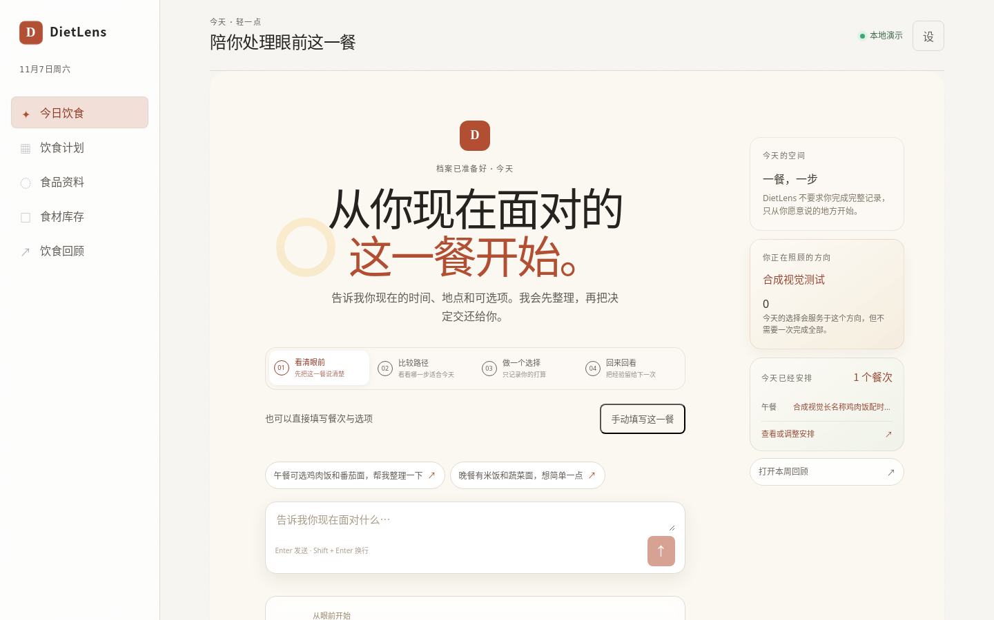
SYSTEM DESIGN PROGRESS
DietLens
From meal choice
to trusted reflection
A lightweight, user-controlled personal meal decision
and reflection companion.
AGENTIC WORKFLOW
HUMAN CONFIRMATION
EVIDENCE-FIRST DATA
Product evidence · current meal composer
Assignment 2 · Design presentation · 2026–2027
DIETLENS · SYSTEM DESIGN PROGRESS · 2026
Evidence: artifacts/dietlens-round-3/after/dietlens-home-1440.png

Slide 2
01 · DESIGN THESIS
02 / 07
Make every meal decision traceable
Progress since Part I: the product is now designed around a trustworthy loop, not a generic chatbot.
What changed in the design
THE PRODUCT PROMISE
Generic assistant
→
Bounded decision companion
STATE + CONFIRMATION
Context →
Decision →
Actual meal →
Reflection
Missing values hidden
→
Unknown is explicit
TRUTHFUL DATA
Plan and intake conflated
→
Plan / actual / feedback separated
CLEAN SEMANTICS
The same confirmed context should remain understandable
when the user looks back later.
Model as authority
→
Model interprets; rules decide
SAFE BOUNDARIES
DIETLENS · SYSTEM DESIGN PROGRESS · 2026
Sources: docs/product-logic.md · docs/DietLens-Round-4.1-Data-Truth-and-Experience-Closure.md

Slide 3
02 · KEY DECISIONS
03 / 07
The architecture makes trust a system property
Each decision removes a specific failure mode identified in the requirements and product audit.
1
One control plane
2
Rules decide safety
3
Facts stay separate
4
Unknown is real
Harness owns state transitions, consent and writes.
UI stays thin and recoverable.
The model may extract intent.
Deterministic rules decide blocked / needs confirmation / safe.
Plan servings, ingredient quantity and actual intake are different fields.
No silent copying.
Missing allergy or source data remains unknown.
No invented zeros or certainty.
DESIGN CONSEQUENCE
A recommendation is not a write. A source field is not proof. A plan is not an actual meal.
The system keeps each transition explicit so users can understand, confirm and revise it.
DIETLENS · SYSTEM DESIGN PROGRESS · 2026
Decision log: docs/product-logic.md · docs/model-routing.md · docs/profile-workflow.md

Slide 4
03 · LOGICAL ARCHITECTURE
04 / 07
One control plane, bounded intelligence
The Harness coordinates the workflow; domain services keep safety and persistence deterministic.
DOMAIN RULES
HARNESS
food safety · profile
WEB APP
API BOUNDARY
state machine
consent gate
operation key
recovery
USER
React / Vite
route + focus + draft
FastAPI
validation + auth
DOMAIN SERVICES
meal · profile · feedback
planning · meals · review
REPOSITORY / STORE
SQLite or Supabase
OPTIONAL MODEL PROVIDER
structured intent only · never writes · never declares safety
DIETLENS · SYSTEM DESIGN PROGRESS · 2026
Evidence: api_server.py · dietlens_mvp/harness.py · dietlens_mvp/tools.py · models.py

Slide 5
04 · DEPLOYMENT + TECHNOLOGY
05 / 07
Small runtime footprint, clear seams
The prototype can run locally with SQLite while keeping an explicit path to hosted auth, storage and source adapters.
DEPLOYMENT VIEW
CLIENT DEVICE
APP RUNTIME
DATA NODE
EXTERNAL SOURCES
Browser
React static assets
FastAPI
Harness + domain services
SQLite / WAL
or Supabase Postgres
Food data adapters
optional model API
TECHNOLOGY CHOICES
Frontend
Backend
Persistence
Verification
React + TypeScript
Vite
FastAPI + Pydantic
Python services
SQLite prototype
Supabase path
pytest · Playwright
contrast + syntax
DIETLENS · SYSTEM DESIGN PROGRESS · 2026
Rationale: low operational friction now; explicit seams for deployment and testability later.

Slide 6
05 · INTERACTION DESIGN
06 / 07
From user input to a confirmed fact
The agentic part is intentionally narrow: interpret the request, then hand control back to rules and the user.
01
02
03
04
05
06
Describe
Interpret
Check
Offer
Confirm
Reflect
meal + options
structured intent
profile + source
bounded actions
explicit write
feedback + review
PERSISTED STATE
MODEL BOUNDARY
Draft → interpreted → needs confirmation → confirmed → feedback
Cannot write,
bypass consent or declare safety.
DIETLENS · SYSTEM DESIGN PROGRESS · 2026
Interaction evidence: docs/product-logic.md · docs/model-routing.md

Slide 7
06 · REFINEMENT + NEXT VALIDATION
07 / 07
Design decisions are explicit—and testable
Requirements were refined where implementation exposed a safety or semantic gap. Part III validates the remaining risks.
REQUIREMENT REFINEMENTS
OPEN ISSUES FOR PART III
01
Allergy state is tri-state
• Secure authenticated browser fixture
• Ingredient-level restaurant allergen verification
• A truthful 7-day planning editor
• Portion-aware nutrition coverage
• Feedback-driven preference signals
unknown / none / specified
02
Planning is single-day in UI
7-day backend remains future work
03
Quantities are separate
servings ≠ ingredient ≠ actual intake
04
Nutrition is bounded
no inference from meal names
05
Shopping is explicit
Prototype the risky assumptions before scaling the claims.
main ingredients only; no auto conversion
DIETLENS · SYSTEM DESIGN PROGRESS · 2026
Next: prototype, measure, then promote only verified capabilities.

