Slide 1
Web Trends
-Presented by,
Namrata Patel
SIESGST,Nerul

Slide 2
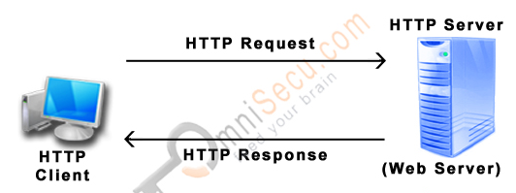
HTTP Request and HTTP RESPONSE
Communicates through TCP/IP port no .80

Slide 3
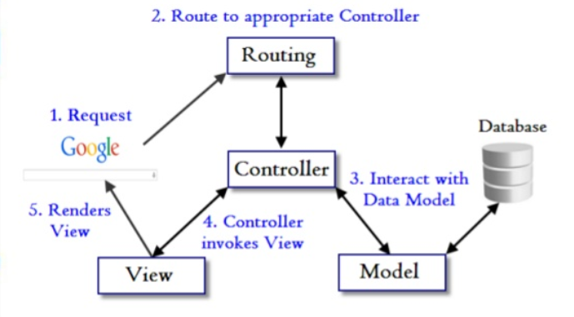
MVC Architecture

Slide 4
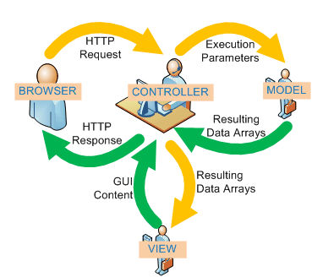
Diag-2

Slide 5
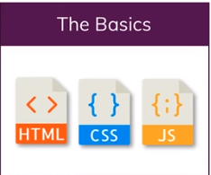
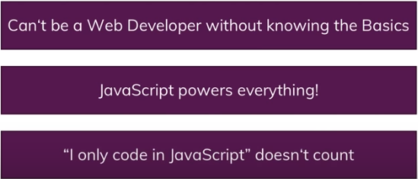
BASIC

Slide 6
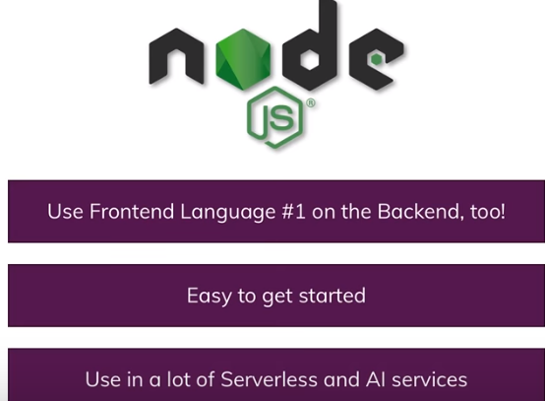
NODE JS

Slide 7
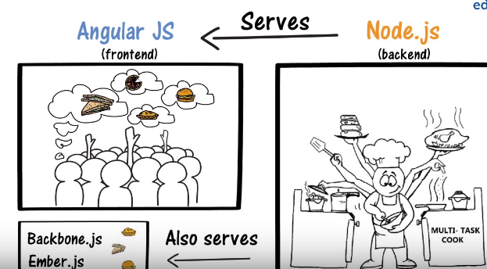
Difference between Angular JS and Node JS
https://www.youtube.com/watch?v=t7x7c-x90FU
https://blog.sagipl.com/node-js-vs-angular-js/

Slide 8
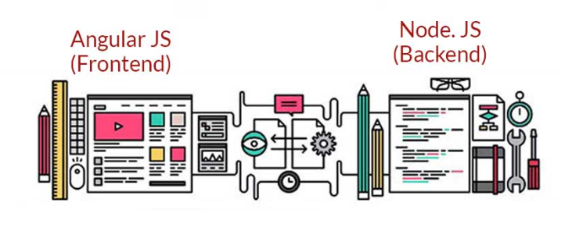
Continued…

Slide 9

Famous Javascript Framework
https://www.techuz.com/blog/angular-vs-react-vs-vue-js-which-one-is-perfect-for-your-project/

Slide 10

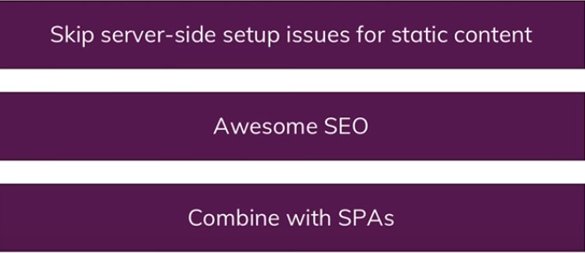
Static Web Pages

Slide 11

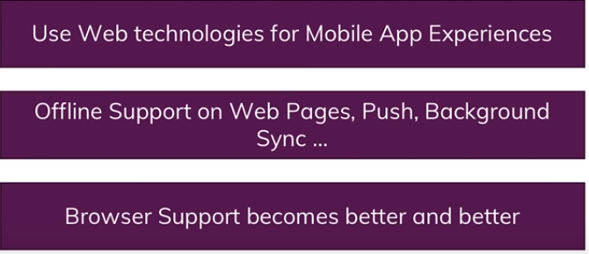
Progressive Web Apps

Slide 12
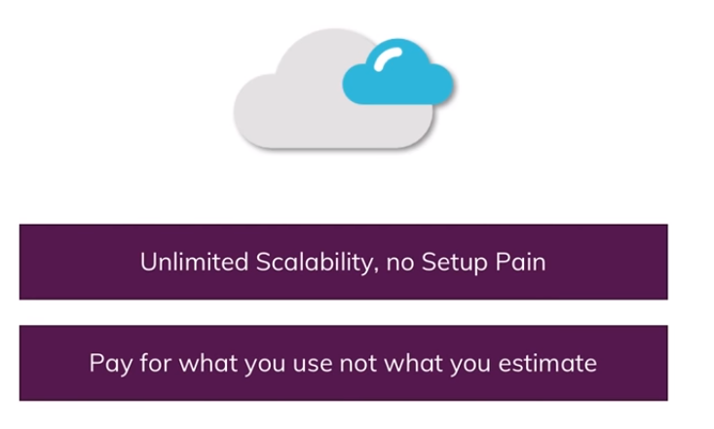

Server less

Slide 13
