Slide 1
QIIME2: 16S rRNA analysis platform
CMPBIO293 Tutorial 1
Audrey Wang, Mark Young

Slide 2
Content
Introduction
Installation
QIIME2 analysis workflow

Slide 3
Introduction

Slide 4


16S platforms
The “glue” that connects individual bioinformatics tools
Mothur
Less flexible, self contained workflows
Only CLI
Small development team
Qiime 2: what we will use
Highly extensible
Python/R APIs, CLI
Large community with frequent update (current version: 2024.5)

Slide 5
Get yourself familiar with basic Unix commands
Bash cheatsheet:
ls: list
cd: change directory
pwd: print working directory
mkdir [directory_name]: make (create) directory
rm [file_name]: remove file
e.g., removing all the files that end with .fasta: rm *.fasta
rm -r [directory]
Press Ctrl+c to cancel the current running task

Slide 6
QIIME2 Installation

Slide 7
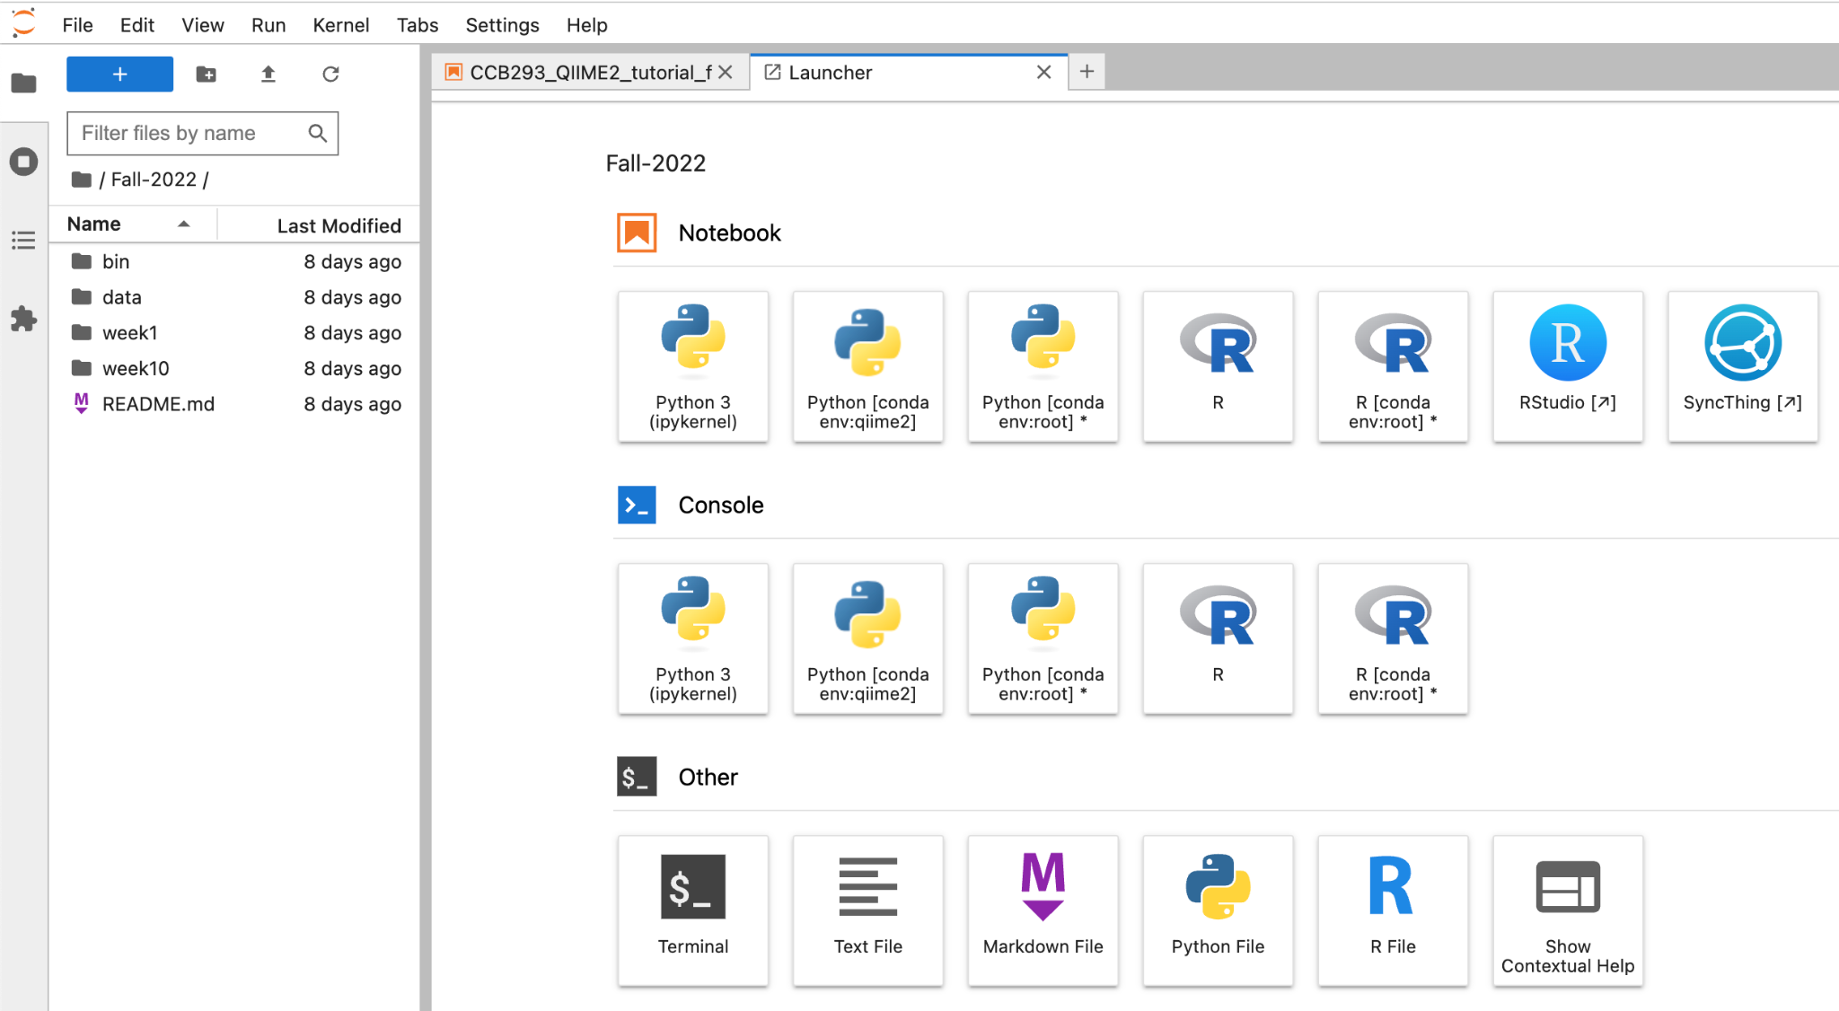
Install QIIME2 via Conda or Virtual Machine
QIIME2 can be installed with all dependencies through conda
The Berkeley has a biology datahub (https://biology.datahub.berkeley.edu/) already has conda and QIIME2 installed :)

Slide 8
QIIME2 Workflow

Slide 9
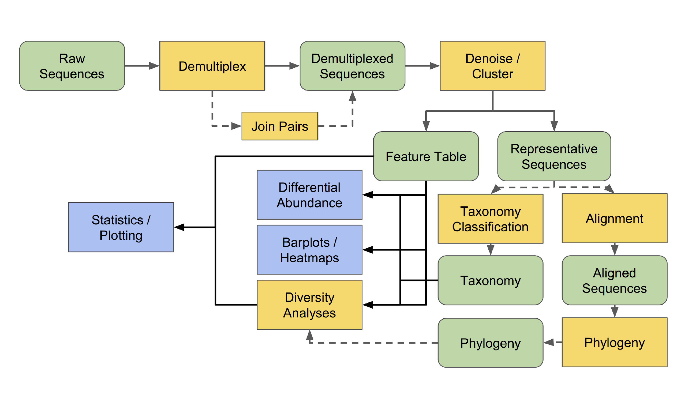
Step 1: import data
Step 2: demultiplex
Step 3: QC/features
(DADA2 or Deblur)
Step 7: Differential abundance testing with ANCOM
Step 6: Taxonomic analysis
Step 5: alpha and beta diversity analysis
Step 4: phylogenetic tree

Slide 10
Step 1: import data
metadata tsv file
sequence fastq file
barcode fastq file

Slide 11
Let’s open datahub and import the files!
First click on the “Terminal” and type: git clone https://github.com/audreywang1997/CMPBIO293_Fall2024.git
We are now cloning all the files from that path, where the example files were first downloaded
Use pwd to check your current working directory
cd to change into the directory where the files are located
you will then see a .ipynb file, please double-click it to open
Now in the .ipynb file, the top right corner is now written in “Python 3 (ipykernel)”, click on that and change it to “Python [conda env:qiime2]”

Slide 12
Importing Data
QIIME 2 use specific file types called QIIME 2 artifacts (.qza), so the fasta and fastq files we normally received from the sequencing servicer will need to be import before the analysis.
For this tutorial, we will use all the example files provided from the QIIME tutorial website, including the metadata.tsv file, the FASTQ file, and the barcode file

Slide 13
Step 1: import data
Step 2: demultiplex
assign sequences to each sample using barcode info from metadata

Slide 14
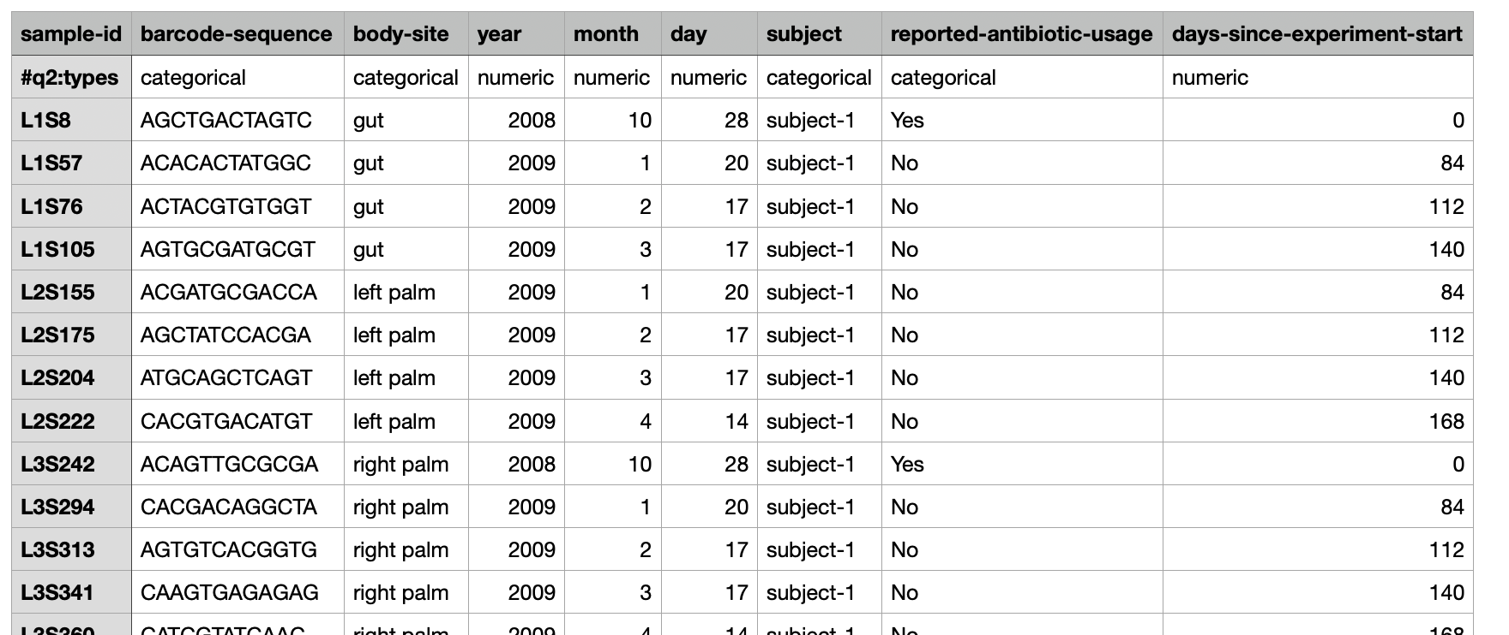
Metadata

Slide 15
Step 1: import data
Step 2: demultiplex
Step 3: QC/features
(dada2 or deblur)
quality filtering (trim/truncate)
denoising with error models
chimera removal

Slide 16
Quality Filtering: DADA2
Given the expected error rate and the observed reads, which true sequences likely produced the underlying data?
QIIME 2 supports the DADA2 and Deblur quality filtering pipelines
DADA2 is generally favored
Deblur only supports single-end read data
Recommended to trim low quality ends from read
>Q30 is best, >Q20 is ok (DADA2 should handle them)
QIIME 2 also has old fashioned OTU clustering algorithms, which we’ll skip
Phred Quality Score | Probability of incorrect base call | Base call accuracy
10 | 1 in 10 | 90%
20 | 1 in 100 | 99%
30 | 1 in 1000 | 99.9%
40 | 1 in 10,000 | 99.99%
50 | 1 in 100,000 | 99.999%
60 | 1 in 1,000,000 | 99.9999%

Slide 17
Quality Filtering: DADA2
Chimeras and singleton reads are also filtered
Chimera: An artificial DNA sequence produced through accidental combination of two underlying sequences during PCR
Occurs when a polymerase fails to complete copying a template and the incomplete fragment is used as a primer in the next cycle. More cycles == more chimeras
DADA2 rule: If a low frequency ASV is a perfect combination of two other ASVs -> call it a chimera
Singleton: A read without a pair. Happens in paired-end workflows when one mate fails QC.

Slide 18
Step 1: import data
Step 2: demultiplex
Step 3: QC/features
(dada2 or deblur)
counts of each ASV in each sample
representative seq. of each ASV

Slide 19
Step 1: import data
Step 2: demultiplex
Step 3: QC/features
(dada2 or deblur)
Step 4: Generate a phylogenetic tree
Phylogenetic tree: understand relationship/similarity between and within samples

Slide 20
MAFFT and FastTree
Alignment function: align-to-tree-mafft-fasttree
Creates phylogeny from ASV representative sequences
MAFFT: multiple sequence alignment algorithm
de novo alignment: solely based on sequences provided
Highly variable positions masked for tree building
FastTree: phylogenetic tree construction
Faster than traditional maximum likelihood tree building algorithms (RAxML, PhyML)
Accuracy vs scale tradeoff for metagenomics (sometimes >1mil ASVs)

Slide 21
Step 1: import data
Step 2: demultiplex
Step 3: QC/features
(dada2 or deblur)
Step 5: Alpha and Beta diversity analysis
Step 4: phylogenetic tree

Slide 22
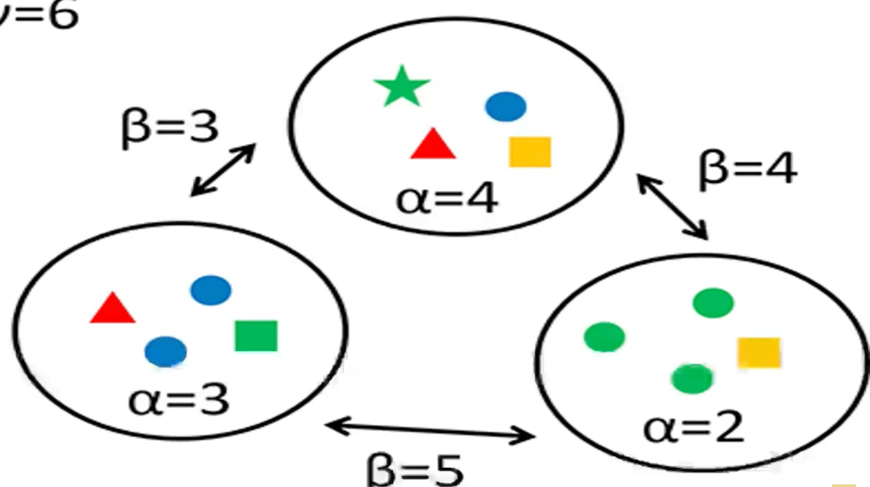
Alpha and Beta diversity
Alpha diversity
Faith’s PD: Sum of the branch lengths in a phylogeny of a community.
Shannon Diversity: Expected information content of a sample from a community
Beta diversity
Unweighted UniFrac: Proportion of branch lengths in a phylogenetic tree that are not shared between communities
Weighted UniFrac: Weighted by branch length relative abundance
Jensen Shannon Distance: Based on information theory, treating abundances as probability distribution

Slide 23
Step 1: import data
Step 2: demultiplex
Step 3: QC/features
(dada2 or deblur)
Step 6: Taxonomic analysis
Taxonomy: names
(need a reference database)
Step 5: diversity analysis
Step 4: phylogenetic tree

Slide 24
Pick a reference database
16S reference databases: Greengenes, RDP, or SILVA
Naive Bayes classifiers are standard for taxonomic assignment down to the genus level. Exact string matches are generally used for species and below.
Pre-trained classifiers are available on the qiime2 site.
Tutorial: Naive Bayes classifier trained on Greengenes13.8 database
Notes:
naive Bayes classifiers are a family of linear "probabilistic classifiers" which assumes that the features are conditionally independent, given the target class. The strength (naivety) of this assumption is what gives the classifier its name. These classifiers are among the simplest Bayesian network models.

Slide 25
Step 1: import data
Step 2: demultiplex
Step 3: QC/features
(dada2 or deblur)
Step 7: Statistical tests
Step 6: Taxonomic analysis
Step 5: alpha and beta diversity analysis
Step 4: phylogenetic tree

Slide 26
Statistical Tests
Differential Abundance: ANCOM
Associations with beta diversity: PERMANOVA
Associations with alpha diversity: Kruskal-Wallis (ANOVA on ranks)
Notes:
naive Bayes classifiers are a family of linear "probabilistic classifiers" which assumes that the features are conditionally independent, given the target class. The strength (naivety) of this assumption is what gives the classifier its name. These classifiers are among the simplest Bayesian network models.

