Slide 1
RADseq
April Wright

Slide 2
Outline
What are RADseq data?
How do we analyze these data for population history and phylogenetics?
How is RADseq data usually collected here on campus?

Slide 3
RADseq data
Genome reduction technology
Aim: Obtain thousands of variable sites that could be used for QTL, genotyping population history

Slide 4
RADseq data
Genome reduction technology
Aim: Obtain thousands of variable sites that could be used for QTL, genotyping population history
Especially for non-model organisms, as it requires no reference genome (though you can use one for mapping)

Slide 5
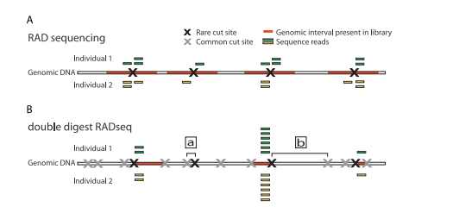
RADseq data
Peterson et al. 2012 PLoS ONE

Slide 6
RADseq data
Restriction Site: 4-8 nucleotide sequences in genome; recognized by restriction enzymes

Slide 7
RADseq data
Restriction Enzyme: Enzyme to cut at a restriction site

Slide 8
RADseq data
Read: a set of bp obtained via RADseq. Of a target size

Slide 9
RADseq data
Barcode: Added sequence of nucleotides so samples can be identified

Slide 10
What you get
Fastq files filled with reads.
Refresher from last week: Fastq encodes data and quality information

Slide 11
What you get
Fastq files filled with reads.
Refresher from last week: Fastq encodes data and quality information
Identified by the lane in the machine
Coded with barcodes

Slide 12
Processing RADseq
Process Fastq files into individual samples
‘Demultiplex’

Slide 13
Processing RADseq
Process Fastq files into individual samples
‘Demultiplex’
Result: sequence data are now tagged to individuals

Slide 14
Processing RADseq
Process Fastq files into individual samples
‘Demultiplex’
Result: sequence data are now tagged to individuals
Process check: Do individuals have the same amount of data?

Slide 15
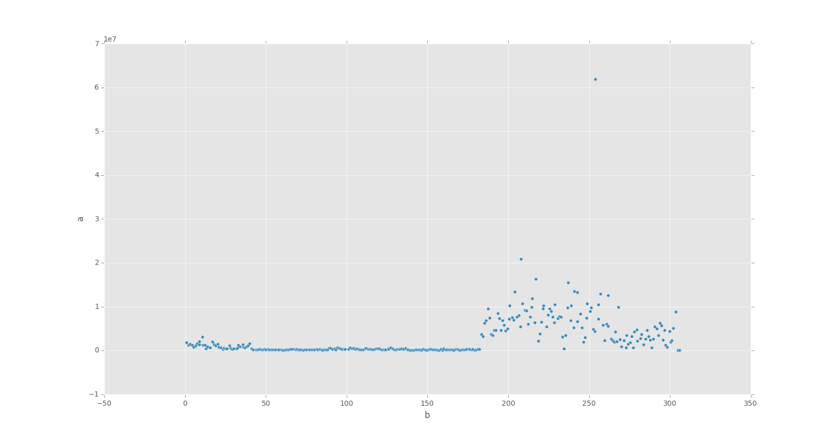
for file*fq
do
wc -l $file >> counts
done

Slide 16
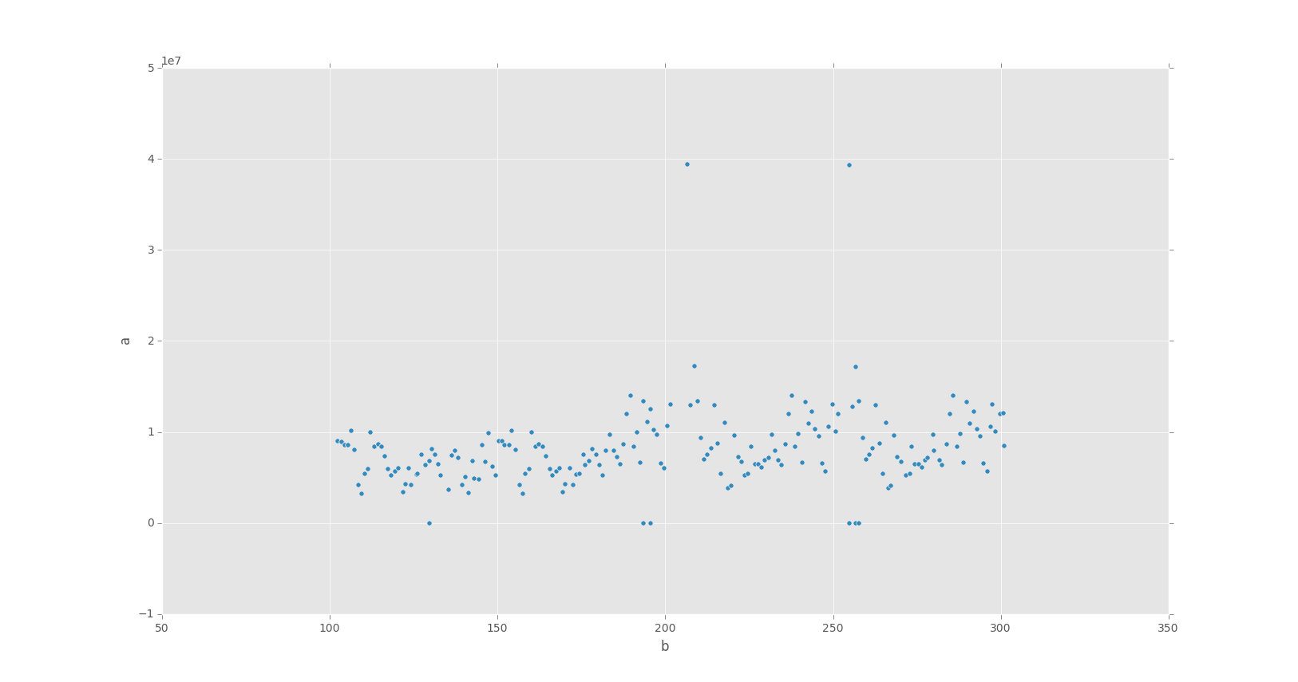

Slide 17
Two Major Pipelines
Stacks and pyRAD

Slide 18
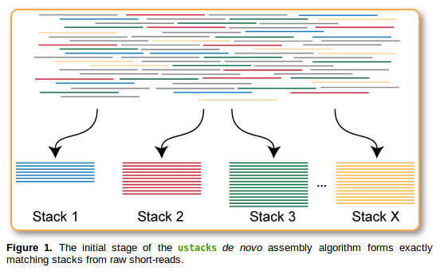
Locus-building

Slide 19
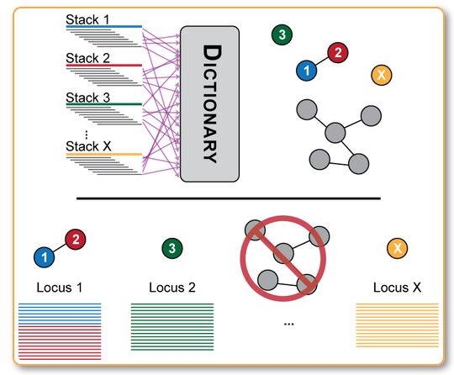
Locus-building

Slide 20
Locus-building
# of loci
# of reads at a locus

Slide 21
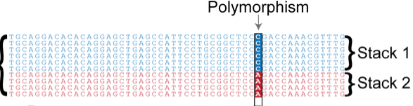

Slide 22
Locus-building
So far, within sample
pyRAD has an additional alignment step and estimate error rate and heterozygosity. It uses these measures to build consensus sequences for the individual

Slide 23
Locus-building: across individuals

Slide 24
Locus-building: across individuals

Slide 25
 | Locus1 | L2 | L3 | L4 | L5 | L6 | L7 | L8 | L9 | L10
Sample 1
Sp. 2
Sp. 3
Sp. 4
Green = present
Red = absent
Blue = fragment

Slide 26
 | Locus1 | L2 | L3 | L4 | L5 | L6 | L7 | L8 | L9 | L10
Sample 1
Sp. 2
Sp. 3
Sp. 4
Green = present
Red = absent
Blue = fragment

Slide 27
Making the matrix
How many populations must a loci be present in in order to be output?
What kind of output do you want?

Slide 28
Making the Matrix
Phylogenetic trees
Often take all SNPs at a locus
STRUCTURE
Don’t

Slide 29
Making the Matrix
Phylogenetic trees
Often take all SNPs at a locus
Lots of literature on missing data
STRUCTURE
Don’t
Not nearly as much

Slide 30
Making the Matrix
Phylogenetic trees
Often take all SNPs at a locus
Lots of literature on missing data
Do you need all individuals?
STRUCTURE
Don’t
Not nearly as much
Specific assumptions about Hardy-Weinberg equilibrium

Slide 31
Structure
Data can generally be run as-is from either Stacks or pyRAD
Note: Stacks adds a footer to Phylip files and a header to structure: remove these

Slide 32
Special challenges for phylogenetic trees
We don’t know where our data came from

Slide 33
Special challenges for phylogenetic trees
We don’t know where our data came from
Partitions?
http://www.robertlanfear.com/partitionfinder/
Huge amounts of missing data
Acquisition bias
Parsimony
Mk
https://github.com/stamatak/standard-RAxML

Slide 34
Here at UT
GSAF manages this data type

Slide 35
Here at UT
GSAF manages this data type
Sample prep managed in-lab, sequencing performed at GSAF

Slide 36
Analyses on TACC
TACC has STACKS on both Lonestar and Stampede

Slide 37
Analyses on TACC
TACC has STACKS on both Lonestar and Stampede
Do not have pyRAD, though the SciPy Stack is present to run pyRAD
http://wrightaprilm.github.io/posts/pyrad-and-tacc.html

Slide 38
Questions?

