Slide 1
The CCBR microarray pipeline Shiny App
Quick Start

Slide 2
Running the Microarray App locally
library(shiny)
runApp(“MicroArrayPipeline”)

Slide 3
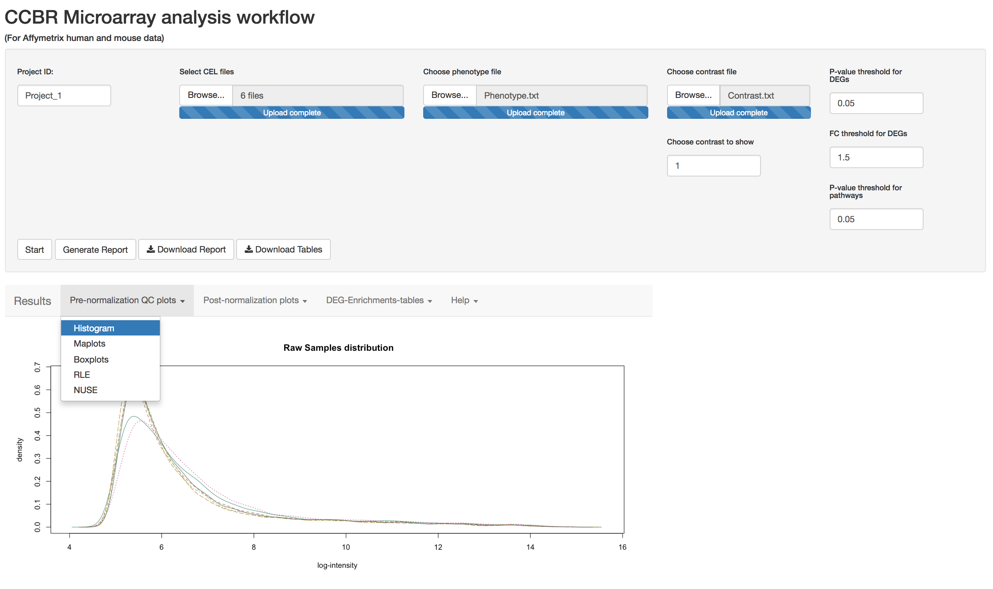
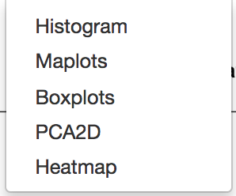
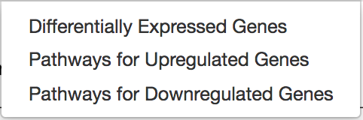
App Interface
Step1- Provide input
Step5- generate Html report and download results
Step4- select contrast and enrichment analysis thresholds
Step2- click on start to load/normalize data
1
2
3
Step 3- access all menu options
Notes:
tep4

Slide 4
App Input
Mandatory input
Project id
Affymetrix Raw data (cel files)
Phenotype data file
List of contrasts file

Slide 5
Supported platforms
Current supported human platforms:
GeneChip™ Human Genome U133 Plus 2.0 Array
GeneChip™ Human Gene 2.0 ST Array
Clariom™ S Assay HT, human
Clariom™ S Assay, human
Current supported mouse platforms:
GeneChip™ Mouse Gene 2.0 ST Array
Clariom™ S Assay HT, mouse
Clariom™ S Assay, mouse

Slide 6
Phenotype file
Mandatory Field names
SampleName | SampleID | SampleGroup | GroupNumber
b1.CEL | b1 | gb | 1
b2.CEL | b2 | gb | 1
b3.CEL | b3 | gb | 1
s1.CEL | s1 | gs | 2
s2.CEL | s2 | gs | 2
s3.CEL | s3 | gs | 2
… | … | … | …
Only one factor
(you can simulate multifactor variable)

Slide 7
Contrast file
Group1 | Vs. group2
gs | gb
… | …

Slide 8
App Output
Plots/reports
Raw data QC plots:
Histogram, MAplot, boxplot
RLE: Relative Log Expression
NUSE: Normalized Unscaled Standard Error
Post-normalization RMA data QC plots
Histogram, MAplot, boxplot
PCA (2D)
Heatmap (samples clustering)
Html report
Interactive tables
Differentially Expressed Genes, Pathways
Downloadable files
Differentially Expressed Genes and Pathways results files
Html report
Notes:
NUSE = It is the standard error of each probeset value (using summarization method PLM) normalized by the median across all arrays
RLE= expr of each probset normalized by the median of each array

Slide 9
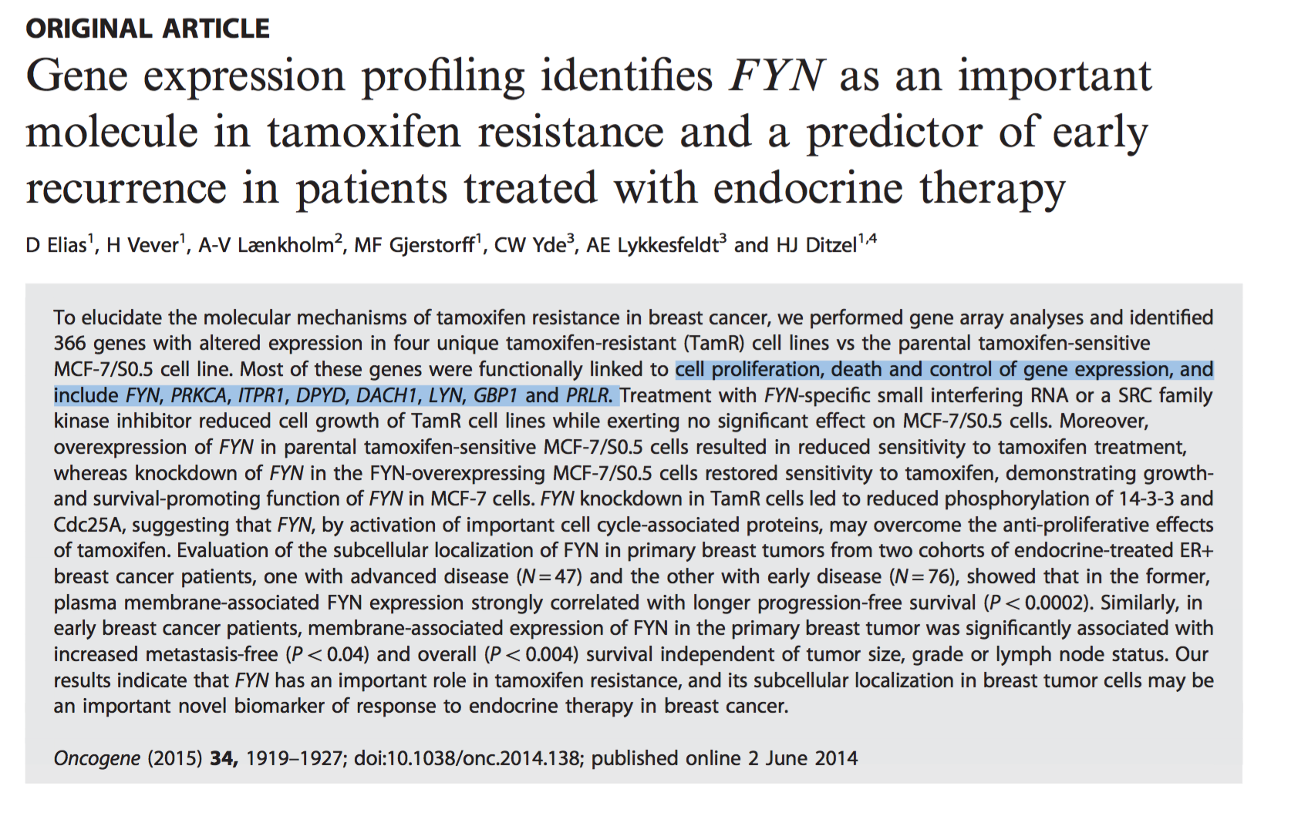
DEMO: use case
https://www.ncbi.nlm.nih.gov/geo/query/acc.cgi?acc=GSE67916

Slide 10
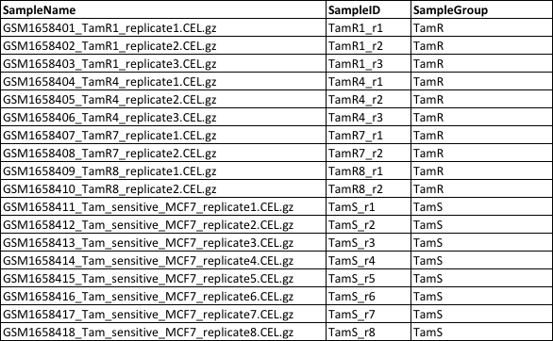

Comparing Resistant vs Sensitive: Phenotype and contrast files

Slide 11
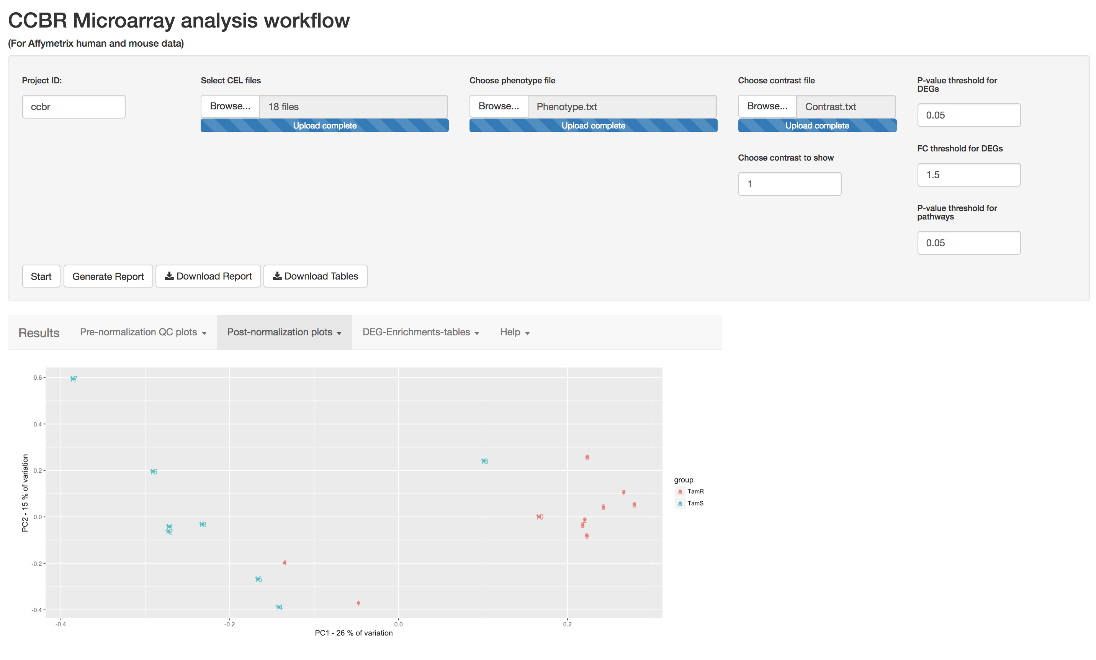
Run: Comparing All TamR vs. TamS

Slide 12
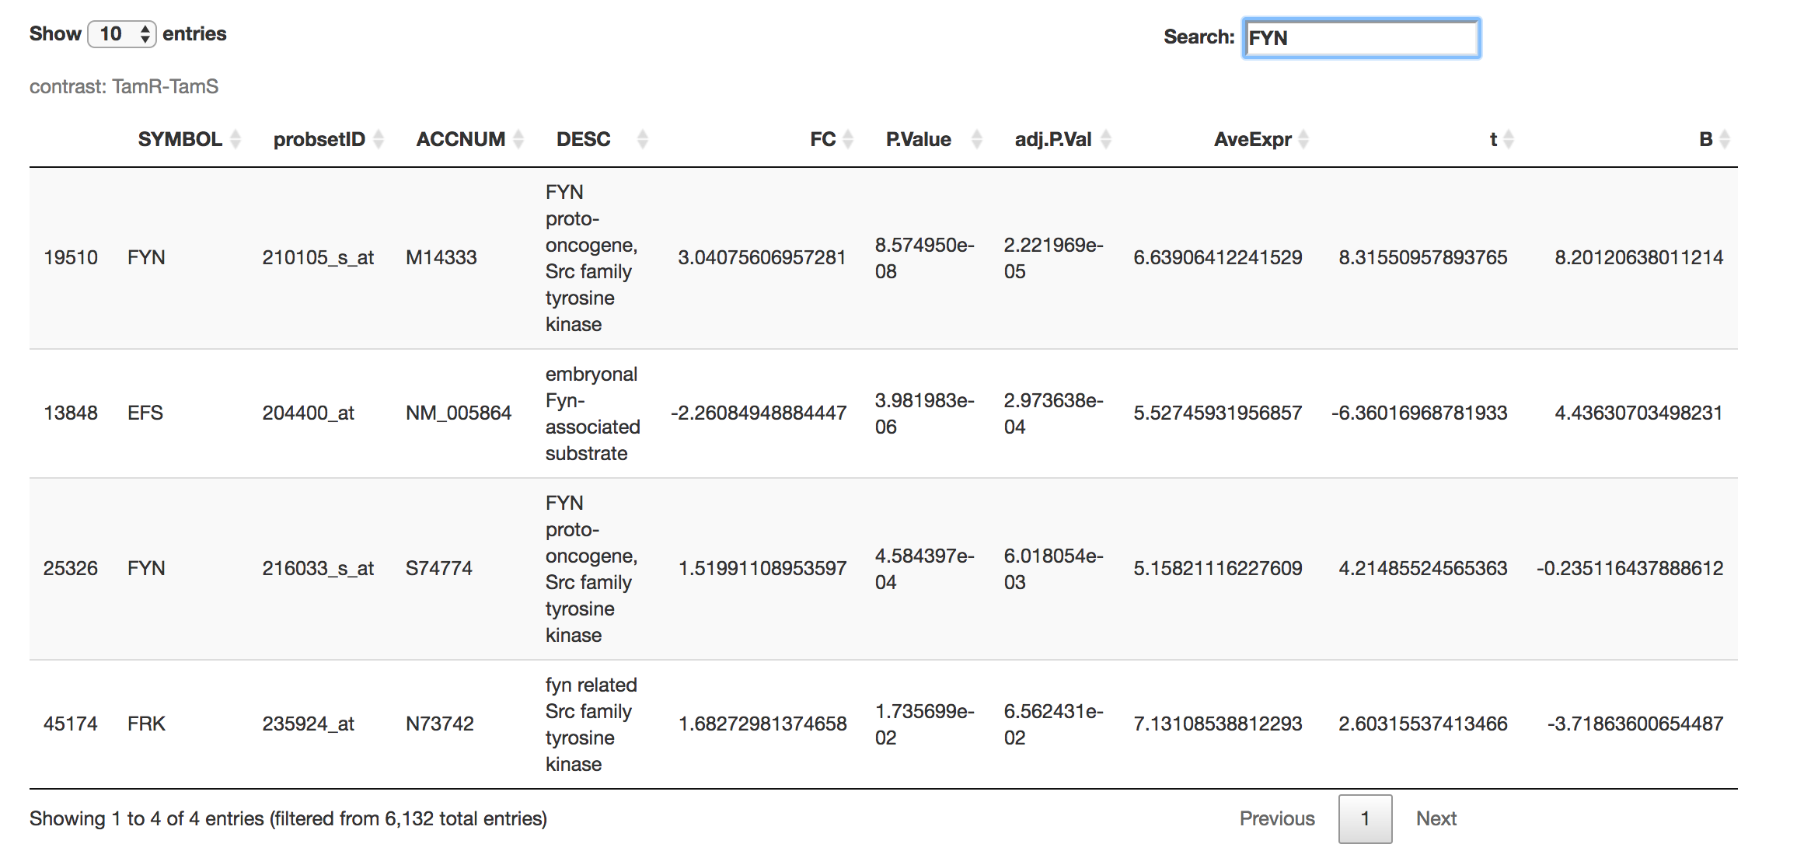
DEG: Comparing All TamR vs. TamS
FILTER
 | P-value<0.05 | + abs(FC)>=3 | + abs(FC)>=4
TamR vs. TamS | 20,302 | 542 | 222
SEARCH

Slide 13
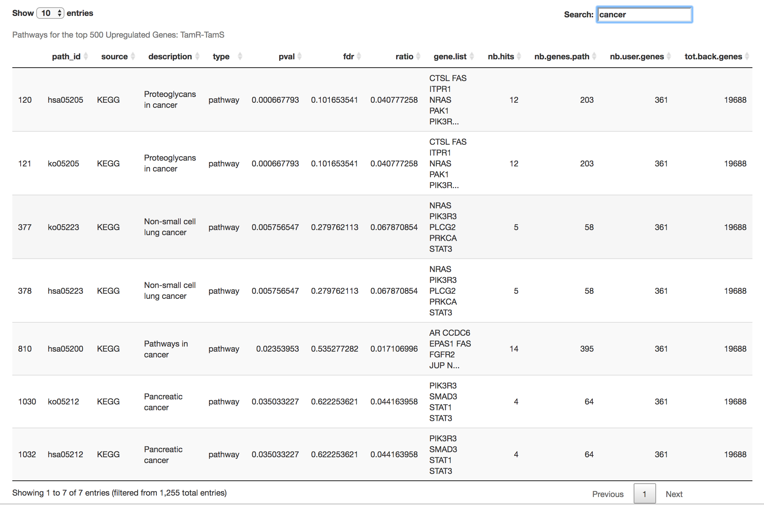
Pathways: Comparing All TamR vs. TamS

