Slide 1
Binding Free Energy Calculations
This module will introduce you to:
What binding free energy is, and why it is useful to predict.
Different types of free energy calculations, and their relative accuracy.
At the conclusion of this module, you will:
Understand the application of binding free energy calculations in research.
Review a binding free energy calculation by the replica exchange software, YANK.

Slide 2
This Presentation
What is binding free energy?
Free energy of a reaction, and of a binding reaction. Selectivity and Affinity.
Why is it useful to predict binding free energy?
Methods of predicting binding free energy.
End-Point methods
Alchemical (“Phase space overlap”) methods

Slide 3
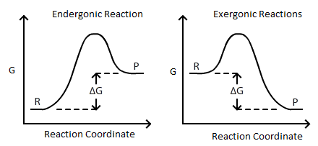

What is the free energy of a reaction?
$ΔG=ΔH −TΔS=RTln(K_{d})$
https://www.google.com/url?sa=i&url=https%3A%2F%2Fchem.libretexts.org%2FBookshelves%2FAnalytical_Chemistry%2FSupplemental_Modules_(Analytical_Chemistry)%2FElectrochemistry%2FElectrochemistry_and_Thermodynamics&psig=AOvVaw19TUHfYXk_UXc63ZrRB9GY&ust=1647023570005000&source=images&cd=vfe&ved=0CAsQjRxqFwoTCJCPia-XvPYCFQAAAAAdAAAAABAD

Slide 4
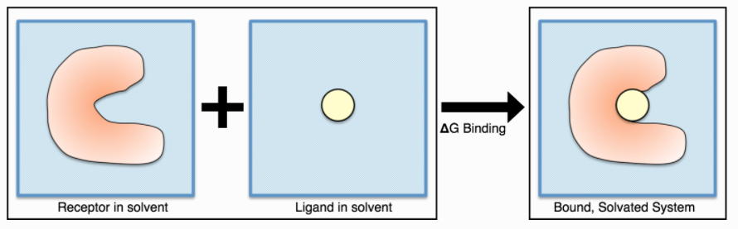
What is binding free energy?
Binding free energy is the free energy of a binding reaction.
http://getyank.org/0.22.2/theory.html
Notes:
Add relation of binding free energy to dissociative constant

Slide 5
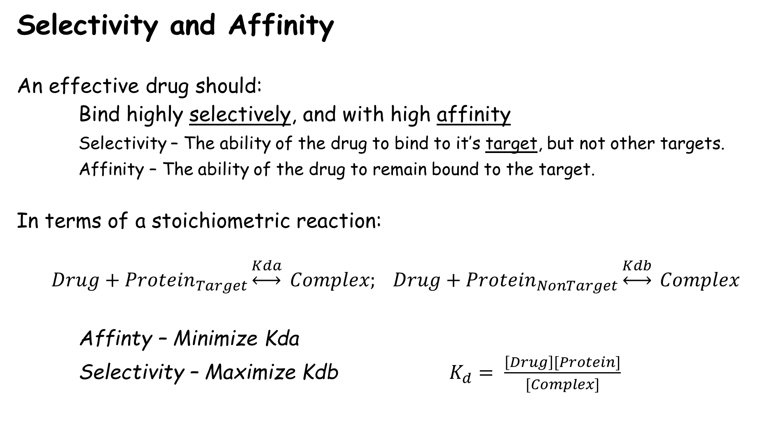
Selectivity and Affinity
An effective drug should:
Bind highly selectively, and with high affinity
Selectivity – The ability of the drug to bind to it’s target, but not other targets.
Affinity – The ability of the drug to remain bound to the target.
In terms of a stoichiometric reaction:
$$Drug+{Protein}_{Target}\underset{↔}{Kda} Complex; Drug+{Protein}_{NonTarget}\underset{↔}{Kdb} Complex$$
Affinty – Minimize Kda
Selectivity – Maximize Kdb $K_{d}= \frac{\left[Drug\right][Protein]}{[Complex]}$

Slide 6

Enthalpy and Entropy of Binding
What do you think that the signs of $ΔG, ΔH, ΔS$ are for the following rxn?
$${Drug}_{aq}+{Protein}_{aq} \underset{↔}{ }{ Complex}_{aq}$$

Slide 7
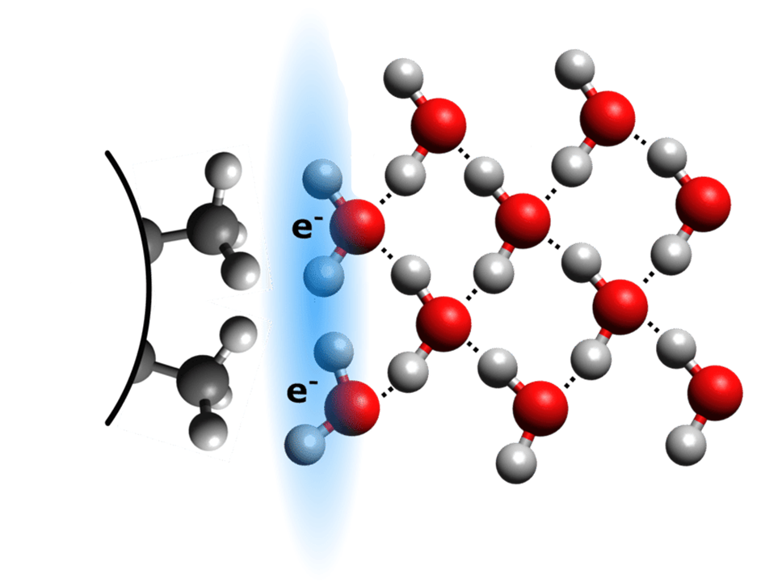
The Hydrophobic Effect –
An entropically driven process
Fats do not engage in hydrogen bonds with water.
The surface area of the “vacant” space left by the lack of interaction between water and hydrophobic is the basis of Hydrophobic Surface Area
Hydrophobic Surface Area in contact with water is entropically unfavorable and is therefore “buried” whenever possible. This is the basis of the Hydrophobic Effect.

Slide 8
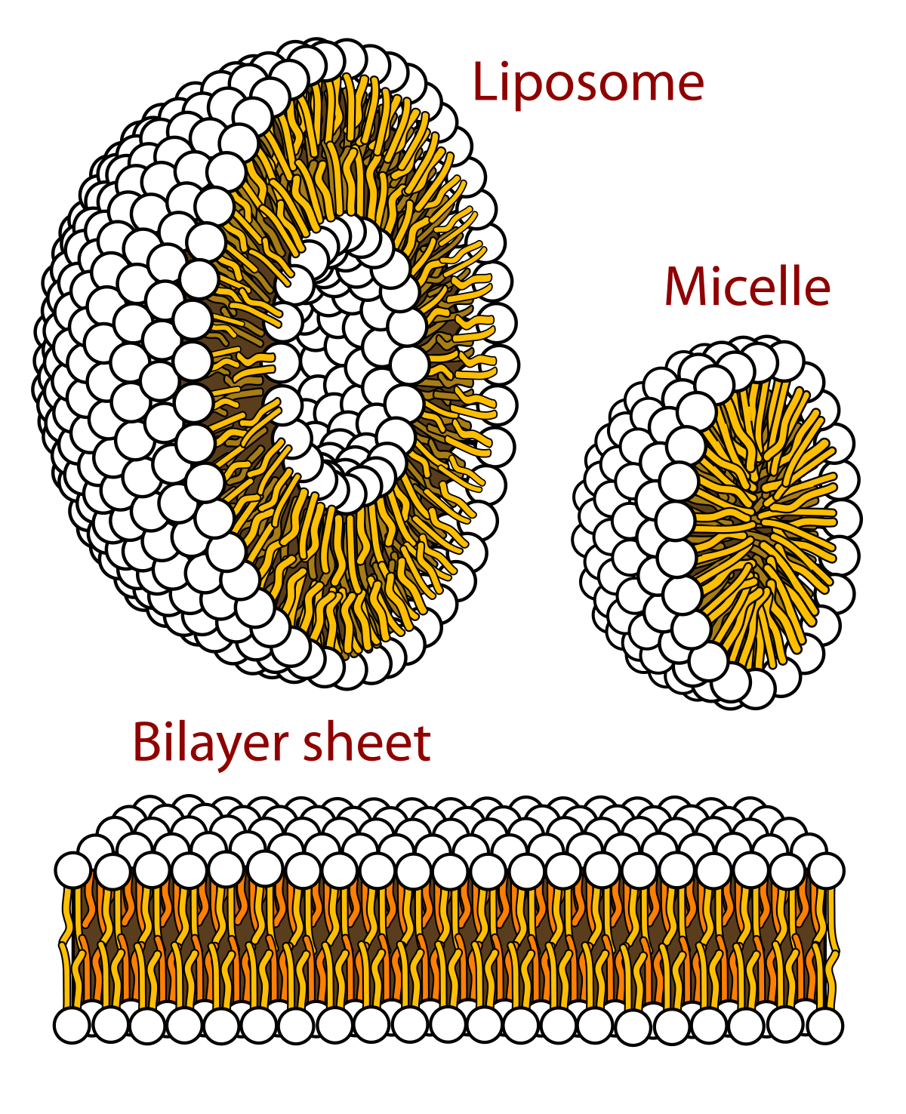
Burial of Hydrophobic Surface Area by Aggregation
The Hydrophobic effect is responsible for the aggregation of fats (lipids) in water.
The structures presented at right all derive stability from the hydrophobic effect.
https://www.google.com/imgres?imgurl=https%3A%2F%2Fupload.wikimedia.org%2Fwikipedia%2Fcommons%2Fthumb%2Fc%2Fc6%2FPhospholipids_aqueous_solution_structures.svg%2F1200px-Phospholipids_aqueous_solution_structures.svg.png&imgrefurl=https%3A%2F%2Fen.wikipedia.org%2Fwiki%2FMicelle&tbnid=IxuWMcfHm8DoLM&vet=12ahUKEwj0gIzZvbz2AhXLPM0KHZUhBXkQMygAegUIARDZAQ..i&docid=nPCQd4EaFsOaXM&w=1200&h=1476&q=formaiotion%20of%20micelles&client=opera-gx&ved=2ahUKEwj0gIzZvbz2AhXLPM0KHZUhBXkQMygAegUIARDZAQ

Slide 9
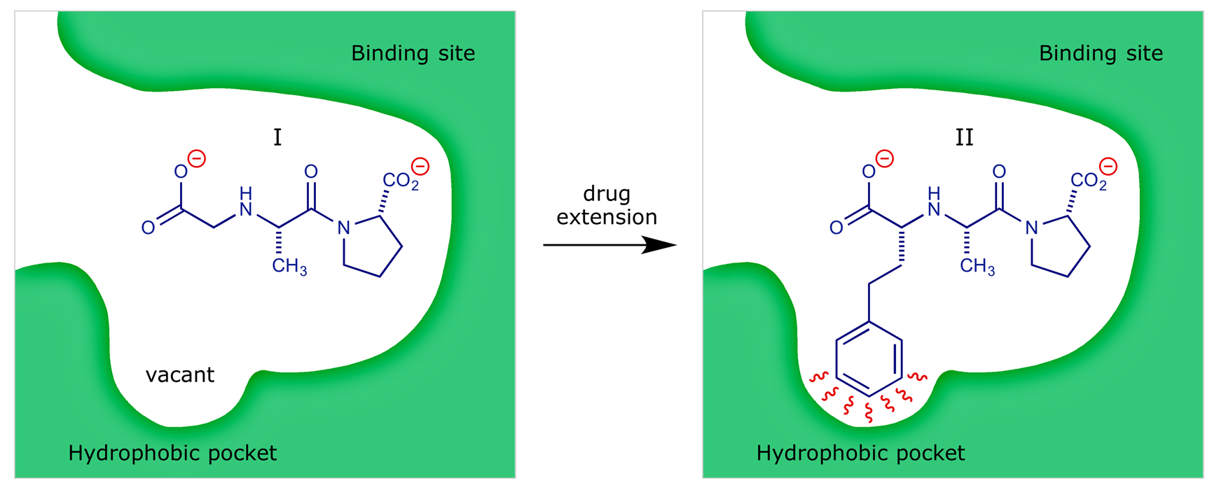
Hydrophobicity of binding sites
https://www.google.com/url?sa=i&url=https%3A%2F%2Fwww.stereoelectronics.org%2FwebDD%2FDD_04.html&psig=AOvVaw2iQZ1fFnfos2tQ4IF72BM7&ust=1647033787525000&source=images&cd=vfe&ved=0CAsQjRxqFwoTCJDVrpi9vPYCFQAAAAAdAAAAABAD

Slide 10
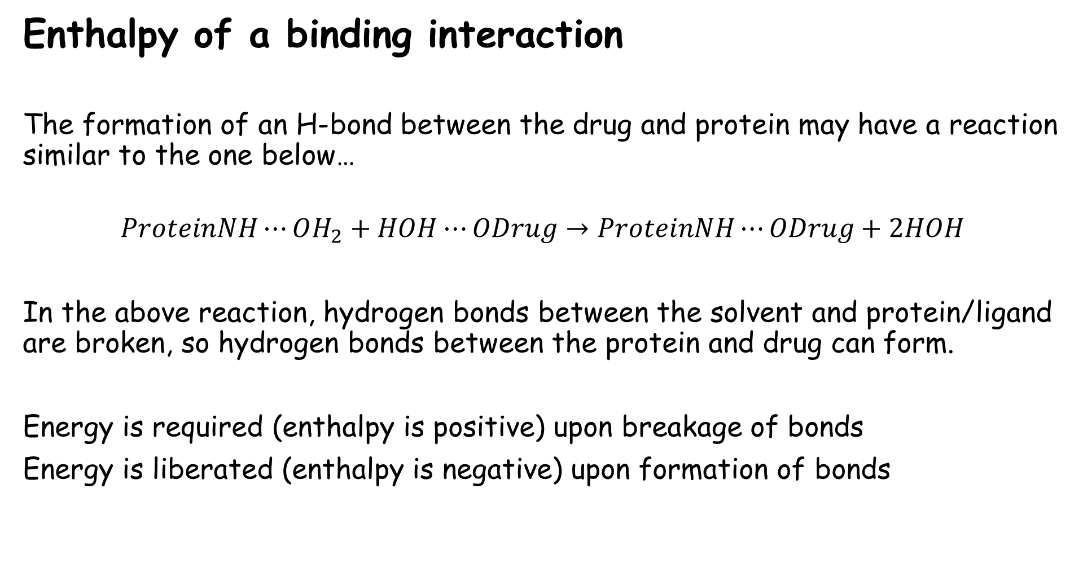
Enthalpy of a binding interaction
The formation of an H-bond between the drug and protein may have a reaction similar to the one below…
$$ProteinNH⋯OH_{2}+HOH⋯ODrug→ProteinNH⋯ODrug+2HOH$$
In the above reaction, hydrogen bonds between the solvent and protein/ligand are broken, so hydrogen bonds between the protein and drug can form.
Energy is required (enthalpy is positive) upon breakage of bonds
Energy is liberated (enthalpy is negative) upon formation of bonds
https://www.google.com/imgres?imgurl=https%3A%2F%2Fupload.wikimedia.org%2Fwikipedia%2Fcommons%2Fthumb%2Fc%2Fc6%2FPhospholipids_aqueous_solution_structures.svg%2F1200px-Phospholipids_aqueous_solution_structures.svg.png&imgrefurl=https%3A%2F%2Fen.wikipedia.org%2Fwiki%2FMicelle&tbnid=IxuWMcfHm8DoLM&vet=12ahUKEwj0gIzZvbz2AhXLPM0KHZUhBXkQMygAegUIARDZAQ..i&docid=nPCQd4EaFsOaXM&w=1200&h=1476&q=formaiotion%20of%20micelles&client=opera-gx&ved=2ahUKEwj0gIzZvbz2AhXLPM0KHZUhBXkQMygAegUIARDZAQ

Slide 11
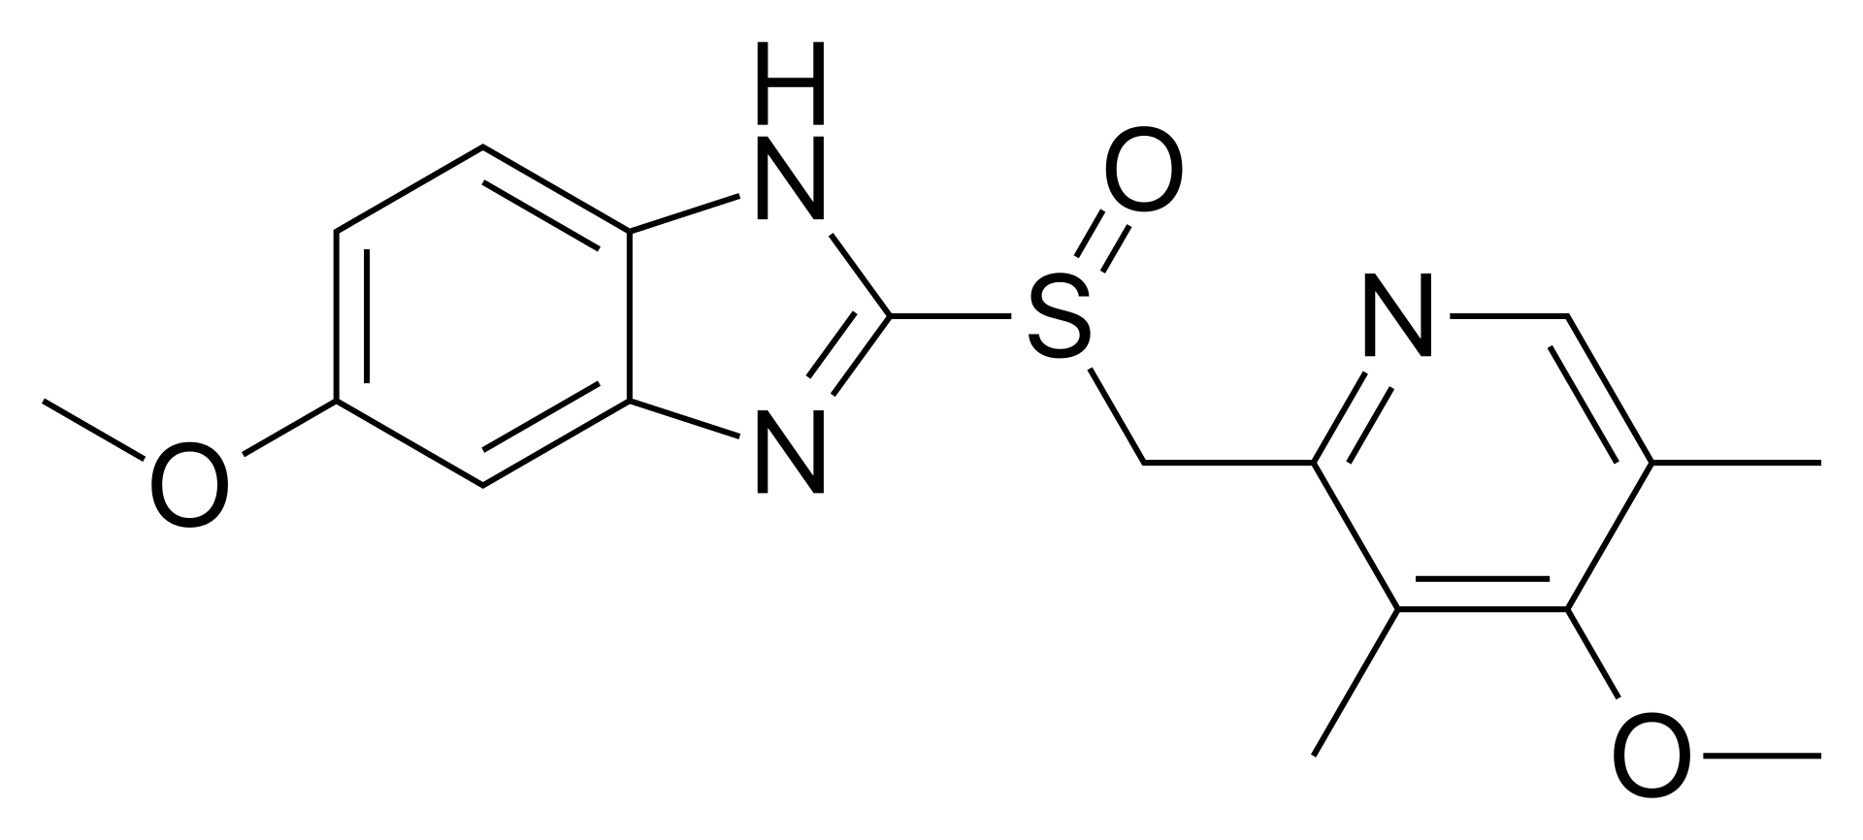
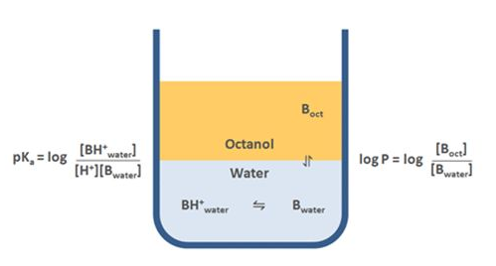
Lipinski's Rule of Five
So called, because each maxim uses a multiple of 5.
No more than 500 g/mol
No more than 5 h-bond donors
No more than 10 h-bond acceptors
Lipophilicity less than 5
https://www.google.com/imgres?imgurl=https%3A%2F%2Fupload.wikimedia.org%2Fwikipedia%2Fcommons%2Fthumb%2F4%2F48%2FOmeprazole.svg%2F1200px-Omeprazole.svg.png&imgrefurl=https%3A%2F%2Fen.wikipedia.org%2Fwiki%2FLipinski%2527s_rule_of_five&tbnid=otokzSeJk0Uz2M&vet=12ahUKEwiA17_vvbz2AhUROc0KHfTKDDQQMygGegUIARDHAQ..i&docid=CGWavJuXEf0ZsM&w=1200&h=541&q=lipinski%20rule%20of%205&client=opera-gx&ved=2ahUKEwiA17_vvbz2AhUROc0KHfTKDDQQMygGegUIARDHAQ
https://www.google.com/imgres?imgurl=https%3A%2F%2Fimages.slideplayer.com%2F27%2F9196853%2Fslides%2Fslide_4.jpg&imgrefurl=https%3A%2F%2Fslideplayer.com%2Fslide%2F9196853%2F&tbnid=lyV8aVWwU2XsmM&vet=12ahUKEwi3wsKBvrz2AhWXUs0KHXSGCkUQMygZegUIARCLAg..i&docid=ixY1NsvLAC90xM&w=960&h=720&q=lipophilicity&client=opera-gx&ved=2ahUKEwi3wsKBvrz2AhWXUs0KHXSGCkUQMygZegUIARCLAg
Notes:
Why the h bond donor and acceptor numbers
Who is Lipinski, why do we use his rules, are they rules or guidelines
Calirify which are about oral bioavailability

Slide 12
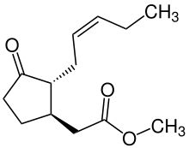
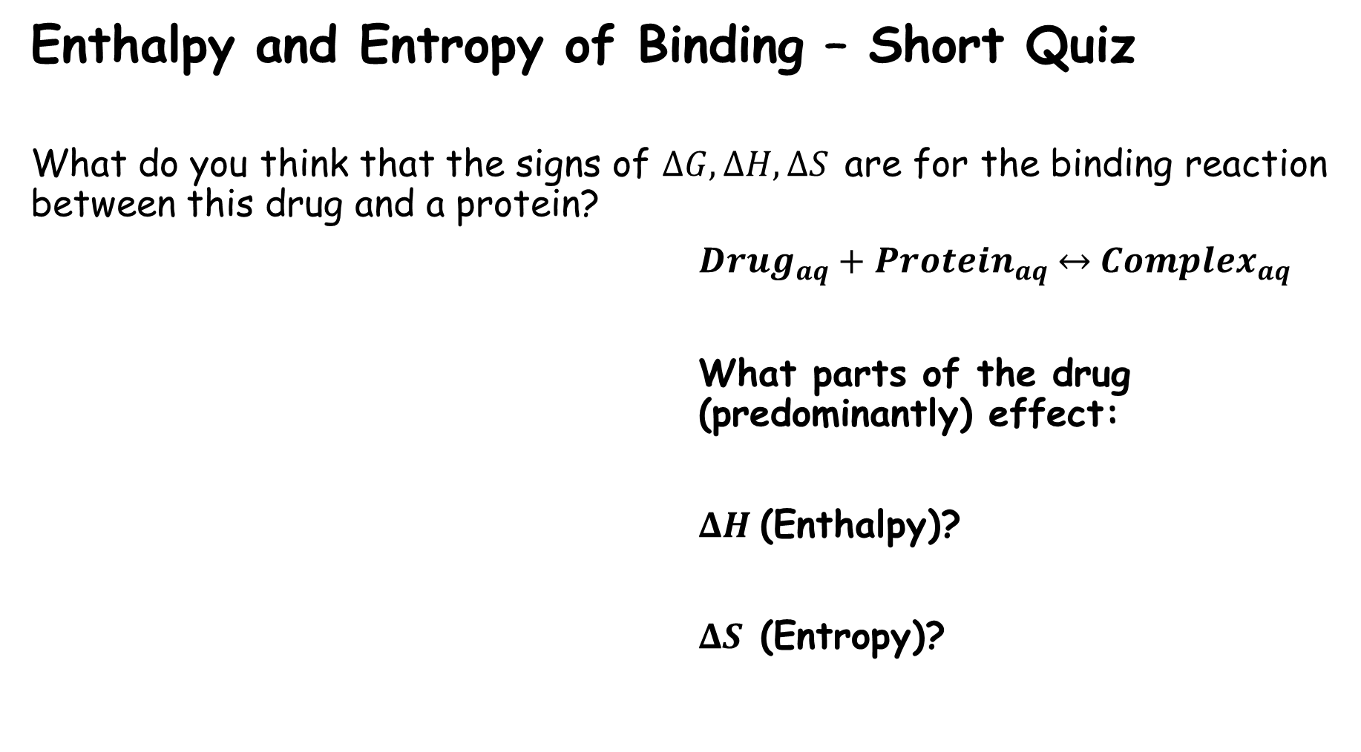
Enthalpy and Entropy of Binding – Short Quiz
What do you think that the signs of $ΔG, ΔH, ΔS$ are for the binding reaction between this drug and a protein?
${Drug}_{aq}+{Protein}_{aq} \underset{↔}{ }{ Complex}_{aq}$
What parts of the drug (predominantly) effect:
$ΔH$(Enthalpy)?
$ΔS$ (Entropy)?

Slide 13
Short Review #1 – Discuss then answer
How is binding free energy related to binding affinity and selectivity?
What factors contribute to the Enthalpy of a binding reaction?
What factors contribute to the Entropy of a binding reaction?

Slide 14
Why predict binding free energy?
Binding free energy is mathematically related to binding affinity,
and therefore ideally suited for ranking potential drugs’ affinity.
Binding free energy is observable in an experimental laboratory, via techniques such as Isothermal Titration Calorimetry.
Binding free energy is an ensemble property.

Slide 15
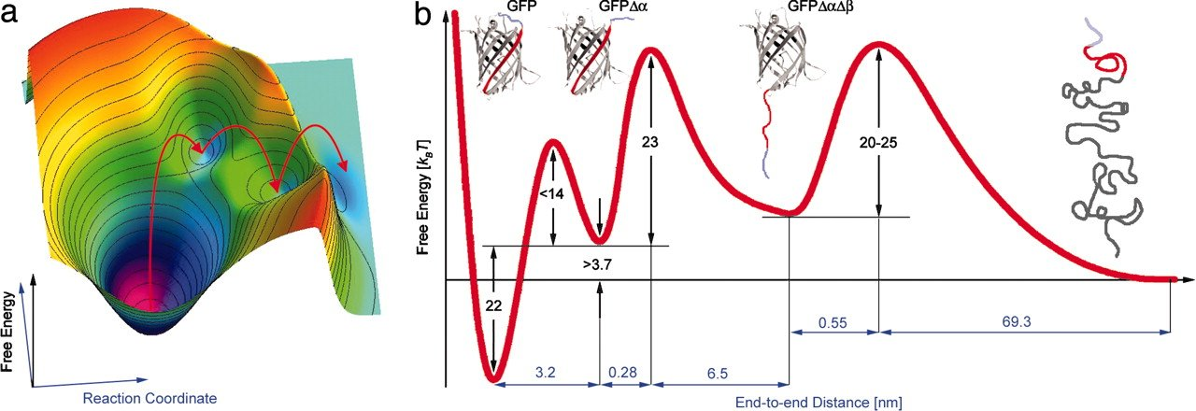
How to predict the free energy differences between states
End-Point
Alchemical
Simulate the protein and ligand in realistic conditions.
Intermediate computational expense, compared to docking and alchemical methods.
Better correlation with experiment than docking alone.
Simulate realistic states, as well as non-existent intermediates.
Greatest computational expense.
Best correlation with experiment.

Slide 16
How to predict the free energy differences between states
End-Point
Alchemical
Simulate the two states of interest in realistic conditions.
Intermediate computational expense, compared to docking and alchemical methods.
Better correlation with experiment than docking alone.
Simulate realistic states, as well as non-existent intermediates.
Greatest computational expense.
Best correlation with experiment.

Slide 17
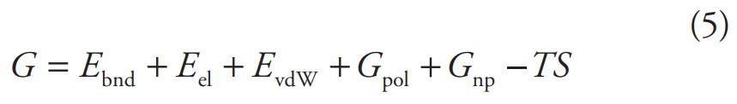
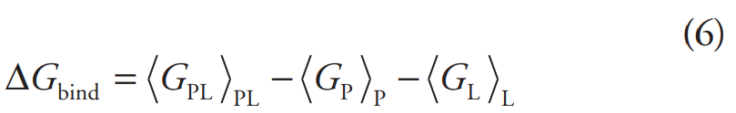
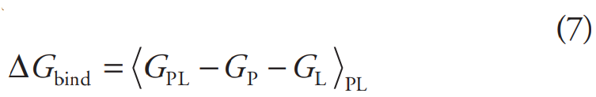
MMPBSA and MMGBSA – A popular end point method
The free energy of a state (P, L, PL) is defined as the sum of:
MM energy from bonds (Bonded Interactions).
Electrostatics and Van der Waals interactions (Non-Bonded Interactions).
Polar and non-polar solvation energies.
Entropy

Slide 18
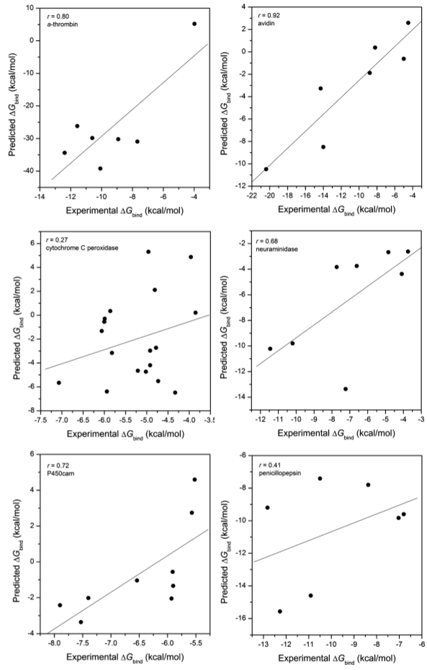
MMPBSA and MMGBSA –
How Accurate is it?
At right, the free energy change of 59 ligands binding to:
Alpha-Thrombin Avidin
Cytochrome C peroxidase Neuraminidase
P450cam Penicillopepsin
Is evaluated by MMPBSA and compared to experiment.

Slide 19
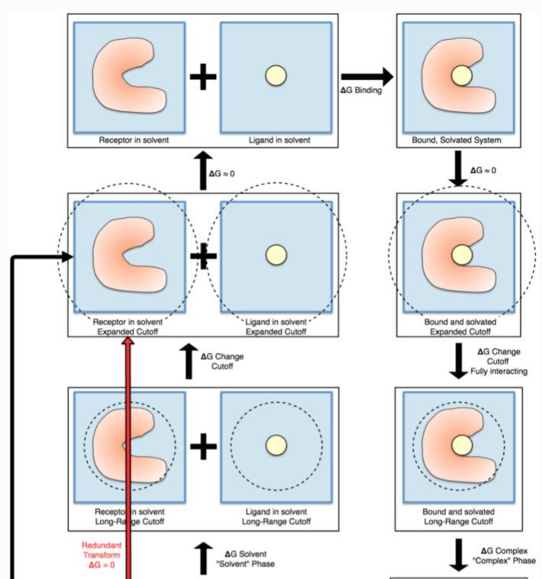
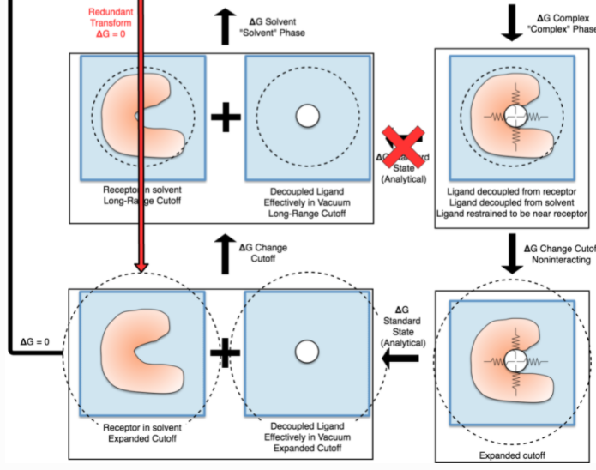
Alchemical Free Energy Methods
– Thermodynamic Cycles
What is a Thermodynamic Cycle?
Free Energy is a State Function
A state function has the same result regardless of the path taken.

Slide 20
Alchemical Free Energy methods what makes it alchemical?
Artificial Addition and deletion of forces which are not physiologically present.
Restraints Lambda Nonbonded Interactions
End-to-end elongation Center of Mass Force

Slide 21
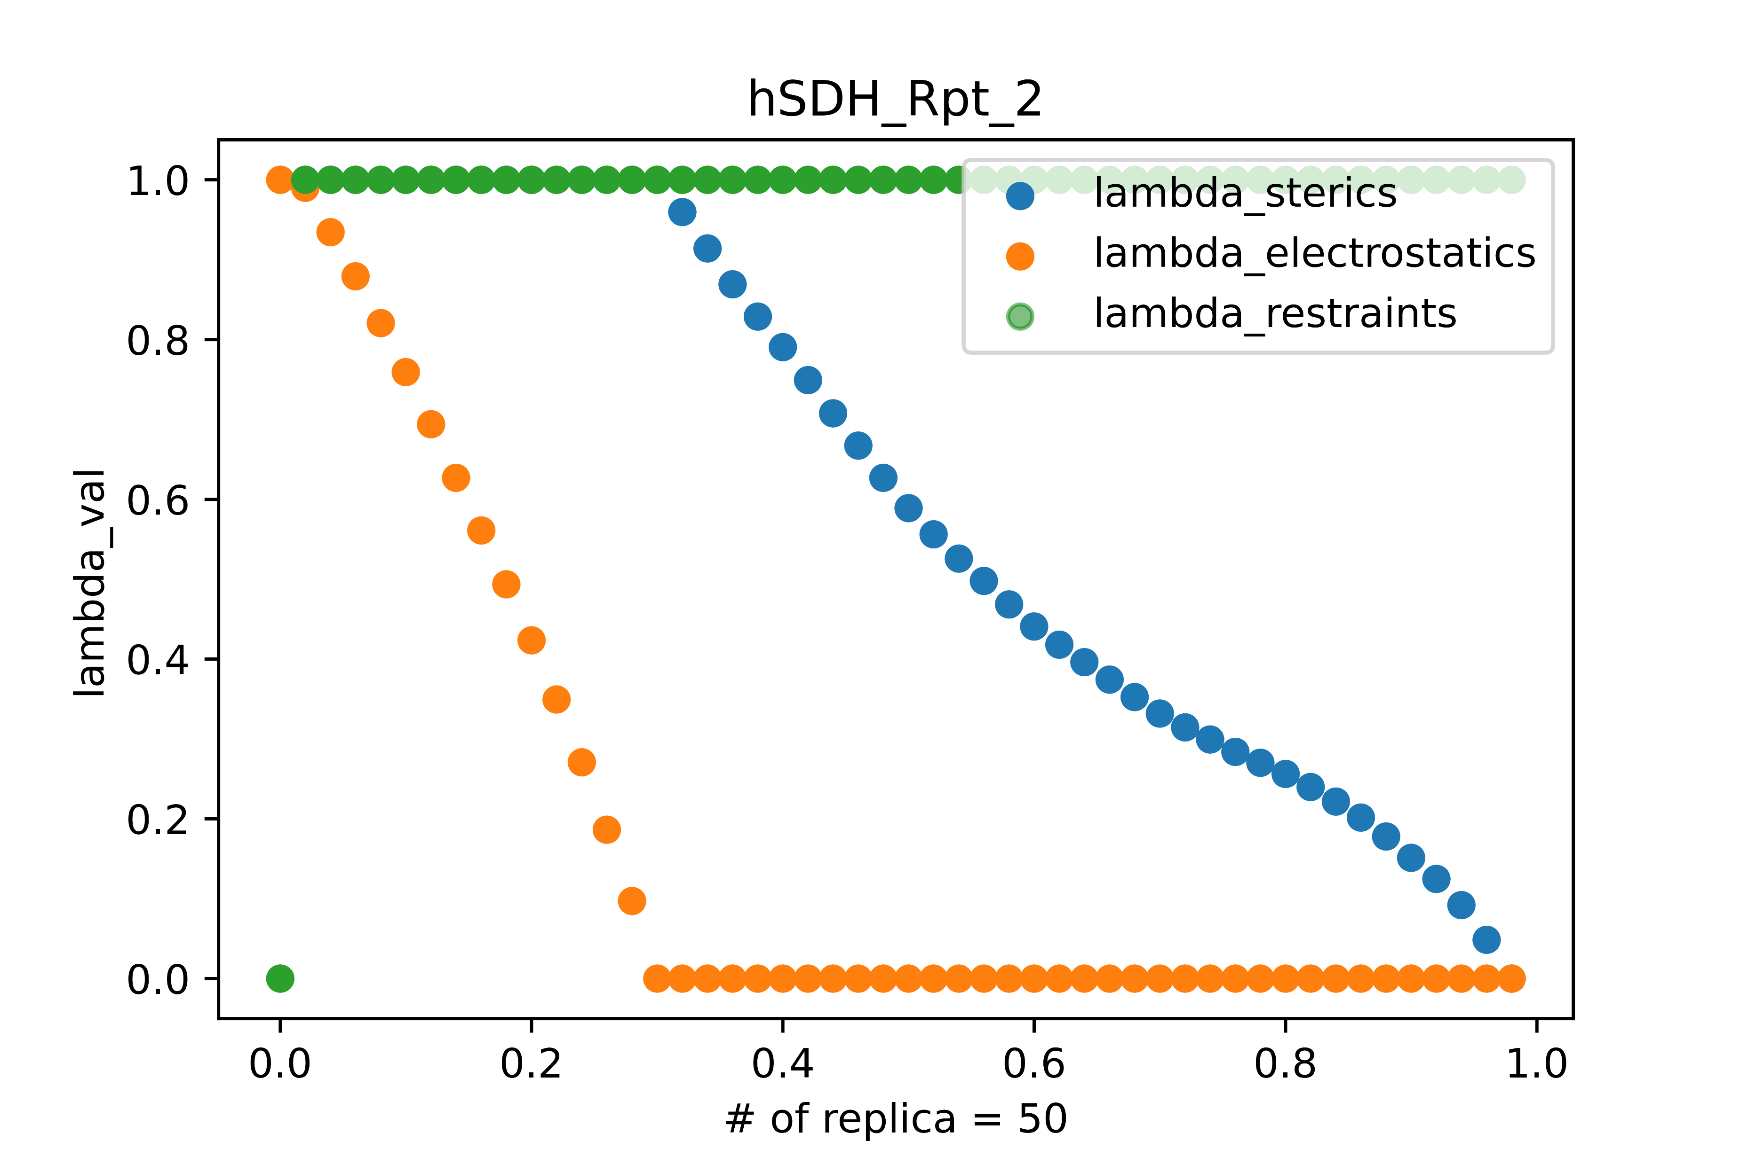
Alchemical Free Energy methods – Lambda Electrostatics and Sterics
One replica exchange package, YANK, utilizes a series of intermediates called Lambda Windows.
The value of Lambda for restraints, electrostatics, and sterics for one YANK experiment is plotted at right.

Slide 22
Alchemical Free Energy methods

Slide 23
The Final Short Review
Why is it useful to computationally predict the binding free energy between a protein and ligand?
What are the benefits and drawbacks of End-Point BFE Calculations?
What are the benefits and drawbacks of Alchemical BFE Calculations?
Why are alchemical calculations called ’Alchemical’?

