Slide 1

Hybrid Quantum Mechanics/ Molecular Mechanics (QM/MM) Approach
Sivanujan S (Sivanu)

Slide 2
Introduction
Quantum-mechanical (QM) methods are required for describing chemical reactions and other electronic processes, such as charge transfer or electronic excitation.
Restriction: QM methods are restricted to systems of up to a few hundred atoms
Highly efficient, force-field-based molecular mechanics (MM) methods are capable of treating up to several 100 000 atoms and allowing for simulations over time scales of tens of nanoseconds.
A logical model is built to use;
a QM method for the chemically active region (e.g., substrates and co-factors in an enzymatic reaction) and
an MM treatment for the surroundings (e.g., protein and solvent).

Slide 3
Introduction (Contd.)
The prime challenges with QM/MM calculations are;
bonds between the QM and MM systems,
the selection of the QM system, and
the local-minima problem.
There are two approaches to treat proteins with QM methods.
QM-cluster approach: In the QM-cluster approach, a small number of residues (typically 30–200 atoms) are cut out from the protein and are studied by QM in a continuum solvent.
continuum solvent - (sometimes known as Implicit solvation ) is a method to represent solvent as a continuous medium instead of individual “explicit” solvent molecules.
2. The active site is treated by a similar QM model, but the surrounding protein and solvent are modeled by molecular mechanics (MM), giving the QM/MM approach.

Slide 4
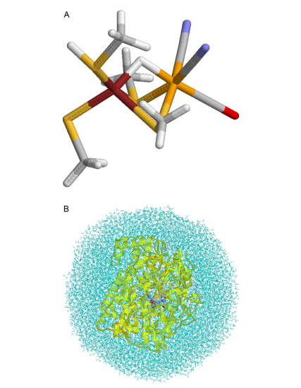
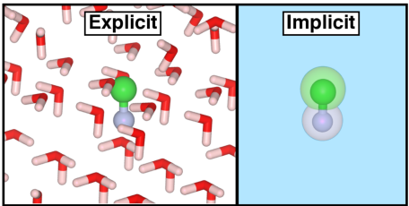
Introduction (Contd.)
Solvation Models
QM-Cluster
QM/MM
Ryde, U., 2016. QM/MM Calculations on Proteins. Methods in Enzymology, pp.119-158.
Iyemperumal, S. and Deskins, N., 2017. Evaluating Solvent Effects at the Aqueous/Pt(111) Interface. ChemPhysChem, 18(16), pp.2171-2190.

Slide 5
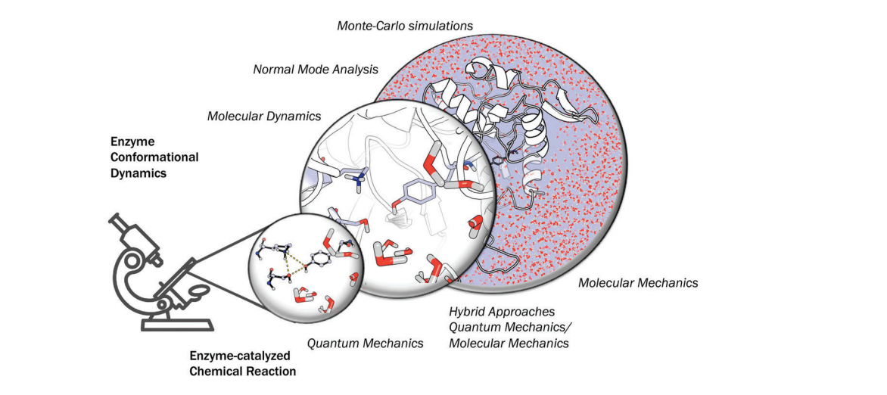
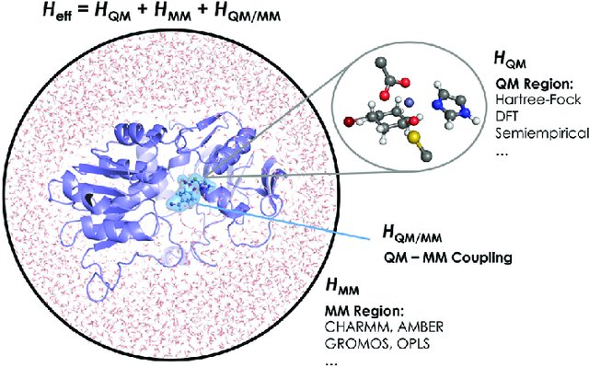
QM/MM approach; a big picture
Romero-Rivera, A., Garcia-Borràs, M. and Osuna, S., 2017. Computational tools for the evaluation of laboratory-engineered biocatalysts.
Chemical Communications, 53(2), pp.284-297.

Slide 6

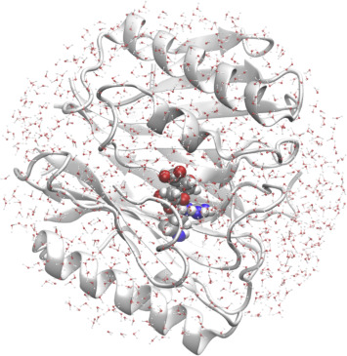
B
A
A – MM region
B – QM region

Slide 7
QM–MM partitioning
QM: inner region
Boundary region
MM: outer region

Slide 8
QM/MM Boundary region
The term boundary region is used rather loosely to designate the region where the standard QM and MM procedures are modified or augmented in any way.

Slide 9
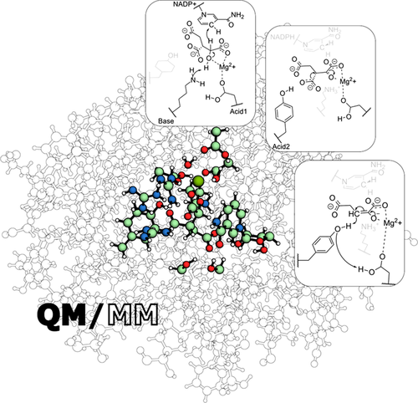
Choice of the QM/MM boundary
Ideally far away from reactive centre.
Bond formation and bond-breaking processes?
Sousa, S., Ribeiro, A., Neves, R., Brás, N., Cerqueira, N., Fernandes, P. and Ramos, M., 2016. Application of quantum mechanics/molecular mechanics methods in the study of enzymatic reaction mechanisms. WIREs Computational Molecular Science, 7(2).

Slide 10
Choice of the QM level
In QM calculations, the Schrodinger equation is solved for a molecular system. The input is the coordinates, the net charge, and the total spin. The result is the total energy and the wave function, from which all measureable properties of the system can be calculated.
Self-consistent-field (SCF) treatment: presence of the external point-charge field that represents the MM charge model in the case of electronic or polarized embedding.
The most basic QM approach is the Hartree–Fock (HF) method. Unfortunately, it gives quite approximate results and it is therefore mainly used as a starting point of more accurate methods, based on perturbation theory or series expansions, eg, Møller–Plesset second-order perturbation theory (MP2).

Slide 11
Choice of the QM level (Contd.)
Currently, the great majority of QM calculations are performed with density functional theory (DFT).
It is not based on the wave function, which is a function of the coordinates of all involved particles, but instead on the electron density, which is a function of only the three coordinates of Cartesian space.
All mentioned QM methods expand the wave function in a set of known functions, the basis set.
Generically, a basis set is a collection of vectors which spans (defines) a space in which a problem is solved.
In QM, the “basis set” usually refers to the set of (non-orthogonal) one-particle functions used to build molecular orbitals.

Slide 12
What is a Basis Set?
Basis set:
Basis sets determine the number of functions used to describe the electronic structure.
Basis set:
Basis set:

Slide 13
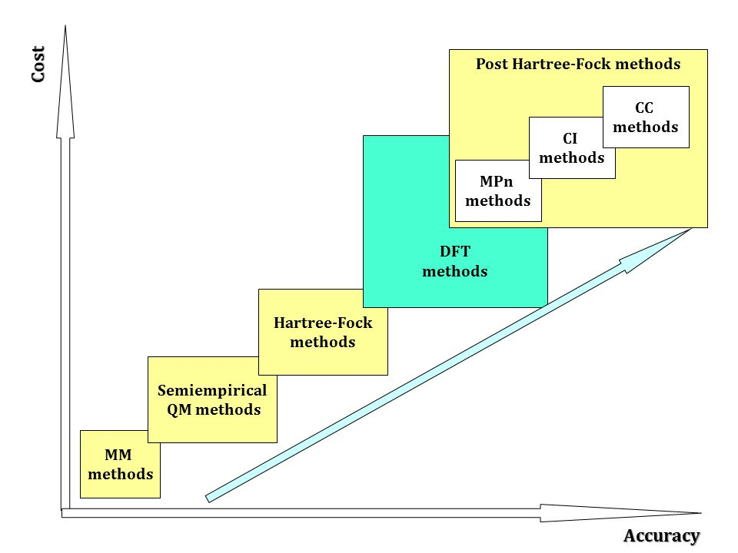
QM methods; accuracy vs cost
DFT, Density Functional Theory
MPn, Møller–Plesset perturbation theory
CI, Configuration Interaction
CC, Coupled Cluster
The quest for a universal density functional: The accuracy of density functionals across a broad spectrum of databases in chemistry/ slideshare

Slide 14
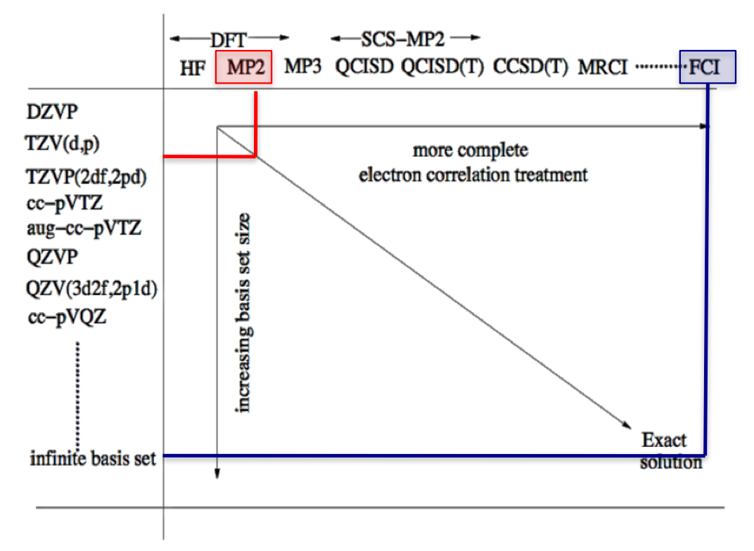
QM methods; basis sets and levels
https://adreasnow.com/Self%20Directed%20Learning/Katya%20Pas/05/

Slide 15
How do you define basis sets?
A basis set is a mathematical description of orbitals of a system, which is used for approximate theoretical calculation or modeling.

Slide 16

Let’s Check!
Criteria | MM | QM
Molecules as a systems of nuclei and electrons
Energy as a function of nuclear position only
Faster approach
Interactions are governed by nuclear, electron charges and electron motions
Explicit electron – electron interactions
Interactions determine spatial distribution of atoms & energies

Slide 17
QM methods; solvent phases
QM calculations are normally performed on isolated molecules in gas phase. However, most experiments are performed in condensed phases (aqueous solution).
Methods have been developed to model a surrounding homogeneous solvent in QM calculations, continuum solvation methods.
Polarizable continuum model (PCM)
Conductor-like solvent model (COSMO)
For protein-sized systems, methods based on the Poisson–Boltzmann (PB) equation or the generalized Born (GB) approach are more common.

Slide 18
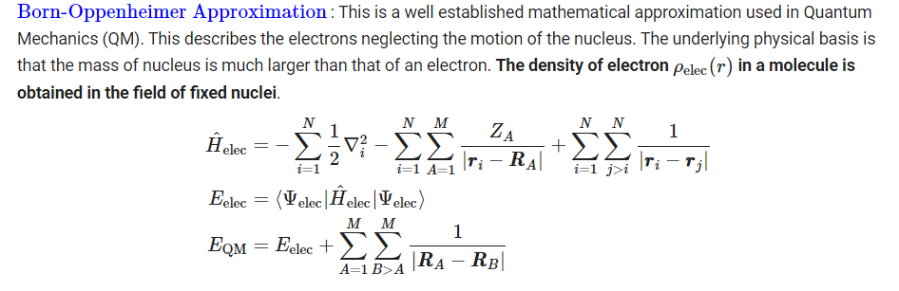
Potential Energy of QM region

Slide 19
MM Methods
No attempt is made to solve the Schrodinger equation and electrons are ignored. Instead, molecules are considered as a collection of balls, connected by springs.
The energy of the system as a function of the coordinates is described by an empirical function, a force field (FF).

Slide 20
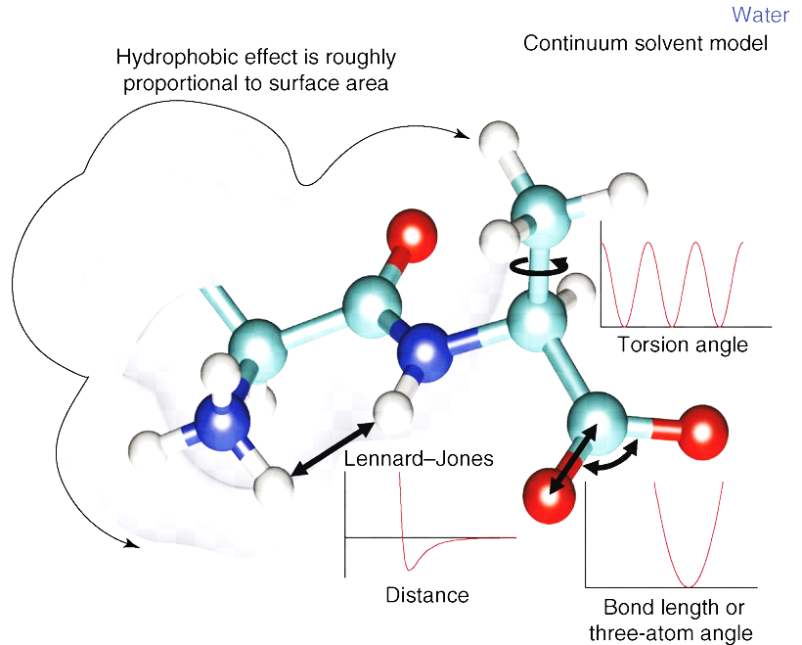
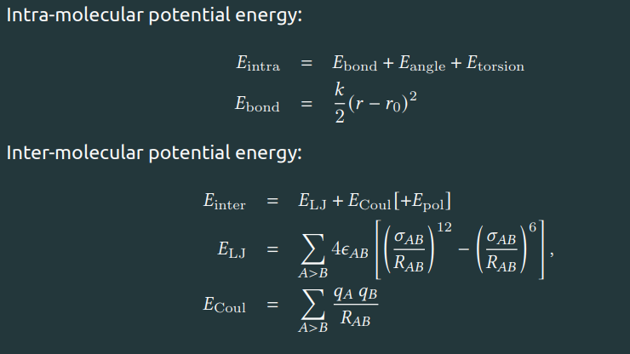
Potential Energy of MM region
Source: https://favpng.com/png_view/energy-molecular-mechanics-molecular-dynamics-force-field-classical-mechanics-computational-chemistry-png/RV6AhQ7Z
https://github.com/swillow/modelingworkshop

Slide 21
MM (Contd.)
Energy can be calculated for a whole protein in seconds, allowing for extensive sampling of the accessible phase space by molecular dynamics (MD) or Monte Carlo methods.
The protein is typically solvated with several thousands of explicit water molecules and possibly counter ions to provide a more realistic account of the surroundings.
To mimic infinite systems, periodic boundary conditions are employed.
Choice of MM method: biomolecular force fields available.
Popular examples include AMBER, CHARMM, GROMOS and OPLS-AA.
Biomolecules - typically includes proteins and in most cases also nucleic acids, but less frequently carbohydrates or lipids.
Lopes PE, Guvench O, MacKerell AD Jr. Current status of protein force fields for molecular dynamics simulations.
Methods Mol Biol. 2015;1215:47-71. doi:10.1007/978-1-4939-1465-4_3

Slide 22
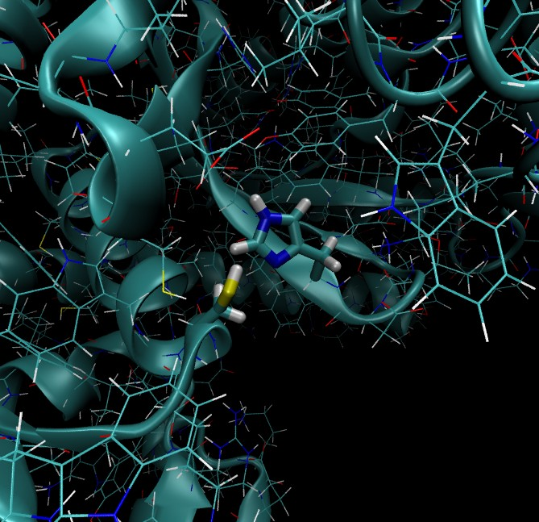
QM/MM methods for biomolecular systems
Problem: There are covalent linkages between QM atoms and MM atoms.
Consider that the QM region is connected to the MM region via one covalent bond: CB-CA.
The ‘CB’ atom belongs to the QM region and the ‘CA’ atom to the MM region.
The link-atom (L) method: the free valency is capped by an additional atom (H):
CB-CA –> CB-H.
https://github.com/swillow/modelingworkshop

Slide 23
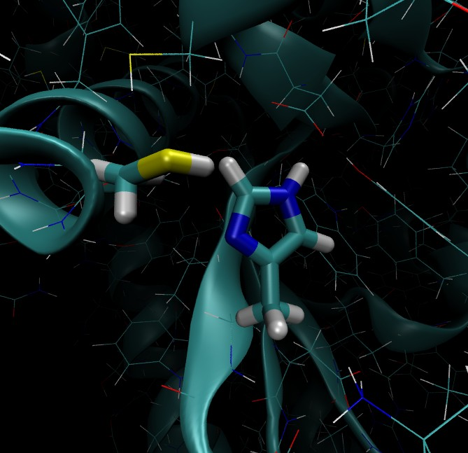
Before adding link-atoms.
After adding link-atoms.
https://github.com/swillow/modelingworkshop

Slide 24
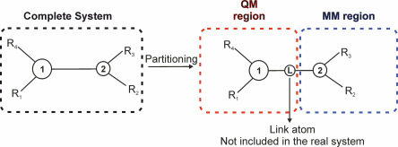
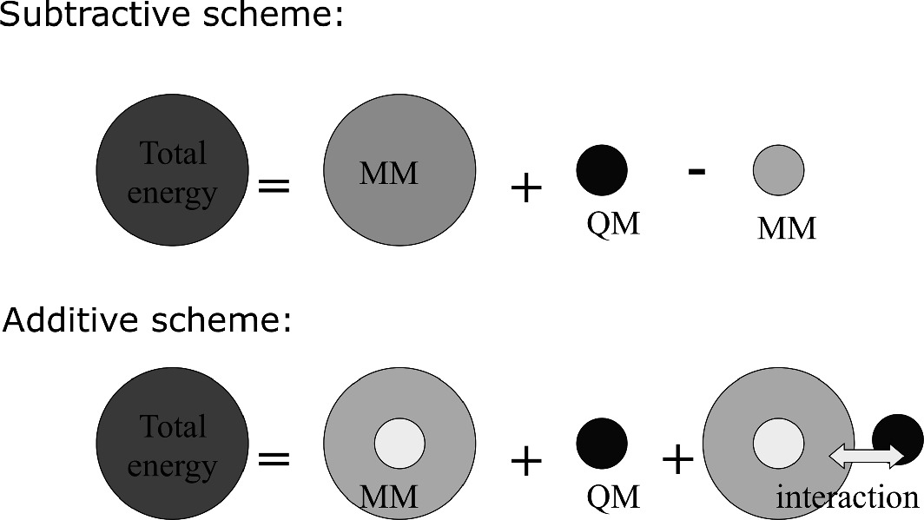
The QM/MM Energy Expression; Subtractive and Additive QM/MM Schemes
Navizet, I., 2020. QM/MM Study of Bioluminescent Systems. Challenges and Advances in Computational Chemistry and Physics, pp.227-270.

Slide 25
The QM/MM Energy Expression (Contd.)
Subtractive QM/MM schemes require-
(1) an MM calculation on the entire system;
(2) a QM calculation on the inner subsystem; and
(3) an MM calculation on the inner subsystem.
The QM/MM energy of the entire system is then obtained by summing (1) and (2) and subtracting (3).

Slide 26
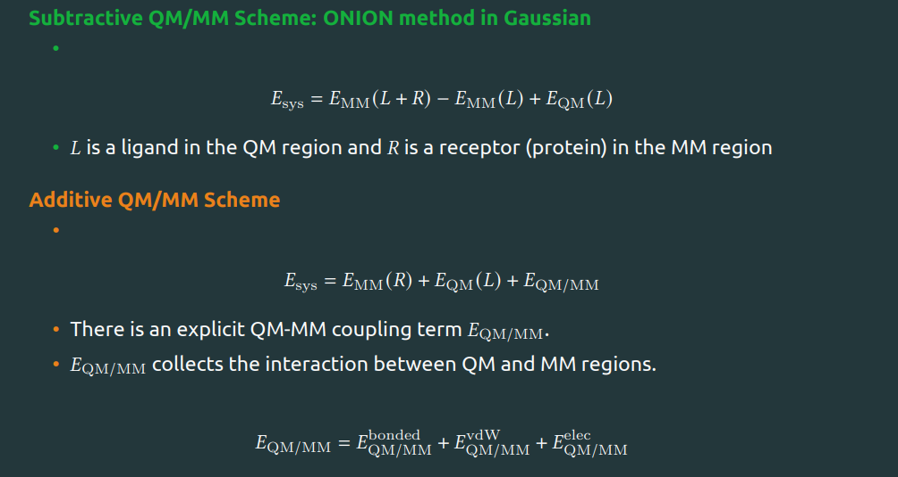
The QM/MM Energy Expression (Contd.)
Subtractive Scheme: ONIOM Method
own N-layered Integrated molecular Orbital and molecular Mechanics
Additive Scheme
https://github.com/swillow/modelingworkshop

Slide 27
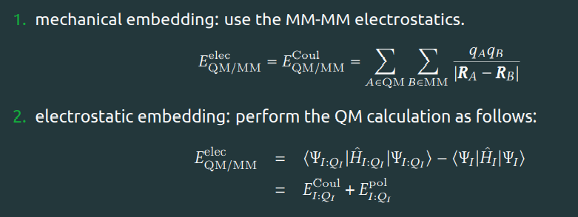
The Electrostatic QM–MM Interaction
The electrostatic coupling between the QM charge density and the charge model used in the MM region can be handled at different levels of sophistication, characterized essentially by the extent of mutual polarization and classified accordingly as;
mechanical embedding electrostatic embedding, and polarized embedding.
https://github.com/swillow/modelingworkshop

Slide 28
Other Nonbonded and Bonded QM–MM Interactions
There are also van der Waals and bonded contributions to the QM–MM coupling term.
Their treatment is considerably simpler as they are handled purely at the MM level, irrespective of the class (subtractive or additive) of QM/MM scheme.
The van der Waals interaction is typically described by a Lennard–Jones potential
The formal reservations against using standard MM parameters to describe QM–MM interactions apply of course also to the bonded (bond stretching, angle bending, torsional, etc.) interactions.
For electrostatic or polarized embedding, overpolarization of the QM density by the MM charges close to the cut has to be prevented, especially when using link atoms.

Slide 29
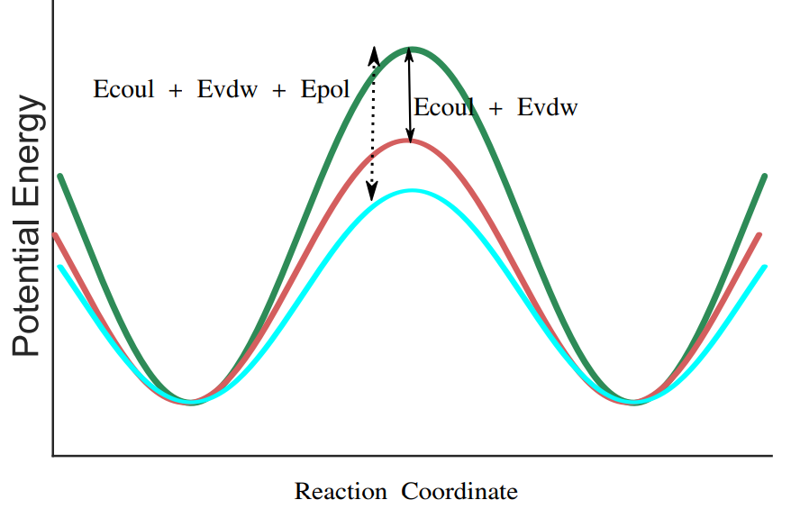
Potential Energy Surface for a reaction
QM
QM/MM with the MM interaction between QM and MM regions
QM/MM with the polarization energy
https://github.com/swillow/modelingworkshop

Slide 30
Google Colab Session

