Slide 1
Molecular Docking Using Autodock Vina
By: Kunj Patel

Slide 2
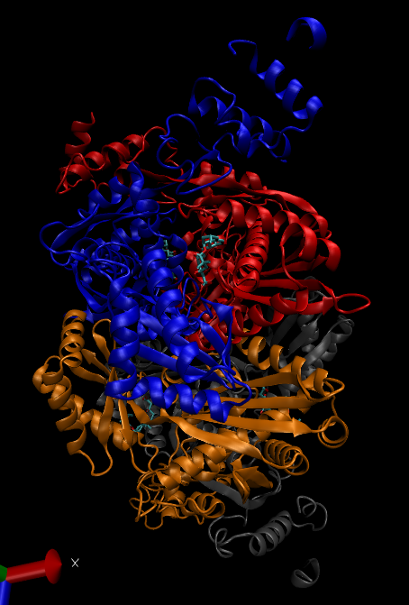
What is Molecular Docking?
To predict:
the 3D structure of a noncovalent complex.
protein-ligand
protein-protein
the binding affinity of the partners (scoring function)
Prior to prediction, the structure of binding partner(s) is known, but
could be affected by binding
may be bound to different partners
Above: Example of protein-protein noncovalent complex.

Slide 3
How Well Does Docking Work?
Fairly successful at generating binding poses [Damm-Ganamet et al, 2013].
Usually successful (~80%) at ranking them.
Poorly correlated with binding free energies [Warren et al, 2006].
Unreliable at separating actives from decoys [Cross et al, 2009].
Decoys are ligands that are structurally similar but topologically different from the active.
Sometimes successful at virtual screening. Hit rates < 20%

Slide 4
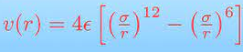
How Does Docking Generally Work?
Docking is optimization of a scoring function, E(x)
E can be the total potential energy or interaction energy
can be entirely physics-based or partly knowledge-based
physics-based are usually molecular mechanics energies (RW).
x is a vector describing the molecular coordinates
Below: Example of a potential-based scoring function. Does anybody recognize this equation?

Slide 5
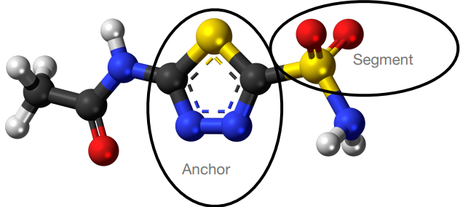
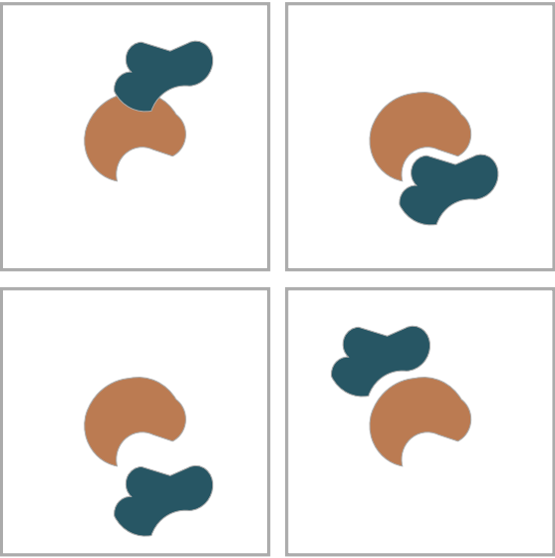
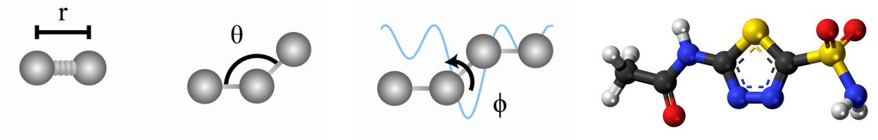
Examples of Older Optimization Algorithms
Optimization algorithms include
anchor-and-grow in UCSF DOCK, the original docking program
genetic algorithm in AutoDock, the most popular docking program
We will be using AutoDock Vina in this module.
Fast Fourier transform (FFT), especially for fragment and protein-protein docking
Below: Stretch and Grow Algorithm Example UCSF Dock
Below: Lamarckian Algorithm for Autodock
Left: FFT optimization function

Slide 6
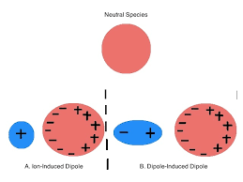
How Can Docking Be Improved?
Free energy includes both enthalpy and entropy. Docking scores usually exclude entropy.
Water often mediates protein-ligand interactions. Docking usually does not consider it.
Polarizability: Ligands can adapt to the protein environment. Docking usually does not consider this.

Slide 7
Review 1
What is molecular docking?
What is it good for?
What are the limitations to molecular docking?

Slide 8
The Autodock Vina Algorithm

Slide 9
Why Use Autodock Vina?
There are many molecular docking programs
Why Autodock Vina?
Free
Works on multiple platforms
Fast
Very popular
>10,000 citations
primary reference: [Trott and Olson, 2010]
>1,400 citations to primary reference of AutoDock 3 & 4 [Morris et al, 1998]

Slide 10
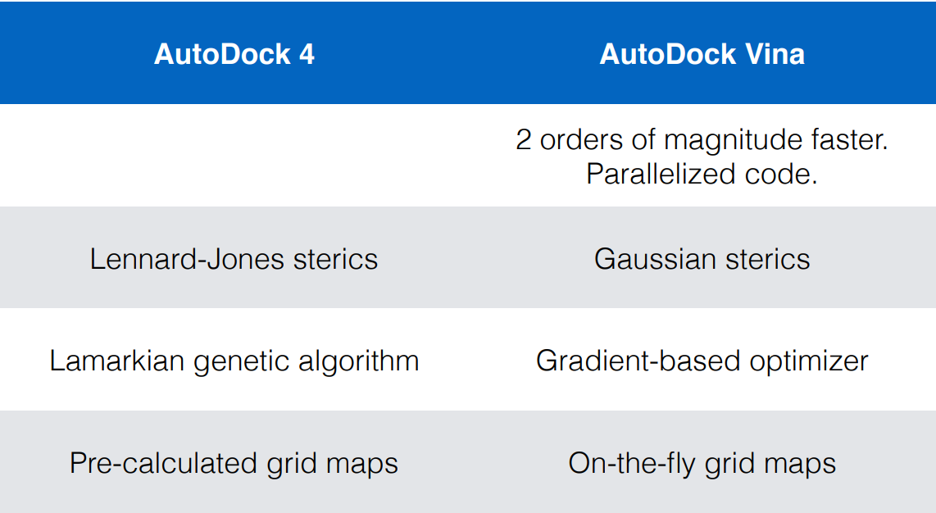
Difference Between Autodock 4 and Autodock Vina

Slide 11
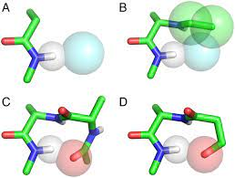
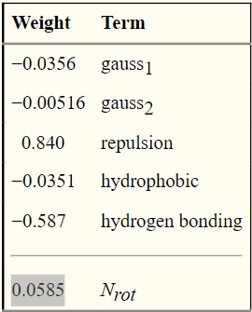
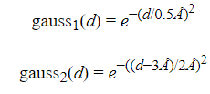
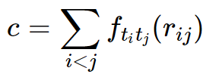

Basics of the Scoring Function (Autodock Vina)
Summation represents all atoms that move relative to each other.
Summates the intermolecular interaction contributions of each atom and outputs a docking score.
Number of rotatable bonds confers a positive contribution to free energy because system more rotatable bonds are assumed to lose entropy when binding.

Slide 12
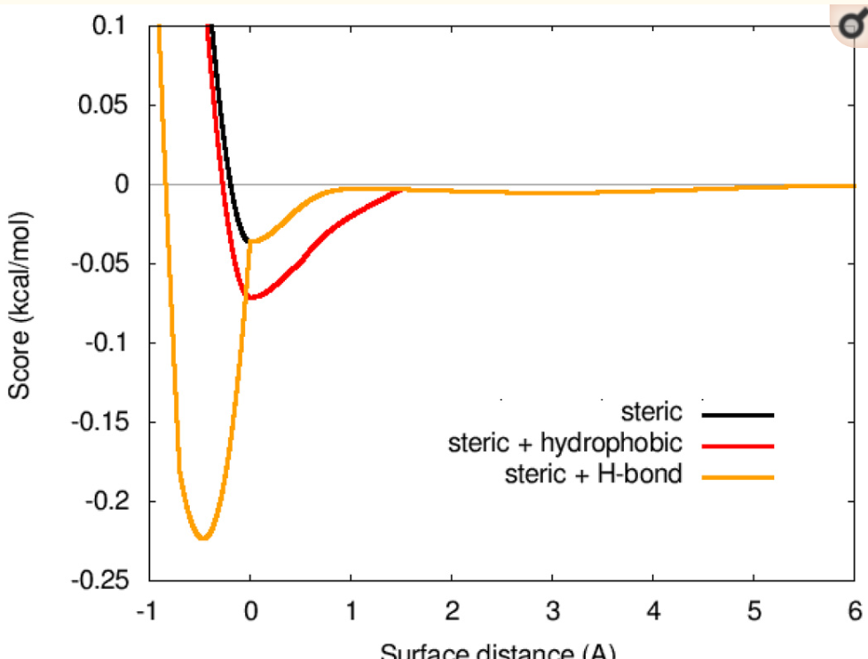
Gaussian Sterics
Contribution was determined of each type of intermolecular interaction using gaussian Sterics.
With these functions, the relative minima of each type of interaction is taken and aggregated.
All steric terms in the Vina algorithm (Below)

Slide 13

Gradient Based Optimization
Theory:
Every molecule, when visualized in three dimensional space, has 3 translational and 3 rotational degrees of freedom.
The number of torsions in this equation depends entirely on how many torsions are in the torsion tree of the ligand.
Since Autodock Vina can only do up to 32 torsions, M cannot be greater than 32.
The optimization function seeks to find a minimum of the scoring function.

Slide 14
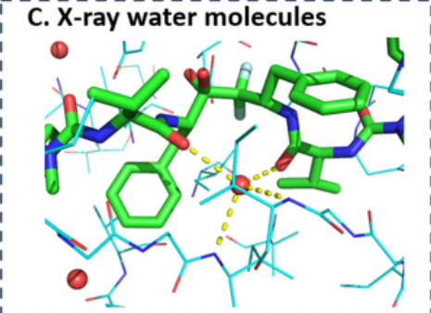
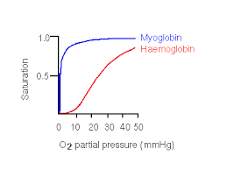
Autodock Vina 2021 Updates
Can simultaneously dock multiple ligands.
Can run controlled experiments to demonstrate cooperative, anti-cooperative, and independent binding (Eg. myoglobin-O₂ vs hemoglobin-O₂).
New atom types are accepted (namely W, for water)
Can modify the number of evaluations of the docking site itself by modifying the exhaustiveness parameter
Hydrated Docking
We can easily model water molecules involved in protein-ligand interaction.
Notes:
-

Slide 15
Review 2
How does Autodock Vina work?
What are its key approximations?
What are some of the important updates, and how do they affect docking?

Slide 16
Time for a Kahoot!
Kahoot Quiz Questions: https://create.kahoot.it/my-library/kahoots/all
Students: https://kahoot.it/

Slide 17
References
Cross, J. B.; Thompson, D. C.; Rai, B. K.; Baber, J. C.; Fan, K. Y.; Hu, Y.; Humblet, C. Comparison of Several Molecular Docking Programs: Pose Prediction and Virtual Screening Accuracy. Journal of Chemical Information and Modeling 2009, 49 (6), 1455–1474. https://doi.org/10.1021/ci900056c.
Damm-Ganamet, K. L.; Smith, R. D.; Dunbar, J. B.; Stuckey, J. A.; Carlson, H. A. CSAR Benchmark Exercise 2011-2012: Evaluation of Results from Docking and Relative Ranking of Blinded Congeneric Series. Journal of Chemical Information and Modeling 2013, 53 (8), 1853–1870. https://doi.org/10.1021/ci400025f.
Durrant, J. D.; McCammon, J. A. Molecular Dynamics Simulations and Drug Discovery. BMC Biol 2011, 9 (1), 71. https://doi.org/10.1186/1741-7007-9-71, adapted under the CC BY 2.0 license.
Katchalski-Katzir, E.; Shariv, I.; Eisenstein, M.; Friesem, A. a; Aflalo, C.; Vakser, I. a. Molecular Surface Recognition: Determination of Geometric Fit between Proteins and Their Ligands by Correlation Techniques. Proceedings of the National Academy of Sciences of the United States of America 1992, 89 (6), 2195–2199. https://doi.org/10.1073/pnas.89.6.2195.
Meng, E. C.; Shoichet, B. K.; Kuntz, I. D. Automated Docking with Grid-Based Energy Evaluation. Journal of Computational Chemistry 1992, 13 (4), 505–524.
Nguyen, T. H.; Zhou, H.-X.; Minh, D. D. L. Using the Fast Fourier Transform in Binding Free Energy Calculations. Journal of Computational Chemistry 2018, 39, 621–636. https://doi.org/10.1002/jcc.25139.
Warren, G. L.; Andrews, C. V. W.; Capelli, A.-M.; Clarke, B.; LaLonde, J.; Lambert, M. H.; Lindvall, M.; Nevins, N.; Semus, S. F.; Senger, S.; et al. A Critical Assessment of Docking Programs and Scoring Functions. Journal of Medicinal Chemistry 2006, 49 (20), 5912–5931. https://doi.org/10.1021/jm050362n.
Trott, O.; Olson, A. J. AutoDock Vina: Improving the Speed and Accuracy of Docking with a New Scoring Function, Efficient Optimization and Multithreading. Journal of Computational Chemistry 2010, 31 (2), 455–461.
Jerome Eberhardt, Diogo Santos-Martins, Andreas F. Tillack, and Stefano Forli. AutoDock Vina 1.2.0: New Docking Methods, Expanded Force Field, and Python Bindings Journal of Chemical Information and Modeling 2021 61 (8), 3891-3898 DOI: 10.1021/acs.jcim.1c00203

