Slide 1
Force Field Parameters
This module will introduce you to:
What force fields are, and their application to molecular dynamics simulations.
Information contained in force field parameter files, and how it is utilized.
How force field parameter files are generated, and how force field parameters are chosen.
At the conclusion of this module, you will:
Understand the physics behind force field calculations.
Parameterize your own biomolecular system.

Slide 2
Previously Learned
Workshop Outcomes
Obtaining a structure
Homology Modeling
Electrostatic Calculations of a Structure
Docking a Ligand
Running and Analyzing
Molecular Dynamics Simulations
Binding Free Energy Calculations
Force Field Parameterization

Slide 3
What is a force field?
Although force field parameters are stored in large files, they are not the force field.
The Force Field is: The equation describing the energy of a configuration of atoms.
Force Field Parameters are: The constants that are applied to chemically unique atoms.
How is this energy calculated?
Summation of: Bonded Interactions
Non-bonded Interactions
(and sometimes) Implicit Solvent Interactions

Slide 4
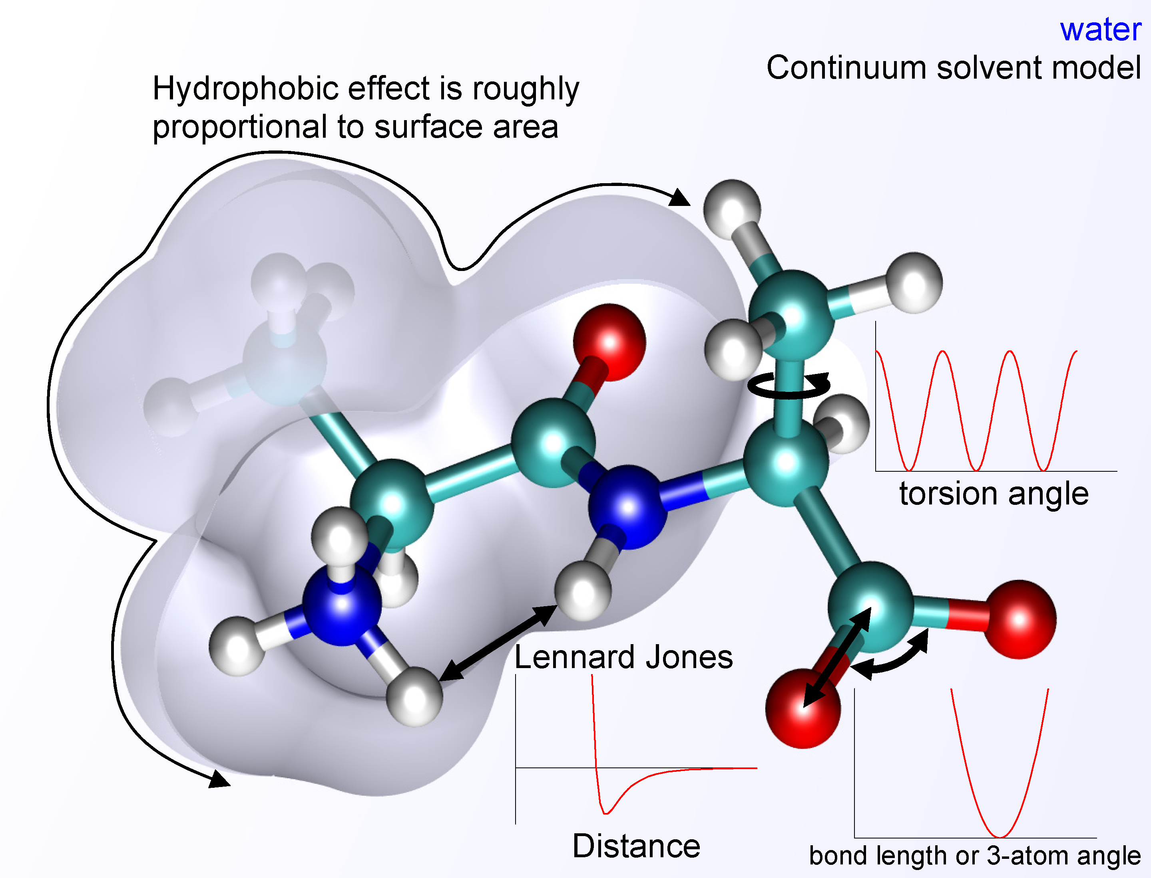

Bonded Interactions
Interactions between atoms which are covalently linked by three or fewer bonds.
$$E_{Bonds}=\sum_{i}^{Bonds}{\frac{k_{i}}{2}{(x_{i}−x_{i,o})}^{2}}$$
$$E_{Angles}=\sum_{i}^{Angles}{\frac{k_{i}}{2}{(ω_{i}−ω_{i,o})}^{2}}$$
$$E_{Torsions}=\sum_{i}^{Torsions}{\frac{V_{i}}{2}[1+\cos\left(n_{i}φ_{i}−γ_{i}\right)]}$$
$$E_{Bonded}=E_{Bonds}+E_{Angles}+E_{Torsions}$$

Slide 5
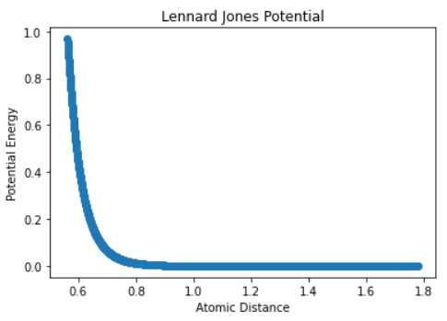
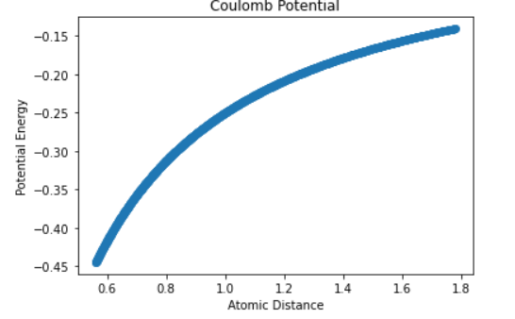
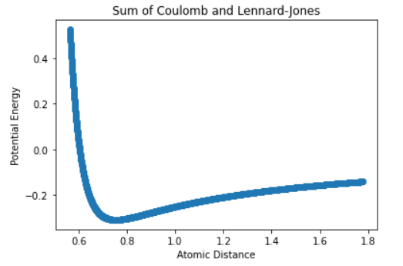
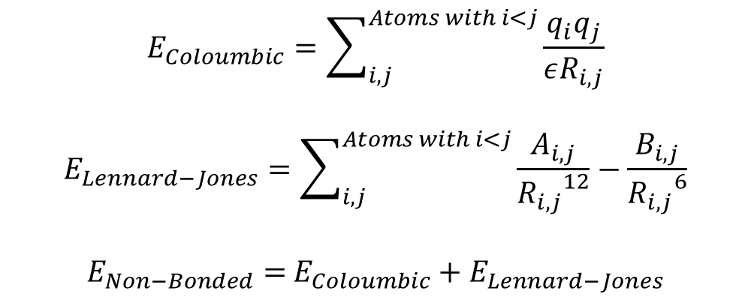
Nonbonded Interactions
Interactions between atoms which are not covalently linked, or linked by more than 3 bonds.
$$E_{Coloumbic}=\sum_{i,j}^{Atoms with i<j}{\frac{q_{i}q_{j}}{εR_{i,j}}}$$
$$E_{Lennard−Jones}=\sum_{i,j}^{Atoms with i<j}{\frac{A_{i,j}}{{R_{i,j}}^{12}}−\frac{B_{i,j}}{{R_{i,j}}^{6}}}$$
$E_{Non−Bonded}=$ $E_{Coloumbic}+E_{Lennard−Jones}$
At right, is an example of these potentials for two particles with opposite charge.

Slide 6
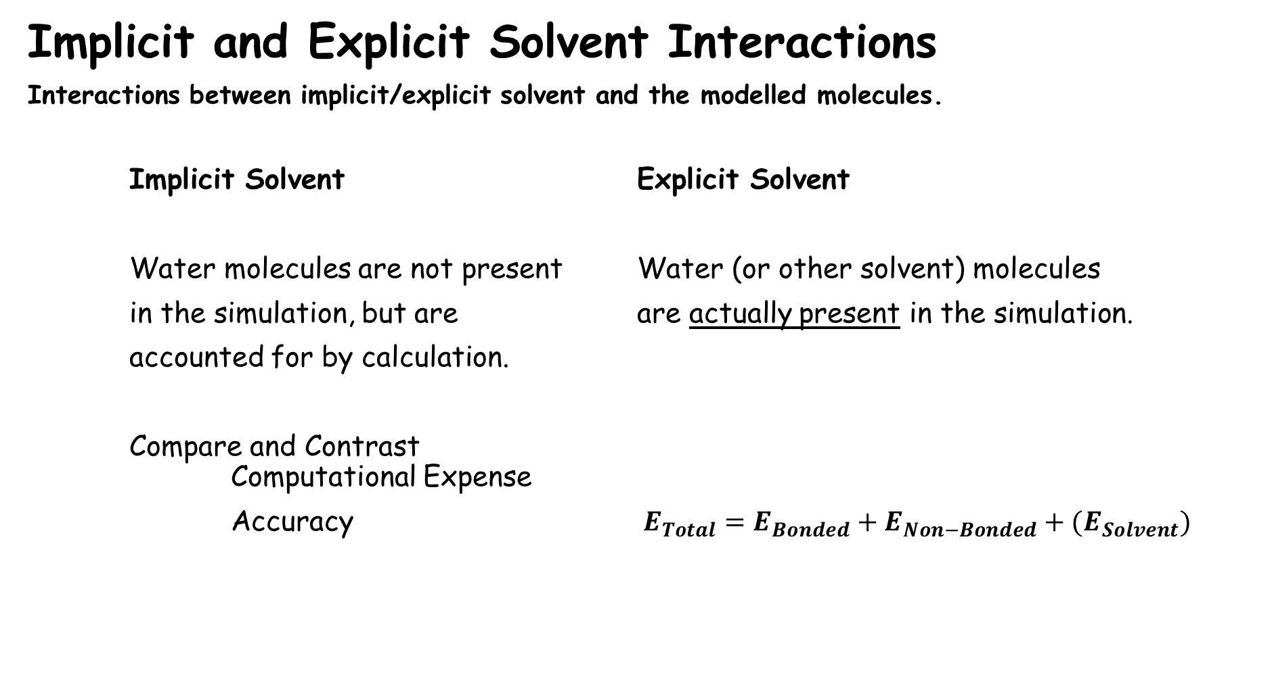
Implicit and Explicit Solvent Interactions
Interactions between implicit/explicit solvent and the modelled molecules.
Implicit Solvent Explicit Solvent
Water molecules are not present Water (or other solvent) molecules
in the simulation, but are are actually present in the simulation.
accounted for by calculation.
Compare and Contrast Computational Expense
Accuracy $E_{Total}=E_{Bonded}+E_{Non−Bonded}+{(E}_{Solvent})$

Slide 7
How Are Force Field Parameters Chosen?
Force Fields must parameterize:
Proteins Nucleic Acids Small Molecules Membranes
Historically, for fields were parameterized with values determined from gas-phase QM calculations.
Quantum is highly accurate for systems that are feasible to calculate.
Correlation between gas and condensed phases is still not strong enough.
Today (literally), open-source protocols (Openmm and Ambertools) are available.
Amber force field can be applied to new molecules.
Notes:
The protocols may not be reproducible and semi-automation often played a role to generate parameters, optimizing for speedy parameter generation and wide coverage, and not for chemical consistency, interpretability, reliability, and sustainability.

Slide 8
What do force fields specify that structure files do not? – Discuss!
Atoms
Hybridization, (Mass)
Charge
Bonds
Bond Order
Length and Spring Constant
Angles
Optimal 3-atom Angle
Force Constant
Torsions
Periodicity
Torsional Force Constant
More!
Lennard Jones Parameters
Hydrophobic Surface Area
Edboas, CC BY-SA 3.0 <https://creativecommons.org/licenses/by-sa/3.0>, via Wikimedia Commons

Slide 9
Short Quiz
What information is specified in force field files, but not structure files?
How are bonded interactions defined here, and accounted for?
How are nonbonded interactions defined here, and accounted for?

Slide 10
Lab-Overview
Necessary Input : .pdb file describing the docked drug’s coordinates.
TASK 1 : Add hydrogens to the protein, parameterize it, and observe it’s net charge.
TASK 2 : Add hydrogens to the ligand (docked drug), parameterize it, and save the parameters.
TASK 3 : Create a pdb file of the complex (the protein and ligand together in one file)
Add explicit water and ions (and membrane if applicable) to create a system.
Parameterize the entire system.
After completion of these tasks, you will have all necessary input files in order to perform molecular dynamics simulations on the paxlovid-Mpro system.

Slide 11
Lab – File Names and Meanings
File Ending: Name/Meaning:
.pdb Protein Data Bank structure file
.pqr A pdb, which includes charge (q) and radius (r)
.pdbqt A pdb, which includes Gasteiger charges (q) and Autodock atom type (t), this file type is specific to Autodock
.mol2 SYBYL format structure File, describes structure in SYBYL format as opposed to .pdb
.frcmod A parameter file that can be loaded into tleap and have missing parameters filled by antechamber
.xml A general parameter file complementary to .pdb
.prmtop AMBER parameter topology file – completely describes the parameters of your system
.inpcrd AMBER structure file – describes the coordinates of the atoms

