Slide 1
CHEMISTRY 456 /
INTERNATIONAL WORKSHOP
Fundamentals of Biological Macromolecules
Andy Howard
Associate Professor of Biology & Physics, Illinois Tech
Monday 28 June 2021
6/28/21
Biological Macromolecules
p. <number> of 38

Slide 2
WHY BIOCHEMISTRY MATTERS
Biochemists point out how chemical processes occur in biological systems, inside and between cells.
These remarks are intended to introduce you to the chemistry of biopolymers and their biological significance.
6/28/21
Biological Macromolecules
p. <number> of 38

Slide 3
WHAT WE’LL DISCUSS
Unity and diversity
Thermodynamics
Organic chemistry
Small biomolecules
Polymers
Proteins
  Components
  Structure
  Functions
Enzymes
Nucleic acids
  Components
  Polymers
  Structure
  Function
Carbohydrates
6/28/21
Biological Macromolecules
p. <number> of 38

Slide 4
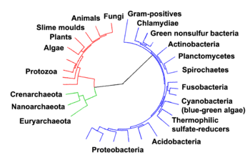
BIOCHEMICAL UNITY
There is a remarkable unity
to biochemical processes all
across eubacteria, archaea, and eukaryota
The genetic code is almost uniform throughout all 3 super-kingdoms
Specific proteins look the same across wide gaps of evolutionary history
6/28/21
Biological Macromolecules
p. <number> of 38

Slide 5
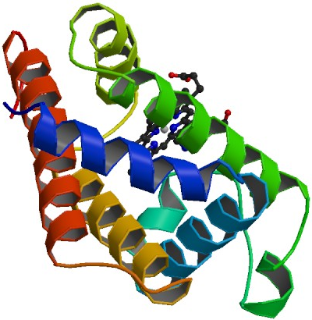
BIOCHEMICAL DIVERSITY
PDB 1emy
Elephant myoglobin
The morphological and
functional differences
between you and an
elephant, or between you
and a flowering plant, or
between you and a bacterium, arise from differences in biochemical phenomena
  Some classes of proteins are present only in certain kinds of organisms
  Structural components in vertebrates differ significantly from those in arthropods
6/28/21
Biological Macromolecules
p. <number> of 38

Slide 6
THERMODYNAMICS AND KINETICS
T
G
Systems of molecules tend toward an equilibrium state in which the minimum free energy is obtained
In order to go from an initial state R to a final, lower-energy state P, a higher-energy transition state T may have to be overcome
Free energy has both enthalpic (heat) and entropic (organizational) components (Gibbs & Boltzmann): ΔG = ΔH - TΔS
ΔG‡
R
ΔG
P
Reaction
Coordinate
6/28/21
Biological Macromolecules
p. <number> of 38

Slide 7
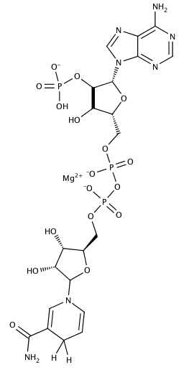
BIOORGANIC CHEMISTRY
Most biological reactions involve carbon-containing compounds
Therefore organic chemistry (the chemistry of compounds that contain C-C or C-H bonds) explains a large fraction of what’s happening below the surface in biochemical systems
NADPH
6/28/21
Biological Macromolecules
p. <number> of 38

Slide 8
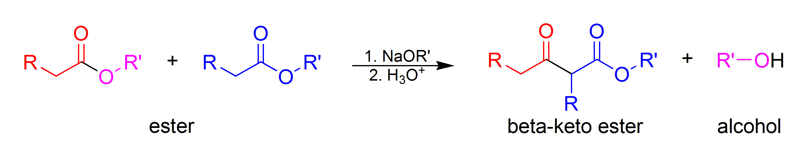
WE CAN IGNORE A LOT OF ORGANIC REACTION MECHANISMS!
Only a subset of all possible organic reactions occur in biochemistry:
  They’re almost all aqueous
  Generally occur at temperatures between 3ºC and 50ºC
  Most occur between pH 5 and pH 9 (exception in humans: the stomach, which is highly acidic)
  Entire classes of organic reactions are unrepresented
Claisen condensation
6/28/21
Biological Macromolecules
p. <number> of 38

Slide 9
WHAT REACTIONS DO OCCUR?
Mostly nucleophilic substitutions (SN1 and SN2)
  These are two-electron transformations, as we’ve discussed in previous lectures
  These take place under enzymatic control
  Therefore they can proceed at measurable rates even though the nucleophiles aren’t very powerful by organic lab standards
Some free radical reactions, as we’ve said
  There are enzymatic free-radical reactions
  But there are non-enzymatic ones too
6/28/21
Biological Macromolecules
p. <number> of 38

Slide 10
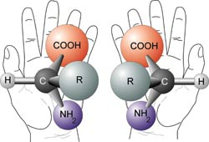
CHIRALITY
Many biomolecules are chiral:
  At least one carbon atom has 4 distinct substituents
  Therefore the mirror image of the molecule is different from the original molecule
Specific classes of biomolecules are chiral
Standard amino acids are L- and so are their polymers
Most sugars are D- and so are their polymers
Lipids are usually not chiral
Nucleic acid bases: achiral; but ribose is chiral
6/28/21
Biological Macromolecules
p. <number> of 38

Slide 11
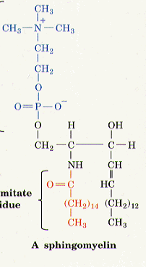
SMALL BIOMOLECULES
Most common small molecule in biological systems is water
There are other important small molecules and ions:
  CO₂, O₂, glyceraldehyde, glucose
  HCO₃⁻, PO₄³⁻, Na⁺, Cl⁻, K⁺, Ca²⁺, Fe²⁺,Mg²⁺
  Palmitate, oleate, stearate, choline, sphingomyelin
  Amino acids (20 ribosomal + others)
  Nucleic acids (A,C,G,U,dA,dC,dG,dT, …)
6/28/21
Biological Macromolecules
p. <number> of 38

Slide 12
BIOPOLYMERS
Most complex activities in biology involve polymers
Biology achieves catalysis, reproduction, specificity, and many other things by making polymers, not by building complex monomeric molecules
Biological polymers are built up by formal (and actual) elimination of water (M₁ + M₂ → M₁₋₂ + H₂O)
  Protein: polymer of amino acids
  RNA: polymer of ribonucleotides
  DNA: polymer of deoxyribonucleotides
  Polysaccharides: polymers of sugars
Except for polysaccharides, they’re unbranched
6/28/21
Biological Macromolecules
p. <number> of 38

Slide 13
MAJOR CLASSES OF BIOPOLYMERS
Category | Types of monomers | <mol wt/ monomer> | # mono-mers per polymer | Branched?
Protein | 20 | 110 | 65-5000 | no
RNA | 4-10 | 150-300 | 10-15K | no
DNA | 4 | 130-270 | 50-10⁶ | no
Polysac-charide | ~10 | 162 | 2-10⁵ | Some- times
6/28/21
Biological Macromolecules
p. <number> of 38

Slide 14
PROTEINS
Proteins are polymers of L-amino acids
There are 20 amino acids in proteins from 99% of all organisms; a few use 2 others
Variety of functions:
  Enzymes (catalysts)
  Structural proteins
  Storage and transport proteins
  Hormones
  Receptors
  Nucleic-acid binding proteins
  Molecular machines
  Specialized functions (e.g. sweetness)
6/28/21
Biological Macromolecules
p. <number> of 38

Slide 15
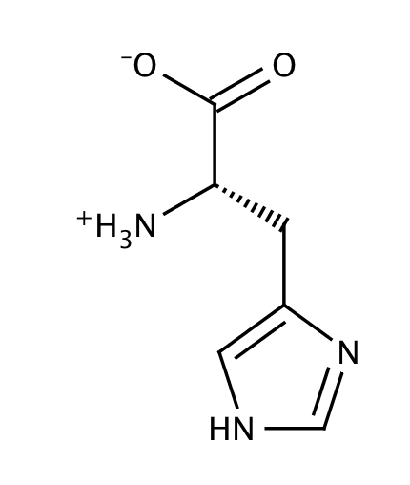
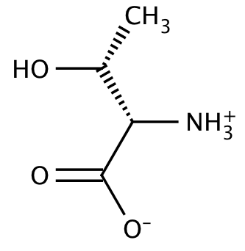
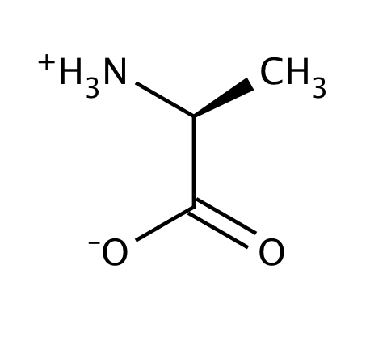
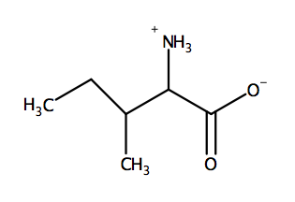
ALPHA-AMINO ACIDS
These are the building blocks from which proteins are made
Alpha carbon covalently bonded to a carboxylate and an amine
Polymerization makes peptide bonds between the α-amino acids
6/28/21
Biological Macromolecules
p. <number> of 38

Slide 16
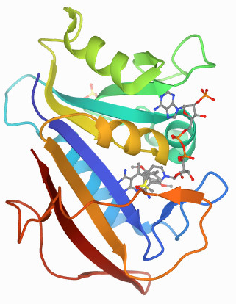
PROTEIN STRUCTURE
Most (>80%) proteins fold into a
specific 3-D conformation
at room temperature
This isn’t intuitively obvious:
many polymers are much floppier than that
A few proteins are “intrinsically unstructured”
Held together by ionic interactions (H-bonds, salt bridges) and nonpolar interactions (van der Waals and solvent exclusion)
Human DHFR
PDB 1KMV, 1.05Å
6/28/21
Biological Macromolecules
p. <number> of 38

Slide 17
LEVELS OF PROTEIN STRUCTURE
Primary structure: linear sequence of amino acids, e.g.
val-gly-ser-leu-asn-cys-ile-val-ala-val-ser-gln-asn-met-gly …
Secondary structure: short-range ordering provided by main-chain hydrogen bonds between amine nitrogens and carbonyl oxygens
Tertiary structure: three-dimensional arrangements of all atoms in a single polypeptide
Quaternary structure: arrangement of individual polypeptides into a complete multimeric structure
6/28/21
Biological Macromolecules
p. <number> of 38

Slide 18
HOW DO PROTEINS PERFORM SO MANY FUNCTIONS?
Amino acid side chains have a wide variety of reactivities
Scaffolding surrounding active or binding site can significantly change reactivity of specific moieties within the protein
Side chains that would normally be hard to ionize become easy to ionize because the ion is stabilized by interactions with neighboring groups
Regions that would be hydrophilic if exposed become hydrophobic when buried within protein
6/28/21
Biological Macromolecules
p. <number> of 38

Slide 19
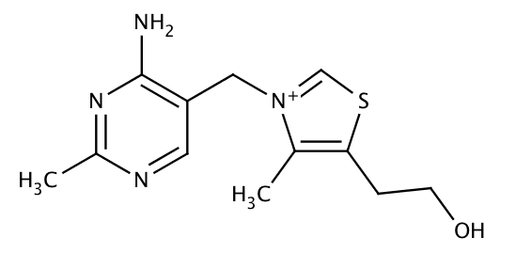
IS THAT ALL?
No; Some proteins have non-amino-acid components bound, loosely or tightly, to the amino acid chain(s); these entities are cofactors
Cofactors can be inorganic (e.g. Mg²⁺ ions) or organic (coenzymes)
These provide functionalities that would otherwise be unavailable to the polypeptide
Many coenzymes are derived from vitamins, particularly the B-complex vitamins
6/28/21
Biological Macromolecules
p. <number> of 38

Slide 20
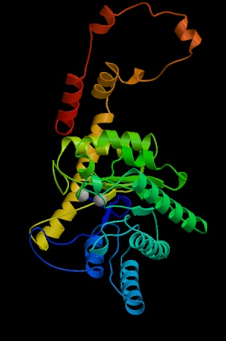
WHY ARE PROTEINS SO BIG?
Typical enzyme active site or
carrier-protein binding site involves
< 5% of the amino acids in the protein
So what are all those other amino acids doing?
  Creating environment perfectly suited to the electrostatics and hydrophobicity or hydrophilicity required for proper function
  Guarantees that the active site or binding site keeps its shape and electrostatic properties over time
  Enables binding of cofactors and other effectors
  Allows for appropriate interactions with other macromolecules
6/28/21
Biological Macromolecules
p. <number> of 38

Slide 21
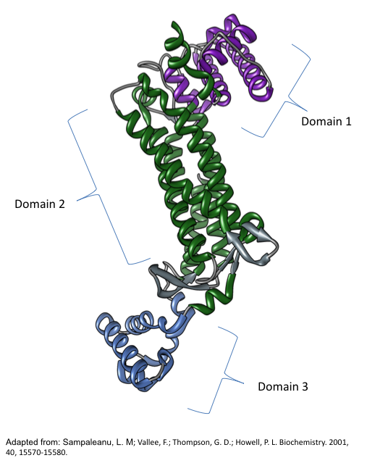
DOES EVERY PROTEIN HAVE EXACTLY ONE FUNCTION?
No.
Some proteins that have evolved for one purpose become pressed into service in a different guise
Example: some of the proteins that make up the eye lens are actually enzymes, reused as structural proteins
6/28/21
Biological Macromolecules
p. <number> of 38

Slide 22
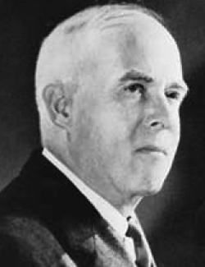
ENZYMES
Enzymes are defined as biological catalysts
Biochemists figured out in the 1920’s that
all enzymes were proteins, although it took
until the 1930’s for that notion to be
definitively accepted
In the 1970’s this assertion had to be modified: some enzymes (biocatalysts) are actually RNA molecules
1990’s: Recognition that the catalytic step in protein synthesis is performed by a specific adenine base in ribosomal RNA
James Sumner
6/28/21
Biological Macromolecules
p. <number> of 38

Slide 23
WHAT PROPERTIES MUST AN ENZYME HAVE?
Catalysis:
must lower the activation energy of a reaction
Specificity:
must act preferentially on certain substrates
Regulation:
must be subject to some sort of regulation
6/28/21
Biological Macromolecules
p. <number> of 38

Slide 24
HOW IS CATALYSIS ACCOMPLISHED?
Multiple mechanisms, often acting in concert:
  Acid-base catalysis (specific amino acid side-chains participate temporarily in reactions by acting as nucleophiles or electrophiles)
  Proximity effect (enzyme contains channels with appropriate shape and electrostatic properties to cause substrates to travel down them toward one another)
  Induced fit (enzyme reshapes itself to bind substrate, but substrate gets reshaped as well)
  Transition state stabilization
6/28/21
Biological Macromolecules
p. <number> of 38

Slide 25
HOW EFFECTIVE ARE ENZYMES, AND HOW ARE THEY REGULATED?
The best can speed up a reaction by a factor of 10¹² or more
They don’t change equilibrium: they just make the reaction go faster.
Regulation by:
  Control of transcription
  Control of translation
  Interference with activity via inhibitors
6/28/21
Biological Macromolecules
p. <number> of 38

Slide 26
INHERENT PROPERTIES OF ENZYMES
K_{m} is an inherent property of an enzyme
  Can be measured for a specific substrate, independent of enzyme and substrate concentration
  Measures binding affinity of enzyme for substrate
V_{max} clearly depends on how much enzyme we put in: the more we put in, the faster the reaction
But k_{cat} = V_{max}/[E]_{tot} is an inherent property
  Measures turnover rate
  k_{cat} = number of substrate molecules converted to product per unit time by a single enzyme molecule
6/28/21
Biological Macromolecules
p. <number> of 38

Slide 27
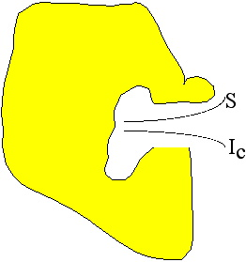
ENZYME INHIBITION
Various small molecules can bind to an enzyme and slow it down
Competitive inhibitors compete with the substrate for the active site and raise K_{m}
Noncompetitive inhibitors interfere with catalysis and decrease V_{max}
Uncompetitive inhibitors decrease both V_{max} and K_{m}, but do so in a way that slows the reaction
6/28/21
Biological Macromolecules
p. <number> of 38

Slide 28
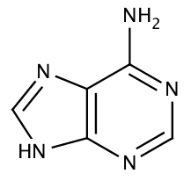
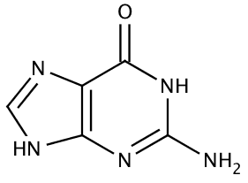
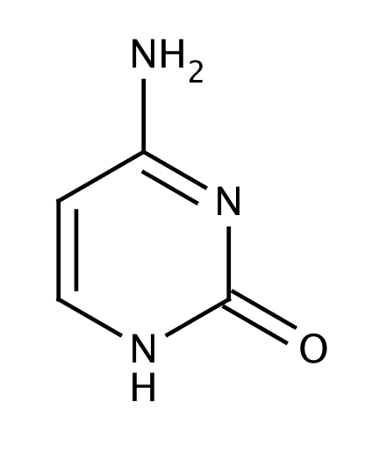
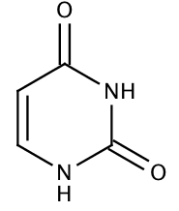
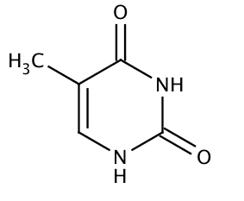
NUCLEIC ACID BUILDING-BLOCKS
All nucleotides are based on nucleobases, which are either purines (9 ring-atoms, double-ring structures) or pyrimidines (6 ring-atoms)
The nucleobase is attached to a ribose or deoxyribose sugar by an N-C bond
A phosphate is attached to the 5’-position of the sugar
6/28/21
Biological Macromolecules
p. <number> of 38

Slide 29
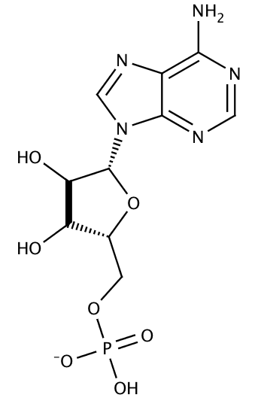
NUCLEOSIDES AND NUCLEOTIDES
Attach a nitrogen on a nucleobase to carbon 1 of ribose to make a nucleoside
Attach a phosphate to the 5’ position on the nucleoside to make a nucleotide
6/28/21
Biological Macromolecules
p. <number> of 38

Slide 30
POLYNUCLEOTIDES
Connect the 5’ phosphate of one nucleotide to the 3’ position on the previous nucleotide and continue
A DNA molecule can comprise millions of nucleotides
RNA is somewhat smaller but still substantial
6/28/21
Biological Macromolecules
p. <number> of 38

Slide 31
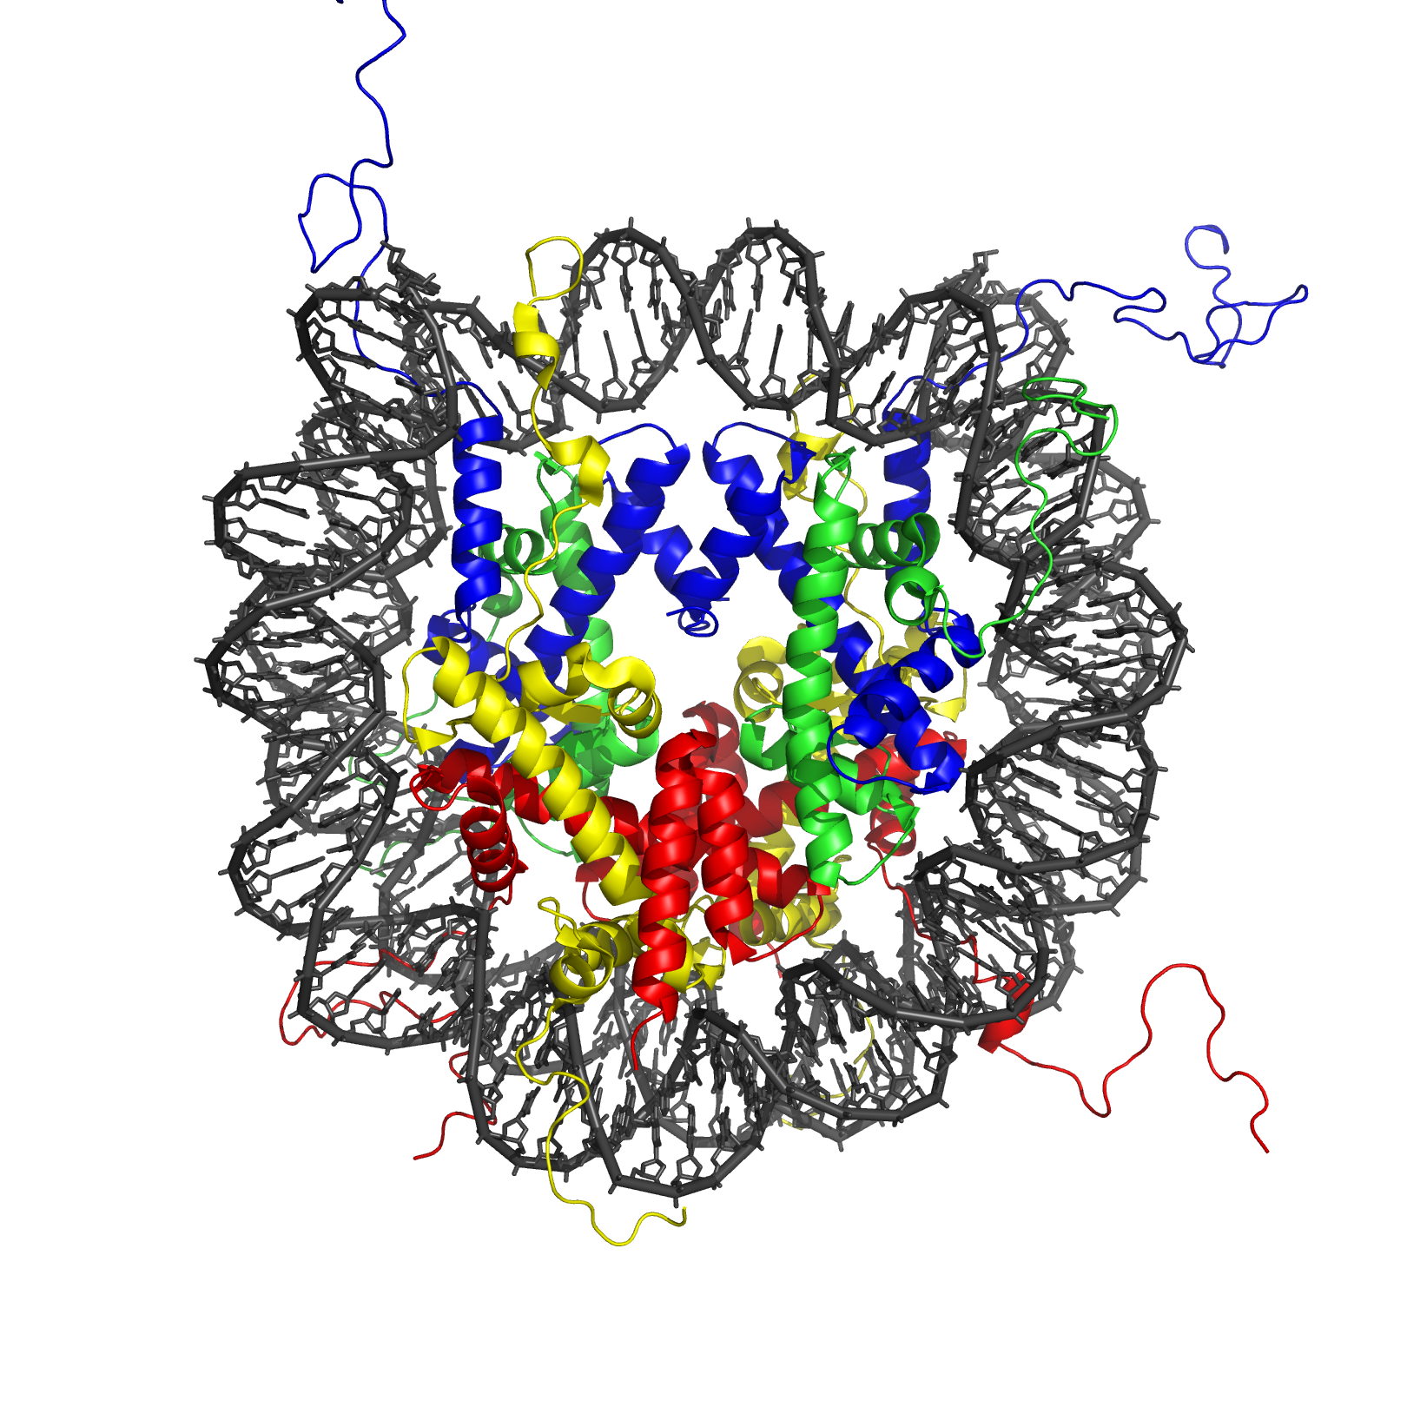
NUCLEIC ACID STRUCTURE
DNA is generally double-helical
Many RNA molecules are partially double-stranded too
DNA is unstructured above the double-helix level during G1 but becomes structured during S within spool-like structures called nucleosomes
Higher levels of organizations occur too
6/28/21
Biological Macromolecules
p. <number> of 38

Slide 32
TYPES OF RNA
We generally recognize four major classes of RNA, differing in size, cellular role, and replacement rate
Type % %turn- Size, Partly Role
RNA over bases DS?
mRNA 3 25 50-10⁴ no protein template
tRNA 15 21 55-90 yes aa activation
rRNA 80 50 10²-10⁴ yes transl. catalysis
& scaffolding
sRNA 2 4 15-10³ yes various
6/28/21
Biological Macromolecules
p. <number> of 38

Slide 33
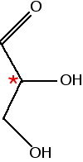
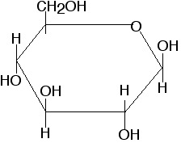
CARBOHYDRATES
Monomers are three-carbon to seven-carbon
polyalcohols with one carbonyl group at either
C1 or C2. They’re very soluble.
Simplest: glyceraldehyde &
dihydroxyacetone - C₃
Most important other ones:
  Ribose, xylose (C5)
  Glucose, fructose, galactose (C6)
Monomers are fuel, signals, intermediaries
(especially when phosphorylated)
6/28/21
Biological Macromolecules
p. <number> of 38

Slide 34
SUGAR DERIVATIVES
Sugar monomers that have been modified
  Deoxyribose
  Phosphorylated sugars (especially at C1 and C5 or C6)
  Aminated sugars (mostly C6 sugars)
  N-acetyl sugars
  Sugar acids
  Sugar alcohols (carbonyl converted to alcohol)
These derivatives are often the active agents in intermediary metabolism
6/28/21
Biological Macromolecules
p. <number> of 38

Slide 35
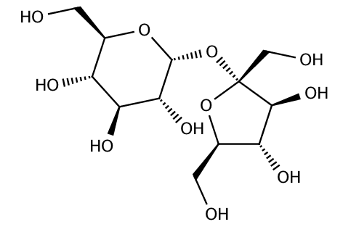
DISACCHARIDES
Compounds made up of
two sugar monomers
Glucose + glucose → Maltose + H₂O
Glucose + fructose → Sucrose + H₂O
Glucose + galactose → Lactose + H₂O
These are instances of oligomers
(few rather than many building blocks)
sucrose
6/28/21
Biological Macromolecules
p. <number> of 38

Slide 36
STORAGE POLYSACCHARIDES
Starch: storage form of glucose in plants
  Amylose: 1-4 linkages only
  Amylopectin: mostly 1-4 linkages, a few 1-6
Glycogen: storage form of glucose in animals, some bacteria
  mostly 1-4 linkages, some 1-6
  Glycogen is primary short-term fuel in humans;
  long-term fuel is usually fats (more efficient)
6/28/21
Biological Macromolecules
p. <number> of 38

Slide 37
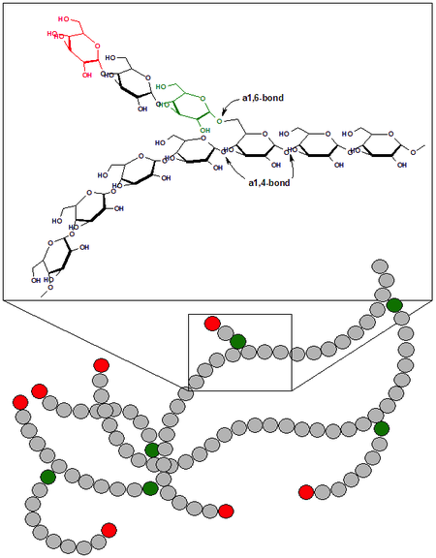
GLYCOGEN STRUCTURE
Single glucose units broken off & phosphorylated to use as fuel
Amylases cleave the 1-4 linkages;
Other enzymes deal with the 1-6 linkages
6/28/21
Biological Macromolecules
p. <number> of 38

Slide 38
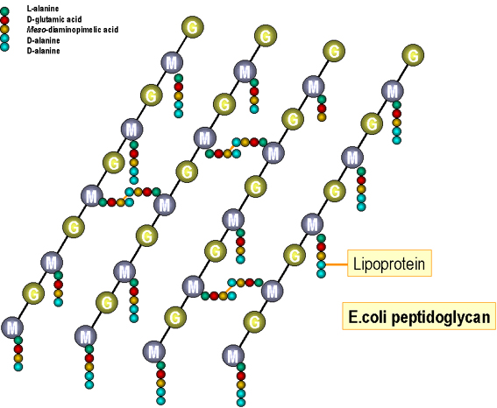
SUGAR-PEPTIDE COMPLEXES
Sugars are often complexed
either to peptides
(oligomers of amino acids)
or proteins
(polymers of amino acids)
Smaller-peptide complexes make up cell walls
Full-size proteins that have been decorated with a few sugar molecules are ubiquitous in eukaryotes and often alter the properties of the protein or enable it to be involved in cell-cell communication
6/28/21
Biological Macromolecules
p. <number> of 38

