Slide 1
CHEMISTRY 456 /
INTERNATIONAL WORKSHOP
Structure Determination
Andy Howard
Associate Professor of Biology & Physics, Illinois Tech
Monday 28 June 2021
6/28/21
Structure Determination
p. <number> of 30

Slide 2
WHERE DID ALL THESE LOVELY STRUCTURES COME FROM?
Structures as studied by computational chemists are based on experimentally-determined structures
Determining the structure of a big molecule is a challenging endeavor no matter how you do it.
6/28/21
Structure Determination
p. <number> of 30

Slide 3
WHAT WE’LL DISCUSS
Structure-function relationships
High-resolution methods
  X-ray crystallography
  High-field NMR
  Cryoelectron microscopy
Additional methods
  Solution scattering
  Circular dichroism
  Fiber diffraction
The PDB’s role
Applications in drug design
Applications in molecular dynamics
6/28/21
Structure Determination
p. <number> of 30

Slide 4
STRUCTURE-FUNCTION RELATIONSHIPS
If you wish to sound wise in a room full of structural biologists, train a parrot to say structure-function over and over.
But the point is that if we know something about the structure of a macromolecule, we can use that knowledge to deduce useful insights into how it works.
From there we can go on to design ligands or do simulations
6/28/21
Structure Determination
p. <number> of 30

Slide 5
EXPERIMENTS AND MODELS
Computational chemists and biologists are accustomed to regarding the entities they analyze as models rather than primary realities
But even the experimentally derived structures that we’re talking about today are models.
The task of the experimentalist is to obtain data and then build a model that is as consistent as possible with those data without over-fitting!
6/28/21
Structure Determination
p. <number> of 30

Slide 6
RESOLUTION
Resolution refers to the size of the smallest detail that is discernable within a structural model
Thus high resolution is associated with a small value of the resolution, and low-resolution goes with a big value; and high resolution is almost always better than low.
We can characterize any structure according to the resolution with which we can distinguish neighboring model entities (atoms, residues, subunits, …)
With some methods it’s easy to characterize the resolution of the structural models; not with some others
6/28/21
Structure Determination
p. <number> of 30

Slide 7
HOW HIGH A RESOLUTION IS REQUIRED?
That depends on what you want to do with the structure.
For drug design we generally need near-atomic (~1.8Å resolution so we can tell how the ligand is going to fit into the structure
We might want even better resolution if we want to analyze alternate conformations or solvent dynamics
For molecular dynamics, we need high resolution if we’re trying to do QM in parts of the structure or if we want to begin the simulation with the atoms precisely located; but if we only want to model big changes, we can make do with 3Å or even 5Å resolution
6/28/21
Structure Determination
p. <number> of 30

Slide 8
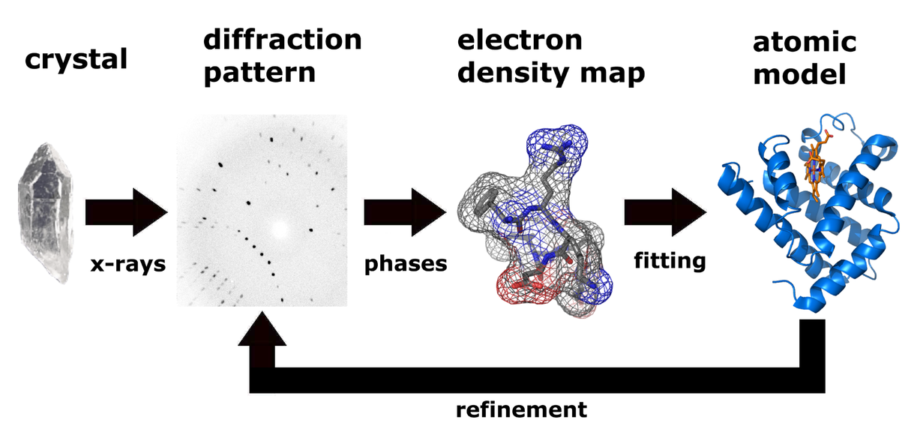
X-RAY CRYSTALLOGRAPHY
Crystals are translationally ordered arrays of molecules, and most solids are crystalline
Entraining an X-ray beam at a crystal causes coherent interference in specified directions (diffracted rays) associated with contents of repeating unit of crystal
If you intercept the diffracted rays with a detector, you can measure intensities of spots (“Bragg reflections”)
Each intensity is proportional to the square of a complex Fourier coefficient associated with the structure
6/28/21
Structure Determination
p. <number> of 30

Slide 9
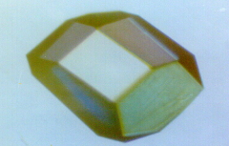
CRYSTALLOGRAPHY ON MACROMOLECULES
The physics of diffraction isn’t different for macromolecules
What is different?
  More data to a given resolution
  Fewer unit cells in the crystal’s volume
  Static and dynamic disorder limit resolution to considerably higher than λ/2
  Phasing methods that work for small molecules don’t work for macromolecules
6/28/21
Structure Determination
p. <number> of 30

Slide 10
SOLVING THE PHASE PROBLEM
F_{hkl}
α
b_{hkl}
a_{hkl}
Early structures determined by soaking heavy atom compounds (Hg, Pt, … ) into the crystal and carefully measuring F_{PH} – F_{P}
That can tell you where the heavy atom is, and then you can bootstrap to find the light atoms (C, N, O, S)
Alternative: vary the X-ray wavelength and measure F(λ₁) - F(λ₂)
OR survey the PDB for similar structures and use one or more of those as a rotated & translated start model
6/28/21
Structure Determination
p. <number> of 30

Slide 11
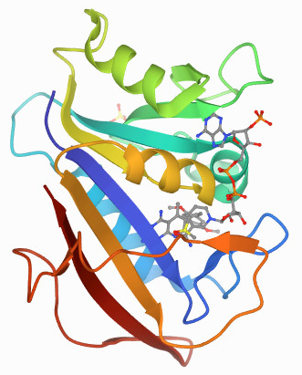
HOW DO YOU KNOW THE CRYSTAL STRUCTURE IS INFORMATIVE?
This was a big concern in the early days of
protein crystallography: is the solution
structure really all that similar to the crystal structure?
Answer: generally yes, especially on the interior
  Crystalline proteins still have biological activity!
  Multiple crystal forms yield the same structure
  Structures determined by other methods look similar
Interior relevant for enzymes: active sites are inside
6/28/21
Structure Determination
p. <number> of 30

Slide 12
WHAT CAN YOU LEARN?
(X,Y,Z) coordinates of atoms in the macromolecule
(X,Y,Z) coordinates for well-ordered water molecules
Mobility and fuzziness of individual atoms
Multiple conformations visible at high-resolution
ATOM 64 CB AVAL A 10 13.809 27.281 23.136 0.50 13.07 C
ANISOU 64 CB AVAL A 10 1479 727 2759 71 -70 297 C
ATOM 65 CB BVAL A 10 13.611 27.375 22.837 0.50 11.05 C
ANISOU 65 CB BVAL A 10 1470 952 1778 -14 -121 4 C
6/28/21
Structure Determination
p. <number> of 30

Slide 13
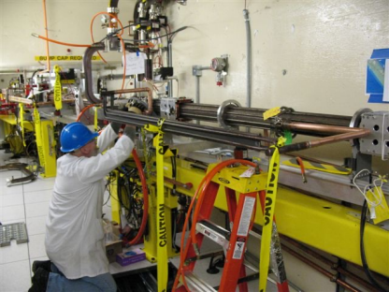
STATIC & DYNAMIC STRUCTURES
Initially, crystal structures were static or time-averaged images of the macromolecule, and that’s often still true
Some approaches are now available that enable us to look at each distinct step within an protein’s mechanism: a movie, or at least a slide-show, of the mechanism
Part of what makes that possible is the availability of free electron laser facilities like the LCLS at Stanford, where structures can be derived from 10⁻¹⁵ sec X-ray bursts
6/28/21
Structure Determination
p. <number> of 30

Slide 14
HIGH-FIELD NUCLEAR MAGNETIC RESONANCE SPECTROSCOPY
NMR relies on resonant interactions between an applied, microwave-frequency electromagnetic field and unpaired nuclear spins in a sample held in a strong magnetic field
For small molecules each individual resonance can be identified as arising from a specific atom or cluster
Simple spectra from big molecules are uninterpretable:
too many peaks, and they overlap disastrously
So we have to resort to multiple pulse trains or examine two or more resonating atoms, typically ¹H and ¹⁵N
6/28/21
Structure Determination
p. <number> of 30

Slide 15
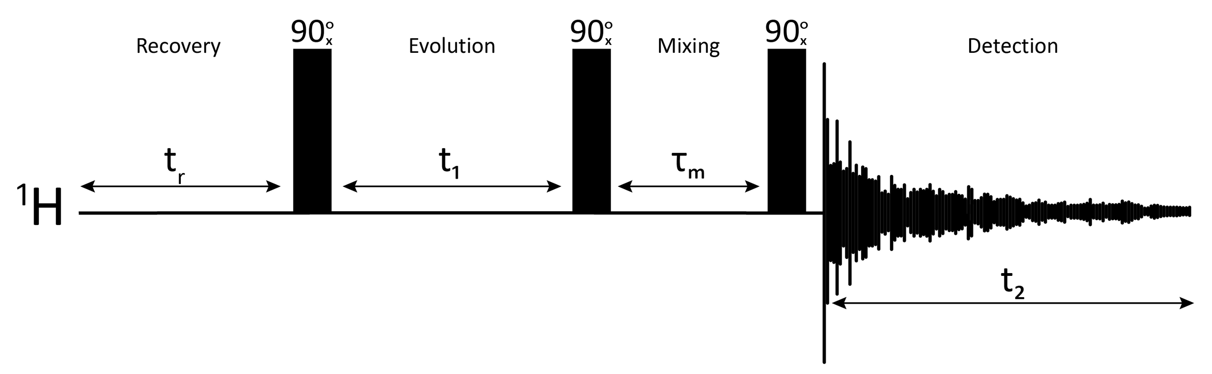
INTERATOMIC DISTANCES
Most productive approach with big molecules uses Nuclear Overhauser Effect measurements (NOEs): measure the change in one resonance when another resonance is saturated
Enables measurement of interatomic distances between the two affected spins
Many measurements required and a considerable amount of hypothesis-testing to assign specific NOESY peaks to specific atom-atom pairs
Ultimately these can be brought together to define coordinates for H (and N) atoms; bootstrap the rest.
6/28/21
Structure Determination
p. <number> of 30

Slide 16
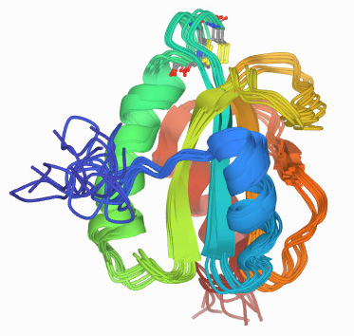
FAMILIES OF STRUCTURES
Ultimate outcome for many macromolecular experiments is a family of structures, typically with certain atoms having well-defined locations and multiple paths between those atoms
Why this lack of specificity?
  It partly reflects real heterogeneity in the conformations in solution
  It also results from the structure-definition problem being under-determination
Fungal protein disulfide
PDB 2RUE
6/28/21
Structure Determination
p. <number> of 30

Slide 17
COMPARING X-RAY TO NMR
Big overlap in the achievable domains of these two methods (5 kDa – 60 kDa for NMR; 1 kDa – 500 kDa for Xray)
So what do you do when they differ?
  Trust the surface in the NMR structure because it isn’t influenced by intermolecular contacts
  Rely on H’s in NMR because the data are based on them
  Trust the X-ray structure elsewhere because it’s probably obtained at higher resolution
6/28/21
Structure Determination
p. <number> of 30

Slide 18
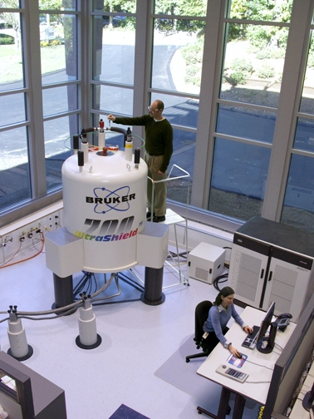
POLITICS AND ECONOMICS
NMR equipment capable of measurements on > 20 kDa proteins have > 17 T magnets, i.e 700 MHz; that’s a $1M instrument, and it costs $100K/yr to maintain it
State-of-the-art Lab X-ray equipment costs about the same
BUT most X-ray structures are determined at government-funded storage rings or FELs, which (for non-commercial users) are essentially free!
So one can equip an “X-ray” lab without X-ray equipment
6/28/21
Structure Determination
p. <number> of 30

Slide 19
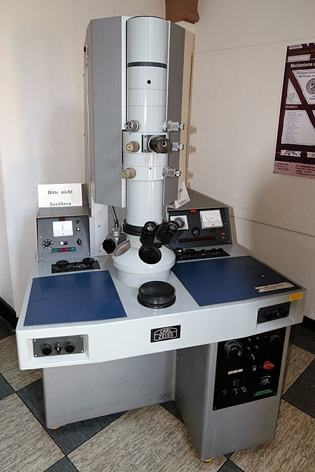
ELECTRON MICROSCOPY
EM: long history of imaging biological
samples at organelle size-scale (> 10 nm)
~0.5 nm-resolution EM on macromolecules mostly failed before 1985 because of sample damage
Two experimental advances enabled ~0.4 nm by 1990:
  Cooling the sample (< 100K): slows sample damage
  Plating samples on a 2D grid and using image software to merge the images in 3D at improved resolution
6/28/21
Structure Determination
p. <number> of 30

Slide 20

MATURATION OF CRYO-EM
3 additional advances bring cryogenic EM
into the near-atomic resolution range
(2Å in ideal circumstances, 3Å in many cases, 4Å in most):
  Highly sensitive and linear electronic detectors
  Better sample-prep techniques
  Software innovations that improve sample averaging and error correction
Definitely the method of choice for large, multi-component protein or protein-RNA complexes
Recent advances enable good outcomes even < 50 kDa
6/28/21
Structure Determination
p. <number> of 30

Slide 21
MOLECULAR LEGO
Many biological systems consist of a collection of medium-sized polypeptides that together constitute a protein complex.
Frequently it’s possible to obtain a 3.5-4Å cryoEM structure of the intact complex
Meanwhile, it’s possible to obtain < 2Å X-ray crystal structures of the individual components
Then the best way to use the data from both is to combine them: molecular lego
6/28/21
Structure Determination
p. <number> of 30

Slide 22
IS CRYO-EM MORE REALISTIC THAN CRYSTALLOGRAPHY?
Perhaps: CryoEM doesn’t require growth of crystals
But it does require exposure of biological samples to cryo conditions and dehydration on an EM grid
CryoEM is probably less sensitive to impurities carried through to the structure determination step
6/28/21
Structure Determination
p. <number> of 30

Slide 23
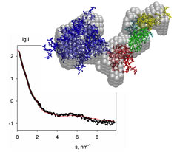
SOLUTION SCATTERING
Proteins and polynucleotides scatter X-rays or neutrons even when the macromolecules are in solution
One-dimensional experiment because angular dependence is averaged out over many molecules
Intensity as a function of angle yields low-resolution information about the size and shape of the scatterer
Hypothesis-testing: “I think this molecule is shaped like a dumb-bell. Does the scattering pattern match that of a dumb-bell”?
6/28/21
Structure Determination
p. <number> of 30

Slide 24
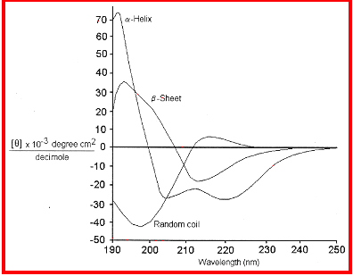
CIRCULAR DICHROISM
Biopolymers have asymmetric carbons in them: they’re chiral
Chiral molecules rotate circularly polarized light: direction and magnitude of the rotation varies with wavelength
Secondary structure, particularly alpha helices, produce characteristic; spectra in the 190-250 nm range
In practice this is usually used only to monitor helical content
Sample holder can be heated, so you can monitor loss of helicity as f(temp)
6/28/21
Structure Determination
p. <number> of 30

Slide 25
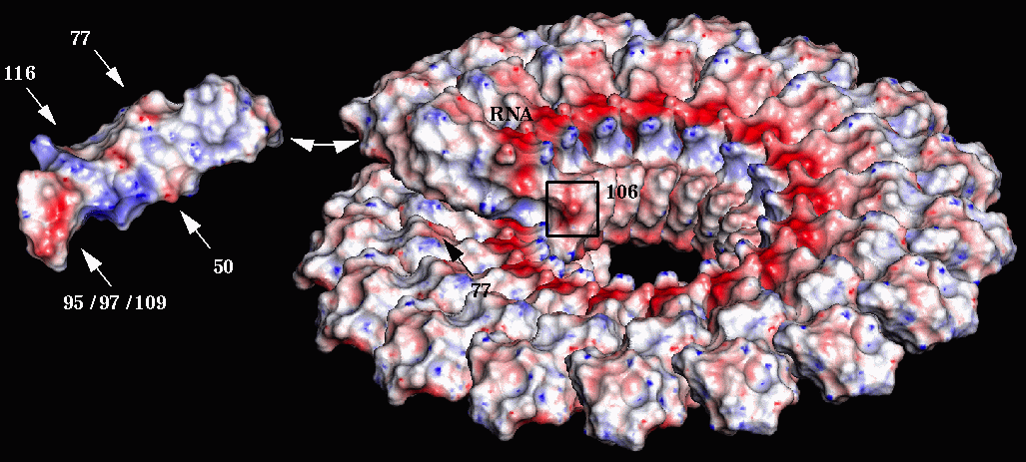
FIBER DIFFRACTION
Many biopolymers naturally form aggregates that have 2-D (fiber-like) order:
  Actomyosin in muscles
  Some viral coat assemblies
  DNA (!)
  Collagen (most plentiful human protein)
Fiber diffraction patterns can be interpreted using math that is similar to 3-D crystals
IIT and the APS have long been centers for fiber studies
6/28/21
Structure Determination
p. <number> of 30

Slide 26

ROLE OF THE PROTEIN DATA BANK
Roughly 180,000 macromolecular structures are contained in the PDB: 90% proteins, 10% polynucleotides
89% determined by X-ray crystallography; rest by NMR, CryoEM, neutron diffraction, combined techniques
CryoEM fraction is increasing rapidly
Perhaps 40,000 independent structures; rest are mutants, ligand-bound, or redeterminations
Drug designers and dynamicists use these as input data
6/28/21
Structure Determination
p. <number> of 30

Slide 27
DRUG DESIGN
Until about 2005 virtually all drug targets were enzymes
  Essential proteins in pathogens
  Human proteins that were overexpressed or expressed under the wrong circumstances
  Proteins produced in cancer cells at higher levels than in normal tissue
In each case, designing an effective inhibitor (competitive, mixed, or non-competitive) enabled a desirable health outcome
6/28/21
Structure Determination
p. <number> of 30

Slide 28
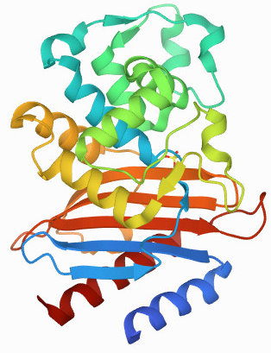
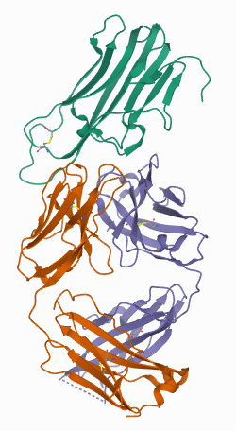
HOW HAS THAT CHANGED ?
6MU9
For pathogens:
constant concern over resistance
Many drugs (the majority of the big sellers) are now biologics, i.e. macromolecules,
not small-molecule inhibitors
~ half of the biggest revenue-producers
are monoclonal antibodies
3WD5
6/28/21
Structure Determination
p. <number> of 30

Slide 29
CONNECTION WITH THE REST OF THIS WORKSHOP
Clearly, design of effective pharmaceuticals is one of the goals of this workshop
Predicting effectiveness before (and after) doing wet-lab experiments is part of the point of molecular modeling and docking studies
6/28/21
Structure Determination
p. <number> of 30

Slide 30
MOLECULAR DYNAMICS
Every MD simulation has to begin with a plausible structure
Typical starting point is an experimentally-determined structure
  Remove all or most of the water
  Fill in the blanks and the hydrogens
  Energy-minimize the structure before beginning molecular dynamics
6/28/21
Structure Determination
p. <number> of 30

