Slide 1
Binding TDISP & Platform Attestation Reports for Confidential VMs
Anna Trikalinou, Microsoft

Slide 2
Agenda
Confidential Computing 101
TDISP
I/O in CC without TDISP
I/O in CC with TDISP
Attestation
Platform Attestation Evidence
TDISP Device Attestation Evidence
Binding Evidence
Proposal
Open questions

Slide 3
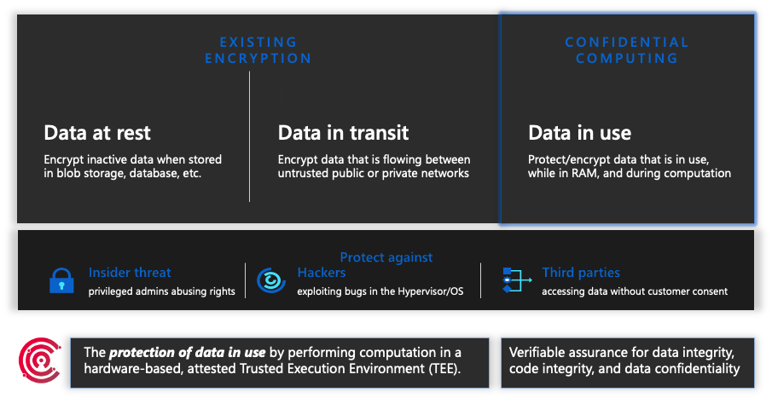
Confidential Computing 101

Slide 4
TEE Device Interface Security Protocol (TDISP)
TDISP is a specification written from PCI SIG
Defines how to:
Establish trust between CVM and a device (device attestation)
Secure the interconnect between the host and the device
Attach/detach a device interface to/from a CVM
To support TDISP, we need:
Device changes, HW & FW
Host CPU changes (1st generation w. TDISP support: Intel GNR, AMD Turin)
Hypervisor, Host OS, CVM changes
Lots of infrastructure changes

Slide 5
I/O in Confidential VM without TDISP (1/2)
In CVM arch., memory is divided into:
Private memory, which is only accessible to in-TCB components (i.e. CVM and trusted HW)
Shared memory, which can be accessed by out-of-TCB components (i.e. HV, Host, devices)
Without TDISP, the device cannot be added to the CVM TCB and can only access the CVM’s shared memory.
To do I/O, i.e. smart NIC:
The device driver encrypts(/decrypts) & copies I/O data from private memory to shared (/from shared memory to private)
Device accesses encrypted data via shared memory
CVM
Private Memory
IO Data
Device
i.e smart NIC
Root Partition
1
Shared Memory
Encrypted IO Data
2
Hypervisor
HW
In-TCB components
Out-of-TCB components
Notes:
NIC: Network Interface Card

Slide 6
I/O in Confidential VM without TDISP (2/2)
Other types of I/O devices:
GPU:
GPU needs to perform computations on the plaintext confidential data (i.e. training); cannot process encrypted data
CC principle is that only in-TCB components can access plaintext confidential data
NVIDIA Hopper offers a Confidential Computing architecture without TDISP to add the GPU into the Platform TCB and allow the GPU to work on confidential data
Crypto Accelerator:
Needs to process plaintext data; cannot double-encrypt
Will also require a custom Confidential Computing architecture to add the accelerator into the Platform TCB

Slide 7
I/O in Confidential VM without TDISP - Impact
For smart NIC type of devices:
CPU encrypts/decrypts all data exiting/entering the TEE
Consumes CPU cycles, instead of working on CVM workload
Can impact IOPS and reduce performance
Can increase cost
For GPU & Crypto Accelerator type of devices:
Need to define a TDISP-like Confidential Computing architecture to add the device into the CVM’s TCB, so that the device can process confidential data
Impact: Confidential Computing becomes more complex, less performant and more expensive than General Purpose Computing

Slide 8
I/O in Confidential VM with TDISP
With TDISP, the CVM can do device attestation and choose to add the device into the CVM’s TCB
An accepted device can access the CVM’s private memory
To do I/O, i.e. smart NIC:
The accepted device can access the I/O data directly from the CVM’s private memory. No CPU encryption/decryption is needed.
CVM performance is closer to GP
Impact of IDE and other non-TDISP CVM features, i.e. memory encryption & integrity, IPI.
Less cost and complexity to support other accelerators
CVM
Private Memory
IO Data
1
Device
i.e smart NIC
Root Partition
Shared Memory
Encrypted IO Data
Hypervisor
HW
In-TCB components
Out-of-TCB components
Notes:
IDE: Integrity & Data Encryption
IPI: Inter Processor Interrupt

Slide 9
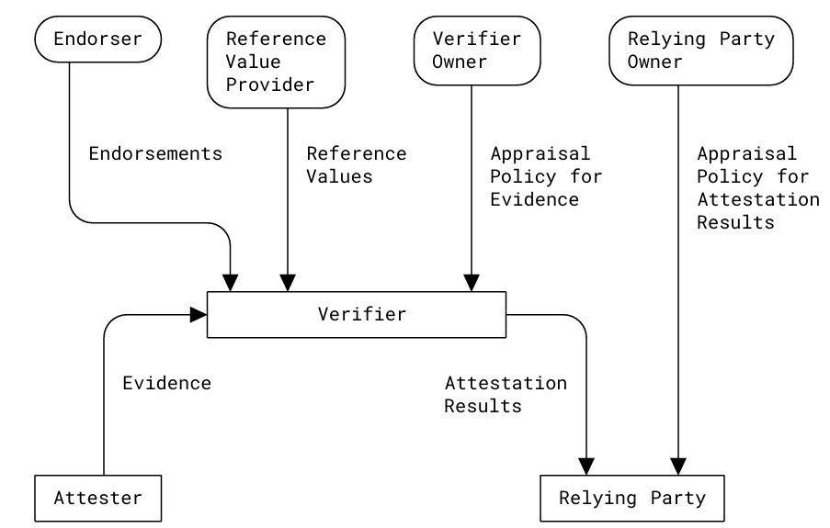
Attestation in Confidential Computing
CC offer verifiable assurance via Attestation
“Attestation is the process by which an Attester produces Evidence (believable, verifiable information about its own state), which is then evaluated by a Verifier. The Verifier appraises this Evidence using trusted inputs like Endorsements and Reference Values, and produces an Attestation Result. This result is then used by the Relying Party to make a trust decision about the Attester.” according to Remote ATtestation procedureS (RATS) Architecture
Platform Attestation and TDISP Attestation are distinct
Notes:
RFC 9334: Remote ATtestation procedureS (RATS) Architecture

Slide 10
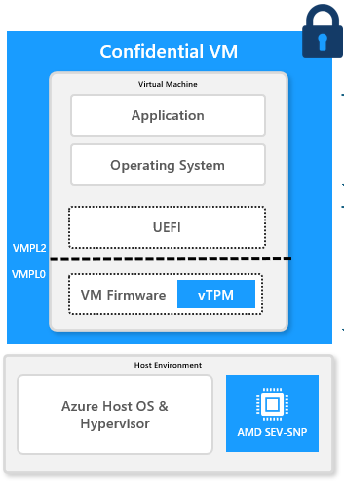


Platform Attestation Evidence
In-TCB components
Platform Attestation Evidence describe the in-TCB components of the CVM
Uses a chain of trust where one component measures the next and the root-of-trust is the CPU HW
A Verifier can check that the Guest Evidence is bound to the CPU Platform key, which proves that the CVM is running in a Confidential environment.
Guest kernel & drivers are measured at boot. Runtime attestation relies on IMA & systemd and their policy.
Contains no TDISP device information
Out-of-TCB components
CPU HW
Measures
CPU FW &
uCode
Measures
VM FW &
UEFI
incl. vTPM
Measures
Part of
Guest OS &
Apps
vTPM Attestation Key
signs Evidence
Platform Key
signs Evidence
Notes:
OVMF (Open Virtual Machine Firmware) is an implementation of UEFI (Unified Extensible Firmware Interface) for VMs.

Slide 11
TDISP Attestation Evidence (1/2)
TDISP Device Attestation Evidence describe the in-TCB components of a particular TDISP device
The TDISP Device Attestation Evidence contain:
Device certificates, Measurements & Device Interface Report
The Evidence is transferred from the Device to the CVM via the CPU FW/HW.
Since the CVM (VM FW or Guest OS) collects the Platform and TDISP device evidence, the CVM can verify that both evidence are mapped to the CVM itself.
CPU HW
Measures
CPU FW &
uCode
Measures
VM FW &
UEFI
incl. vTPM
Measures
Part of Guest
OS & Apps
TDISP
vTPM Attestation Key
signs Evidence
Deliver Evidence
Platform Key
signs Evidence
Device HW
Device FW
&
TDI Config
Measures
(Optionally) Device Key signs some Evidence
Notes:
TDI: TEE Device Interface

Slide 12
TDISP Attestation Evidence (2/2)
However, a remote Verifier cannot know if the TDISP Device Evidence originated from the same CVM as the Platform Evidence
No existing binding between Platform and TDISP Device Evidence
An attacker could replay old TDISP Attestation Evidence with a CVM that doesn’t have that TDISP device and cause a Relying Party to disclose secrets to the CVM that wouldn’t otherwise
i.e. A Relying Party may have a policy to release proprietary training data to a CVM that has an attached TDISP GPU device.
Notes:
TDI: TEE Device Interface

Slide 13
Binding Evidence – Goal
Goal: Binding method is the same across OSes and CSPs
Becomes easier for anyone to implement their own Verifier ☺
Proposed Solution:
CVM collects TDISP Device Attestation Evidence and uses evidence to extend a vTPM NVIndex
NVIndex gets signed using vTPM Attestation Key, which is already part of Platform Attestation Report

Slide 14
TPM NVIndex 101
TPM 2.0 Spec. defines that each TPM/vTPM implementation needs to have at least 6 KB of Non-Volatile Storage
Stores TPM-internal data (i.e. hierarchy seeds, counters, clocks, etc.)
Stores user-defined data and accessed via an NVIndex
NVIndex is a handle (aka pointer) to a specific NV memory region. It includes:
Size of data
Attributes
Define static behavior and access rules of the NVIndex.
Defined at NVIndex creation time and cannot be changed afterwards.
i.e. If NV data acts as a counter, raw data or PCR, which hierarchy can read/write, etc.
Access control policy
Define dynamic authorization rules on who can access the NVIndex
i.e. require a password, key, specific PCR value to access NVIndex

Slide 15
Binding Proposal (1/3)
Define a PCR-like NVIndex that gets extended with the hash of each TDISP Device Attestation Evidence
Create a file to store Event Log Records related to this NVIndex
Every time a new TDISP Device Attestation Evidence is retrieved by the CVM, the CVM would do:
Digest ← Hash(TDISP Device ID, Device Certificate, Measurements, Interface Report) NVIndex_New_Value ← Hash(NVIndex_Old_Value | Digest) Create a new Event Log Record <NVIndex, extend event, digest> Append the new Event Log Record to the NVIndex Event Log file
Every time the CVM wants to invoke a remote Verifier to perform attestation, the CVM would do:
NVIndex_Quote ← Sign(NVIndex, vTPM Attestation Key) Send to remote Verifier: (existing) Platform Attestation Evidence and all supporting certificates (existing) All TDISP Device Attestation Evidence NVIndex_Quote NVIndex Event Log file

Slide 16
Binding Proposal (2/3)
CPU HW
Measures
CPU FW &
uCode
Measures
VM FW &
UEFI
incl. vTPM
Measures
Part of Guest
OS & Apps
TDISP
vTPM Attestation Key
signs Evidence
Deliver Evidence
Platform Key
signs Evidence
Device HW
Device FW
&
TDI Config
Measures
(Optionally) Device Key signs some Evidence
By generating the NVIndex Quote using the vTPM Attestation Key we bind the Platform Attestation chain of trust to the TDISP Attestation

Slide 17
Binding Proposal (3/3)
NVIndex needs to be defined by VM FW using Platform hierarchy
Platform hierarchy is under the control of the platform manufacturer (TPM) or VM FW (vTPM)
Platform hierarchy is needed to use TPMA_NV_POLICY_DELETE attribute, which restricts everyone else (i.e. Guest) from deleting and redefining the NVIndex and its data
This would prevent an attacker with Guest OS kernel privileges from deceiving the remote Verifier into approving a malicious TDISP device
Other NVIndex attributes to use:
TPMA_NV_POLICY_READ, TPMA_NV_OWNERWRITE, TPM_NT = 0x4 (extend-only), TPMA_NV_CLEAR_STCLEAR (reset on reboot)
Use Canonical Event Log Record format for Event Log format

Slide 18
Open Questions
Maintain history of all TDISP devices that were evaluated, including rejected TDISP devices and accepted TDISP devices with outdated evidence
Each TDISP device evidence is a few KBs in size
A Relying Party might use this information in its policy
i.e. a CVM that has previously accepted a device with vulnerable FW might have become compromised, even though the device FW got updates to a non-vulnerable version
Still, can cause unnecessary bloating for long lived CVMs and attestation requests to the remote Verifier
Need some policy over log and NVIndex reset
Decide on location and permissions of Event Log file and NVIndex extend
Isolated to kernel drivers or allow applications?

Slide 19
Thank you!

