Slide 1

Project 1
Data Science & Visualization
Chicago Mag Mile Crime 2010:2020

Slide 2
Agenda
Intro/Approach – Carl Coffman
Code Review – Tom Henry
Chart Review - Gisela Gutierrez
Results/Analysis – Mason McCoy

Slide 3
What we learned
Sessions 1-6 (<project1, :Project1)
Project Team Challenges
Excel Charting, PivotTables, and VBA (import)
Column and Bar Category Chart
Line Chart over Time
Record Total, Max, Min, Mean, % of Total
Sort Highest to Lowest, and %Change from previous
Work with variable types, float (rounding), integer, lists, string (concatenation, len, search, left/right)
Average, Average Change (from previous)
Print formatted report to terminal/file
Store/retrieve/iterate list, DataFrame, series, tuple, csv
Random generator
Advanced charts: Boxplot, Scatter, annotate, set x/y limits/labels
Linear regression model (Y=a + bX)
Get: API, Key, json, csv – sources
Mapping Lat/Long, find nearest
Pythonistas? Not yet - still learning GIT ☺
Not enough time, had to stop pursing other ideas to meet deadline. Good to understand data codes (such as IUCR codes, 350 of them!)
Combining code
Aliases non-aliased (pd/pandas)
Inconsistent “ or ‘ – both work ☺
Working with smaller datasets during development, causing errors in design
Avoiding Excel - analyzing in Excel is still simpler in Excel! (Carl’s comment)

Slide 4
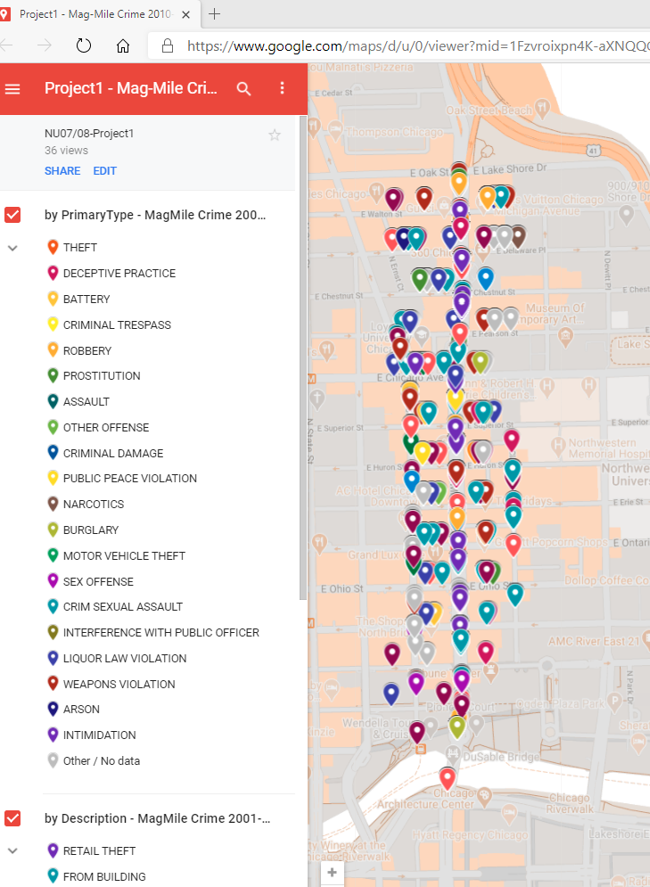
Approach
Chicago Mag Mile Crime
Crime within Chicago’s Magnificent Mile (Mag Mile)
Report on volume of overall crime and categories of crime
Are the number of crimes increasing or decreasing?
What type of crimes are increasing?
Defined Latitude and Longitude area for Mag Mile
Find API to source with 10 or more years of crime records and specific location data to identify geo location (latitude/longitude)
Use the tools and the knowledge gained to pull data via API, process it, store it, and analyze/report on it.
https://www.google.com/maps/d/u/0/edit?mid=1Fzvroixpn4K-aXNQQGaWB7dLD1c649Z3&ll=41.894382436893366%2C-87.61286242201719&z=16

Slide 5
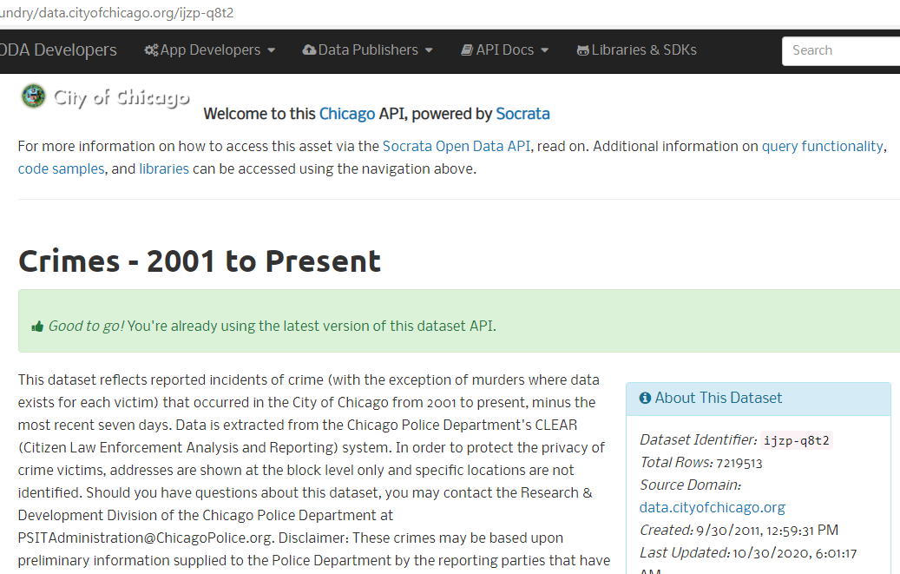
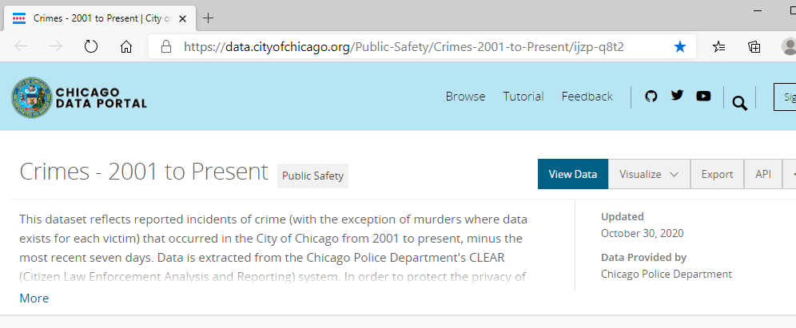
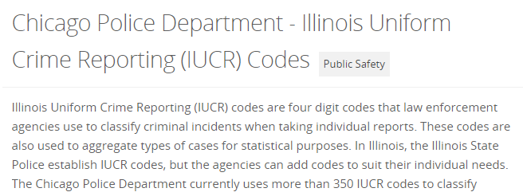
Key API Source
https://data.cityofchicago.org/Public-Safety/Crimes-2001-to-Present/ijzp-q8t2
Dataset Identifier

Slide 6
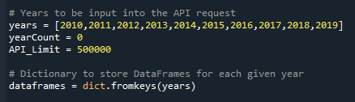

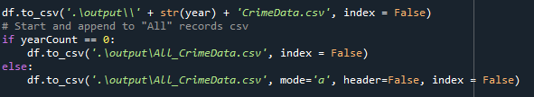
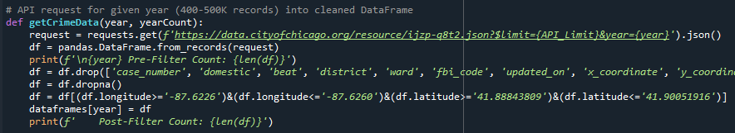
Key Code Items
Iteration List of previous-full 10yrs
Output csv and png files ‘./output/’
Writing each year’s csv data to its own file and appending to an all-data file
Year iterations, tracking number of years processed via ‘getCrimeData’ function
Function ‘getCrimeData’ to get, via API, a specific crime year’s data, dropping nulls and non-Mag Mile coordinates

Slide 7
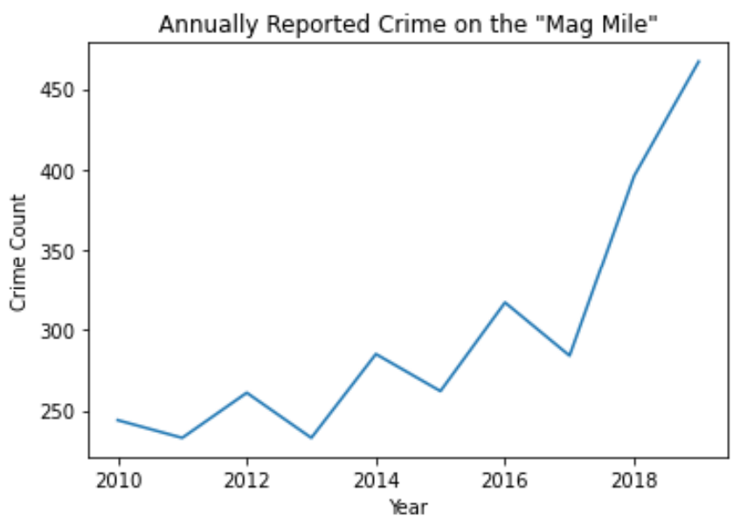
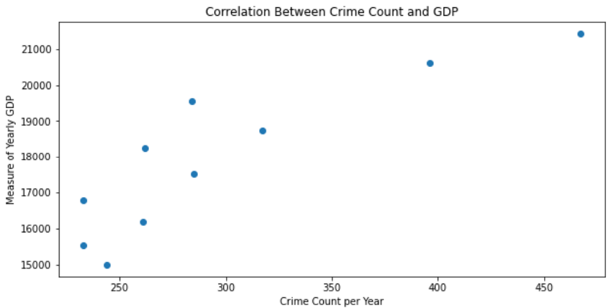
Key Charts

Slide 8
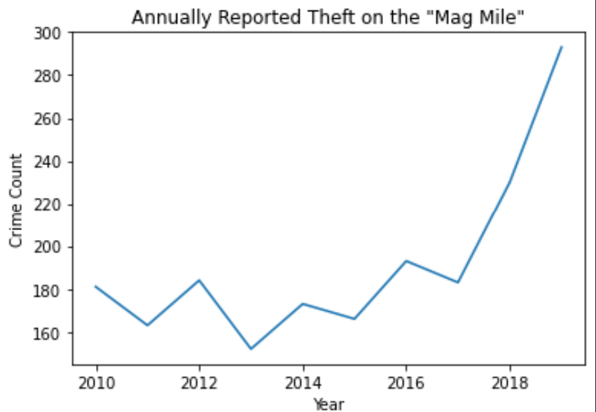
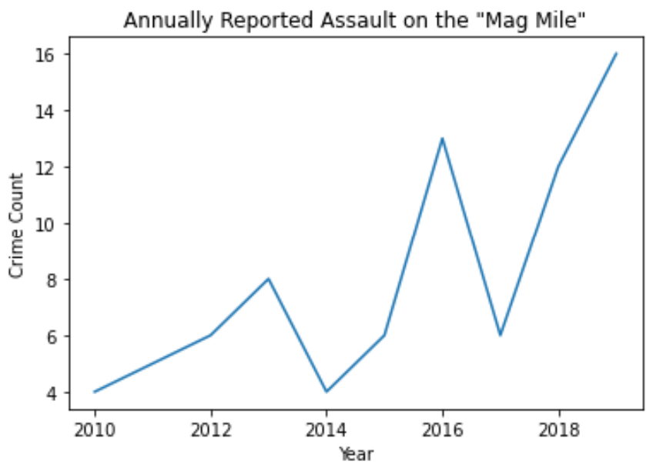
Key Charts

Slide 9
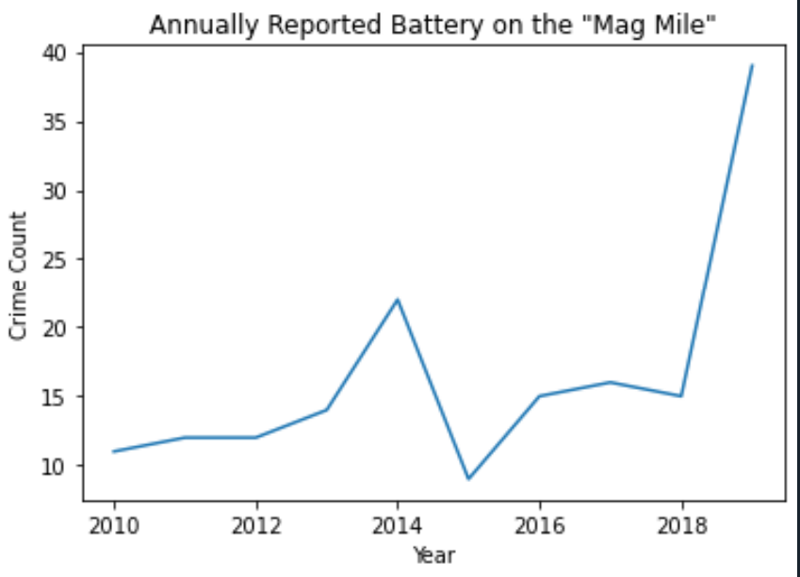
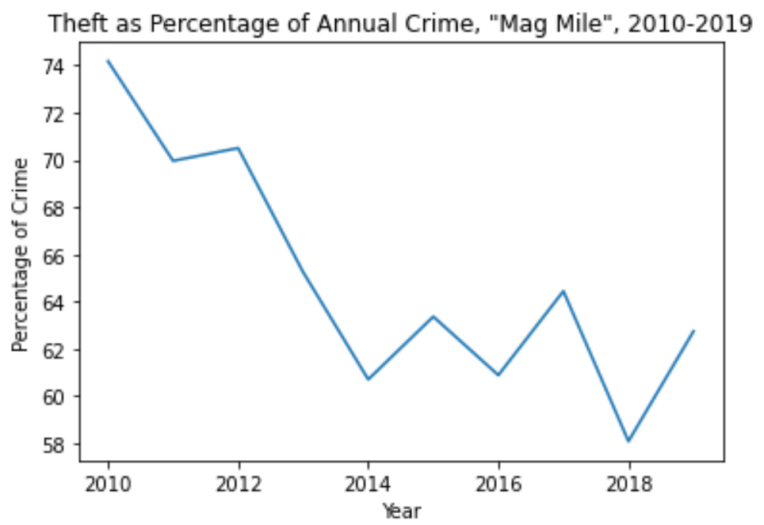
Key Charts

Slide 10
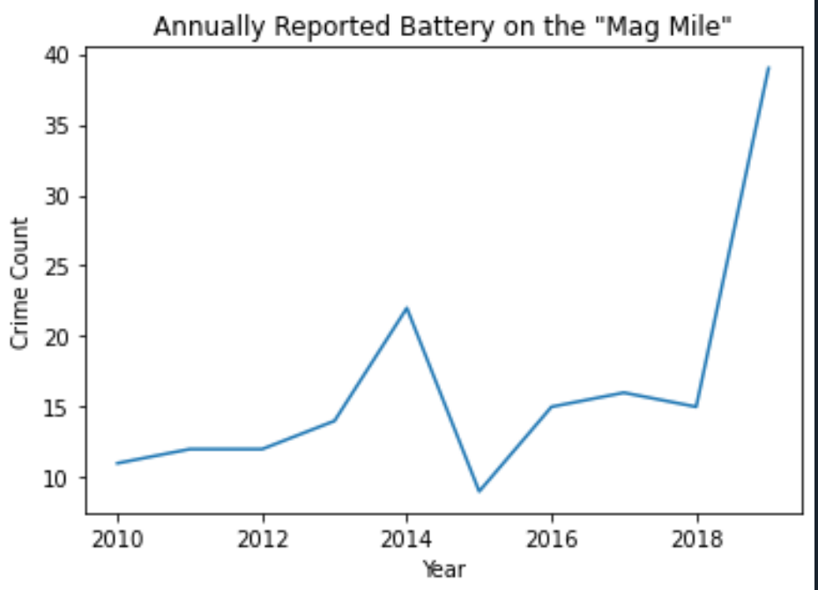
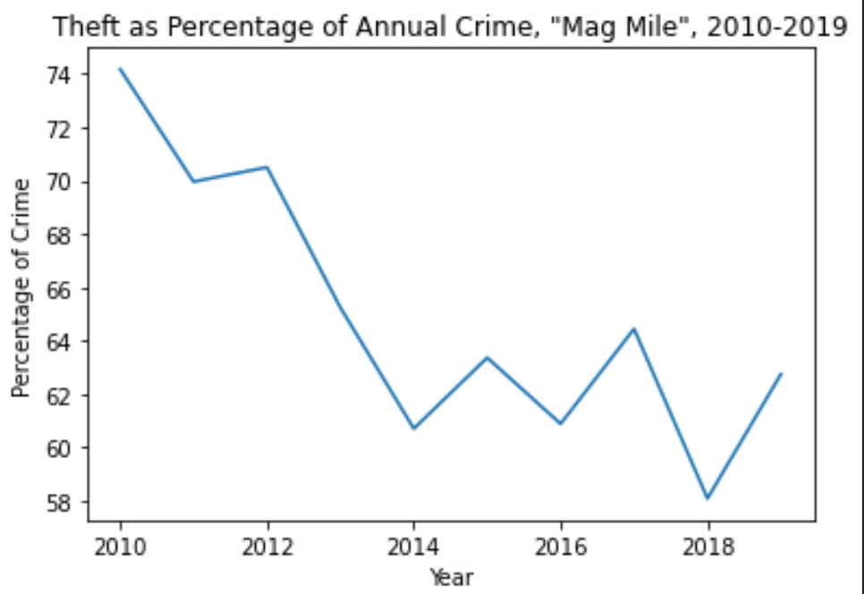
Key Charts

Slide 11
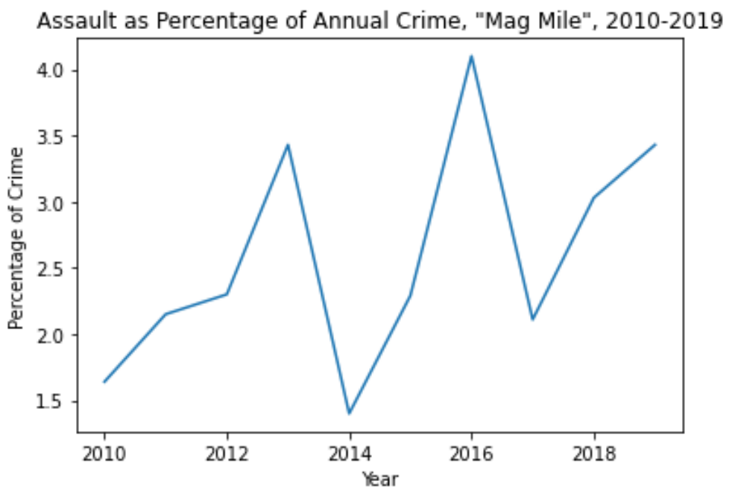
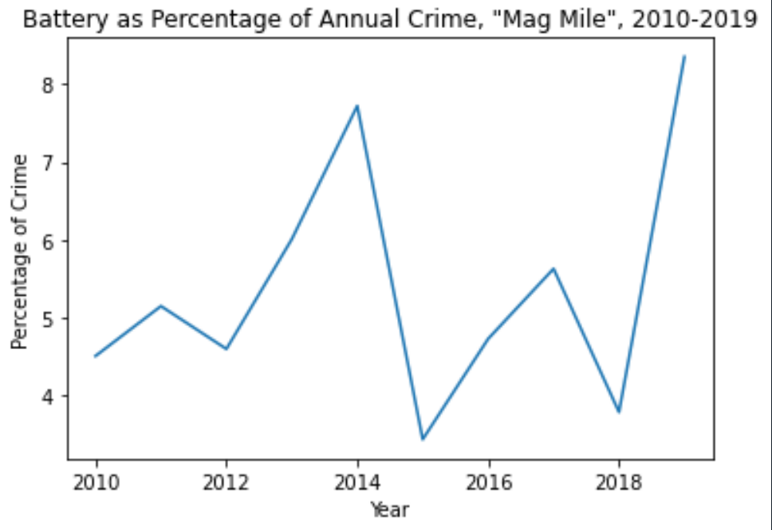
Key Charts

Slide 12
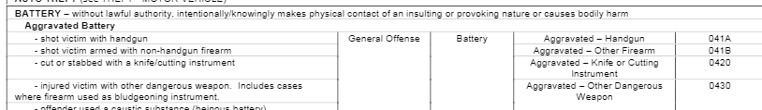
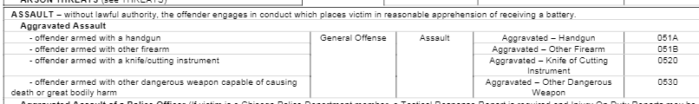
Key Charts

Slide 13
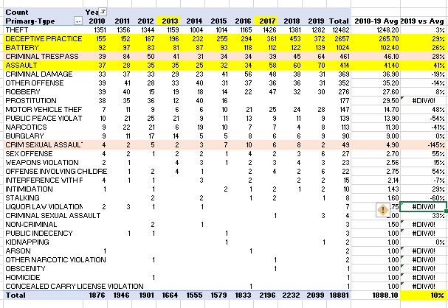
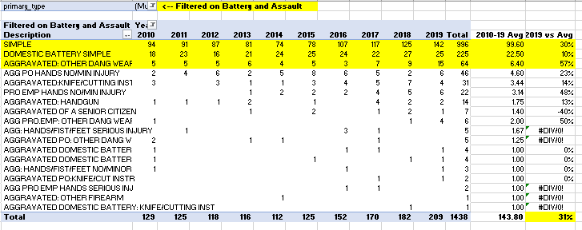

Results & Analysis
Overall 2019, up 10% from 10-year Mean
2019, up 31% for Battery & Assault
“Top-Talker” count and a significant % increase from previous year since 2014+

Slide 14
Potential Next Steps
Identify and source Mag Mile’s revenue and sales to report possible relationship between crime and revenue.
Research any additional granularity within Assault and Battery categories for additional insights within.
Another item
Another item
Another item

