Slide 1

Final Project (24.3)
Stock Predictor – Price & Media

Slide 2
Agenda and Team Members
Brian Young
Carl Coffman
Push Palani
Steven Crutcher

Slide 3
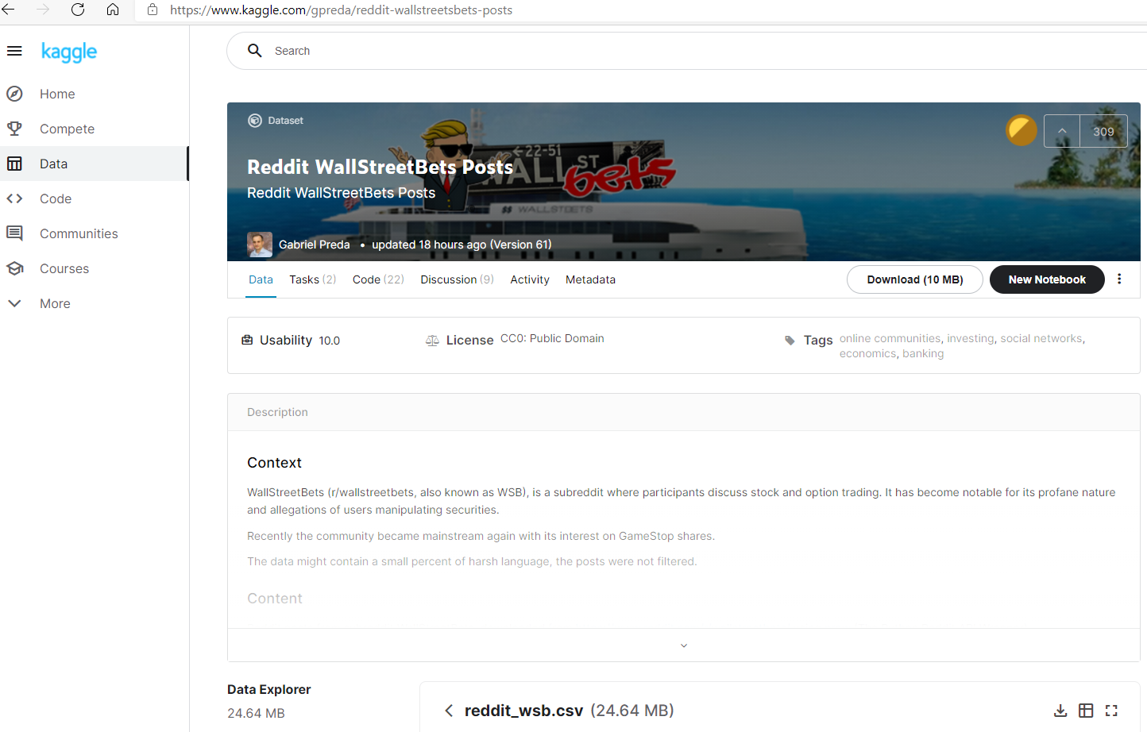
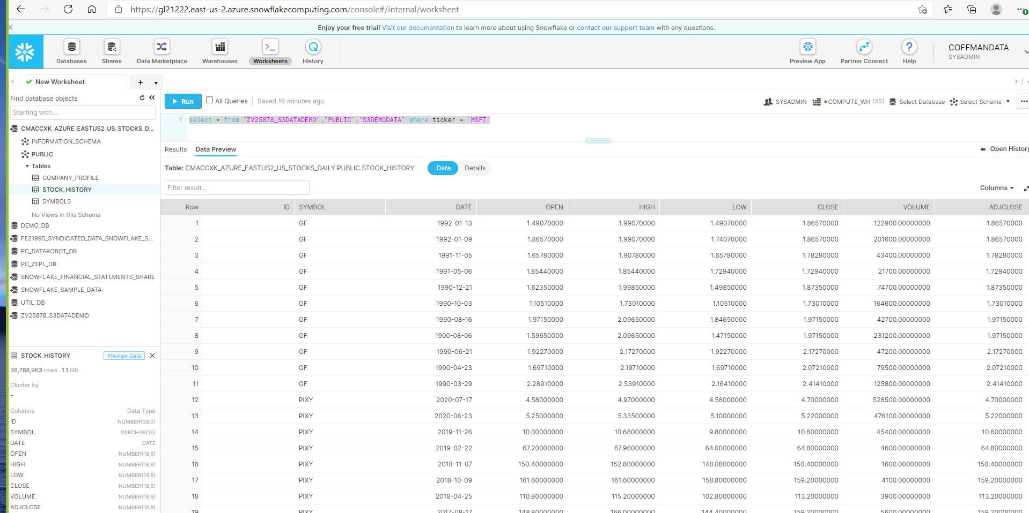
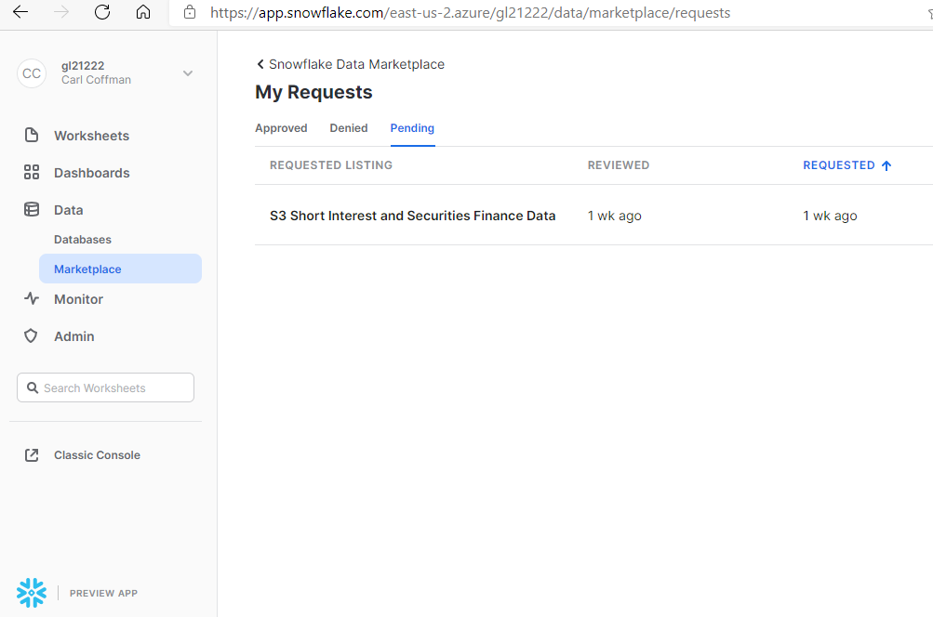
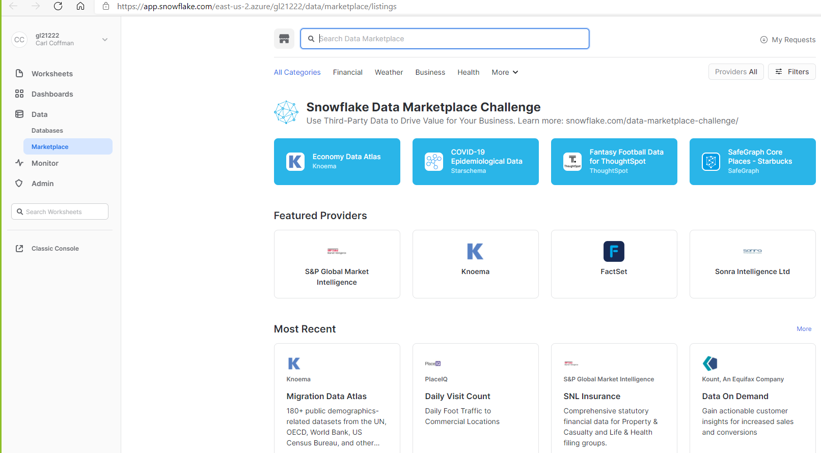
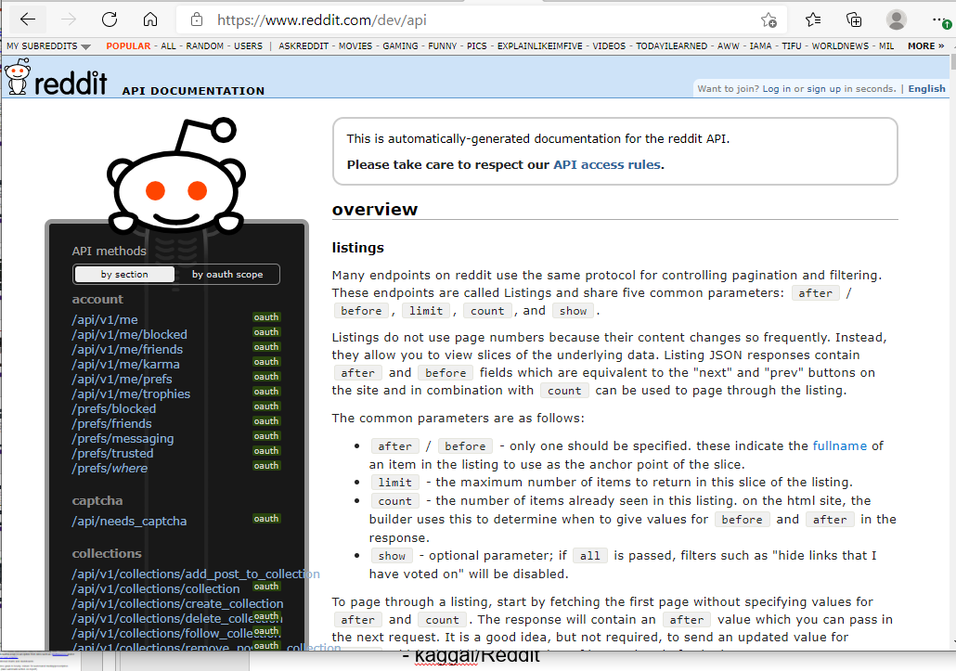


Final Project - Stocks
Hosted Project Sites
Project Team Challenges
Stock Predictor (ccc-gh.github.io)
https://ccc-gh.github.io/FinalProject-Stock/
GitHub Code Repository
https://github.com/CCC-GH/FinalProject-Stock
Finding “free” historical data source for a particular stock’s short activity – current (.info) and basic-historical (.history) is made available: open, close, volume, high, low social activity or amount of noise and its trend.
Key Data Sources
Used:
yfinance - # Yahoo! Finance market data
$ pip install yfinance
import yfinance
pandas-datareader – Tweet data feed for Twitter
$pip install pandas-datareader
import pandas_datareader
snowflake
- kaggal/Reddit - download
- Reddit/API

Slide 4
Libraries Used
from sklearn:
linear_model import LinearRegression
tree import DecisionTreeRegressor
model_selection import train_test_split
metrics import mean_squared_error
*ARIMA - A popular and widely used statistical method for time series forecasting.
from statsmodels.tsa.arima_model import ARIMA
Other:
import pandas as pd
import numpy as np
import matplotlib.pyplot as plt
from pandas.plotting import lag_plot
from pandas.tseries.holiday import USFederalHolidayCalendar
from pandas.tseries.offsets import CustomBusinessDay
from pandas_datareader.data import DataReader
import yfinance as yf
import datetime
*ARIMA - AutoRegressive Integrated Moving Average
AR:<Auto Regressive> uses the dependent relationship between an observation and some predefined number of lagged observations (also known as “time lag” or “lag”).
I:< Integrated > model employs differencing of raw observations (e.g. it subtracts an observation from an observation at the previous time step) in order to make the time-series stationary.MA:
MA: < Moving Average > model exploits the relationship between the residual error and the observations.
Model parameters - expect as input parameters 3 arguments (p,d,q)
p is the number of lag observations
d is the degree of differencing
q is the size/width of the moving average window

Slide 5
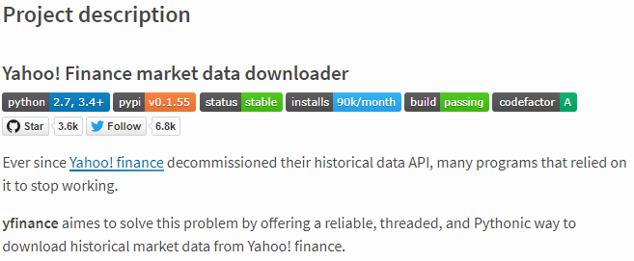

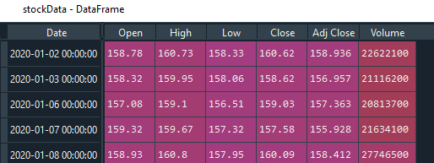
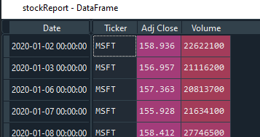
Stock Data
Import Daily Stock Price
yfinance - # Yahoo! Finance market data
https://github.com/ranaroussi/yfinance
Install yfinance using pip:
$ pip install yfinance --upgrade --no-cache-dir
Requirements
Python >= 2.7, 3.4+
Pandas >=0.23.1
Raw data
Required Fields
Each stock’s CSV data merged with complete CSV dataset

Slide 6
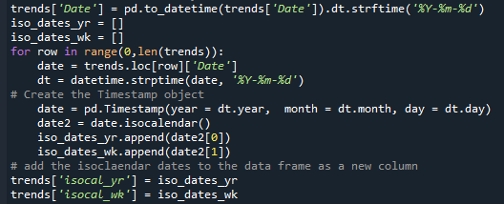
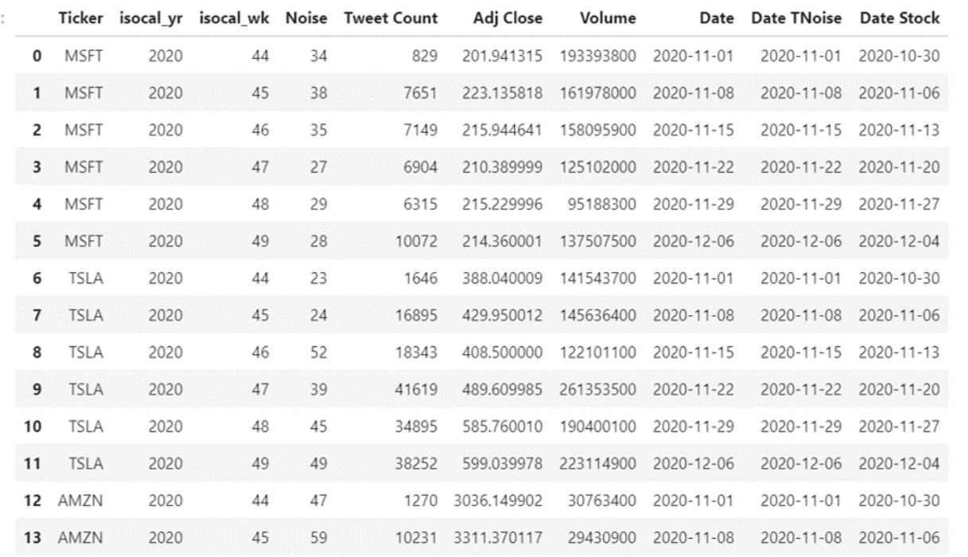
Merging Stock, Trend, and Tweet Data
Incoming dates are transformed, or Yearly/Weekly grains added to conform the time frequency to its lowest-time grain across both sources – weekly.
Weekly grain converted to ISO, Monday start of week
Stock CSV and Trend CSV data is merged to a single dataset

Slide 7
Potential Next Steps
Additional historical stock data such as short activity to focus on potential GameStop(GME) or AMC activity.
If data can’t be found, warehouse daily to build missing data – screen-scaping(beautiful-soup) is an option from sites such as shortsqueeze and/or Daily Short Sale Volume.
Build additional charts and dashboards
Reduce time grain to hourly, minute for automated trading/prescription reporting (take automatic action on report).

Slide 8
Questions?

