Slide 1

Final Project (24.3)
Stock Predictor – Price & Media

Slide 2
Agenda and Team Members
Brian Young
Carl Coffman
Push Palani
Steven Crutcher

Slide 3

Final Project - Stocks
Hosted Project Sites
Project Team Challenges
Stock Predictor (ccc-gh.github.io)
https://ccc-gh.github.io/FinalProject-Stock/
GitHub Code Repository
https://github.com/CCC-GH/FinalProject-Stock
Finding “free” historical data source for a particular stock’s short activity – current (.info) and basic-historical (.history) is made available: open, close, volume, high, low social activity or amount of noise and its trend.
Key Data Sources
Used:
yfinance - # Yahoo! Finance market data
$ pip install yfinance
import yfinance
pandas-datareader – Tweet data feed for Twitter
$pip install pandas-datareader
import pandas_datareader

Slide 4
Libraries Used
from sklearn:
linear_model import LinearRegression
tree import DecisionTreeRegressor
model_selection import train_test_split
metrics import mean_squared_error
*ARIMA - A popular and widely used statistical method for time series forecasting.
from statsmodels.tsa.arima_model import ARIMA
Other:
import pandas as pd
import numpy as np
import matplotlib.pyplot as plt
from pandas.plotting import lag_plot
from pandas.tseries.holiday import USFederalHolidayCalendar
from pandas.tseries.offsets import CustomBusinessDay
from pandas_datareader.data import DataReader
import yfinance as yf
import datetime
*ARIMA - AutoRegressive Integrated Moving Average.
AR:<Auto Regressive> uses the dependent relationship between an observation and some predefined number of lagged observations (also known as “time lag” or “lag”).
I:< Integrated > model employs differencing of raw observations (e.g. it subtracts an observation from an observation at the previous time step) in order to make the time-series stationary.MA:
MA: < Moving Average > model exploits the relationship between the residual error and the observations.
Model parameters - expect as input parameters 3 arguments (p,d,q)
p is the number of lag observations
d is the degree of differencing
q is the size/width of the moving average window

Slide 5
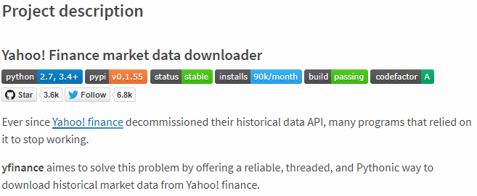

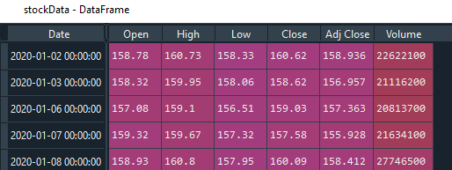
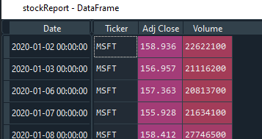
Stock Data
Import Daily Stock Price
yfinance - # Yahoo! Finance market data
https://github.com/ranaroussi/yfinance
Install yfinance using pip:
$ pip install yfinance --upgrade --no-cache-dir
Requirements
Python >= 2.7, 3.4+
Pandas >=0.23.1
Raw data
Required Fields
Each stock’s CSV data merged with complete CSV dataset

Slide 6
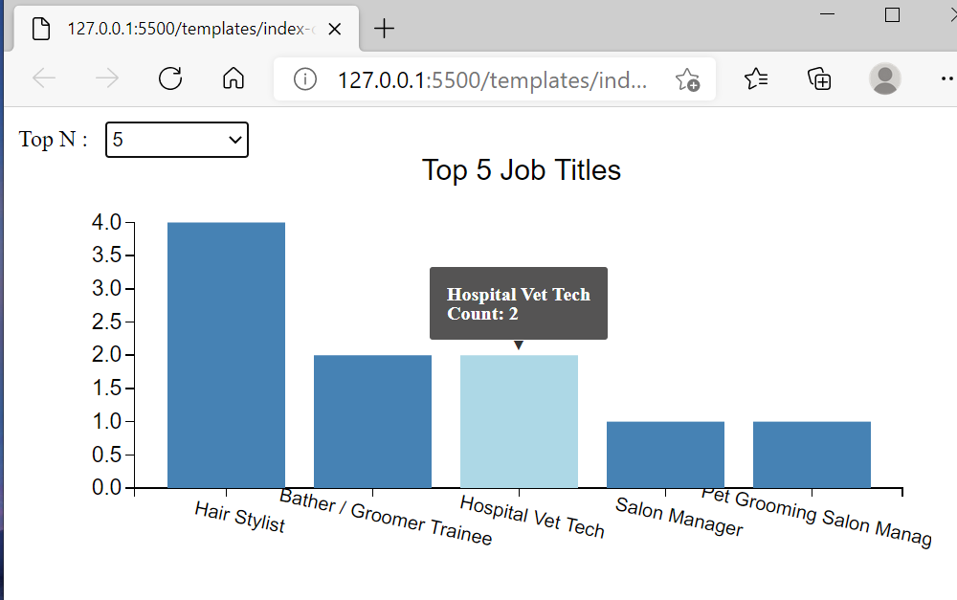
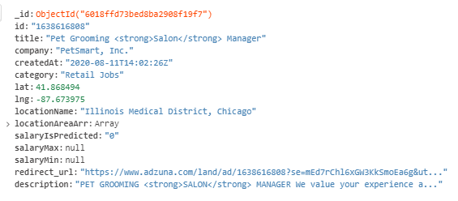
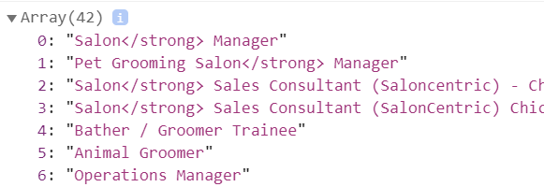

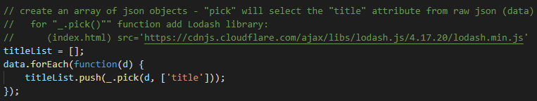
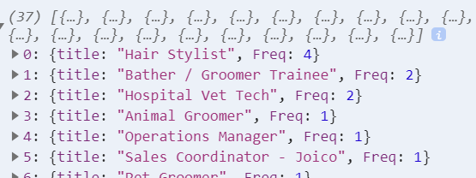

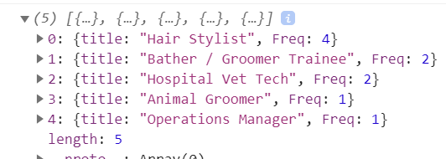



Grooming Data for Top-N

Slide 7

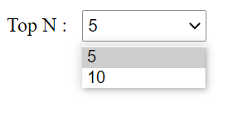

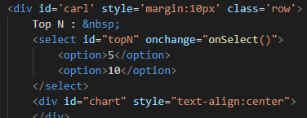

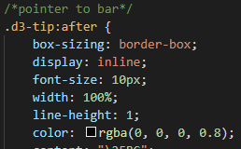
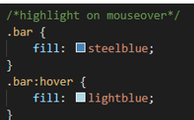
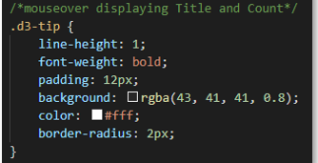
Charting Top-N with D3/SVG

Slide 8
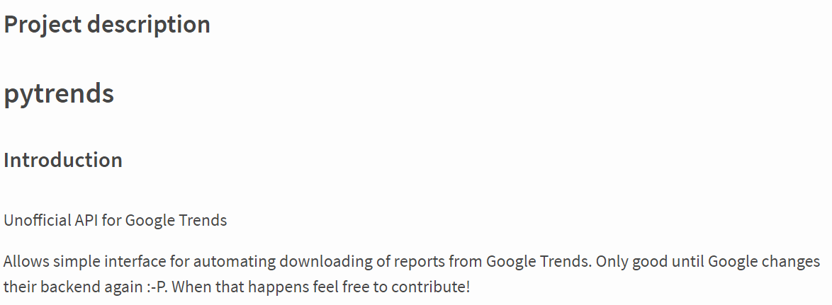
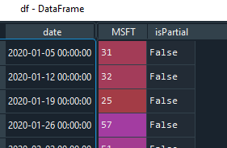
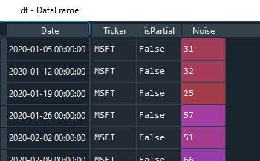
Trend Data
Import Daily Trend of key word (stock/ticker)
Raw data
pytrends - Unofficial API for Google Trends $pip install pytrends
- Interface for automating downloads of reports from Google Trends
Required Fields
Each stock’s CSV data merged with complete CSV dataset

Slide 9
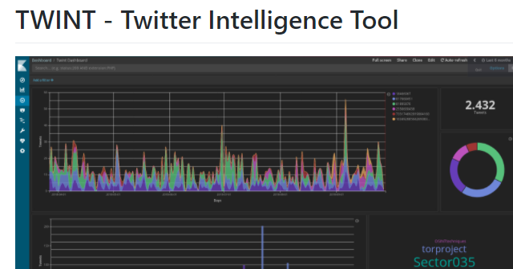

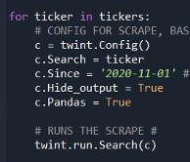
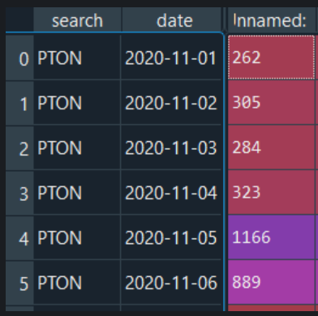
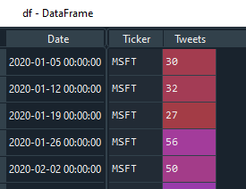
Tweet Data
Import stock Tweet activity: twint.run.Search()
Twint – Tweet data feed for Twitter
$pip install twint
Advanced Twitter scraping tool allowing for scraping from specific Twitter topics (almost all Tweets)
Note: Twitter’s API limits to 3200 Tweets
Strip time from time stamp
Required Fields
Moved to CSV dataset

Slide 10
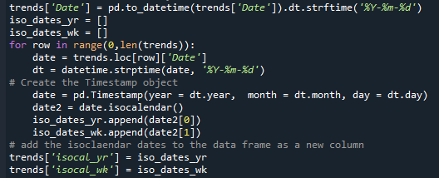
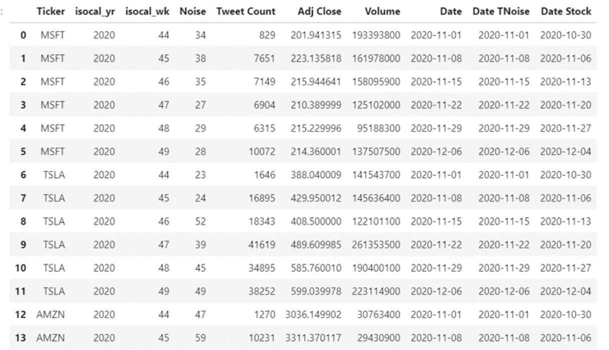
Merging Stock, Trend, and Tweet Data
Incoming dates are transformed, or Yearly/Weekly grains added to conform the time frequency to its lowest-time grain across both sources – weekly.
Weekly grain converted to ISO, Monday start of week
Stock CSV and Trend CSV data is merged to a single dataset

Slide 11
Potential Next Steps
Additional historical stock data such as short activity to focus on potential GameStop(GME) or AMC activity.
If data can’t be found, warehouse daily to build missing data – screen-scaping(beautiful-soup) is an option from sites such as shortsqueeze and/or Daily Short Sale Volume.
Build additional charts and dashboards
Reduce time grain to hourly, minute for automated trading/prescription reporting (take automatic action on report).

Slide 12
Questions?

