Slide 1

Final Project (24.3)
Stock Predictor – Price & Media

Slide 2
Agenda and Team Members
Brian Young
Carl Coffman
Push Palani
Steven Crutcher

Slide 3




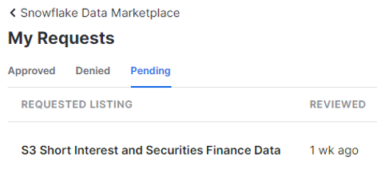
Final Project - Stocks
Project Scope
Key Data Sources
Used:
yfinance - # Yahoo! Finance market data
$ pip install yfinance
import yfinance
pandas-datareader – Tweet data feed
$pip install pandas-datareader
import pandas_datareader
Reddit – user-generated bulletins
https://www.reddit.com/r/datasets/
Kaggle – WallStreetBest posts
https://www.kaggle.com/datasets
Reviewed:
snowflake – great data cloud connectivity store/retrieve, but no access given to stock-shorting data.
Predict future stock price and how it may be influenced by social media noise – such as what had happened recently to GameStop and AMC.
Site Hosts
Stock Predictor (ccc-gh.github.io)
https://ccc-gh.github.io/FinalProject-Stock/
GitHub Code Repository
https://github.com/CCC-GH/FinalProject-Stock

Slide 4
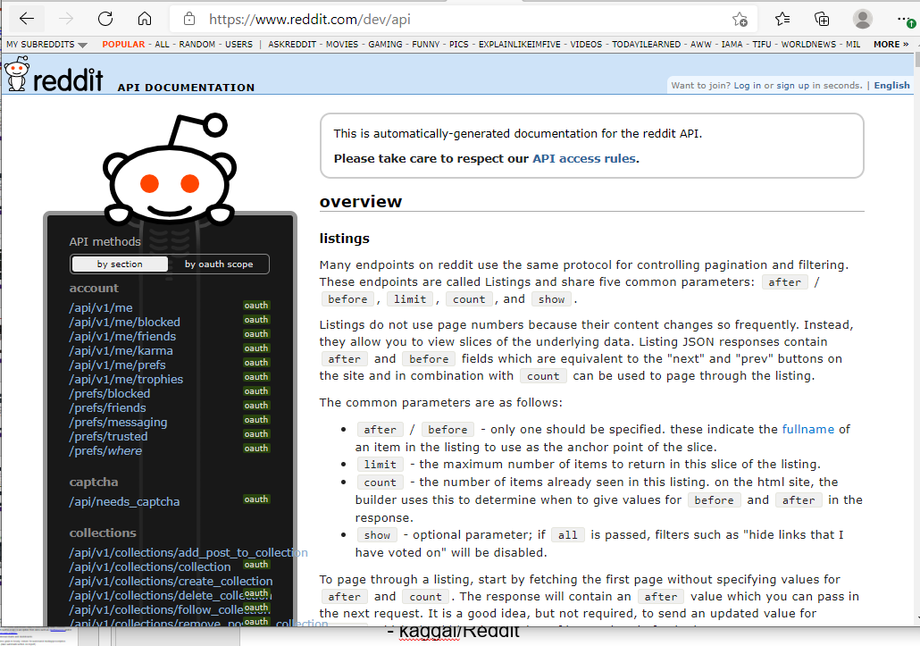
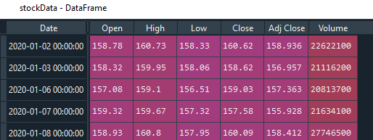
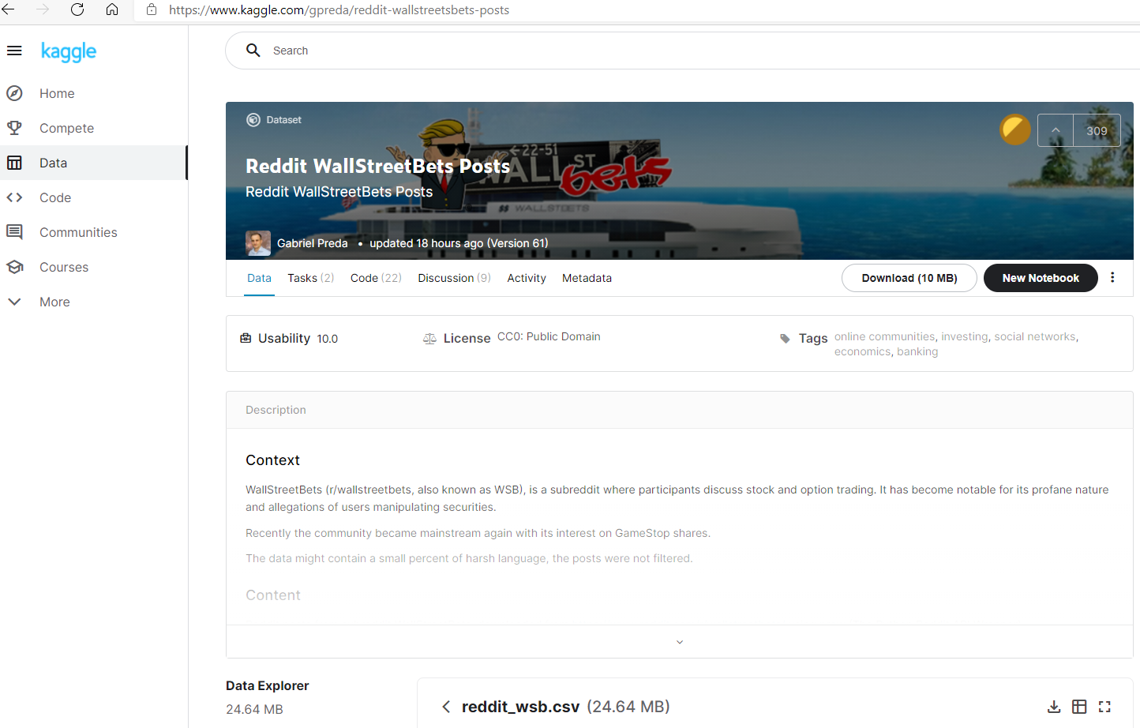
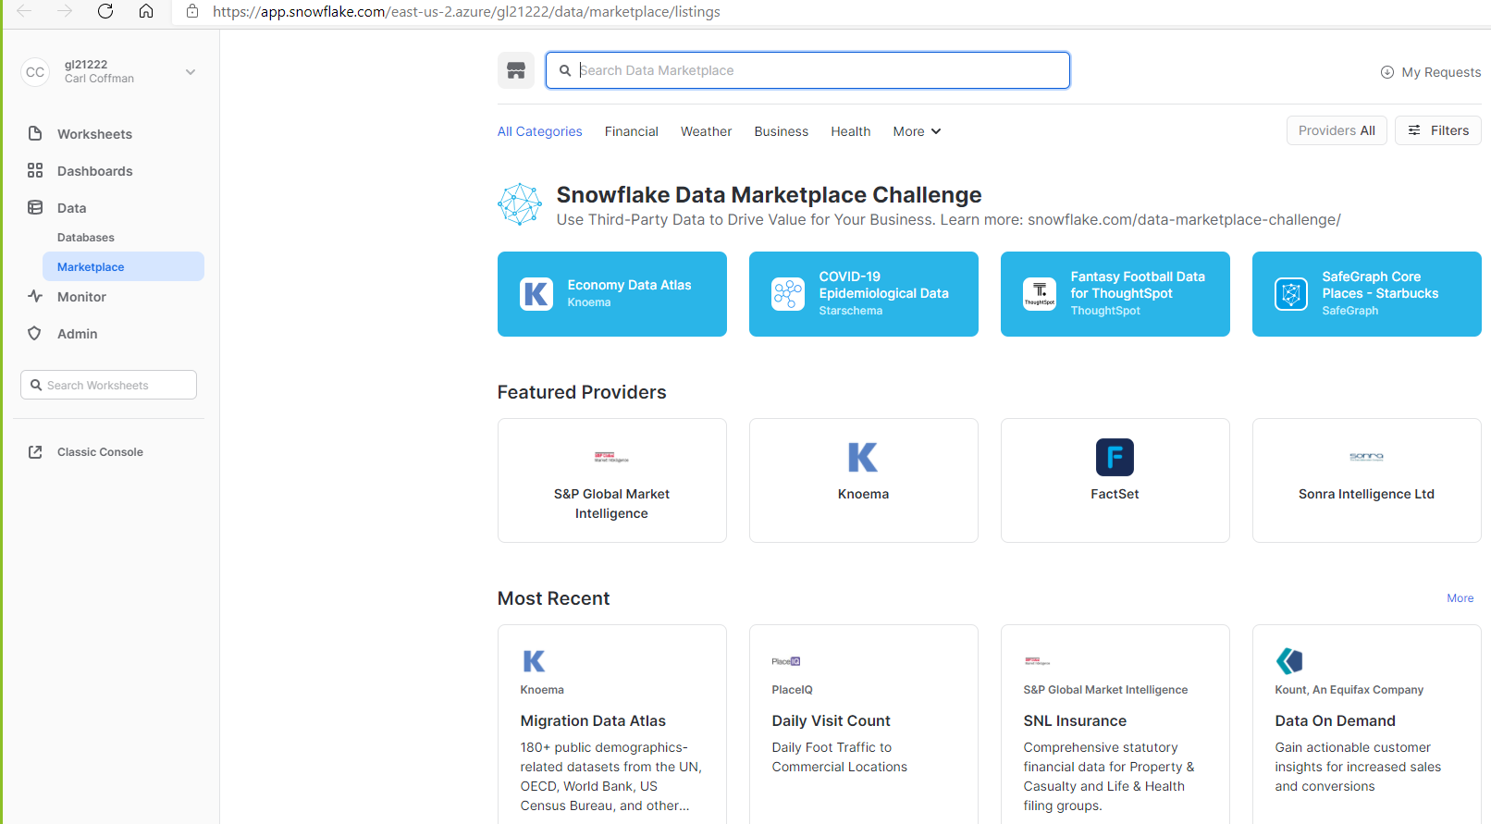
Social Media and Cloud Data
Reddit – https://www.reddit.com/r/datasets/
Data Challenges
No significant, historical warehouse for social media data.
Finding “free” historical data source for a particular stock’s short activity – current (.info) and basic-historical is made available; Open, High, Low, Close, Volume
snowflake – Cloud Data/warehouse & Market Data
Kaggle – WallStreetBest posts

Slide 5
Libraries Used
from sklearn:
linear_model import LinearRegression
tree import DecisionTreeRegressor
model_selection import train_test_split
metrics import mean_squared_error
*ARIMA - A popular and widely used statistical method for time series forecasting.
from statsmodels.tsa.arima_model import ARIMA
Other:
import pandas as pd
import numpy as np
import matplotlib.pyplot as plt
from pandas.plotting import lag_plot
from pandas.tseries.holiday import USFederalHolidayCalendar
from pandas.tseries.offsets import CustomBusinessDay
from pandas_datareader.data import DataReader
import yfinance as yf
import datetime
Linear Regression - Time Series Forecasting
*ARIMA - AutoRegressive Integrated Moving Average:
AR:<Auto Regressive> uses the dependent relationship between an observation and some predefined number of lagged observations (also known as “time lag” or “lag”)
I:< Integrated > model employs differencing of raw observations (e.g. it subtracts an observation from an observation at the previous time step) in order to make the time-series stationary
MA: < Moving Average > model exploits the relationship between the residual error and the observations
Model parameters - expect as input parameters 3 arguments (p,d,q)
p is the number of lag observations (using 4 lags)
d is the degree of differencing (not-stationary, days, so placed “1” in model)
q is the size/width of the moving average window

Slide 6
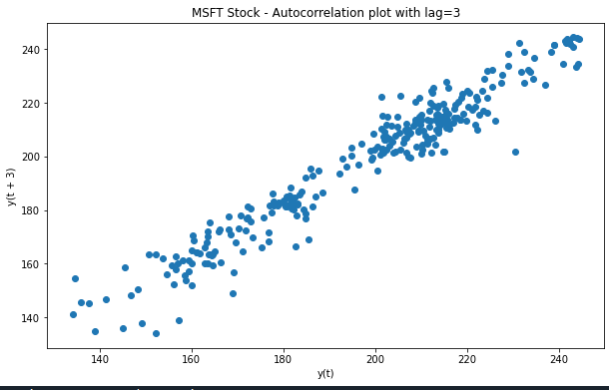
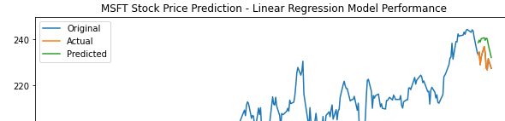
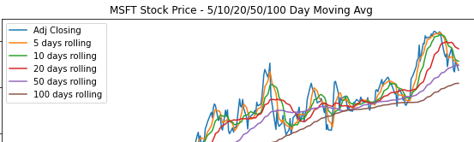
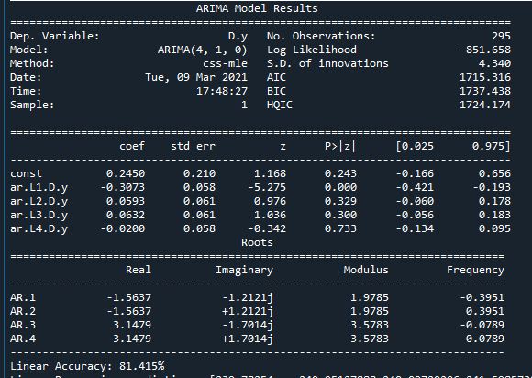
ARIMA / Linear Regression
ARIMA (or Box-Jenkins method)
is a good model to be applied to this type of data (there is auto-correlation in the data).
ARIMA Test - 75% data split test model to train/fit model *10.2 MSE
*note: average squared value across all the test set predictions
ARIMA MSE - *10.2 MSE
*note: avg squared value across all the test set predictions
order: p=4 lags, d=1 (not stationary)

Slide 7
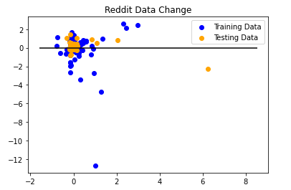
Reddit Data

Slide 8
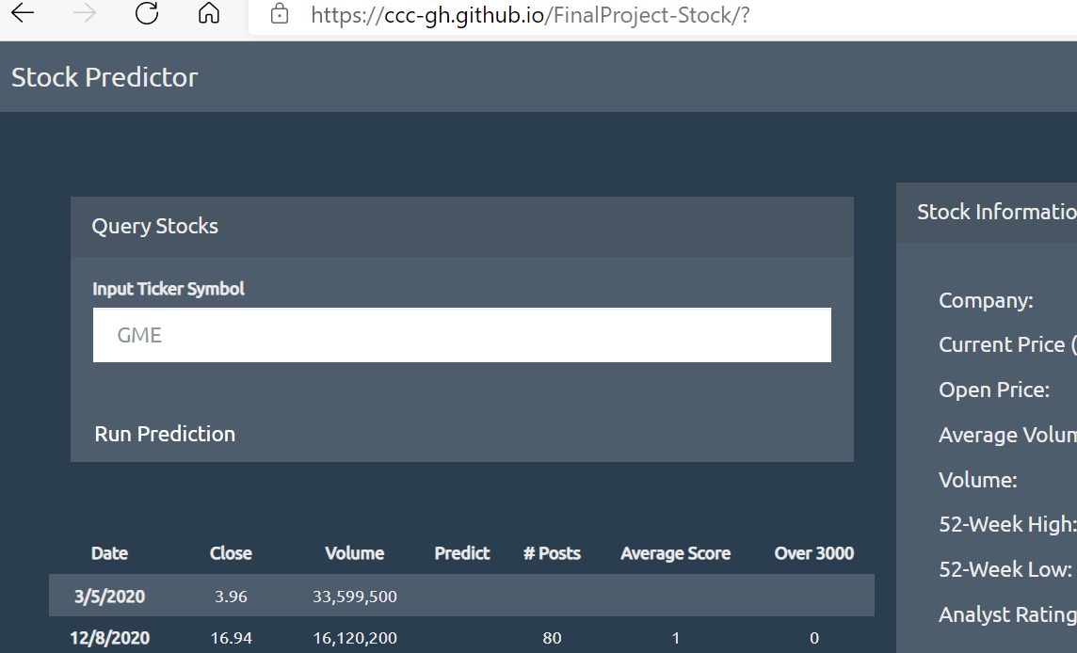
Stock Predictor Web Page

Slide 9
Potential Next Steps
Additional historical stock data such as short activity to focus on potential GameStop(GME) or AMC activity.
If data can’t be found, warehouse daily to build missing data – screen-scaping(beautiful-soup) is an option from sites such as shortsqueeze and/or Daily Short Sale Volume.
Further investigation of ARIMA model – test/track various P/D/Q configs
Reduce time grain to hourly, minute for automated trading/prescription reporting (take automatic action on report).
Build additional charts and dashboards to track multiple stocks.

Slide 10
Questions?

