Slide 1

Project 2 – ETL (HW13)
Stock and Trend Analysis

Slide 2
Agenda and Team Members
Rob Bowen
Carl Coffman
Mason McCoy
Push Palani

Slide 3

ETL Project - Stocks
Sessions 9-12 ()
Project Team Challenges
HW09 - SQL
HW10 – Advanced-Data-Storage-and-Retrieval
HW11 – Web
HW12 – Web-Scaping-and-Document-Databases
Finding a historical data source for a particular stock’s social activity or amount of noise and its trend.
Stock data was by day and trend data was by week aggregated to a Sunday. Team transformed the Sunday date to additional columns of data of Year and Week along with stocks’ Adjusted Closing data on Friday
Not enough time, had to stop pursing other ideas such as a cool tweeter feed Mason had worked on to meet deadline.
GitHub: https://github.com/ppalani09/Stocks-ETL-Project
Products
Used:
yfinance - # Yahoo! Finance market data
pytrends - Unofficial API for Google Trends
$pip install pytrends
Twint – Tweet data feed for Twitter
Other Products Investigated:
Mentions.com - popular, more for visualization
Keyhole.co – does have API, but cost $ ☺

Slide 4
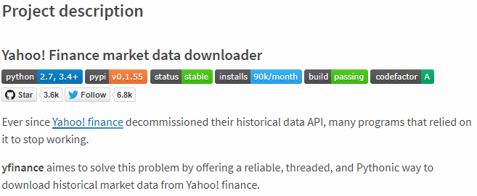

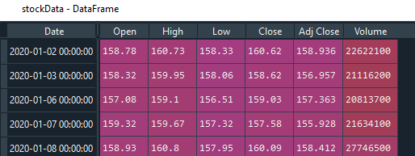
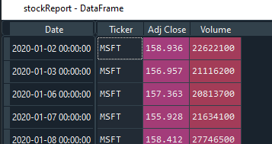
Stock Data
Import Daily Stock Price
yfinance - # Yahoo! Finance market data
https://github.com/ranaroussi/yfinance
Install yfinance using pip:
$ pip install yfinance --upgrade --no-cache-dir
Requirements
Python >= 2.7, 3.4+
Pandas >=0.23.1
Required Fields
Each stock’s CSV data merged with complete CSV dataset

Slide 5
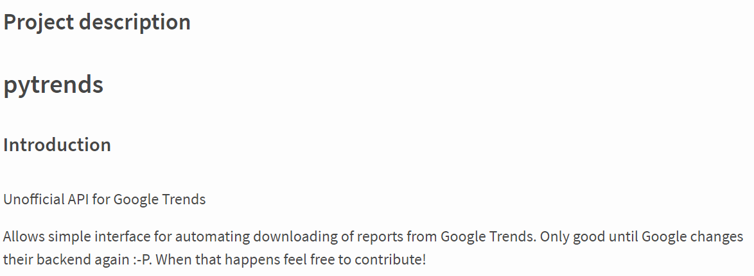
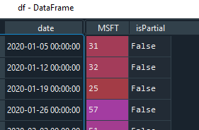
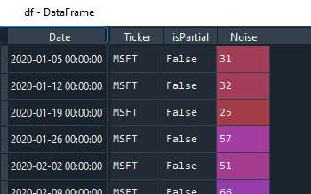
Trend Data
Import Daily Trend of key word (stock/ticker)
pytrends - Unofficial API for Google Trends $pip install pytrends
- Interface for automating downloads of reports from Google Trends
Required Fields
Each stock’s CSV data merged with complete CSV dataset

Slide 6
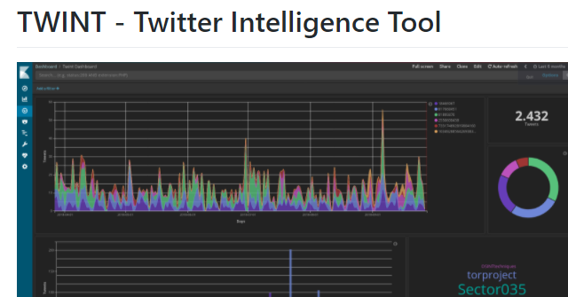

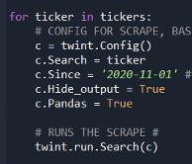
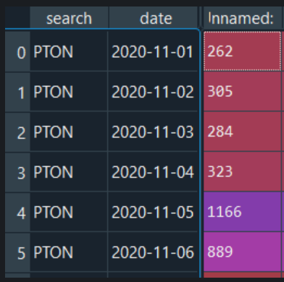
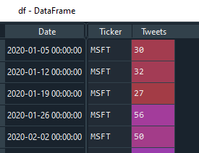
Tweet Data
Import stock Tweet activity: twint.run.Search()
Twint – Tweet data feed for Twitter
$pip install twint
Advanced Twitter scraping tool allowing for scraping from specific Twitter topics (almost all Tweets)
Note: Twitter’s API limits to 3200 Tweets
Strip time from time stamp
Required Fields
Moved to CSV dataset

Slide 7
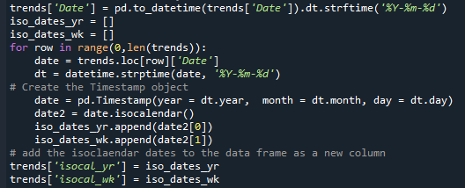
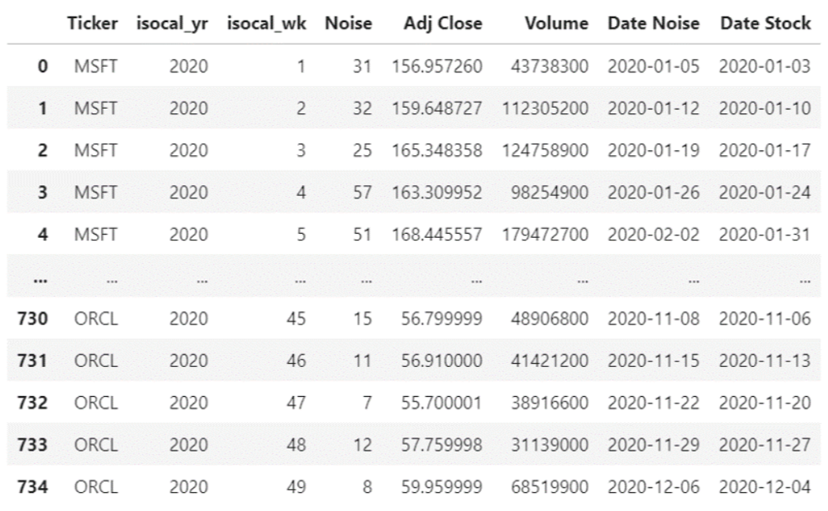
Merging Stocks & Trend Data
Incoming dates are transformed, or Yearly/Weekly grains added to conform the time frequency to its lowest-time grain across both sources – weekly.
Weekly grain converted to ISO, Monday start of week
Stock CSV and Trend CSV data is merged to a single dataset

Slide 8
Results & Analysis

Slide 9
Potential Next Steps
Find Daily Trend/Noise data to align with daily-frequency stock data
If daily source can’t be found, warehouse daily to build missing data
Build charts/dashboards
Reduce time grain to hourly, minute for automated trading/prescription reporting (take automatic action on report).
Setup automated sleep logic to keep Twint collection engine running (watchdog)

Slide 10
Questions?

