Slide 1

Project 2 – ETL (HW13)
Stock and Trend Analysis

Slide 2
Agenda and Team Members
Rob Bowen
Carl Coffman
Mason McCoy
Push Palani

Slide 3

ETL Project - Stocks
Sessions 9-12
Project Team Challenges
HW09 - SQL
HW10 – Advanced-Data-Storage-and-Retrieval
HW11 – Web
HW12 – Web-Scaping-and-Document-Databases
Finding a historical data source for a particular stock’s social activity or amount of noise and its trend.
Stock data was by-day and trend data was by week aggregated to a Sunday. Team transformed the Sunday date given from Google-Trend data to match the same week as stock data. Additional columns added, Year and Week to conform amongst data sets.
GitHub: https://github.com/ppalani09/Stocks-ETL-Project
Products
Used:
yfinance - # Yahoo! Finance market data
pytrends - Unofficial API for Google Trends
$pip install pytrends
Twint – Tweet data feed for Twitter
Other Products Investigated:
Mentions.com - popular, more for visualization
Keyhole.co – does have API, but cost $ ☺

Slide 4
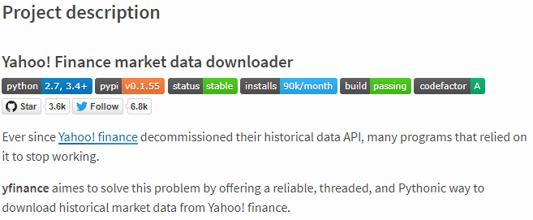

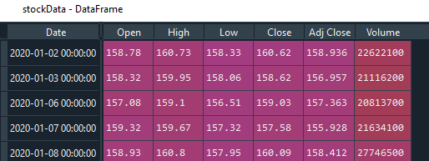
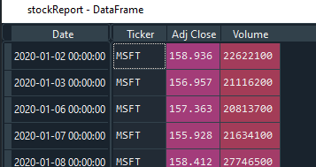
Stock Data
Import Daily Stock Price
yfinance - # Yahoo! Finance market data
https://github.com/ranaroussi/yfinance
Install yfinance using pip:
$ pip install yfinance --upgrade --no-cache-dir
Requirements
Python >= 2.7, 3.4+
Pandas >=0.23.1
Raw data
Required Fields
Each stock’s CSV data merged with complete CSV dataset

Slide 5
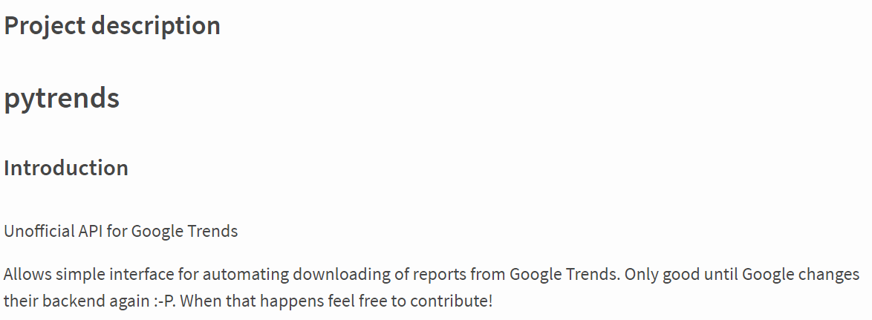
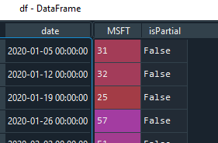
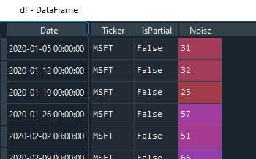
Trend Data
Import Daily Trend of key word (stock/ticker)
Raw data
pytrends - Unofficial API for Google Trends $pip install pytrends
- Interface for automating downloads of reports from Google Trends
Required Fields
Each stock’s CSV data merged with complete CSV dataset

Slide 6
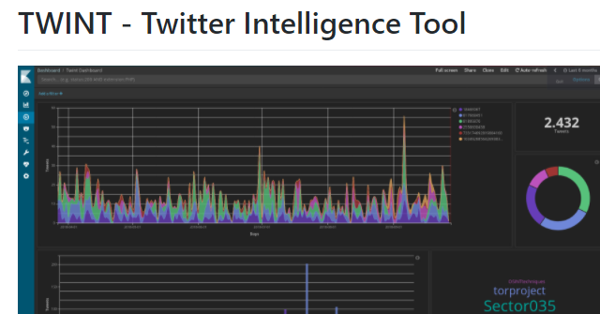

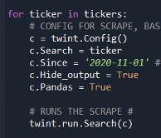
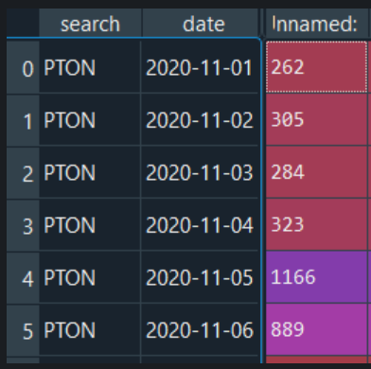
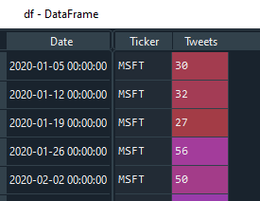
Tweet Data
Import stock Tweet activity: twint.run.Search()
Twint – Tweet data feed for Twitter
$pip install twint
Advanced Twitter scraping tool allowing for scraping from specific Twitter topics (almost all Tweets)
Note: Twitter’s API limits to 3200 Tweets
Strip time from time stamp
Required Fields
Moved to CSV dataset

Slide 7
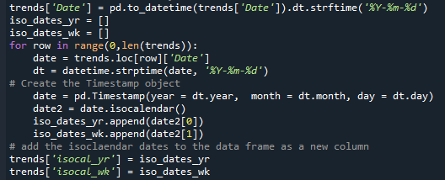
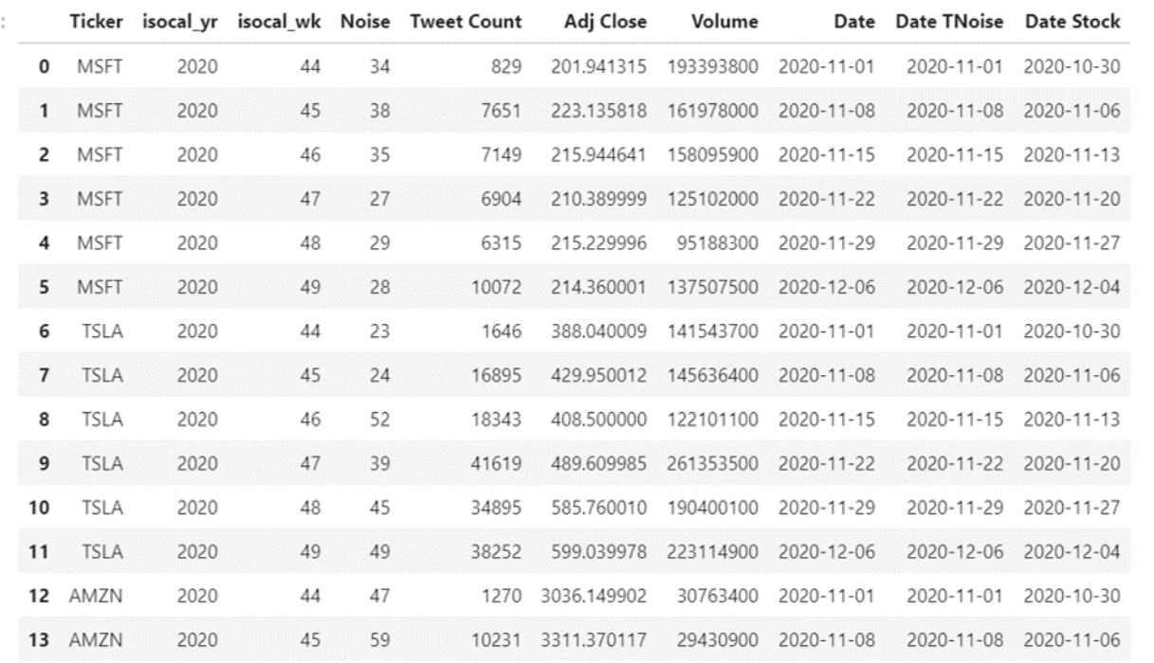
Merging Stock, Trend, and Tweet Data
Incoming dates are transformed, or Yearly/Weekly grains added to conform the time frequency to its lowest-time grain across both sources – weekly.
Weekly grain converted to ISO, Monday start of week
Stock CSV and Trend CSV data is merged to a single dataset

Slide 8
Potential Next Steps
Charts, and more charts ☺
Find Daily Trend/Noise data to align with daily-frequency stock data
If daily source can’t be found, warehouse daily to build missing data
Build charts/dashboards
Reduce time grain to hourly, minute for automated trading/prescription reporting (take automatic action on report).
Setup automated sleep logic to keep Twint collection engine running (watchdog)

Slide 9
Questions?

