Slide 1
Cours 3 : Ontology Alignment
And
Ontology Enrichment for Data Integration
Data Integration
Master D&K
pernelle@lri.fr

Slide 2
Ontology
An ontology provides a vocabulary that describes a domain of interest and a specification of the meaning of terms used in the vocabulary.
Depending on the precision of this specification, the notion of ontology encompasses several data and conceptual models, including simple taxonomies, or fully axiomatized ontologies.

Slide 3
Semantic web
The semantic web is an effort for publishing such formal knowledge on the web.
  RDF allow to expressing data as graphs;
  OWL, RDFS allow to express ontologies governing such graphs;
  SPARQL: a query language for such graphs
There exist many tools for dealing with such languages.
Tens of billions of RDF triples and thousands of ontologies on the web. Now, governments and their agencies publish their data in RDF.

Slide 4
But
It is not one guy’s ontology.
It is not several guys’ common ontology.
It is many guys’ many ontologies.
So it is a mess …

Slide 5
Ontology Alignment

Slide 6
Alignment of a simple taxonomy
(Θ=EQUIVALENTCLASS)
CS Dept. US
CS Dept. Australia
Entity
Entity
Undergrad
Courses
Grad
Courses
People
Courses
Staff
Faculty
Staff
Academic Staff
Technical Staff
Assistant
Professor
Associate
Professor
Professor
Senior
Lecturer
Lecturer
Professor

Slide 7
Objective of an Alignment process
Data integration provided by other organisations (ex: providers) in a Data Warehouse
(ETL construction).
Data Integration in a virtualized approach (Wrapper construction)
Information shared in a P2P architecture
Composition of Web services.
Ontology Evolution/Ontology Fusion.

Slide 8
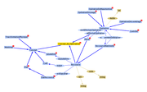




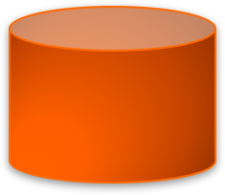

Alignments used in a virtualized approach
Alignment
Alignment
A1
Global Ontology
A2
Mappings
Mediator
Mappings
Local Ontology 1
Local Ontology n
Rewrited query/Answers
Rewrited query/Answers
Source 1
Source n
Sources are described by a local ontology.
The alignment allows to discover mappings between a local ontology and a global ontology.
Queries are formulated in the global ontology vocabulary. The mediator reformulates the query to obtain answers.

Slide 9


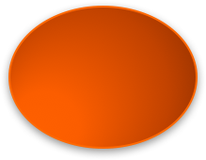
Alignments in P2P Architectures
Alignment
Ontology - Peer 1
Ontology-Peer n
A
Peer 1
Query
Mediator
Query
Peer n
Answer
Answer

Slide 10
What kind of hetereogeneity ?
Syntaxic: 2 ontologies are not described using the same langage (OWL-DL / RDFS): equivalence between language constructs, transformations, abstractions are needed.
Terminological : variations in equivalent concept labels. (Homonymies, Synonymies, various languages) CD/Compact Disk, paper/publication, paper/papier
Conceptual : differences between two models of the same domain (coverage, granularity, different points of view)

Slide 11
Conceptual heterogeneity
Coverage: the two ontologies describe different domains but share a more or less important set of concepts and properties.
Granularity: the two ontologies describe the same domain, but they are more or less accurate (ex: detailed bio-medical ontology for experts, versus simple ontology used by ordinary patients).
Distinct Point of views
(ex : geographical vs geopolitical)

Slide 12
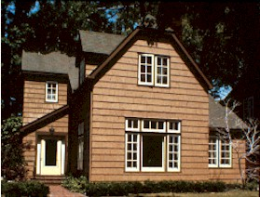
Similar problem in schema matching (relational databases)
Global relational schema
price agent-name address
1-1 mapping
Complex mapping
homes.com
listed-price contact-name city state
320K Jane Brown Seattle WA
240K Mike Smith Miami FL

Slide 13
Similar problem in schema matching
Mediated schema
price agent-name agent-phone office-phone description
If “office”
occurs in name
=> office-phone
listed-price contact-name contact-phone office comments
Schema of realestate.com
realestate.com
listed-price contact-name contact-phone office comments
$250K James Smith (305) 729 0831 (305) 616 1822 Fantastic house
$320K Mike Doan (617) 253 1429 (617) 112 2315 Great location
If “fantastic” & “great”
occur frequently in
data instances
=> description
homes.com
sold-at contact-agent extra-info
$350K (206) 634 9435 Beautiful yard
$230K (617) 335 4243 Close to Seattle

Slide 14
What is an Ontology Alignment ?
Alignment A: set of mappings declared between ontology entities (properties or classes) of two ontologies O1 and O2.
f(O1,O2)=A
Θ is the set of relations that can be used to express a mapping (chosed by the alignment approach).
Example: Θ={owl:disjointWith, owl:equivalentClass, rdfs:subclassOf, closeTo…}
A = {owl:equivalentClass(http://amaz.com/dvd, http://fnac.com/etol/filmdvd), closeTo(http://amaz.com/road, http://ign.com/tronçon-route) }

Slide 15
What is an Ontology Alignment ?
Each mapping can be associated with a confidence degree.
closeTo(http://amaz.com/road, http://ign.com/tronçon-route), 0.8
A mapping can be complex: realisation(y,concat(x.firstName,x.Name)) ⬅ 0.9 film(y) Λ realised(x,y)
An alignment can be1-1 (« one to one » mapping) bijective relation.
Some alignment approaches are not symetric :
f(O1,O2) <> f(O2,O1)

Slide 16
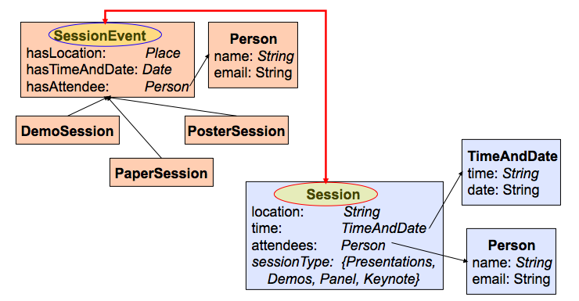
DIFFICULTIES

Slide 17
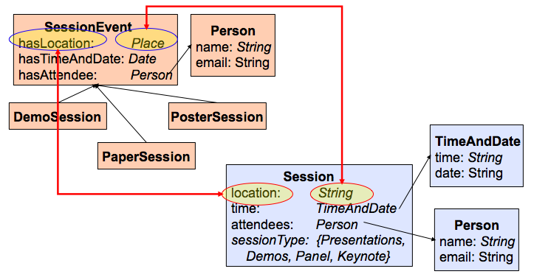
DIFFICULTIES

Slide 18
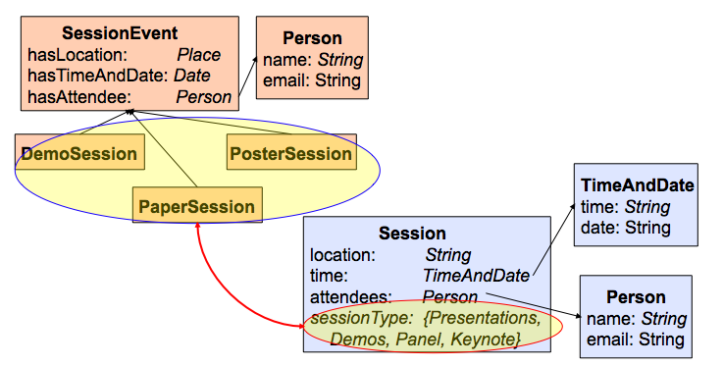
DIFFICULTIES

Slide 19
What can be taken into account to decide?
Terminological Information (concept labels, alt-labels, property names), coments, names of other linked entites, …)
➔ Usual similarity measures can be used: token-based (n-grams, jaccard, or edit-based (levenstein, jaro-winkler) …
→ Other linguistic informations
Examples:
Stop-words (of, le, for, the,..)
Word weights can vary depending on its syntactic function (example : an adjective is less important than a nominal … national road/ national organization)

Slide 20
What can be taken into account to decide?
Ontology Structure :
Internal Structure (datatype properties, range, cardinalities)
Author Artist
- Name -A-name
- FName -A-first-name
- Century -A-birth-date
- Book -Work
1..1
string
1..1
1..1
1..1
1..n
integer
1..n
1..1
1..1
date

Slide 21
SIMILARITY OF INTERNAL STRUCTURES
Compatibility measures can be defined [Valchev et Euzenat 97, 04]
→ To compare the range (table)
compatibility (integer,date)=0.5
compatibility(integer, number)=0.9
→ To compare cardinalities
As it can be done for an XML DTD : compatibility (*, +)=0.9
In OWL: mincardinality b /maxcardinality e
Sim([b1 e1], [b2 e2])=0 if b2>e1 ou b1>e2
else = (min(e1,e2)-max(b1,b2))/(max(e1,e2)-min(b1,b2))

Slide 22
SIMILARITY OF EXTERNAL STRUCTURE
External Structure (related concepts) :
Hypothesis: the more 2 concepts are similar, the more their linked concepts are similar.
Given a property r (usually r=subclassOf)
r : concepts that are directly linked using r
r+: concepts that belong to the transitive closure (w.r.t the property r)
r-1; more general concepts
r! : leaves that belong the transitive closure of subclassOf.

Slide 23
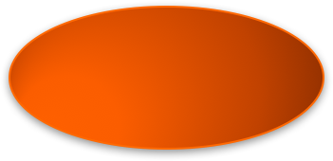
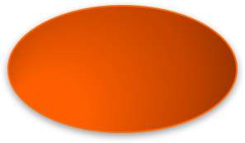
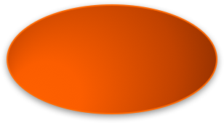
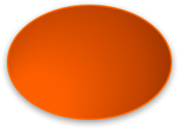


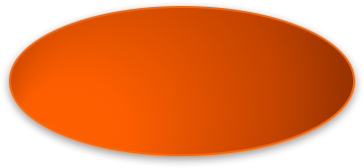
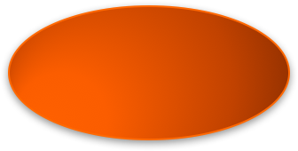
EXAMPLE
Computer Science
Artificial Intelligence
Architecture
Games Theory
Machine Learning
Semantic
Web
Supervised Learning supervisé
Unsupervised learning

Slide 24
EXAMPLE
With r= subclassOf
subclassOf(Artificial Intelligence)={Game theory, Machine Learning, Semantic web}
subclassOf+(Artificial Intelligence)={Game theory, Machine Learning, Supervised Learning, Unsupervised learning, Semantic web}
subclassOf-1(Artificial Intelligence)={Computer Science}
subclassOf!(Artificial Intelligence)={Game theory, Supervised Learning, Unsupervised learning, Semantic web}

Slide 25
EXTERNAL RESOURCE
Two concepts can be compared using an external ontology or taxonomy they also belong to (or they have been found in).
Similarity Measure: Wu et Palmer [Wu &al. 94]
Sim(C1, C2) =
2*depth(C)/ (depthc(C1) +depthc (C2) )
where C is the most specific common ancester (LCS) of C1 and C2.

Slide 26
EXTERNAL RESOURCE
Examples
Sim(Supervised Learning, Unsupervised Learning)
= 2* Depth(Machine Learning)/Depthc(Supervised Learning)+Depthc( Unsupervised Learning)
= (2*3)/(4+4)=6/8=0.75
Sim(Art Intelligence, Architecture)
=(2*1)/(2+2)=0.5
Sim(Supervised Learning, Architecture)
= (2*1)/(4+2)=0.33

Slide 27
EXTERNAL RESOURCE
Results that can be obtained using Wordnet [Madche et Zacharias 2002]
 | illustrator | author | creator | person
illustrator | 1 | 0.5 | 0.67 | 0.4
author |  | 1 | 0.67 | 0.4
creator |  |  | 1 | 0.67
person |  |  |  | 1

Slide 28
EXTERNAL RESOURCE
Similarity measure of [Resnik, 1995]: based on the informational content (CI).
This measure exploits the ontology and its instances.
CI allow to take into account the frequency of the concept in the studied domain.
CI(c) = - log(P(c))
where P(c) is the probability to find an instance of c (number of instances(c)/N where N is the number of concepts).

Slide 29
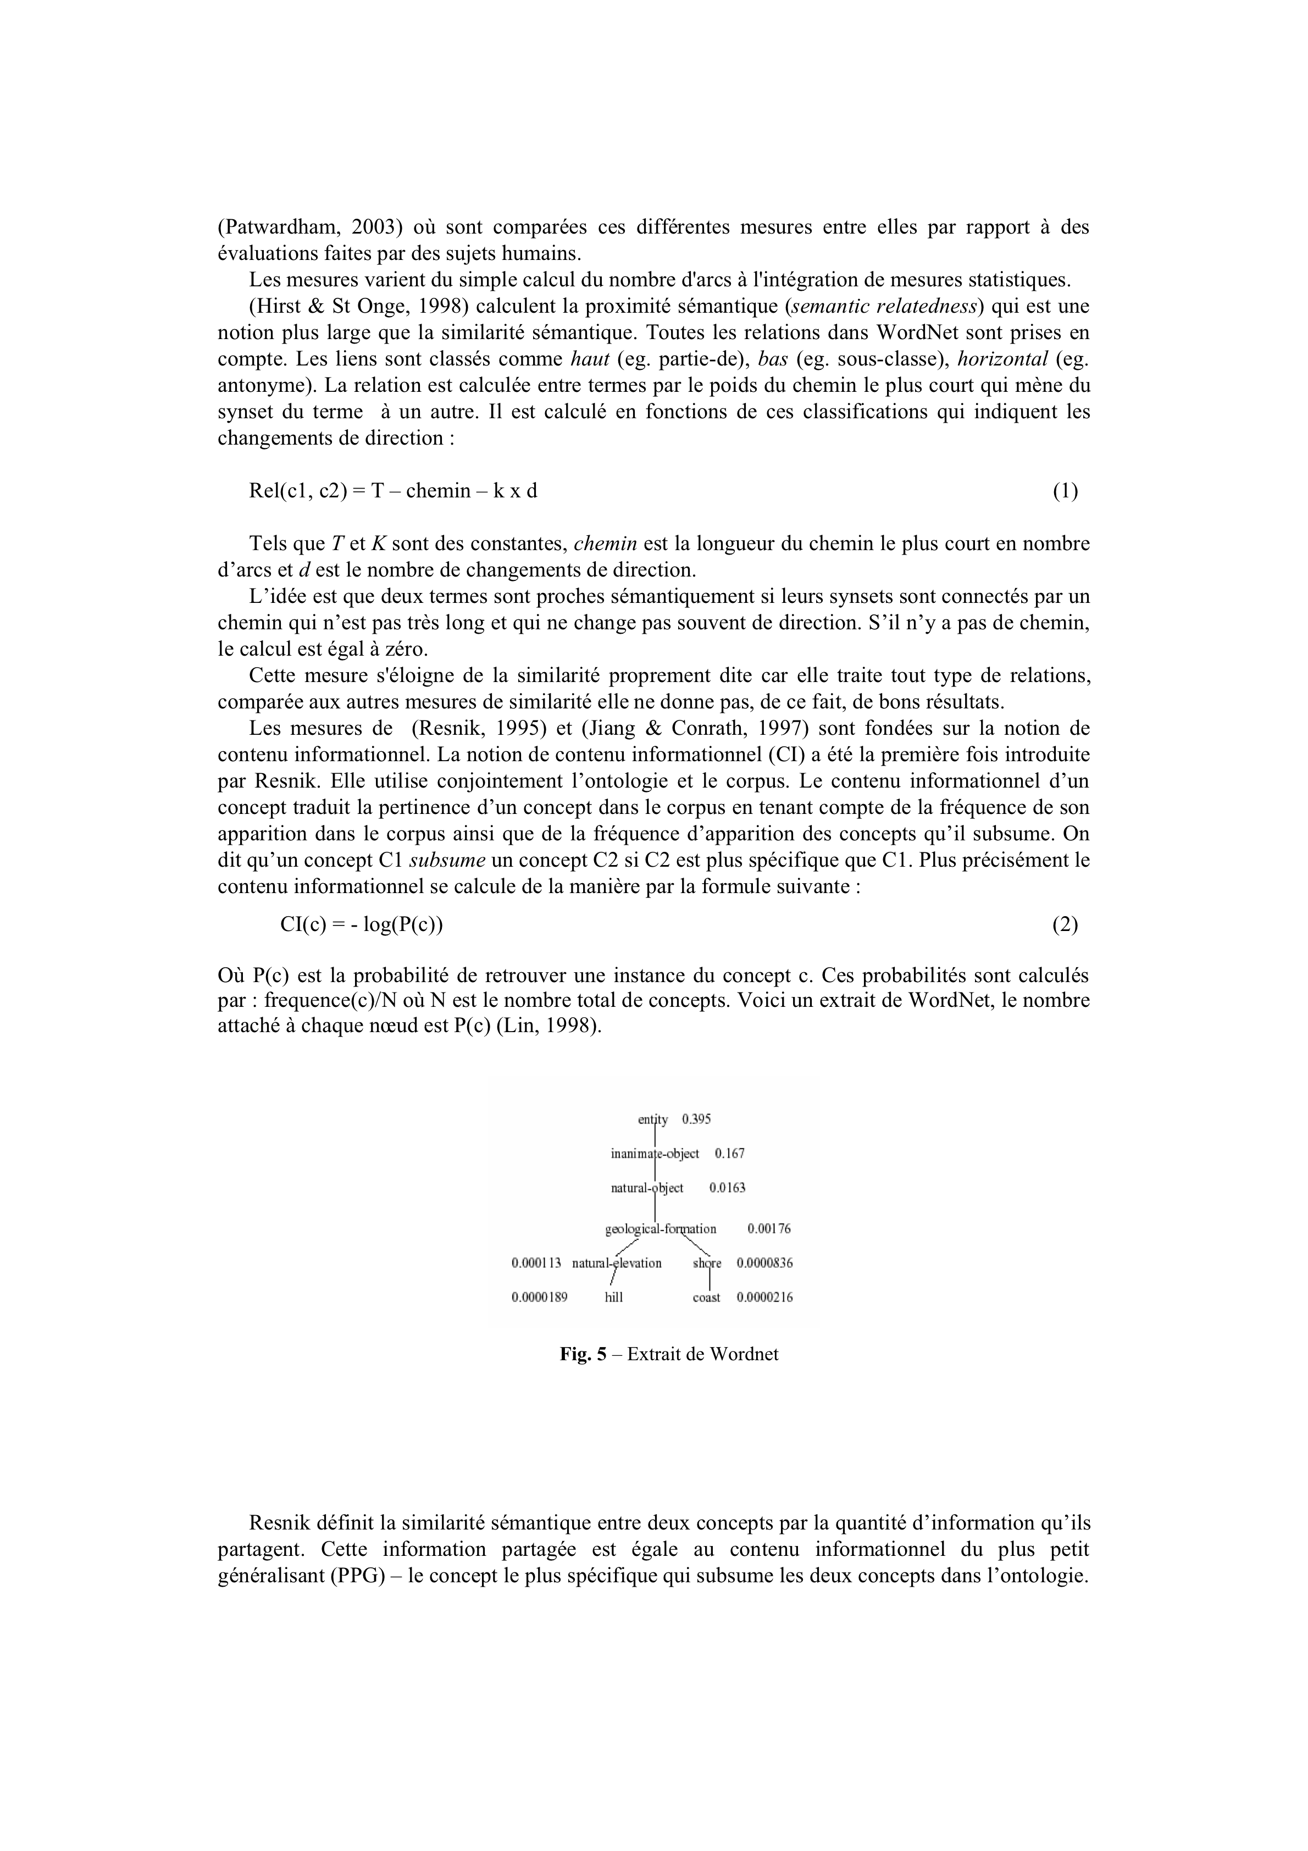
EXTERNAL RESOURCE
The semantic similarity of two concepts c1, c2 is here the informational content they share in their LCS .
P(C) computed on wordnet

Slide 30
HOW SEMANTICS CAN BE USED?
Infer new alignments thanks to A and a reasoning step
Example: (Description Logic: [Bouquet et al 2006])
Micro-company=CompanyΠ ≤5 employee
SME = Firm Π ≤10 associate
If we know in a first alignment result A that:
Company = Firm, associate [ employee,
Micro-company [ SME is inferred
Detect inconsistencies when A is used (filtering step) … Example ?

Slide 31
How to use concept instances (extensional information)?
Naive way: compute the intersection of two concept extensions.
Equivalence if C1 ∩ C2 = C1 = C2
Subsumption if C1 ∩ C2 = C1
Disjunction if C1 ∩ C2 is empty
And more generally, define and use a similarity measure based on the size of this intersection.
Example : (jaccard) (C1 ∩ C2)/(C1 ∪ C2)
[RIMOM14] [PARIS12]

Slide 32
Extensional Approaches
Problem: how do you know that two instances are the same.
Possible if instance URI are the same or if the distinct but identical instances share same document url that describe them (ex: DBPedia/Yago).
……. If not, a linking method is needed (that detect identity links) .

Slide 33
STRATEGIES
Computation of the similarity scores then selection‏ of the proposed mappings. [AML15]
Combinaison of different strategies in //
[Glue 2004]
Sequential application of different strategies [Taxomap 2008] [PARIS2012]
Filtering
Ontology partionning [Falcon 2008]

Slide 34
MAPPING SELECTION
Thresholds are defined ….
Absolute threshold (sa) : select all mappings such that the similarity score is >sa
Relative threshold (sd) : select all mappings such that the similarity score >MaxScore – sd
Rate (n%) : select the n% best scores in A.

Slide 35
MAPPING SELECTION
Example:
 | book | translator | editor | author
product | .84 | 0 | .9 | .12
provider | .12 | 0 | .84 | .60
artist | .60 | .05 | .12 | .84
Absolute threshold 0.7: (product, book), (product, editor) (provider,editor), (artist, author)
Relative Threshold delta 0.3: (product, book), (product, editor) (providor,editor), (providor,author), (artist, book), (artist, author)
Rate =30% (4): (product, book), (product, editor), (provider, editor), (artist, author)

Slide 36
MAPPING SELECTION
When a 1-1 alignment is wanted, a choice is necessary
Greedy algorithm (best score at each iteration).
Stable marriage problem (local optimum):
Given 2 entity (concept) sets E et E’ and a similarity function sim : E x E’ → [0,1], selection of an alignment A s.t. for all (e1,e2) in A, and for all (e3,e4) in A, we have:
sim(e1,e3)+sim(e2,e4) ≥sim(e1,e2)+sim(e3,e4)
Notes:
Hungarian algo to obtain a global optimum (O(n3))

Slide 37
MAPPING SELECTION
Maximum weight graphs (global optimum):
Given 2 entity (concept) sets E et E’ and a similarity function sim : E x E’ → [0,1], selection of an alignment A s.t.:
Σ_{(ei,ej) in} _{A} ≥ Σ_{(ei,ej) in} _{A’}

Slide 38
MAPPING SELECTION
Example :
 | book | translator | editor | author
product | .84 | 0 | .9 | .12
provider | .12 | 0 | .84 | .60
artist | .60 | .05 | .12 | .84
Greedy : (product,editor), (artist, author), (provider, book) (1.96)
Local: replace with (artist, book), (provider, author) (2.1)
Global : (product,book), (provider, editor), (artist, author) (2.52)

Slide 39
OAEI Competition
Ontology Alignment Evaluation Initiative (OAEI)
→ every year since 2006
Different Tracks (ontology size, formalism, domain, instances or not)
Various results
(< 50% of precision/recall,
to 100% when ontology are highly similar)‏

Slide 40
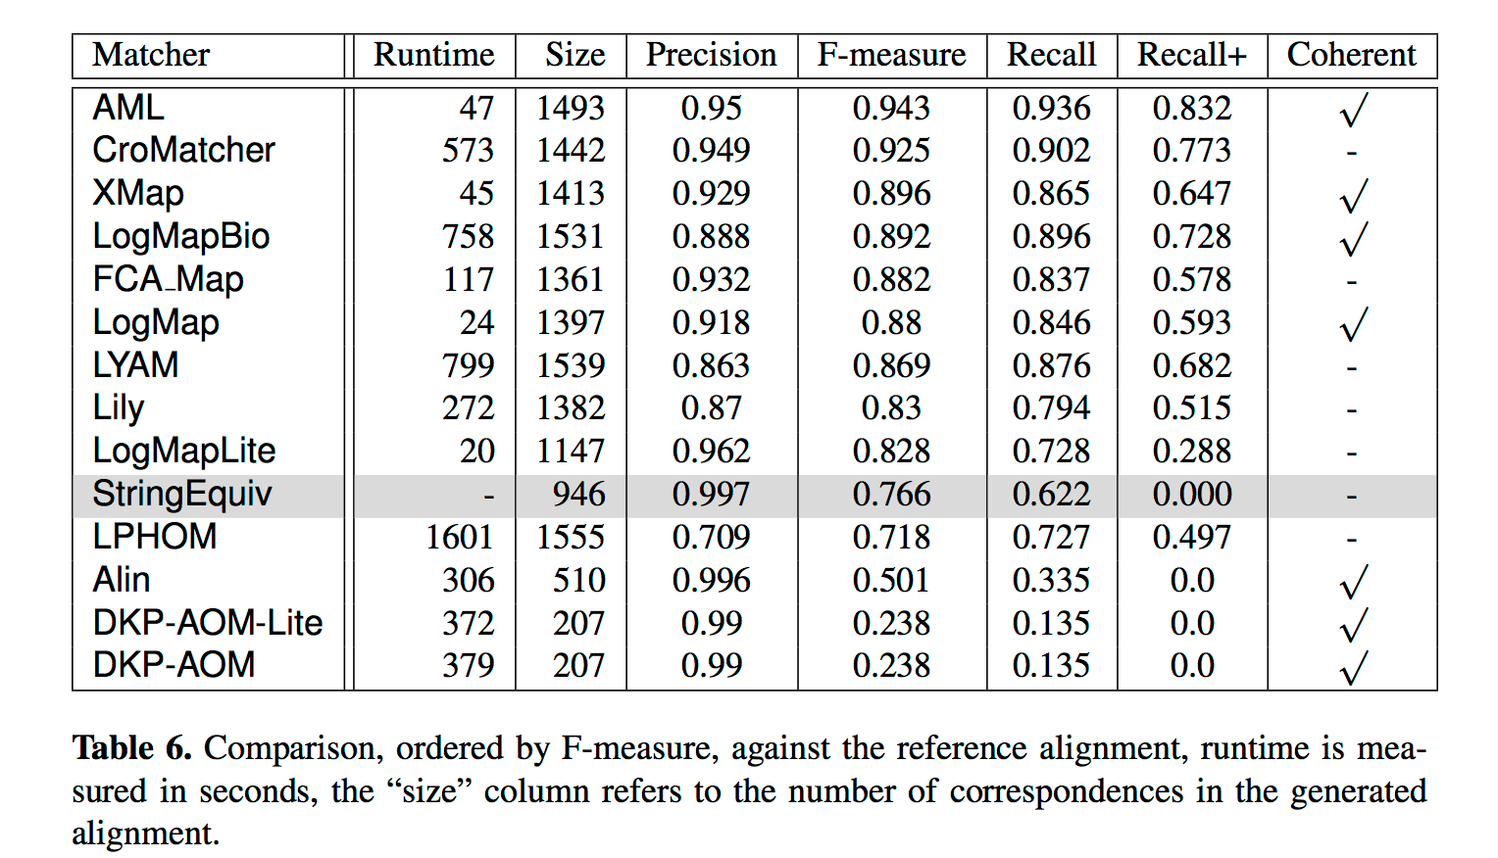
Anatomy ontologies – Results OAEI 2016

Slide 41
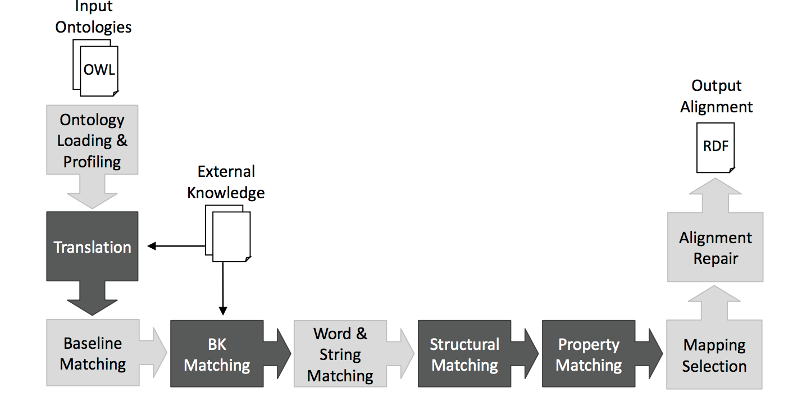
AML

Slide 42
OAEI 2016
Ressource : http://disi.unitn.it/~pavel/om2016/papers/oaei16_paper0.pdf
Number of participants?
Type of tracks? Types of correspondences?
Are all the approaches tested on all tracks ?
Table 5 (track anatomy) : size of the ontologies ?
Precision/recall?
Are there many approaches that check the result consistency Best approach (best F-Mesure)?

Slide 43
Challenges
How to interact with user experts during the alignment process (validation, updates, suppression),
How to explain discovered mappings
How to scale
How to mix data linking and ontology alignment processes
How confidence degrees that can be associated to mappings can be used.
Ontology evolution → How to update alignments efficiently

Slide 44
REFERENCES
“Ontology Matching” by Euzenat and Shvaiko , springer, 2007.
AML (AgreementMakerLight) : D. Faria, C. Martins, A. Nanavaty, D. Oliveira, B. S. Balasubramani, A. Taheri, C. Pesquita, F. M. Couto, and I. F. Cruz. AML results for OAEI 2015. In Ontology Matching Workshop. CEUR, 2015.
Proceedings des conferences ISWC, ESWC, SIGMOD, WWW, EKAW, K-Cap.
Journal of web semantics, Journal on data semantics.
http://www.ontologymatching.org

Slide 45
Ontology Enrichment for Data Integration

Slide 46
Data Linking approaches
Different criteria can be used to distinguish data linking approaches [FNS11]
Instance-based approaches: exploit property values to link 2 instances / Graph-based approaches: propagate similarities, decisions
Supervised approaches : exploit labeled training data given by an expert / Unsupervised approaches
Knowledge based approaches : exploit ontology axioms (eg. functional properties, disjunctions) or expert rules
Logical or Numerical approaches

Slide 47
Data Linking using rules
Rules
  Logical Rules
    SSN(p1, y) ∧ SSN(p2, y) ➔ sameAs(p1, p2)
  Complex Rules
    max(jaccard(Name(p1, n); Name(p2, m);jarowinkler(address(p1, x);
    address(p2, y))) > 0.8 ➔ sameAs(p1, p2)

Slide 48
Data Linking using rules
Rules use discriminative properties => keys
  Not easy to be declared by expert
    {SSN}, {ISBN} easy
    {Name, dateOfBirth, BornIn} is it a key?
  Erroneous keys can be given by experts
  As many keys as possible
Automatic discovery of keys

Slide 49
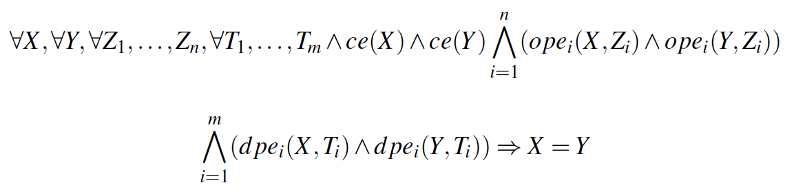
OWL2 Key
OWL (Web Ontology Language)
  Declaration of classes, properties, axioms (subsumption, equivalence, etc.)
OWL2 Key for a class: a combination of properties that uniquely identify each instance of a class
  hasKey( CE ( OPE₁ ... OPE_{m} ) ( DPE₁ ... DPE_{n} ) )
  hasKey(Book(Author) (Title)) means:
  Book(x₁)∧Book(x₂)∧Author(x₁, y)∧Author (x₂, y)
  ∧Title(x₁, w)∧Title(x₂, w) ➔ sameAs(x₁, x₂)

Slide 50
How to discover keys ? Assumptions
Open World Assumption (OWA)
  what is not in the data is not false
How to discover keys in Open World Assumption (OWA)??
id | lastName | firstName | hasFriend
i1 | Tompson | Manuel | i2,i3
i2 | Tompson | Maria
i3 | David | George | i2, i4
i4 | Solgar | Michel
i1 =?= i2 =?=i3 =?=i4
hasFriend(i1,i4) …. ?
hasFriend(i2, i3) …. ?
firstName(i1, Elodie) … ?

Slide 51
Assumptions
Unique Name Assumption (UNA): different identifiers refer to distinct real world objects
  i1 <> i2 <> i3 <> i4
Fulfilled in datasets extracted from RDB, YAGO
Uniform Vocabulary: Syntactically different ➔semantically different in one dataset
  “UK” and “United Kingdom” never in the same dataset

Slide 52
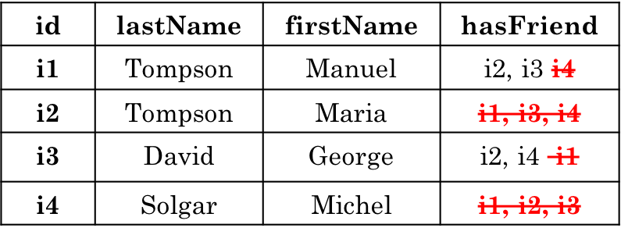
Optimistic keys
Optimistic key: set of properties that has a unique value for every instance described by this property set in the data
  ∀X ∀Y ((X≠Y)∧c(X)∧c(Y)) ⇒ (∀Z ¬(p_{j}(X,Z) ∧p_{j}(Y,Z)))
  Keys: {hasFriend, lastName}, {firstName}

Slide 53
Algorithms
Naive automatic way to discover keys
  Examine all the possible combinations of properties
  Scan all instances for each candidate key
  Example: Class described by 15 properties ➔2¹⁵ = 32767 candidate keys
Discover keys efficiently by:
  Reducing the combinations
  Partially scanning the data

Slide 54






SAKEY - Algorithm
Non key discovery first (Partially scan the data)
  All the sets of properties that are not subsets of maximal non keys are keys
    Example: class described by the properties p1, p2, p3, p4
Key
Non key
 | museumName | … | museumAddress | inCountry
Museum1 | “Archaeological Museum” |  | “44 Patission Street” | “Greece”
Museum2 | “Pompidou” |  | ------ | “France”
Museum3 | “Musée d’Orsay” |  | “62, rue de Lille” | “France”
Museum4 | “Madame Tussauds” |  | “Marylebone Road” | “England”
Museum5 | “Vatican Museums” |  | “Piazza San Giovanni” | “Italy”
Museum6 | “Deutsches Museum ” |  | “Museumsinsel 1” | “Germany”
Museum7 | “Olympia Museum” |  | “Archea Olympia” | “Greece”
Museum8 | “Dalí museum” |  | “1, Dali Boulevard” | “Spain”
➔
    keys = {{p3}, {p4}}
Maximal non key = {{p1, p2}}
Notes:
Keys can be discovered only by maximal non keys

Slide 55
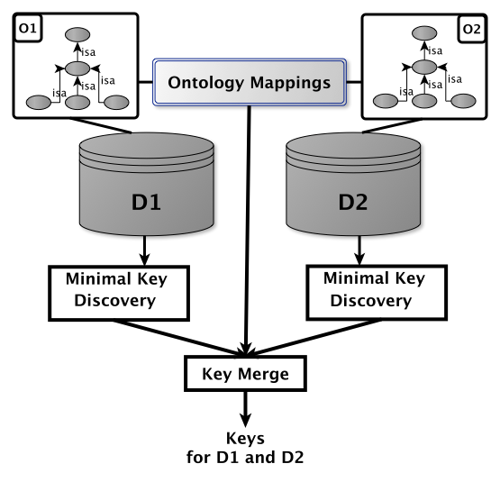
Objective

Slide 56
Key derivation [SBNHR06]
Intuition: All the sets of properties not belonging to maximal non keys are keys
Given the complete set of maximal non keys
  Compute complement sets of each non key
  Compute the Cartesian product of complement sets
  Simplify the discovered keys

Slide 57
Key merge
Goal: Keys valid in both datasets
  More sure keys
Intuition: Computation of Cartesian product of sets of keys
  Keep only minimal keys
K₁
K₂
{firstName, LastName}
{hasFriend}
{firstName}
K₁₋₂
?

Slide 58
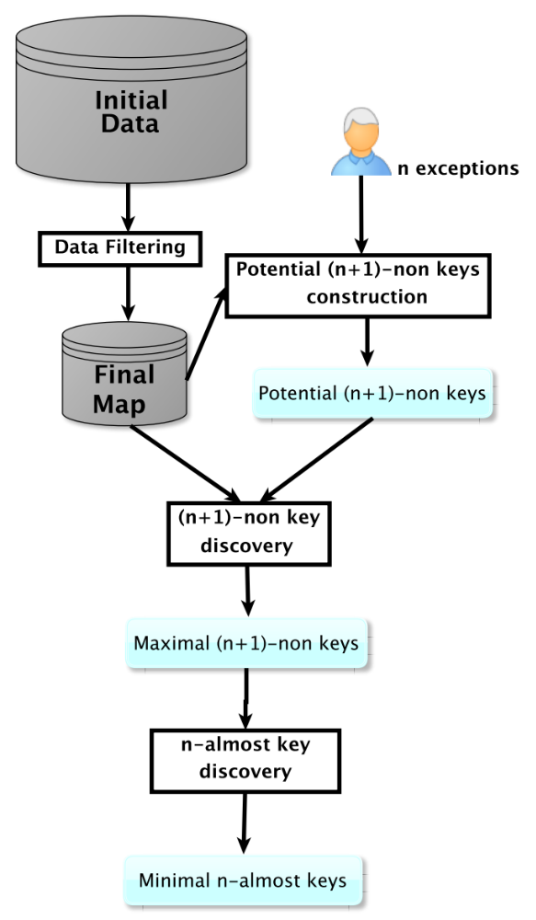

SAKey - General Architecture

Slide 59
n-almost keys
Exception of a key: an instance that shares values with another instance for a given set of properties P
  f1, f2, f3, f4 are exception for {Actor}
 | Name | Actor | Director | ReleaseDate | Website | Language
f1 | “Ocean’s 11” | “B. Pitt” “J. Roberts” | “S. Soderbergh” | “3/4/01” | www.oceans11.com | ---
f2 | “Ocean’s 12” | “B. Pitt” “G. Clooney” “J. Roberts” | “S. Soderbergh” “R. Howard” | “2/5/04” | www.oceans12.com | ---
f3 | “Ocean’s 13” | “B. Pitt” “G. Clooney” | “S. Soderbergh” “R. Howard” | “30/6/07” | www.oceans13.com | ---
f4 | “The descendants” | “N. Krause” “G. Clooney” | “A. Payne” | “15/9/11” | www.descendants.com | “english”
f5 | “Bourne Identity“ | “D. Liman” | --- | “12/6/12” | www.bourneIdentity.com | “english”
f6 | “Ocean’s 12“ | --- | “R. Howard” | “2/5/04” | --- | ---
Notes:
To obtain n almost keys we need n+1 non keys
Almost key => set of properties that has at least n exceptions
Exception represents an instances that shares values with another instance for this set of properties
If we remove this

Slide 60
n-almost keys
n-almost key: a set of properties where |E_{P}|≤ n
  {Actor} is a 4-almost key
n-non key: a set of properties where |E_{P}|≥ n
  Using all the maximal n-non keys we can derive all the minimal (n-1)-almost keys
    Example: All the sets of properties that are not maximal 5-non keys are 4-almost keys
Notes:
To obtain n almost keys we need n+1 non keys
Almost key => set of properties that has at least n exceptions
Exception represents an instances that shares values with another instance for this set of properties
If we remove this

Slide 61
n-non key discovery: Initial Map
“S. Soderbergh”
“J. Roberts”
“B. Pitt”
“G. Clooney”
“N. Krause”
“D. Liman”
Actor | {{f1, f2}, {f1, f2, f3}, {f2, f3, f4}, {f4}, {f5}}
Director | {{f1,f2,f3}, {f2, f3, f6}, {f4}}
ReleaseDate | {{f1}, {f2, f6}, {f3}, {f4}, {f5}}
Name | {{f1}, {f2, f6}, {f3}, {f4}, {f5}}
Language | {{f4, f5}}
Website | {{f1}, {f2}, {f3}, {f4}, {f5}, {f6}}

Slide 62
n-non key discovery: Final Map
Actor | {{f1, f2, f3}, {f2, f3, f4}}
Director | {{f1,f2,f3}, {f2, f3, f6}}
ReleaseDate | {{f2, f6}}
Name | {{f2, f6}}
Language | {{f4, f5}}

Slide 63
n-non key discovery
Actor
  {f1, f2, f3} ∪ {f2, f3, f4} = {f1, f2, f3, f4} => 4-non key
Composite n-non keys
  Intersections between sets of different properties
Actor | {{f1, f2, f3}, {f2, f3, f4}}
Director | {{f1,f2,f3}, {f2, f3, f6}}
ReleaseDate | {{f2, f6}}
Name | {{f2, f6}}
Language | {{f4, f5}}

Slide 64
Data Linking using almost keys
Goal: Compare linking results using almost keys with different n
Evaluation of linking using
  Recall
  Precision
  F-Measure
Datasets
  OAEI 2010
  OAEI 2013

Slide 65
Data Linking using almost keys
Goal: Compare linking results using almost keys with different n
Evaluation of linking using
  Recall
  Precision
  F-Measure
Datasets : OAEI 2010 , OAEI 2013
Conclusion
  Use keys is almost the same or better than using expert keys, Linking results using n-almost keys are the better than using keys

Slide 66
Data Linking using almost keys
OAEI 2013 - Person
 | Almost keys | Recall | Precision | F-Measure
0-almost key | {BirthDate, award} | 9.3% | 100% | 17%
2-almost key | {BirthDate} | 32.5% | 98.6% | 49%
# exceptions | Recall | Precision | F-measure
0, 1 | 25.6% | 100% | 41%
2, 3 | 47.6% | 98.1% | 64.2%
4, 5 | 47.9% | 96.3% | 63.9%
6, ..., 16 | 48.1% | 96.3% | 64.1%
17 | 49.3% | 82.8% | 61.8%
Notes:
Strinct equality in linking

Slide 67
Scalability of SAKey
n > 1
  Class DB:NaturalPlace
n | Runtime | # n-non keys
1 | 61s | 298
50 | 55s | 118
100 | 58s | 78
200 | 56s | 53
300 | 59s | 45
400 | 56s | 41

Slide 68
Conditional keys [VICKEY 17]
Conditional key: a key, valid for instances satisfying a specific condition
  Condition part: pairs of property and value
  Eg. {Lab=INRA}, {Gender=Male}, {Gender=Female ^ Lab=INRA} etc.
  Key part: a set of properties
Instances of the
class Person
 | FirstName | LastName | Gender | Lab | Nationality
instance1 | Claude | Dupont | Female | Paris-Sud | France
instance2 | Claude | Dupont | Male | Paris-Sud | Belgium
instance3 | Juan | Rodríguez | Male | INRA | Spain, Italy
instance4 | Juan | Salvez | Male | INRA | Spain
instance5 | Anna | Georgiou | Female | INRA | Greece, France
instance6 | Pavlos | Markou | Male | Paris-Sud | Greece
instance7 | Marie | Legendre | Female | INRA | France
  {LastName} is a key under the condition {Lab=INRA}

Slide 69
VICKEY: Mining efficiently conditional keys
A key is also a conditional key under any condition
  {LastName, Gender} is a key
  {LastName, Gender} is a key under the condition {Lab=INRA}
 | FirstName | LastName | Gender | Lab | Nationality
instance1 | Claude | Dupont | Female | Paris-Sud | France
instance2 | Claude | Dupont | Male | Paris-Sud | Belgium
instance3 | Juan | Rodríguez | Male | INRA | Spain, Italy
instance4 | Juan | Salvez | Male | INRA | Spain
instance5 | Anna | Georgiou | Female | INRA | Greece, France
instance6 | Pavlos | Markou | Male | Paris-Sud | Greece
instance7 | Marie | Legendre | Female | INRA | France
Instances of the
class Person
Conditional keys can be found in non-keys

Slide 70
Conditional key graph exploration
  Given a non-key
    Step 1: Discover all minimal conditional keys with condition of size 1
    Step 2: Discover all minimal conditional keys with condition of size 2
    …Step n: Discover all minimal conditional keys with condition of size n
Condition
Conditional key graph
FirstName
Nationality
Gender=Female
Lab
FirstName
Lab
FirstName
Nationality
Lab
Nationality
FirstName
Nationality
Lab
  Key {FirstName} for cond {Gender=Female}

Slide 71
Data Linking - VICKEY vs. SAKey[1]
Class |  | Recall | Precision | F-Measure
Actor | Keys[1]* | 0.27 | 0.99 | 0.43
 | Conditional keys** | 0.57 | 0.99 | 0.73
 | Keys[1]+Conditional keys | 0.6 | 0.99 | 0.75
Album | Keys[1] | 0 | 1 | 0.00
 | Conditional keys | 0.15 | 0.99 | 0.26
 | Keys[1]+Conditional keys | 0.15 | 0.99 | 0.26
Film | Keys[1] | 0.04 | 0.99 | 0.08
 | Conditional keys | 0.38 | 0.96 | 0.54
 | Keys[1]+Conditional keys | 0.39 | 0.98 | 0.55
Museum | Keys[1] | 0.12 | 1 | 0.21
 | Conditional keys | 0.25 | 1 | 0.40
 | Keys[1]+Conditional keys | 0.31 | 1 | 0.47
x 1.75
x 869
x 7.1
x 2.19
*Keys[1] from SAKey
**Conditional keys from VICKEY

Slide 72
Runtime results - VICKEY
Class* | #Triples | #Instances | #Properties | #NonKeys | VICKEY | #ConditionalKeys
Actor | 57.2k | 5.8k | 71 | 137 | 4.52m | 311
Album | 786.1k | 85.3k | 39 | 68 | 1.53h | 304
Book | 258.4k | 30.0k | 51 | 95 | 11.84h | 419
Film | 832.1k | 82.6k | 74 | 132 | 1.37h | 185
Mountain | 127.8k | 16.4k | 58 | 47 | 2.86m | 257
Organization | 1.82M | 178.7k | 553 | 3221 | 26.32h | 28
Scientist | 258.5k | 19.7k | 73 | 309 | 27.67m | 582
*All used classes are obtained from DBpedia

Slide 73
Conclusion
SAKey: almost key discovery approach in RDF data
  Erroneous data, duplicates
  n-almost keys: keys with at most n exceptions
  Scalable thanks to:
    filtering and pruning strategies
  Experiments show the scalability of SAKey and the relevance of almost keys in data linking
VICKEY: Conditional key discovery approach
Can improve the results
Notes:
Thanks to what we have achieved, different problems have arised
Problem
More and more data published
Not enough links between them
Need
Automatic discovery of links
Existing data linking approaches need keys to links

Slide 74
Challenges
Can the number of exceptions be set automatically?
Define different merging strategies
  How to merge almost keys with different n values?
  How to exploit mappings, subsumptions etc?
  Should all the keys participate in the merge?
Key update when data evolve

Slide 75
References
[SBHR06] Yannis Sismanis, Paul Brown, Peter J. Haas, and Berthold Reinwald. Gordian: efficient and scalable discovery of composite keys. In Proceedings of the 32nd International conference Very Large Data Bases (VLDB), VLDB ’06, pages 691–702. VLDB Endowment, 2006.
[ADS12] Manuel Atencia, Jérôme David, and François Scharffe. Keys and pseudo- keys detection for web datasets cleansing and interlinking. In EKAW, pages 144–153, 2012.
[HJAQR+13] A. Heise, Jorge-Arnulfo, Quiane-Ruiz, Z. Abedjan, A. Jentzsch, and F. Nau- mann. Scalable discovery of unique column combinations. VLDB, 7(4):301– 312, 2013.
[SAKey14] Danai Symeonidou, Vincent Armant, Nathalie Pernelle, Fatiha Saïs. SAKey: Scalable Almost Key discovery in RDF data. 13th International Semantic Web Conference (ISWC 2014).
[VICKEY17] Danai Symeonidou, Luis Galarraga, Nathalie Pernelle, Fatiha Saïs, Fabian Suchanek, VICKEY, ISWC 2017.

